Slide 1
Not crimped on this side
fan
Crimped on this side
Also coming with the fan:
→a good crimper
→some spare crimp butts ( )
neph
connector
fan
This is how it’s set up now (photos (from neph in boulder) on next page)

Slide 2
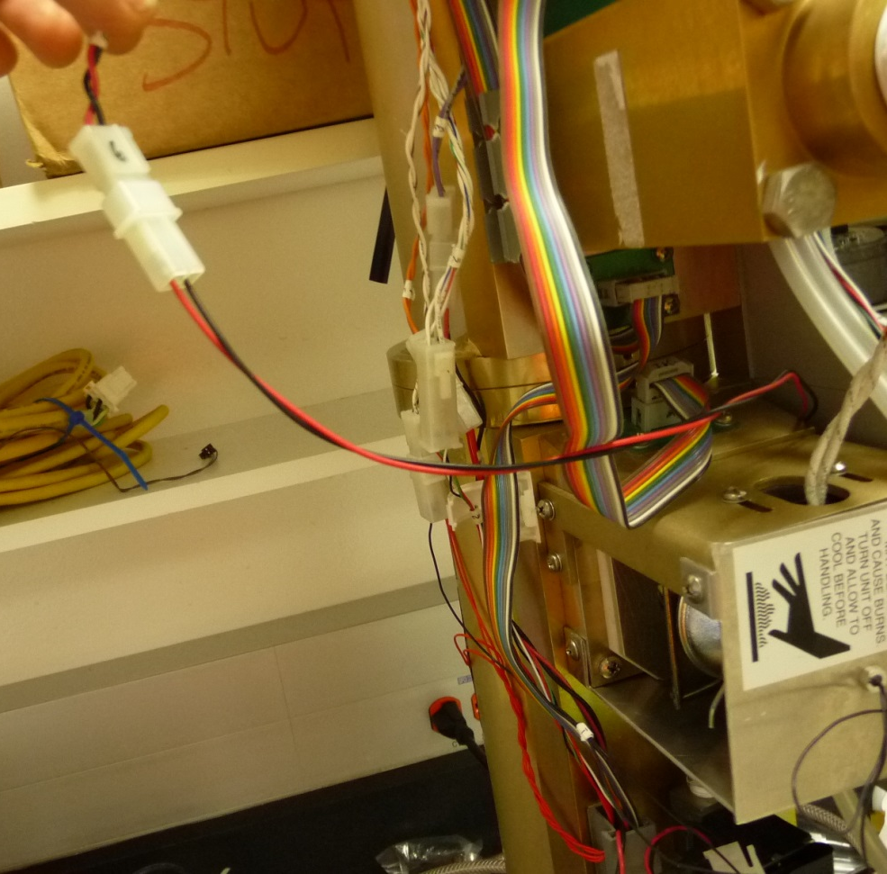
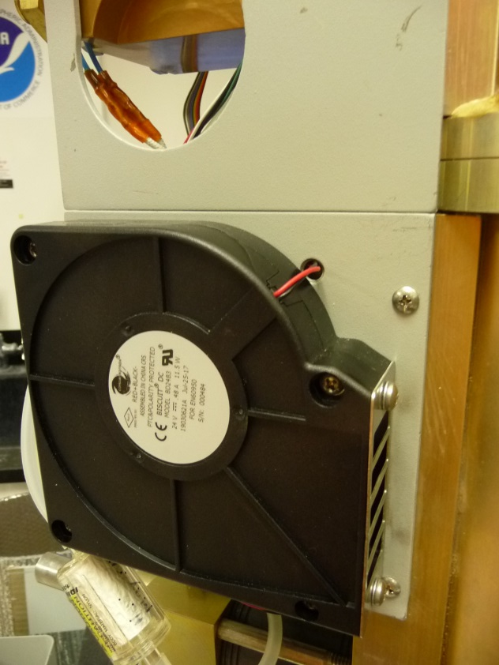
To circuit board
connector
hole
Thru hole to fan

Slide 3
Replacing fan…
Put a message in the message log you are doing the repair and turn the neph off.
Cut cable between fan and connector. You want to leave yourself plenty of wire to work with (like 8” or so). The pink circle sortof indicates where you can make the cut
Remove old fan.
To circuit board
neph
connector
hole
Thru hole to fan
fan

Slide 4
3) Thread the crimped wires from the new fan through the hole
4) Crimp the cut wires to the fan wires
We’ve included some spare crimp butts both so you can PRACTICE crimping on other wire. They could also come in handy if you mess up when doing the real crimp. The potential for messing up is why you want give yourself as much wire as you can when you do the cut in step 1…just in case you need to cut the crimp off and try again.
(3)
(4)
neph
neph
connector
hole
hole
connector
fan
fan

