Slide 1
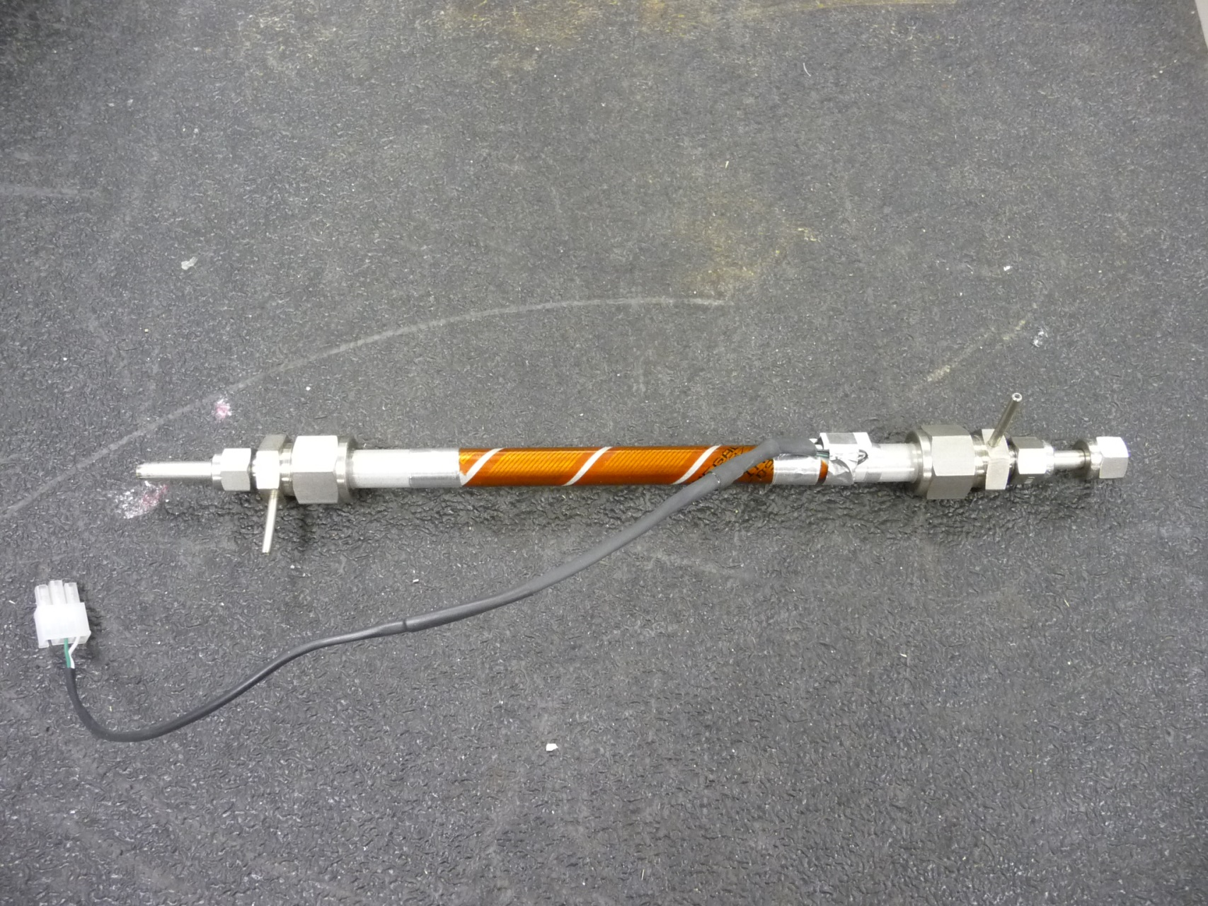
NOAA Humidifier – smaller (lower flow) version (yours will have larger tubing and fittings)
Ribbon heater
Swagelok reducing union, bored out to pass smaller tube
Thermal cutoff switch
Water port (hole drilled into fitting and tube press fit into hole)
Exterior aluminum tube

Slide 2
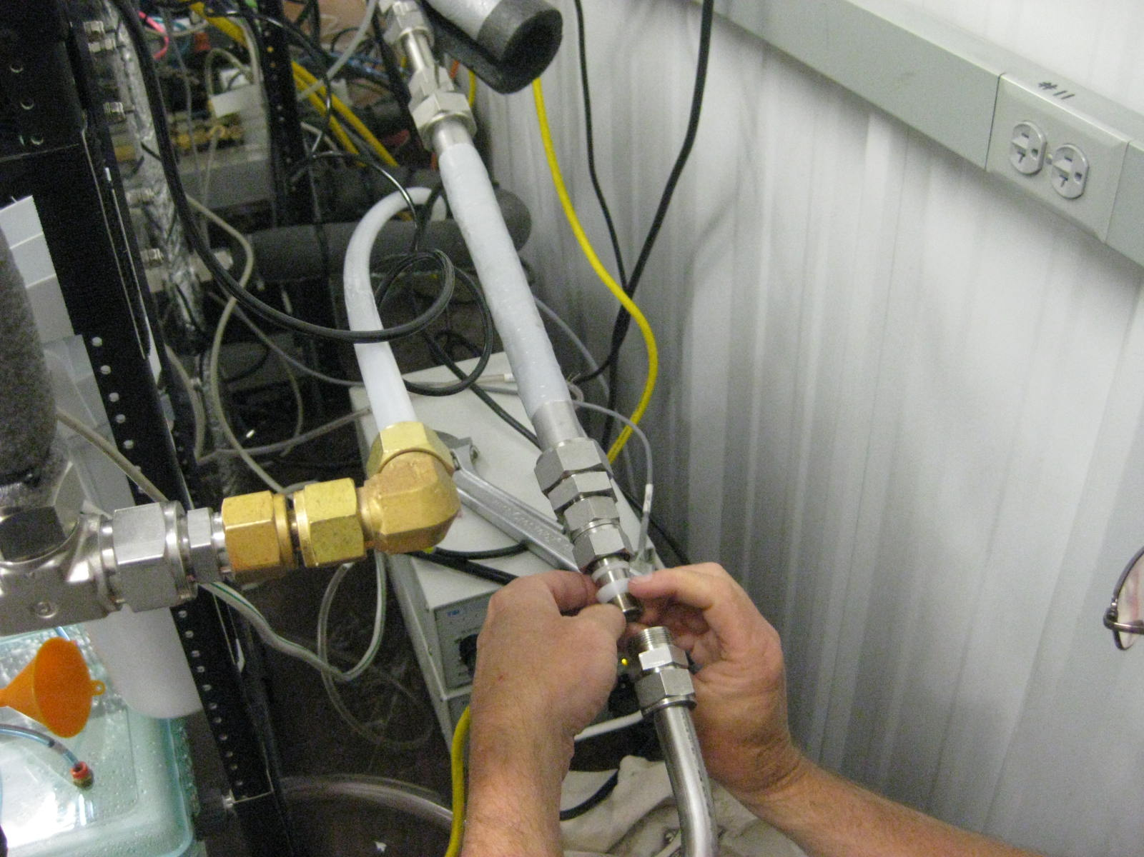
What the high-flow assembled humidifier looks like
Water port (hole drilled into fitting and tube press fit into hole)
Swagelok stainless steel reducing union, 1” – ¾”
1-inch OD aluminum tube
Self fusing silicone tape
¾-inch teflon ferrules
¾-inch stainless tube

Slide 3
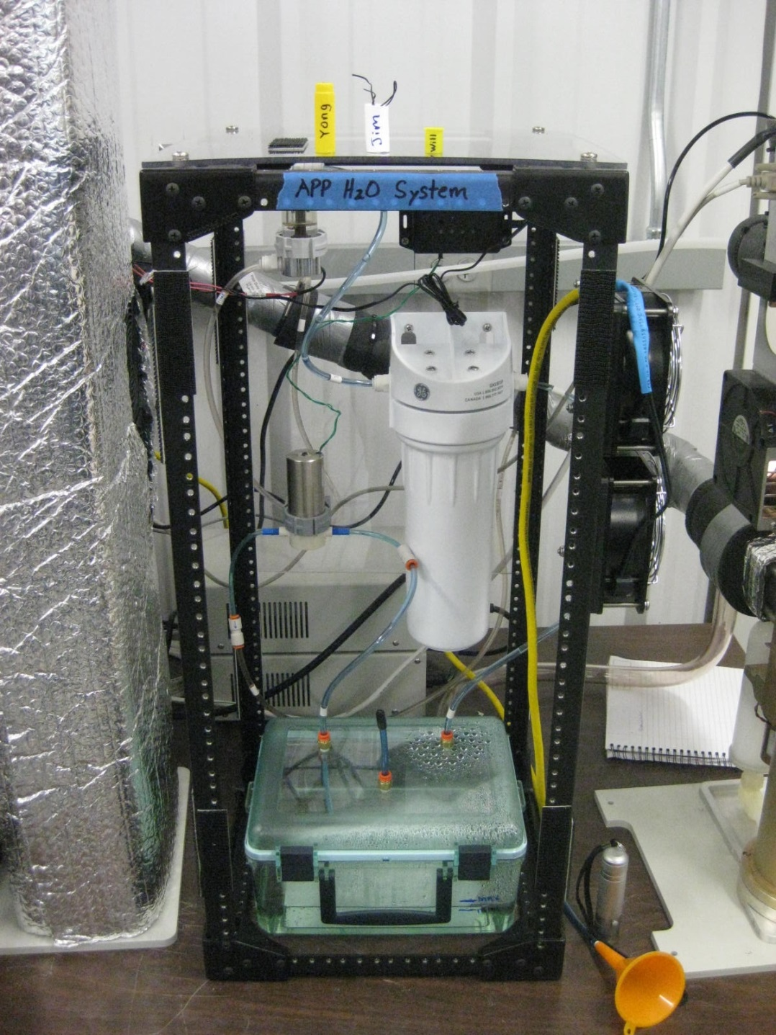
What our water circulation system looks like
Water float switch – shuts off heater when no water flow
Water pump controller (can adjust the pump flow)
Water filter
Water flow path:
reservoir → water pump → inlet (bottom) of humidifier → outlet (top) of humidifier → water float switch → water filter → reservoir
Water pump
Water fill port
Water reservoir

