Slide 1
NOAA CLAP: Continuous Light Absorption Photometer
Why bother with a new instrument?
lost data due to overloaded filters
unheated sample block
leak-prone filter holder
"black box" internal processing of PSAP
User interface – KISS (Keep It Simple, Stupid!)
filter change button and status indicator
flow control
primary user interface is through 'cpd' software
Data output optimized for machine processing
Firmware can be upgraded in the field, remotely from Boulder
Characterization
internal construction (photos)
noise vs. averaging time
LED intensity
planned open source release of drawings, schematics, code

Slide 2
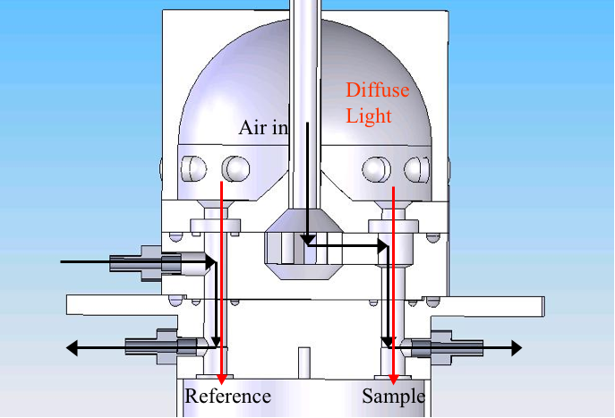
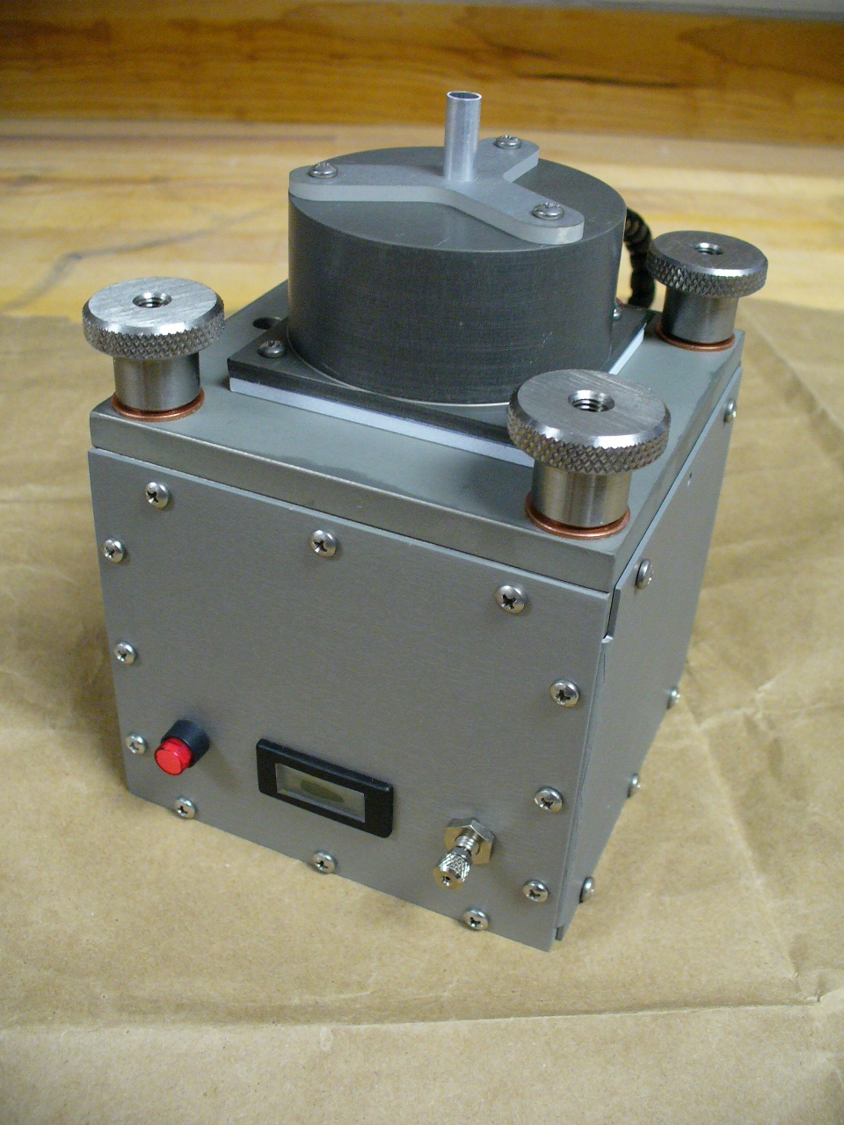
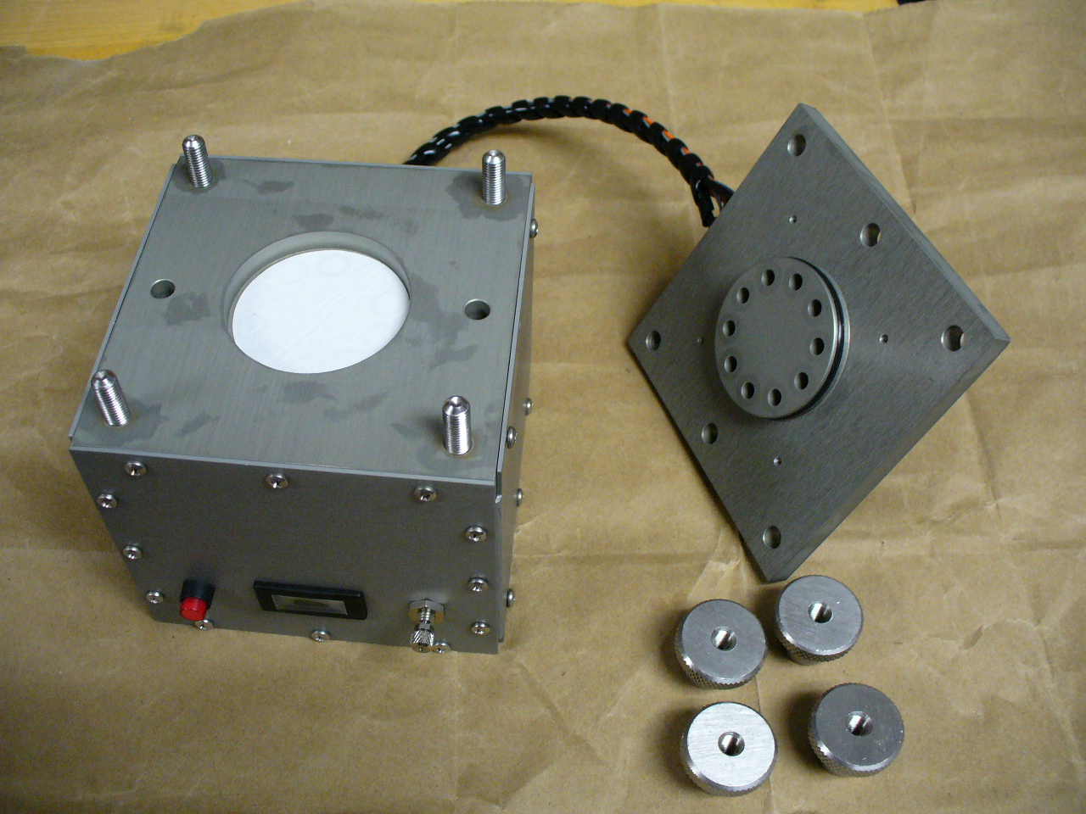
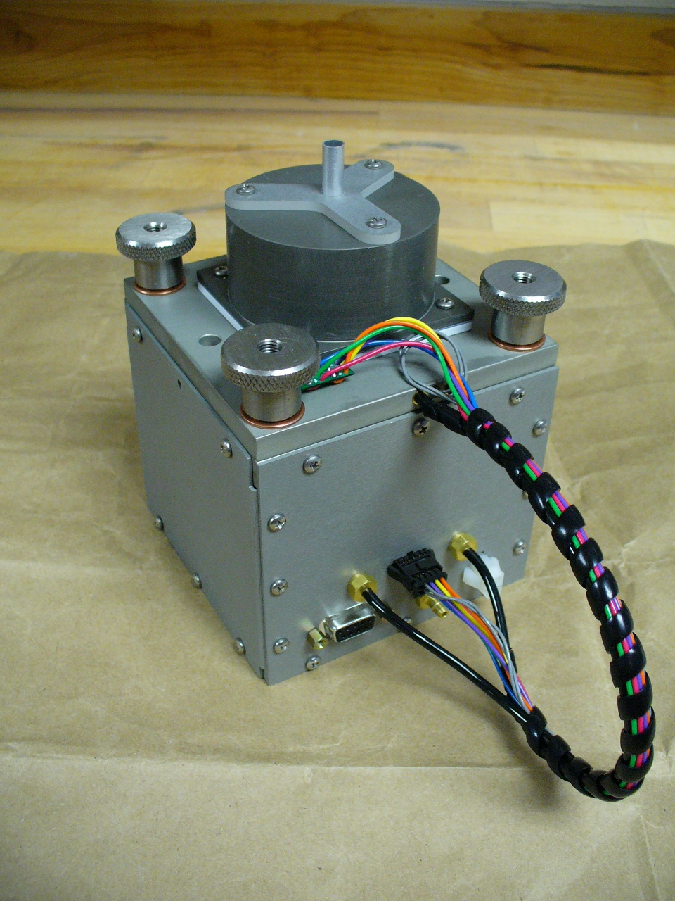
NOAA CLAP – Assembled Product

Slide 3
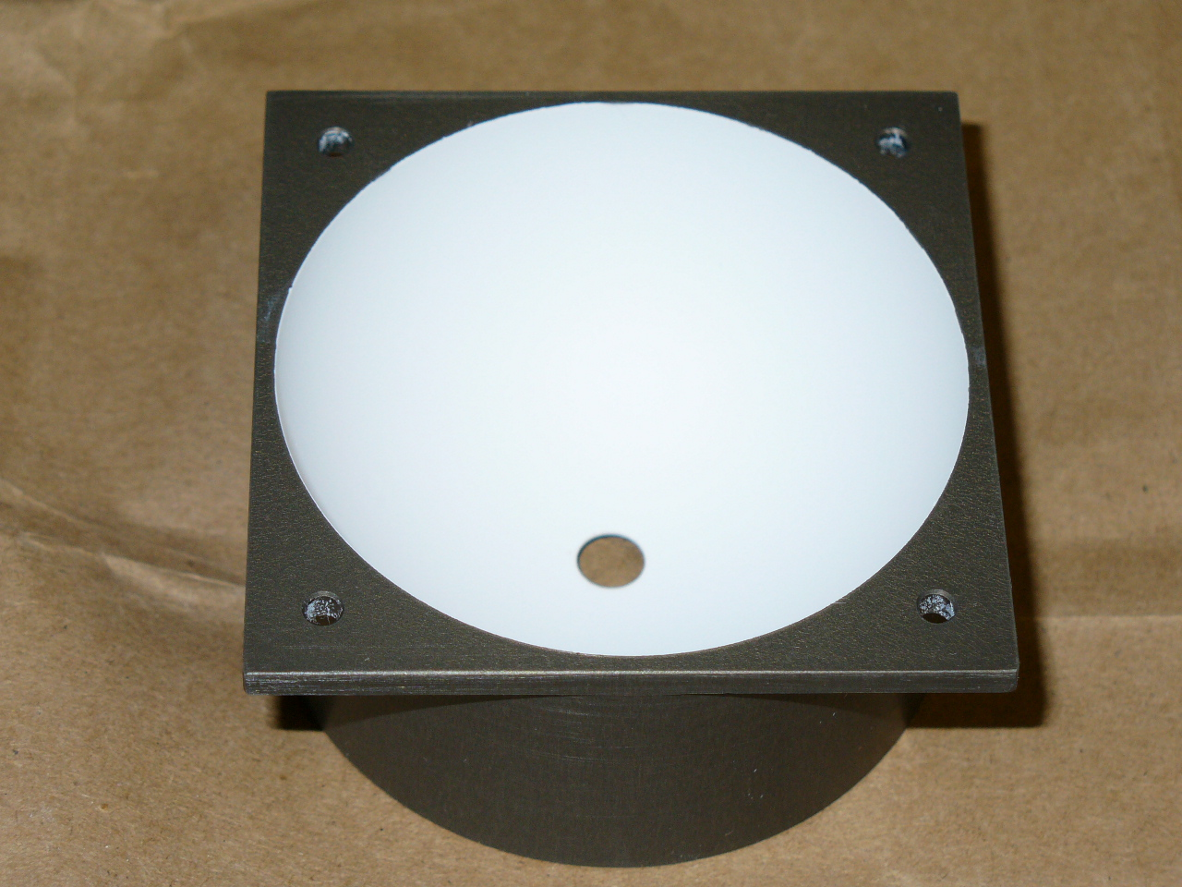
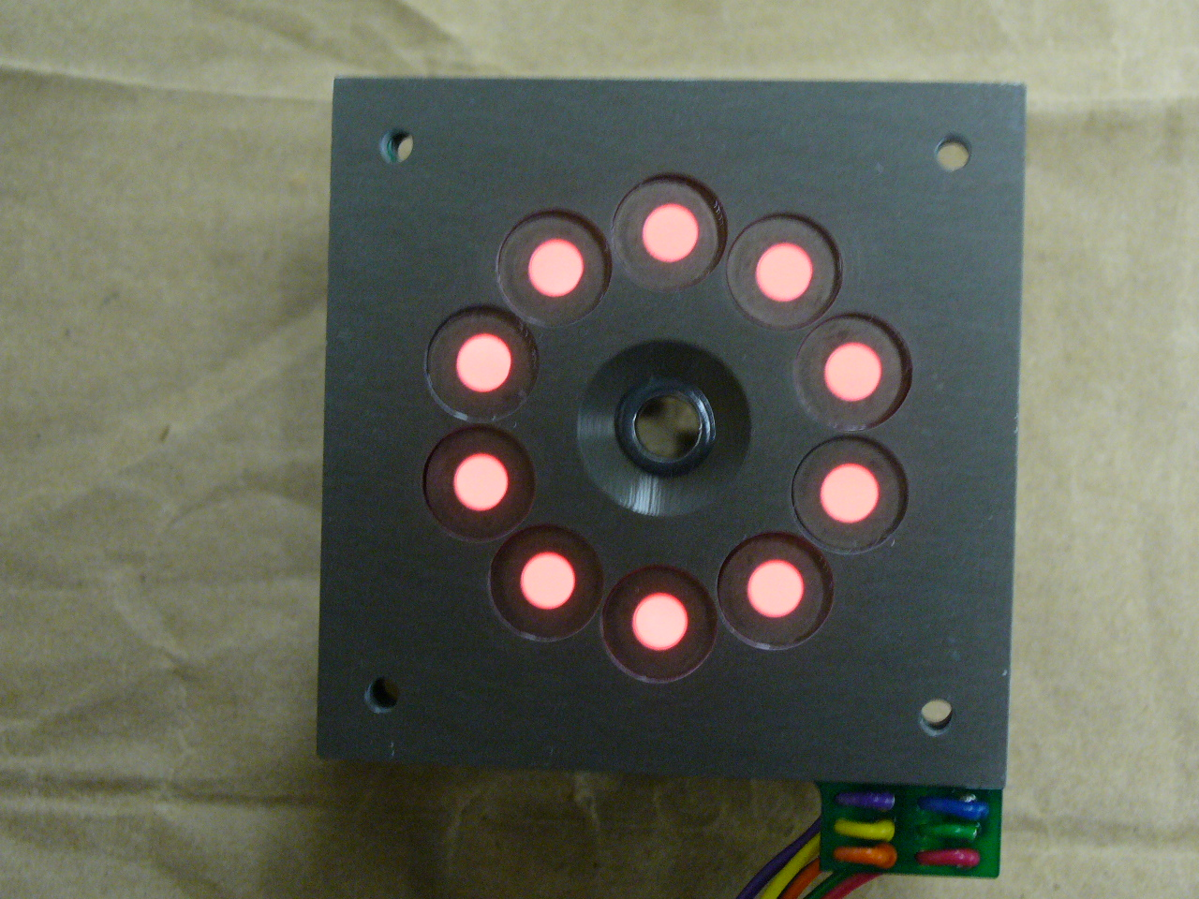
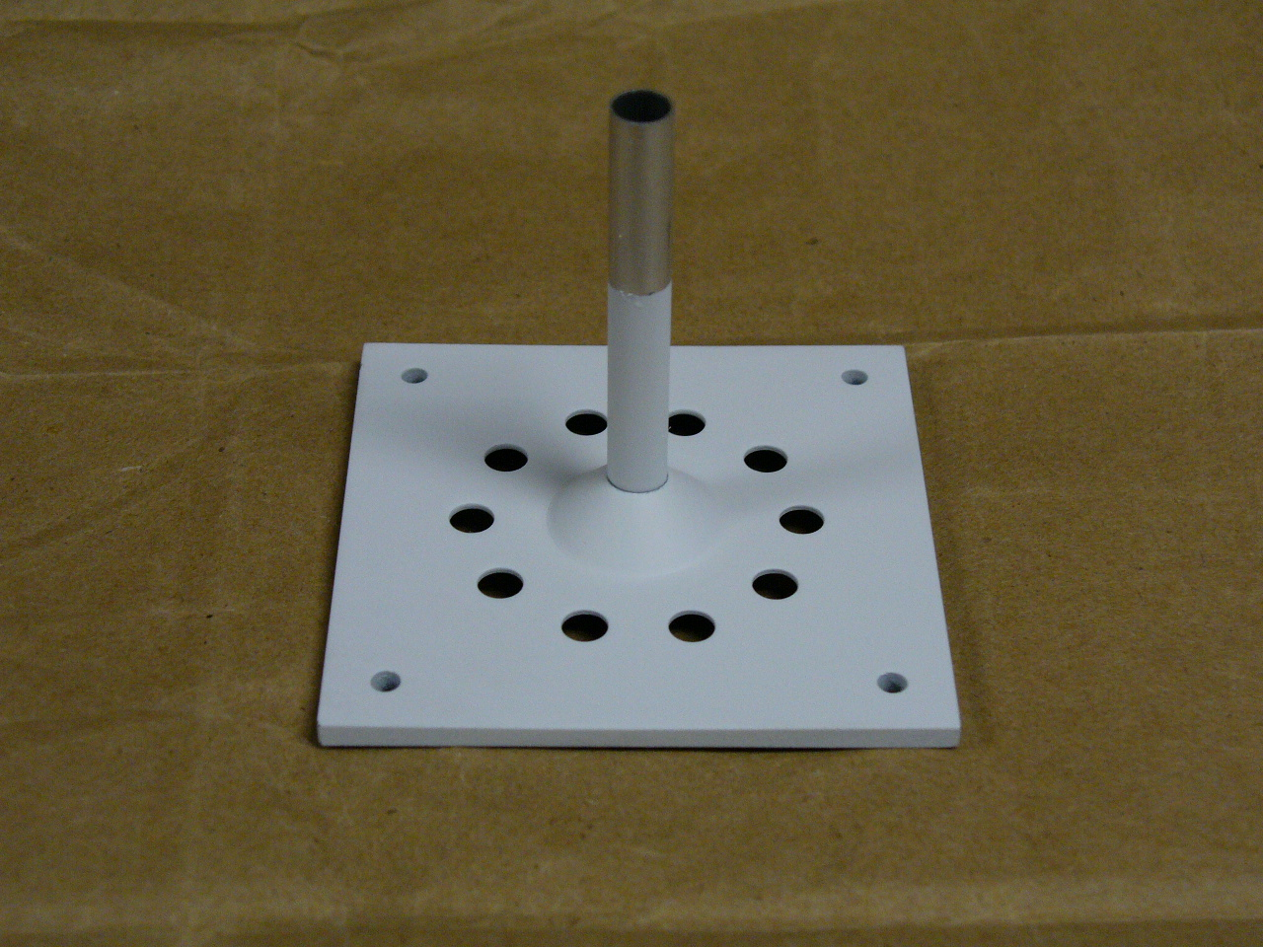
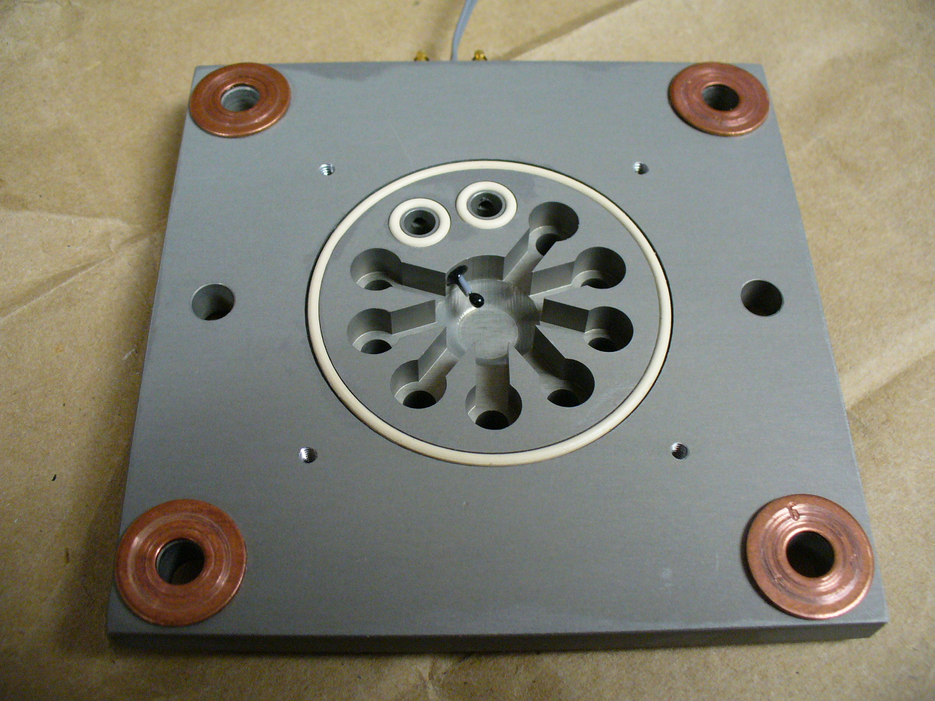
NOAA CLAP – Light Source Internal View

Slide 4
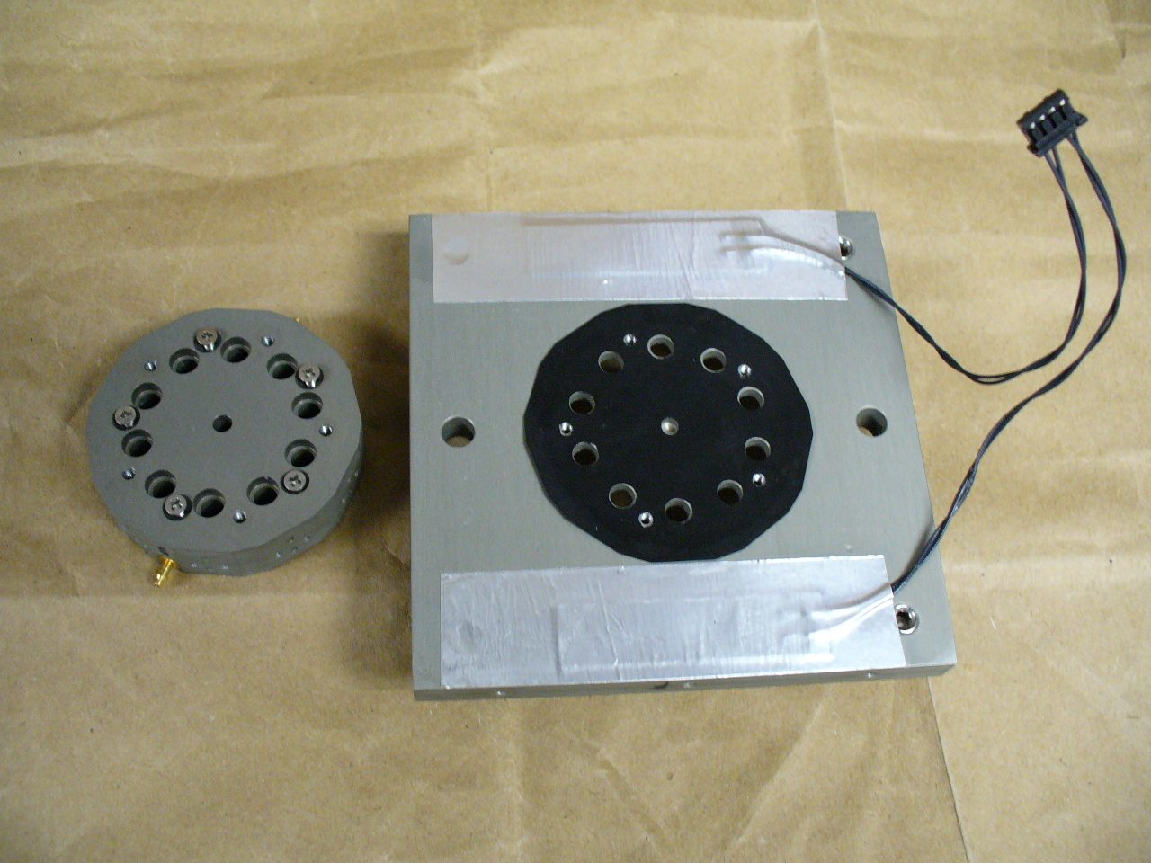
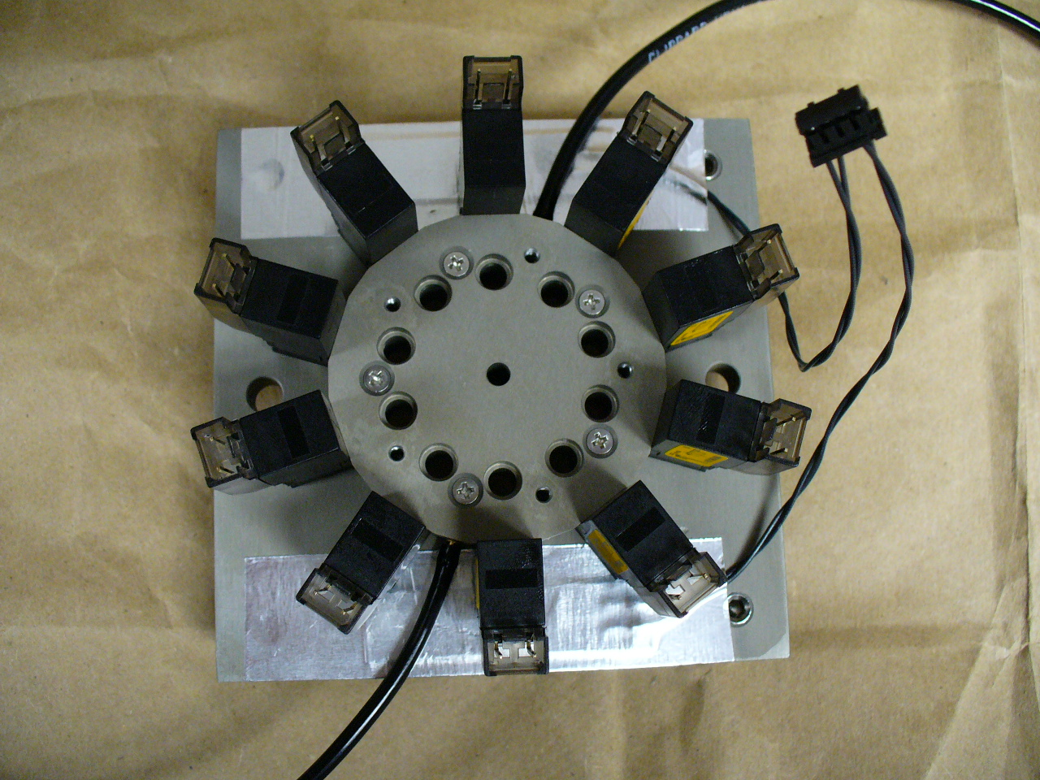
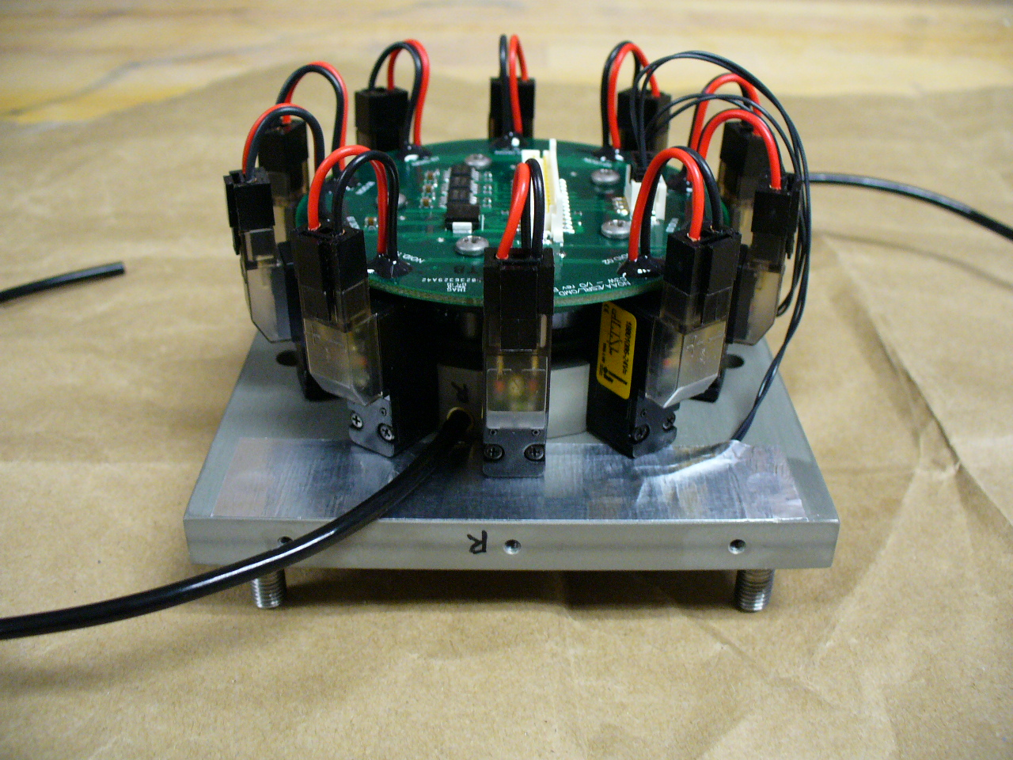
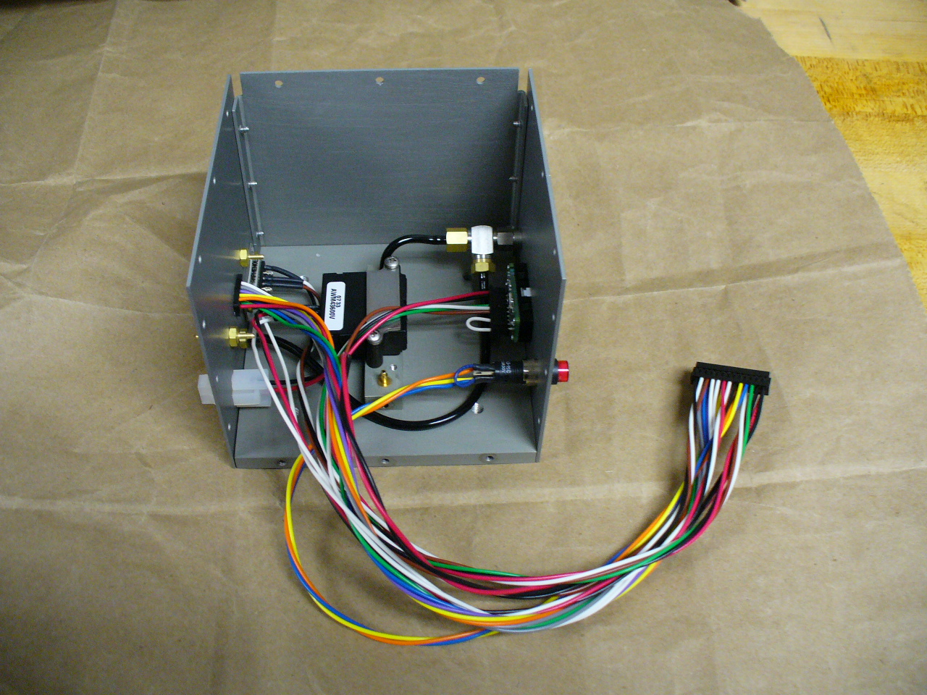
NOAA CLAP – Assembly Details

Slide 7
CLAP vs. PSAP Comparison
CLAP (new)
σ_{ap} (Mm⁻¹)
PSAP (old)

