Slide 1
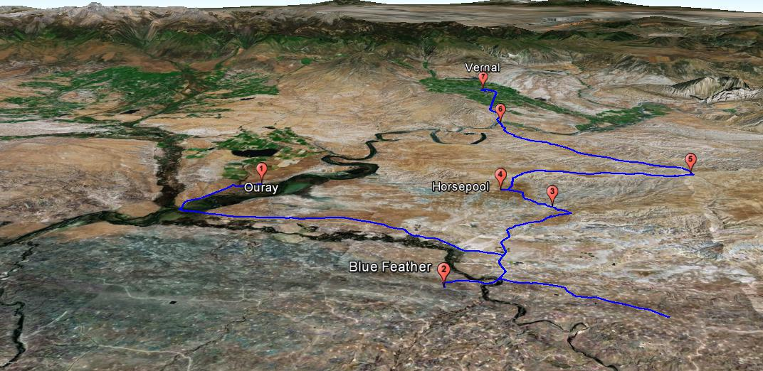

Slide 2
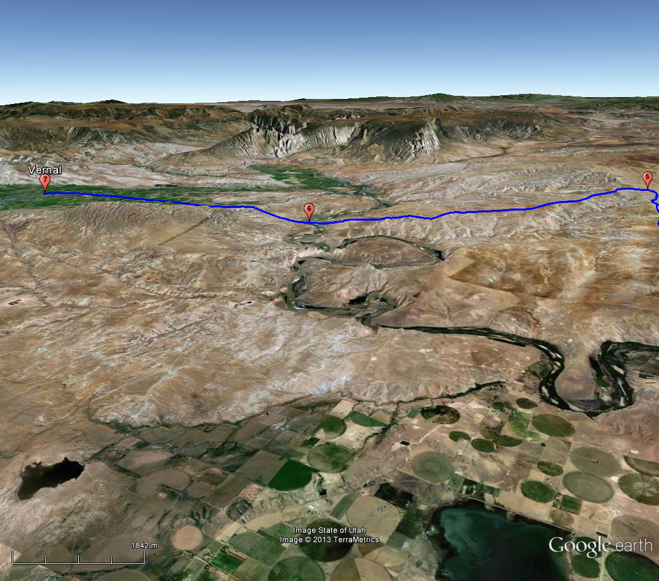

Slide 3
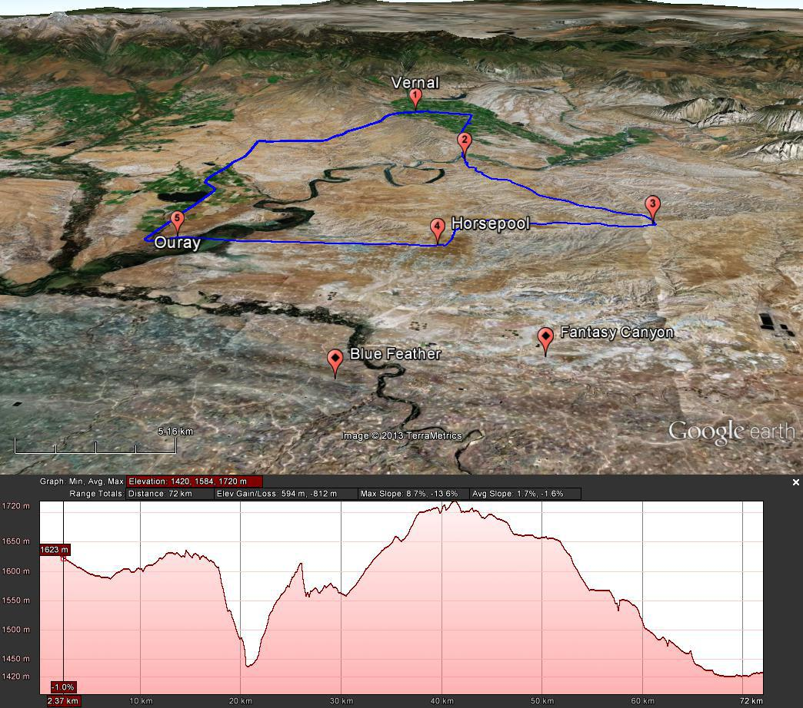

Slide 5
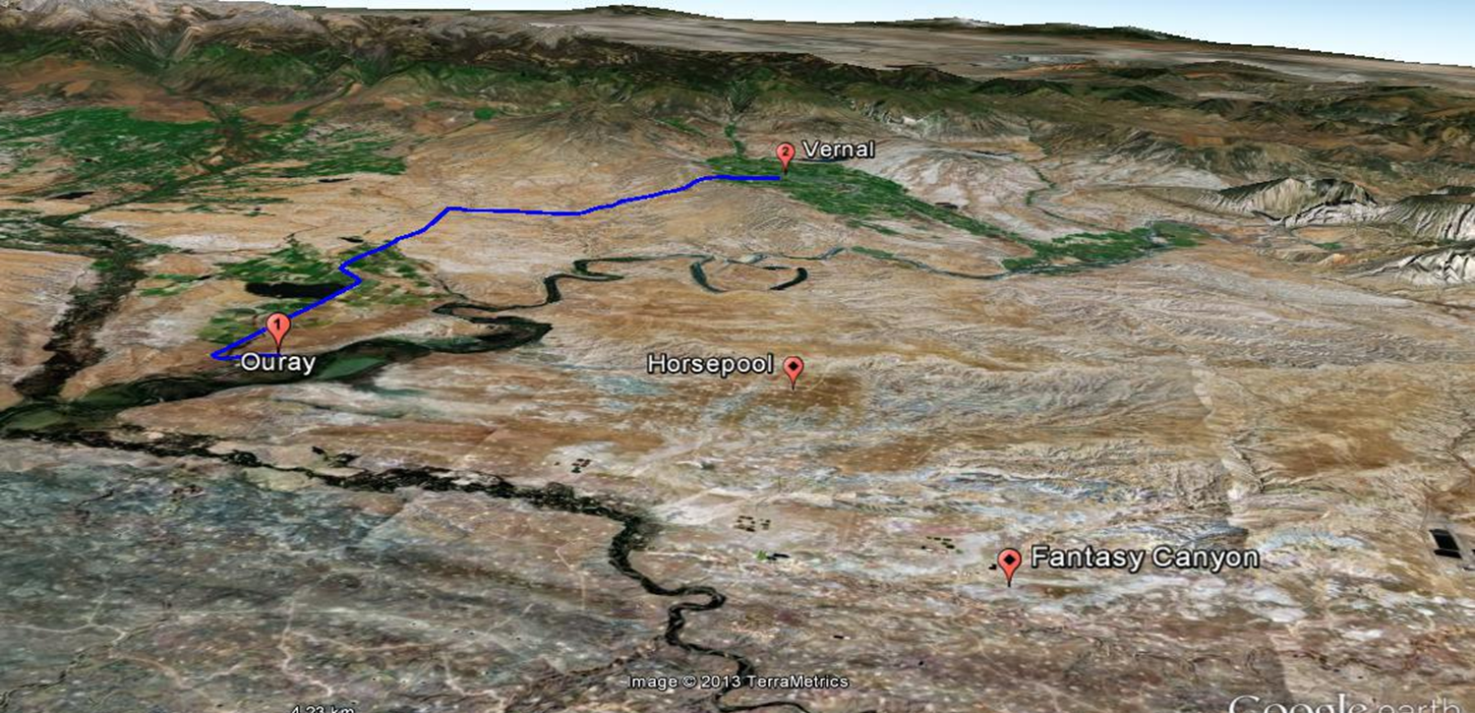
Notes:
Ozone axis range changed

Slide 6
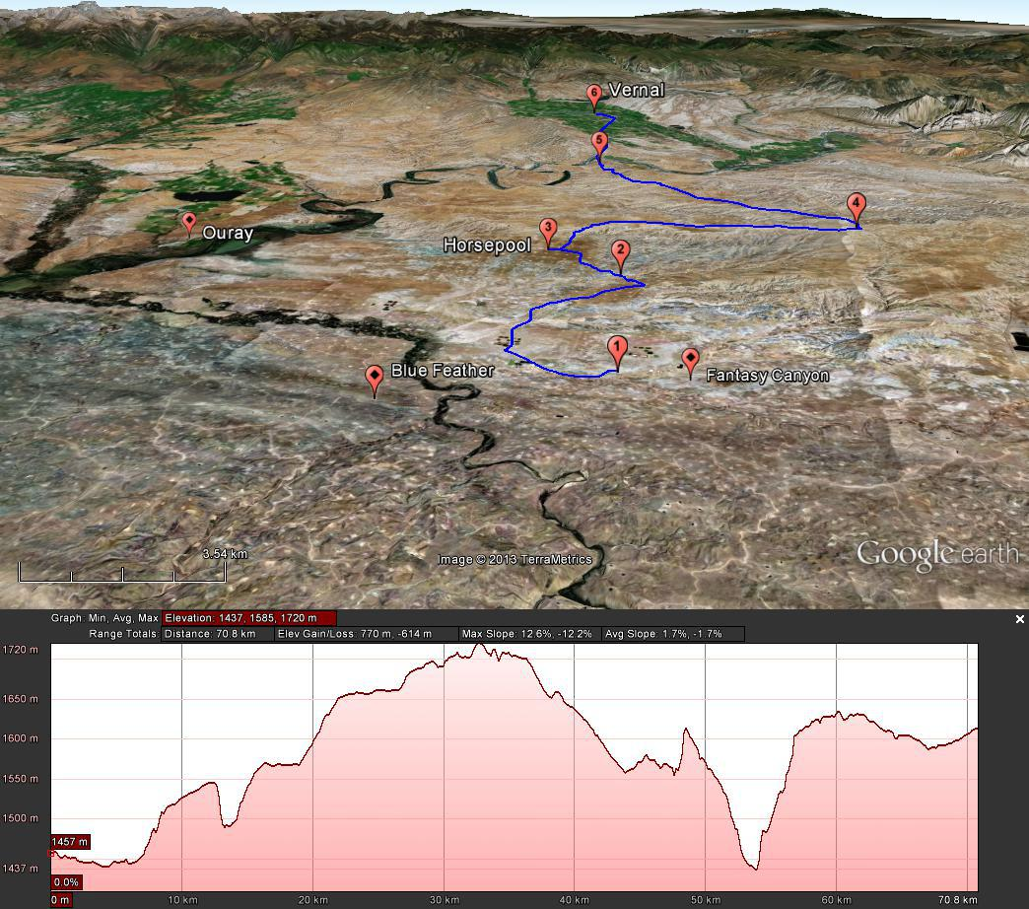

Slide 7
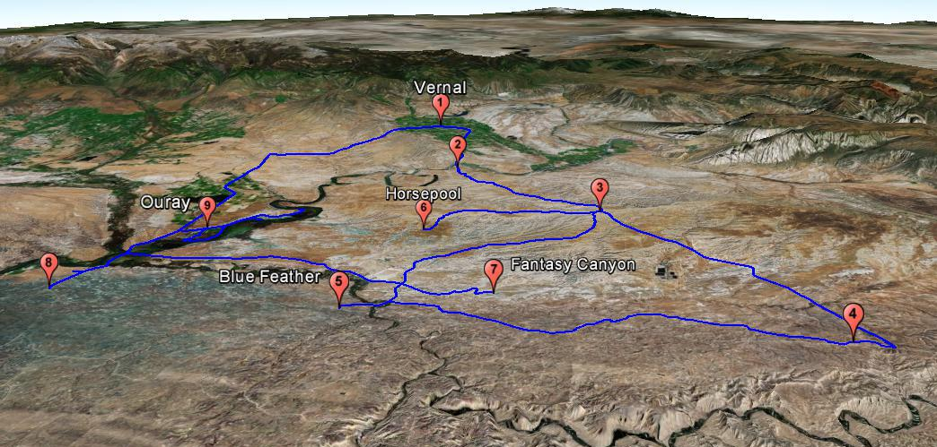

Slide 8
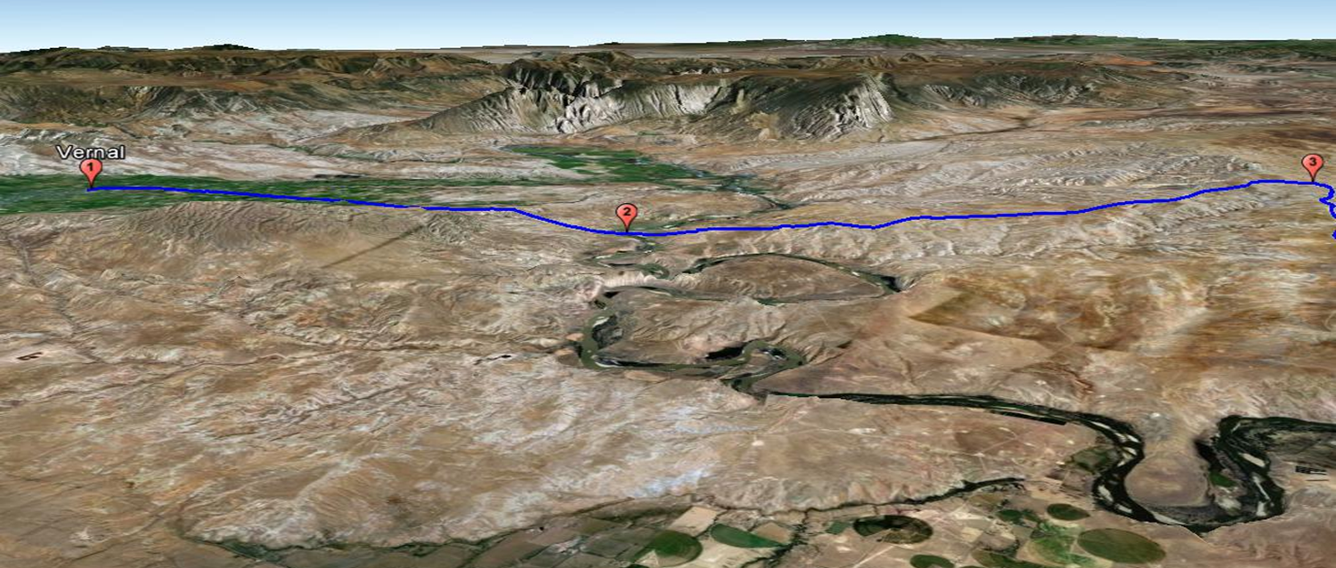

Slide 9
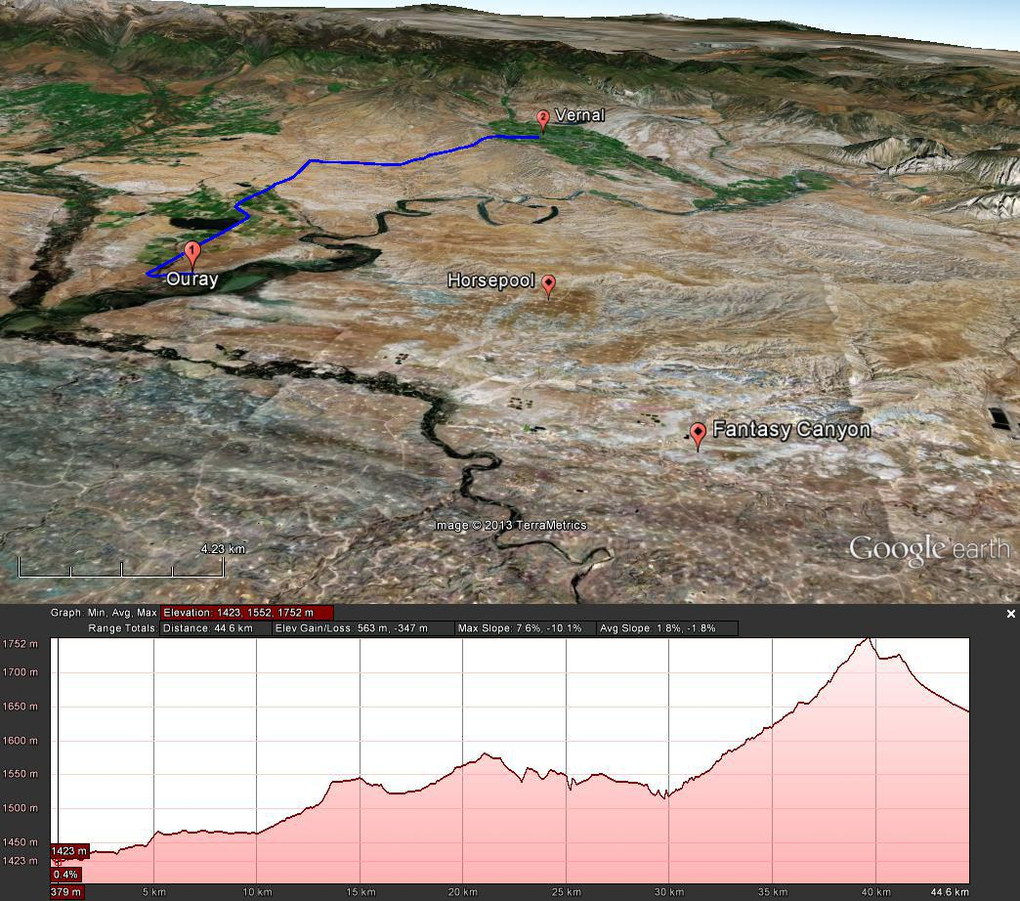

Slide 10
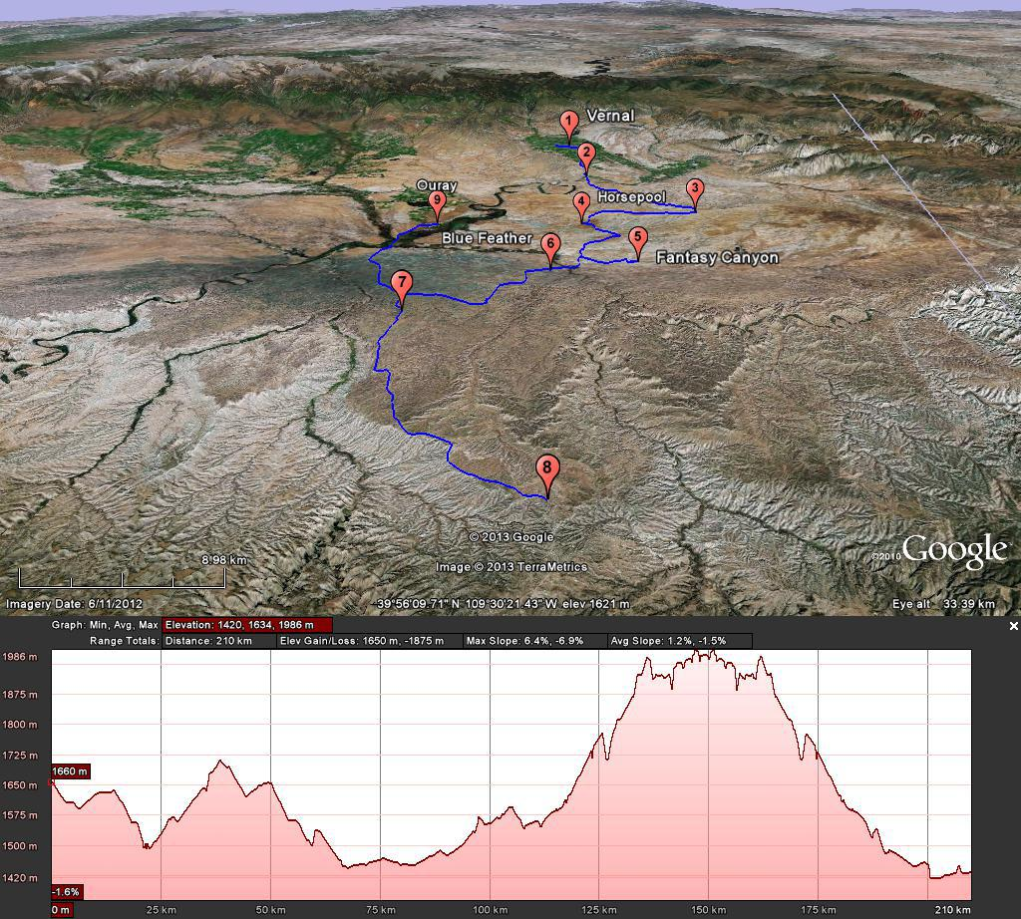

Slide 13
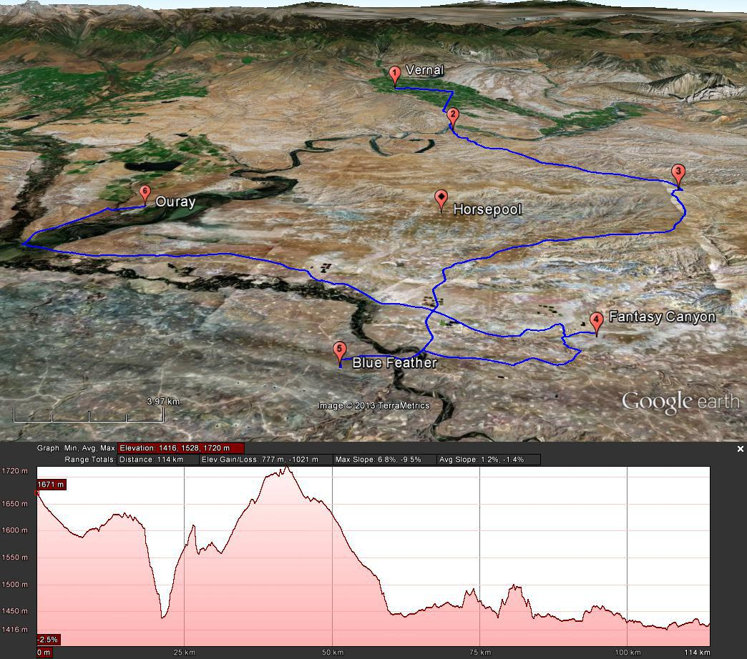

Slide 15
Bonanza Power Plant
Location - 40º 05’ 11” North and 109º 16’48” West
Elevation - 1533 m ASL , 5030 ft ASL
Stack Height - 182.88 m , 600 ft
Stack Elevation - 1715.88 m ASL , 5630 ft ASL
ftp://ftp.cmdl.noaa.gov/pub/gaby/UBS2011/Presentations/GMD_Utah_09092011.pdf
http://www.epa.gov/region8/air/pdf/FinalStatementOfBasis.pdf

