Slide 1
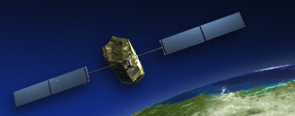
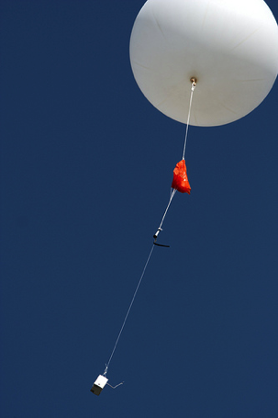
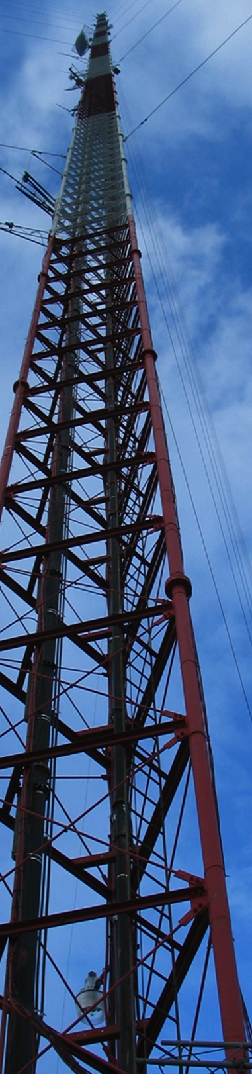
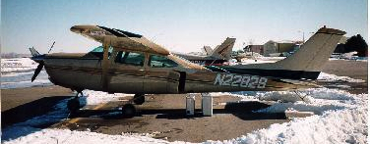
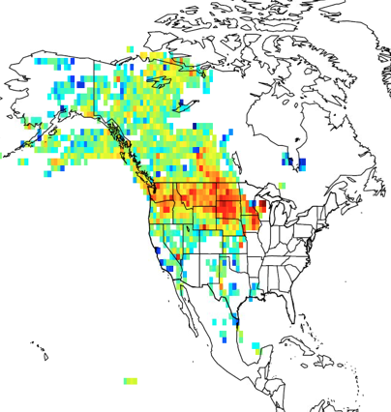
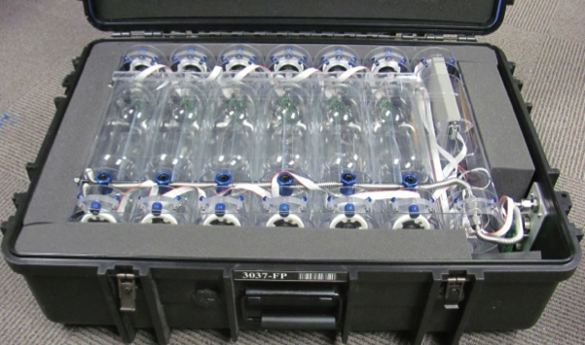
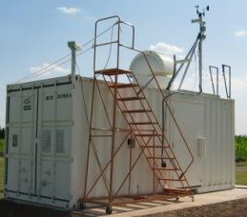
Top-down constraints on the North American carbon cycle from the first decade of the North American Carbon Program
Arlyn Andrews, Lei Hu, Anna Michalak, Yoichi Shiga, Michael Trudeau,
Kirk Thoning, Marikate Mountain, Vineet Yadav, Joshua Benmergui,
John Miller, Thomas Nehrkorn, Colm Sweeney, Ivar Van der Velde,
Pieter Tans, Edward Dlugokencky, Sourish Basu, Doug Worthy, Marc Fischer, Sebastien Biraud, Scott Lehman, Britt Stephens, Ken Davis, Natasha Miles, Scott Richardson, Huilin Chen, Wouter Peters
ICOS Science Conference
Prague 2018
11-13 September

Slide 2
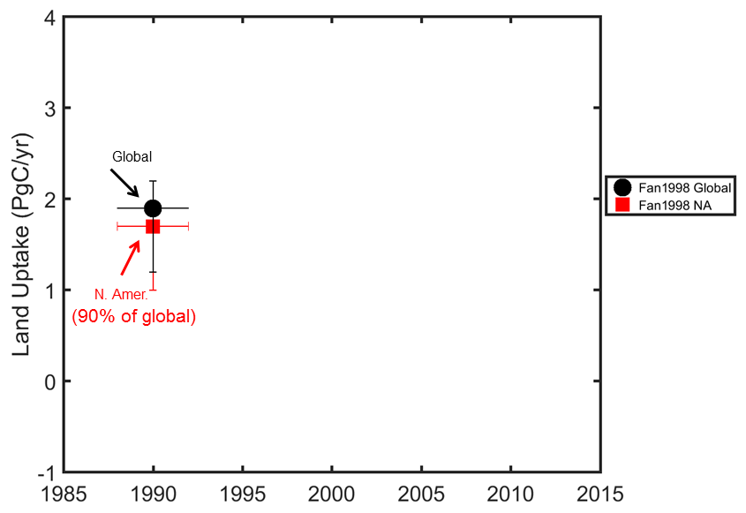
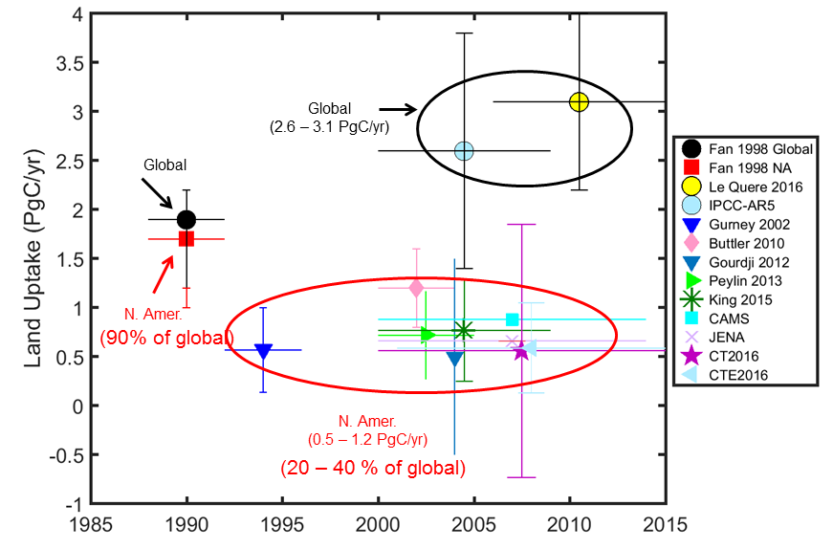
Fan et al. estimated that North America was a strong net carbon sink:
Fan et al., 1998, Science
2

Slide 3
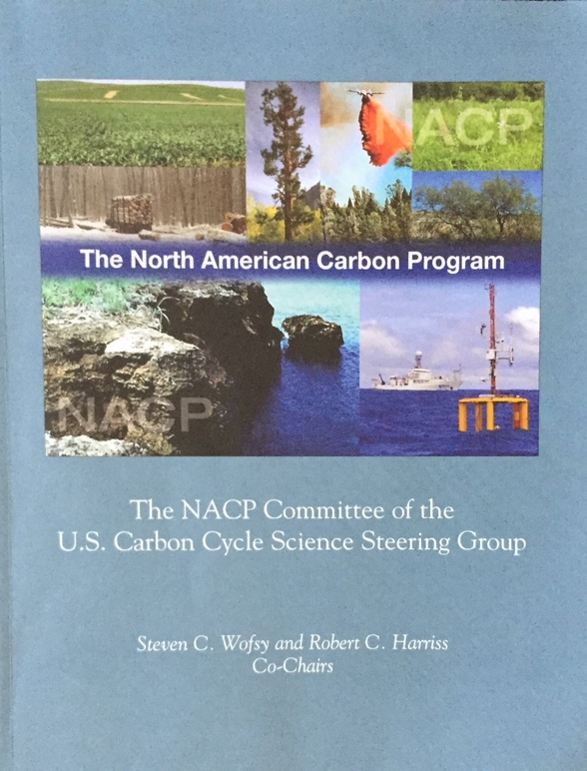
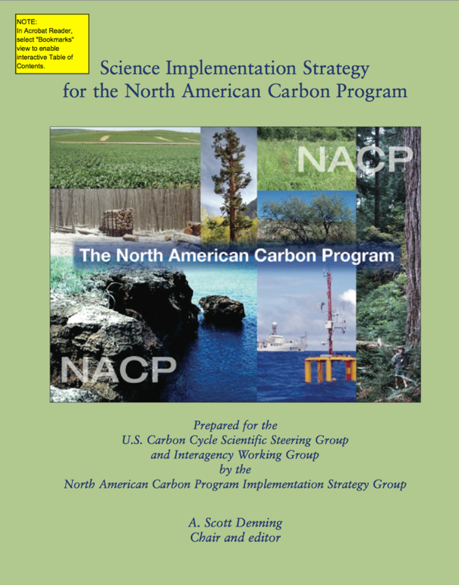

North American Carbon Program: A US Inter-Agency Effort
“Consider uptake of CO₂ due to woody encroachment… 0.12 GtC/yr… spread out over an area the size of Texas, the annual mean decrease of CO₂ in the column would be 0.11 ppm/day…The associated depletion in atmospheric CO₂ over 1000 km could be 0.6 ppm in the lowest 3 km, comparable to the CO₂ from fossil fuels…A total of 30 sites for North America are anticipated...Vertical profiles should be obtained at frequency of every other day…”
  - 0.1 ppm measurement comparability to resolve the signal of important processes

Slide 4
  The past decade has seen major expansion of the North American atmospheric carbon observing system:
2005
2015
  Growth of surface network has exceeded expectations >100 sites in 2015/2016
  NOAA aircraft network: 14 sites profiling up to ~8 km once or twice per month

Slide 5
  Many different laboratories are providing data, with different levels of quality assurance and stability of funding:
  Data Providers
In Situ:
  NOAA Earth System Research Laboratory Global Monitoring Division (A. Andrews, E. Dlugokencky, K. Thoning, C. Sweeney, P. Tans)
  Environment and Climate Change Canada (D. Worthy)
  Penn State University (N. Miles, S. Richardson, K. Davis)
  NCAR (B. Stephens)
  Oregon State University (B. Law, A. Schmidt)
  Lawrence Berkeley National Lab (S. Biraud, M. Fischer, M. Torn)
  Earth Networks (C. Sloop)
  California Air Resources Board (Y. Hsu)
  Harvard University (J. W. Munger, S. Wofsy)
  U of Minnesota (T. Griffis)
  Scripps (J. Kim, R. Keeling, R. Weiss, J. Kim)
  NASA JPL (C. Miller, K Verlhulst)
Remote Sensing:
  TCCON (D. Wunch, P. Wennberg, G. Toon)
  GOSAT-ACOS (C. O’Dell)
  OCO-2 team
2015
Comparability among datasets is crucial for flux estimation and trend detection.

Slide 6
  Many different laboratories are providing data, with different levels of quality assurance and stability of funding:
US efforts under North American Carbon Program
  NOAA Network Expansion
  Regional efforts, e.g., ORCA, Calibrated AmeriFlux, RACCOON, California Air Resources Board
  Special projects, e.g., INFLUX, CARVE, MCI, LA Megacities, Gulf Coast Intensive, CALGEM
Expansion of Environment and Climate Change Canada GHG monitoring network
Earth Networks commercial GHG network
2015
NOAA/ESRL & Partners
Environment and Climate Change Canada
Earth Networks

Slide 7
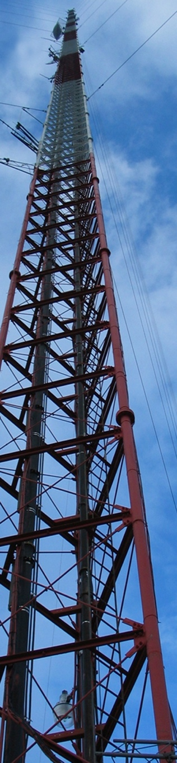
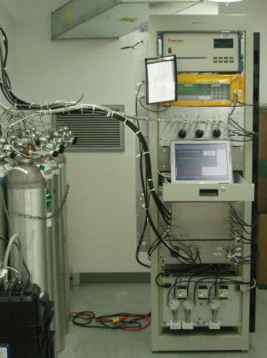
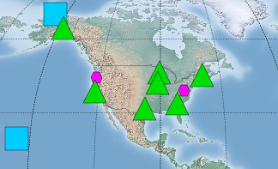
NOAA Global Greenhouse Gas Reference Network: tall tower in situ and flask sampling
NOAA tall tower sites have continuous CO₂ and CO and flask measurements (every other day sampling, Δ¹⁴CO₂ 3x per week)
Three sites also have continuous CH₄
Additional mountain sites have continuous CO₂ and/or flask sampling
Many partners!
Surface Continuous
Tower
Observatory
Tall tower program PI: Arlyn Andrews

Slide 8
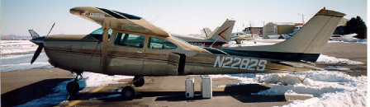
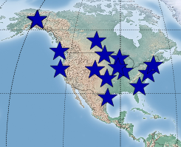
NOAA Global Greenhouse Gas Reference NetworkAircraft Sampling
Aircraft program PI: Colm Sweeney
Nominal schedule 2 flights per month
Most aircraft max altitude 6000 to 8000 masl
Twelve flasks per package
Flasks measured for CO₂, CH₄, CO, N₂O, SF₆, H₂, stable isotopes of CO₂ and sometimes CH₄, Δ¹⁴CO₂ (subset of samples), hydrocarbons ethane (starting in 2015), halocarbons

Slide 9

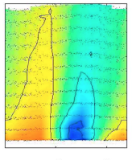


Average Seasonal Cycle of CO₂ above Homer, Illinois:
∆CO₂, ppm
Sweeney et al., JGR, 2015

Slide 10
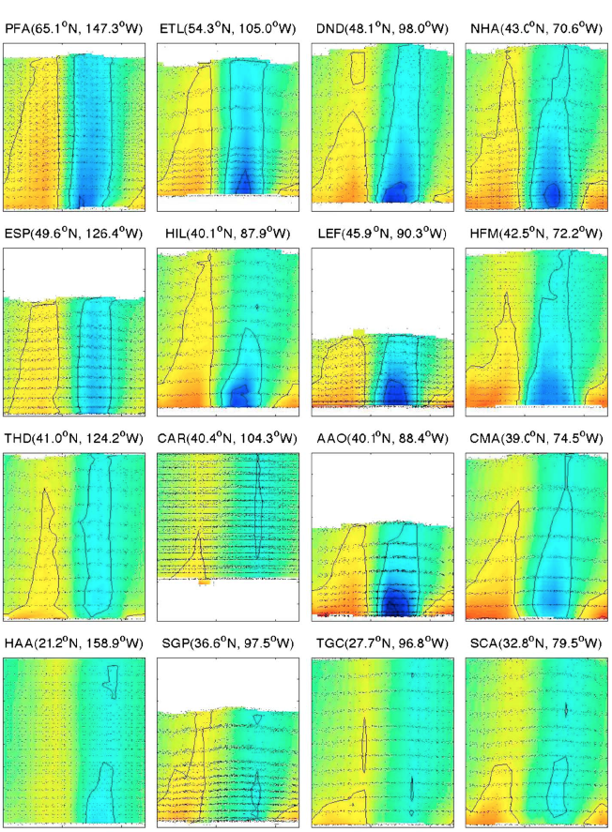
Annual CO₂ Climatology above North America, from Sweeney et al., JGR, 2015:
Poker Flat, Alaska
Wisconsin
∆CO₂, ppm
Hawaii
South Carolina

Slide 11
Multi-species profiles provide powerful constraints on flux estimates:
Eastern USA (NHA)
Nov 2005
Strong anthropogenic influence
Surface uptake
Slide Courtesy of Steve Montzka

Slide 12
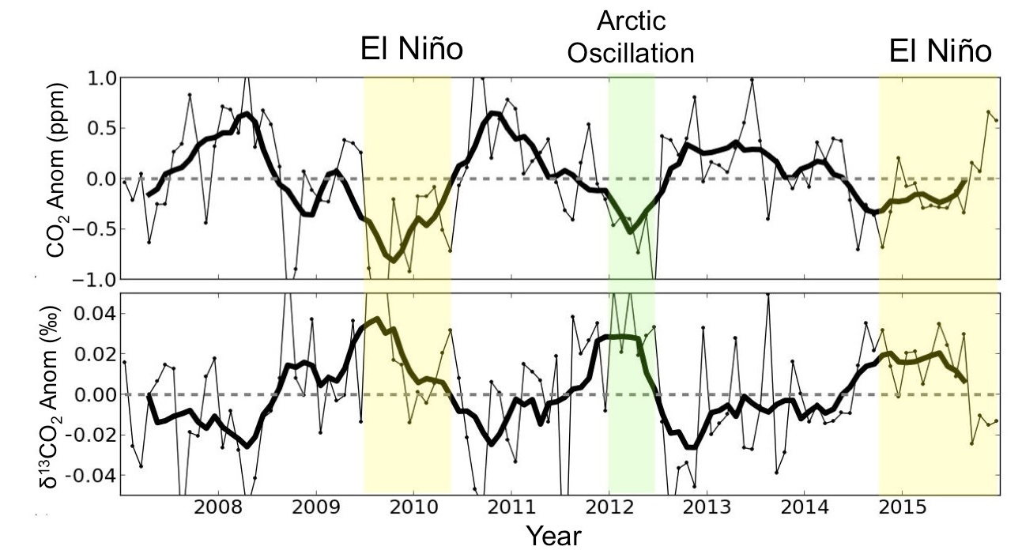
  CO₂ and ¹³CO₂ anomalies over North America are correlated with large-scale climate anomalies:
Monthly anomalies (thin lines) of atmospheric CO₂ and δ¹³CO₂ averaged across North American sampling sites.
δ¹³CO₂ provides information about how plants respond to drought stress.
Figure Courtesy of Lei Hu

Slide 13
  Radiocarbon over North America shows decreasing trend due to global fossil fuel emissions and local depletion due to local fossil fuel sources:
10 ppm C_{ff}
Altitude > 3.5 km
Most Polluted Sites
Altitude > 3.5 km
Data from John Miller (NOAA) and Scot Lehman (INSTAAR)

Slide 14
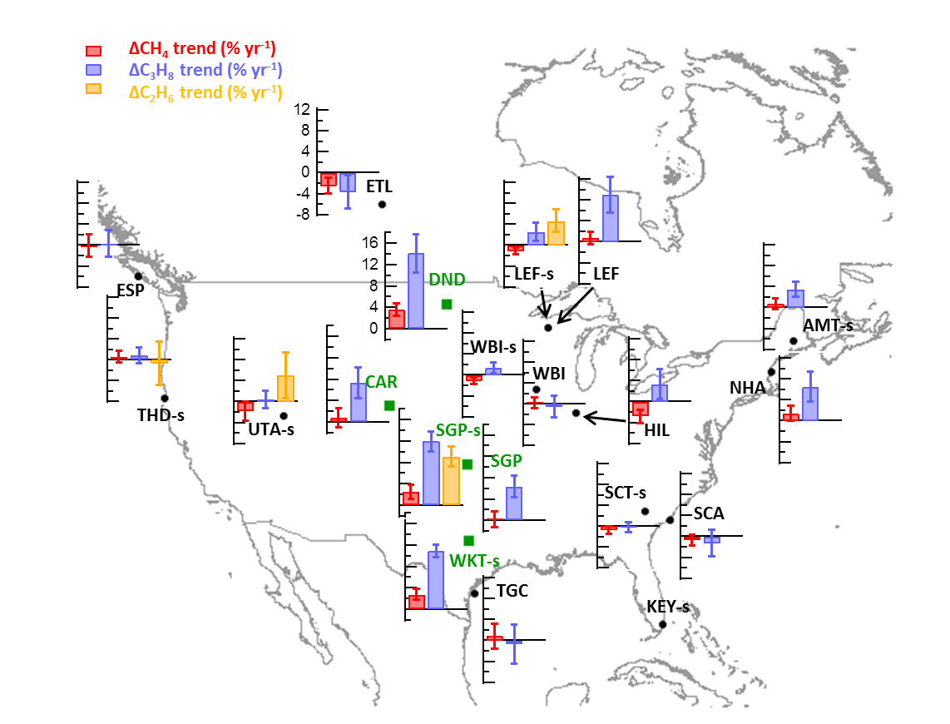
  Methane and Hydrocarbon trends over North America:
10%/yr
Methane trends are only observed at a few sites near oil and gas development
Increasing propane and ethane trends are observed at many sites
Slide Courtesy of Xin Lan

Slide 15
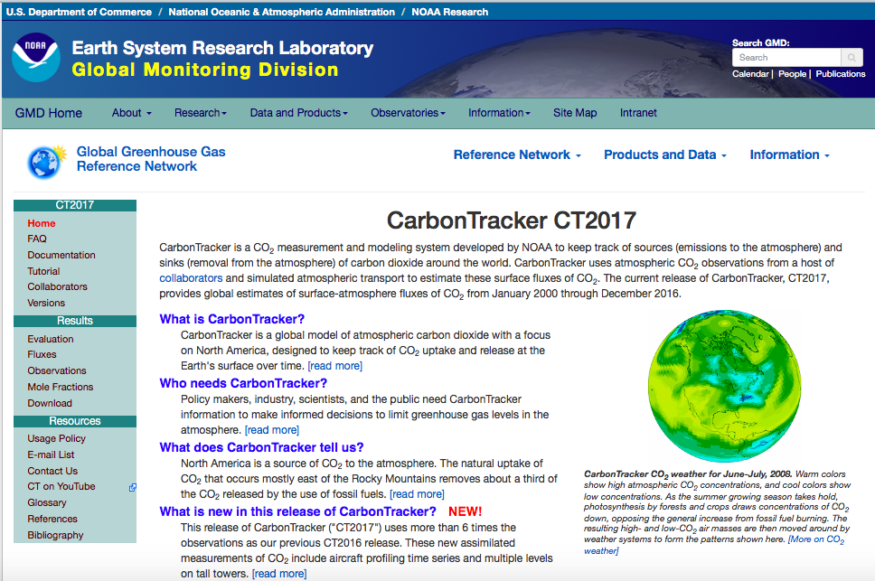
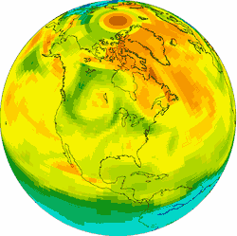
CarbonTracker PI: Andy Jacobson

Slide 16
  NOAA’s CarbonTracker provides up to date estimates of regional carbon fluxes, but stated uncertainty of North American biological CO₂ uptake remains large:
North American
Optimized Annual Total Emissions
CO₂ emissions (PgCyr⁻¹)
Total Uptake: 0.56±1.29
Temperate: 0.37±0.92
Boreal: 0.19±0.91
Fossil Fuel: 1.74±0.02

Slide 17
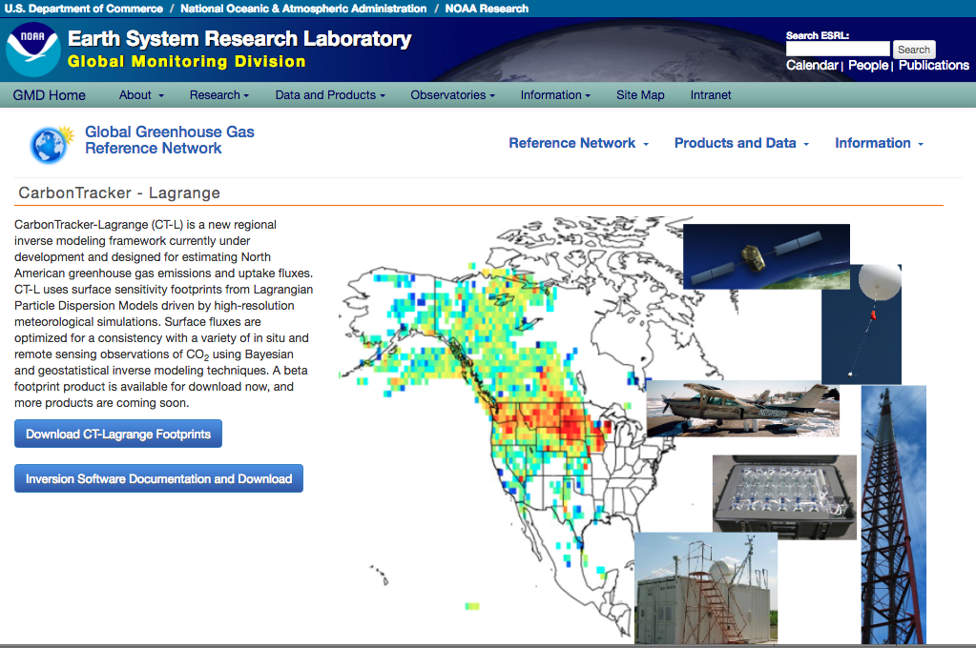
Footprint library > 3 million measurements including flask samples, in situ, TCCON, OCO-2, GOSAT
http://www.esrl.noaa.gov/gmd/ccgg/carbontracker-lagrange/

Slide 18
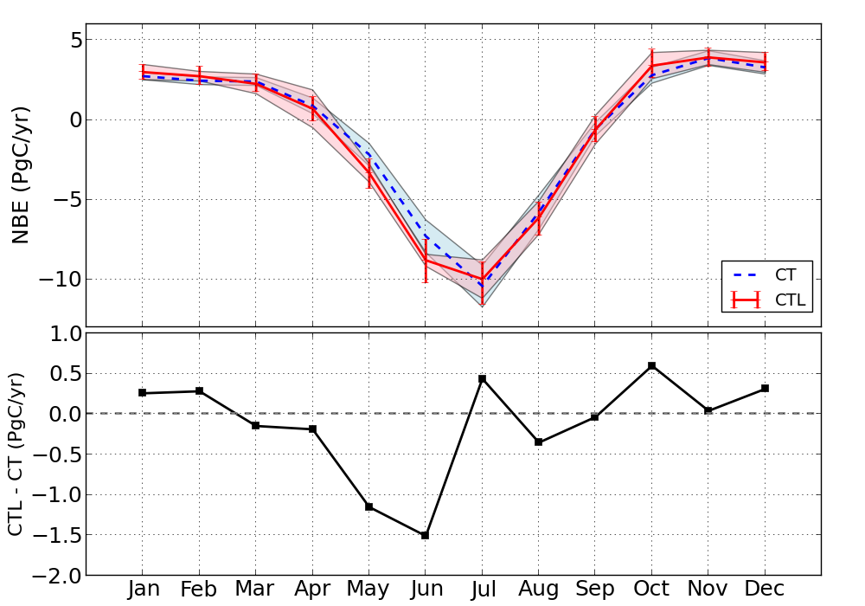
CT Lagrange versus CT2016 Fluxes: Long-term Mean
Multi-Year Monthly Averages (2007 – 2015)
CarbonTracker v2016 (CT)
CarbonTracker-Lagrange(CTL)
CT2016: -0.56±1.29 PgCyr⁻¹
CT-L: -0.70 (-1.24 to -0.34) PgCyr⁻¹
Net biospheric uptake is similar despite very different atmospheric transport models
Slide by Lei Hu

Slide 19
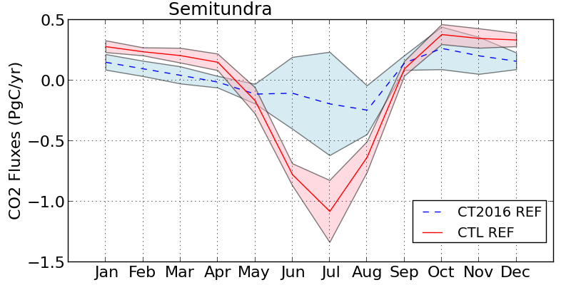
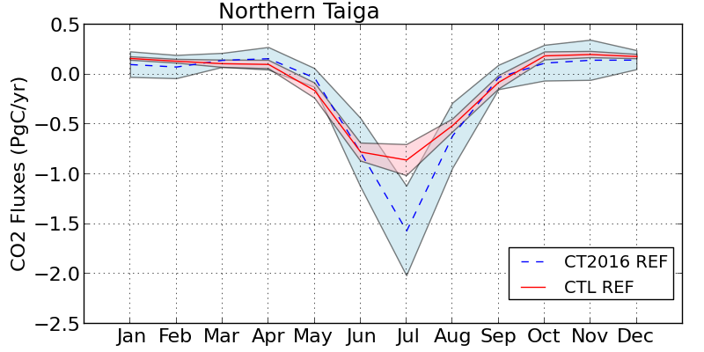
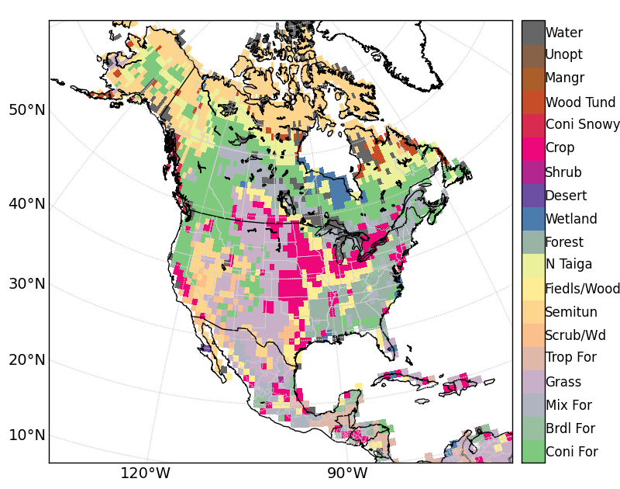
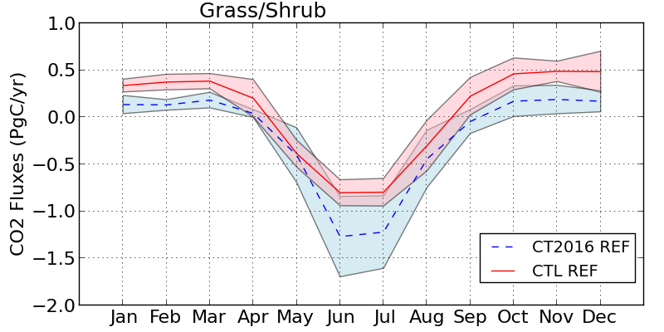
Larger differences observed between CTL- and CT- fluxes on eco-regional scales
CT2016
CTL
Semi-tundra
Northern Taiga
Slide by Lei Hu
Grass/Shrub

Slide 20
Annual net terrestrial CO₂ fluxes from North America:

Slide 21
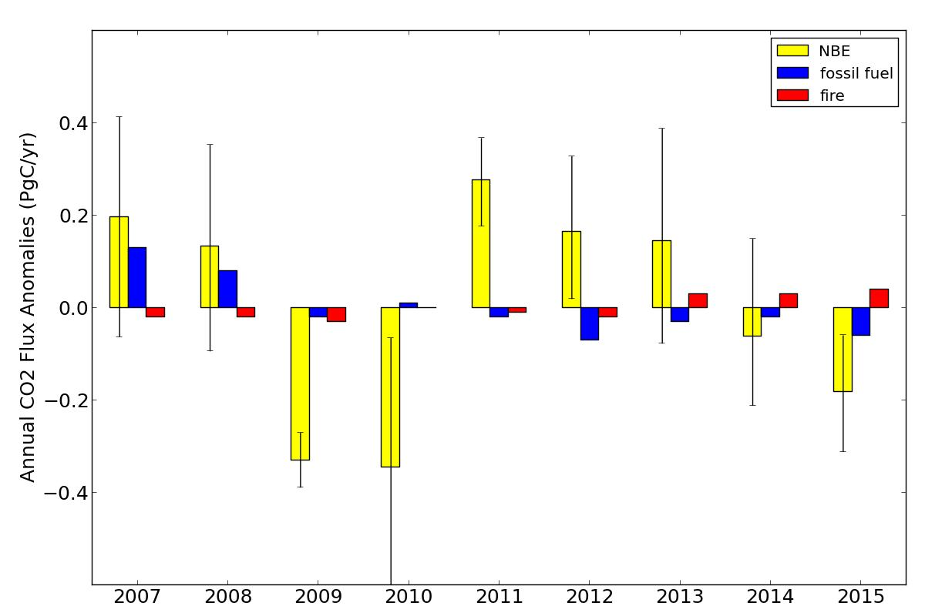
CT-L terrestrial CO₂ fluxes show emergent and persistent response to ENSO:
La Niña
El Niño
El Niño
Slide by Lei Hu

Slide 22
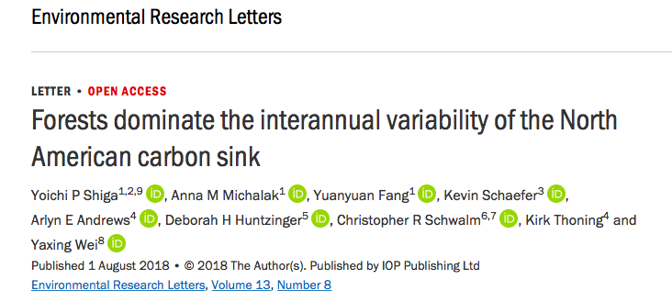

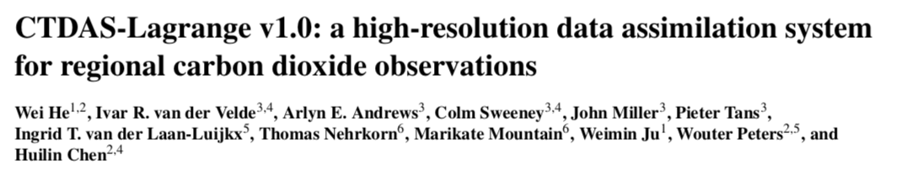

Slide 23
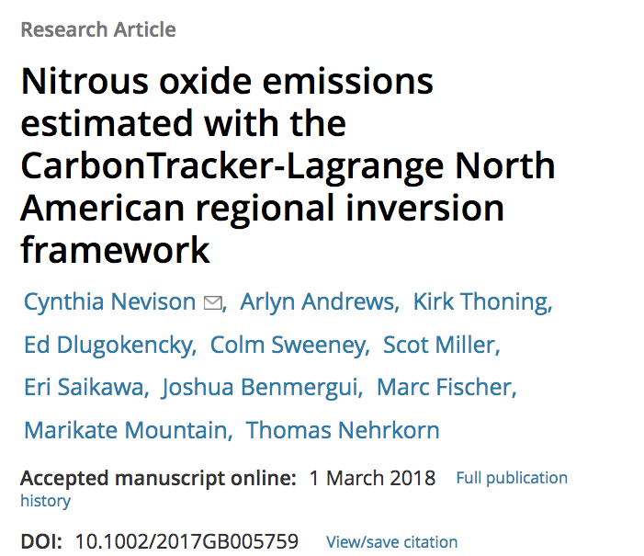
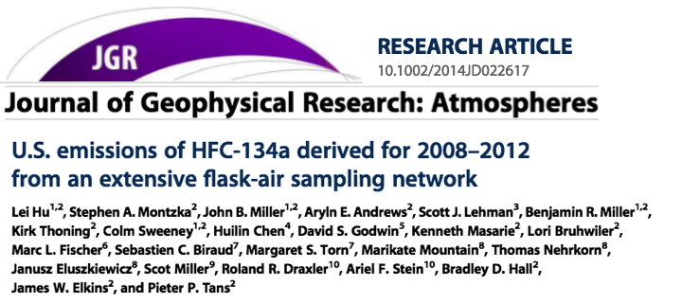

Slide 24
Parting Thoughts
North American ecosystems remove about 40% as much CO₂ as is emitted by North American fossil fuel combustion
Precipitation/moisture anomalies drive year-to-year variability in carbon uptake by North American temperate ecosystems.
Atmospheric CO₂ measurements suggest a stronger response to precipitation anomalies than is simulated by ecosystem models
Atmospheric CH₄ measurements show modest trends over oil and gas producing regions and no detectable trends over the Eastern USA
Future work is planned to incorporate isotopes and multi-species data and to incorporate multiple transport simulations.

