Slide 1
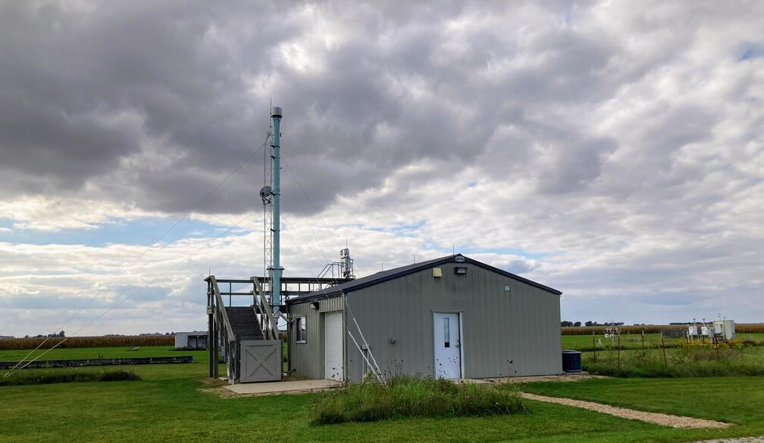
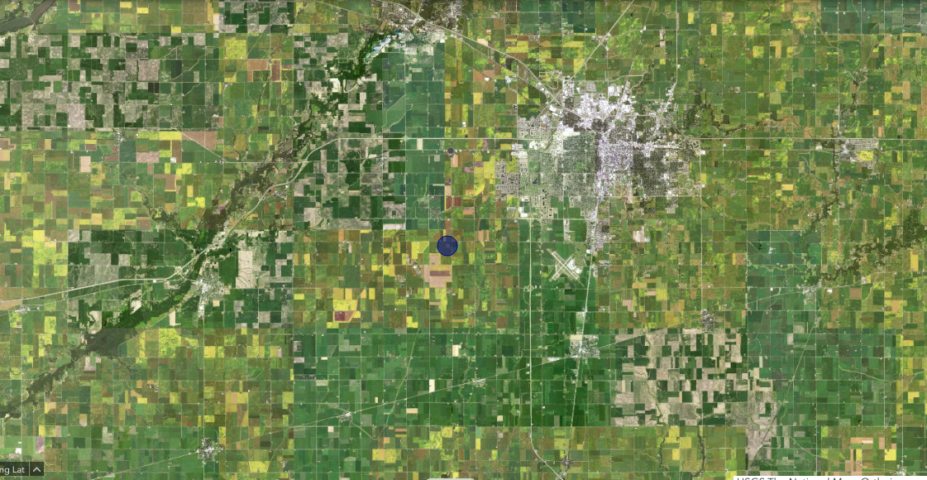
Exploring causes of low single scattering albedo during autumn in central North America
Elisabeth Andrews and Erin Boedicker
University of Colorado, Boulder, USA
NOAA/Global Monitoring Laboratory, Boulder USA
BND (Bondville, IL)
5 km
USGS national map
Notes:
Aerosol measurements established 1994. Wind from west hemisphere, highest prevalence SSW, followed by NW (extra slide). Site is ~20km from champaign-urbana (pop ~100k)

Slide 2
Introduction
Single scattering albedo (SSA) at BND is lower in September and October.
WHY???
D&O=Delene and Ogren, JAS, 2002
Sherman=Sherman et al., ACP, 2015
Single scattering albedo
1996-2001 D&O
2010-2013 Sherman
2014-2023 Last 10 y
Several hypotheses have been proposed:
Preferential scavenging of scattering aerosol by precipitation (Sherman et al., 2015)
Biomass burning (Buzcu-Guven et al., 2007)
Agricultural harvest activities (Delene and Ogren, 2002)
Notes:
CC 2020 – slight decreasing trend in SSA (getting slightly darker) between -0.0005 and 0 annually and summer (other seasons no SS trend)

Slide 3
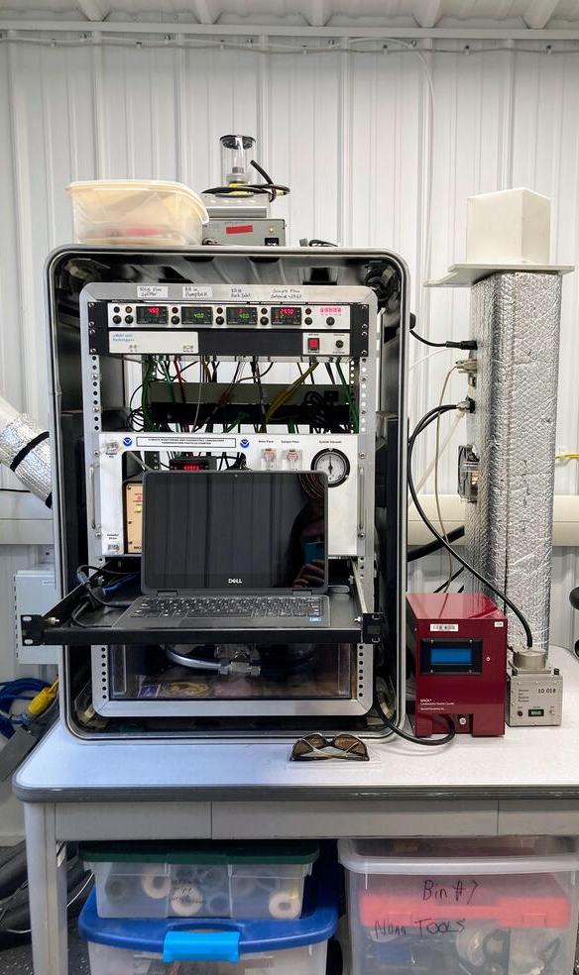
Site Measurements
In-situ aerosol system
Measurement | Institute
Aerosol optical properties | NOAA GML, since 1994
Meteorology (RH, Wind, etc.) | NOAA/GML, since 1994
Aerosol chemistry | NOAA/PMEL, 1994-2008
Carbon monoxide | US EPA, 2012-2018
Precipitation | Illinois Climate Network, since 1990 NOAA Online Weather, since 1995
Soil Moisture | Illinois Climate Network, since 2012
Other measurements at BND include:
NASA AERONET
NADP precipitation chemistry
IMPROVE aerosol chemistry
US EPA dry deposition chemistry, PM2.5, AQ gases
SURFRAD solar radiation
USDA UV-b radiation
https://www.isws.illinois.edu/climate-and-atmospheric-science/bondville-environmental-and-atmospheric-research-site

Slide 4
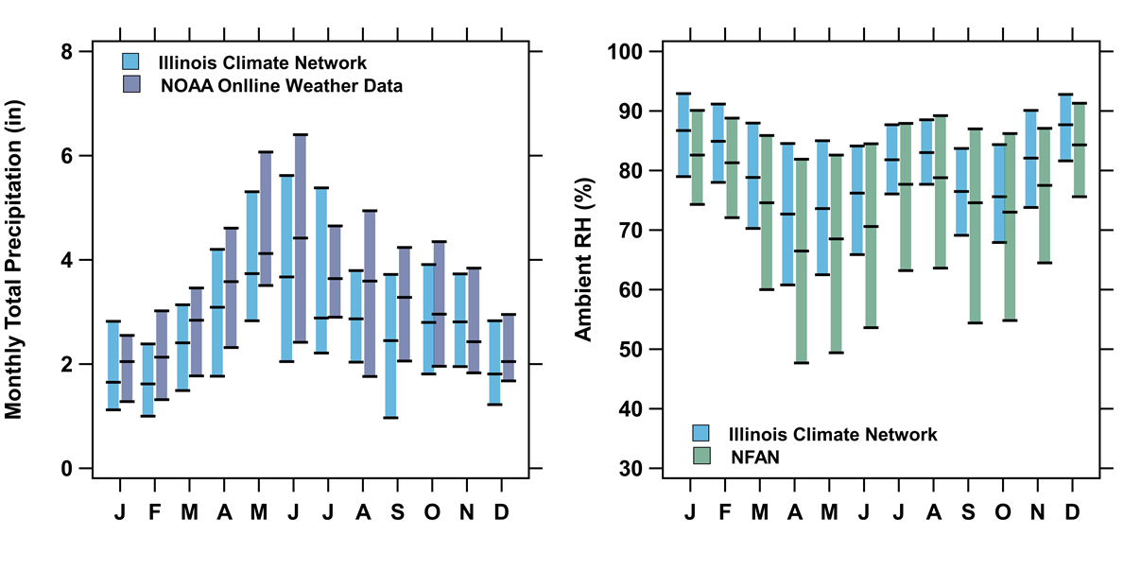
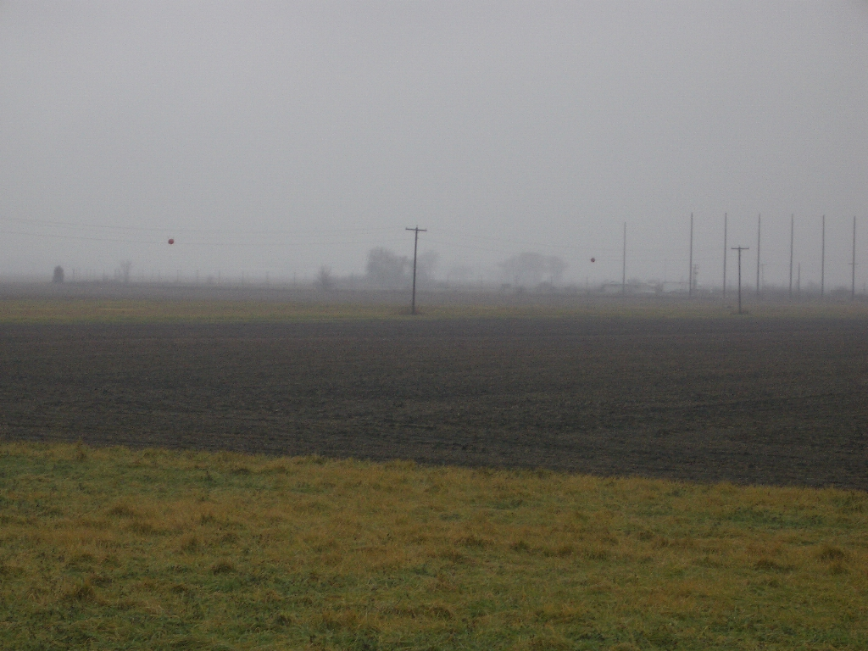
Is wet scavenging causing low SSA at BND?
Ambient RH (%)
Monthly Precipitation (in)
Single scattering albedo
NOAA/GML
Relative humidity (%)
Relative humidity is low in September and October
Precipitation is also low in September and October
September/October SSA is lower than other months regardless of RH
No indication that wet removal is causing the low SSA.
Foggy October day at BND

Slide 5
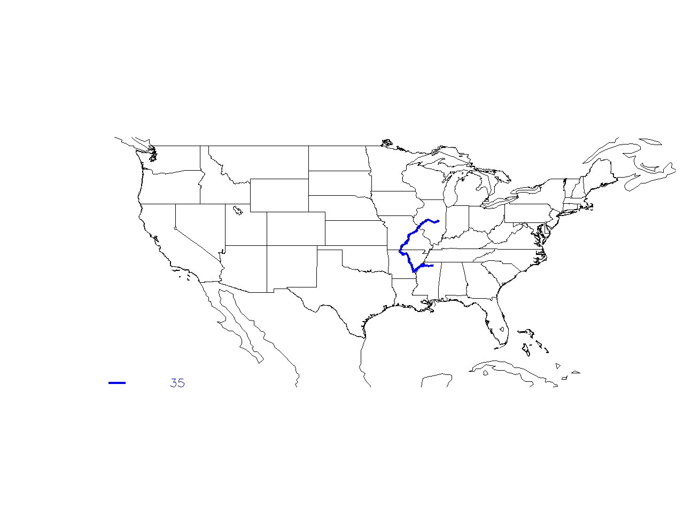
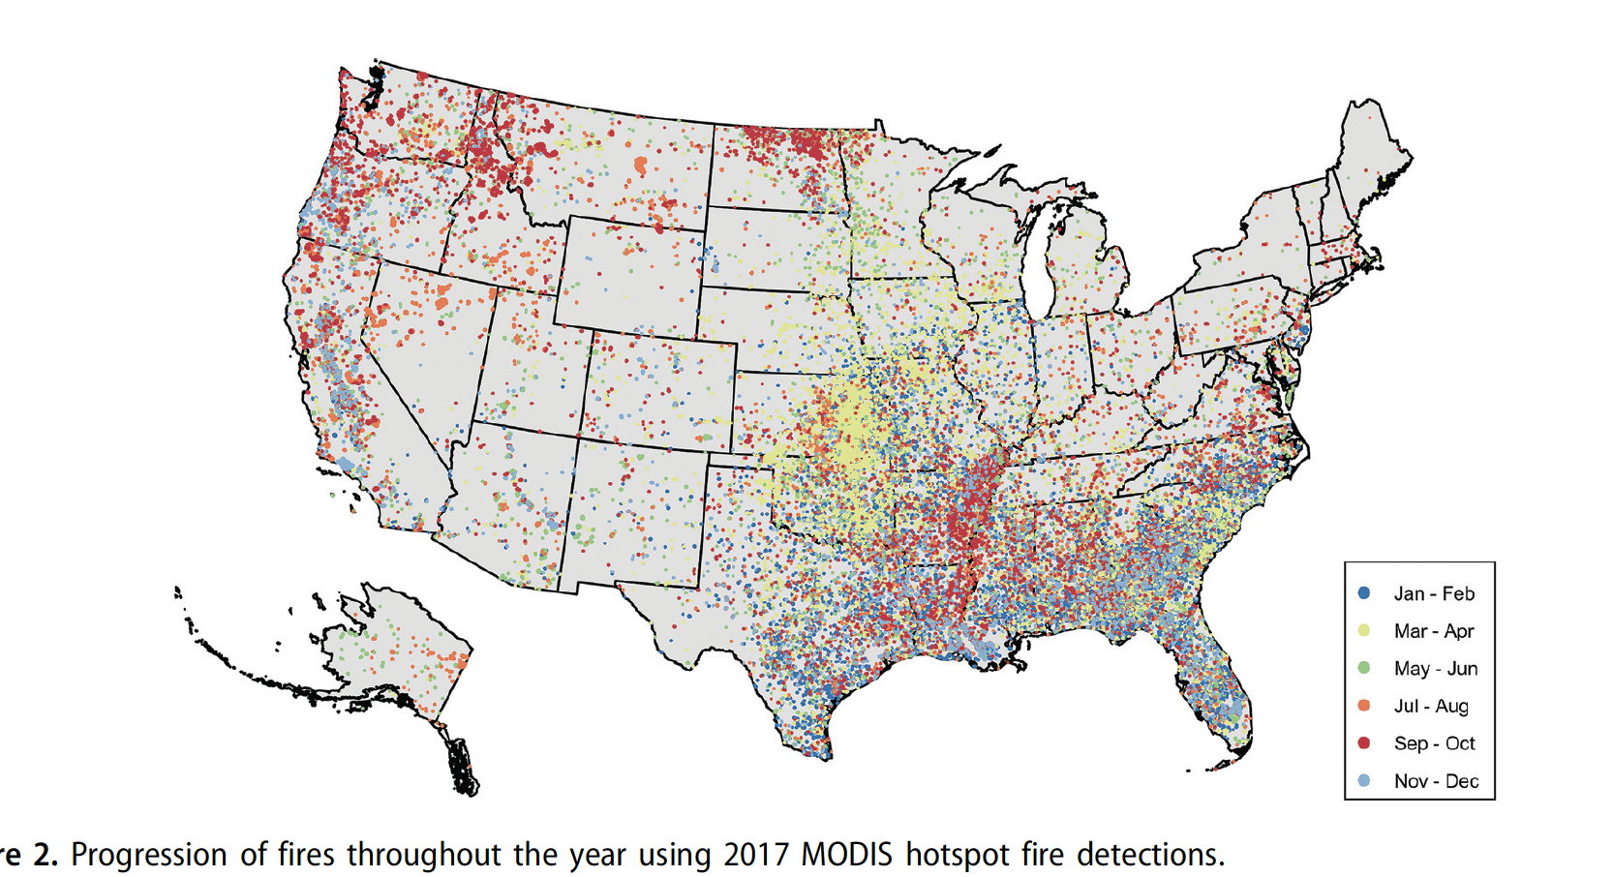
Is biomass burning causing low SSA at BND?
US fires by month (MODIS data 2017)
Median back trajectories for September & October
Jaffe et al, JAWMA, 2020
September/October fires
NW fires are likely forest fires
SW fires are likely agricultural burning
SSA<0.90 (113 traj)
SSA>0.95 (35 traj)
Both trajectories could perhaps transport smoke to BND
NW trajectory associated with low SSA
5 day back trajectories,
NCEP/NCAR Reanalysis for 2012-2017
Notes:
Traj met data has 2.5x2.5 degree spacing

Slide 6
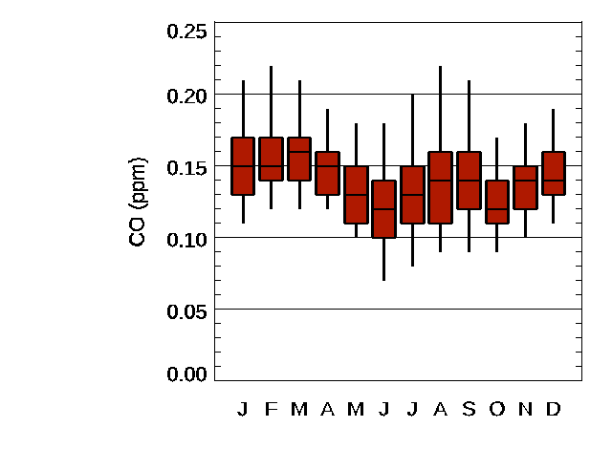
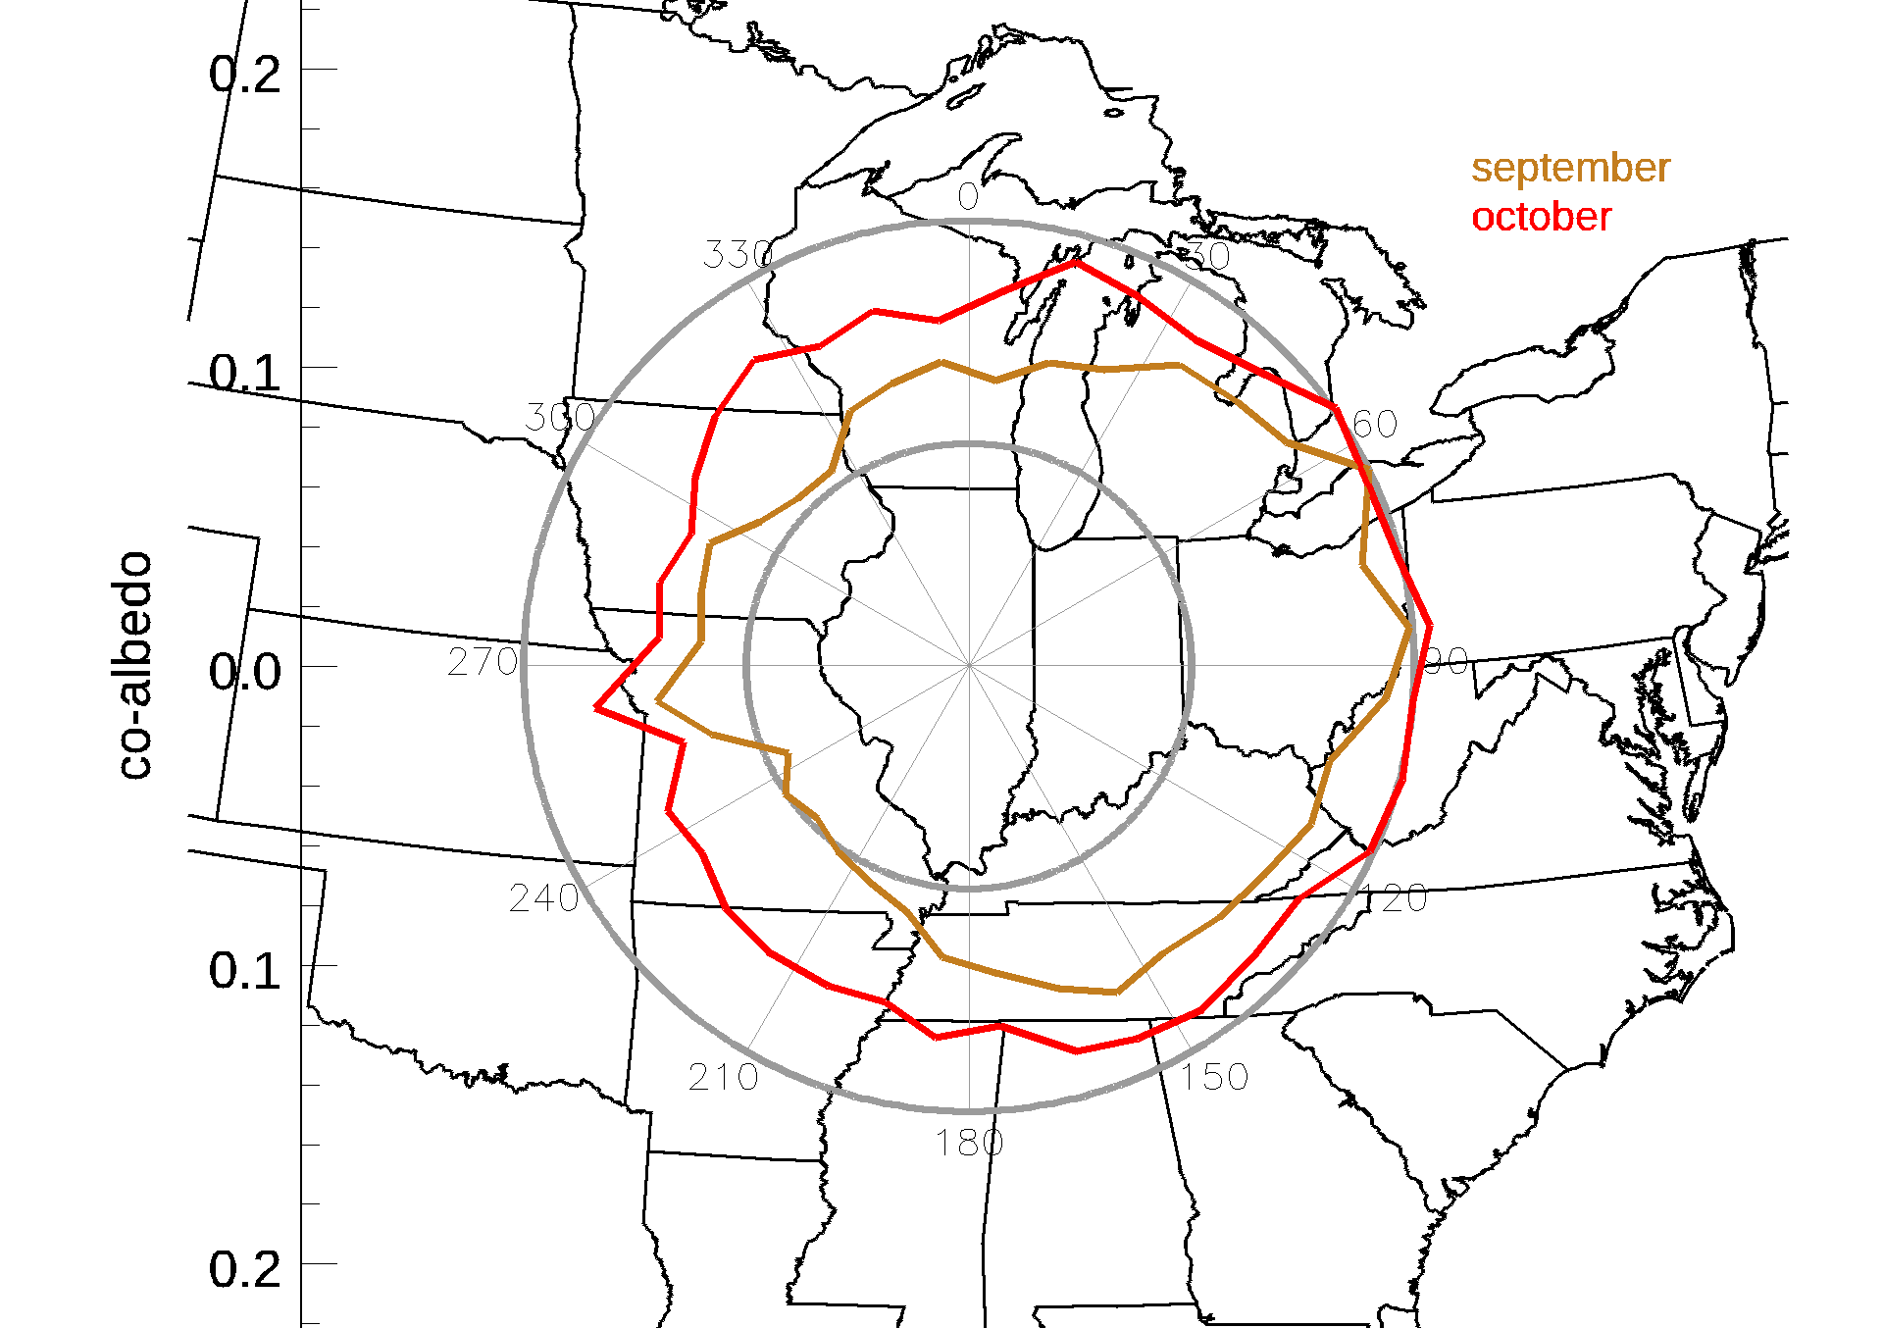
Is biomass burning causing low SSA at BND?
Biomass burning markers
Pollution rose of co-albedo (1-SSA)
Potassium
Carbon monoxide
September
October
μg/m³
Potassium – elevated in September & October
CO – elevated in September, low in October
Local winds more easterly for low albedo (high co-albedo) but contributions from all directions
No clear chemical signal for BB
No clear local source of darker aerosol
Potassium is PM1 data from NOAA/PMEL (1995-2008)
Carbon monoxide data is from US EPA (2012-2018)
NOAA/GML wind and aerosol data (2012-2023)
Notes:
Traj for SSA<0.85 and 0.85<SSA<0.9 look similar to SSA<0.9,

Slide 7
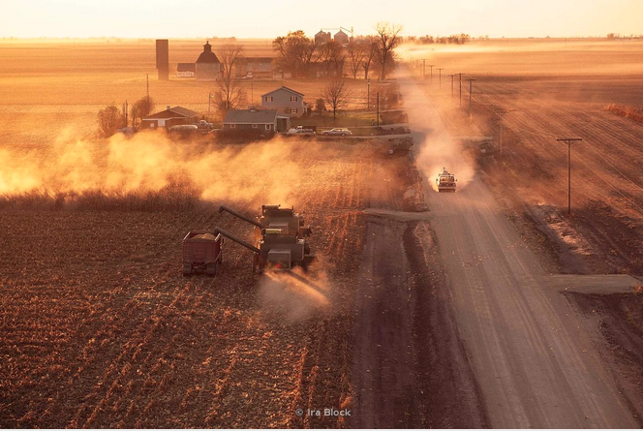
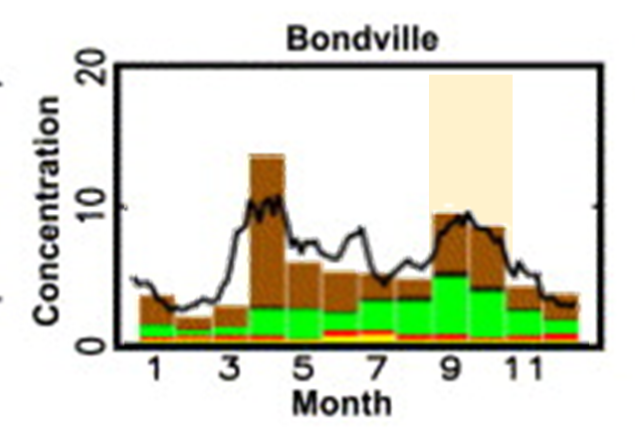
Are agricultural harvest activities causing low SSA at BND?
Soil markers
Calcium
Potassium
Magnesium
Photo by Ira Block
μg/m³
Harvest day in northern Illinois
BND has enhanced soil loading during spring planting and fall harvesting. (Malm et al., 2007).
All three soil markers are elevated in Sept. & Oct.
No increase in soil markers during April
Chemistry measurements suggest increased soil source in September/October
Ion data is PM1 data from NOAA/PMEL (1995-2008)
Notes:
Malm suggests highest soil loading in spring (April).

Slide 8
Are agricultural harvest activities causing low SSA at BND?
Illinois corn planting and harvesting schedule
Weekly SSA and Scattering Angstrom exponent
SSA
SAE
Crop progress and condition charts
J F M A M J J A S O N D
Corn and soybean crop schedules suggest harvesting occurs from mid-September to late October
SSA and SAE decrease as harvesting increases indicating larger, darker particles
Sept./Oct. decrease in SSA is consistent with regional harvest emissions
Soil signal in April during planting is not as strong
NOAA GML aerosol data (2012-2023)
Notes:
Could be some diesel from harvesters contributing to SSA decrease, but don’t see increase in CN or clear change in AAE.

Slide 9
Why isn’t SSA low at BND during spring agricultural activities?
BND soil moisture
ISWS, Illinois Climate Network
BND
Highest in April during planting
Lowest in September and October during harvest.
Dry soil in autumn leads to more dust emission than in spring when soil is moist?
Coarse mass soil loading near BND is higher in fall than in spring. (Hand et al., 2019)

Slide 10
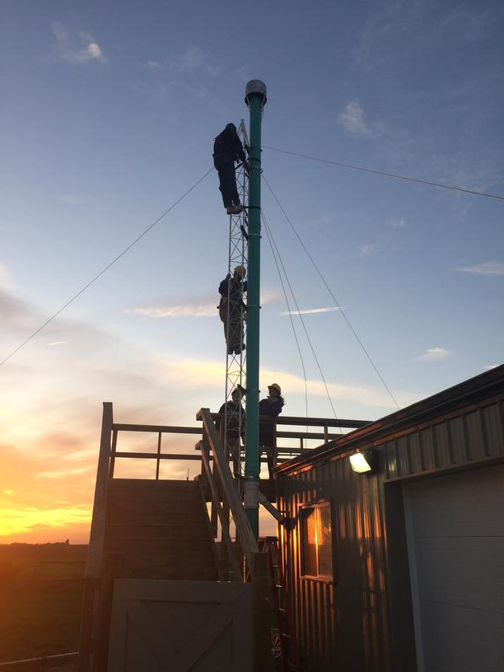
Take-aways
Wet scavenging and biomass burning seem unlikely to cause the low SSA at BND in September and October.
Low SSA at the site is likely related to harvesting activities combined with dry soil.
Other intensive agricultural activities (planting) appear to have less impact on SSA, possibly due higher soil moisture content.

Slide 11
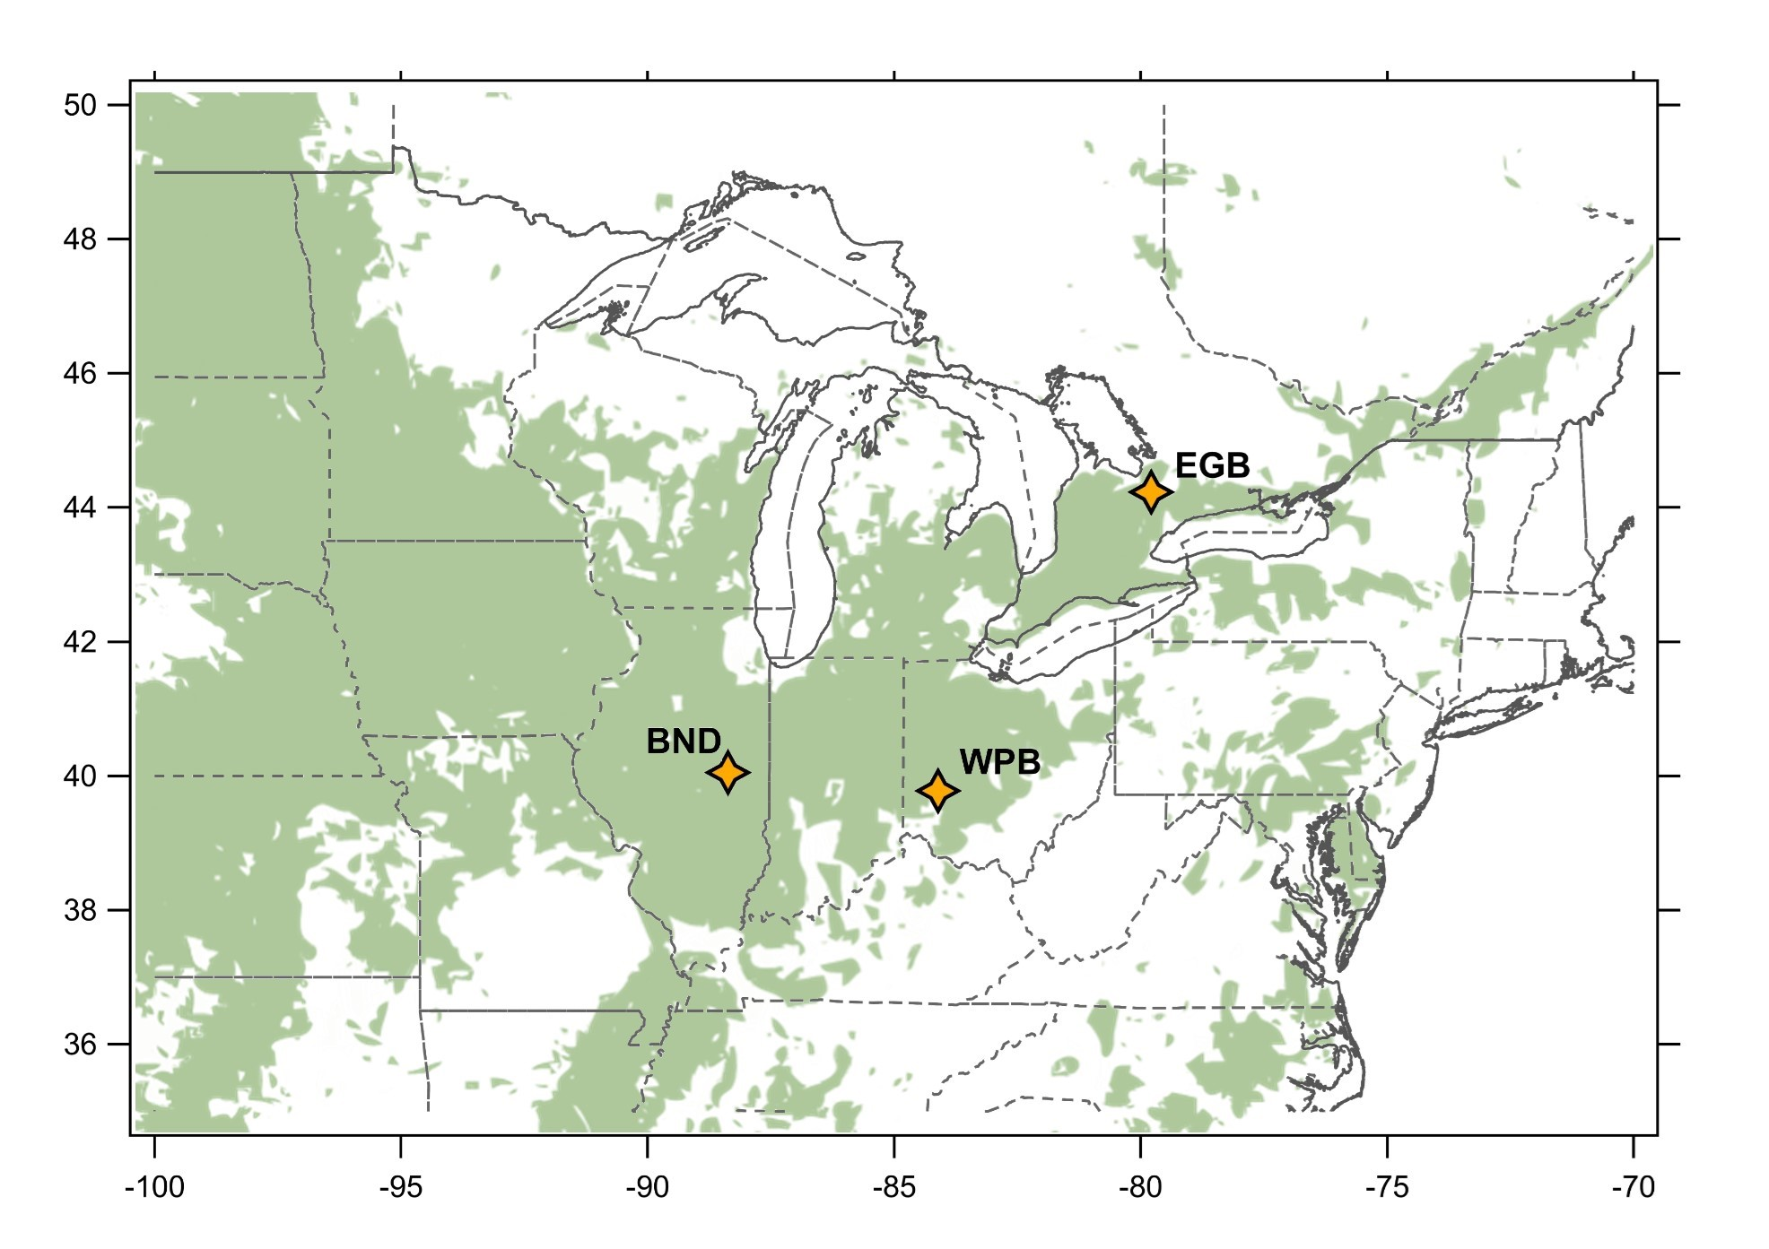
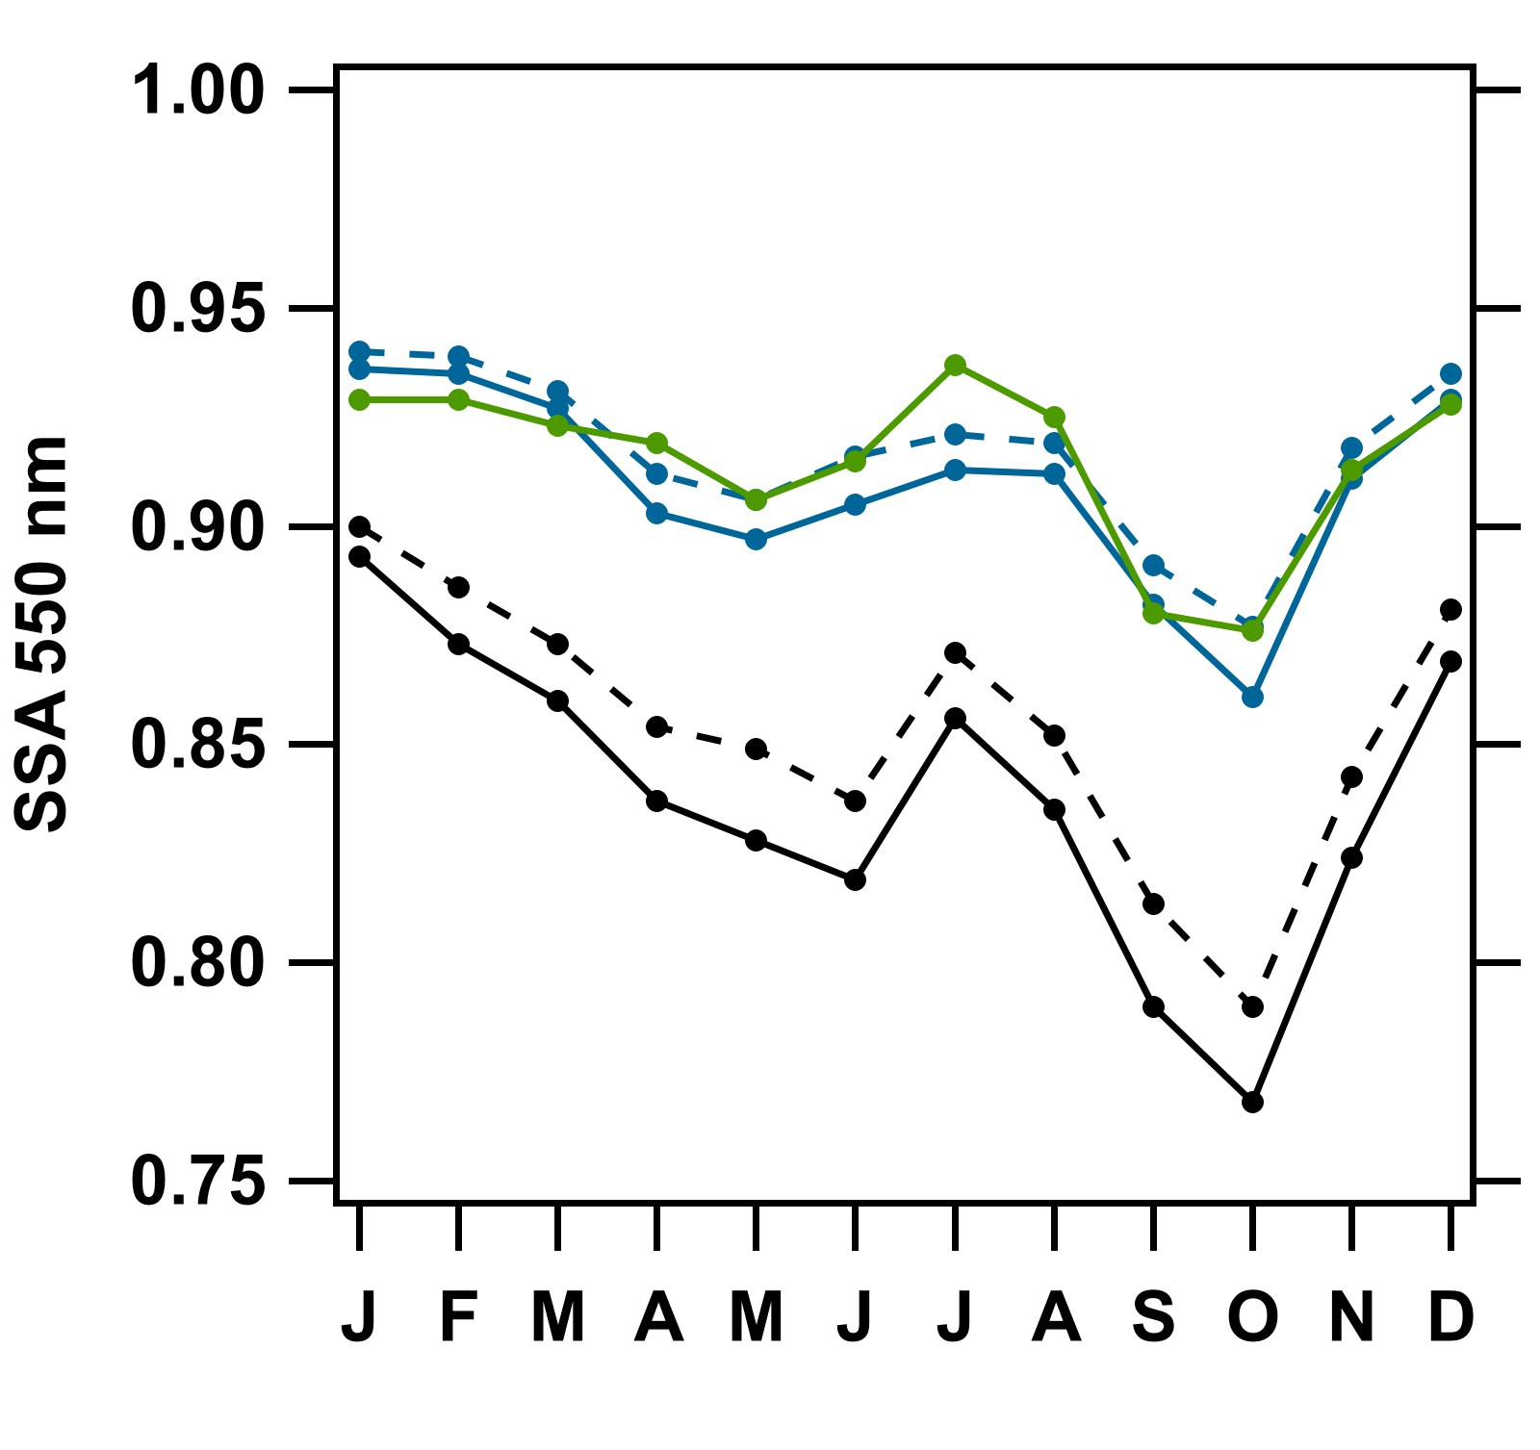
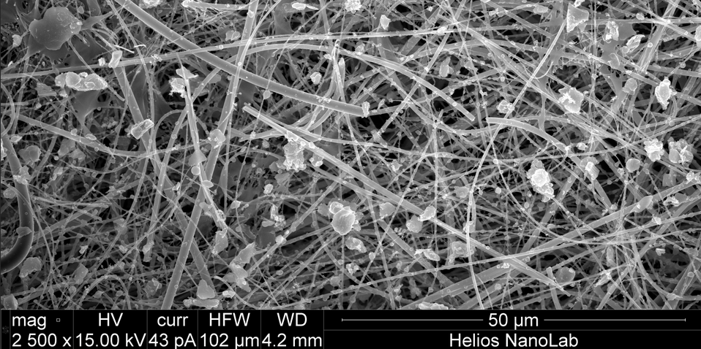
Future work
Explore SSA decrease across central North American sites
Investigate correlations between soil moisture and aerosol optical properties
Perform PMF analysis to identify sources impacting site
Source apportionment of absorbing aerosol using spectral absorption data
Review literature on optical properties of non-desert soils
Evaluate CLAP fllters using SEM
EGB
BND
WPB
CLAP filter from BND, April 9, 2018
PM₁
PM₁₀
Image courtesy of Andras Vlader at NIST and Adam Deitsch SUNY-Albany

Slide 12
Extra slides

Slide 13
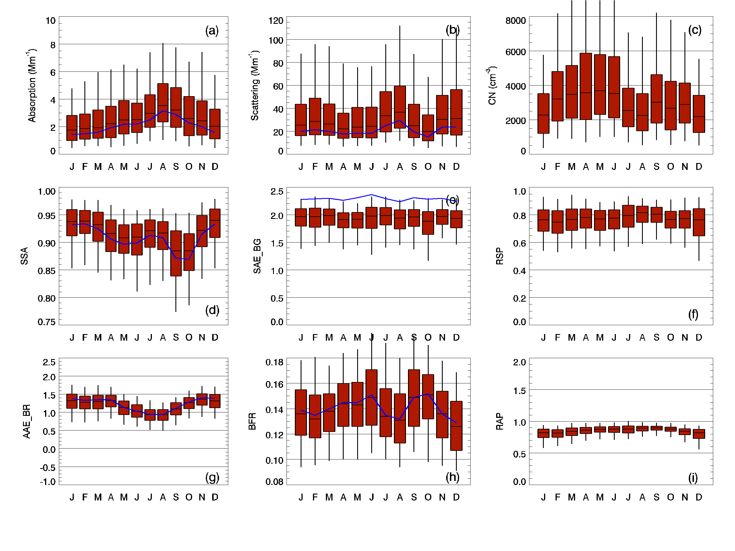
Monthly stats for aerosol optical properties. Red=PM10, Blue=PM1

Slide 14
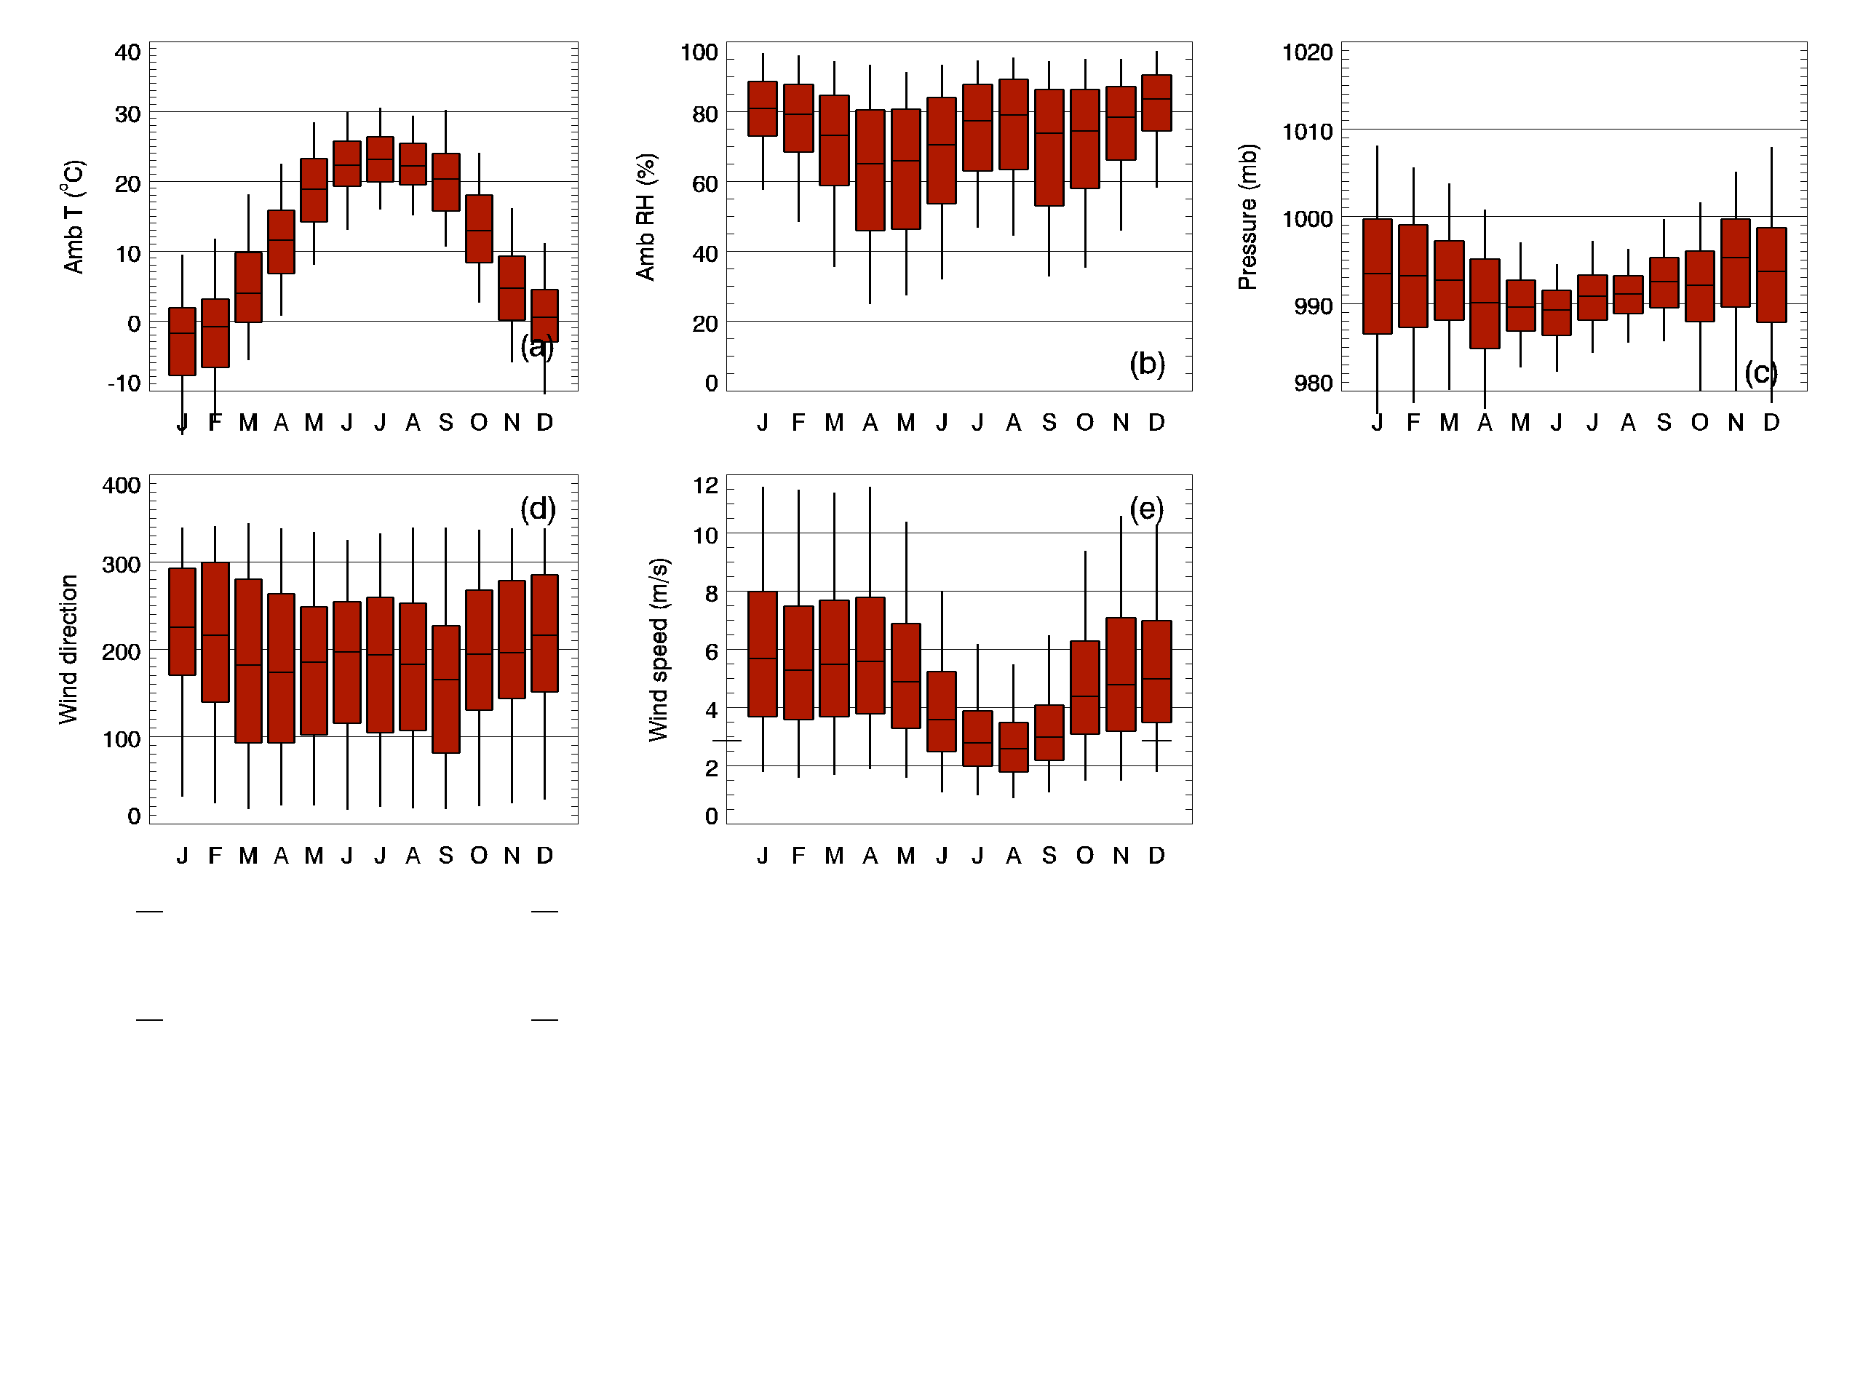
Monthly stats for basic meteorological data (GML measurements)

Slide 15
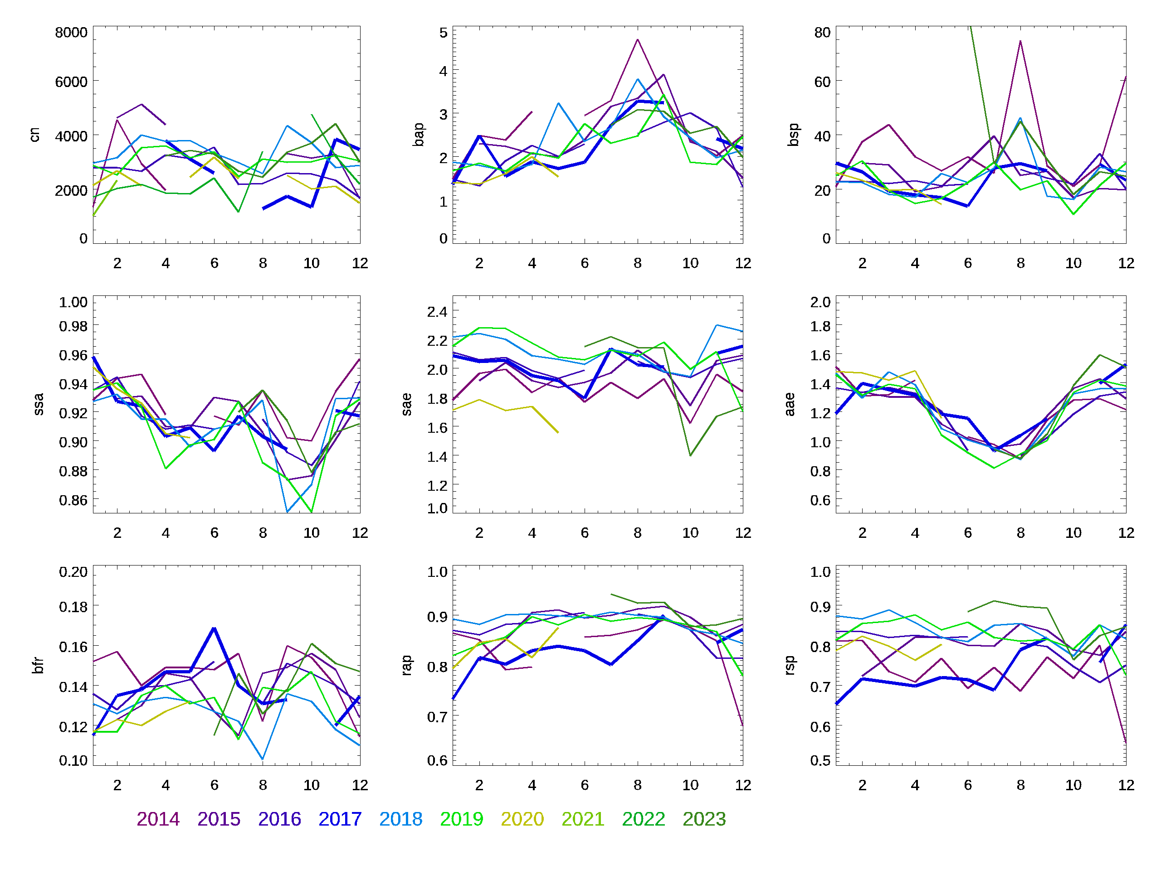
Aerosol property interannual variability over 10 years at BND

Slide 16
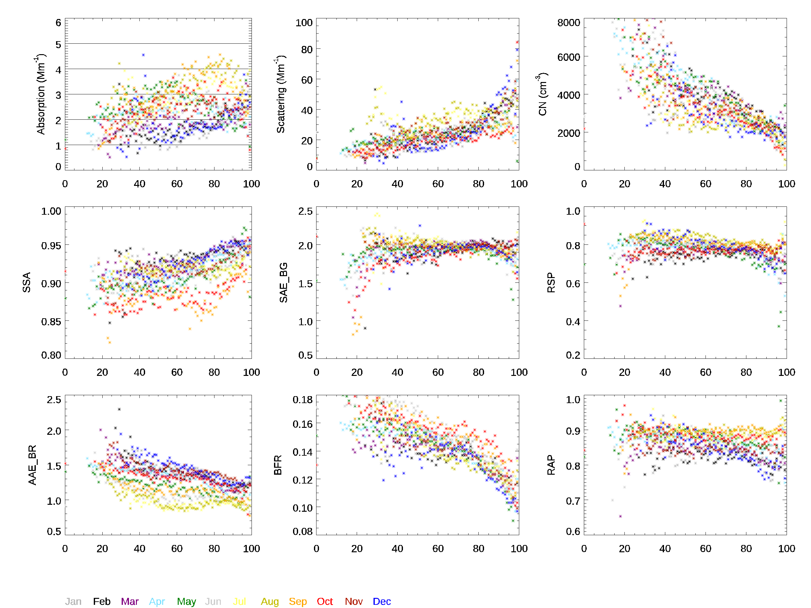
Aerosol property variability with RH at BND
Ambient RH

Slide 17
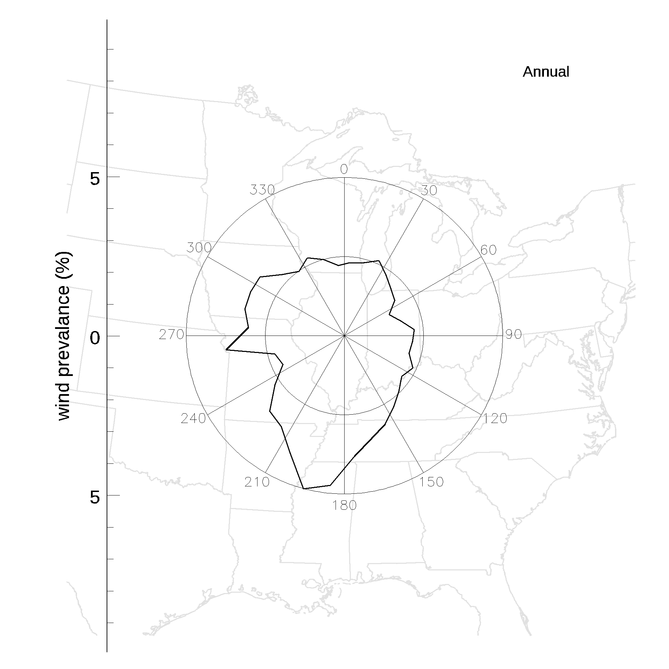
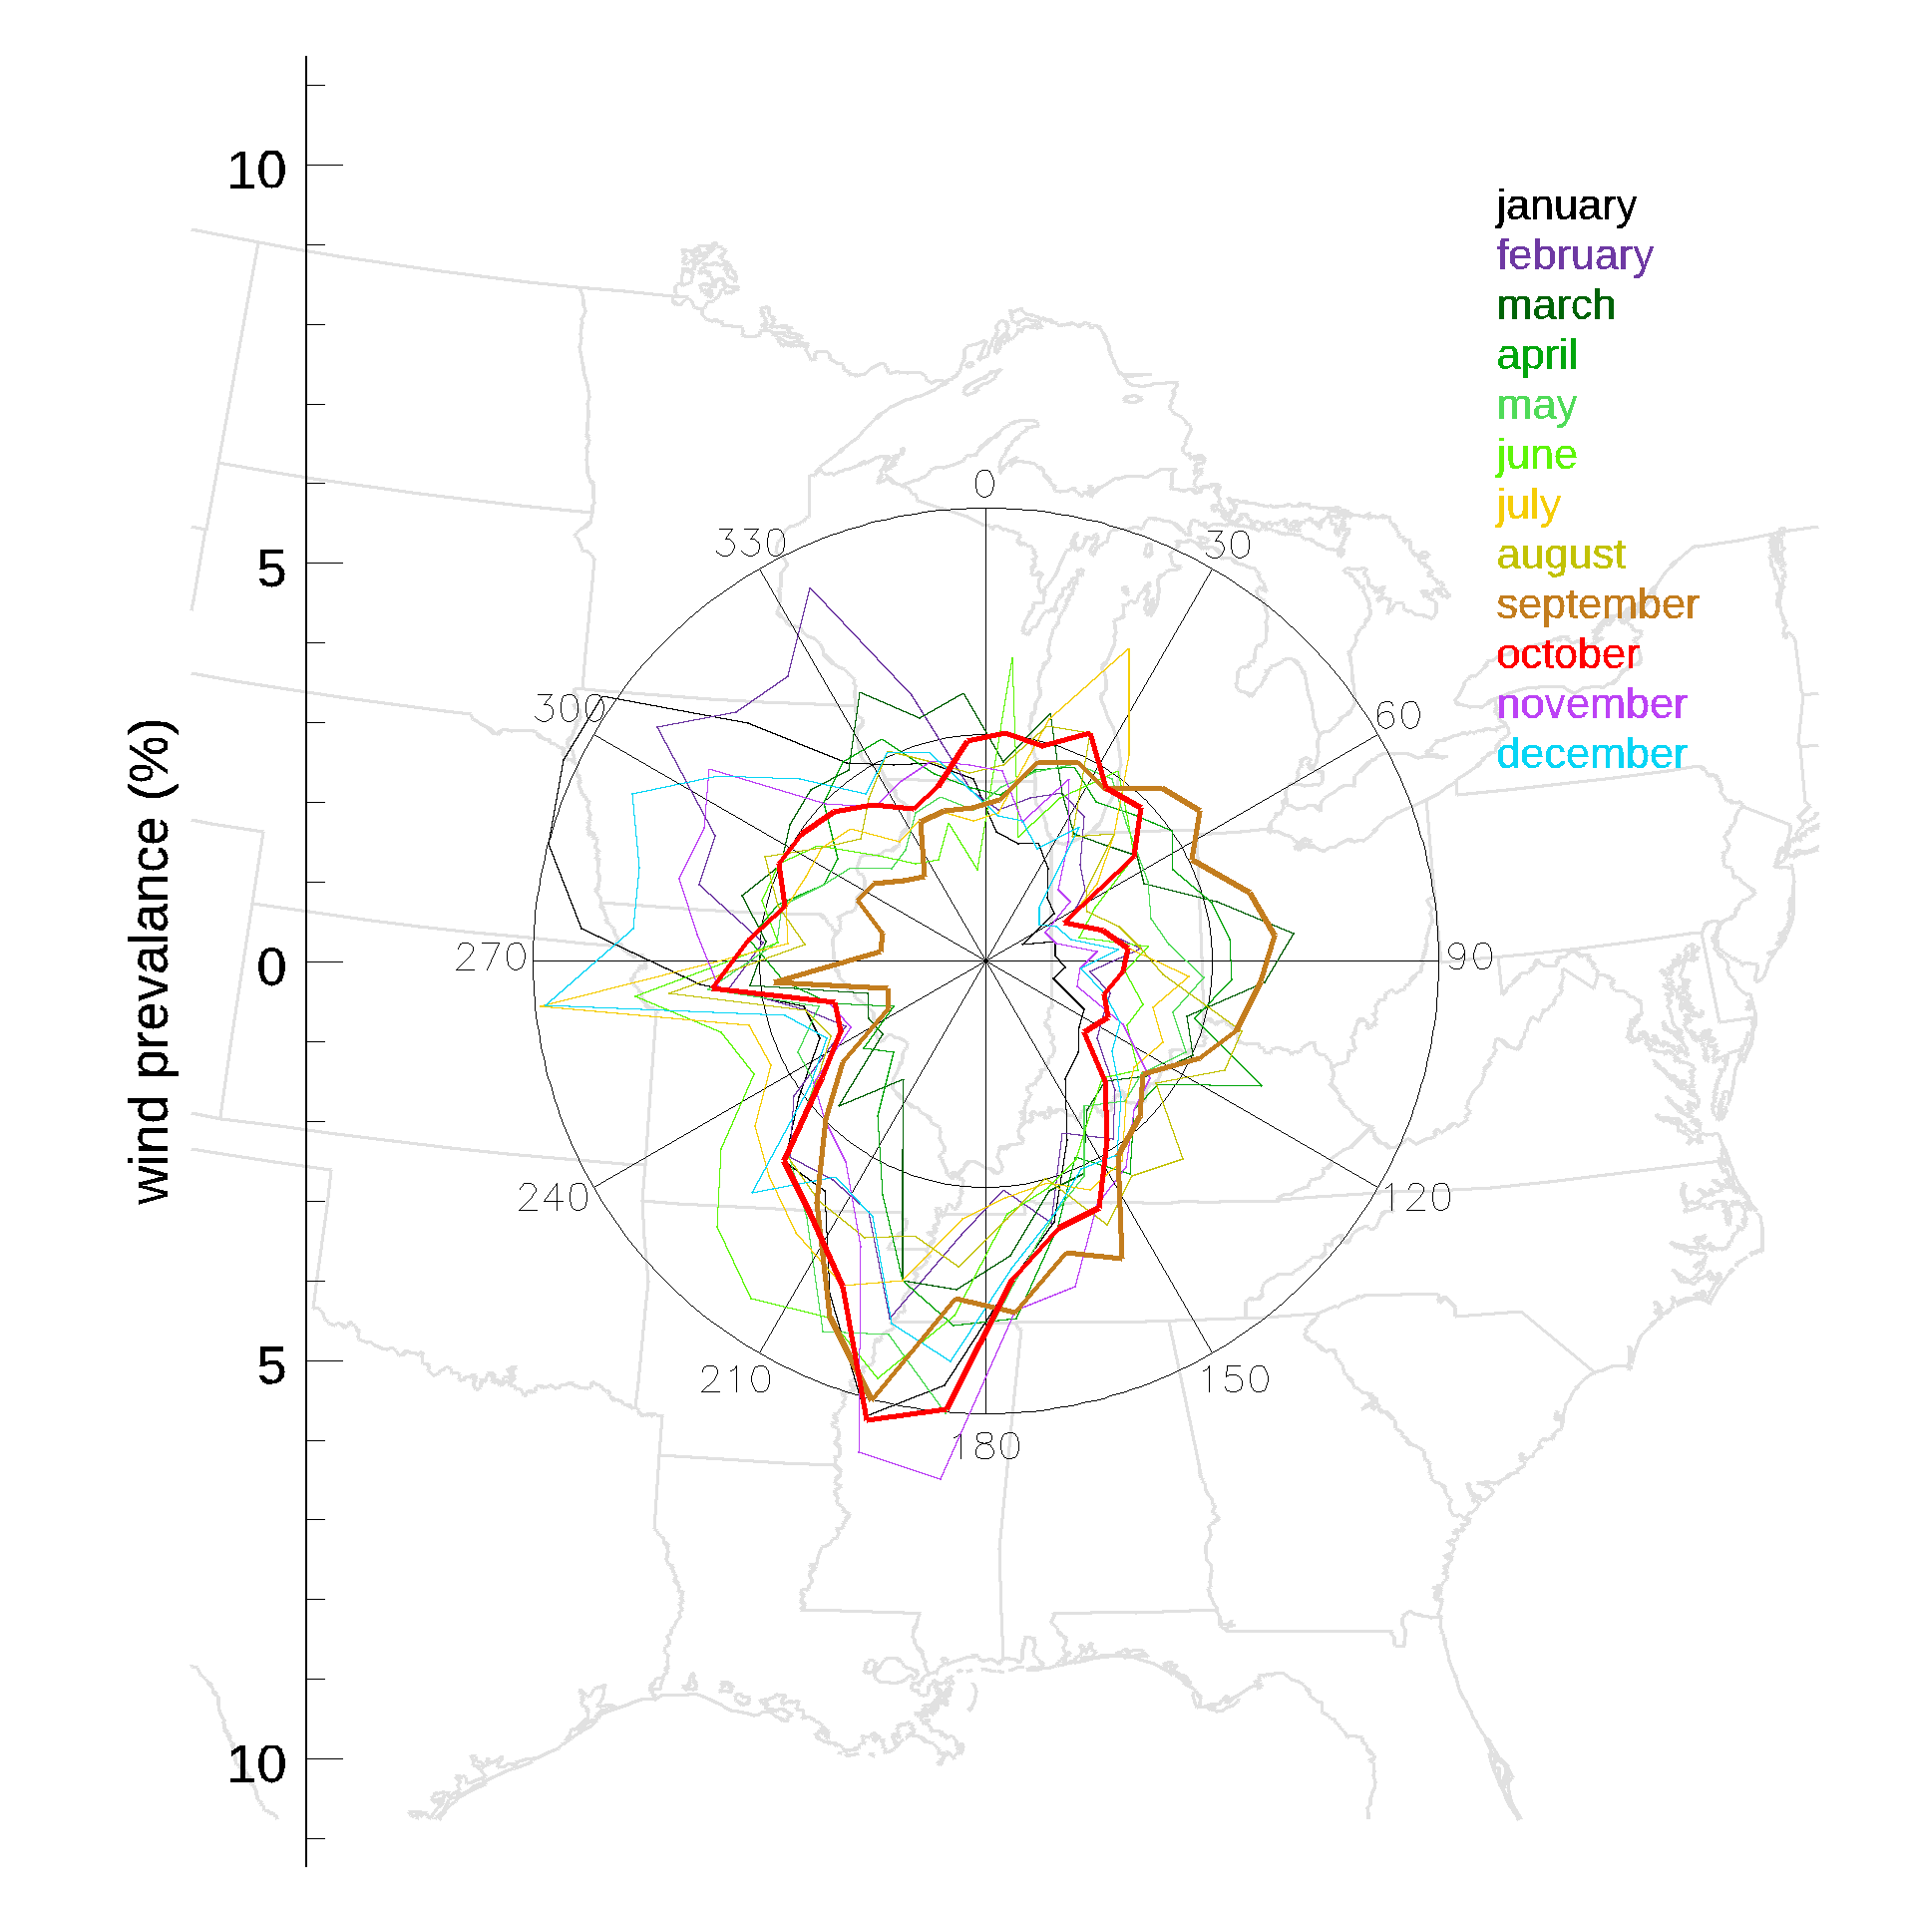
Wind is primarily from the south and west, though it changes with month.

Slide 18
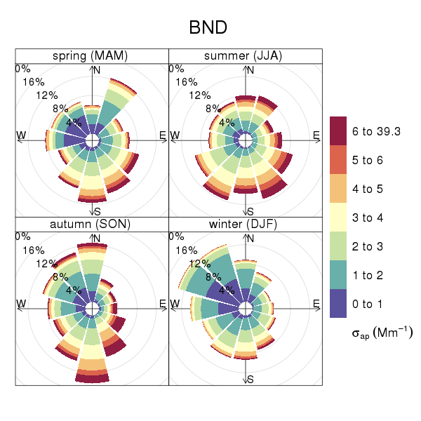
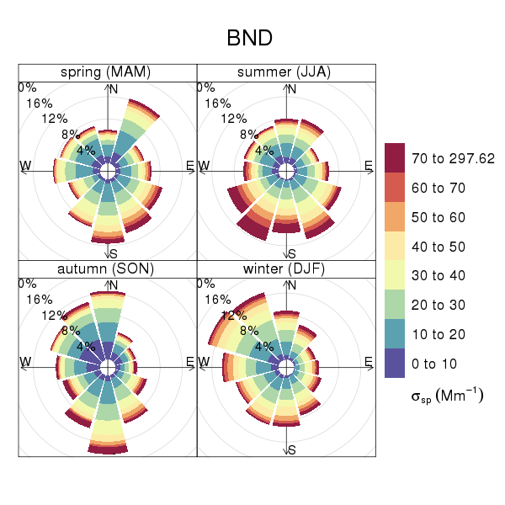
Absorption wind rose
Scattering wind rose
Sherman et al., 2015

Slide 19
Hand et al 2019

Slide 20
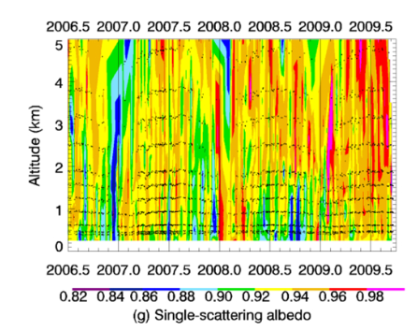
Motivation
Sheridan et al., 2012

