Slide 1
Measurement Techniques for Aerosol Radiative Properties
John A. Ogren National Oceanic and Atmospheric Administration Earth System Research Laboratory
Boulder, Colorado, USA
http://www.esrl.noaa.gov/gmd/aero/

Slide 2
WMO/GAW Aerosol Variables
Core, continuous measurements
Aerosol optical depth at multiple wavelengths
Mass concentration in two size fractions
Major chemical components in two size fractions
Light absorption coefficient (at various wavelengths)
Light scattering coefficient (at various wavelengths)
Other recommended measurements
Vertical distributions
Microphysical properties (number concentration, size distribution, CCN)
Optical properties (backscattering)
Chemical properties (detailed composition vs. size)
Dependence on relative humidity
http://www.wmo.ch/pages/prog/arep/gaw/documents/gaw153.pdf

Slide 3
Aerosol Extensive Radiative Properties
Value of extensive properties depends on amount of aerosol
Extinction coefficient, σ_{ep}(λ) aerosol cross-sectional area for extinction per unit volume of air (m² m⁻³, 10⁻⁶ m⁻¹ = 1 Mm⁻¹)
Scattering coefficient, σ_{sp}(λ)
Absorption coefficient, σ_{ap}(λ)
180° backscatter coefficient, β_{π}(λ)
Optical depth, τ(λ) =

Slide 4
Extinction and Visibility
extinction = scattering + absorption σ_{ext} = σ_{sg} + σ_{ag} + σ_{sp} + σ_{ap}
Rayleigh scattering by gases: σ_{sg}(air) = 12.26 Mm⁻¹ at STP, 550 nm
Absorption by gases (σ_{ag}) is generally negligible except when NO₂ concentrations are high.
Visual range
typical eye has a 2% contrast threshold)

Slide 5
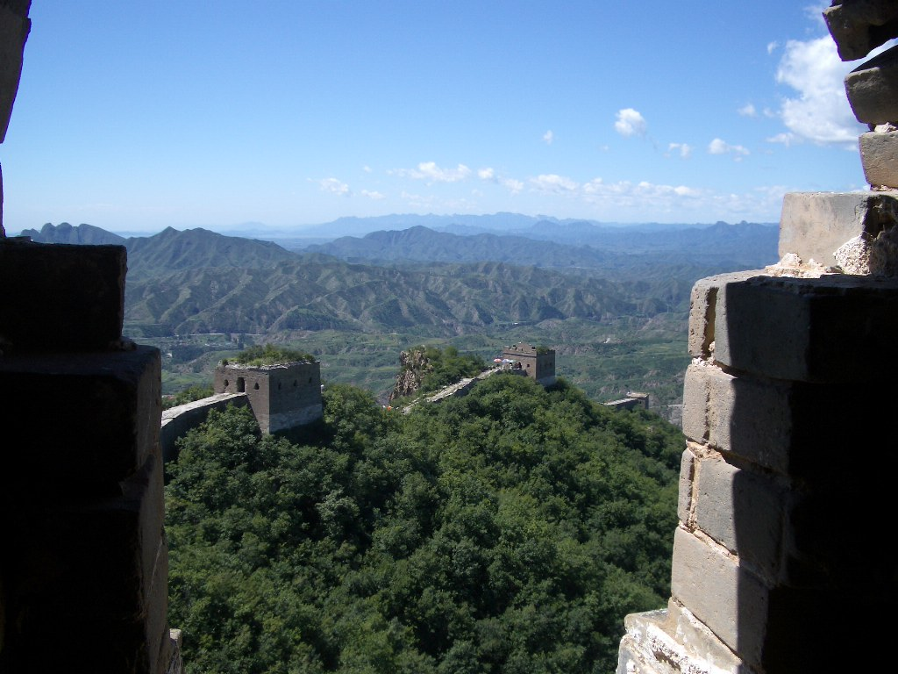
Light Scattering, Visibility and Aerosols
Distant visible peak ~100 km?
σ_{ext} ≅ 4 / (100 km) = 40 Mm⁻¹
σ_{ep} ≅ 40 - 15 Mm⁻¹ = 25 Mm⁻¹
σ_{sp} ≅ 23 Mm⁻¹, σ_{ap} ≅ 2 Mm⁻¹

Slide 6
Instrumental Methods
Extinction coefficient, σ_{ep}(λ)
transmissometer, extinction cell, cavity ringdown, cavity assisted phase shift
Scattering coefficient, σ_{sp}(λ)
integrating nephelometer, polar nephelometer
Absorption coefficient, σ_{ap}(λ)
filter transmission (integrating plate, PSAP, Aethalometer, MAAP)
photoacoustic
180° backscatter coefficient, β_{π}(λ)
lidar, backscatter nephelometer
Optical depth, τ(λ)
sun photometer, rotating shadowband radiometer

Slide 7
Aerosol Intensive Radiative Properties
Value of intensive properties depends on nature of aerosol (size, chemical comp.)
Single-scattering albedo, ϖ_{o} = σ_{sp} / σ_{ep}
Angular scattering distribution
phase function, β(φ)
asymmetry parameter, g = cos(φ)
hemispheric backscattering fraction, b
Ångström exponent, å = - dlogσ / dlogλ
Hygroscopic growth, f(RH) = σ(RH) / σ(dry)
Lidar ratio, R = σ_{ep} / β_{π}

Slide 8
Size-dependence of Extinction Efficiency
Mie calculations for refractive index 1.45-0.005i at 550 nm wavelength

Slide 9
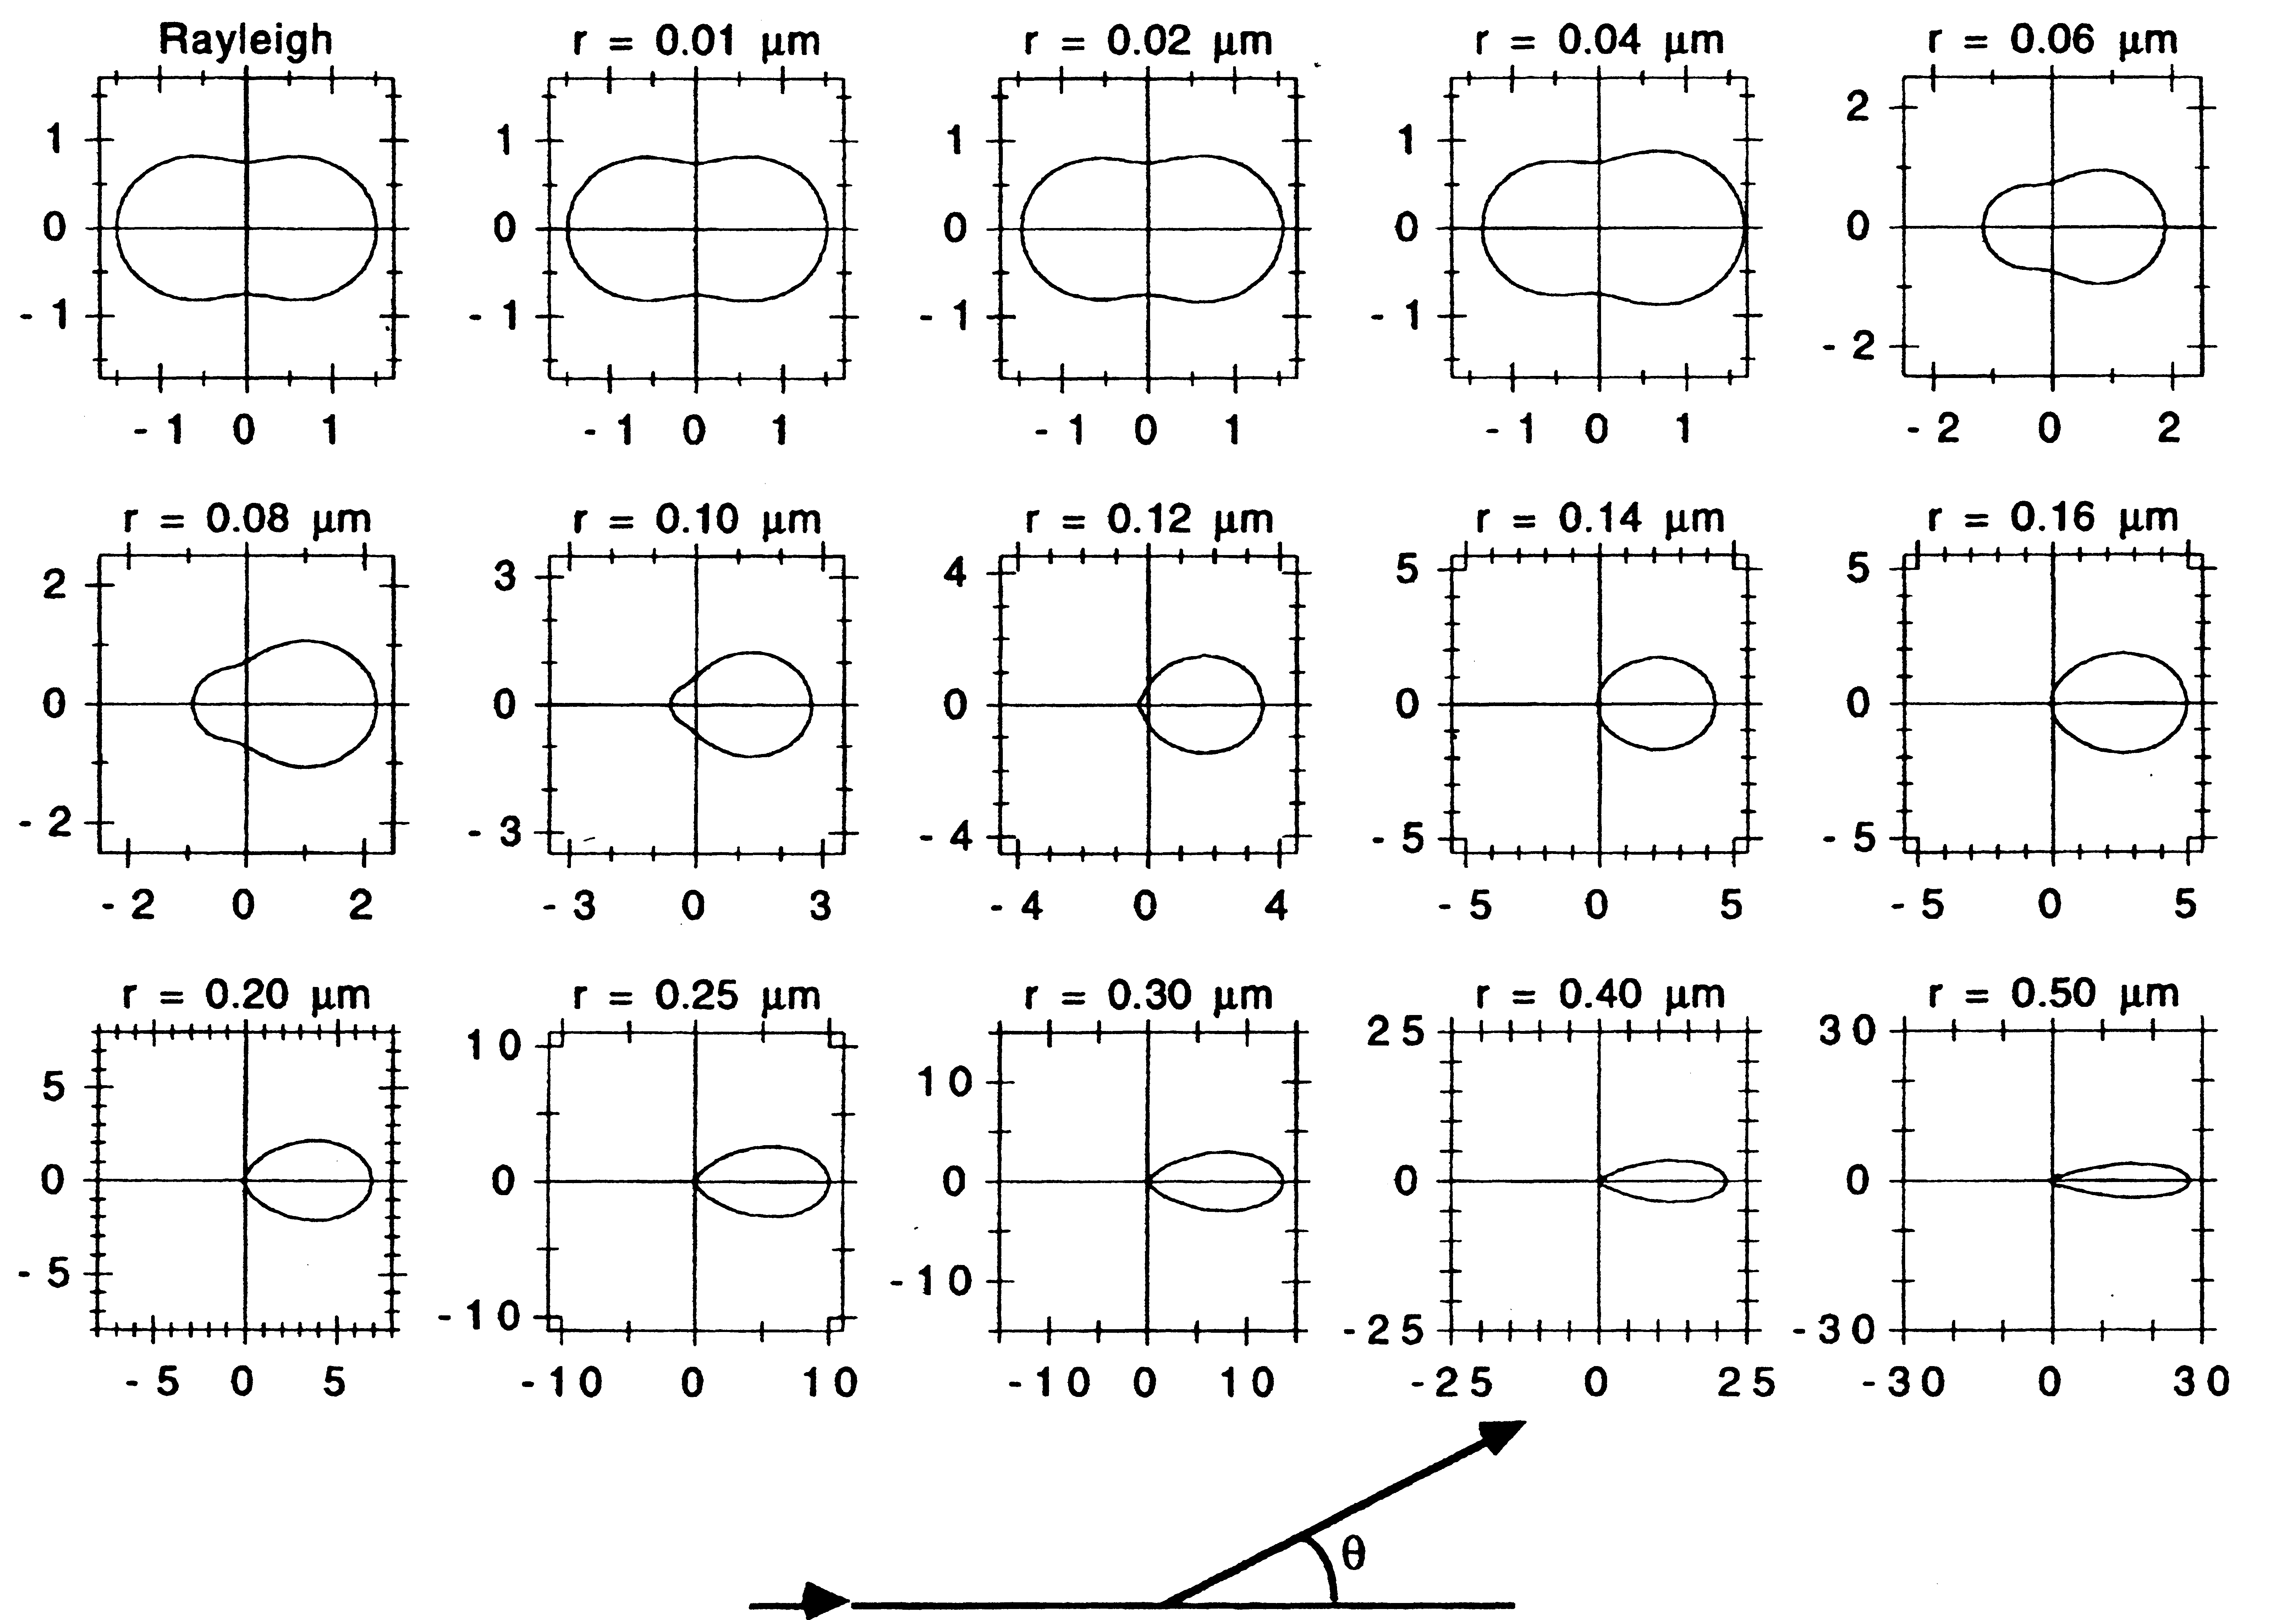
Phase Function vs. Size (λ = 550 nm)
Source: Schwartz (1996)

Slide 10
Size-dependence of Aerosol Radiative Properties
Mie calculations for λ=550 nm, m=1.45-0.005i

Slide 11
Parameters controlling aerosol forcing
D daylight fraction
S₀ solar constant
T_{at} atmospheric transmission
A_{c} cloud fraction
R_{s} surface albedo
ΔF average aerosol forcing at top of atmosphere (TOA)
δ aerosol optical depth
aerosol single- scattering albedo
average aerosol up-scatter fraction
Source: Haywood and Shine (1995)
Notes:
I dislike using equations too, but sometimes they are the clearest way to illustrate relationships.
This eqn (or close variant) being used in current models of aerosol forcing, e.g., IPCC estimates.
This eqn represents an annual mean forcing at TOA, instantaneous forcings can be much larger. Sfc. Forcings can also be much larger
CMDL is measuring the relevant aerosol terms in this eqn. Corresponding eqn for GHG much simpler, as radiative properties of all CO2 molecules are identical. Not so for aerosols.

Slide 12
Limitations of Average Forcing
Annual-average illumination
No dependence of upscatter fraction on solar zenith angle or latitude
Not suitable for direct comparison with radiative flux measurements
Applies to clear-sky conditions only, but is averaged over all sky conditions
Appropriate uses:
estimating average forcing for climatological values of aerosol optical depth
comparing different types of aerosols

Slide 13
Principle of Integrating Nephelometer
Light source
θ
Apex of scattering cone
Sensor
dv
φ
r
Light source intensity is proportional to cosθ, which gives the sinφ weighting in the integrand.
Conical viewing volume dv increases as r², but intensity of light from dv reaching sensor follows an inverse-square law. The r² and 1/r² dependencies cancel, yielding equal weighting of each linear increment dr.
Source: Butcher and Charlson (1972)

Slide 14
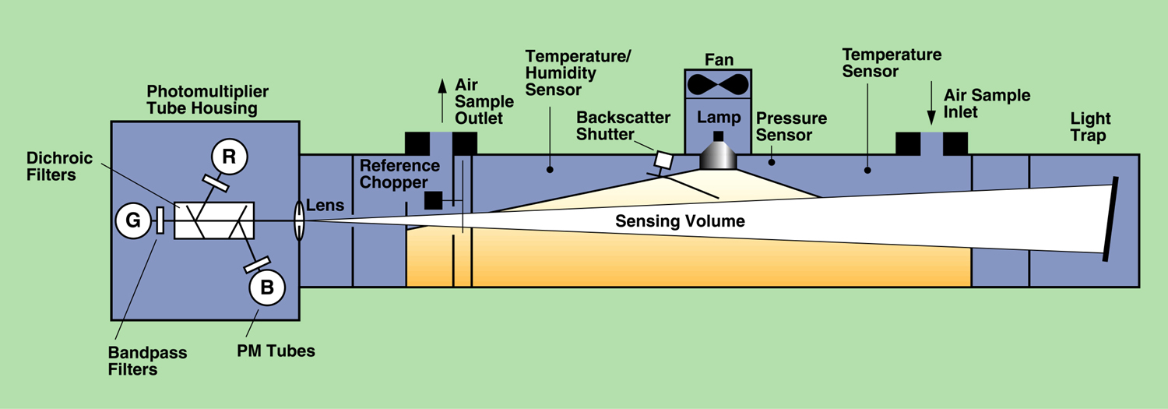
TSI 3563 Integrating Nephelometer
Wavelengths: | 450, 550, 700 nm
Bandwidth: | 40 nm FWHM
Angular range: | 7-170° (total), 90-170° (backscatter)
Sensitivity: | 2-3 x 10⁻⁷ m⁻¹ (60-sec average)
Source: TSI, Inc.

Slide 15
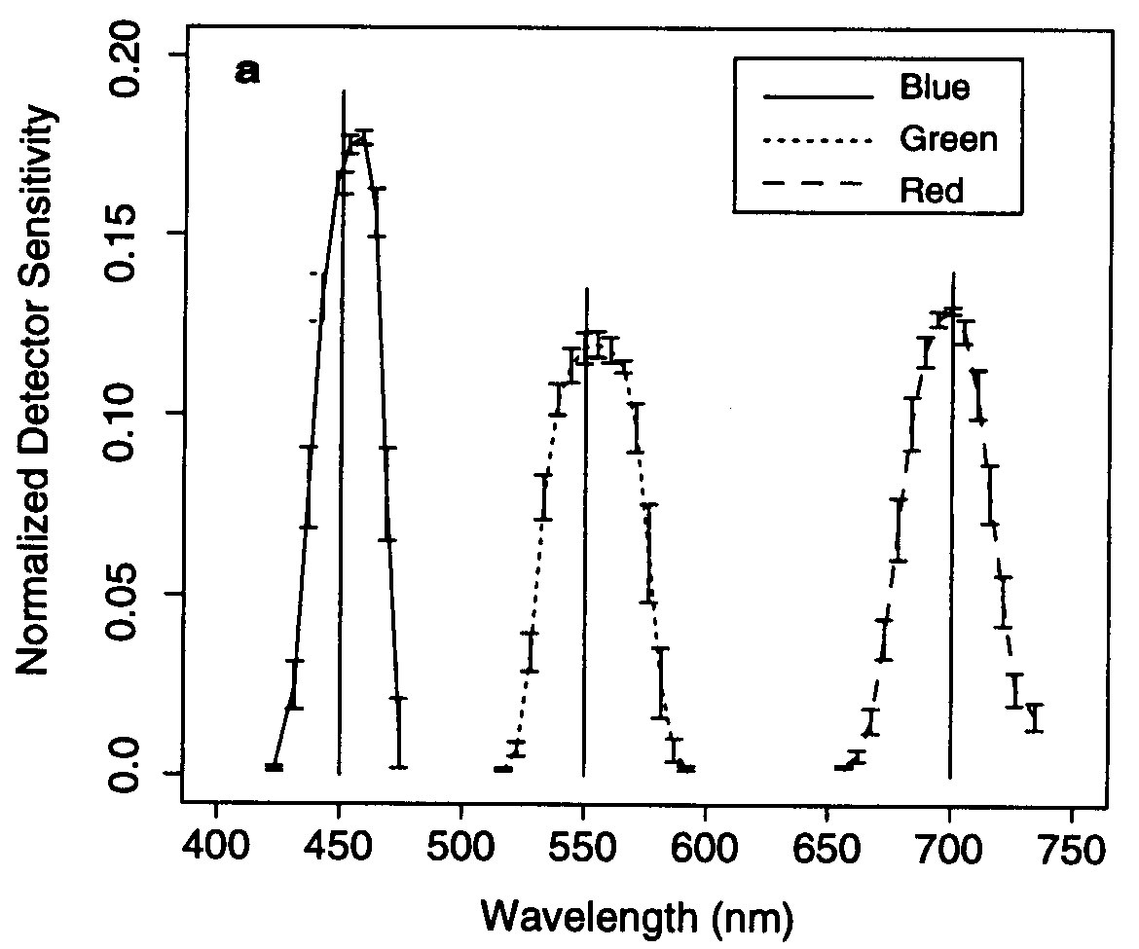
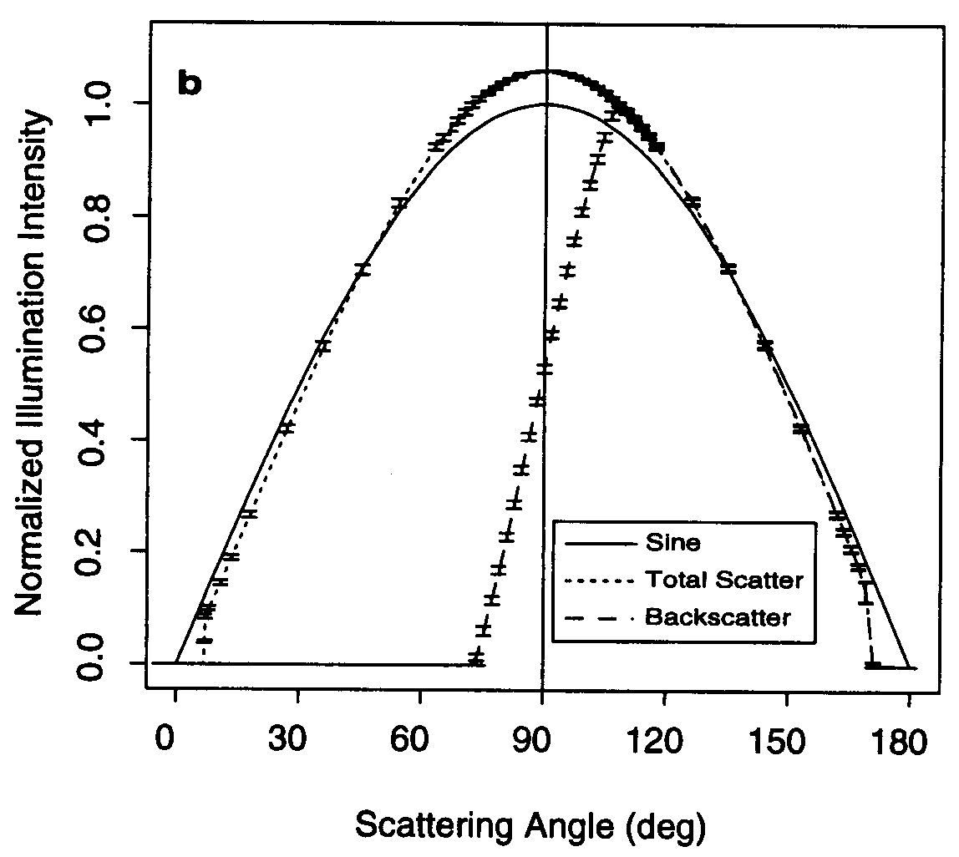
TSI Nephelometer Non-Idealities
wavelength response
angular response
Source: Anderson et al. (1996)

Slide 16
TSI Nephelometer Angular Errors

Slide 17
Measured (points) vs. Calculated (lines) Response of TSI Nephelometer
Source: Anderson et al. (1996)

Slide 18
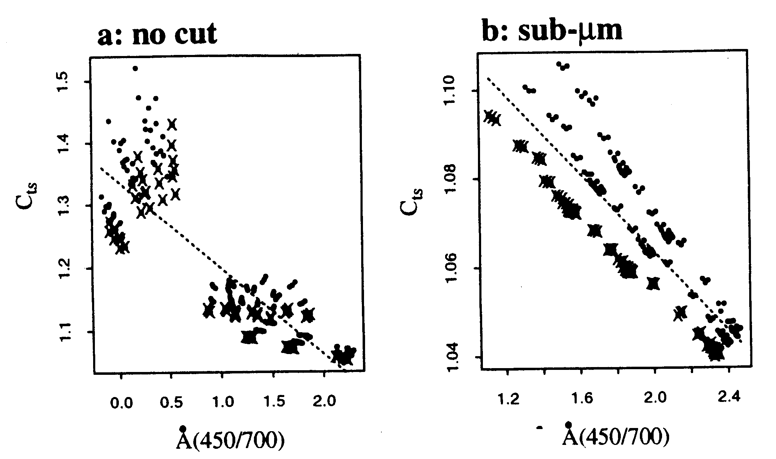
Nephelometer Truncation Corrections
Source: Anderson and Ogren (1998)
Notes:
Trend up to 1991 published by Bodhaine & Dutton. They attributed likely cause of 1982-1991 decrease to changes in emissions from FSU.
Subsequent flattening out of “trend” illustrates need to continue monitoring to follow up apparent trends. Could it just be that 1982-1987 were anomalies?
Followup analysis being done as part of NOAA Arctic Research Initiative.
No other obvious trends at baseline stations..
Aerosol properties at baseline sites show clear seasonality, reflecting seasonal changes in sources and sinks.

Slide 19
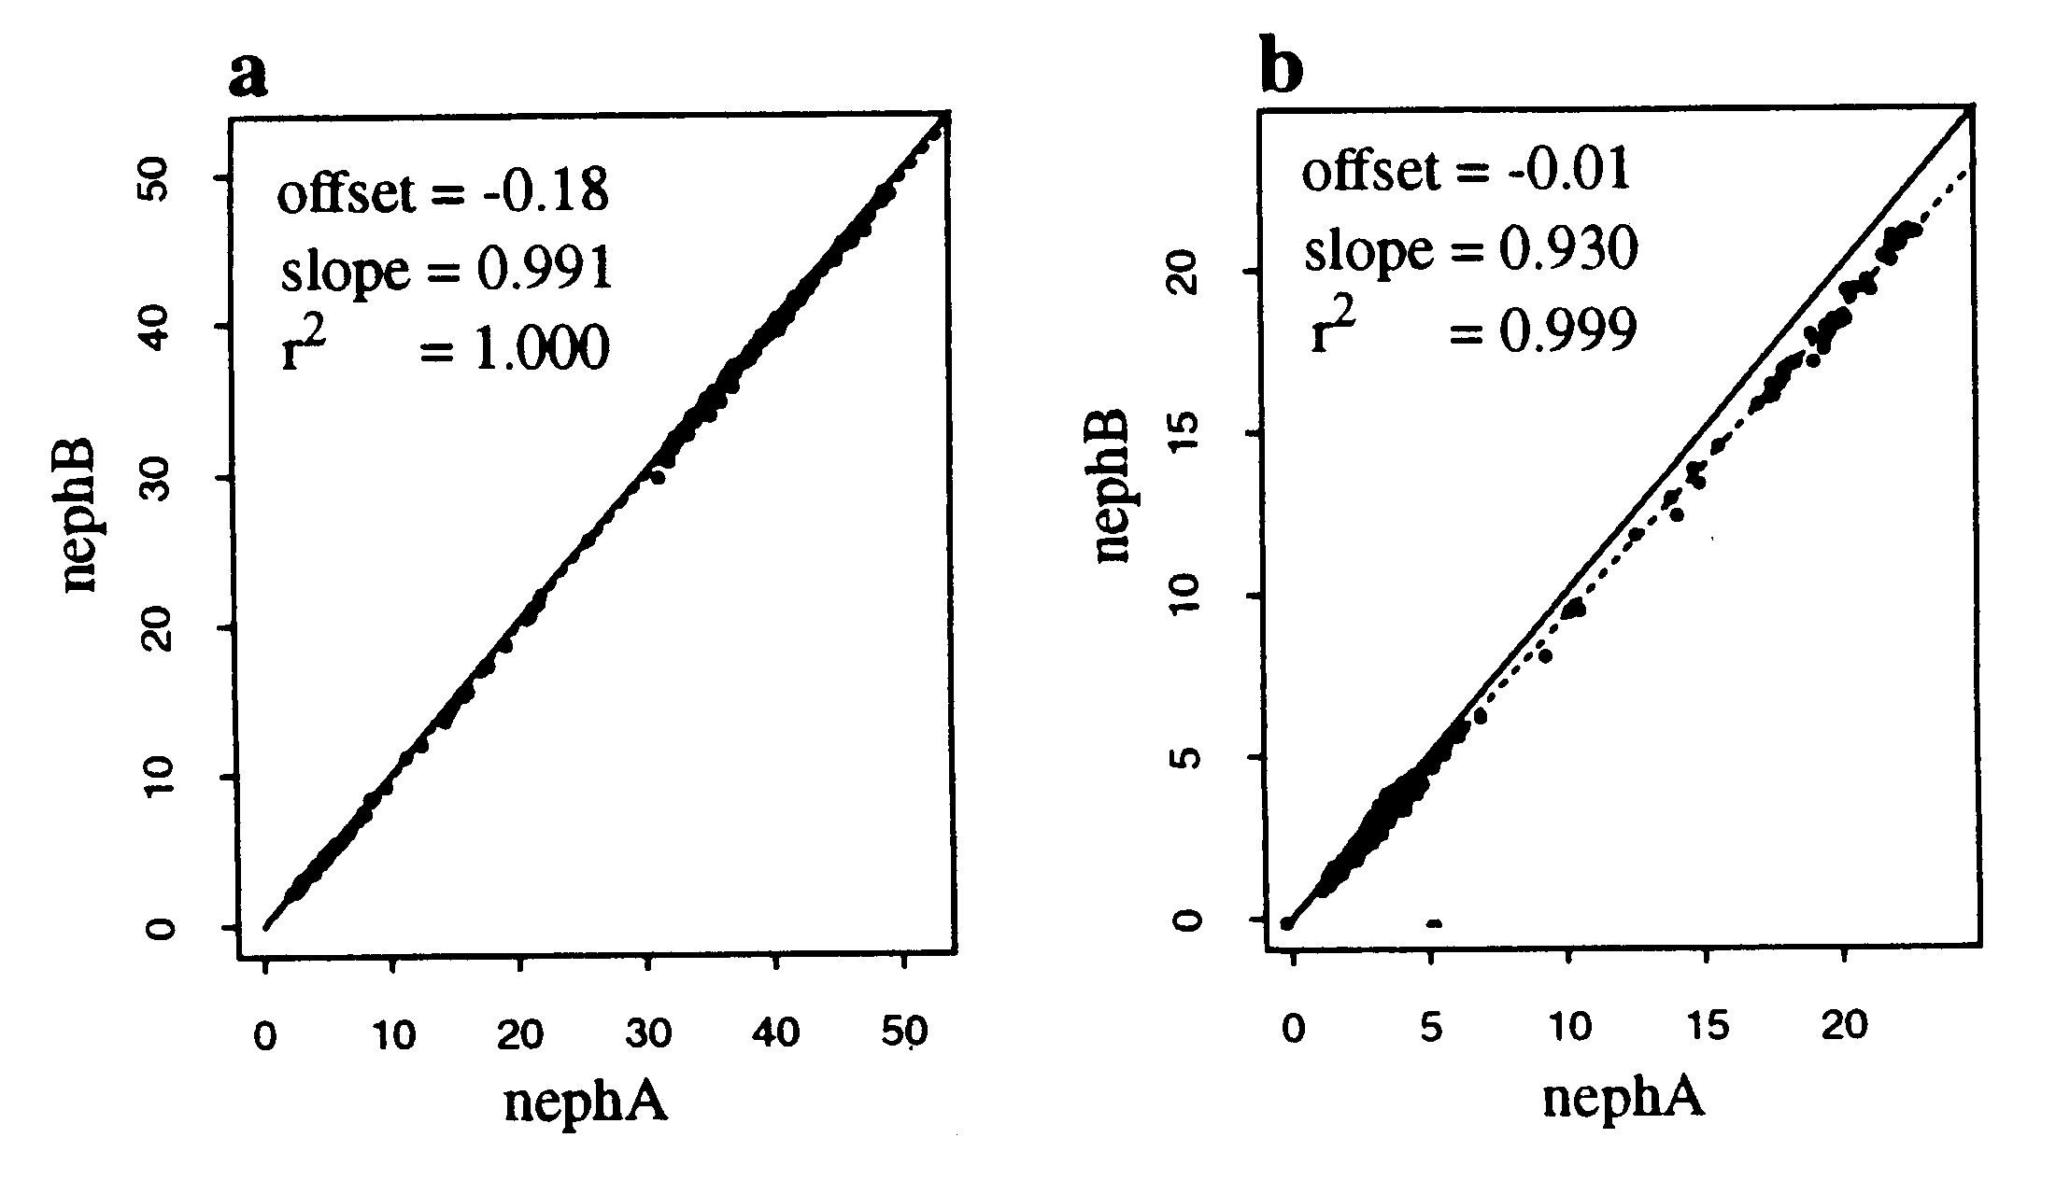
Serial Nephelometer Losses
D_{p} < 1 μm
D_{p} > 1 μm
Source: Anderson and Ogren (1998)
Notes:
Trend up to 1991 published by Bodhaine & Dutton. They attributed likely cause of 1982-1991 decrease to changes in emissions from FSU.
Subsequent flattening out of “trend” illustrates need to continue monitoring to follow up apparent trends. Could it just be that 1982-1987 were anomalies?
Followup analysis being done as part of NOAA Arctic Research Initiative.
No other obvious trends at baseline stations..
Aerosol properties at baseline sites show clear seasonality, reflecting seasonal changes in sources and sinks.

Slide 20
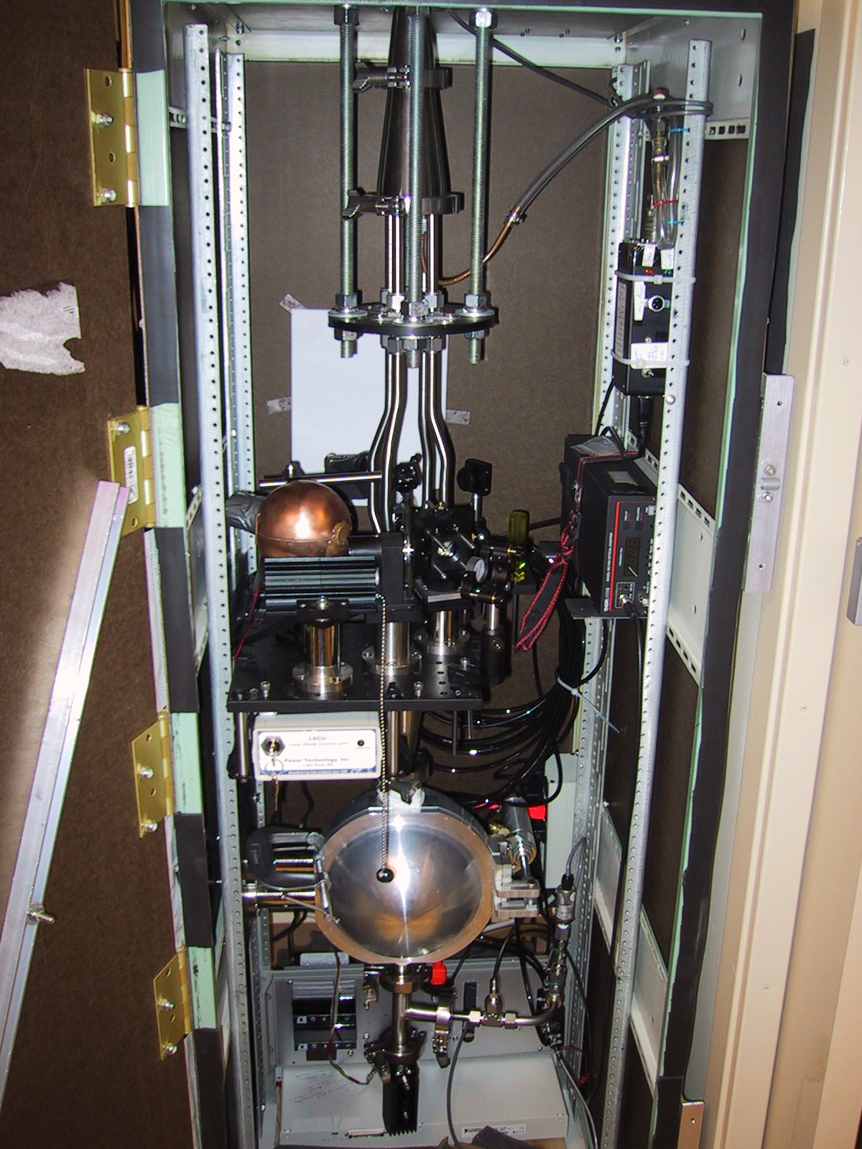
DRI Integrating Sphere Nephelometer
Advantage: integrating sphere yields a truncation angle of < 1 degree, important for supermicron particles
Source: Varma et al. (2003)

Slide 21
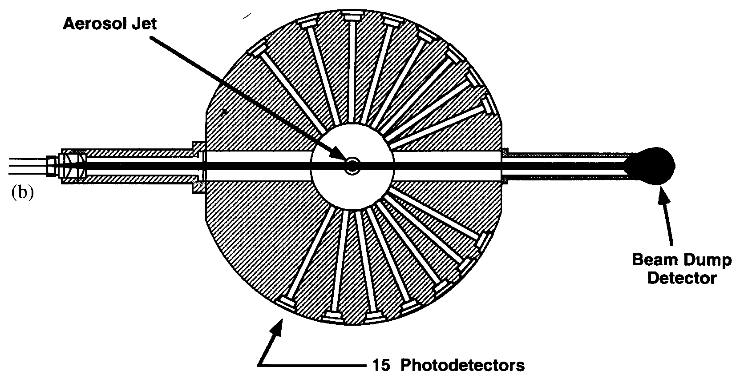
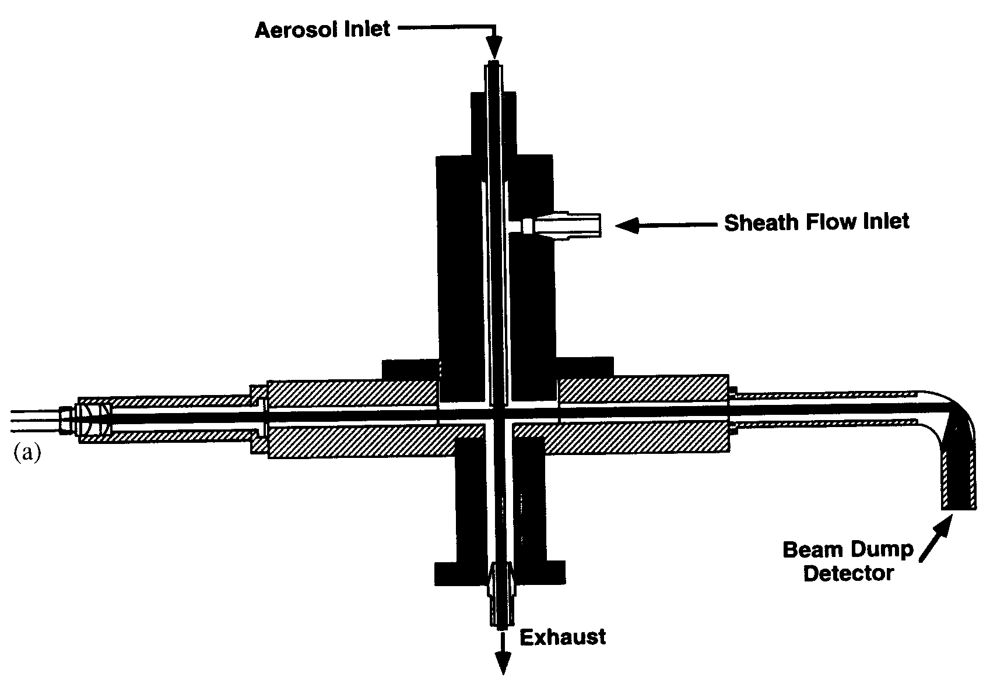
Polar Nephelometer Geometry
Scattering Angles (degrees)
23.1 | 29.0 | 35.0 | 41.0 | 47.2
53.5 | 60.0 | 66.7 | 73.7 | 81.1
88.9 | 97.2 | 106.3 | 116.4 | 128.3
Source: Leong et al. (1995)

Slide 22
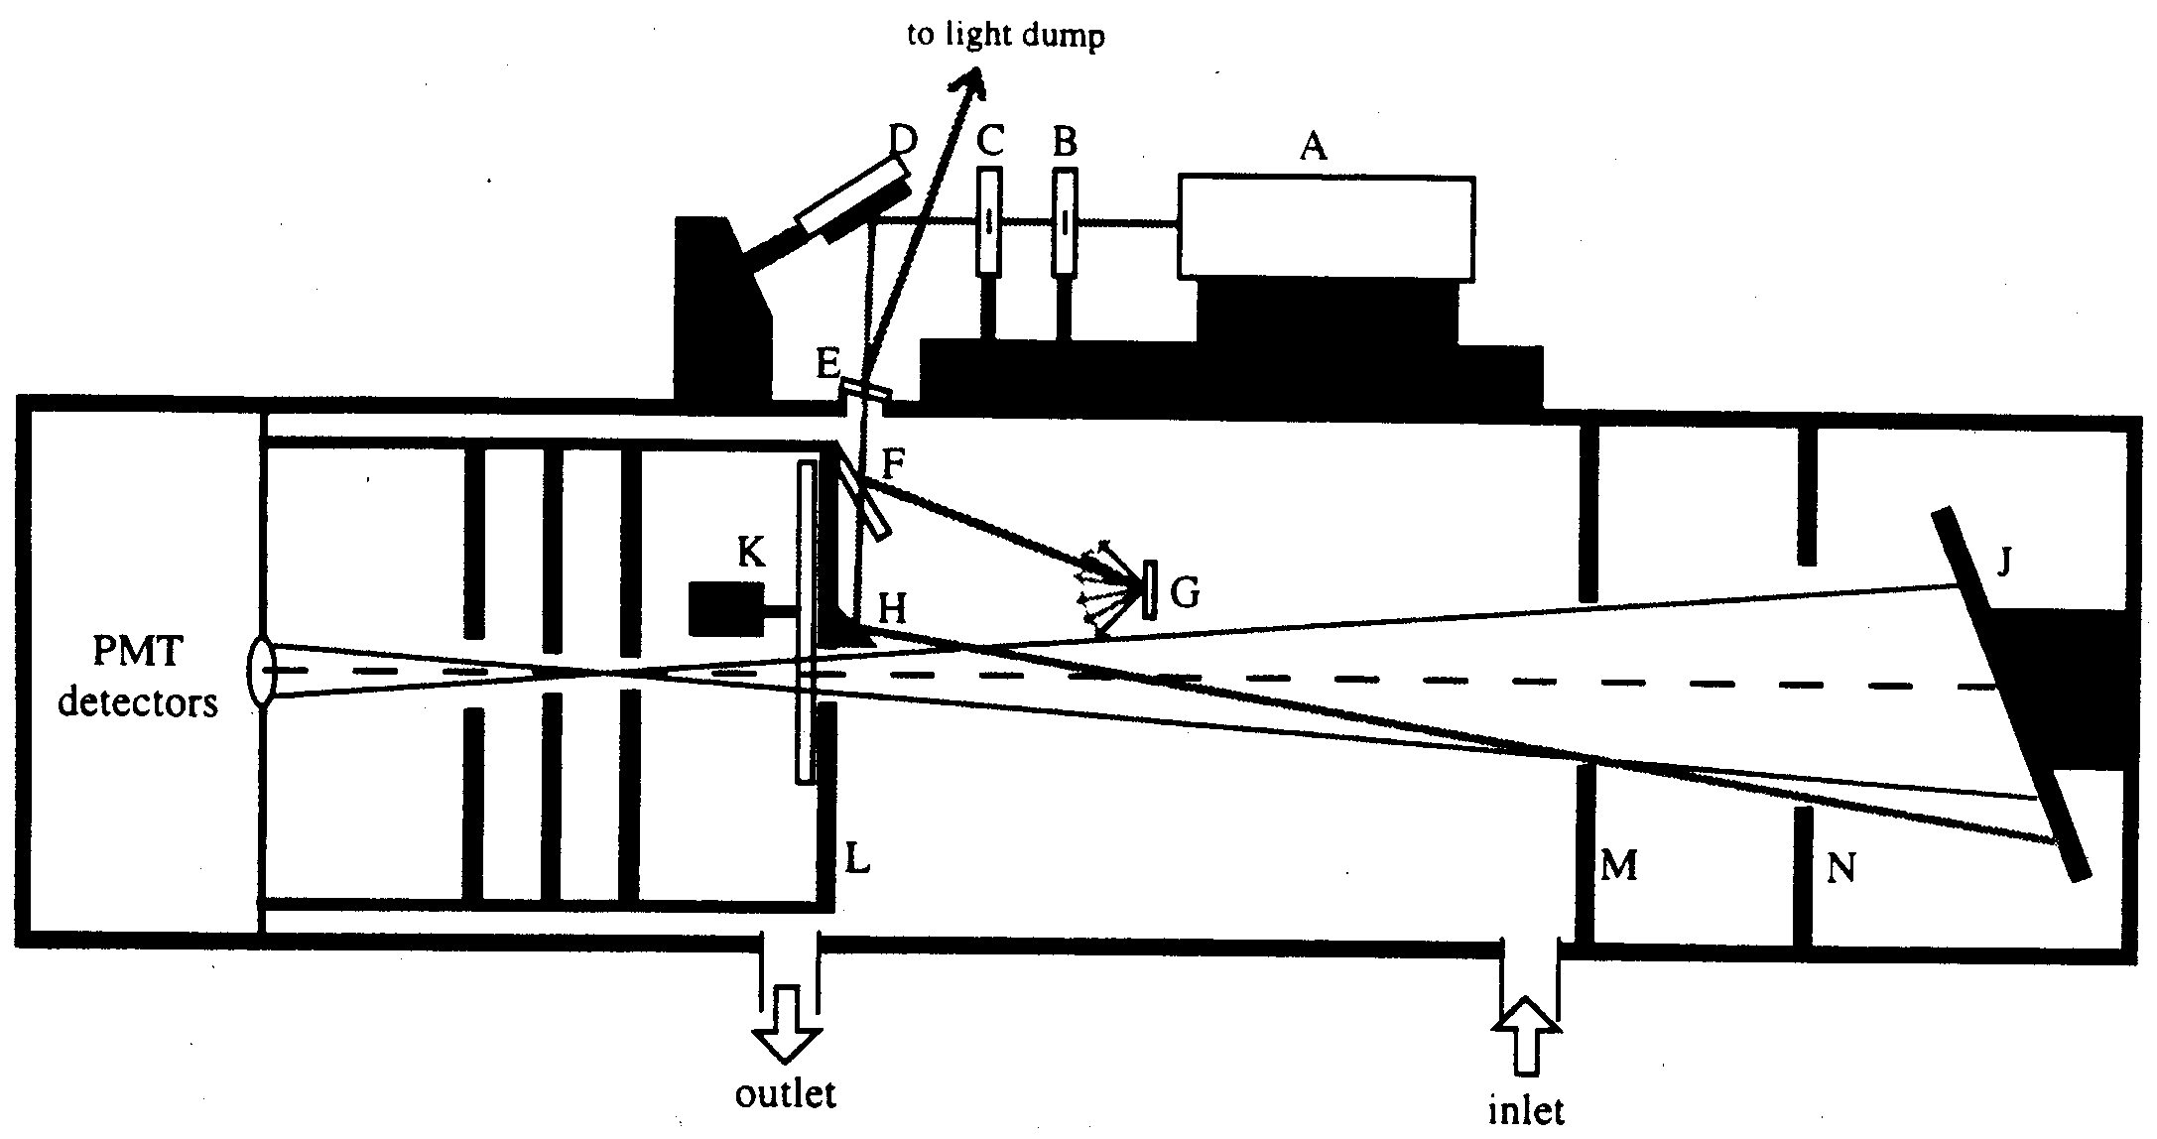
180°-Backscatter Nephelometer
Wavelength: 532 nm
Scattering angle: 176.4° - 178.4°
Source: Doherty et al. (1999)

Slide 23
Filter Methods for Light Absorption
Particles are deposited on the filter, which is a light-diffusing, multiple scattering substrate.
Light absorbing particles reduce the light power at the photodetector.
Ideally, light scattering particles don't reduce power.
Variants:
Time-integrated: integrating plate method, integrating sphere, integrating sandwich
Continuous: aethalometer, PSAP, MAAP

Slide 24
Calculating Light Absorption on Filters
I(t) = photodetector signal measured at time t
A = area of particle deposit on filter
Q = sample flowrate
k = calibration factor
k = 1 for an ideal instrument
k ~ 2 for fiber filters, varies with filter type and particle loading on filter
most instruments show a dependence on scattering by the particles (IPM, PSAP, aethalometer)

Slide 25
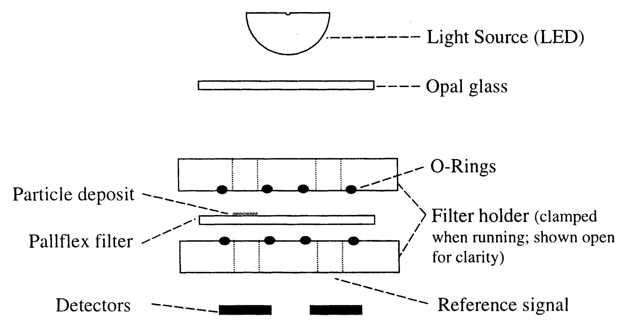
PSAP Optical Configuration
sample
reference
Source: Bond et al. (1999)

Slide 26
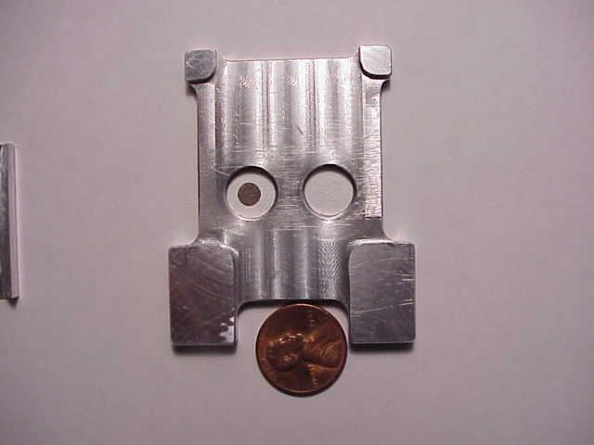
PSAP Filter Holder
Particle-loaded filter on the left, reference filter on the right. Compare light transmission through these filters as a measure of light absorption

Slide 27
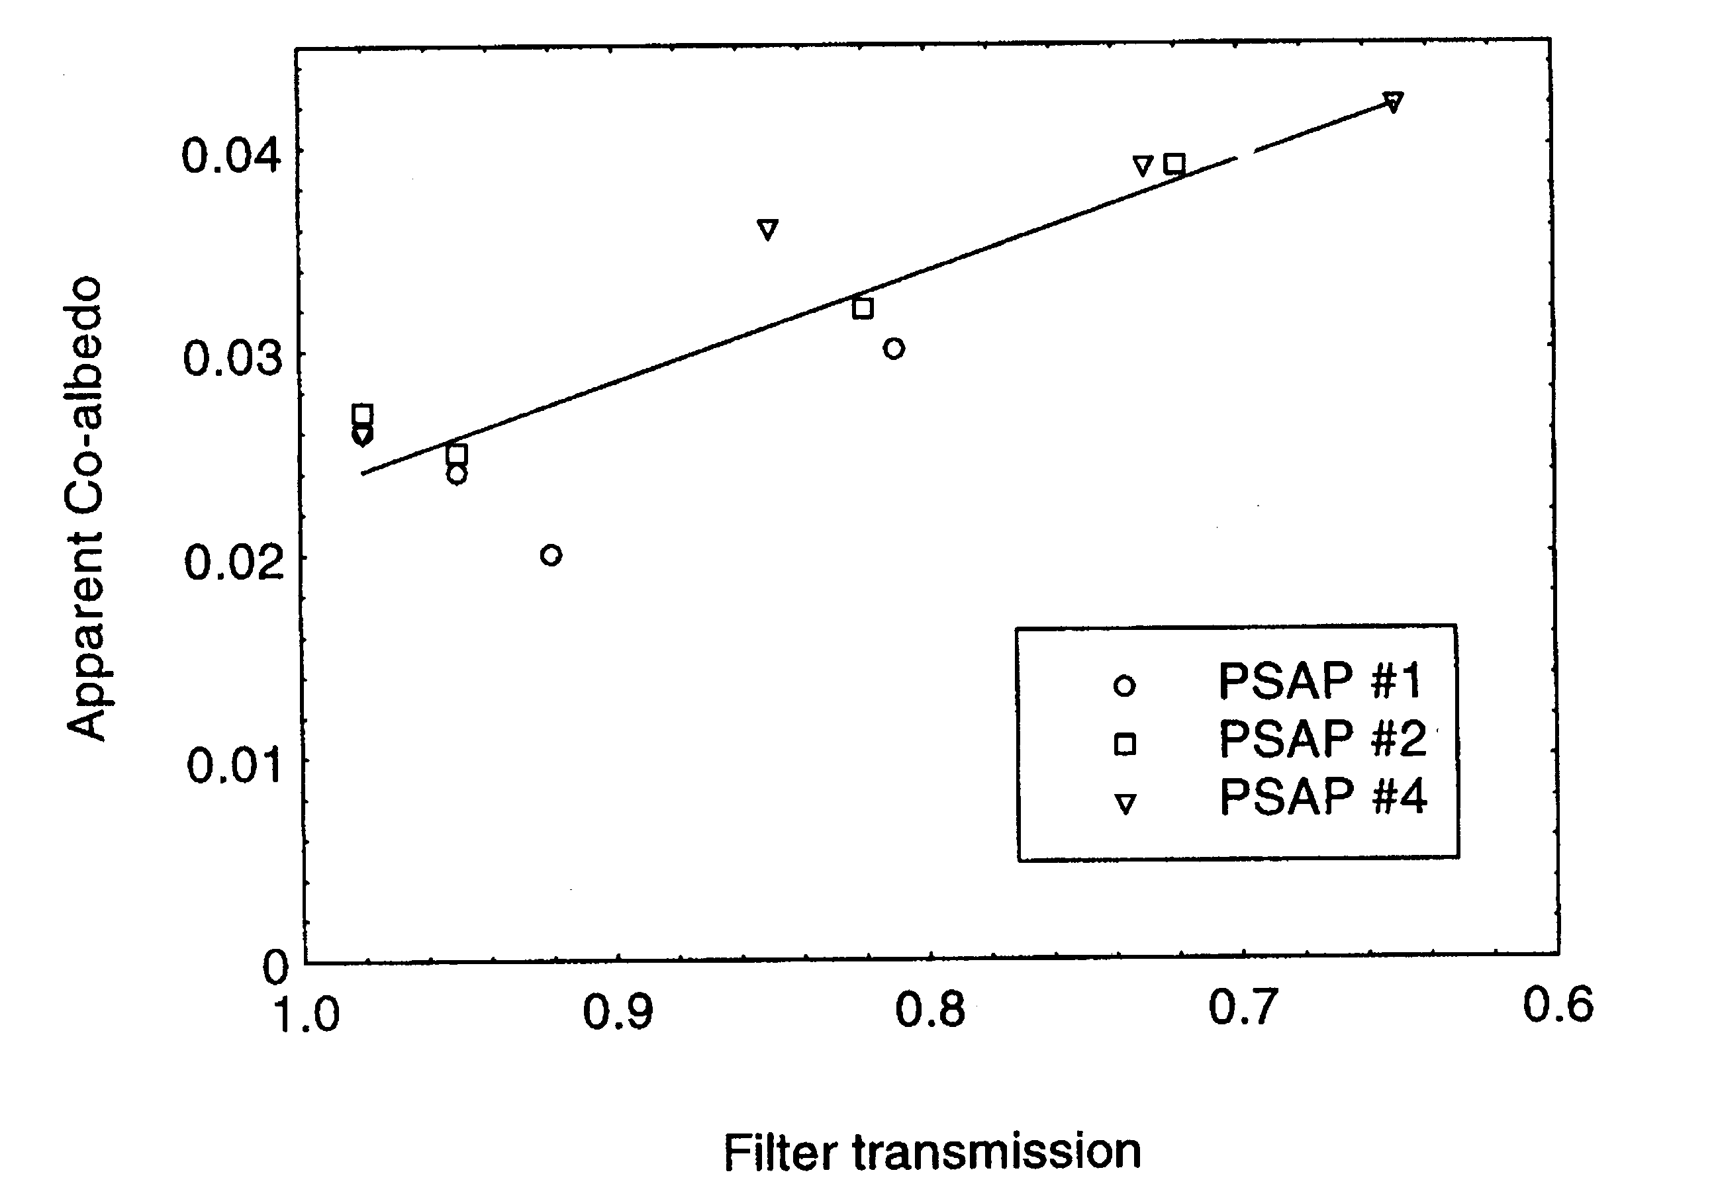
PSAP Response to Non-Absorbing Particles Depends on Filter Loading
Source: Bond et al. (1999)
Notes:
Trend up to 1991 published by Bodhaine & Dutton. They attributed likely cause of 1982-1991 decrease to changes in emissions from FSU.
Subsequent flattening out of “trend” illustrates need to continue monitoring to follow up apparent trends. Could it just be that 1982-1987 were anomalies?
Followup analysis being done as part of NOAA Arctic Research Initiative.
No other obvious trends at baseline stations..
Aerosol properties at baseline sites show clear seasonality, reflecting seasonal changes in sources and sinks.

Slide 28
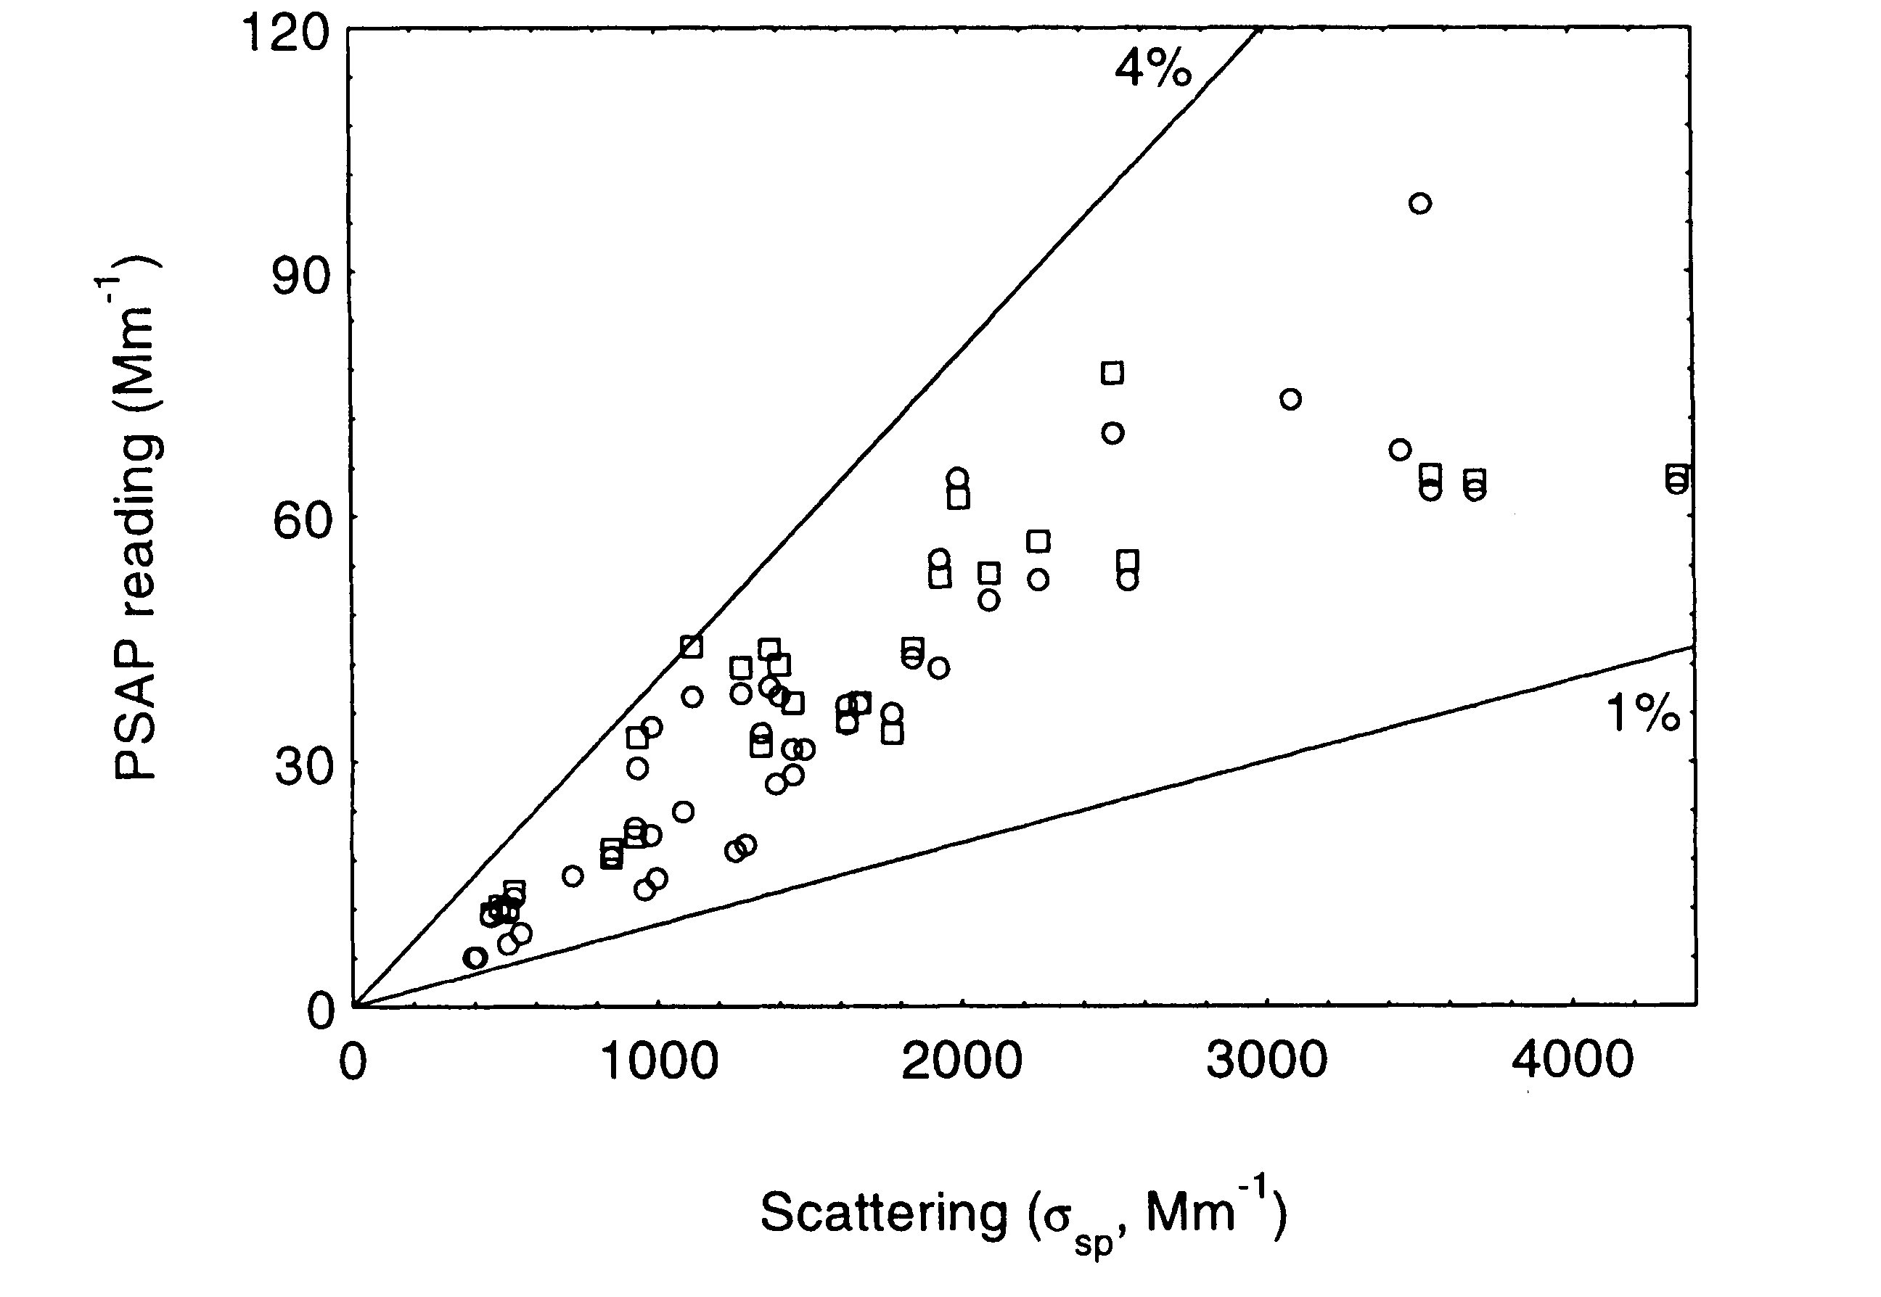
PSAP Response to Scattering
Source: Bond et al. (1999)
Notes:
Trend up to 1991 published by Bodhaine & Dutton. They attributed likely cause of 1982-1991 decrease to changes in emissions from FSU.
Subsequent flattening out of “trend” illustrates need to continue monitoring to follow up apparent trends. Could it just be that 1982-1987 were anomalies?
Followup analysis being done as part of NOAA Arctic Research Initiative.
No other obvious trends at baseline stations..
Aerosol properties at baseline sites show clear seasonality, reflecting seasonal changes in sources and sinks.

Slide 29
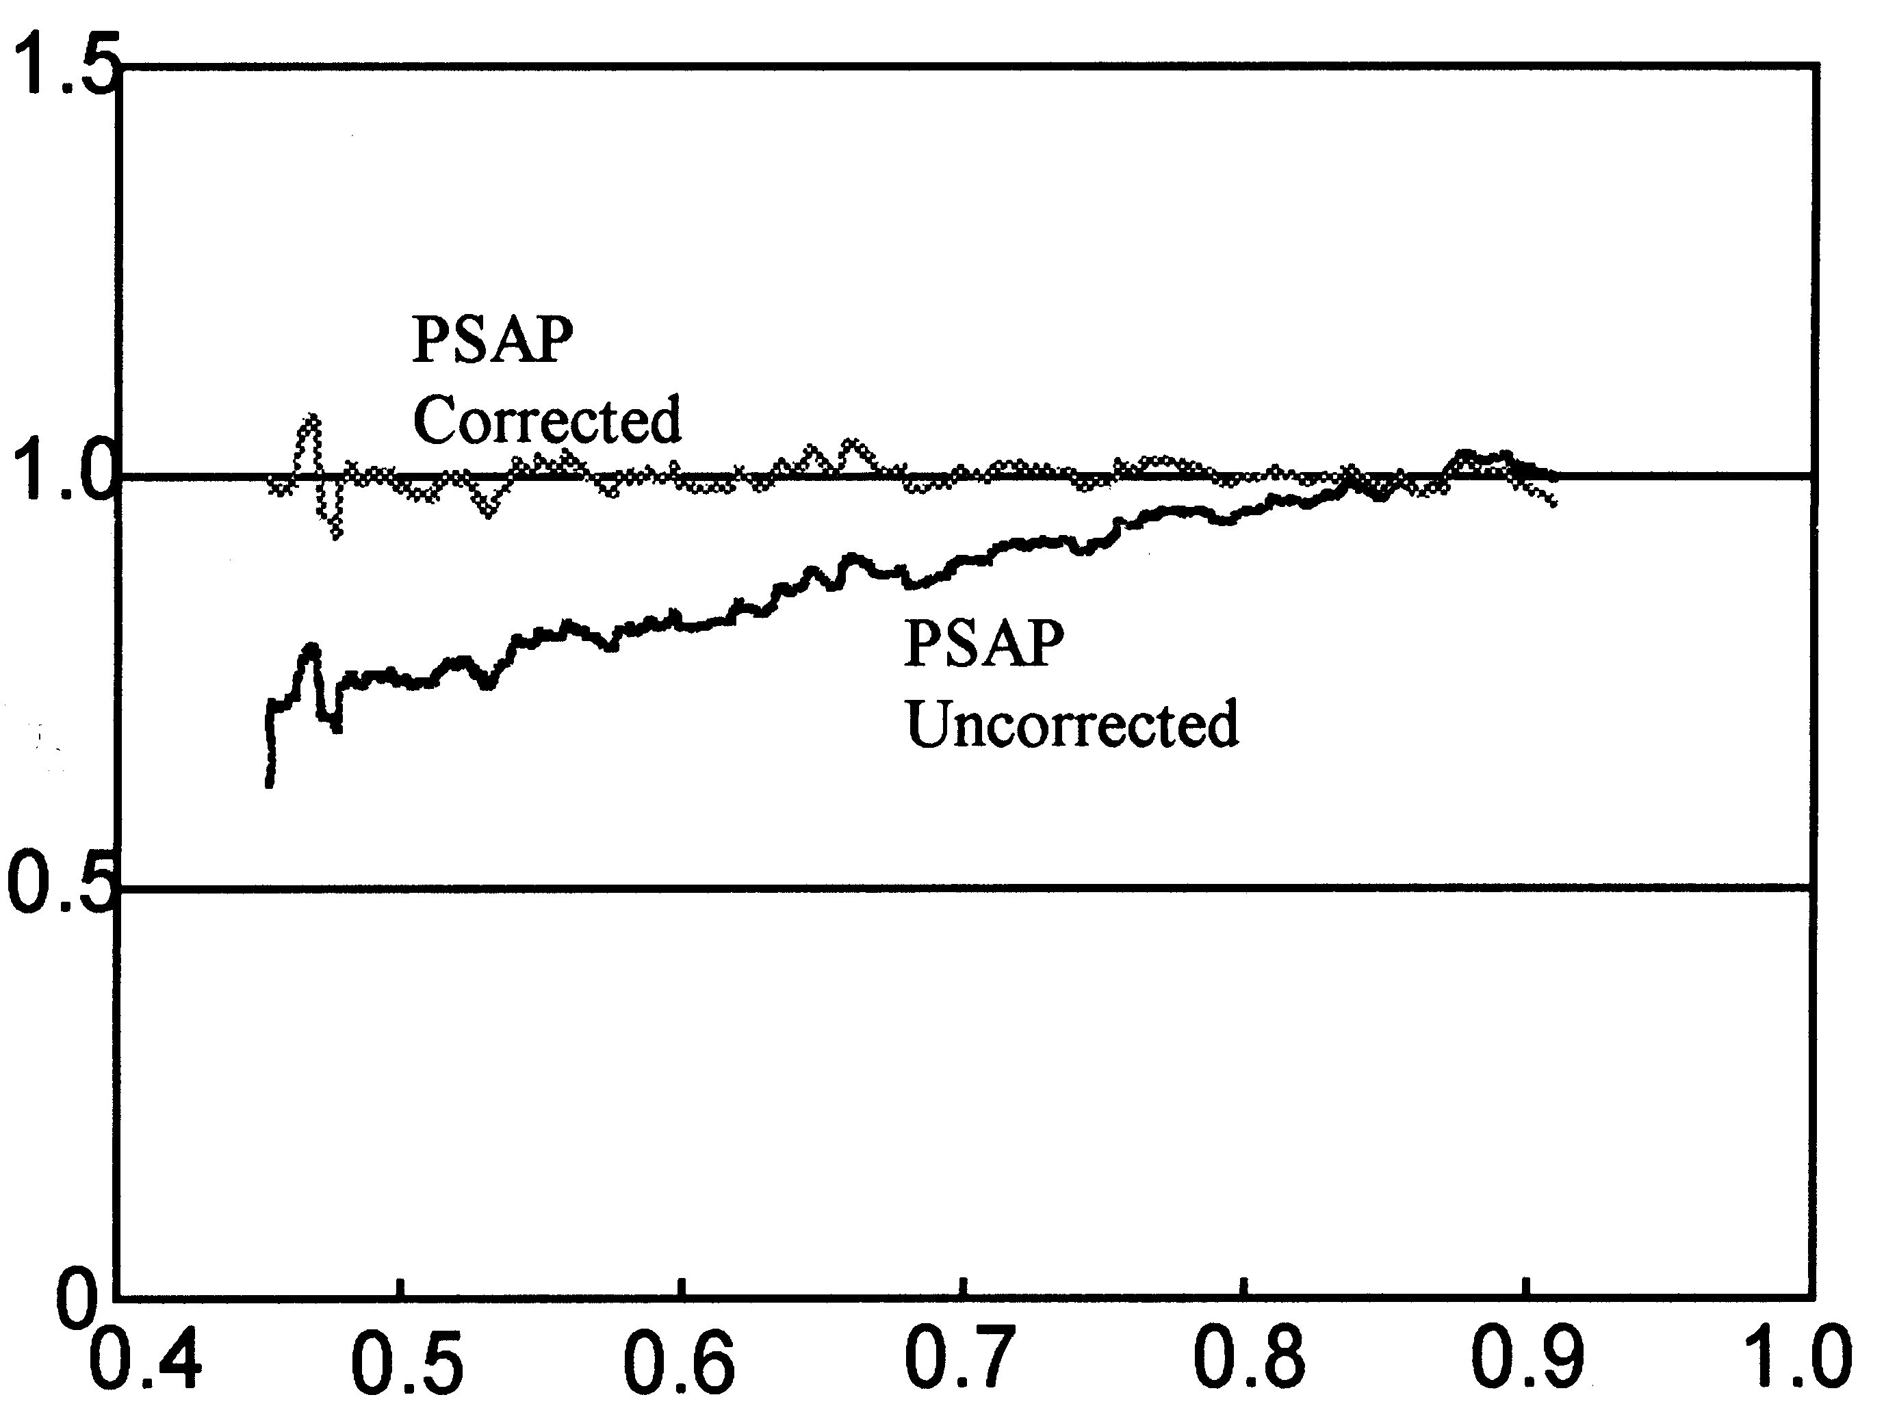
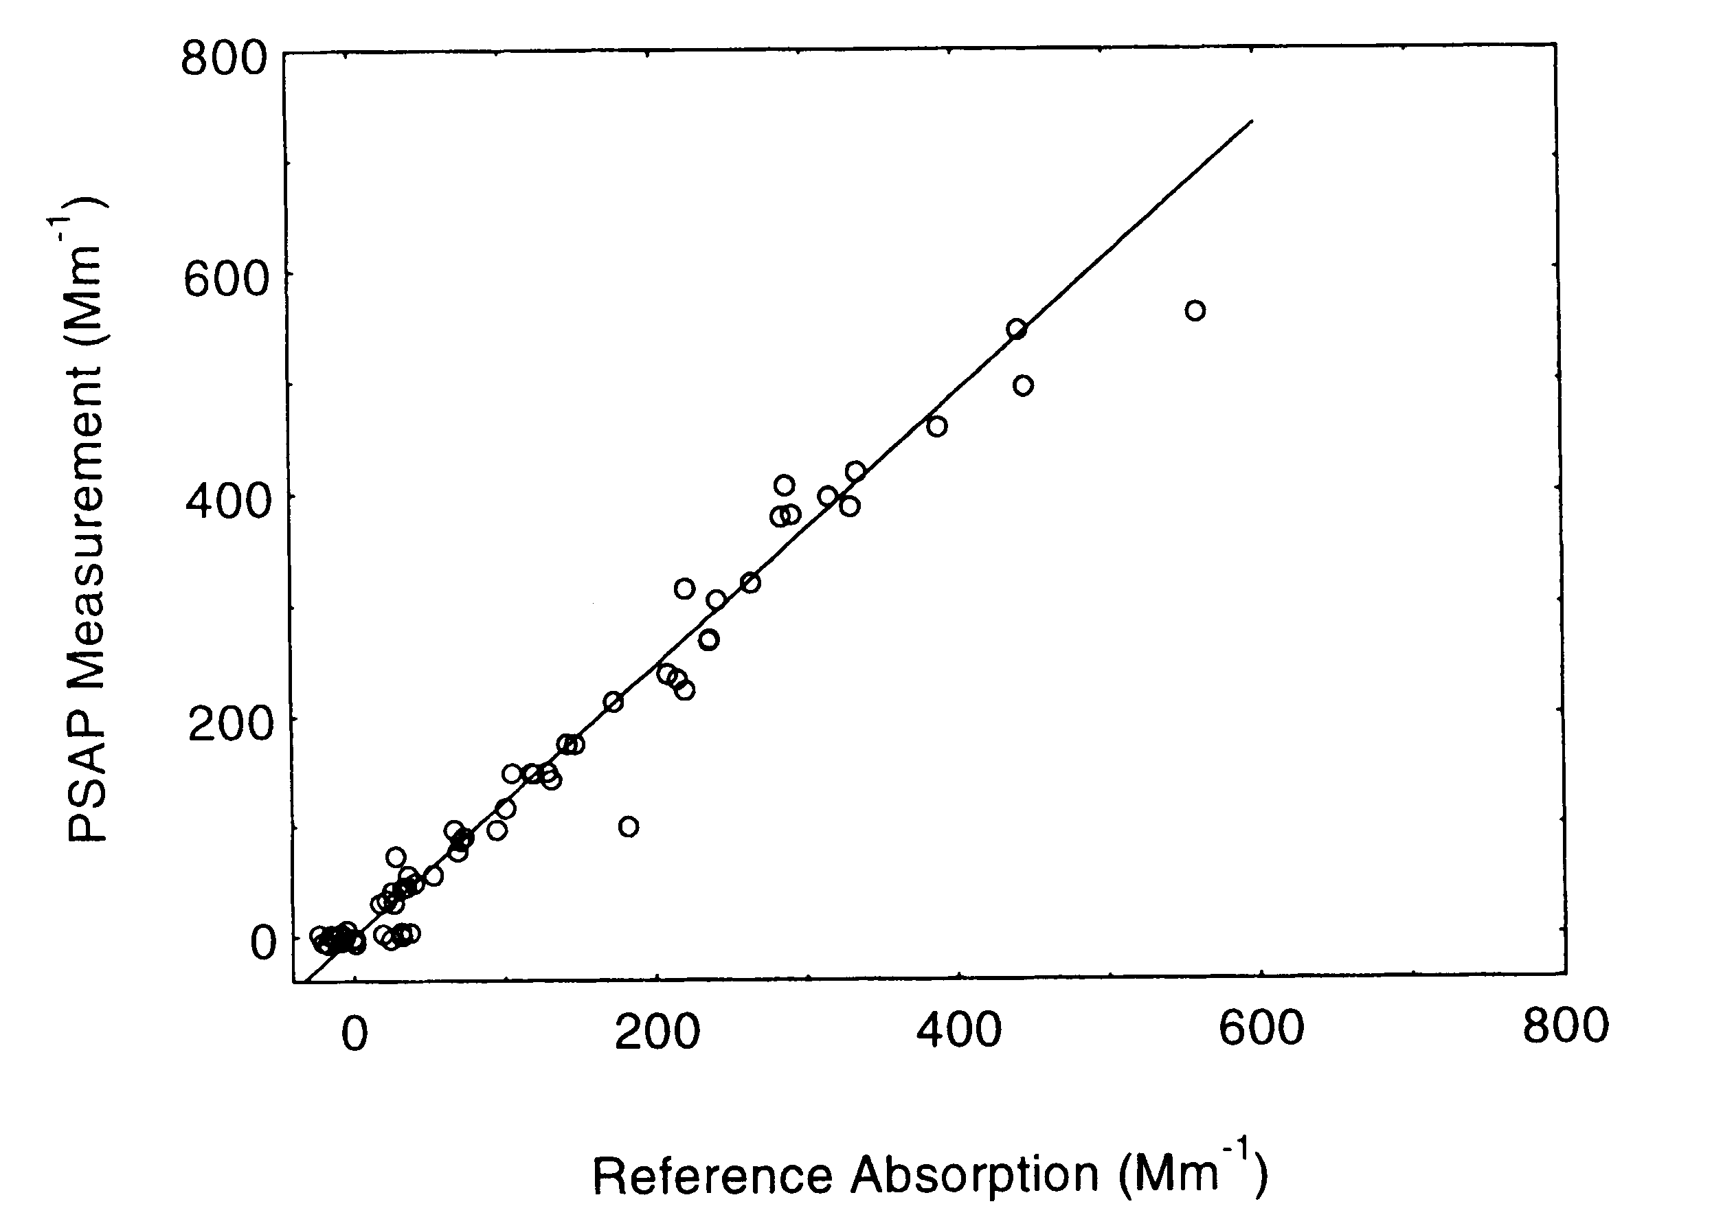
Current PSAP Correction Factors
Slope=1.22 with 2% of σ_{sp} subtracted
σ_{ap}(PSAP)/σ_{ap}(TRUE)
filter transmittance
Manufacturer’s built-in calibration (Weiss, unpublished)
Bond et al. (1999)

Slide 30
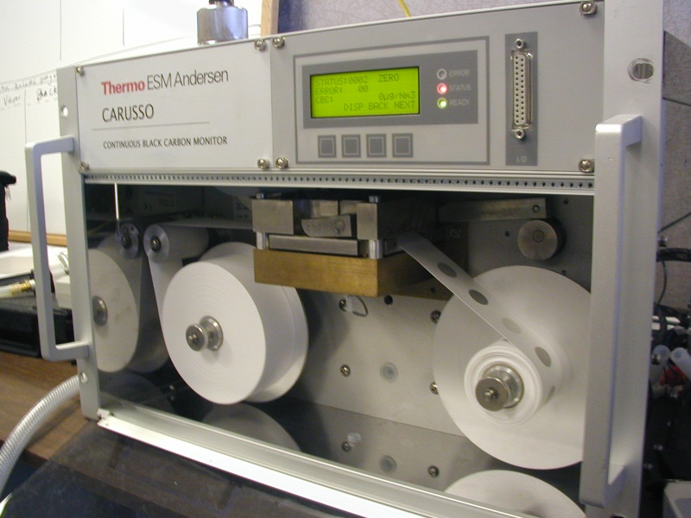
Multi-Angle Absorption Photometer
"MAAP"
Simultaneously measures light (670 nm) transmitted and reflected by aerosol deposit on filter
A two-stream radiative transfer model is used to derive the aerosol absorption coefficient, accounting for light scattering by particles and filter.
Detection limit ~ 1 Mm⁻¹ for 2-minute average at 16.7 lpm flowrate.
Source: A. Petzold¹ , M. Schönlinner² , H.Kramer² and H. Schloesser²
¹German Aerospace Center, Oberpfaffenhofen, Germany
²ESM Andersen Instruments, Erlangen, Germany

Slide 31
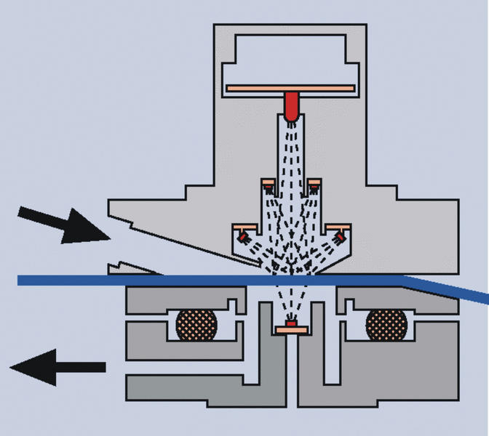
MAAP Optical Configuration
Source: A. Petzold¹ , M. Schönlinner² , H.Kramer² and H. Schloesser²
¹German Aerospace Center, Oberpfaffenhofen, Germany
²ESM Andersen Instruments, Erlangen, Germany

Slide 32
Photoacoustic Absorption Measurement
Laser light is power modulated by the chopper.
Light absorbing aerosols convert light to heat, producing a sound wave.
Microphone signal is a measure of the light absorption.
Light scattering aerosols don't generate heat.
Newer instruments operate at multiple wavelengths and also measure light scattering

Slide 33
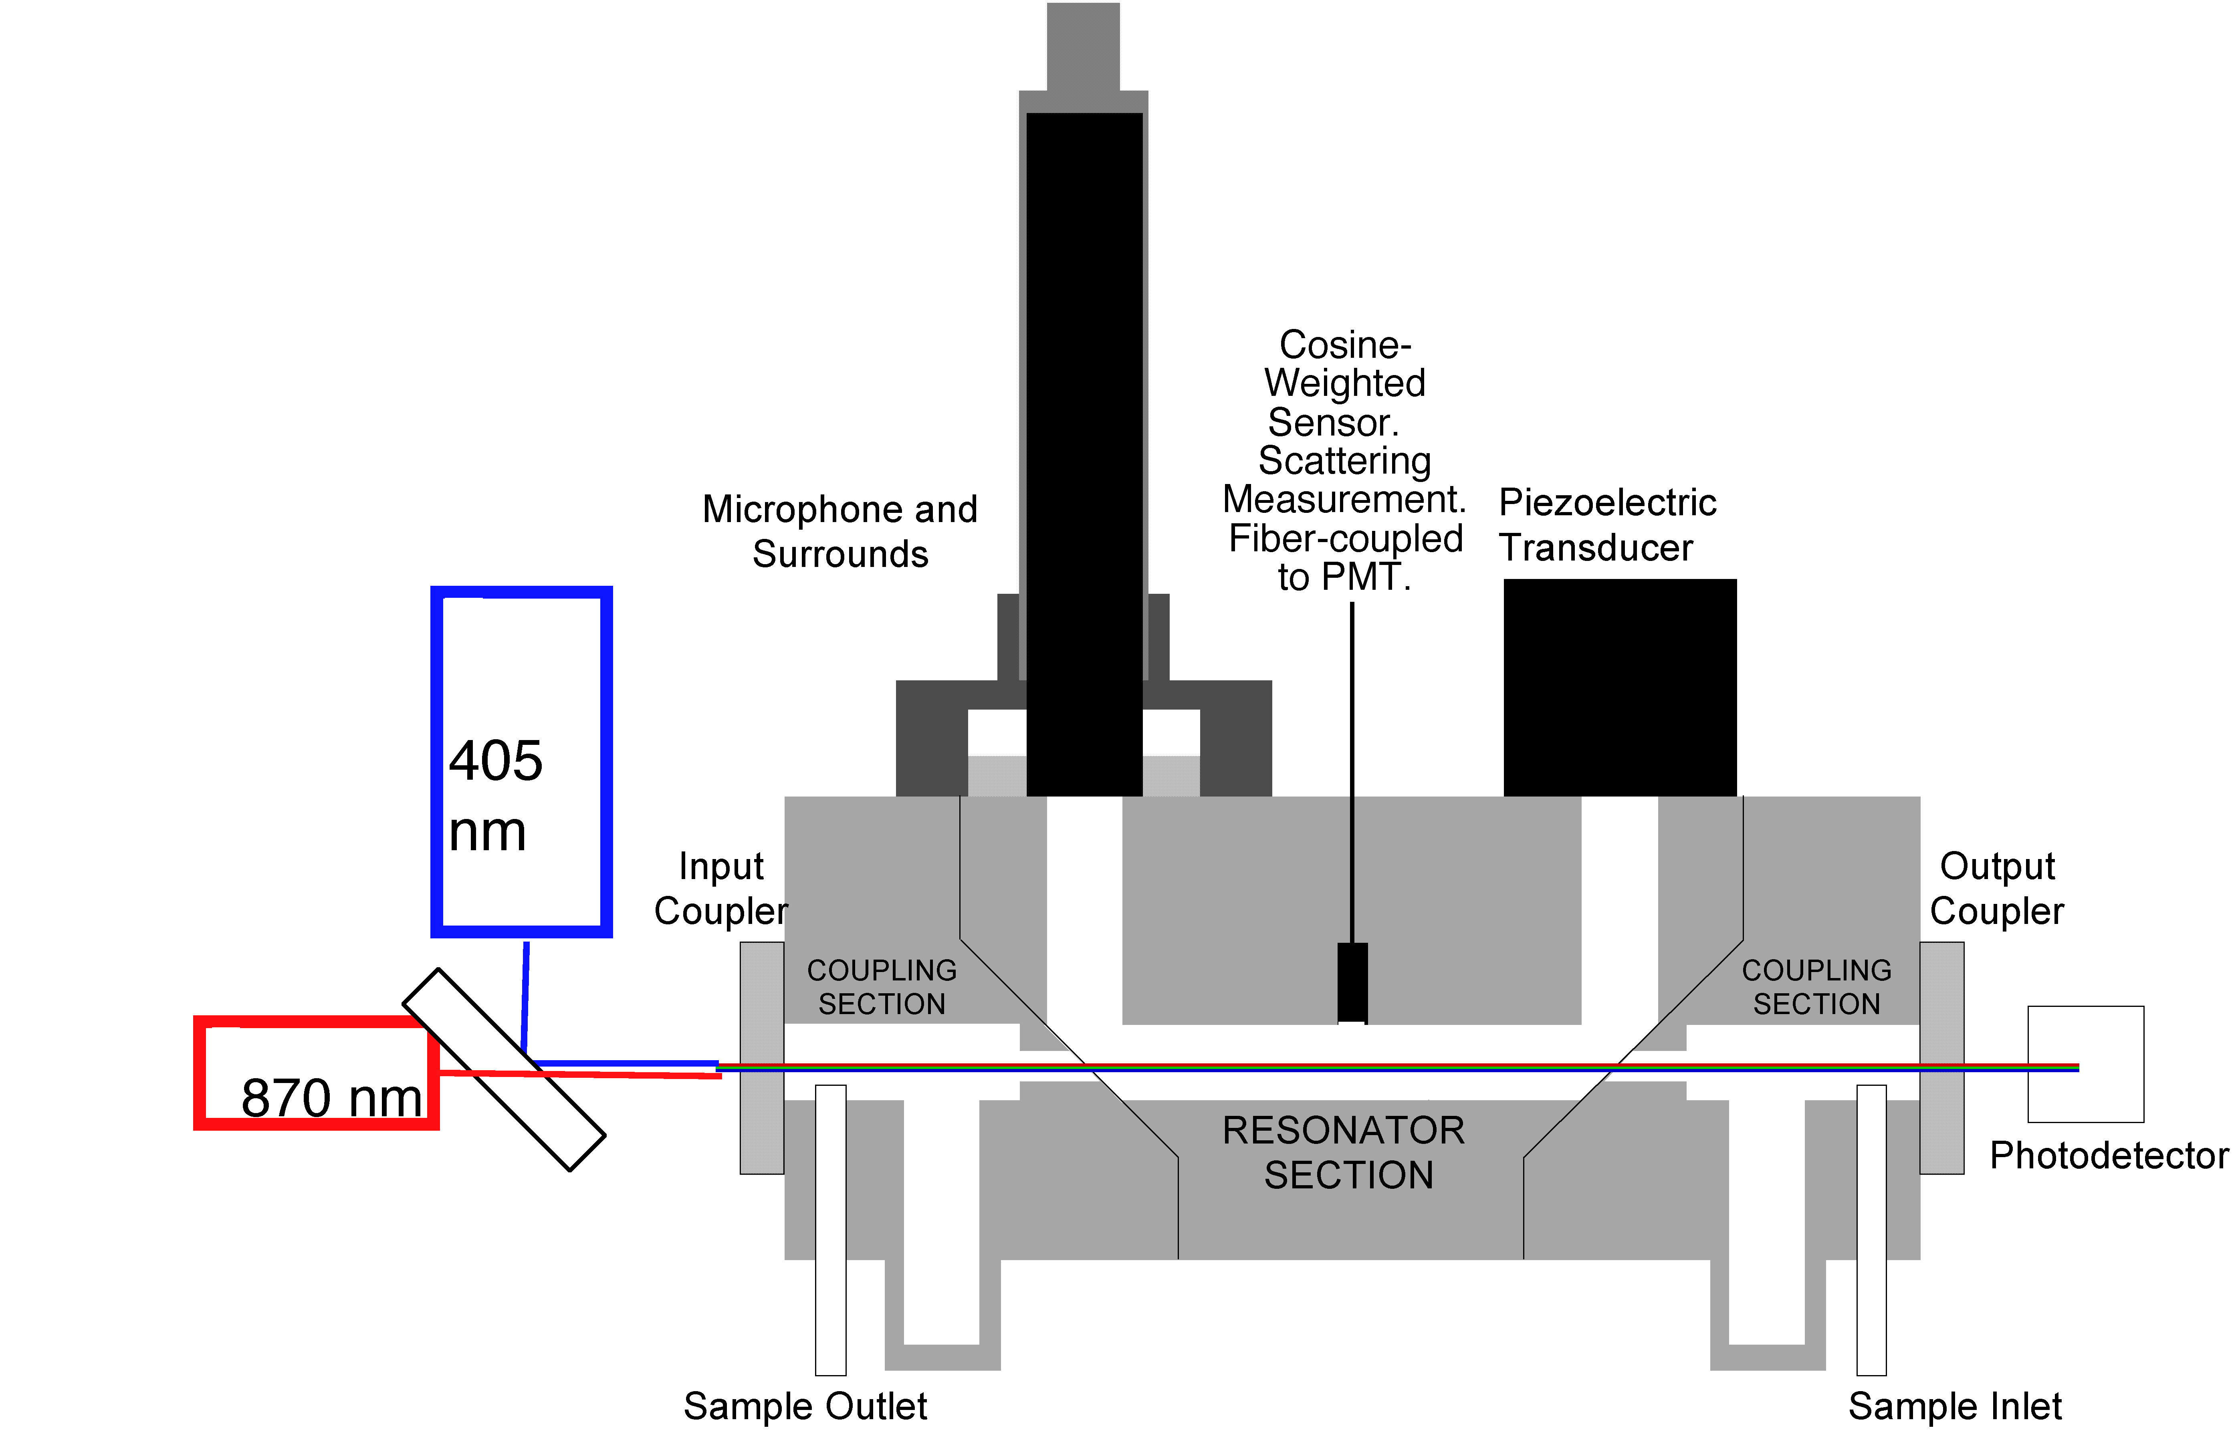
2-wavelength Photoacoustic w/Neph
Source: Arnott, pers. comm. (2006)

Slide 34
NOAA 5-Channel Photoacoustic Spectrometer (PAS)
405 nm: ambient + thermo-denuded
532 nm: ambient + humidified
660 nm: ambient
Source: D. Lack, 2010, personal communication

Slide 35
5
Current PAS Channels
Possible PAS Channels
*
Achieved using thermo-denuder
4
Relative Absorption
BC
+
Brown Shell
High Relative Humidity
3
BC + Clear Shell
2
*
Black Carbon
*
High Relative Humidity
1
Wavelength (nm)
*
405
532
660

Slide 36
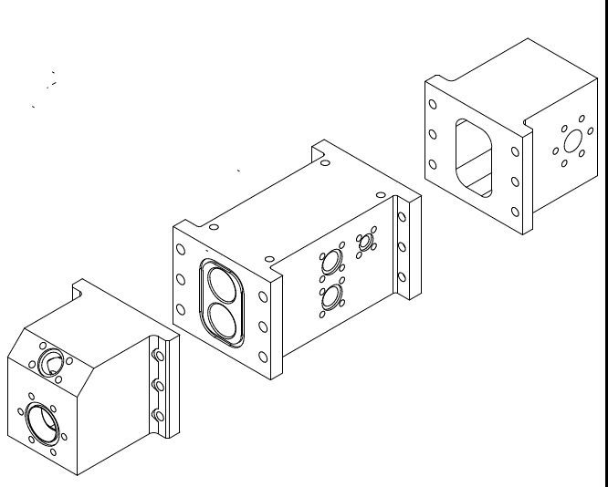
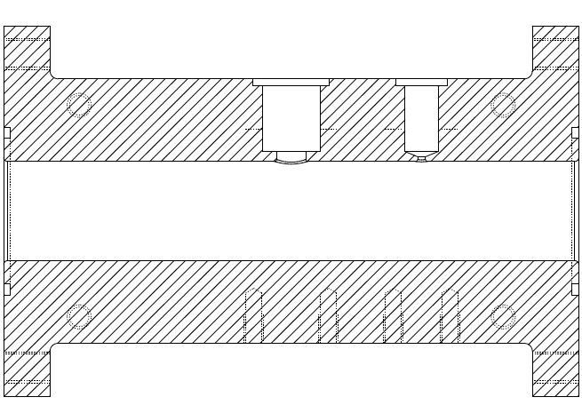
PAS - Expanded
1 Sample Resonator + 1 Background Resonator
Microphone on Each Resonator – Electronic Background Subtraction
Speaker Periodically Calibrates Resonant Frequency (F_{R})
Laser Light Passes Through Transparent Windows
Mirrors (not shown) Reflect Light Multiple Times Through Cell
Laser Power is Modulated at F_{R.}
Particles Absorb Light and Create Acoustics at F_{R}.
Sample Out
Background Microphone
Speaker
Sample In
Sample Microphone
RH/Temp
Microphone
Laser Window
Laser
Anti-Node of Sound Wave @ Microphone
Laser Light - Power Modulated
Source: D. Lack, 2010, personal communication

Slide 37
Multi-Pass Optics in NOAA PAS
Astigmatic Laser Multi-pass
Up to 186 Passes.
Increases Laser Power (sensitivity)
Without Increasing Energy
Intensity on Particle
Produces Unrivaled Sensitivity:
At 1 second (2 σ):
Laboratory:
405nm: 0.1 Mm⁻¹
532nm: 0.1 Mm⁻¹
660nm: 0.3 Mm⁻¹
Aircraft:
405nm: 0.5 Mm⁻¹
532nm: 0.75 Mm⁻¹
660nm: 1.5 Mm⁻¹

Slide 38
NOAA PAS: Example vertical profile 8 hours of 1 Hz data
Source: D. Lack, 2010, personal communication

Slide 39
U.W. Optical Extinction Cell
Purge air in
Outlet
Sample in
Outlet
Purge air in
Plug
Plug
460 nm
540 nm
660 nm
LEDs
DR
O
2
O
1
L
2
L
1
D
2
BS
M
D
1
PT
DS
HD
HD
2
1
F
2
F
1
130’’=330.2 cm
144’’=366 cm
L = 660 cm
Source: Virkkula et al. (2005)

Slide 40
What is Cavity Ringdown (CRD)?
input pulse
ringdown cavity
output signal
time
input pulse width ~ 20 nanoseconds
mirror reflectivity > 99.995%
ring-down time 5-100 microseconds
extinction coefficient derived from fitting an exponential function to decay of output signal

Slide 41
DRI CRD Extinction Instrument
extinction measured at 532 nm effective path length ~10 km Source: Moosmüller et al. (2005)

Slide 42
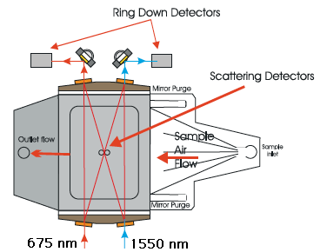
NASA/Ames "Cadenza" CRD Instrument
Current version measures extinction and scattering simultaneously at 675 and 1550 nm. (Strawa et al., 2006)

Slide 43
Reno Aerosol Optics Study June, 2002
John Ogren
NOAA/ESRL

Slide 44
Objectives
Characterize new and existing instruments for measuring aerosol light absorption and extinction
Quantify the uncertainty in the measurements of aerosol light absorption coefficient used by NOAA and ARM
Derive methods for determining spectral aerosol absorption from multi-wavelength measurements of absorption and (extinction - scattering)
N.B. All experiments done at low RH

Slide 45
Participants
NOAA/CMDL (Ogren, Sheridan)
DRI (Arnott, Moosmüller, Varma)
U. Washington (Covert, Virkkula, Ahlquist)
NASA/Ames (Strawa, Schmid) and Picarro Networks, Inc. (Owano, Provencal)
Thermo Andersen/DLR (Schloesser, Petzold)
Portland State U. (Atkinson)

Slide 46
Absorption Coefficient Measurements
Photoacoustic
#1 532 nm
#2 1047 nm
Filter-based
Particle/soot absorption photometer (PSAP)
#1: 565 nm
#2 460, 540, 660 nm
Aethalometer
#1 370, 470, 521, 590, 660, 880, 950 nm
#2 370, 430, 470, 521, 565, 700, 950 nm
MAAP (multi-angle)
#1: 670 nm

Slide 47
Extinction Coefficient Measurements
Folded path extinction cell (6.6 m path)
#1 460, 540, 660 nm
Cavity-ring down (CRD)
#1: 532 nm
#2: 690, 1550 nm
#3: 532, 1064 nm

Slide 48
Scattering Coefficient Measurements
TSI 3563 integrating nephelometer
#1 450, 550, 700 nm
Radiance M903 integrating nephelometer
#1: 530 nm
DRI integrating sphere nephelometer
#1: 532 nm
NASA/Ames CRD nephelometer
#1: 690 nm

Slide 49
Aerosol characterization
Size distribution
scanning mobility particle spectrometer
Number concentration
TSI condensation particle counters
Mass concentration
TEOM
Chemical composition
elemental carbon
organic carbon
Morphology
electron microscopy

Slide 50
Experimental Target Matrix
White aerosols: ammonium sulfate (AS) Black aerosols: kerosene soot (K), diesel soot (D), graphite (G) Other: ambient air (A), filtered air (F), polystyrene latex 0.5 μm dia. (PSL)

Slide 51
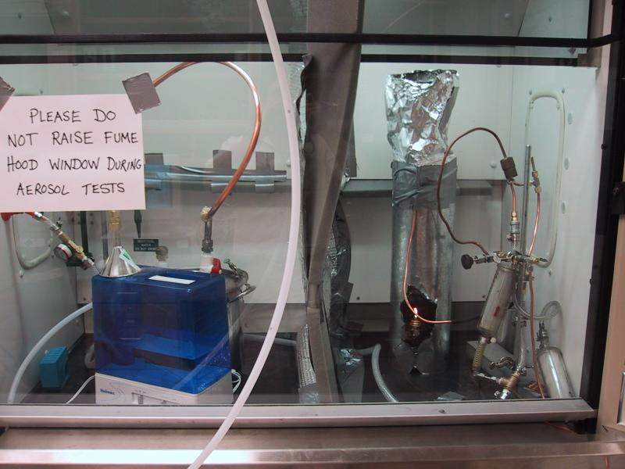
Aerosol Generation System
White aerosols produced from ammonium sulfate in ultrasonic humidifier (left) Black aerosols produced by kerosene lamp (right)

Slide 52
Aerosol Mixing and Distribution
Stirred mixing chamber (76 liters) provides a uniform aerosol to all instruments. Variable mixtures of white particles, black particles, and filtered air can be provided.

Slide 53
Agreement of Absorption Standards
Notes: Data points represent kerosene soot runs with varying amounts of ammonium sulfate. Extinction data were adjusted to agree with scattering measurements on white aerosols (~4% adjustment).

Slide 54
Absorption Comparison (532 nm)
Notes: Data points represent kerosene soot runs with varying amounts of ammonium sulfate. Extinction data were adjusted to agree with scattering measurements on white aerosols (~4% adjustment).

Slide 55
Reno2002 Light Absorption Comparison
Notes: Data points represent all low-extinction kerosene soot runs with varying amounts of ammonium sulfate. Bond et al. (1999) corrections applied to PSAP data. PSAP wavelength adjusted to 532 nm assuming a λ⁻¹ dependence.

Slide 56
Aethalometer response vs. time
Separate runs with pure soot (σ_{ext}~800 Mm⁻¹) and ammonium sulfate (σ_{ext}~450 Mm⁻¹). Photoacoustic wavelength 532 nm, aethalometer wavelength 521 nm.

Slide 57
Summary of RAOS Results
Accuracy of standard methods for absorption is ±5%
PSAP agrees with standard methods within about ±5% for absorption levels observed at ESRL and ARM sites
Filter transmission methods (PSAP, aethalometer) require improved corrections for multiple scattering effects
Cavity ringdown extinction cells appear to be biased low by 10-25% (Note: this bias is not present in current CRD instruments)

