Slide 1
Overview of Ogren Lectures for ISCS-2010
TITLES
THEMES
Atmospheric Cycle of Elemental Carbon
Measurement Techniques for Aerosol Climate-Forcing Properties
Aerosols and Climate Sensitivity
Haze and Clouds: Interactions of Aerosols and Water
Aerosols, water, radiation, climate
In-situ measurements
JAO Career Path
  co-author on a diverse range of studies to be discussed in these lectures
  grab opportunities
  make friends

Slide 2



Clear-sky Aerosol Radiative
Forcing over North Indian Ocean
-7.0 ± 1 W m⁻²
energy loss at top of atmosphere due to backscattering of sunlight to space
+16.0 ± 2 W m⁻²
heating of atmosphere due to aerosol absorption of sunlight
-23 ± 2 W m⁻²
cooling of surface due to aerosol absorption and backscattering
Source: Ramanathan et al., J. Geophys. Res., 2001
average for Jan - March, 1999; 0 - 20°N; τ_{a} = 0.3

Slide 3
Atmospheric Cycle of Elemental Carbon
John A. Ogren
National Oceanic and Atmospheric Administration
Earth System Research Laboratory
Boulder, Colorado, USA
http://www.esrl.noaa.gov/gmd/aero/

Slide 4
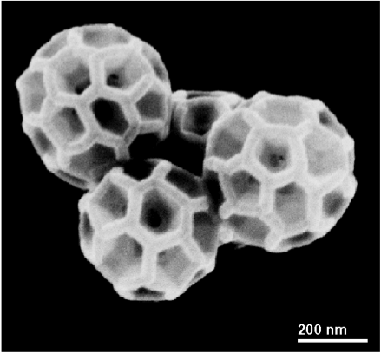

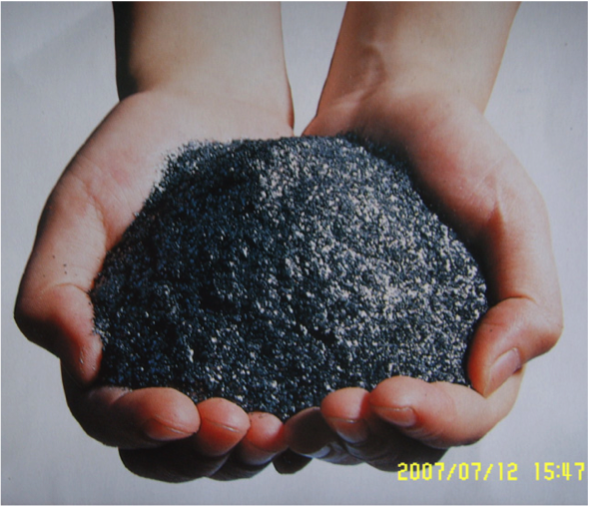
Forms of Elemental Carbon
Diamond, Buckyball, Graphite
"A diamond is forever"… but what is the lifetime of graphite?

Slide 5
Terminology for "soot"
Graphitic (GC) vs. Organic carbon (OC)
  defined by molecular form of carbon
Elemental carbon (EC)
  based on refractory properties of carbon
  also called particulate elemental carbon (PEC)
Black carbon (BC)
  based on optical properties of carbon
  characterized by 1/λ-dependence of absorption
Brown carbon
  light absorbing carbon that is not "black"

Slide 6
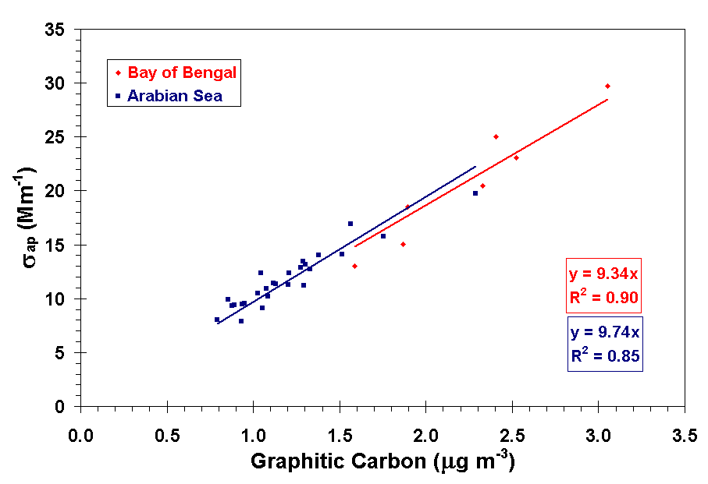
Black Carbon and Light Absorption
Optical methods for determining BC really measure σ_{ap} (PSAP, aethalometer, MAAP, photoacoustic, …)
BC = σ_{ap} x f_{ap} / MAE
  f_{ap} = fraction of light absorption due to BC
  MAE = mass absorption efficiency of BC (m² g⁻¹)
Climate forcing calculations require σ_{ap}
MAE / f_{ap} ≈ 9.5 m² g⁻¹
Empirical relationships, like the one show above for the Indian Ocean, are required to determine BC from σ_{ap} (WMO/GAW report #153)

Slide 7
Terminology: Mixtures
External mixture
  individual particles have different chemical composition
  e.g., EC and sulfate are in separate particles
Internal mixture
  multiple chemical species in each particle
  e.g., EC and sulfate are in the same particles
Implications of mixing state for lifetime and radiative properties
  hygroscopic coatings enhance EC removal
  coatings enhance EC light absorption

Slide 8
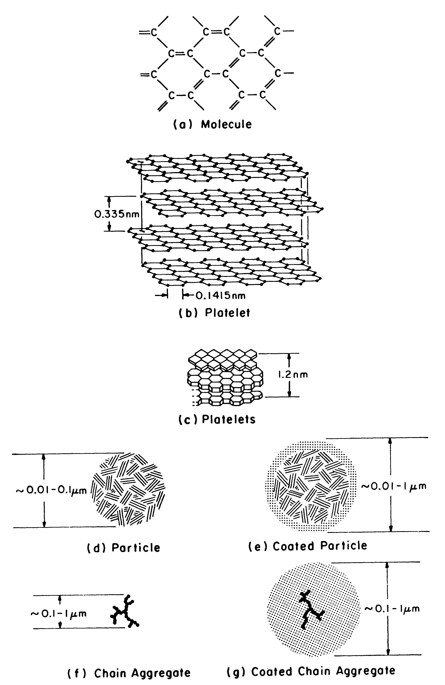
Morphology of Graphitic Elemental Carbon
Π orbitals of planar graphite molecule are the cause of the strong, broadband light absorption of EC
Coatings affect EC lifetime and optical properties
Source: Ogren et al., 1983

Slide 9
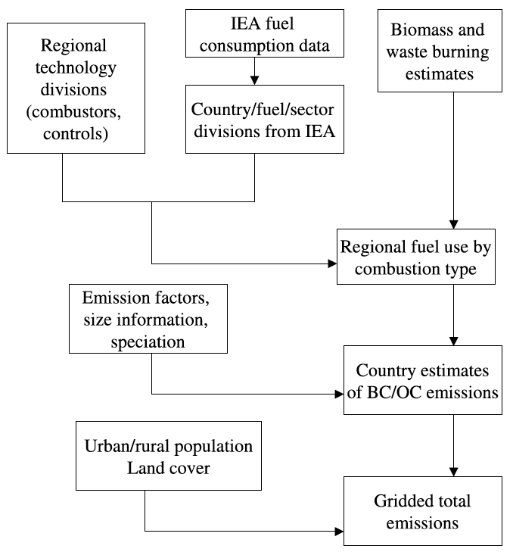
Calculation of EC Emissions
EF_{BC} = EF_{PM} * F_{1.0} * F_{BC} * F_{cont}
EF_{PM} = bulk emission factor, g/kg
F_{1.0} = sub-micron fraction of bulk emissions
F_{BC} = mass fraction of BC in sub-micron emissions
F_{cont} = fraction of sub-micron particles that pass emission controls
Source: Bond et al, 2004

Slide 10
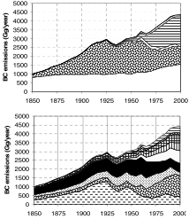

Historical Emissions of BC
Source: Bond, 2010

Slide 11
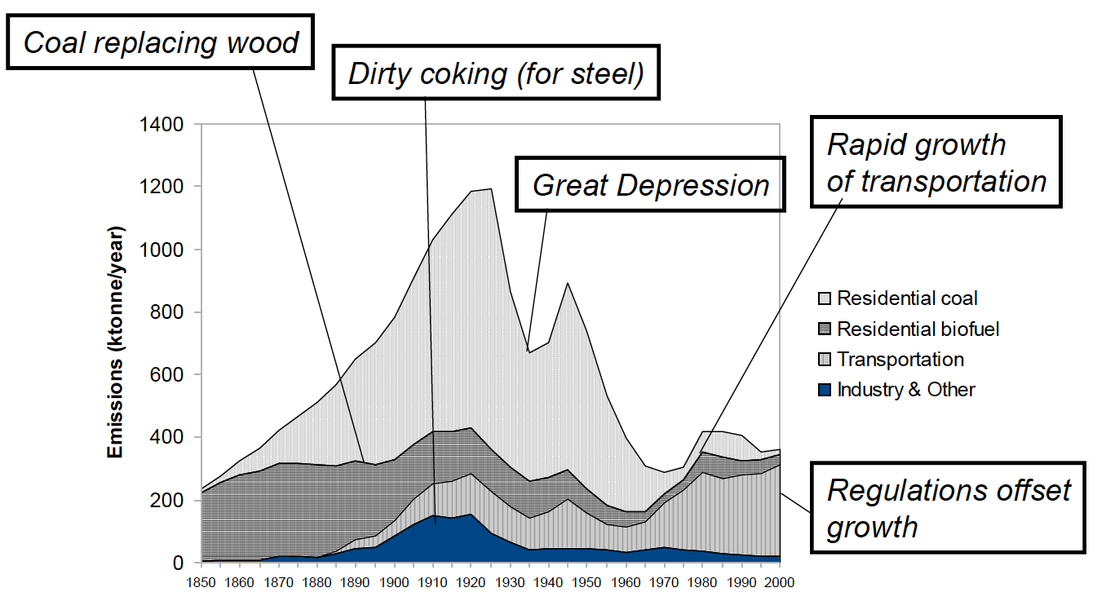
History of US BC Emissions
Source: Bond, 2010

Slide 12
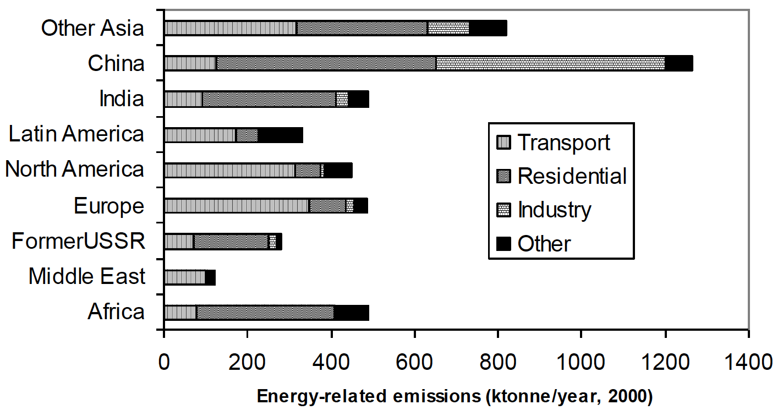
Energy-related emissions of BC
Source: Bond, 2010

Slide 13
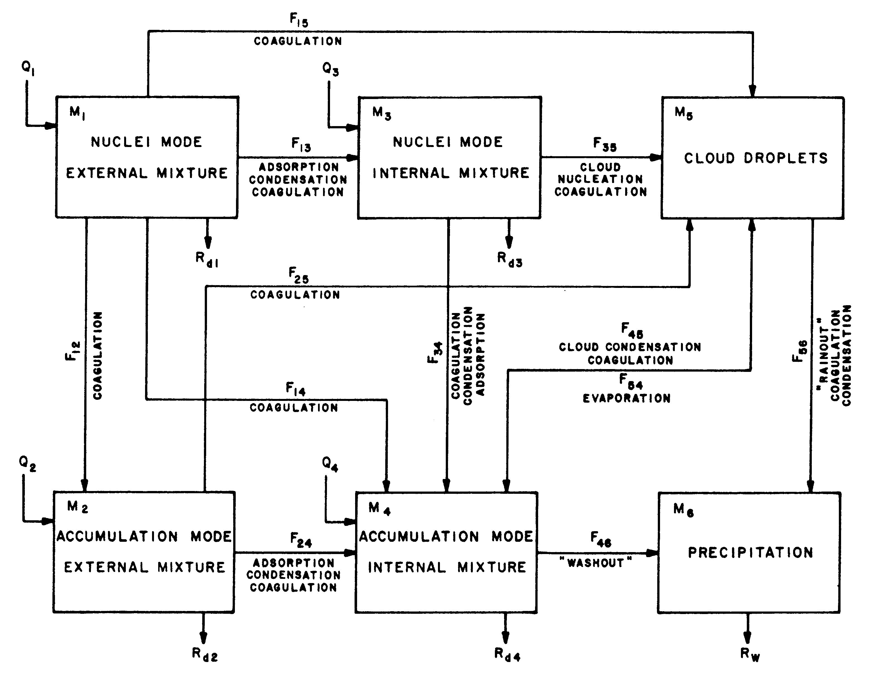
Box Model of Atmospheric Cycle of EC
Source: Ogren et al., 1983

Slide 14
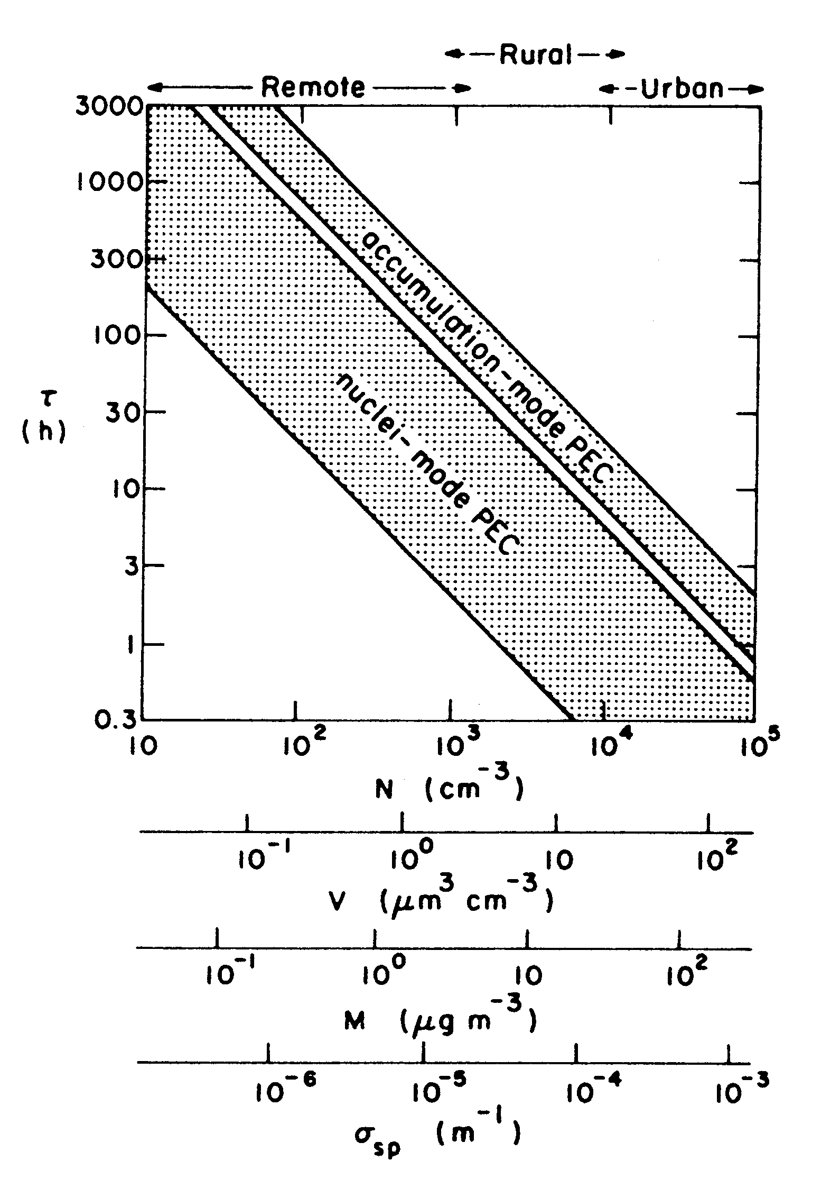
Coagulation Turnover Times (τ=M/F)
Coagulation of EC particles with accumulation mode particles (~0.1-2 μm diameter)
Condensation of vapors (e.g., H₂SO₄) and surface reactions are not included
Source: Ogren et al., 1983

Slide 15
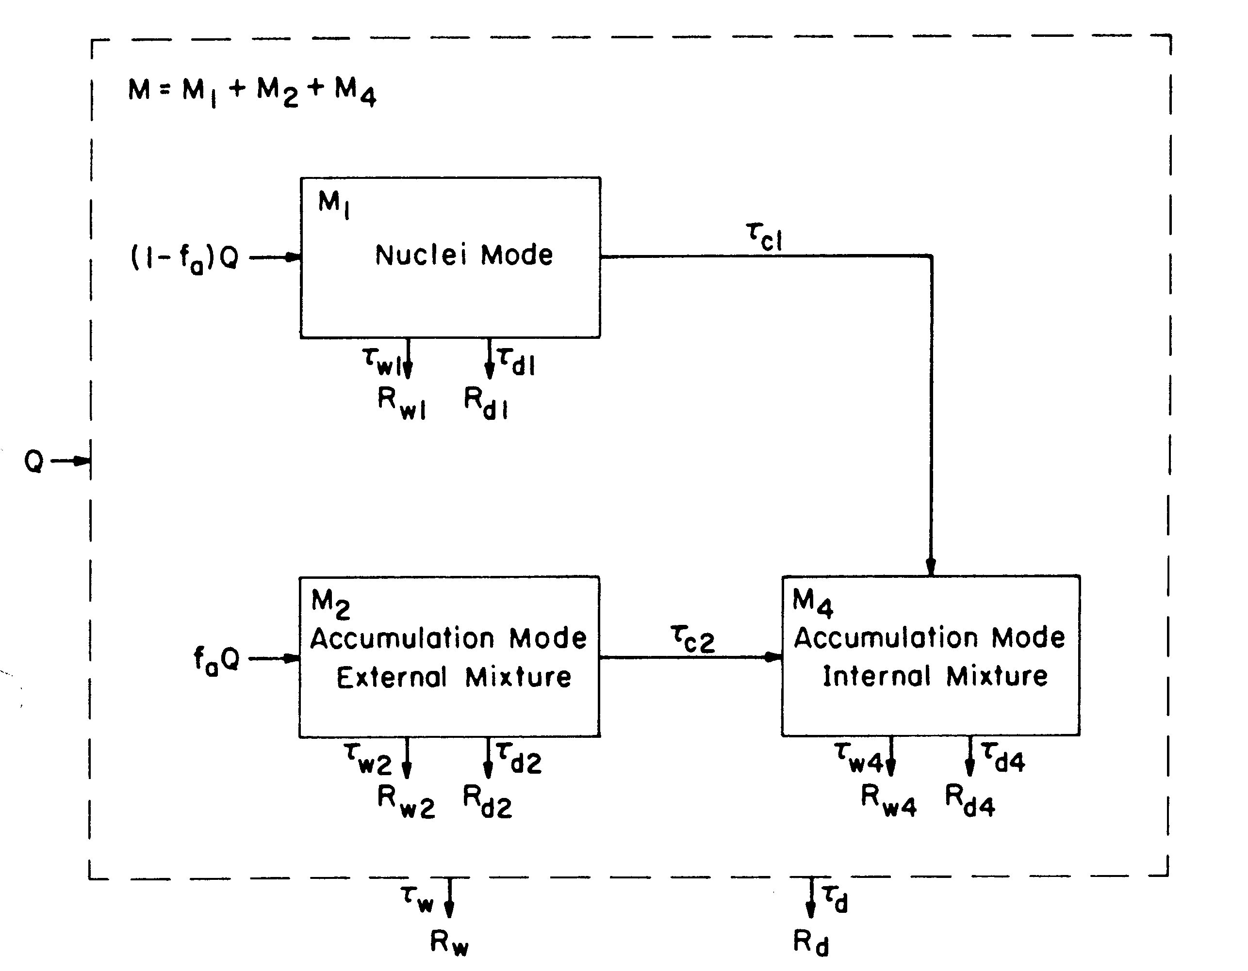
Simplified Box Model of EC Cycle
Ignores cloud processing
Assumes coagulation of nuclei mode particles with accumulation mode dominates turnover time of nuclei mode (i.e., mixing state of nuclei mode particles doesn't matter)
Source: Ogren et al., 1983

Slide 16
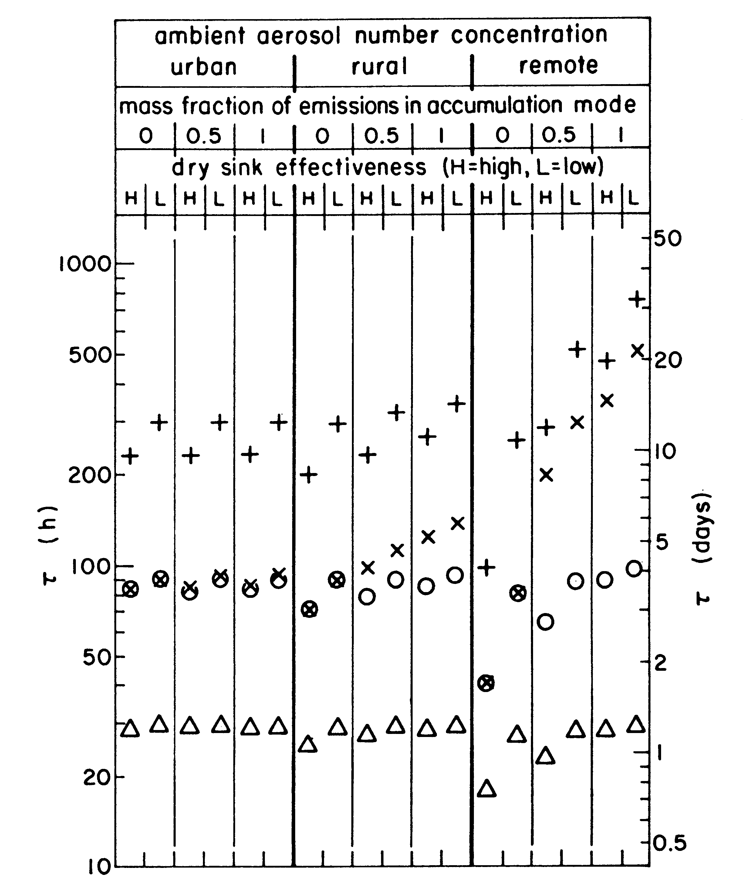
Lifetime of Elemental Carbon from Simple Box Model
Season
  Winter (Δ,x)
  Summer (O,+)
Wet removal
  Effective (Δ,O)
  Ineffective (x,+)
Primary controlling variables are season and wet removal efficiency
Source: Ogren et al., 1983

Slide 17
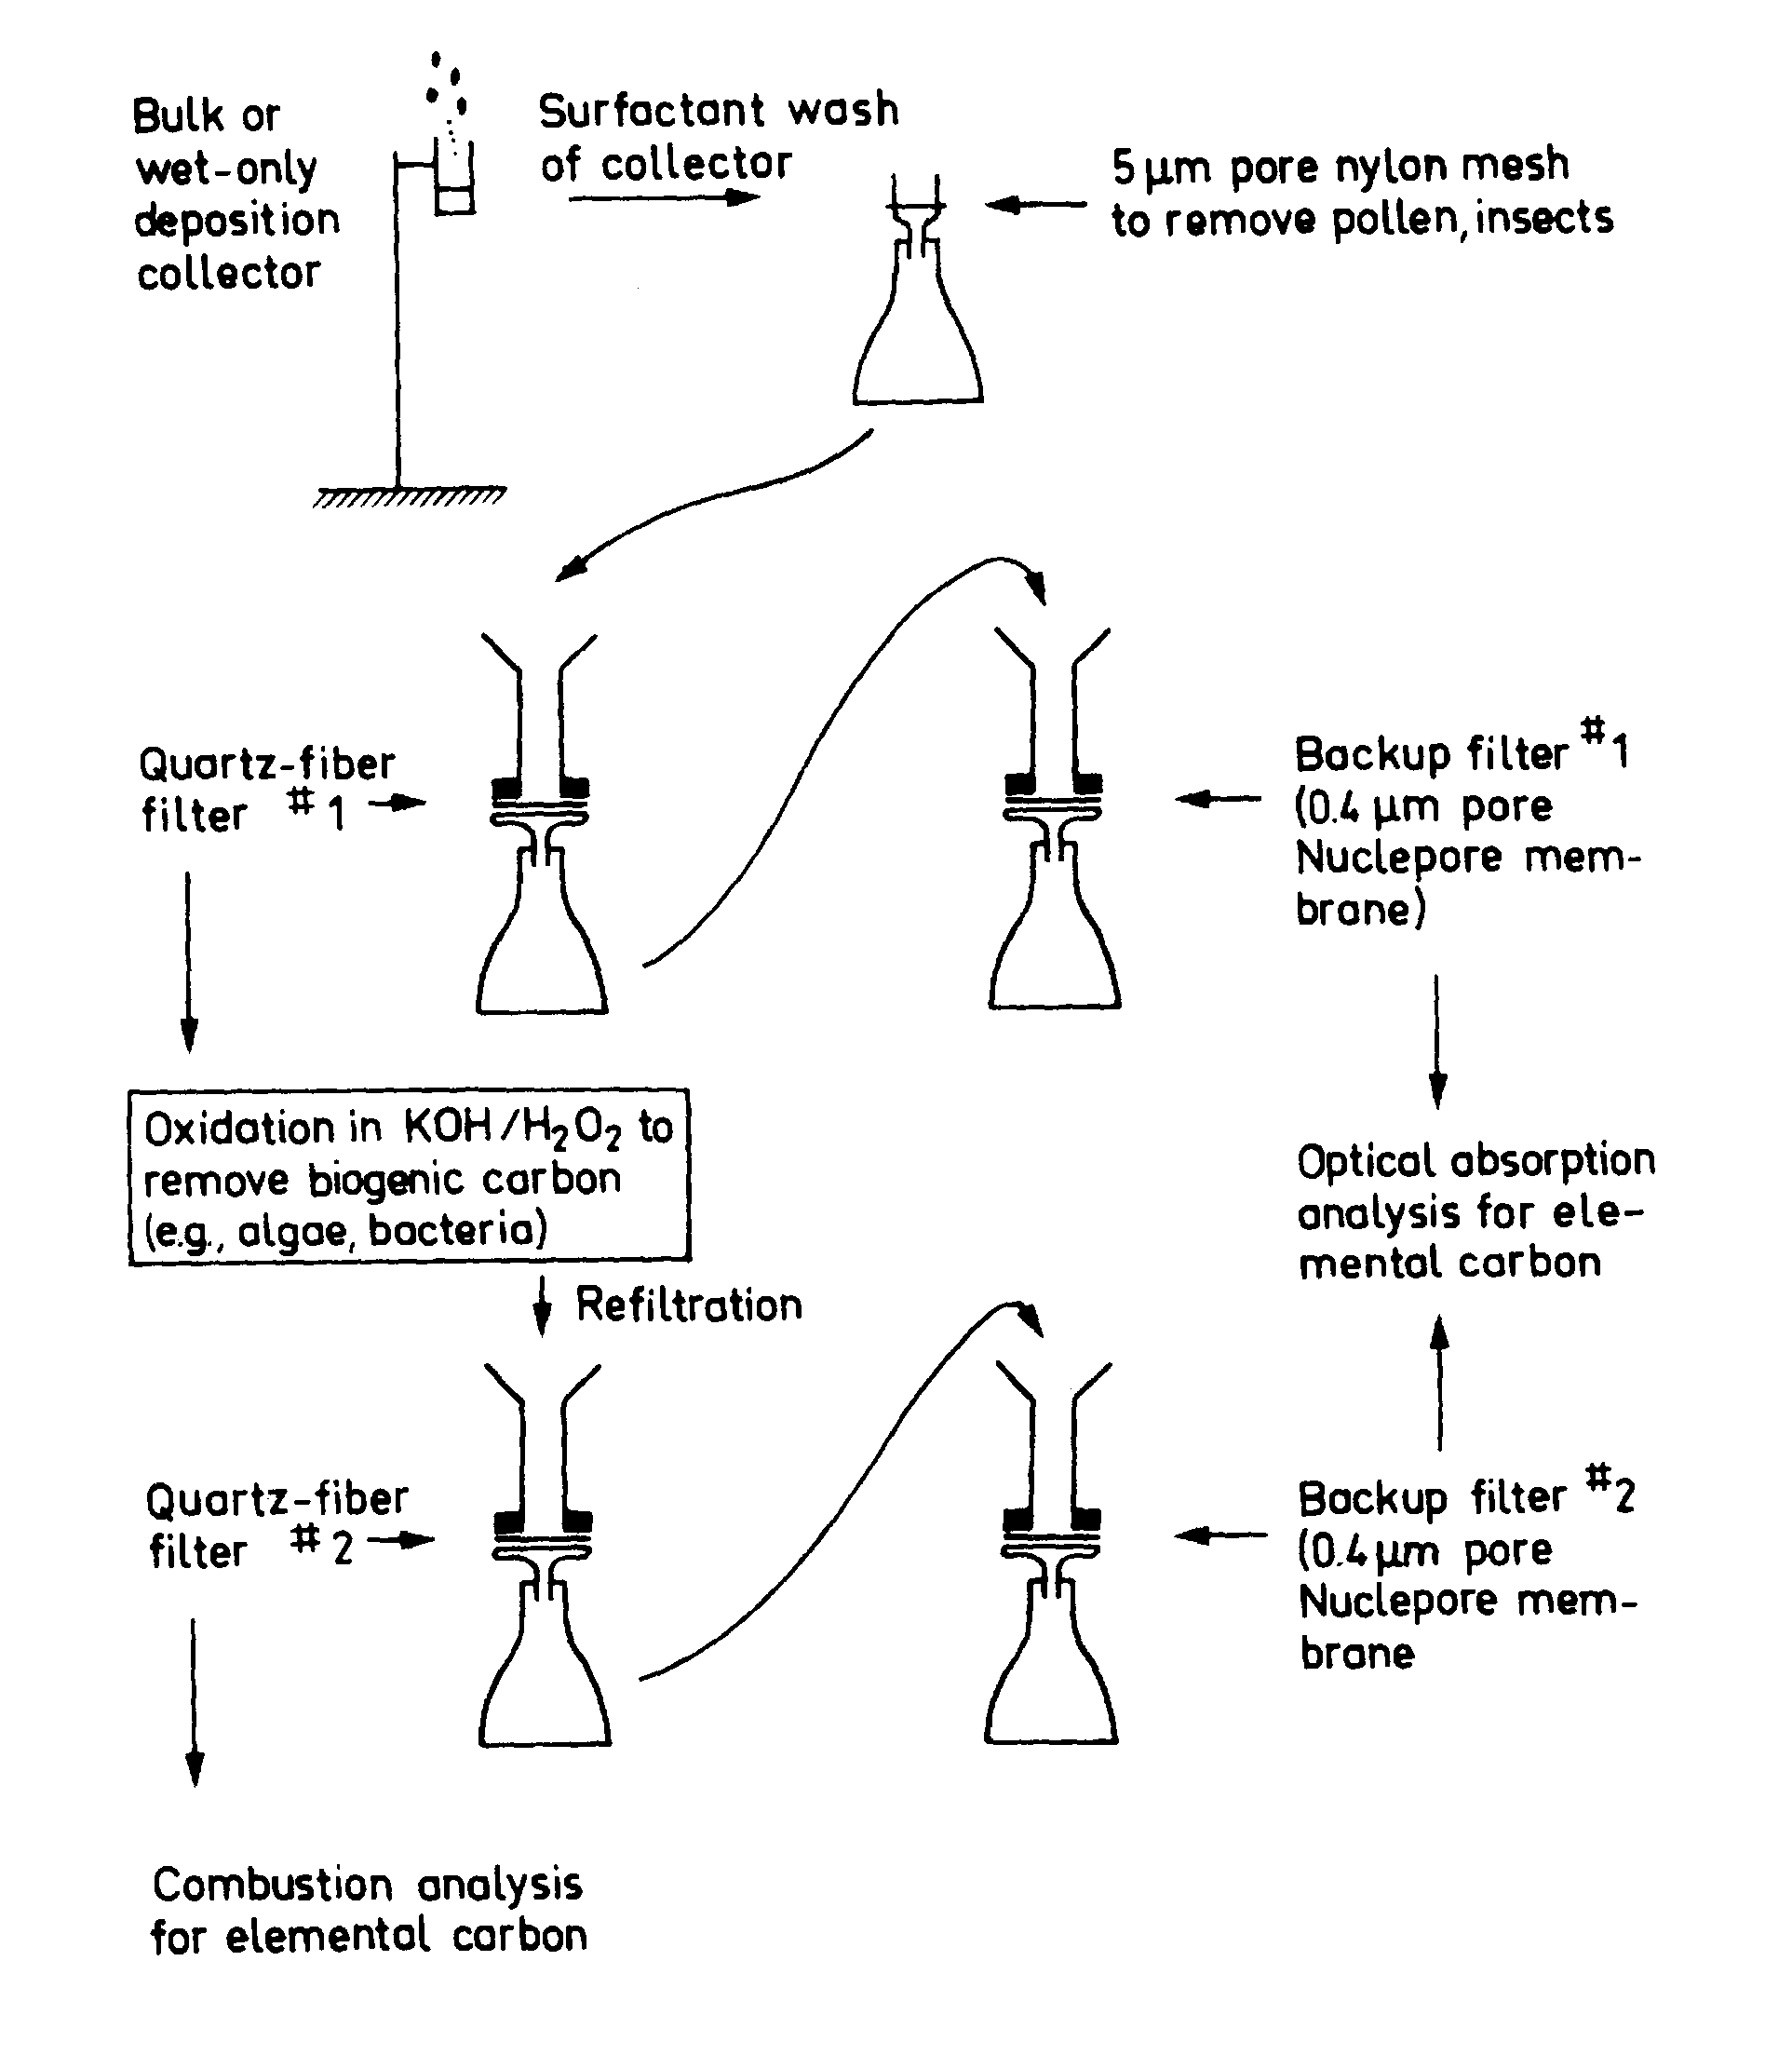
Filtration System for EC in Precipitation
Source: Ogren et al., 1984

Slide 18
Measurements of EC in Precipitation
Month-long samples of snow (April) and rain (August) in Sweden
Typical concentrations were 50-500 μg/L (same as ng/g)
Source: Ogren et al., 1984

Slide 19
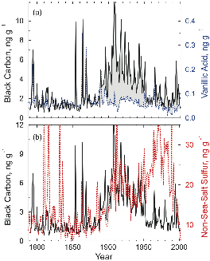
Measurements of BC in Greenland Ice
The shaded region represents the portion of BC attributed to industrial emissions, not boreal forest fires
Large, short-lived increases in nss-S result from explosive volcanism
Source: McConnell et al., 2007
Notes:
long-term changes in BC were greater in winter (red) than summer (black) during the late 19th and early 20th centuries
The shaded region represents the portion of BC attributed to industrial emissions, not boreal forest fires
Large, short-lived increases in nss-S result from explosive volcanism (e.g., Tambora, 1816; Krakatoa, 1883; and Katmai, 1912).

Slide 20
Measurement of Coatings using the Single Particle Soot Photometer (SP2)
Source: J. Schwarz, personal communication

Slide 21
Measurement of Coatings on BC

Slide 22
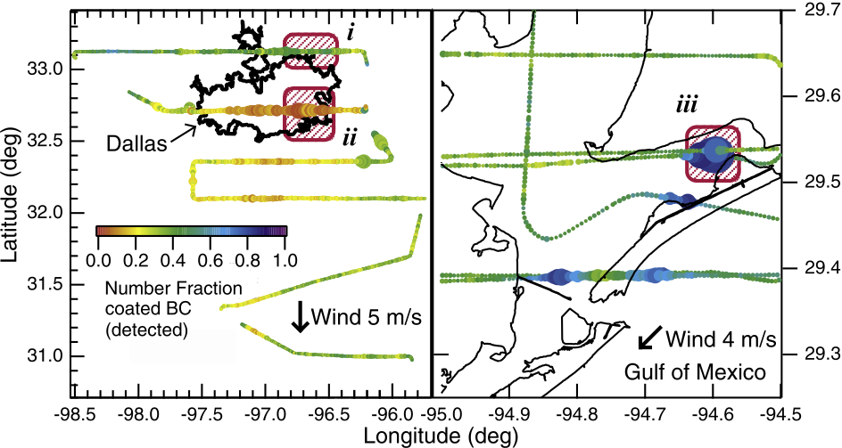
Observations of Coatings in Texas
urban
biomass
Source: Schwarz et al., 2008
Notes:
Portions of the flight path of the NOAA WP-3D research aircraft in the boundary layer on (left) 25 September
2006 and (right) 26 September 2006. The path is marked at 5-s intervals with points colored by the number fraction of
observed BC that was internally mixed in the core size range of 90 – 250 nm VED. The points are sized by the massmixing
ratio of BC in each interval. Highlighted with red crosshatching are (1) the background continental air of
25 September, (2) the analyzed portion of the Dallas urban plume, and (3) the BB plume sampled near the Gulf of Mexico

Slide 23
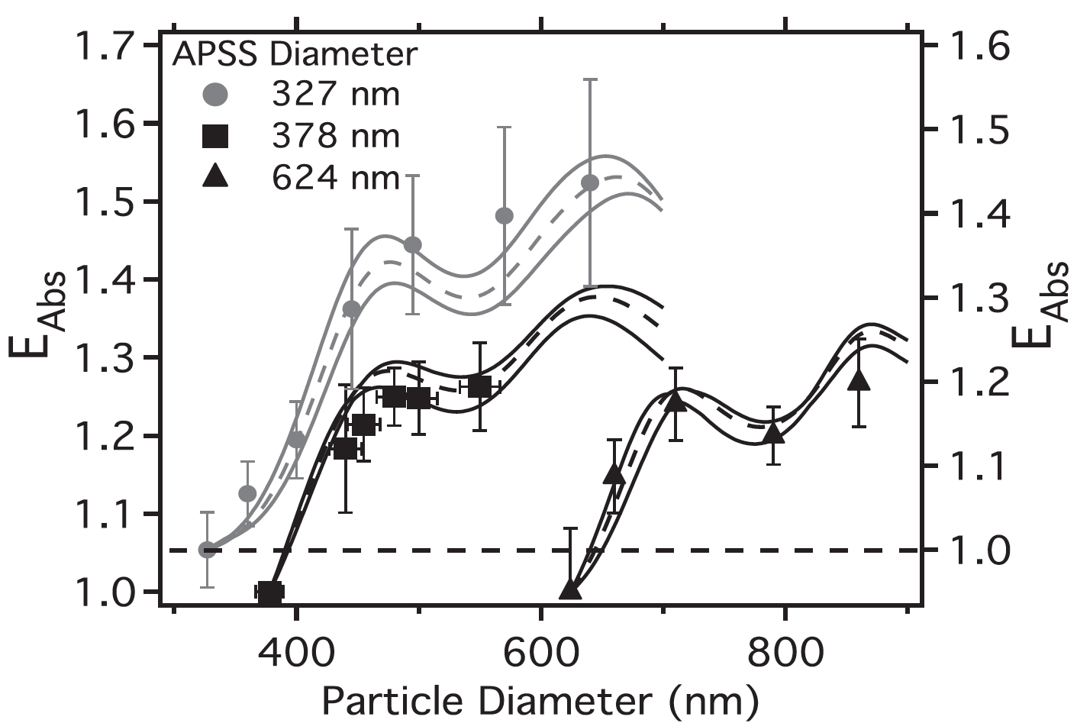
Increase in Absorption by Coating
Source: Lack et al., 2009
Notes:
Absorbing PSL particles were coated with oleic acid

Slide 24
Effects of Cloud Scavenging on Aerosol Optical Properties

Slide 25
Why Does Single-scattering Albedo
Decrease as Pollution Decreases?
white
dark
Notes: Binned, daily mean results for RH<40%, Dp<1μm, and λ=550nm.
BND=Bondville (IL), 1994-2003; SGP=Lamont (OK), 1996-2003; IAP=Lamont (OK) vertical profiles, 2000-2004.

Slide 26
Hypotheses
Aerosol light scattering is dominated by particles that are readily-scavenged by clouds, such as sulfates and water-soluble organics
Aerosol light absorption is dominated by less readily-scavenged particles, such as graphitic carbon (soot)
Cloud droplets are therefore enriched in light scattering particles relative to light absorbing particles
When precipitation falls, it removes more of the light scattering particles than the light absorbing ones
Cloud scavenging therefore systematically decreases aerosol single-scattering albedo

Slide 27
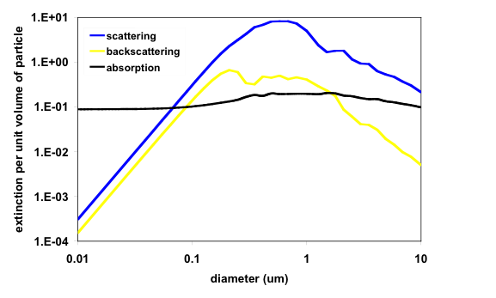
Size-dependence of Extinction Efficiency
Mie calculations for refractive index 1.45-0.005i at 550 nm wavelength

Slide 28
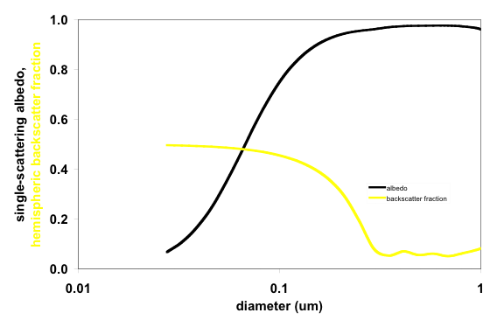
Size-dependence of Aerosol Radiative Properties
Mie calculations for λ=550 nm, m=1.45-0.005i

Slide 29
Cloud Scavenging Decreases Single-scattering Albedo
If the particles are externally mixed
  aerosol light scattering is dominated by particles that are readily-scavenged by clouds, such as sulfates and water-soluble organics
  aerosol light absorption is dominated by less readily-scavenged particles, such as graphitic carbon (soot)
If the particles are internally-mixed
  larger particles are scavenged more efficiently than smaller particles
  the scavenged particles have much higher single-scattering albedos than the smaller particles
Cloud droplets are therefore enriched in light scattering particles relative to light absorbing particles
When precipitation falls, it removes more of the light scattering particles than the light absorbing ones
Cloud scavenging therefore systematically decreases aerosol single-scattering albedo
Notes:
Note change in focus since 1991, in response to global model predictions of sulfate distributions and corresponding forcings.
Change from viewing aerosols as indicators of global change (i.e., response) to agents of global change (i.e., forcing).
Define forcing: an externally imposed perturbation to the radiative balance of the earth. Implies need to separate anthropogenic and natural contributions.
GMCC sites too far away from anthropogenic aerosol source regions, so established regional sites in/near to source regions.

Slide 30
Cloud Scavenging Increases Backscatter Fraction
If the particles are externally or internally mixed
  light scattering efficiency shows a strong size-dependence in the transition region between scavenged and unscavenged particles
  light backscattering scattering efficiency shows a weaker size-dependence in the transition region between scavenged and unscavenged particles
  backscatter fraction shows a very strong size-dependence in the transition region between scavenged and unscavenged particles
Cloud droplets are therefore enriched in light scattering particles relative to light backscattering particles
When precipitation falls, it removes more of the light scattering particles than the light backscattering ones
Cloud scavenging therefore systematically increases aerosol hemispheric backscattering fraction
Notes:
Note change in focus since 1991, in response to global model predictions of sulfate distributions and corresponding forcings.
Change from viewing aerosols as indicators of global change (i.e., response) to agents of global change (i.e., forcing).
Define forcing: an externally imposed perturbation to the radiative balance of the earth. Implies need to separate anthropogenic and natural contributions.
GMCC sites too far away from anthropogenic aerosol source regions, so established regional sites in/near to source regions.

Slide 31
Experimental Approach
Compare σ_{sp}, σ_{bsp}, σ_{ap}, b, and ϖ_{o} before, during, and after cloud events
Use a sampling inlet that excludes cloud droplets, so in-cloud measurements represent the particles that were not scavenged by the clouds
Measure in-cloud visibility as a continuous indicator of the presence of clouds
Field studies:
  Sweden (1250 m asl level on Mt. Åreskutan, 1440 m asl, 63°N, 13°E)
  Chebogue Point, Nova Scotia (10 m asl, 44°N, 66°W)
Notes:
Note change in focus since 1991, in response to global model predictions of sulfate distributions and corresponding forcings.
Change from viewing aerosols as indicators of global change (i.e., response) to agents of global change (i.e., forcing).
Define forcing: an externally imposed perturbation to the radiative balance of the earth. Implies need to separate anthropogenic and natural contributions.
GMCC sites too far away from anthropogenic aerosol source regions, so established regional sites in/near to source regions.

Slide 32
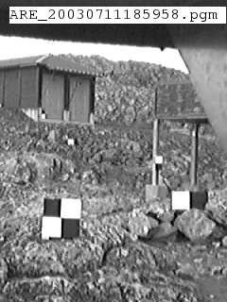
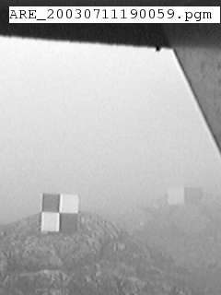
Measuring Clouds with a Webcam
Black/white targets placed at various distances from camera
Clouds decrease the contrast between black and white areas of targets
Contrast reduction is a function of cloud extinction coefficient and distance from camera
Cloud extinction coefficient could be derived every minute nearly 24 hours/day under special lighting conditions of northern Sweden in July
Notes:
Note change in focus since 1991, in response to global model predictions of sulfate distributions and corresponding forcings.
Change from viewing aerosols as indicators of global change (i.e., response) to agents of global change (i.e., forcing).
Define forcing: an externally imposed perturbation to the radiative balance of the earth. Implies need to separate anthropogenic and natural contributions.
GMCC sites too far away from anthropogenic aerosol source regions, so established regional sites in/near to source regions.

Slide 33
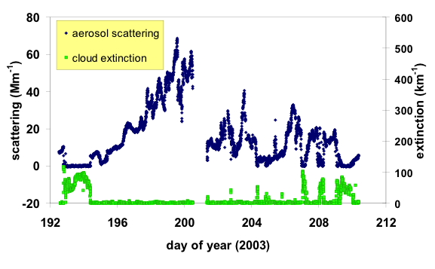
Aerosol Scattering on Åreskutan
Aerosol scattering was near or below detection limits in clouds.

Slide 34
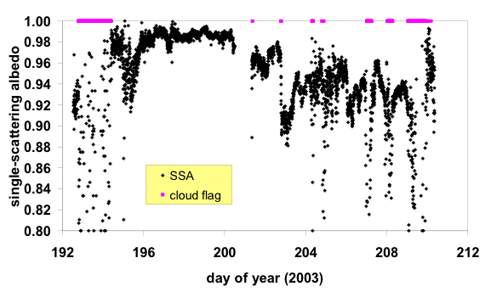
Aerosol SSA on Åreskutan
Single-scattering albedo had values typical of remote continental air, except during cloudy periods. Unusually high SSA values during doy 196-200 were associated with easterly trajectories from Russia, when aerosol mass was primarily organic carbon.

Slide 35
Aerosol SSA during two cloud events
Measurements from Mt. Åreskutan, Sweden (63°N, 13°E)

Slide 36
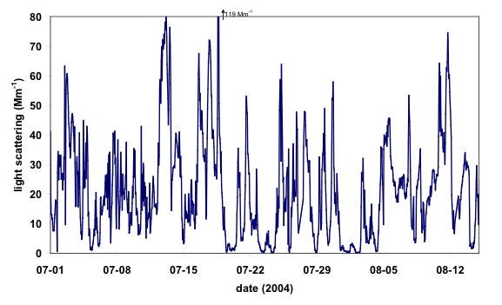
Aerosol Scattering at Chebogue Point
07-04 event
Foggy periods were characterized by strong scavenging of light scattering particles, leading to levels below 5 Mm⁻¹. Measurements at λ=550 nm, D_{p}<10 μm, RH<40%.

Slide 37
Effect of fog on aerosol radiative properties in Nova Scotia
Onset of fog causes strong decrease in light scattering (not shown), modest decrease in light absorption, increase in back-scatter fraction, and decrease in single scattering albedo. Chebogue Point, July 4, 2004.

Slide 38
Summary of Cloud Scavenging Studies
Aerosol light scattering and absorption can both be reduced to near-zero levels in cloudy air
Measurement noise at the near-zero levels limits our ability to draw firm conclusions
The bulk of the evidence from Sweden indicates that single-scattering albedo was lower in cloudy air than in the clear air before and after the cloud events
Virtually all of the evidence from Nova Scotia indicates that single-scattering albedo was lower and backscatter fraction was higher in cloudy air than in the clear air before and after the cloud events
Notes:
Note change in focus since 1991, in response to global model predictions of sulfate distributions and corresponding forcings.
Change from viewing aerosols as indicators of global change (i.e., response) to agents of global change (i.e., forcing).
Define forcing: an externally imposed perturbation to the radiative balance of the earth. Implies need to separate anthropogenic and natural contributions.
GMCC sites too far away from anthropogenic aerosol source regions, so established regional sites in/near to source regions.

Slide 39
Summary
Elemental carbon is the dominant component of the atmospheric light-absorbing aerosol
It is produced by the incomplete combustion of carbonaceous fuels
It is removed primarily by precipitation
Its removal rate and optical absorption are influenced by coatings
  important to consider co-emitted species

