Slide 1
Ground-level aerosol properties from in-situ measurements at GAW stations
John A. Ogren
University of Colorado and
National Oceanic and Atmospheric Administration
Earth System Research Laboratory
Boulder, Colorado, USA
http://www.esrl.noaa.gov/gmd/aero/

Slide 2
Scope of talk
90 minutes, excluding discussion
Define "in-situ" to mean methods that draw a sample of air into an analyzer or collection device
Objective
  give an overview of the in-situ methods used to measure GAW aerosol variables
  describe the techniques used to ensure the quality of GAW in-situ aerosol data

Slide 3
GAW In-situ Aerosol Variables
Chemical (in two size fractions)
  Mass and major chemical components
Optical coefficients at various wavelengths
  Light scattering and hemispheric backscattering
  Light absorption
Physical
  Number size distribution and total concentration
  Cloud condensation nuclei number concentration at various super-saturations
Intermittent
  Detailed, size-fractionated chemical composition
  Dependence on relative humidity

Slide 4
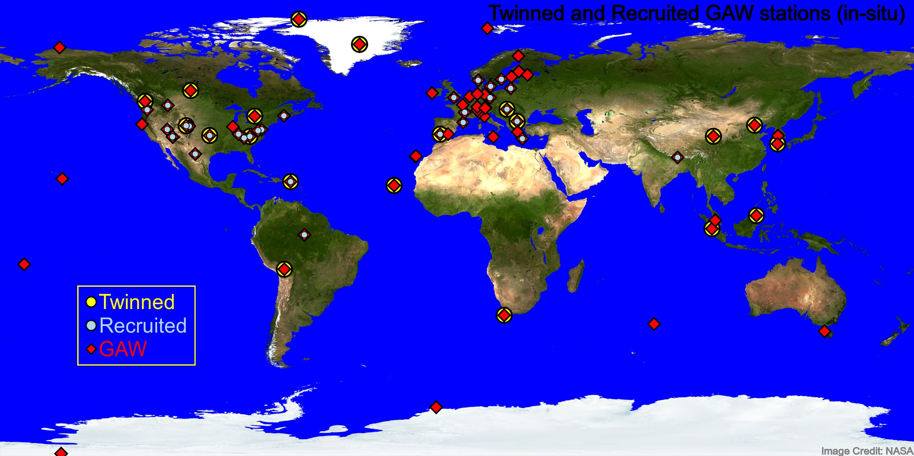
GAW In-situ Aerosol Network
Twinned: Operations supported by GAW Science Advisory Group members
Recruited: Joined GAW through efforts of SAG members
Notes:
We welcome more collaborations, especially in Central and South America, Africa, Central and South Asia

Slide 5
Aerosol Sampling Issues
Key Issues
  any change in the chemical thermodynamic state of the sample air will change the aerosol.
  particle losses (or gains) are size-dependent
RH and size control of sampled aerosol
  heating vs. dilution vs. diffusion driers
    inadvertent vs. deliberate heating
    temperature vs. RH control variable
  inertial vs. diffusive size control
    inadvertent vs. deliberate size control
Examples of particle loss/gain mechanisms
  impaction and diffusion losses in inlet systems
  scrubbing of organic vapors in dilution air changes equilibrium concentration of volatile species in condensed phase
  cooling in adiabatic expansion can lead to growth in mass
  splashing of hydrometeors on inlets in clouds can lead to enhancement of number concentrations
  sub-isokinetic inlets enhance large particle concentrations through inertial enrichment

Slide 6
Key Questions to Ask about Measurements
What is the T, RH, and P of the sample?
  as measured
  as reported
What is the T, RH, and P history during sampling?
  e.g., hysteresis effects
What is the size-dependent efficiency of the sample inlet?

Slide 7
Measurements of number concentration
Grow tiny particles to sizes where they are easily detected
  butanol vs. water as working fluid
  expansion vs. continuous operation
optical detection
  pulse counting from individual particles
  photometric detection of a cloud of particles
absolute calibration
  flow rate
  electrometer measures current from sample of singly-charged particles (hard to do in field)
composition effects
  butanol-based instruments are relatively insensitive to particle composition
  lower detection limit of continuous water CPC's is sensitive to particle composition

Slide 8
Condensation Particle Counter (CPC)
Particles grow to an optically-detectable size by condensation of supersaturated butanol or water vapor
Lower size limit of detection is determined by temperature difference between heated saturator and cooled condenser
Commercial instruments generally have lower size limit of detection of 3-10 nm, depending on the model

Slide 9

CPC Calibration

Slide 10
Measurements of Size Distribution
DMPS/SMPS
  differential mobility particle size spectrometer
  scanning mobility particle size spectrometer
  both select a very narrow size range of particles based on their electrical mobility
  detection is with a CPC
APS
  aerodynamic particle sizer
  particles are accelerated and their resulting change in velocity is related to their aerodynamic size
OPC
  optical particle counter

Slide 11
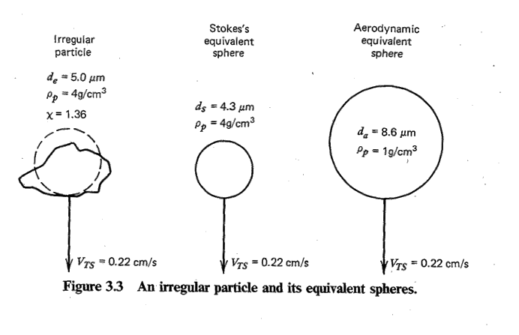
What is the size of a particle?
Beware of radius vs. diameter confusion!
Different sizes
  optical
  electrical mobility
  volume-equivalent sphere
  aerodynamic
  vacuum aerodynamic
Apparent particle size is affected by morphology, density, and refractive index, depending on the measurement method

Slide 12
Differential Mobility Analyzer (DMA)
Only particles with the selected mobility reach the exit slit
The high voltage on the central rod selects the desired mobility diameter
The high voltage is varied to measure the size distribution
Particles are detected with a CPC

Slide 13
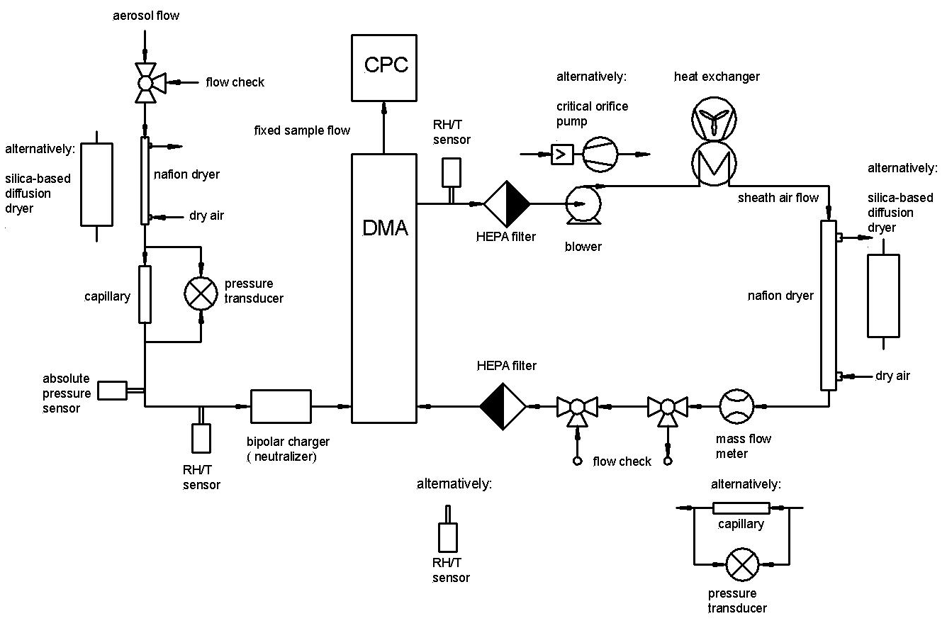
ACTRIS Standard SMPS Set-Up

Slide 14
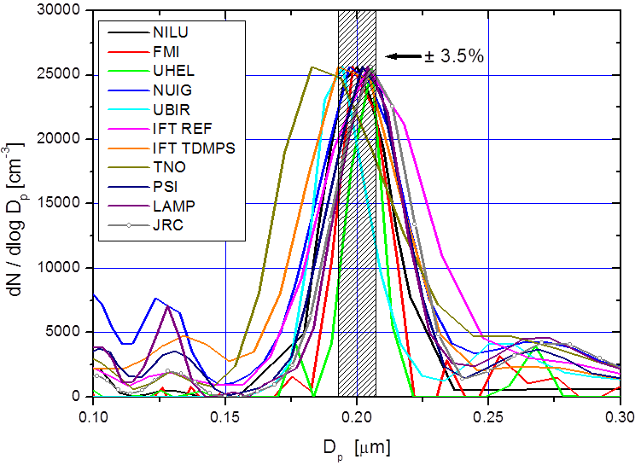
Confirmation of SMPS Sizing
Size of polystyrene latex spheres is measured with an electron microscope

Slide 15
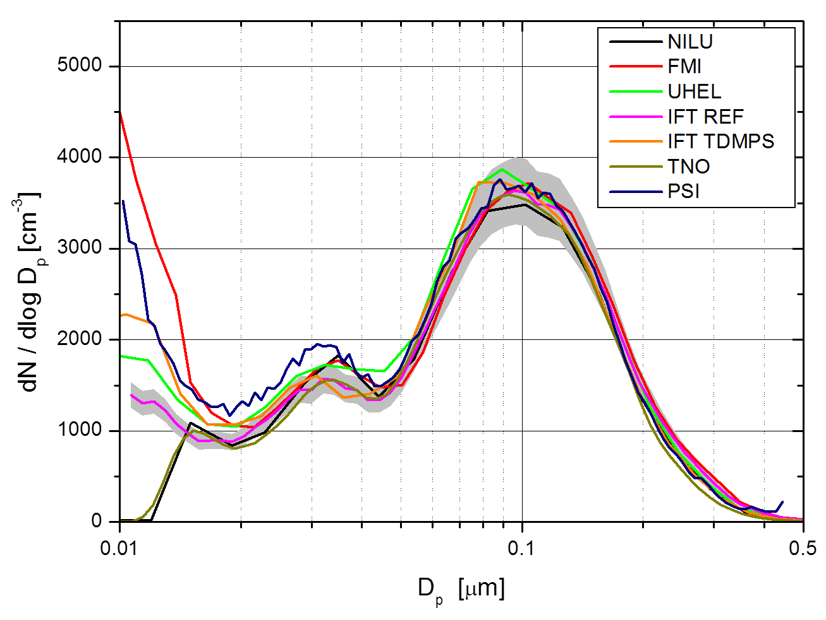
Intercomparison: Number Size Distribution

Slide 16
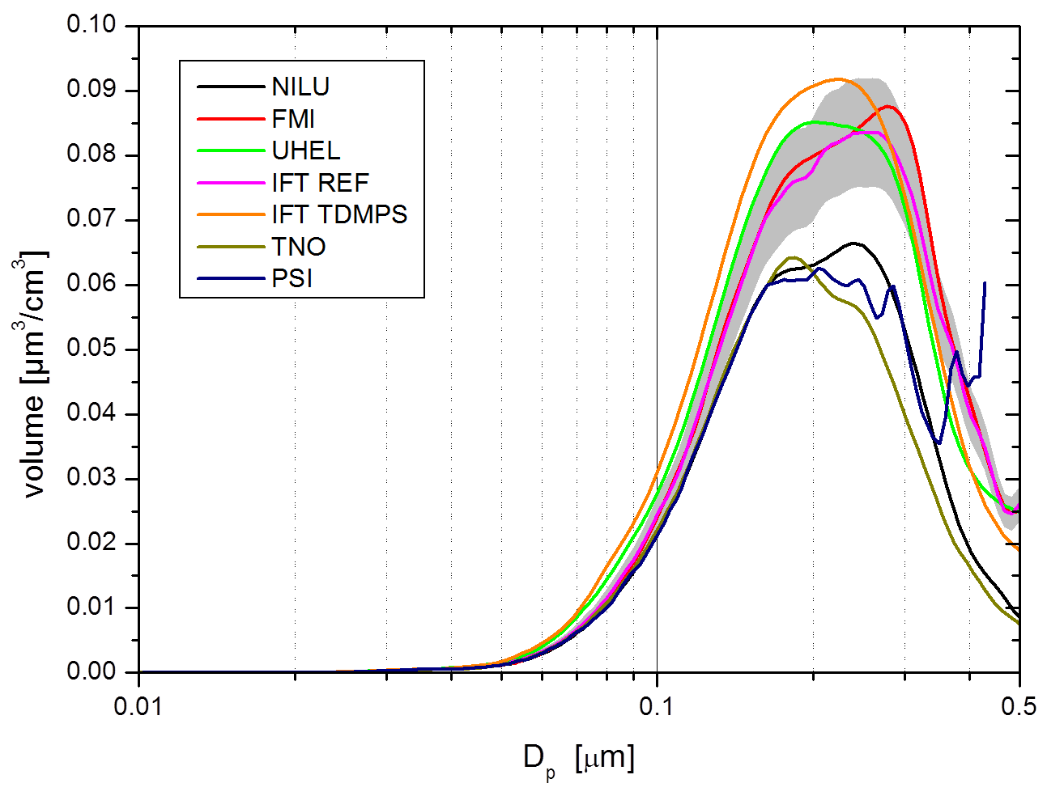
Intercomparison: Volume Size Distribution
Note difference in intercomparison results compared to number size distribution

Slide 17
Intercomparison: Number Size Distribution
Experience gained from repeated intercomparison experiments leads to improved agreement among instruments

Slide 18
Optical Particle Counter (OPC)
OPCs come in a variety of configurations
  Different light sources (laser, laser diode, white light)
  Different optical collection optics

Slide 19
OPC response functions have ambiguity
Depending on optical geometry and particle refractive index, different particle sizes can produce the same signal in an instrument
Heim et al. (2008)

Slide 20
Example of OPC sizing ambiguity
Peak heights of 4-9 (e+3) are associated with particles of 0.7-1.3 μm diameter (solid line)
No size information is available from this OPC for this size range, only total number
Heim et al. (2008)

Slide 21
Aerosol Extensive Radiative Properties
Value of extensive properties depends on amount of aerosol
Extinction coefficient, σ_{ep}(λ)
aerosol cross-sectional area for extinction per unit volume of air (m² m⁻³, 10⁻⁶ m⁻¹ = 1 Mm⁻¹)
Scattering coefficient, σ_{sp}(λ)
Absorption coefficient, σ_{ap}(λ)
180° backscatter coefficient, β_{π}(λ)
Optical depth, τ(λ) =

Slide 22
Extinction and Visibility
extinction = scattering + absorption
σ_{ext} = σ_{sg} + σ_{ag} + σ_{sp} + σ_{ap}
Rayleigh scattering by gases:
σ_{sg}(air) = 12.26 Mm⁻¹ at STP, 550 nm
Absorption by gases (σ_{ag}) is generally negligible except when NO₂ concentrations are high.
Visual range
  typical eye has a
  2% contrast threshold)

Slide 23

Light Scattering, Visibility and Aerosols
Distant visible peak ~100 km?
σ_{ext} ≅ 4 / (100 km) = 40 Mm⁻¹
σ_{ep} ≅ 40 - 15 Mm⁻¹ = 25 Mm⁻¹
σ_{sp} ≅ 23 Mm⁻¹, σ_{ap} ≅ 2 Mm⁻¹

Slide 24
Instrumental Methods
Extinction coefficient, σ_{ep}(λ)
  transmissometer, extinction cell, cavity ringdown, cavity assisted phase shift
Scattering coefficient, σ_{sp}(λ)
  integrating nephelometer, polar nephelometer
Absorption coefficient, σ_{ap}(λ)
  filter transmission (integrating plate, PSAP, Aethalometer, MAAP)
  Photoacoustic

Slide 25
Aerosol Intensive Radiative Properties
Value of intensive properties depends on nature of aerosol (size, chemical comp.)
Single-scattering albedo, ϖ_{o} = σ_{sp} / σ_{ep}
Angular scattering distribution
  phase function, β(φ)
  asymmetry parameter, g = cos(φ)
  hemispheric backscattering fraction, b
Ångström exponent, å = - dlogσ / dlogλ
Hygroscopic growth, f(RH) = σ(RH) / σ(dry)

Slide 26
Measurements of Light Scattering Coefficient
integrating nephelometer
inverse nephelometer
  in photoacoustic absorption instrument
  cavity ringdown extinction instrument
measures count rate from particles as they pass through an illuminated volume
calibrated against known Rayleigh scattering of gases (air, CO₂) at measured T&P
errors: truncation, angular illumination, sample heating

Slide 27
Principle of Integrating Nephelometer
Light source
θ
Apex of scattering cone
Sensor
dv
φ
r
Light source intensity is proportional to cosθ, which gives the sinφ weighting in the integrand.
Conical viewing volume dv increases as r², but intensity of light from dv reaching sensor follows an inverse-square law. The r² and 1/r² dependencies cancel, yielding equal weighting of each linear increment dr.
Source: Butcher and Charlson (1972)

Slide 28
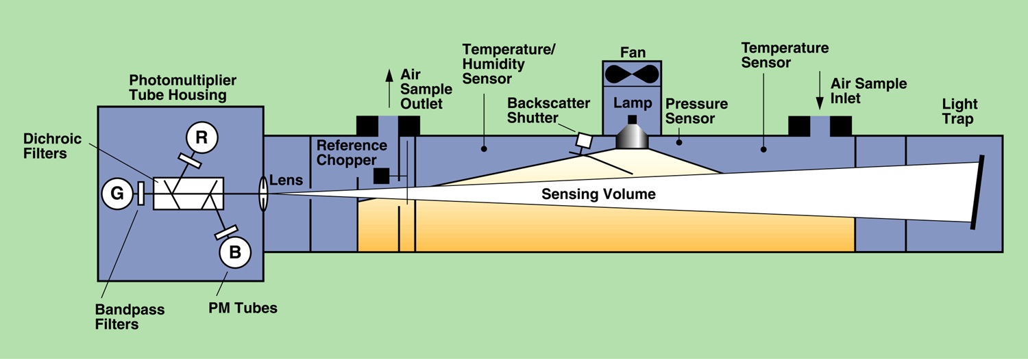
TSI 3563 Integrating Nephelometer
Wavelengths: | 450, 550, 700 nm
Bandwidth: | 40 nm FWHM
Angular range: | 7-170° (total), 90-170° (backscatter)
Sensitivity: | 2-3 x 10⁻⁷ m⁻¹ (60-sec average)
Source: TSI, Inc.

Slide 29
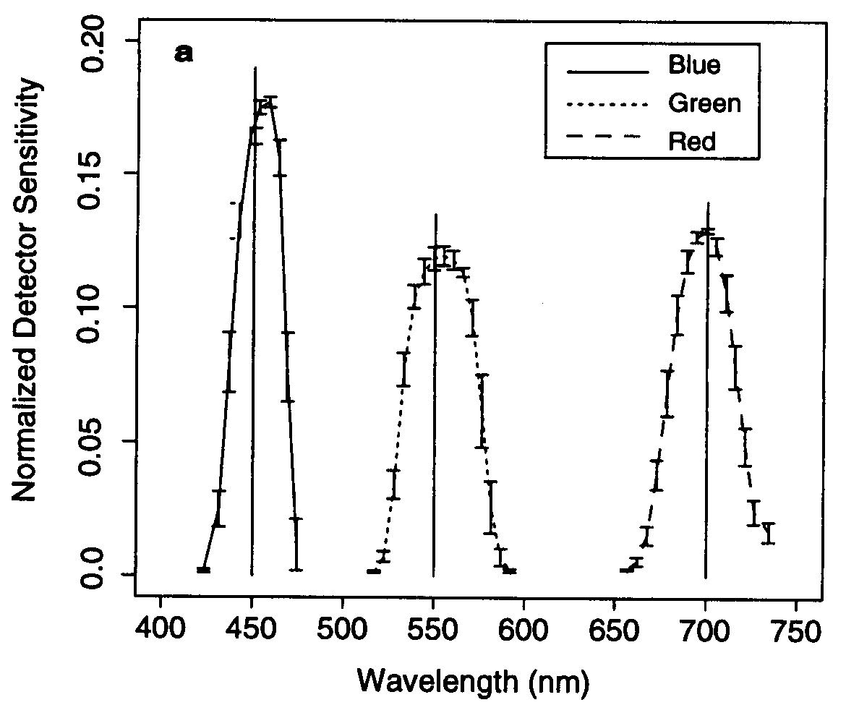
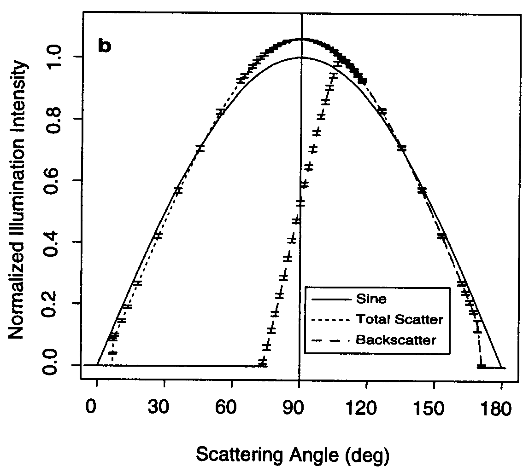
TSI Nephelometer Non-Idealities
wavelength response
angular response
Source: Anderson et al. (1996)

Slide 30
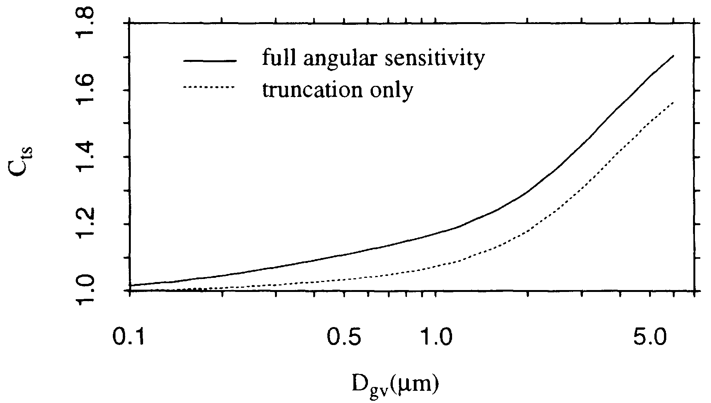
TSI Nephelometer Angular Errors
This error is a consequence of calibration with Rayleigh scattering vs. measurement of Mie scattering particles

Slide 31
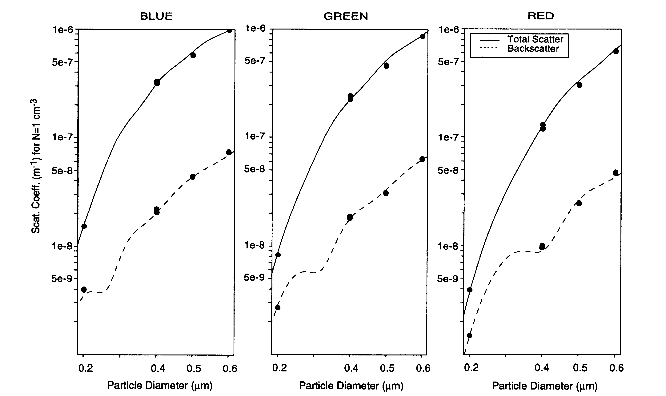
Measured (points) vs. Calculated (lines) Response of TSI Nephelometer
Source: Anderson et al. (1996)

Slide 32
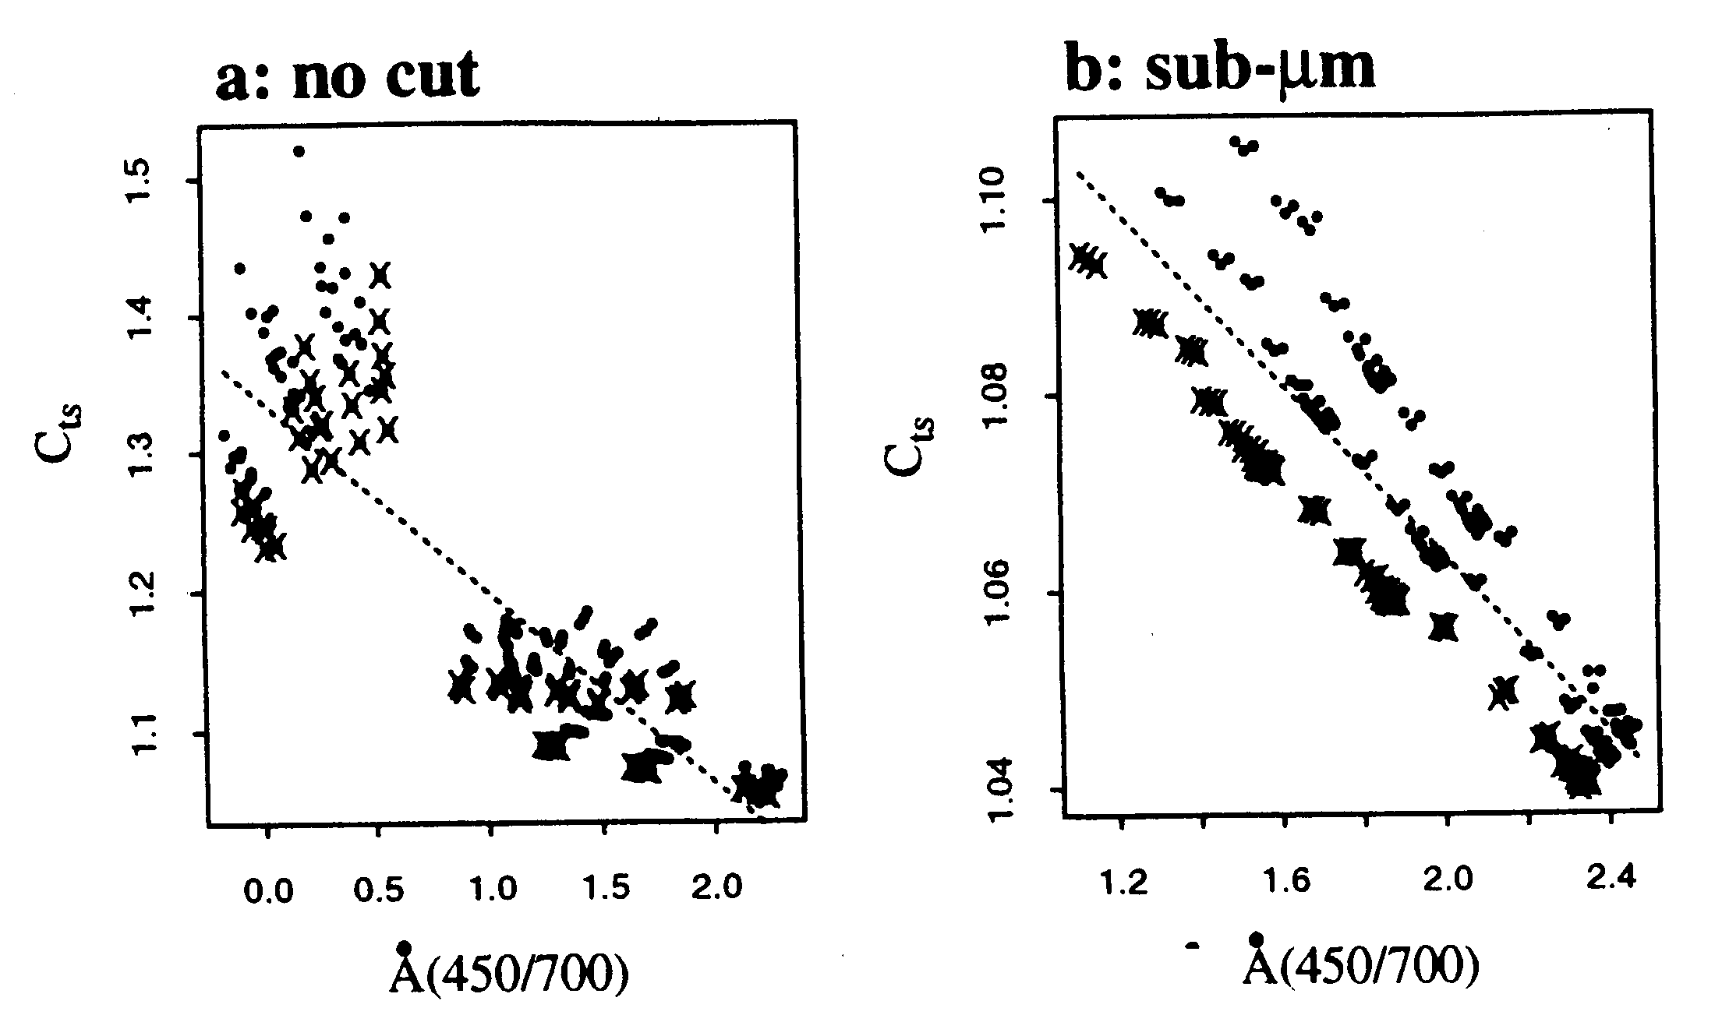
Nephelometer Truncation Corrections
Source: Anderson and Ogren (1998)
Notes:
Trend up to 1991 published by Bodhaine & Dutton. They attributed likely cause of 1982-1991 decrease to changes in emissions from FSU.
Subsequent flattening out of “trend” illustrates need to continue monitoring to follow up apparent trends. Could it just be that 1982-1987 were anomalies?
Followup analysis being done as part of NOAA Arctic Research Initiative.
No other obvious trends at baseline stations..
Aerosol properties at baseline sites show clear seasonality, reflecting seasonal changes in sources and sinks.

Slide 33
Measurements of Light Absorption Coefficient
Filter-based
  PSAP (particle/soot absorption photometer)
  Aethalometer
    broadband
    spectral
  MAAP (multi-angle absorption photometer)
  correction schemes
  comparison results
  "yellow beads" – sensitivity to liquid aerosols
  heated inlet (Kondo, 2009, AS&T)
"Direct"
  photoacoustic
  photothermal interferometer

Slide 34
Filter Methods for Light Absorption
Particles are deposited on the filter, which is a light-diffusing, multiple scattering substrate.
Light absorbing particles reduce the light power at the photodetector.
Ideally, light scattering particles don't reduce power.
Variants:
  Time-integrated: integrating plate method, integrating sphere, integrating sandwich
  Continuous: aethalometer, PSAP, MAAP

Slide 35
Calculating Light Absorption on Filters
I(t) = photodetector signal measured at time t
A = area of particle deposit on filter
Q = sample flowrate
k = calibration factor
  k = 1 for an ideal instrument
  k ~ 1/2 for fiber filters, varies with filter type
  and particle loading on filter
  most instruments show a dependence on scattering by the particles (IPM, PSAP, aethalometer)

Slide 36
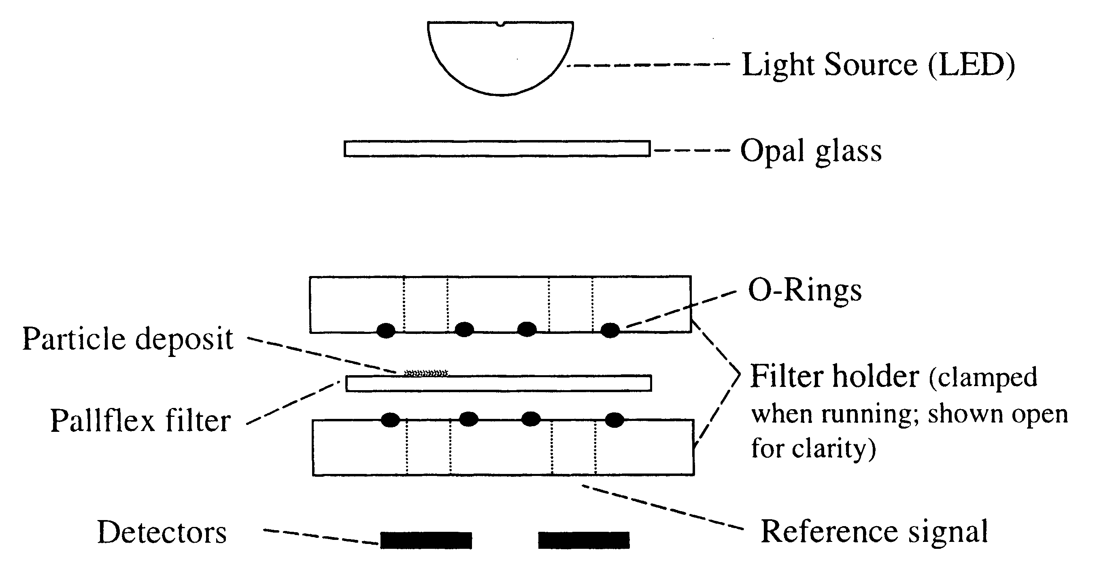
PSAP Optical Configuration
sample
reference
Source: Bond et al. (1999)

Slide 37
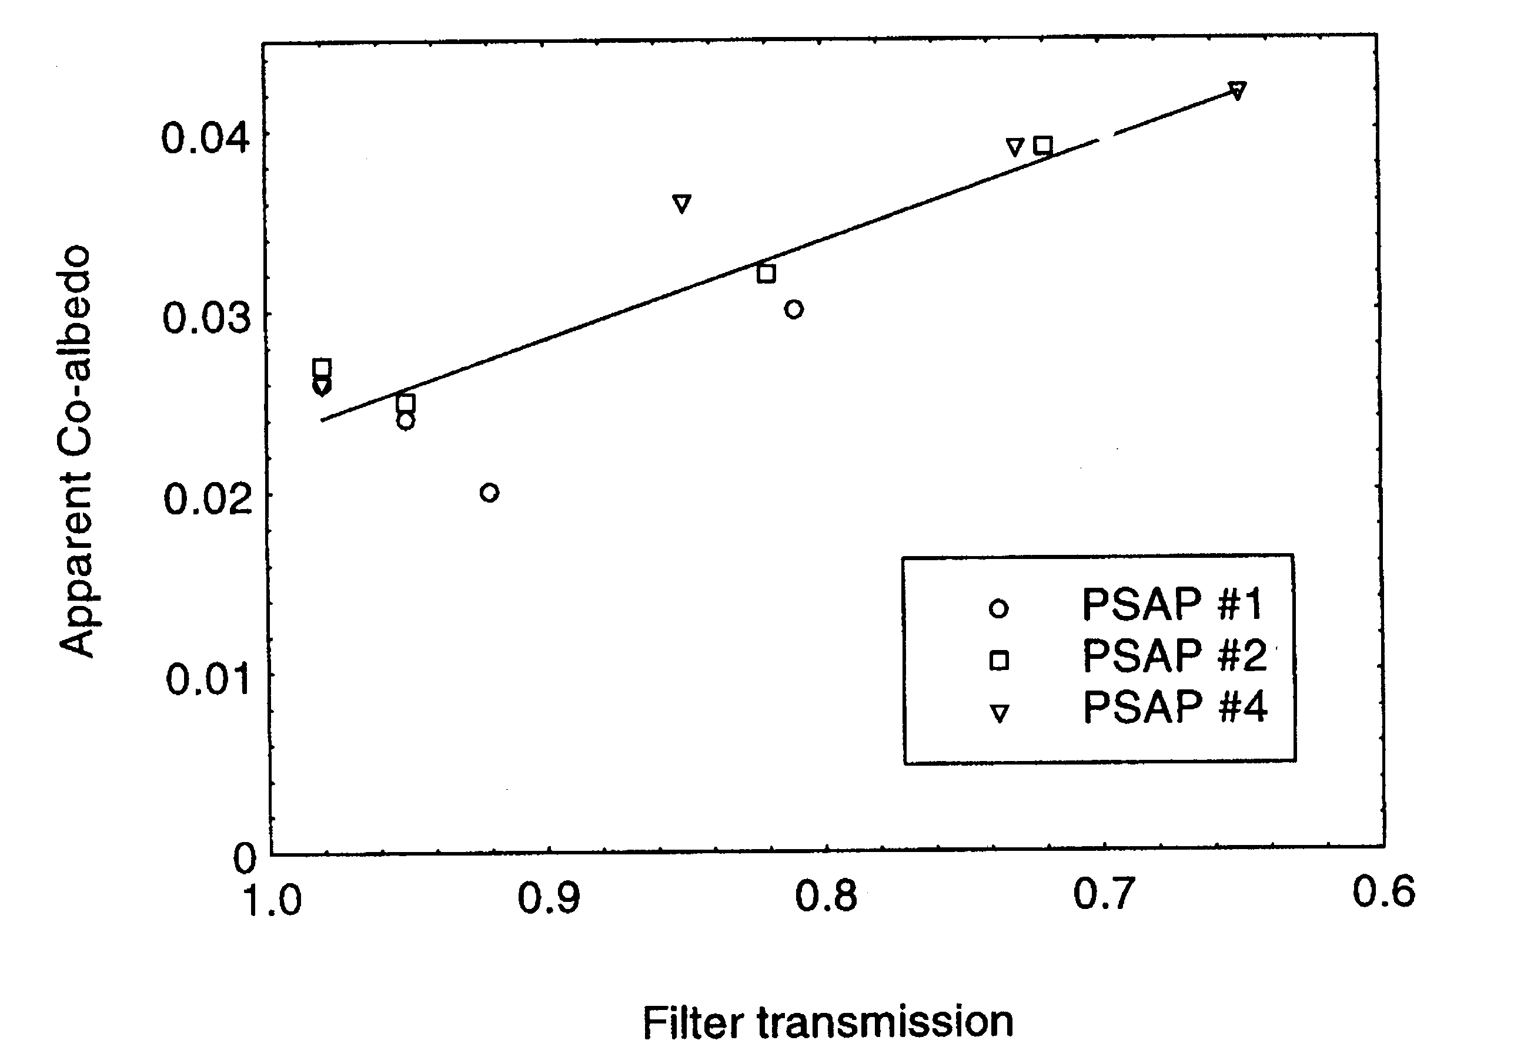
PSAP Response to Non-Absorbing Particles Depends on Filter Loading
Source: Bond et al. (1999)
Notes:
Trend up to 1991 published by Bodhaine & Dutton. They attributed likely cause of 1982-1991 decrease to changes in emissions from FSU.
Subsequent flattening out of “trend” illustrates need to continue monitoring to follow up apparent trends. Could it just be that 1982-1987 were anomalies?
Followup analysis being done as part of NOAA Arctic Research Initiative.
No other obvious trends at baseline stations..
Aerosol properties at baseline sites show clear seasonality, reflecting seasonal changes in sources and sinks.

Slide 38
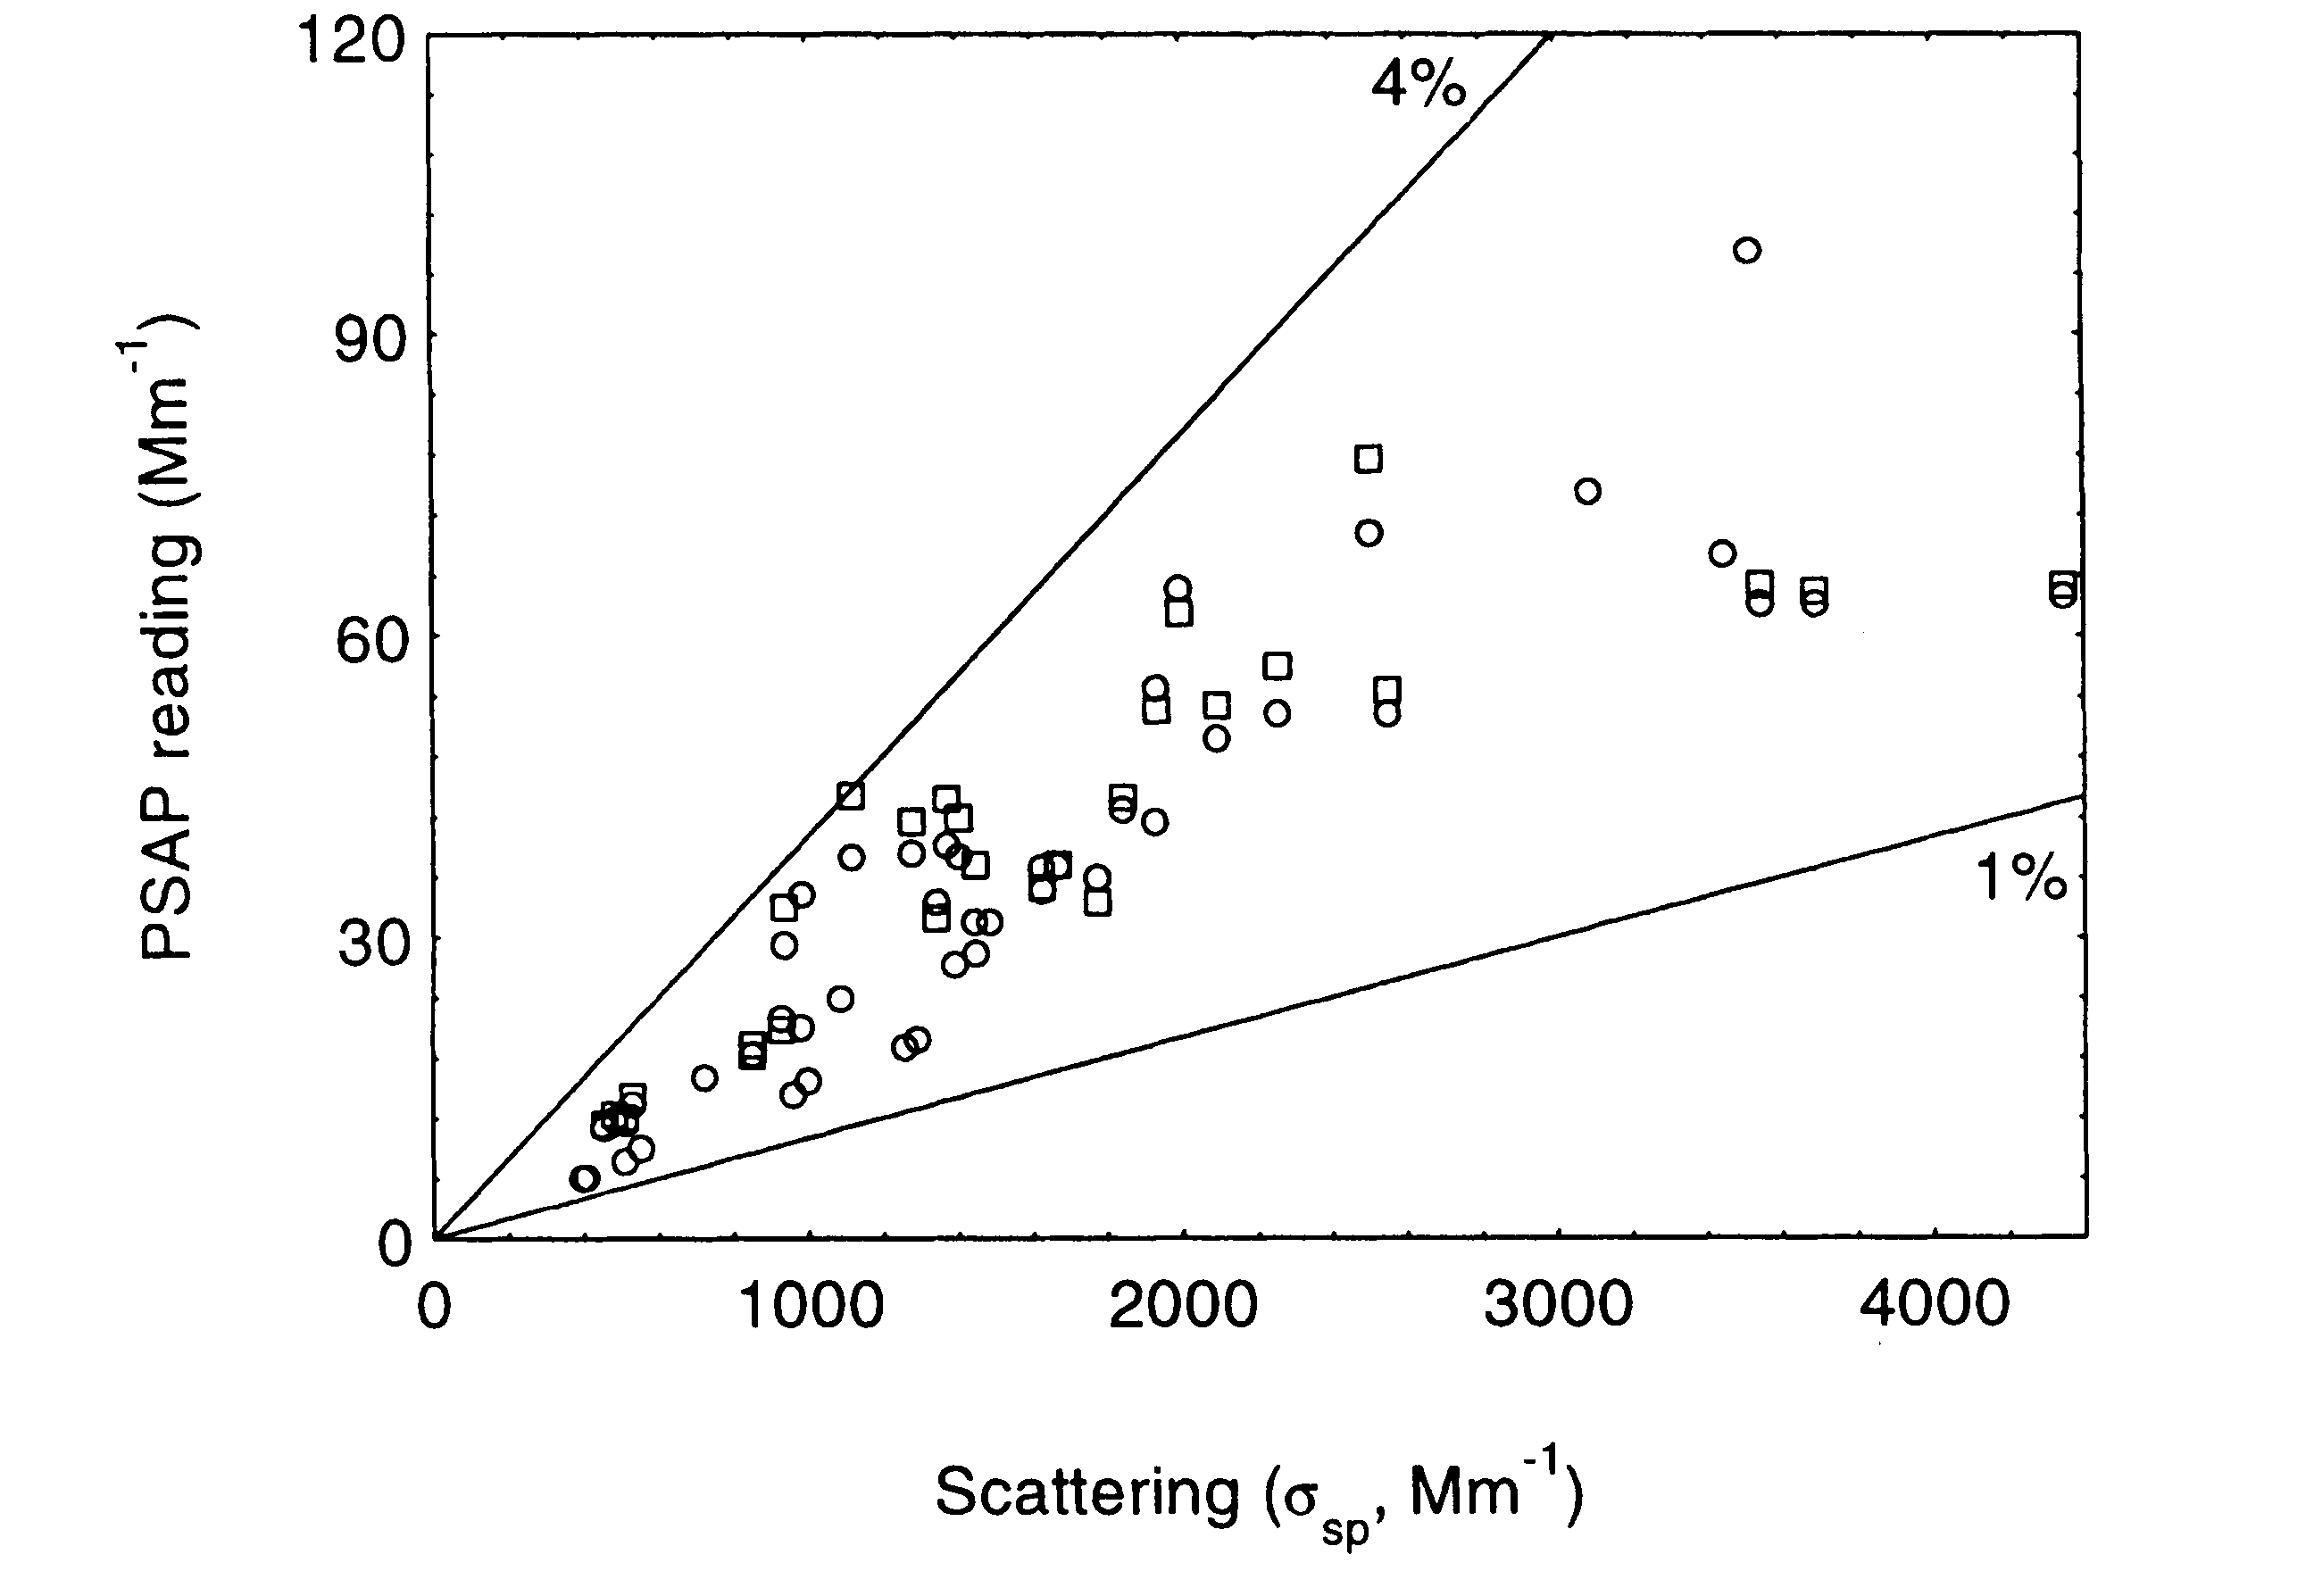
PSAP Response to Scattering
Source: Bond et al. (1999)
Notes:
Trend up to 1991 published by Bodhaine & Dutton. They attributed likely cause of 1982-1991 decrease to changes in emissions from FSU.
Subsequent flattening out of “trend” illustrates need to continue monitoring to follow up apparent trends. Could it just be that 1982-1987 were anomalies?
Followup analysis being done as part of NOAA Arctic Research Initiative.
No other obvious trends at baseline stations..
Aerosol properties at baseline sites show clear seasonality, reflecting seasonal changes in sources and sinks.

Slide 39
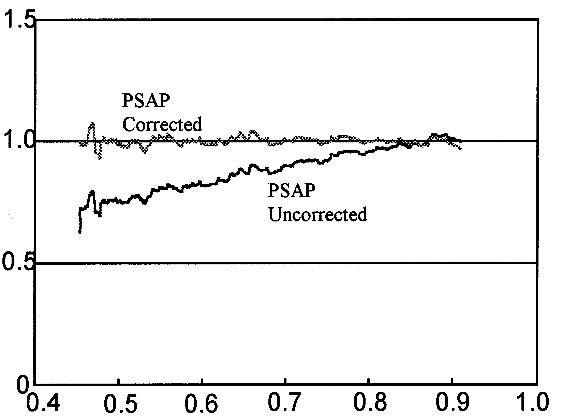
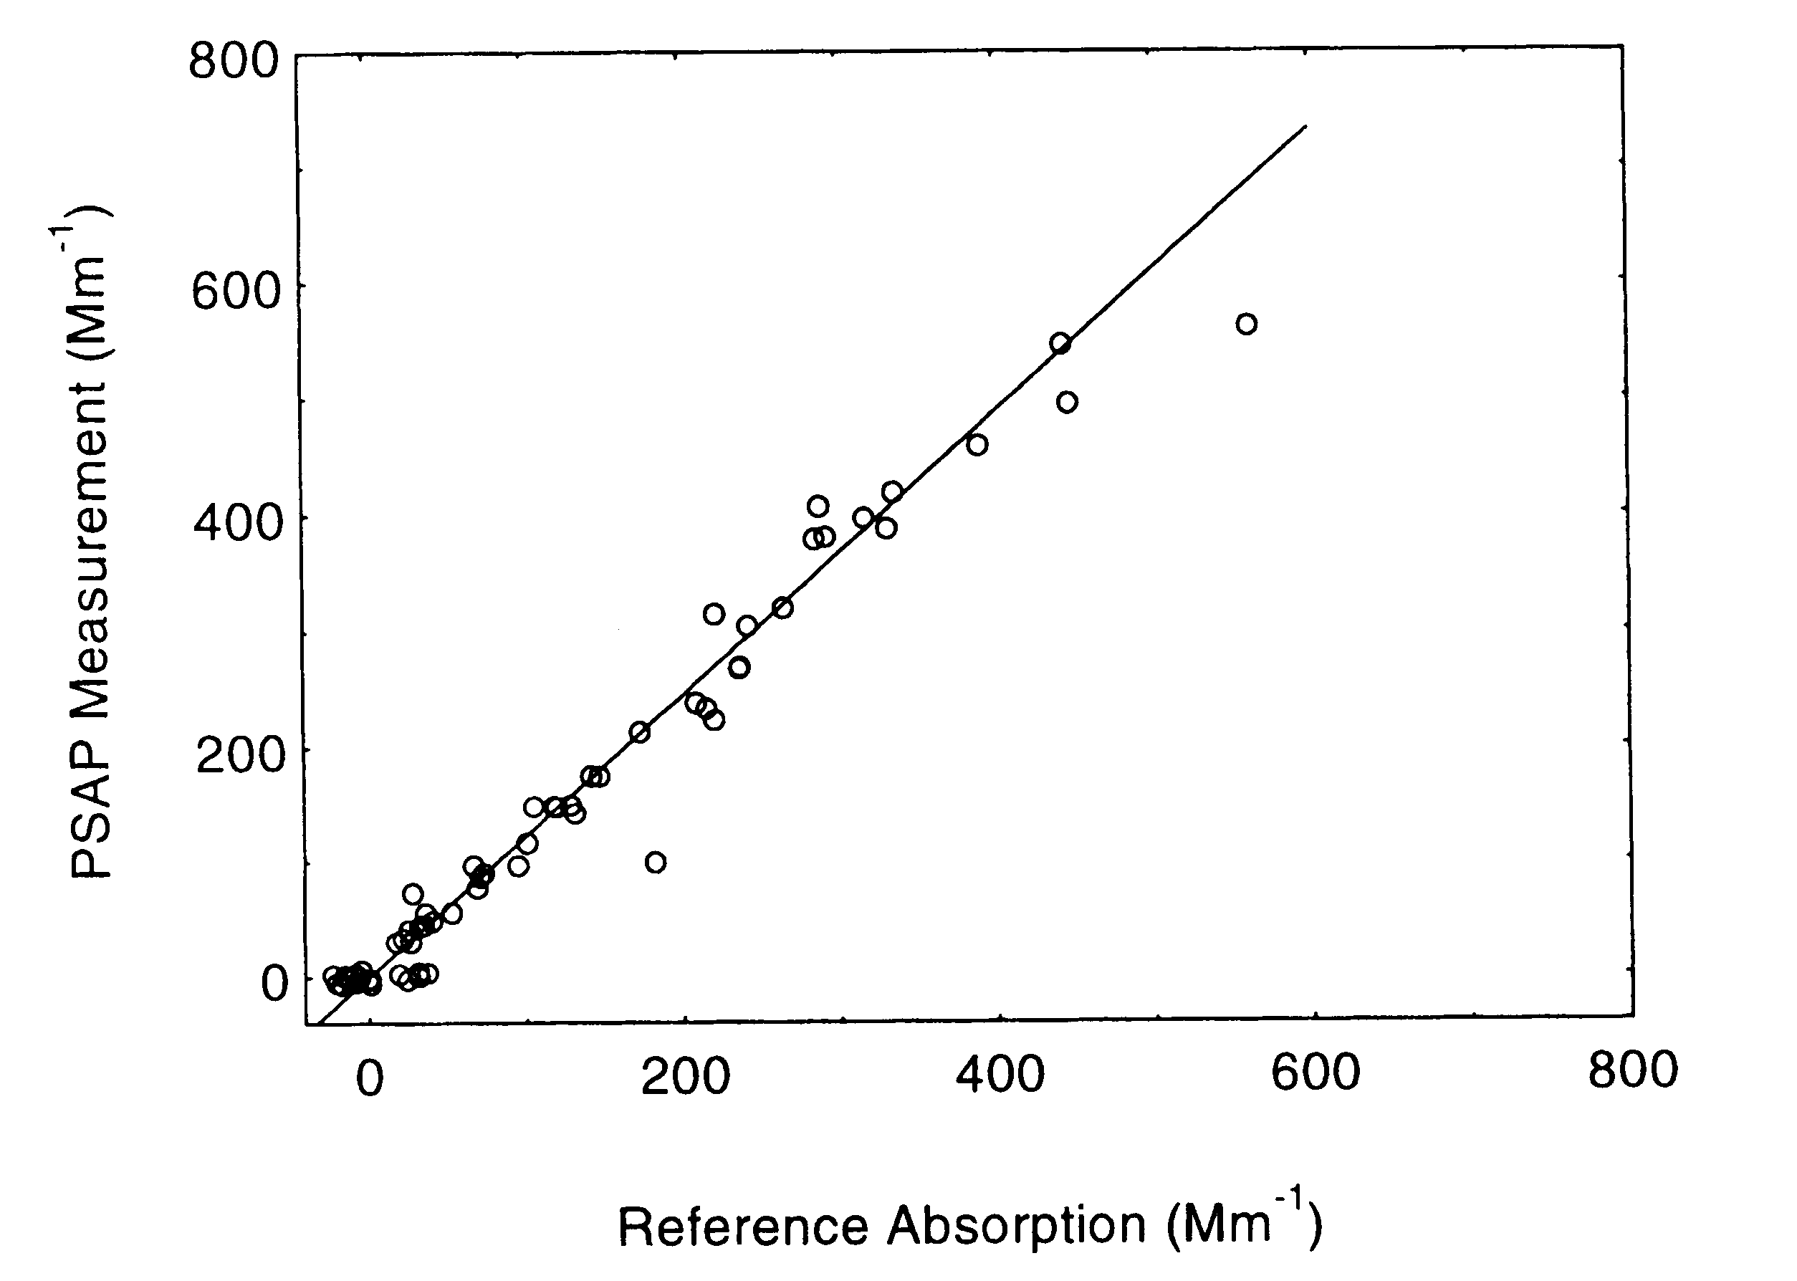
Current PSAP Correction Factors
Slope=1.22
with 2% of σ_{sp} subtracted
σ_{ap}(PSAP)/σ_{ap}(TRUE)
filter transmittance
Manufacturer’s built-in calibration
(Weiss, unpublished)
Bond et al. (1999)

Slide 40
Aethalometer response vs. time
Separate runs with pure soot (σ_{ext}~800 Mm⁻¹) and ammonium sulfate (σ_{ext}~450 Mm⁻¹). Photoacoustic wavelength 532 nm, aethalometer wavelength 521 nm.

Slide 41
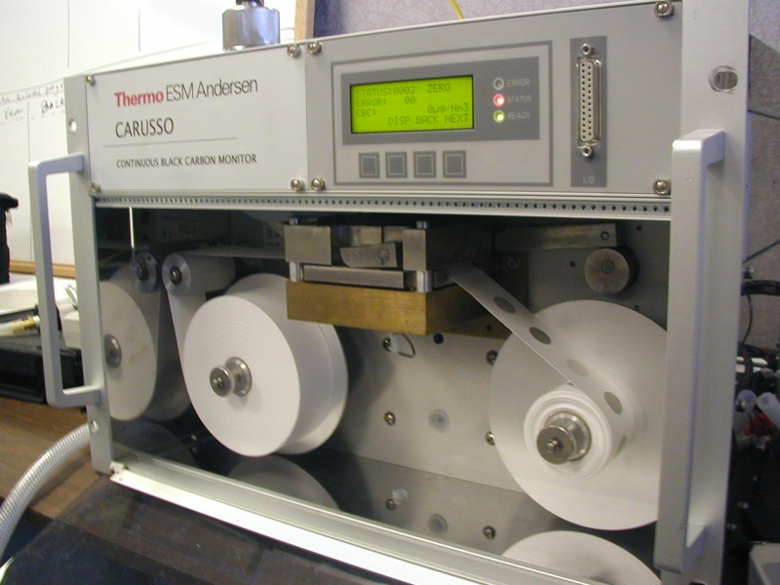
Multi-Angle Absorption Photometer
"MAAP"
Simultaneously measures light (670 nm) transmitted and reflected by aerosol deposit on filter
A two-stream radiative transfer model is used to derive the aerosol absorption coefficient, accounting for light scattering by particles and filter.
Detection limit ~ 1 Mm⁻¹ for 2-minute average at 16.7 lpm flowrate.
Source: A. Petzold¹ , M. Schönlinner² , H.Kramer² and H. Schloesser²
¹German Aerospace Center, Oberpfaffenhofen, Germany
²ESM Andersen Instruments, Erlangen, Germany

Slide 42
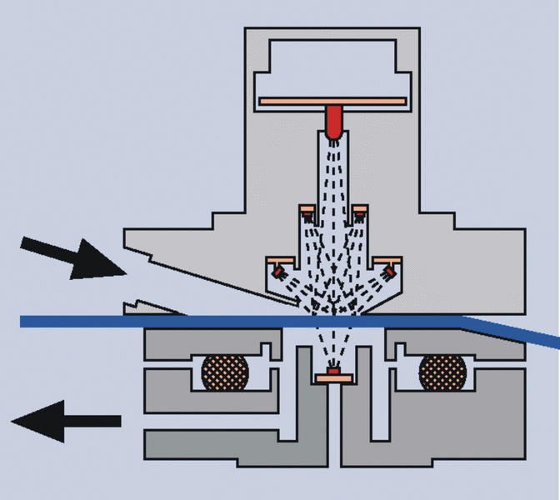
MAAP Optical Configuration
Source: A. Petzold¹ , M. Schönlinner² , H.Kramer² and H. Schloesser²
¹German Aerospace Center, Oberpfaffenhofen, Germany
²ESM Andersen Instruments, Erlangen, Germany

Slide 43
Summary of Filter-based Absorption
Filter spot size and flow rate must be individually calibrated for each instrument
Corrections are required for non-ideal responses of instrument to
  scattering by particles (requires scattering measurement)
  attenuation of light by deposited particles ("shadowing")
Correction schemes
  PSAP: Bond (1999, AS&T)
  Aeth: Collaud Coen (2010, AMT)
  MAAP: done internally, Petzold (2004, J. Aerosol Sci.)
  improvements are coming

Slide 44
Photoacoustic Absorption Measurement
Laser light is power modulated by the chopper.
Light absorbing aerosols convert light to heat, producing a sound wave. No response to light scattering.
Microphone signal at chopper frequency is a measure of the light absorption.
Calibrated by absorption by gases (NO₂, O₃), monodisperse particles, or light extinction

Slide 45
Measurements of Extinction Coefficient
long-path cell (Virkkula, 2005, AS&T)
cavity ring-down (Baynard, 2007, AS&T)
cavity assisted phase shift (Massoli, 2010, AS&T)
Fundamental calibration is geometric path length
measure difference in light extinction between sample air and filtered sample air

Slide 46
U.W. Optical Extinction Cell
Purge air in
Outlet
Sample in
Outlet
Purge air in
Plug
Plug
460 nm
540 nm
660 nm
LEDs
DR
O
2
O
1
L
2
L
1
D
2
BS
M
D
1
PT
DS
HD
HD
2
1
F
2
F
1
130’’=330.2 cm
144’’=366 cm
L = 660 cm
Source: Virkkula et al. (2005)

Slide 47
What is Cavity Ringdown (CRD)?
input pulse
ringdown cavity
output signal
time
input pulse width ~ 20 nanoseconds
mirror reflectivity > 99.995%
ring-down time 5-100 microseconds
extinction coefficient derived from fitting an exponential function to decay of output signal
some variants measure scattering coefficient simultaneously

Slide 48
DRI CRD Extinction Instrument
extinction measured at 532 nm
effective path length ~10 km
Source: Moosmüller et al. (2005)

Slide 49
Hygroscopic Growth Measurements
Diameter growth
  HTDMA
Scattering growth
  humidograph
CCN concentration
  expansion
  axial temperature gradient
    dT scanning
    flow scanning
  parallel plate
Mixed methods
  SMPS + CCNC

Slide 50
Particle hygroscopic growth and hysteresis
Solid particles do not grow as RH increases, "A"
Phase change to aqueous droplet occurs at deliquescence RH, along with a jump in particle size, "B"
Particle size follows Raoult’s Law as RH increases further, "C"
As RH decreases, solution droplets exist in metastable equilibrium below deliquescence RH, "D"
Efflorescence occurs as RH decreases further, well below deliquescence RH, "E"
Source: Tang, 1980

Slide 51
Köhler Curve (Raoult+Kelvin)
SR ≡ RH/100 = a_{w} * f(σ,r) ≅
1 + a/r - b/r³
Critical super-saturation S* and critical radius r* defined at peak in Köhler curve
-> curvature term (Kelvin)
-> solute term (Raoult)
SR > S* → non-equilibrium growth (cloud)
SR < 1 → equilibrium growth/shrinkage
1 < SR ≤ S* → equilibrium (r < r*)
non-equilibrium growth (r>r*)
Notes:
Note that this is a continuum, there is no effective difference between a big, juicy unactivated aerosol particle and an activated cloud droplet.

Slide 52
Composition and Critical Supersaturation
Note linearity of log(S*) vs. log(r*)
For a fixed particle size
  S* for NaCl is lower than S* for (NH₄)₂SO₄
  S* increases as soluble fraction (ε) increases
Source: Pruppacher and Klett

Slide 53
Kappa-Köhler Parameterization
Single parameter κ describes water activity in Köhler theory
Typical values:
  CCN-active salts:
  0.5 < κ < 1.4
  Slightly hygroscopic: 0.01 < κ < 0.5
  Hydrophobic: κ = 0
Derived from subsaturated or supersaturated measurements
Source: Petters and Kreidenweis (2007)

Slide 54
Cloud Condensation Nucleus Counter (CCNC)
Measures number concentration of particles that activate at the selected supersaturation
Activated droplets are detected with an internal optical particle counter

Slide 55
Cloud Condensation Nucleus Counter (CCNC)
Temperature at “B” is greater than at “A”
Diffusion of heat in air is slower than diffusion of water vapor
A particle at point “C” receives its heat from “A” and water from “B”
This causes a supersaturation of water vapor at “C”
Supersaturation can be changed by varying flowrate or temperature gradient along column
cool
increasing temperature
warm
Aluminum column wall

Slide 56
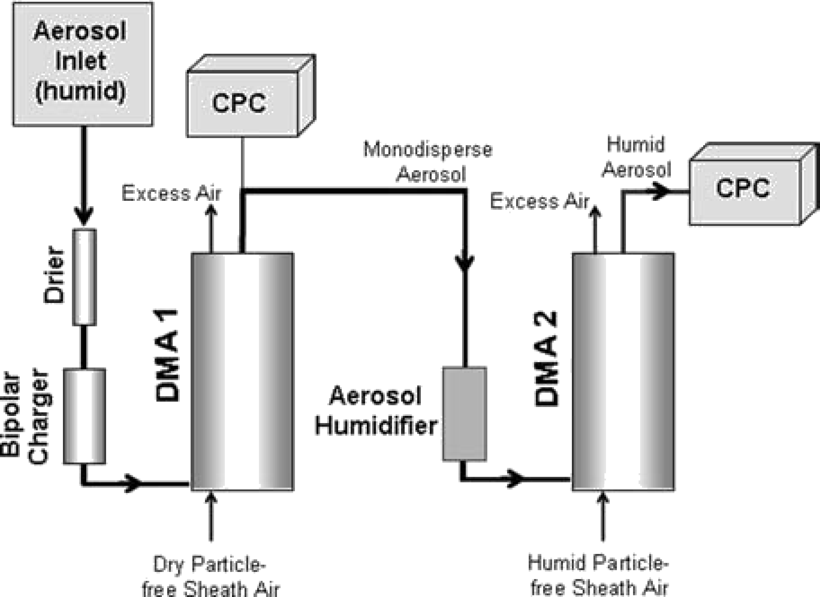
Humidified Tandem
Differential Mobility Analyzer (HTDMA)
DMA #1 selects particles of a single size, D₀
Monodisperse particles are conditioned at a higher RH
DMA #2 measures the size distribution of the humidified particles

Slide 57
HTDMA Hygroscopic Growth Curves
= D/D₀
Source: Berg et al (JGR, 1998)

Slide 58
Humidograph flow diagram
A humidified nephelometer measures RH-dependence of light scattering
Heated water flows past a water-permeable membrane to humidify the air
Sample RH is controlled by the temperature of the heated water
Neph #1
reference
Sample inlet
(low RH)
Optional Preheater
T/RH
T/RH
Flow meter
Vacuum
pump
Neph #2
humidified
T/RH
Humidifier
Float
switch
Drain
Filter
heat
sink
water
pump
water
reservoir

Slide 59
Humidiograms reveal chemical composition
Curves show RH-dependence of light scattering coefficient
Ammonia was added to convert sulfuric acid to ammonium sulfate
Data are from a rural site in the central US (Missouri)
H₂SO₄
σ_{sp}(RH)/σ_{sp}(30% RH)
(NH₄)₂SO₄
Source: Charlson et al. (Science, 1974)

Slide 60
Regional Differences of f(RH)
Parameter plotted is fRH = σ_{sp}(85% RH)/σ_{sp}(40% RH).
BND data courtesy of Prof. Mark Rood, Univ. of Illinois

Slide 61
Chemical control of hygroscopic growth
older
younger
fRH = σ_{sp}(85%)/σ_{sp}(30% RH)
Process studies provide predictive understanding of water uptake by aerosols. This can be parameterized in climate models and compared with results from long-term network.
Notes:
Emphasize importance of chemical data for developing a predictive capability for f(RH)
Quinn et al (2006) derived a parameterization for f(RH) vs. OMF for several field studies. This slide shows how aerosol “age” controls both properties.
Note links between long-term, field intensives, lab studies, and models.
Lab studies show that organics can suppress hygroscopic growth
Process-level research showing how to explain the wide range of f(RH) from long-term studies
the sulfur fraction is molar ratio, after conversion of both SO4-- and SO2 in mol/cc (SO4-- is from Tim Bates AMS and SO2 is from PMEL as well)
- OMF is POM/(POM+SO4--), where POM is not the OC rather the non refractory organic particulate again from the Q-AMS - (as in Quinn at al. 2006)
- fRH is the ratio of extinction at 85% over 25%- Extinction is at 532 nm
-Data are from the TeXAQS-GoMACCS study, in the Houston area, August -September 2006. This is only a subset of data (as chosen after talking to Ann) - data are sub 1 micron

Slide 62
Measurement Methods - Chemical
Ion chromatography
Wet-chemical
X-ray spectroscopy
Atomic absorption spectroscopy
Mass spectroscopy
  single particles
    PALMS
    TSI
  size-resolved
    AMS
  bulk composition
    ACSM
Major ions
Trace metals
Elemental composition
Elemental carbon
Black carbon
Brown carbon
Organic carbon
Organic molecular composition
Chow review paper (2008, JAWMA)

Slide 63
Aerosol Chemical Speciation Monitor (ACSM)
Continuous measurement of particle mass and chemical composition with a mass spectrometer
Being deployed at advanced GAW stations
World Calibration Center is forthcoming

Slide 64
Aerosol Chemical Speciation Monitor (ACSM)
Composition analysis for ammonium, nitrate, sulfate, chloride, and organic species
No size information
Designed for continuous, minimally-attended operation

Slide 65
Black Carbon and Climate
Black carbon (a.k.a. elemental carbon, refractory carbon, soot) is the dominant light absorbing species in the atmospheric aerosol
Light absorption by BC heats the atmosphere and decreases the reflectivity of clouds, snow, and ice
These processes combine to cause a positive (warming) climate forcing that is claimed to be second only to CO₂
Aerosol light absorption is commonly used as a proxy for BC

Slide 66
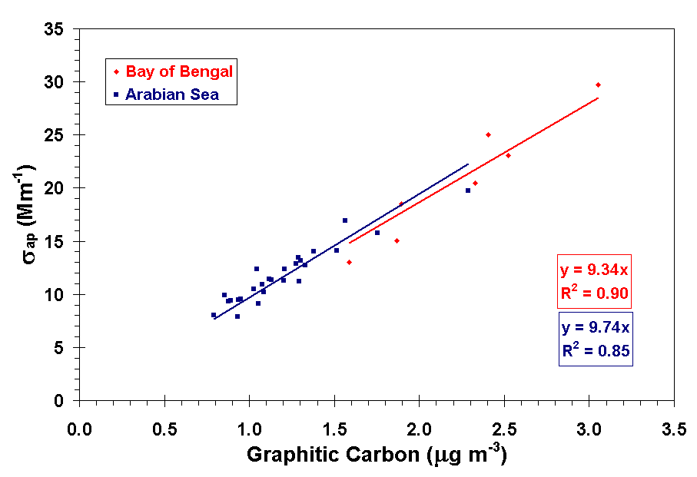
Black Carbon and Light Absorption
Optical methods for determining BC really measure σ_{ap} (PSAP, aethalometer, MAAP, photoacoustic, …)
BC = σ_{ap} x f_{ap} / MAE
  f_{ap} = fraction of light absorption due to BC
  MAE = mass absorption efficiency of BC (m² g⁻¹)
Climate forcing calculations require σ_{ap}
MAE / f_{ap} ≈ 9.5 m² g⁻¹
Empirical relationships, like the one show above for the Indian Ocean, are required to determine BC from σ_{ap} (WMO/GAW report #153)

Slide 67
Measurement of BC + Coatings using the Single Particle Soot Photometer (SP2)
Source: J. Schwarz, personal communication

Slide 68
What is Black Carbon
Black carbon (BC) is carbon that is black.
The formation process is excluded from this definition because of the variety of potential processes. While BC is mostly formed in incomplete combustion, it can be a pro-duct of pyrolysis of carbonaceous matter, dehydration of sugar, or heating of wood in an oxygen-free atmosphere
Elemental carbon (EC) is formally defined as a substance containing only carbon
The formal term “elemental carbon” refers to a set of materials with different optical and physical properties instead of a given material with well-defined properties. Examples of “true” EC are diamond, carbon nanotubes, graphite or fullerenes

Slide 69
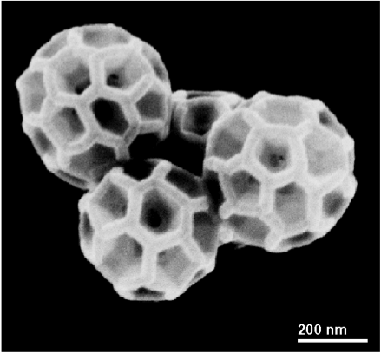
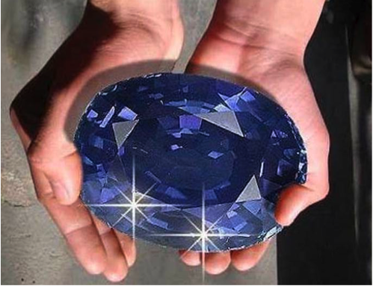
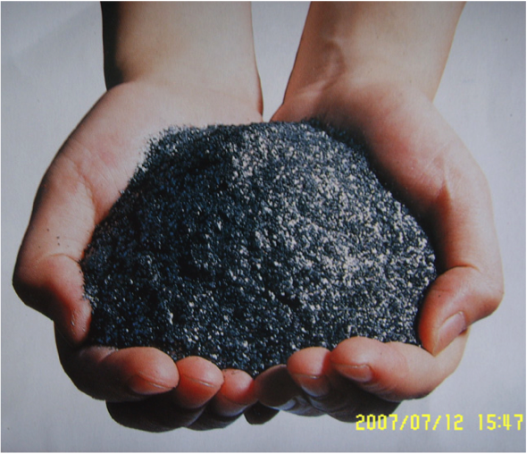
Forms of Elemental Carbon
Diamond, Buckyball, Graphite
"A diamond is forever"… but what is the lifetime of graphite?

Slide 70
What is Black Carbon?
Strict definitions are not particularly useful in practice, because
carbonaceous matter appears in atmospheric aerosols under no circumstances as pure matter;
it occurs as a highly variable mixture of different carbonaceous compounds with different material properties.

Slide 71
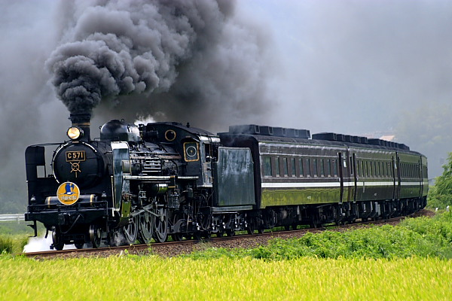
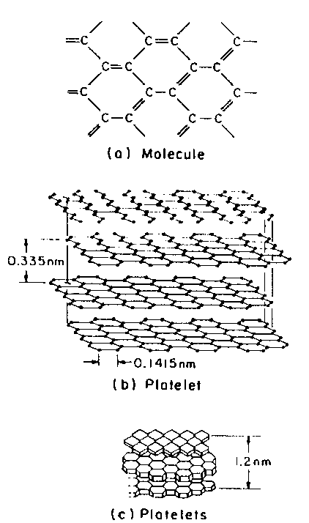
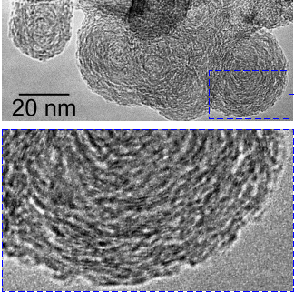

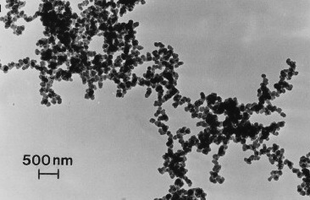
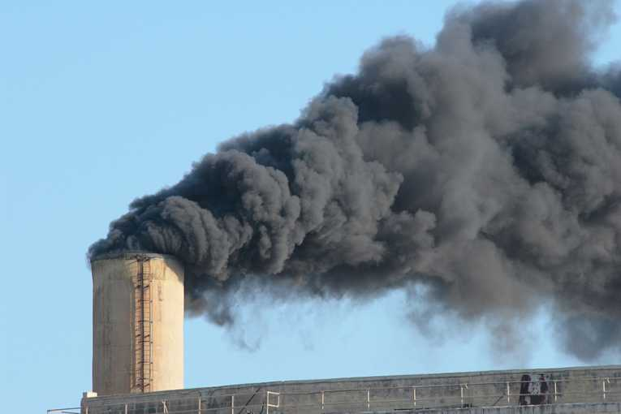
What is Black Carbon?
Nanometer scale → Meter scale
Delhaye, 2009
Soto, 2008
Ogren & Charlson 1983

Slide 72
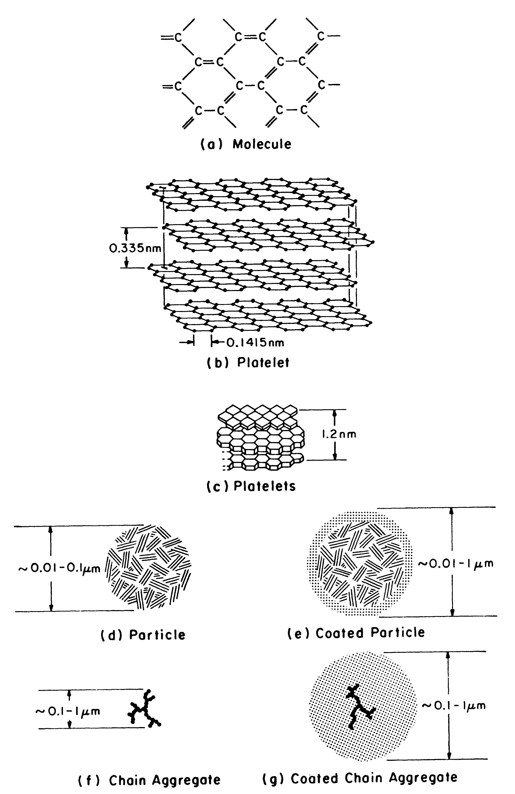
Morphology of Graphitic Elemental Carbon
Π orbitals of planar graphite molecule are the cause of the strong, broadband light absorption of EC
Coatings affect EC lifetime and optical properties
Source: Ogren et al., 1983

Slide 73
Light-absorbing aerosol components
VIS + IR black carbon brown carbon
"green" Fe₂O_{3 ,} mineral dust
near IR H₂O
(NH₄)₂ SO₄
In the VIS, only graphitic-like black carbon and refractory organics (brown carbon) absorb light efficiently.
Classification and molecular structure of carbonaceous aerosol components (Andreae and Gelencser, 2006)
Delhaye, 2009
Ogren & Charlson, 1983
36
36

Slide 74
What is Black Carbon?
Defined by five essential characteristics
  Composition
  Morphology
  Volatility
  Solubility
  Light absorption

Slide 75
What is Black Carbon
Carbonaceous particulate matter
  a high fraction of which is sp²-bonded carbon
Consists of aggregates of spherules
  Individually, from <10 to (typically) 50 nm in diameter
Refractory
Insoluble in water
Strongly absorbs light at all visible wavelengths
  when freshly emitted, has a mass absorption efficiency of at least 5 m² g⁻¹ at the mid-visible wavelength of 550 nm

Slide 76
“BC” Measurement Methods
Evolved Carbon
  CO₂ evolved from thermal or thermo- optical methods: IMPROVE / EUSAAR
  BC properties: composition, volatility
Light Absorption
    Filter-based: Aethalometer, PSAP, MAAP, COSMOS
    In situ: photo-acoustic, ext. minus scat., retrievals from sun/sky radiances
    BC properties: light absorption
Laser Incandescence
  Laser heating of particles, e.g., SP2, LII
  BC Properties: volatility, composition

Slide 77
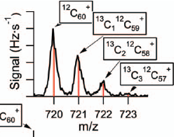
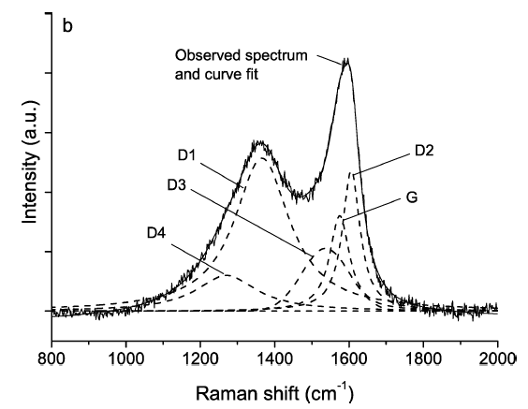
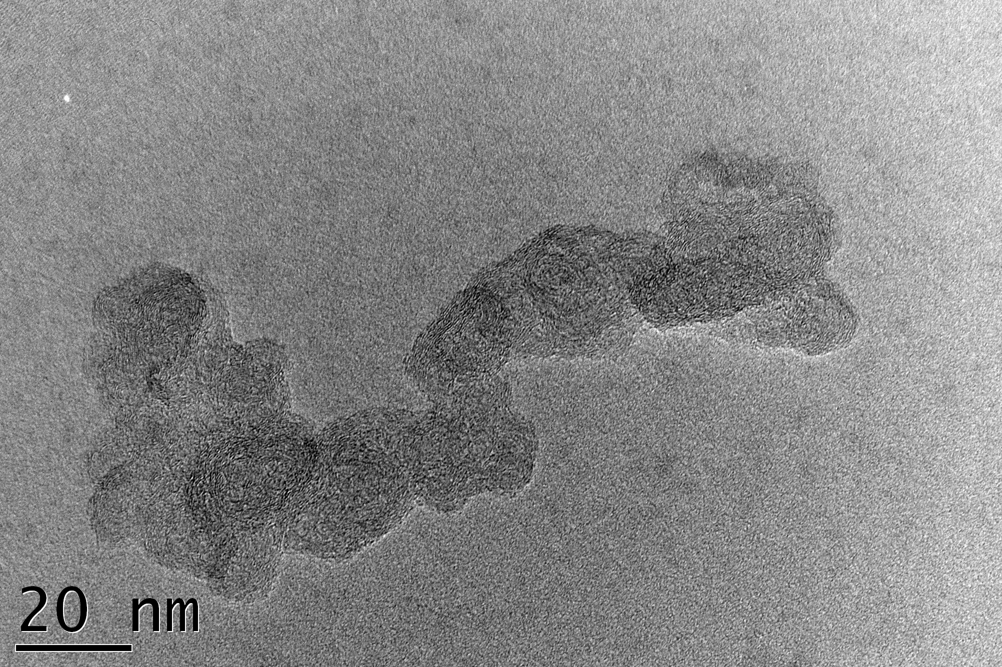
“BC” Measurement Methods
    Aerosol Mass Spectrometry
    Vaporization and detection of carbon ion clusters in mass spectra: ATOFMS, SP-AMS
    BC properties: composition
    Raman Spectrometry
    Detection of graphite-like ordered and disordered carbon
    BC properties: composition
    Electron microscopy
    Detection of particle microstructure and morphology, e.g. TEM
    BC properties: morphology
Onasch et al., AS&T 2012
Ivleva et al., AS&T 2007
Delhaye, 2009

Slide 78
Recommended Terminology
No current method combines all five essential characteristics of BC
Consequently, no current method can justifiably claim to provide a quantitative measurement of BC
Recommendations
  Use “BC” as a qualitative term referring to any of the quantitative methods
  Use terms associated with the measurement methods when reporting quantitative results

Slide 79
Recommended Quantitative Terminology
Equivalent black carbon (EBC)
  Data derived from optical absorption methods.
  Report the optical measurements primarily as light absorption coefficient, and secondarily as EBC, along with the mass absorption efficiency used to convert absorption to EBC.
Refractory black carbon (rBC)
  Data derived from incandescence methods.
Elemental carbon (EC)
  Data derived from methods that are specific to the carbon content of carbonaceous matter (evolved carbon, aerosol mass spectrometry, Raman spectroscopy).

Slide 80

Blind Men and the Elephant

Slide 81

Interpreting “BC” Measurements

Slide 82
Data Quality Control Review
Common edits
Invalidation vs. contamination?
What is a considered a spike?
What not to edit!
Automatic edits
Reasons for edits
Apply correction to data (e.g., known offset or calibration)
Bad neph zero
Size cut wrong or not switching
Pump failure
System left in bypass mode
System humidity too high
Other instrument or system problems

Slide 83
Invalidation vs. Contamination
Data should be invalidated when they are out of the acceptable range (site specific), show abnormal variability, or if a sampling or measurement problem is determined.
Data should be flagged as contaminated if local aerosol sources cause the data to be not representative of the regional or target (e.g. downslope conditions at MLO) aerosol. Flagging for contamination can be either manual or automated (WD, WS, CN threshold).
Big differences: Invalidation can handle different aerosol parameters differently (e.g., CCN invalidated but not scattering), while Contamination flags all aerosol data during the episode. In the data processing functionality, Invalidation and Contamination are slightly different. Invalidation causes MVCs to be inserted into the final corrected data file during the time of the edit, while Contamination flags these data periods.
Neither invalidated nor contaminated data are used to calculate the final, QC-edited and corrected average-format (hourly, daily, monthly) data files.

Slide 84
Spikes
Spikes are short-duration deviations from “normal” measurements, often caused by local contamination or measurement problems.
The time duration and magnitude for a deviation to be considered a spike is dependent on the variability of the “normal” measurement.
Generally, spikes are of 1-15 minutes duration. Longer duration deviations are either considered contamination events, sampling/measurement problems, or real aerosol events.
Spikes can be positive or negative. If the spike is physically unrealistic (e.g., large negative [CN]), then it should be invalidated.

Slide 85
What Not To Edit!
Do not edit out spikes in intensive data (if the extensive data look ok)
Intensive parameters (i.e., the calculated parameters single scattering albedo, angstrom exponent, and backscattering fraction) are calculated and displayed based on the 1-min measured data (scattering and absorption). Because the calculated parameters involve ratios of measured parameters, there may be spikes in the calculated parameters when the measured parameters are close to zero.
Two reasons not to edit intensive parameter spikes:
→bias your data by removing low concentration time periods
→averaged intensive parameters should be calculated by first averaging the measured parameters and then calculating intensive parameters. The spikes in the high frequency (1-min) data are unlikely to affect the average intensive values.

Slide 86
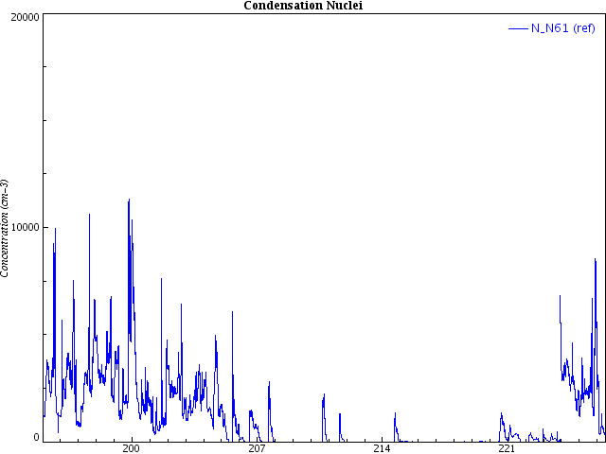
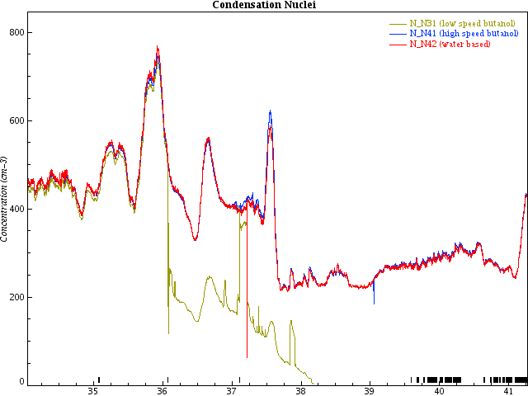
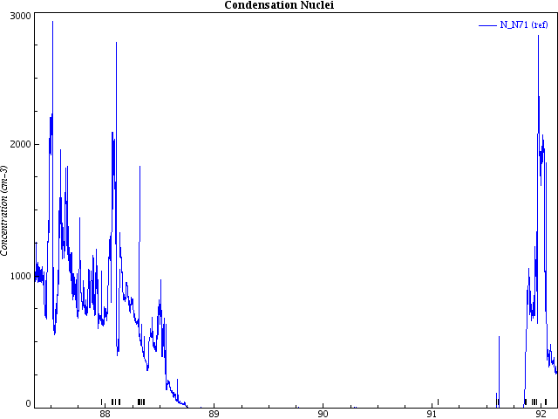
CPC Failures
instrument replaced
butanol drained or contaminated
inlet disconnected or cracked
instrument failure
dying
dead
instrument sampling room air
dying
butanol added
Notes:
It is very difficult to detect all failure modes of a CPC, especially in real time. Best approach is to run two instruments in parallel.

Slide 87
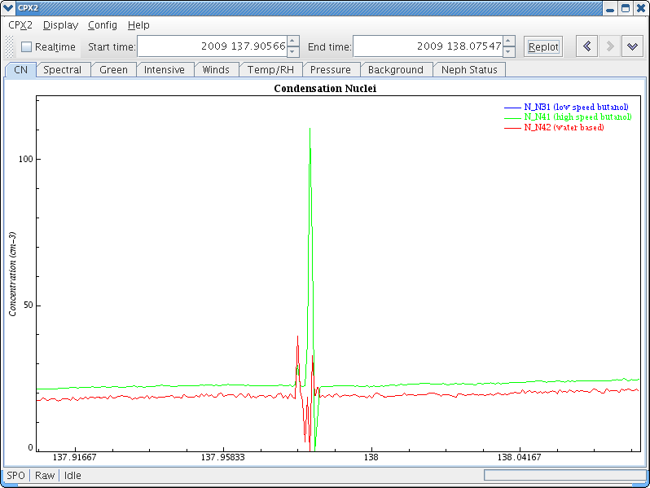
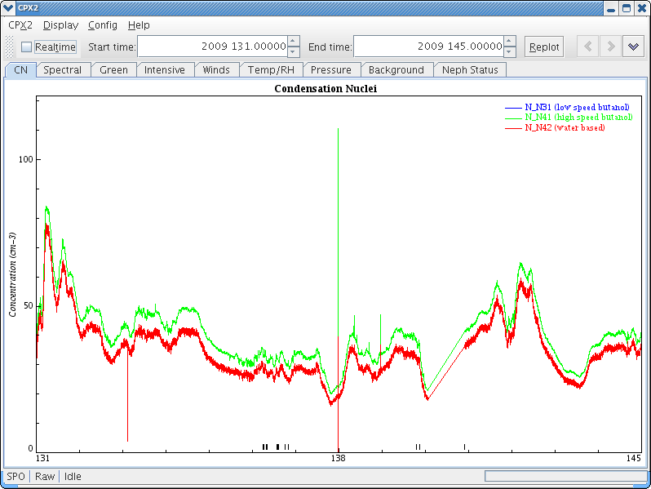
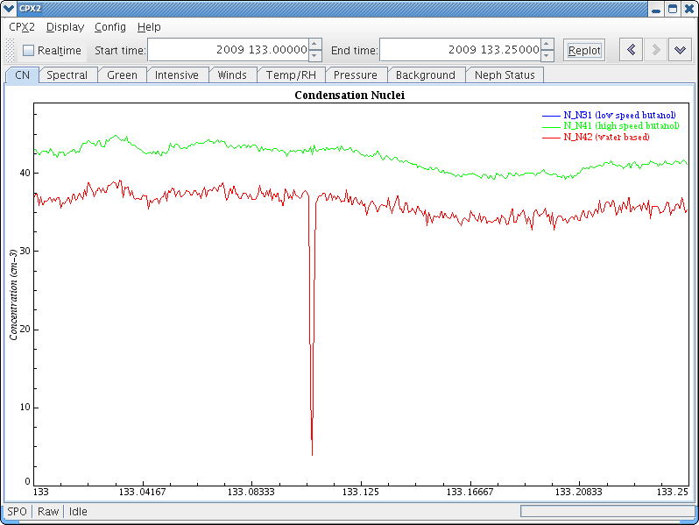
Examples (Invalidation)
Spikes caused by flow checks
These should be invalidated since a known procedure with the instrument or sampling caused them
SPO,2009,137.98613,USER: FLow rate tests completed CNC #626 = 1525 mlpm WCPC = 121.2 mlpm. Zero tests both 0.0 PDC

Slide 88
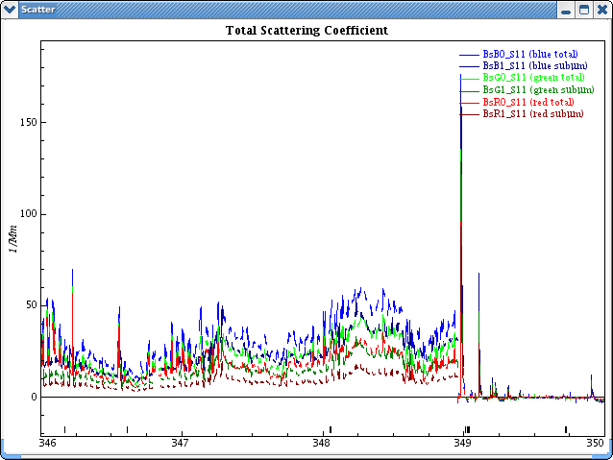
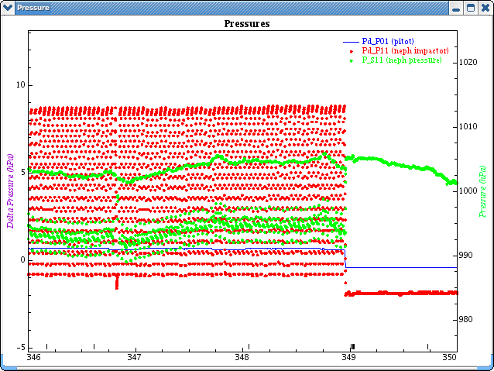
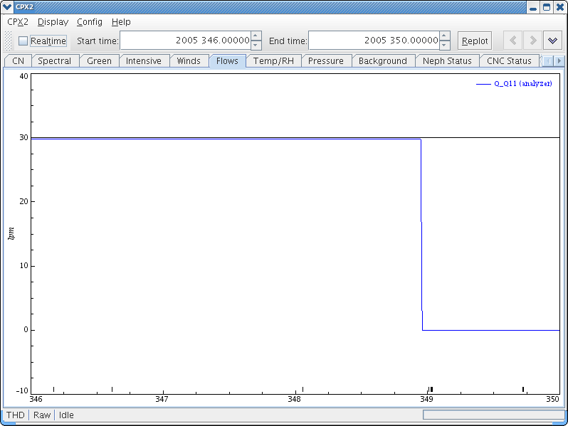
Examples (Invalidation)
Pump failure → no flow through system
Aerosol system issue
Need to invalidate scattering, absorption, CPC, etc., data
This problem looks a lot like when the system is left in bypass mode. Look at Q_Analyzer flow to determine.

Slide 89
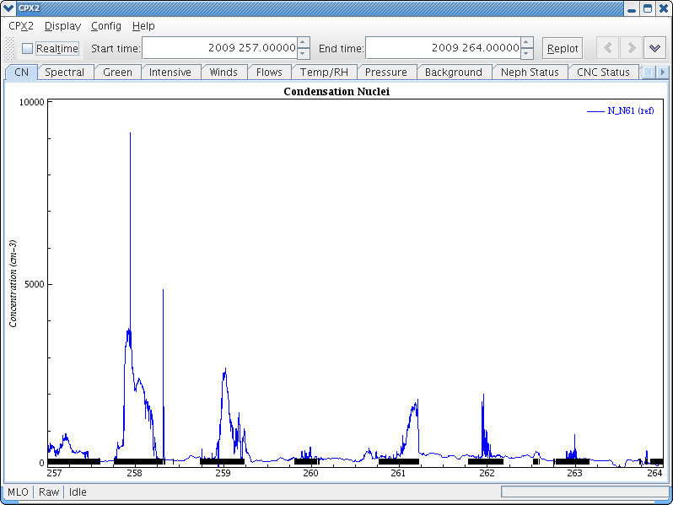
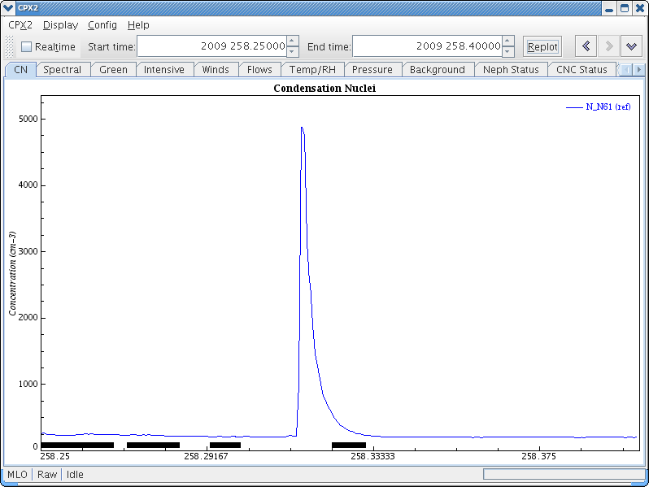
Examples (Contamination)
At MLO, upslope air is usually more polluted than downslope (free tropospheric) air
Measurements during upslope episodes are flagged (black markers at bottom of plot).
Spike at Day 258.315 appears to be local contamination, decaying away rapidly.
Since we did not observe any problem with the instrument or aerosol system operation, we flagged this spike as contamination.

Slide 90
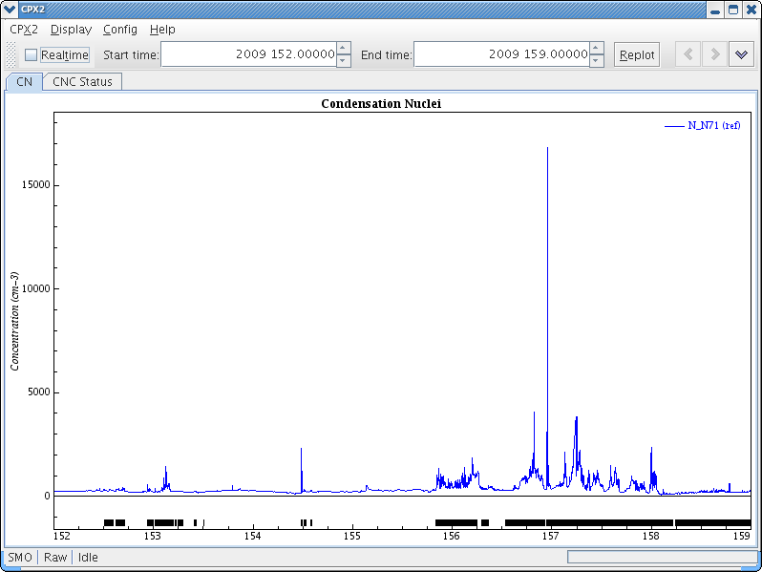
Examples (Automatic Edits)
Data at SMO are flagged based on wind direction
Flagging occurs when aerosol is coming from the island (intense local sources, i.e., spikes) instead of the open ocean
This saves a lot of manual editing of data!

Slide 91
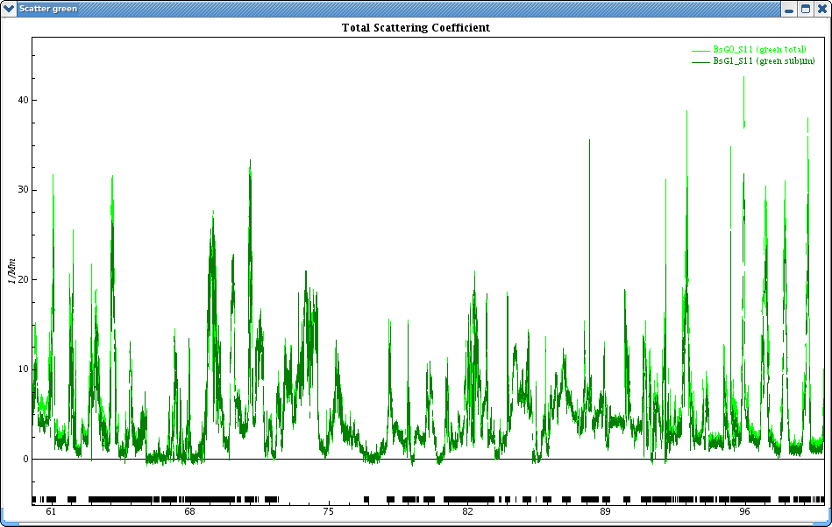
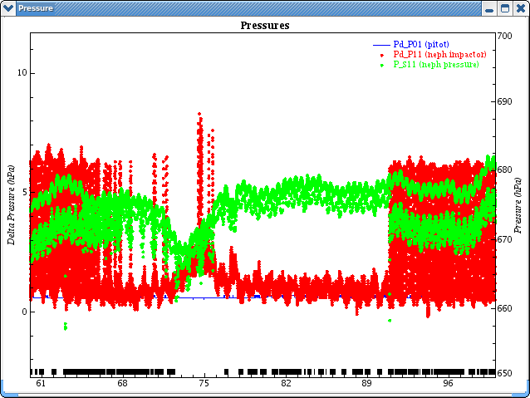
Size cut wrong or not switching (1)
In this example, electronic valve was stuck in the 10-micron cut position.
Data still get flagged alternately as 1-um or 10-um based on cpd configuration.
Can we fix this using the data editing tools?
Let’s look more closely at this period.

Slide 92
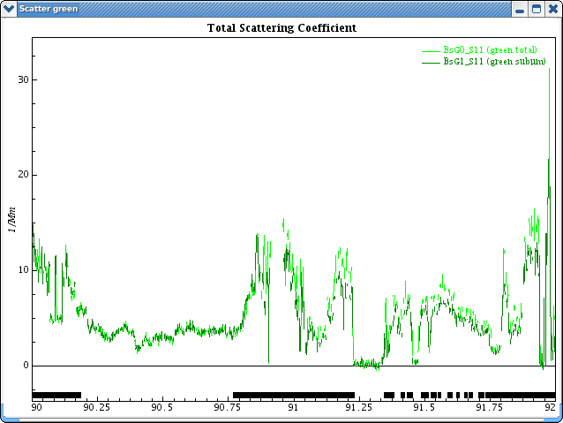
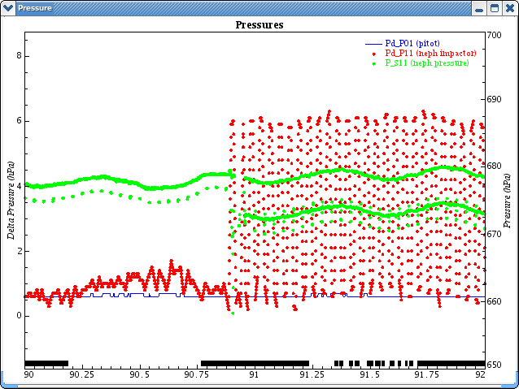
Size cut wrong or not switching (2)
The problem is that data are being flagged as submicron when they are in fact Dp<10um.
Need to flip the hex flag bit that denotes the size cut

Slide 93
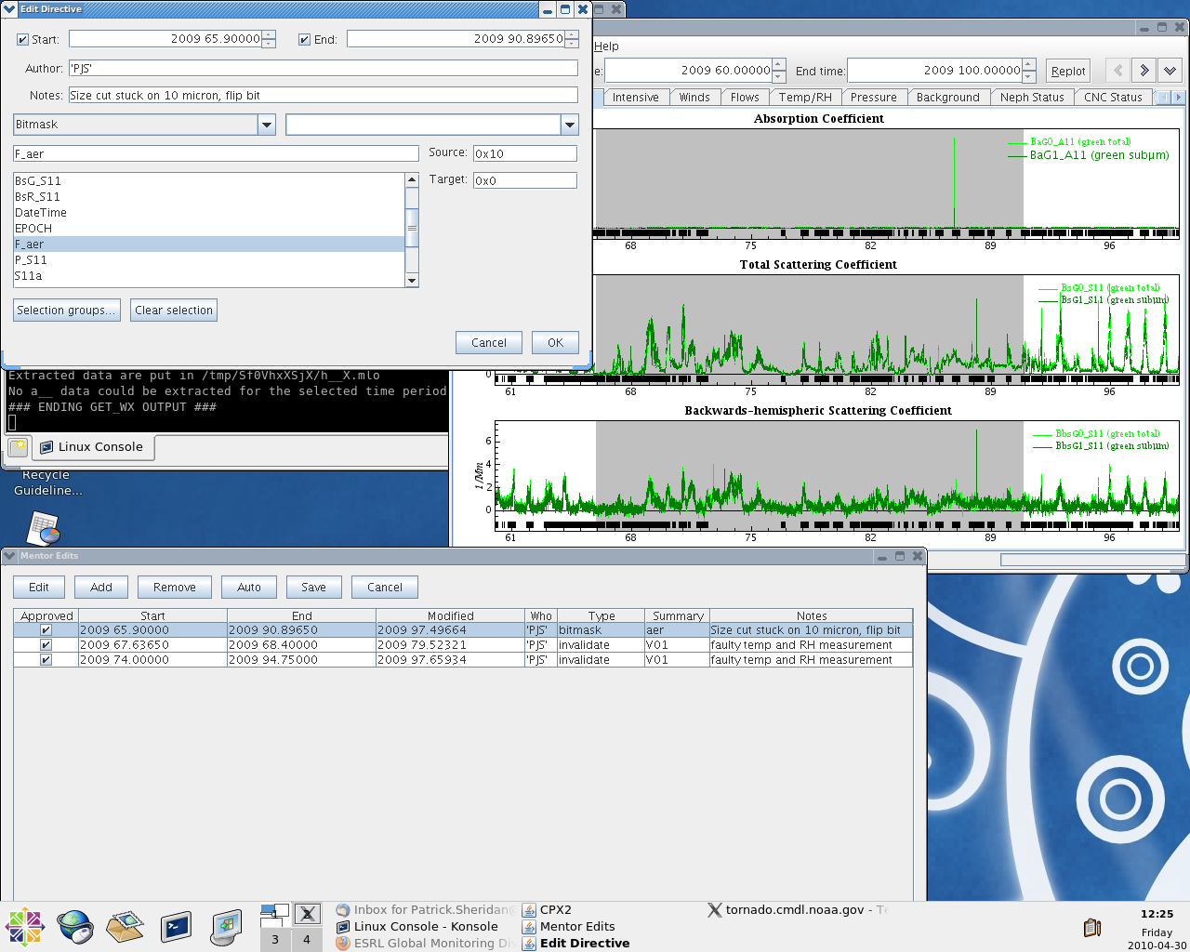
Size cut wrong or not switching (3)
Open Mentor edits window, then click to add a new edit.
In the edit directive window, choose “Bitmask”, then the flags variable “F_aer”.
For the Source Bit, change it to “0x10”.
For the Target Bit, change it to “0x0”.
A discussion of the flag bits and an example of this is provided in the Knowledge Base under “Bitmask Edits”

Slide 94


Relative Humidity Effects on Data
The PSAP absorption measurement is very sensitive to changes in relative humidity. These data should be INVALIDATED.
In this example the absorption is very noisy and the noise increases when the Neph Inlet RH > ~60%
In this example you can clearly see the fluctuations in absorption corresponding to fluctuations in humidity due to air conditioning cycling.

Slide 95
Measurements not Discussed
Mass concentration
  beta attenuation
  TEOM
  gravimetric

Slide 96
Parting Thoughts about In-situ Measurements
Common feature
  sample air is brought into an instrument through an inlet
Common weakness
  sampling changes the chemical and/or physical properties of the particles
Common strength
  ability to measure known substances under controlled conditions, which ties the measurements closely to physical or chemical standards

