Slide 1
A general introduction into aerosols
Elisabeth Andrews
CATCOS Aerosol Workshop, June 2016

Slide 2
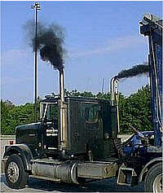
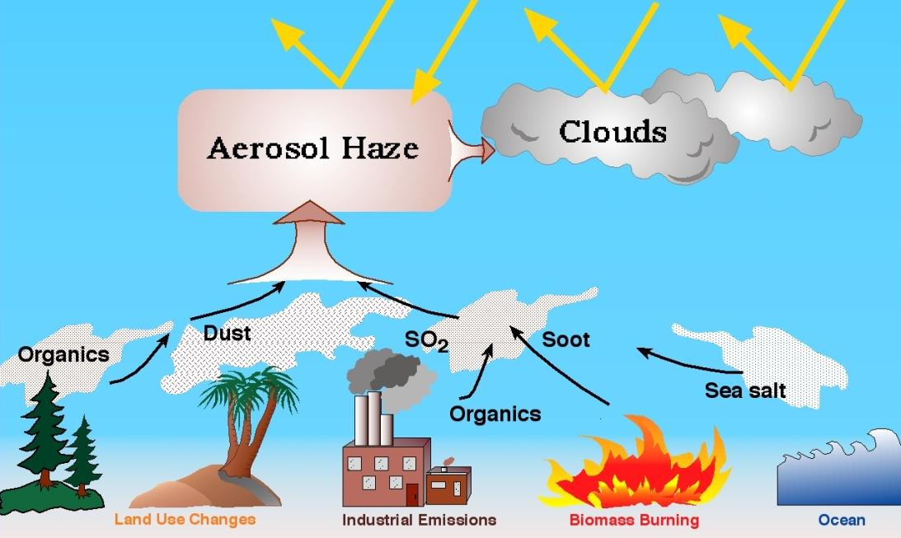
What’s an Aerosol?
Definition: Particle or liquid suspended in a gas.
Examples of atmospheric aerosols:
Dust
Combustion aerosol (forest fires, vehicles…)
Sea salt
Pollen
Pollution particles (e.g., sulfates, nitrates, organics…)
→Natural and man-made

Slide 3
What’s an Aerosol?
Primary particles – directly emitted by a source in particle form
Secondary particles – particulate material formed in atmosphere
Examples of secondary aerosol formation:
Nucleation
Gas phase
molecules
Molecular
Cluster
Detectable
Particle
Condensation
Gas phase
molecules
or
Existing particle

Slide 4
Examples of Aerosol Particles
Aerosol Characteristics
Size
Composition
Shape

Slide 5
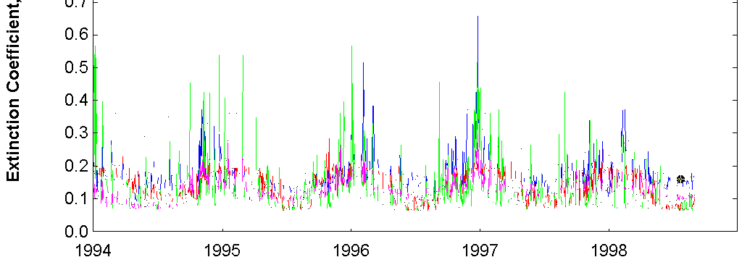
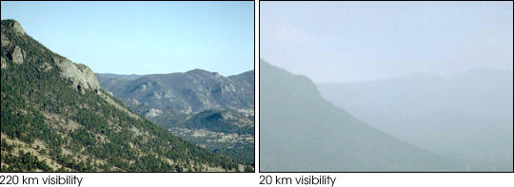
Particle properties – Amount
Different ways of describing aerosol amount:
Mass concentration
Extinction (visibility)
Aerosol optical depth
Bulk
Hanoi
Liuzhou
Beihai
Wuxu
600
6
500
8
400
10
From: capita.wustl.edu
Extinction (Mm⁻¹)
Visibility (km)
300
15
200
20
100
40
σ_{ext} = 20 Mm⁻¹
σ_{ext} = 200 Mm⁻¹
Colorado from: http://vista.cira.colostate.edu/views/

Slide 6
Particle properties – Mass Concentration
Particulate Material (PM) = mass of aerosol particles/sample vol.
→bulk property (integrated over time, size, composition)
PM is often designated by size:
→TSP (total suspended particulate, no size cut)
→PM10 (particles with diameter < 10 μm)
→PM2.5 (particles with diameter < 2.5 μm)
PM mass concentration
Sept-Oct
Wet season
Dec-Jan
Dry season
April
Transitional
Co et al., 2013

Slide 7
Particle properties – SIZE
Importance of aerosol size
Influences the optical properties of particles
→absorption
→scattering
Affects transport and lifetime
→large particles removed from atmosphere more quickly
→smaller particles transported farther
Impacts health and welfare
→determines respiratory system deposition
Size varies with:
Location
Time
Source/composition

Slide 8
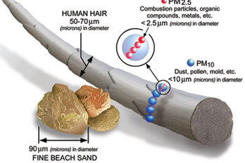
Particle properties – SIZE
How big are atmospheric particles?
→Diameter ~ 0.01-100 μm
Human hair
Diameter~70 μm
PM2.5
Diameter<2.5 μm
PM10
Diameter<10 μm
Fine beach sand
Diameter~90 μm
From USEPA

Slide 9
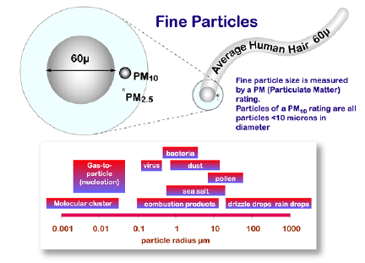
Particle properties – SIZE
How big are atmospheric particles?
→Diameter ~ 0.01-100 μm
bacteria
Gas-to- particle
(nucleation
virus
dust
pollen
Sea salt
Molecular cluster
Fog
Rain drops
http://binational.pharmacy.arizona.edu/content/mine-tailings

Slide 10
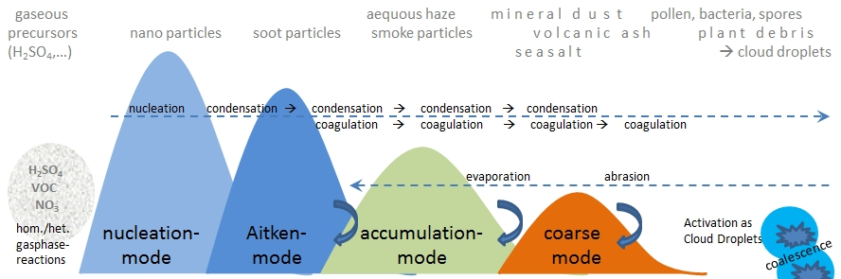
Particle properties – SIZE
→Size of particles determined by source and formation processes.
→Size distribution of atmospheric particles covers wide size range.
PM10
PM2.5
0.001 μm
0.01 μm
0.1 μm
1 μm
10 μm
Particle Diameter
http://www.dwd.de/EN/research/observing_atmosphere/composition_atmosphere/aerosol/cont_nav/particle_size_distribution_node.html

Slide 11
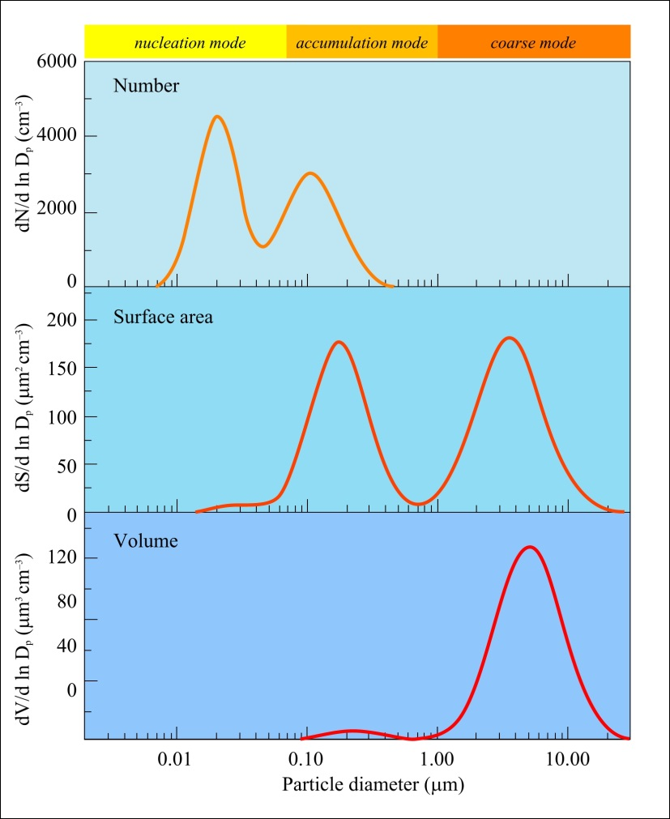
Particle properties – SIZE
Different parts of the size distribution are important for different processes and effects.
Number
Examples:
Health effects (respiratory issues) primarily depend on particles < 2.5 μm.
Optical properties (visibility) primarily depend on particles > 0.1 μm.
Particle mass fluxes (deposition) primarily depend on particles > 1 μm.
PM10 is dominated by coarse mode
Surface area/Scattering
Amount
Volume/Mass
Measurement technique should be based on application.
SIZE
http://elte.prompt.hu/sites/default/files/tananyagok/AtmosphericChemistry/ch09s02.html

Slide 12
Particle properties – SIZE
Deposition Fraction
Particle Diameter (μm)
Particle size determines if/where particles deposit in the respiratory system.
Small particles (Diameter < 0.1 μm) are more likely to end up deep in the lungs
From ‘Deposition of inhaled particles in the human respiratory tract and consequences for regional targeting in respiratory drug delivery, Joachim Heyder

Slide 13
Particle properties – COMPOSITION
Importance of aerosol composition
Provides indicator of sources contributions
Influences the optical properties of particles
→absorption
→scattering
Affects aerosol/water interactions
→water uptake changes size, optical properties
→fog/cloud drops
Impacts health and welfare
→acid rain/deposition
→determines toxicity
Composition varies with:
Location
Particle size
Time
Sources

Slide 14
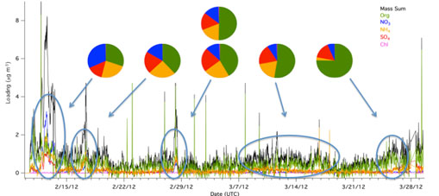
Particle properties – COMPOSITION
Composition varies with time at same location
Study mean
Organic
Nitrate (NO₃)
Ammonium (NH₄)
Sulfate (SO₄)
Concentration
February
March
April
DATE, 2012
DOE/ARM

Slide 15
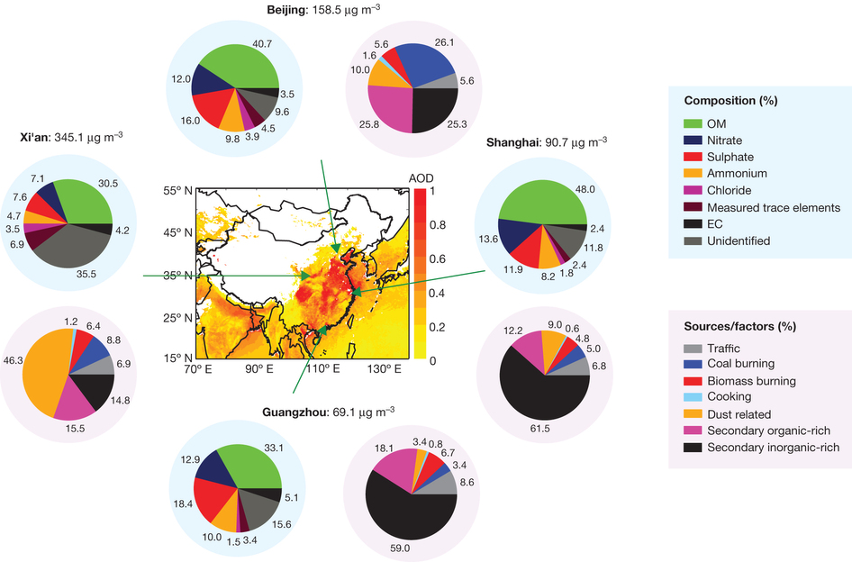
Particle properties – COMPOSITION
Different locations have different chemical composition
Source contributions influence chemical composition
Huang et al., Nature 2014

Slide 16
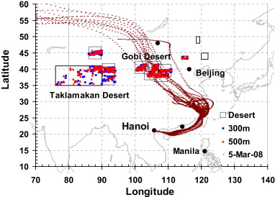
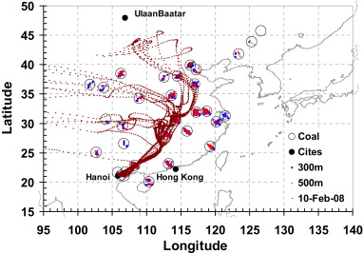
Particle properties – COMPOSITION
Aerosol can be transported over large distances.
Source region will affect aerosol composition.
Air mass trajectories corresponding to desert dust reaching Hanoi
Air mass trajectories corresponding to coal power plant emissions reaching Hanoi
Cohen et al (2010)

Slide 17
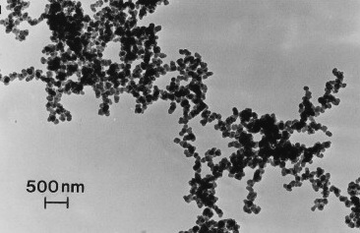
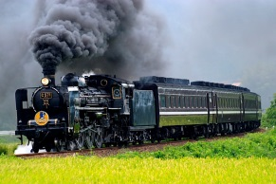
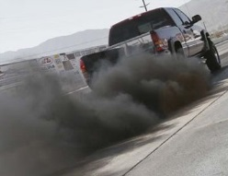
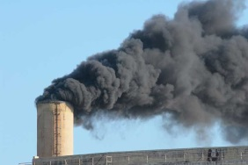
Particle properties – COMPOSITION
Black carbon (BC) has important effects on climate and health.
BC is primary absorbing aerosol in atmosphere
BC is poorly defined in the scientific literature.
BC amounts depend on the measurement method.
Defined by five properties:
Composition
Morphology (shape)
Volatility
Solubility
Light absorption (optical)
Delhaye, 2009
Soto, 2008
Ogren & Charlson 1983

Slide 18
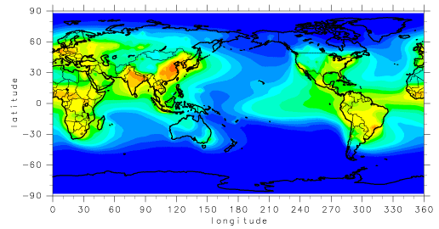
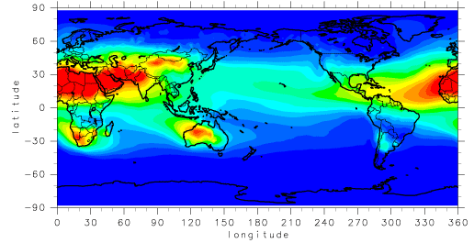
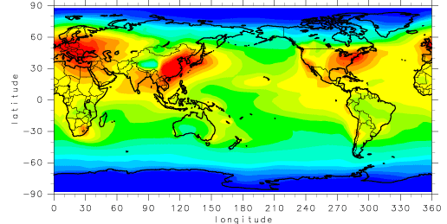
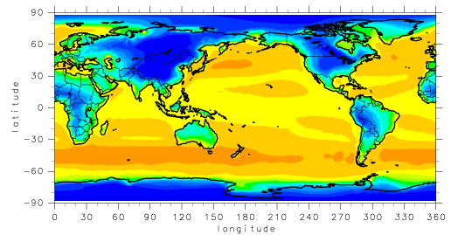
Particle properties – COMPOSITION
Different types of aerosol in different places.
Black carbon
Soil dust
From SPRINTARS model
Sulfate
Sea salt

Slide 19
Particle properties – SIZE+CHEMISTRY
→Different types of aerosol will have different size distributions
→Size distribution chemistry varies with size
Source dependent size distribution
(continental and marine aerosol)
Composition dependent size distribution
(urban aerosol)
PM1
PM10
PM1
Amount
Amount
Finlayson-Pitts and Pitts, 2000
Friedlander, 2000

Slide 20
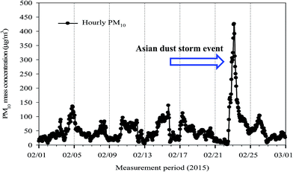
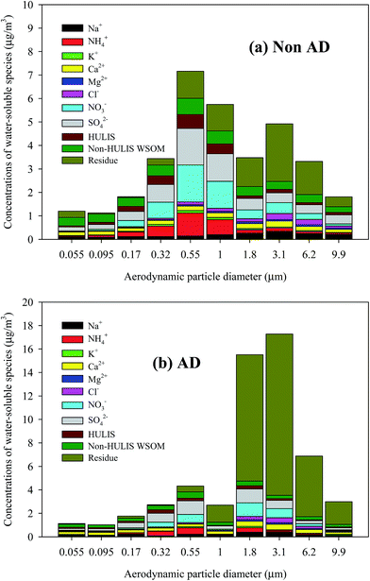
Particle properties – MASS+SIZE+CHEMISTRY
No dust
PM10
Chemical mass concentration
February 2015
mass concentration
Dust
Chemical mass concentration
Diameter (um)
Park and Son, 2015
Diameter (um)

Slide 21
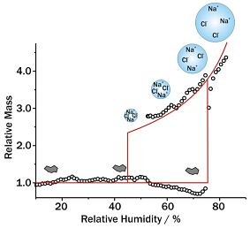
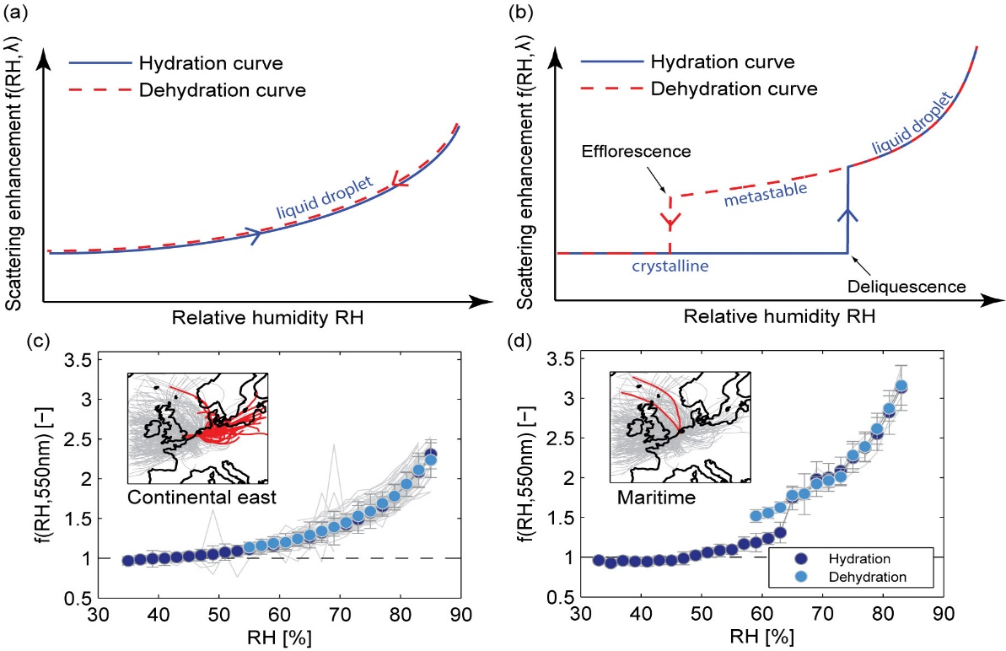
Particle properties – CHEMISTRY and water
Particles interact with water vapor (relative humidity) in the atmosphere
→change size
→change composition
→change optical properties
University of Bristol
Different types of particles interact differently with water
Zieger et al., 2014

Slide 22
It’s all tied together!
In-situ Aerosol
Monitoring
Physical
Properties
Size, shape, amount
Optical
Properties
Scattering,
absorption,
phase function
Chemical
Properties
Hygroscopicity,
toxicity
Health/
Welfare
Climate
Visibility

Slide 23
Not used slides

Slide 24
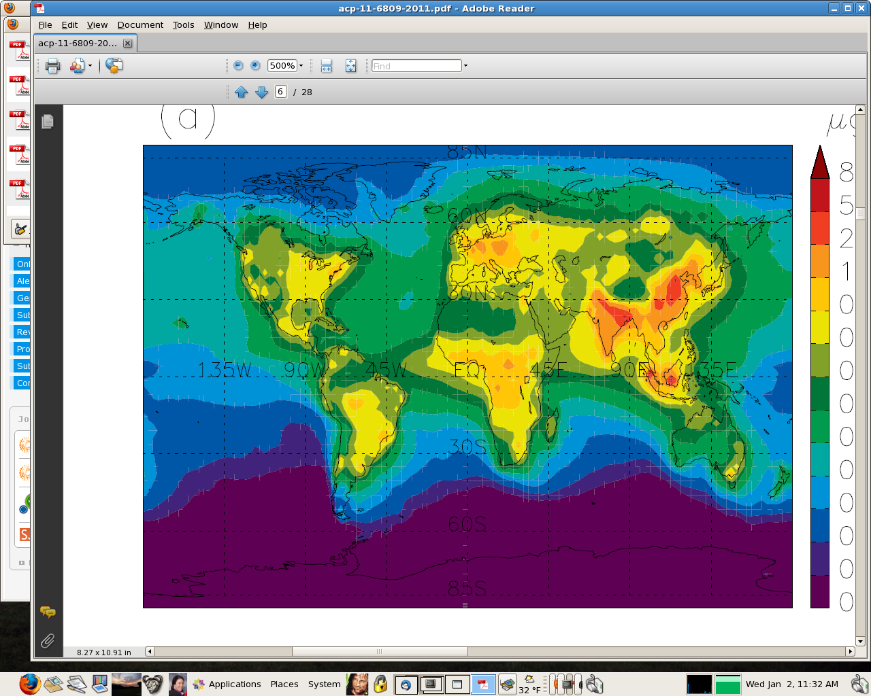
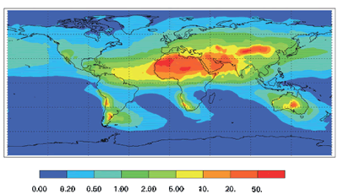
Particle properties – COMPOSITION
Different types of aerosol in different places.
Annual mean values
Various models
Black carbon, Skeie et al., 2011
Dust, Jickells et al., 2005
Number, Spracklen et al., 2010
Sulfate, Xu and Penner, 2012

Slide 25
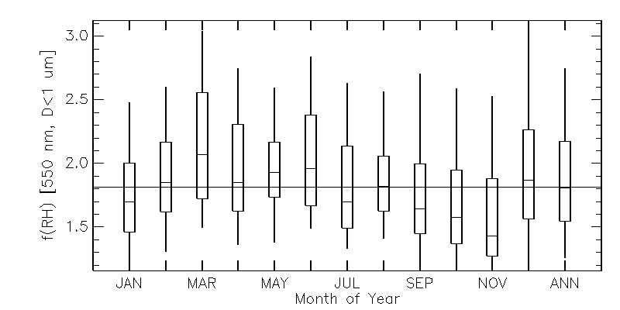
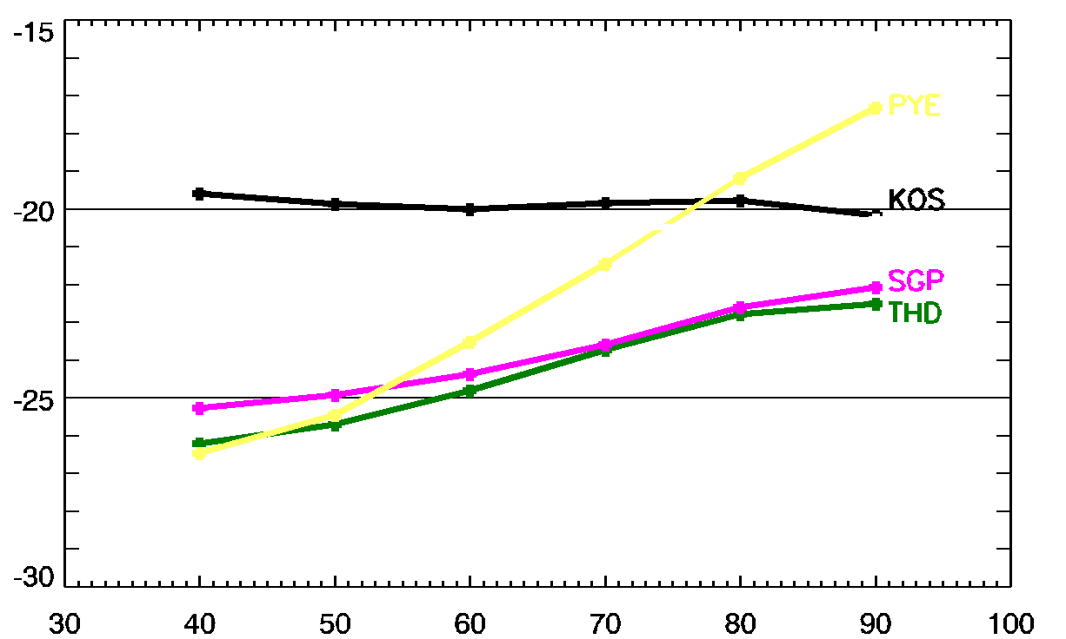
Particle properties – CHEMISTRY and water
Scat(85%)/scat(40%)
Humidity dependence can vary by site and by season.
Long term is important!!
Depending on aerosol, humidity can have strong influence on aerosol optical properties and radiative forcing.
Radiative forcing efficiency (W m⁻² AOD⁻¹)
Relative Humidity (%)

Slide 26
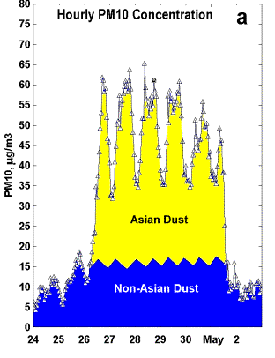
How separate out?
Don’t need complex chem?
http://capita.wustl.edu

Slide 27
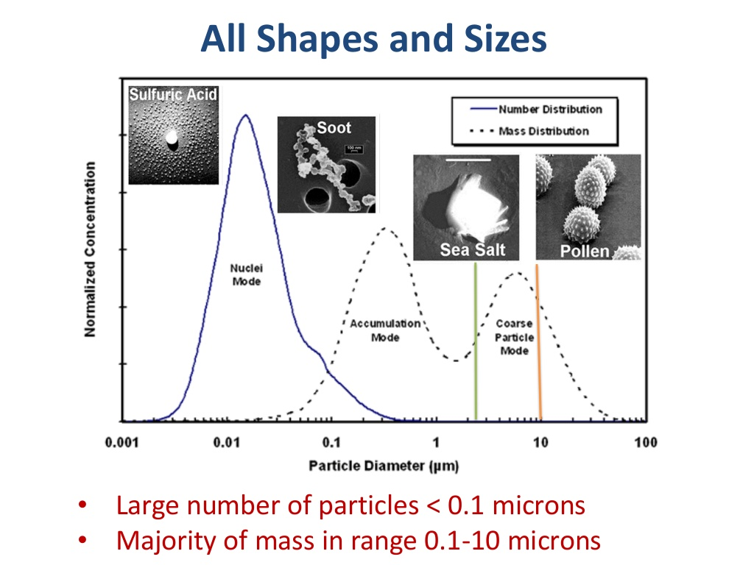
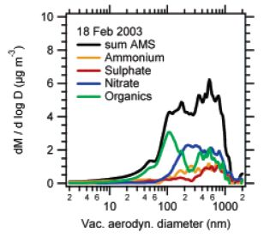
Max planck inst.
John wenger university college cork

Slide 28
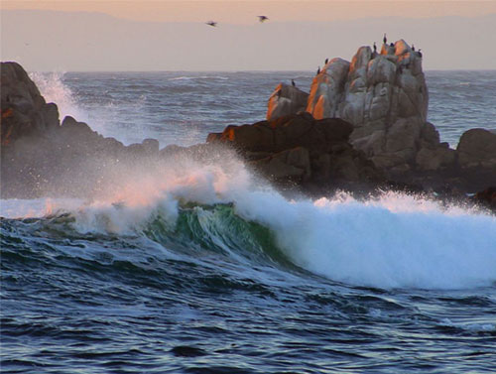
Measured Parameters
These properties depend on AMOUNT of Aerosol:
Light absorption, σ_{ap}
Light scattering, σ_{sp}
Back-scattering, σ_{bsp}
Light extinction, σ_{ext} = σ_{sp} + σ_{ap}
Number concentration, N_{CN}
Clean Region: 10 Mm⁻¹ < Light extinction
Polluted Region: Light extinction > 60 Mm⁻¹
Boulder: light extinction ~10-20 Mm⁻¹
20 Mm⁻¹ ~ 7 μg/m³ PM2.5 ~ 120 miles visibility
100 Mm⁻¹ ~ 33 μg/m³ PM2.5 ~ 24 miles visibility

Slide 29
Mm⁻¹ - What are these weird units?
Visibility → How far one can see (distance)
Light extinction inversely proportional to 1/visibility → 1/distance
Distance unit conversions → 1000 m = 1 km = 0.001 Mm
σ_{ext} = 20 Mm⁻¹
σ_{ext} = 200 Mm⁻¹
(130 miles visibility)
(12 miles visibility)
Rocky Mountain National Park http://vista.cira.colostate.edu/views/

