Slide 1
The climate effects of aerosols
Elisabeth Andrews
CATCOS Workshop, June 2016

Slide 2
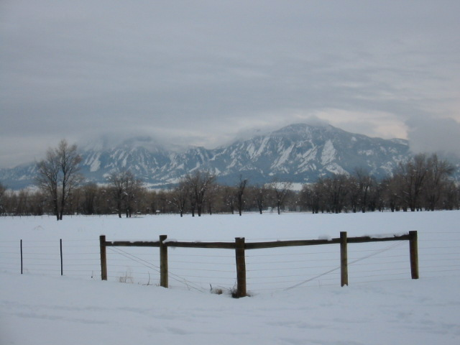
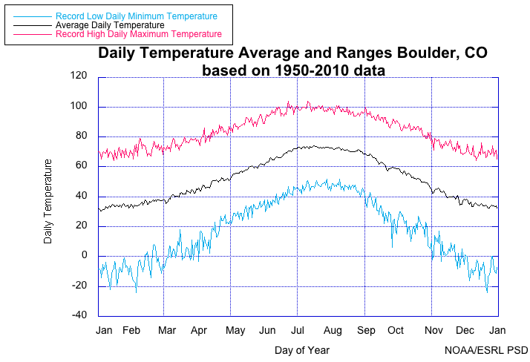
What is climate?
Climate is the average weather
The standard averaging time for climate is 30 years
“Weather is what you’re wearing, climate is what’s in your closet”
CLIMATE
WEATHER

Slide 3
Radiative Forcing…
is a “forced” change in Earth’s energy budget
Causes of radiative forcing include:
  Greenhouse gases, which absorb outgoing infrared radiation and can heat the surface and the lower atmosphere.
  Aerosols, which influence incoming solar radiation (a daytime process) and tend to have a cooling effect - (but not always!)
  Land use changes, which can change surface reflectivity (surface albedo)
  Other things too…

Slide 4
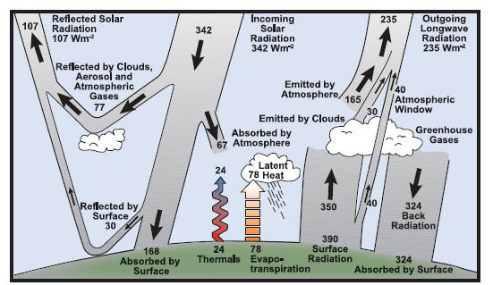
Earth’s Energy Budget
Aerosol both scatter (reflect) and absorb solar radiation – ‘direct effect’
Clouds are formed on aerosol particles – indirect effects
Notes:
This picture shows balanced energy, but if something changes (i.e., more reflected radiation) then the balance is messed up.

Slide 5
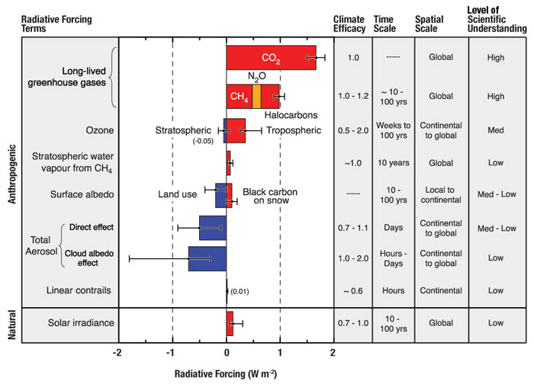
Factors influencing climate change, 2007
Gases
Aerosols
Cooling
Warming
From IPCC, 2007
Global averages based on models, measurements and theory.
Aerosols ‘contribute the largest uncertainty to the total RF estimate’.

Slide 6
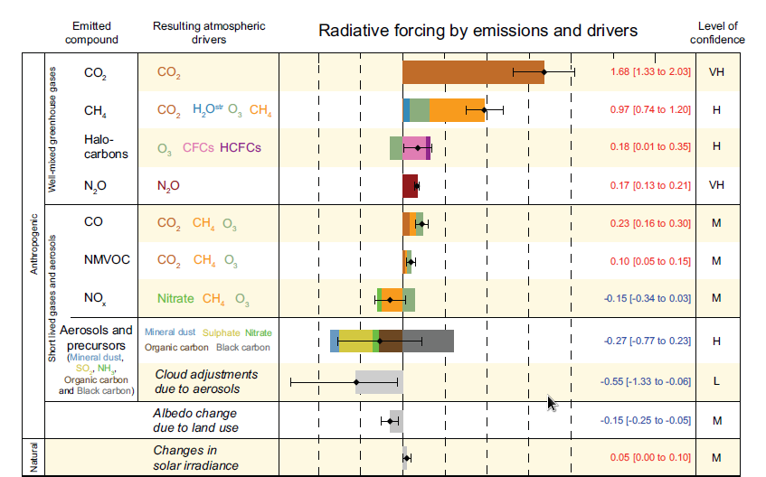
Factors influencing climate change, 2013
Gases
Aerosols
Cooling
Warming
From IPCC, 2013
Scientific knowledge of climate change is evolving.
2007 factors did not include warming by black carbon.
Notes:
Note: in 2013 – IPCC recognized warming potential of aerosol

Slide 7
The problem with aerosols!
A molecule is a molecule - behaves the same everywhere (almost!) →CO₂ and other gases are molecules
One aerosol particle is not like another aerosol particle …
Mineral dust, sea salt, biomass burning, industrial pollution, traffic, … Different types of particles behave differently!
Aerosols are short-lived…. So they are not uniform in space or time
But…

Slide 8
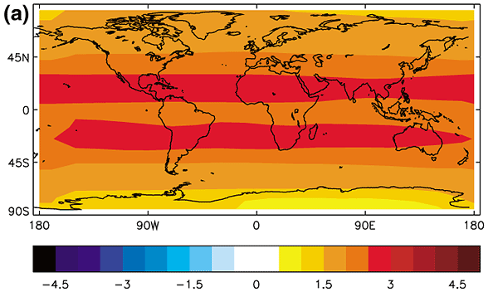
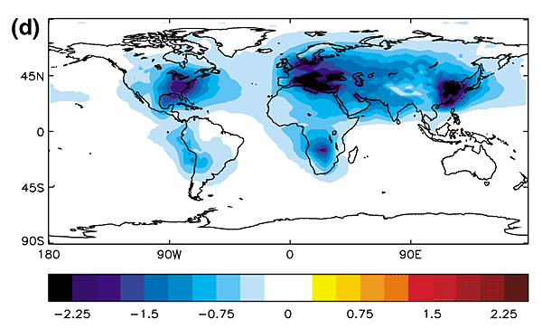
Aerosols vs Greenhouse Gases
Similar to greenhouse gases
atmospheric amount is changing
anthropogenic and natural
Greenhouse gas forcing
Different from greenhouse gases
Short residence times
Very variable over short distances
Sulfate aerosol forcing
From IPCC, 2001

Slide 9
Direct Aerosol Effect on Climate
Forward
scattering
particle
Surface cooling: sunlight is prevented from reaching the Earth’s surface
Atmospheric warming: a warming of the atmosphere via energy transferred as heat by absorbing particles.
Absorbing
particle
Backward
scattering
particle

Slide 10
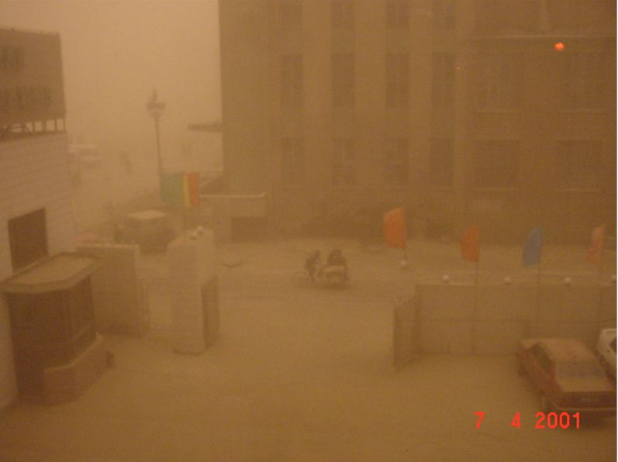
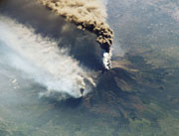
Extreme examples of direct aerosol forcing
Volcanic eruption
Dust storm in China
Aerosols reflecting light back to space
Shadowed – solar radiation isn’t getting through plume

Slide 11
Climate Forcing:
What do we need to know about aerosols?
What do we need to know? | WHY?
AEROSOL AMOUNT | Correlated with forcing
AEROSOL ‘DARKNESS’ | Determines the cooling/warming potential of particles
AEROSOL TYPE | Source identification/contribution Hygroscopicity (water uptake)
AEROSOL SIZE | Anthropogenic aerosol contribution Amount of incoming radiation lost to space
LOCATION | Aerosol forcing depends on the underlying surface and whether they are above or below clouds. →vertical distribution →horizontal distribution
Notes:
Spatial distributions of aerosol amount
Including composition and controlling processes (emissions, transport, transformation, and removal)
Vertical distributions
Important for radiation, ice/water cloud nucleation, and removal
Aerosol properties linking aerosol amount and the effects, e.g.,
radiative properties
hygroscopic properties
(radiation, cloud nucleation, removal)

Slide 12
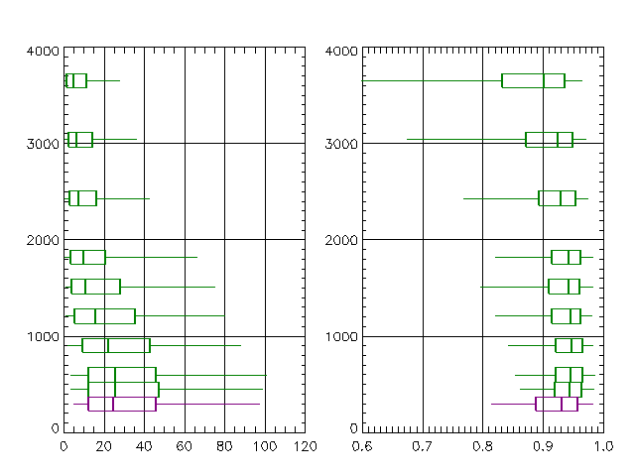
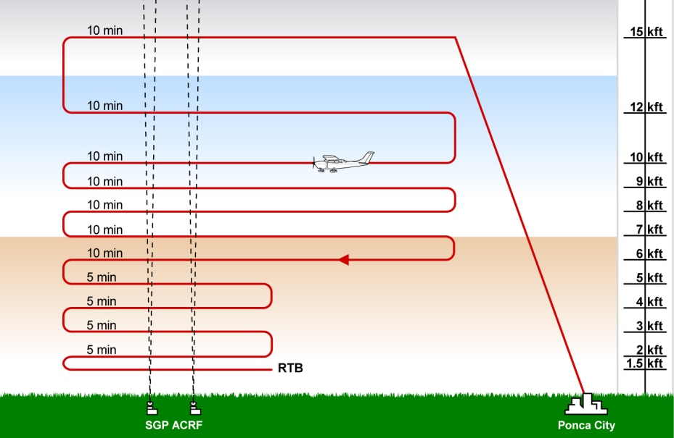
Forcing-related definitions – Aerosol amount
Recall: different ways of describing aerosol amount:
Mass concentration
Extinction (visibility)
Aerosol optical depth
Extinction (σ_{ext}) = aerosol scattering + aerosol absorption
Aerosol Optical Depth (δ, τ) = extinction integrated over height
∫
Altitude (m above sea level)
δ
surface
Surface
Extinction (Mm⁻¹)

Slide 13
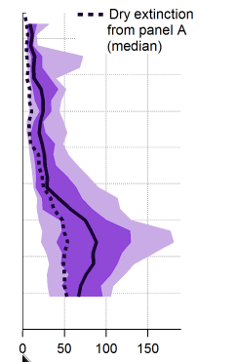
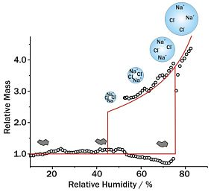
Forcing-related definitions – Aerosol type:
Humidity dependence
Some particles will interact with water, while others will not.
Depending on aerosol type, humidity can have strong influence on radiative forcing efficiency.
→particle size
→particle composition
Dry
Ambient
Altitude
Extinction (Mm⁻¹)
Extinction (Mm⁻¹)

Slide 14
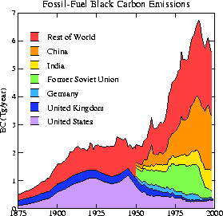
Forcing-related definitions – Aerosol type:
Black Carbon
Black carbon is the dominant light absorbing aerosol in the atmosphere
Light absorption heats the atmosphere and decreases the reflectivity of clouds, snow, and ice
These processes combine to cause a positive (warming) climate forcing
→Black carbon emissions have increased over last century
BC (tg/year)
From Novakov, 2003
Year

Slide 15
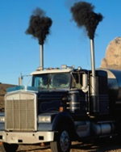
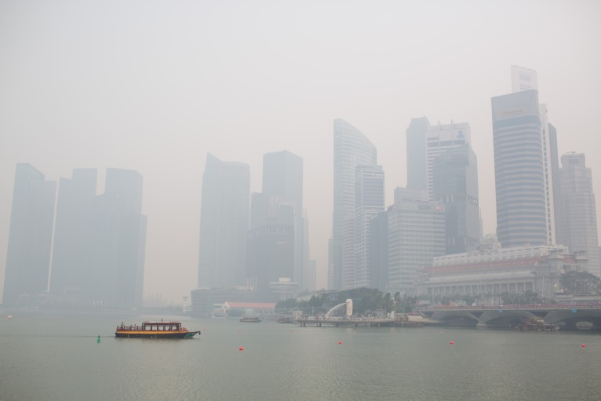
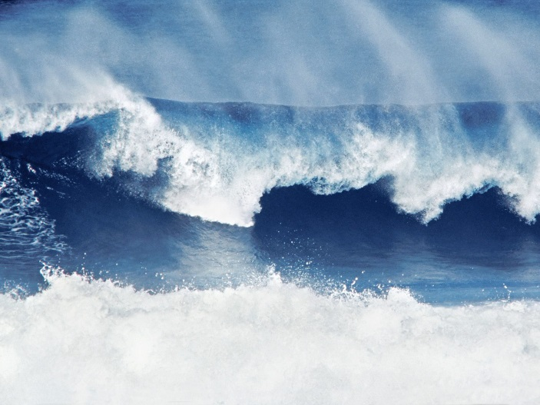
Forcing-related definitions – Aerosol darkness
Recall: Extinction = scattering + absorption
A way to quantify the relative amount of absorption:
Single scattering albedo (SSA, ω) = scattering
extinction
0 < SSA < 1 → typical atmospheric values ~0.8-0.9
SSA ~ 0.4
SSA ~ 0.8
SSA ~ 1.0

Slide 16
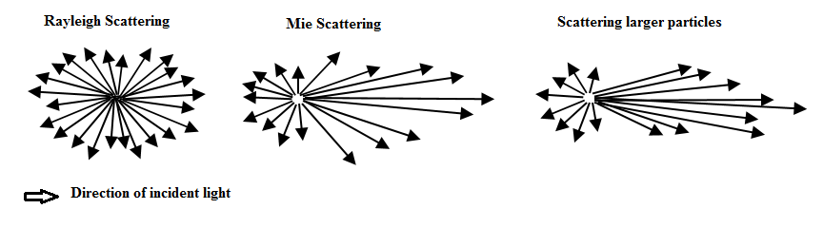
Forcing-related definitions – Aerosol size
Aerosol size affects the direction of scattered light.
Rayleigh scattering
(molecular)
Size<<wavelength
Mie scattering
size~wavelength
Mie scattering
Size>wavelength
Different ways to parameterize angular light scattering:
Asymmetry parameter (g) -1 < g < 1 ~0.65
Up-scatter fraction (β) 0 < β < 1 ~0.26
Back-scatter fraction (b) 0 < b < 1 ~0.12

Slide 17
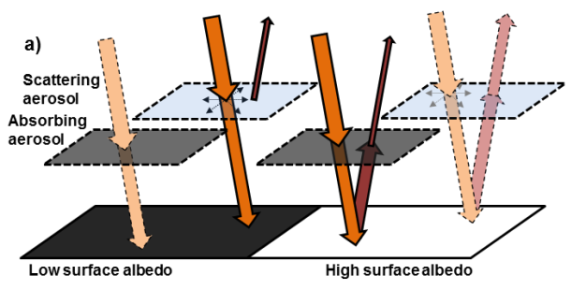
Aerosol location
Dark surface absorbs incoming solar radiation
→Absorbing aerosols will thus have a small effect.
→Scattering aerosols increase reflected solar radiation – cooling effect
Bright surface scatters incoming solar radiation
→Scattering aerosols have a minimal effect.
→Absorbing aerosols reduce the outgoing radiation – warming effect
From Myhre et al 2013
Notes:
Low albedo (i.e., black) aerosols change planetary albedo while suspended and
after deposition on high albedo snow and ice surface.

Slide 18
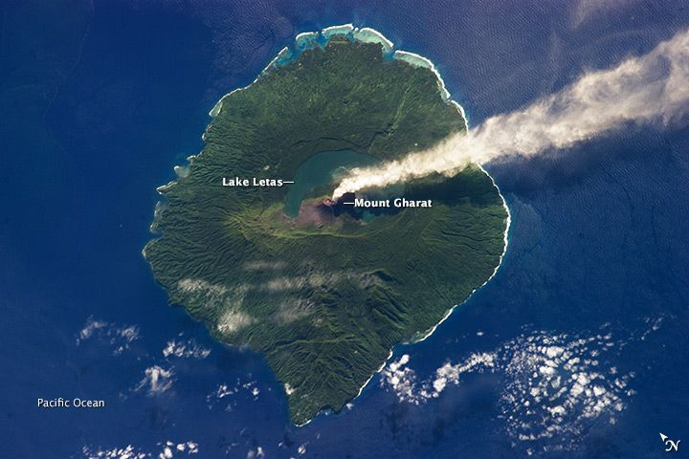
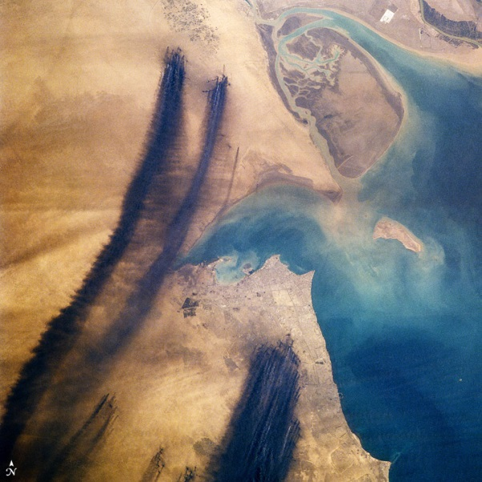
Aerosol location – real world examples
Aerosols → heating if they are darker than the surface below
    Single Scattering Albedo (SSA) < Surface Albedo
Aerosols → cooling if they are whiter than the surface below
    Single Scattering Albedo (SSA) > Surface Albedo
Pacific Ocean under volcano
Kuwait under smoke
Notes:
Low albedo (i.e., black) aerosols change planetary albedo while suspended and
after deposition on high albedo snow and ice surface.

Slide 19
Climate Forcing:
What do we need to know about aerosols?
What do we need to know? | WHY?
AEROSOL AMOUNT | Correlated with forcing
AEROSOL ‘DARKNESS’ | Determines the cooling/warming potential of particles
AEROSOL TYPE | Source identification/contribution Hygroscopicity (water uptake)
AEROSOL SIZE | Anthropogenic aerosol contribution Amount of incoming radiation lost to space
LOCATION | Aerosol forcing depends on the underlying surface and whether they are above or below clouds. →vertical distribution →horizontal distribution
Notes:
Spatial distributions of aerosol amount
Including composition and controlling processes (emissions, transport, transformation, and removal)
Vertical distributions
Important for radiation, ice/water cloud nucleation, and removal
Aerosol properties linking aerosol amount and the effects, e.g.,
radiative properties
hygroscopic properties
(radiation, cloud nucleation, removal)

Slide 20
Parameters controlling aerosol forcing
ΔF aerosol forcing at top of atmosphere (TOA)
δ aerosol optical depth
Location
D daylight fraction
S₀ solar constant
T_{at} atmospheric
transmission
A_{c} cloud fraction
R_{s} surface albedo
Amount
aerosol single-scattering albedo
aerosol up-scatter fraction
Darkness, type
Size, type
Location
From Haywood and Shine (1995)

Slide 21
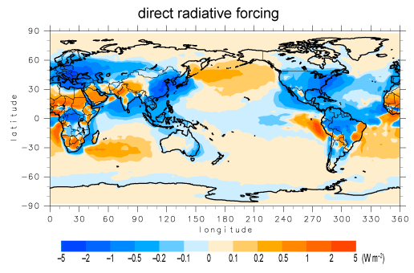
Direct Aerosol Radiative Forcing
From Sprintars model
Aerosol cooling/warming depends on location

Slide 22
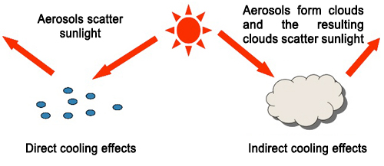
Aerosols and Clouds and Climate
Aerosol particles act as cloud nuclei
Clouds also scatter solar radiation away from earth
Indirect aerosol effect – the clouds are causing forcing effect but the clouds are formed on aerosol particles

Slide 23
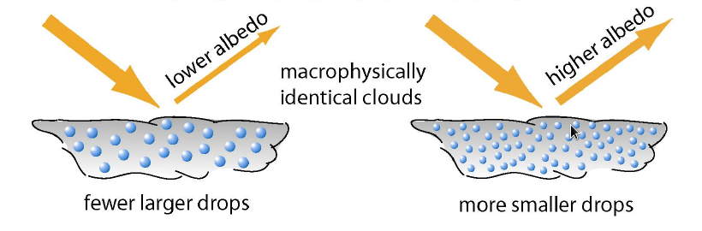
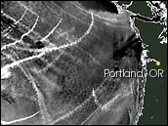
Aerosols and Clouds and Climate
More aerosol particles :
→more cloud droplets
→smaller cloud droplets
→clouds more reflective
→clouds last longer
Shiptracks image
(From M. King)
‘Twomey effect’ or ‘1st Indirect effect’

Slide 24
Aerosols and Clouds and Climate
Black carbon absorbs solar radiation
Heats the air
Warmer temperature → lower relative humidity
Decreased cloud lifetime
Temperature = T
Temperature > T
Less cloud → less cloud scattering → more incoming solar radiation → warmer climate
‘Semi-direct effect’

Slide 25
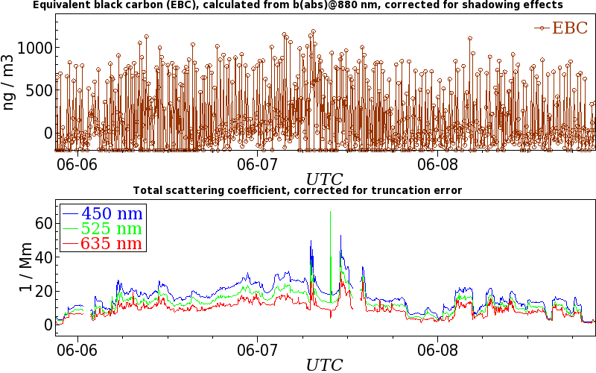
Aerosol Forcing-related measurements in Viet Nam
Aerosol data from Pha Din site in Northern Vietnam
Absorption
Scattering
Back-scattering
Amount: absorption+scattering = extinction
Size: back-scattering
Darkness: scattering/extinction = single scattering albedo

Slide 26
It’s all tied together!
In-situ Aerosol
Monitoring
Physical
Properties
Size, shape, #
Optical
Properties
Scattering,
absorption,
phase function
Chemical
Properties
Hygroscopicity,
toxicity
Health/
Welfare
Visibility
Climate

Slide 27
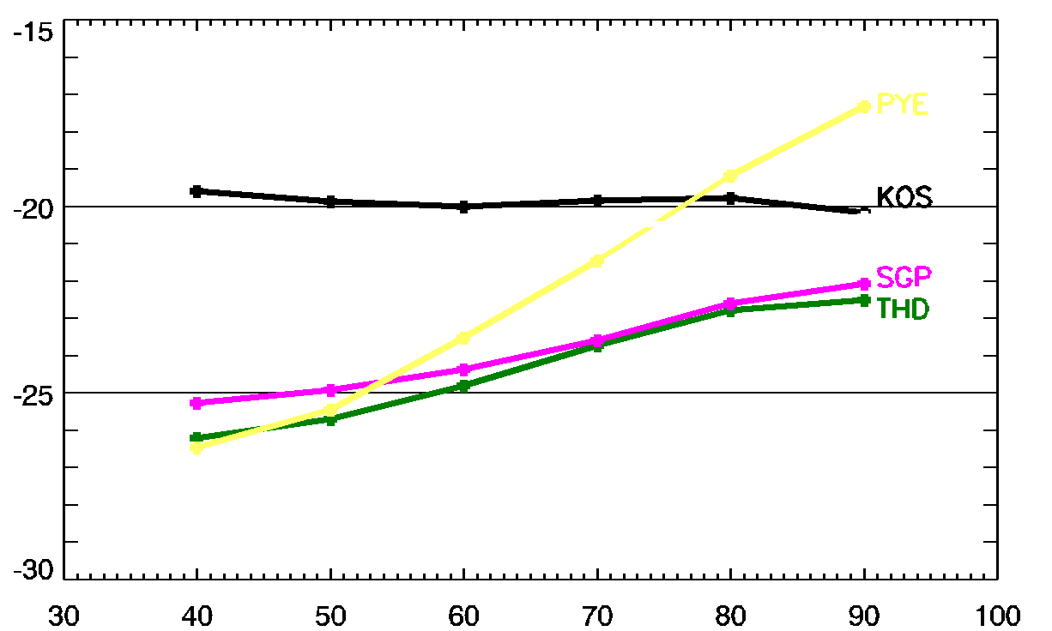
Clean Marine
Radiative forcing efficiency (W m⁻² AOD⁻¹)
Pollutedust
Continental
Polluted Marine
Relative Humidity (%)

Slide 28
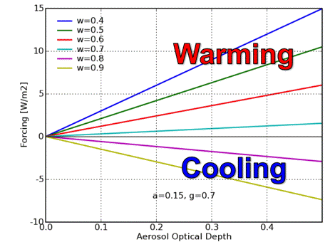
Aerosol amount
Colored lines represent different aerosol darkness values
As aerosol amount increases, the absolute aerosol forcing changes.
Warming/cooling effect depends on aerosol darkness (single scattering albedo)
Increasing Aerosol Amount →
From Olsen, AGU, 2006

Slide 29
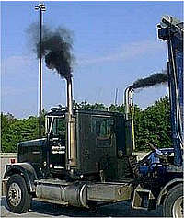
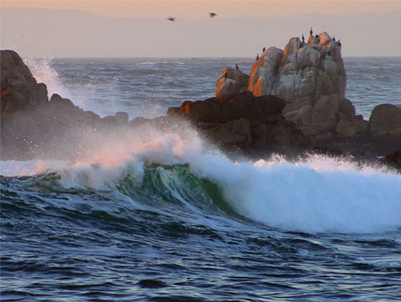
Measured Parameters
These properties depend on AMOUNT of Aerosol:
Light absorption, σ_{ap}
Light scattering, σ_{sp}
Back-scattering, σ_{bsp}
Light extinction, σ_{ext} = σ_{sp} + σ_{ap}
Number concentration, N_{CN}
Clean Region: 10 Mm⁻¹ < Light extinction
Polluted Region: Light extinction > 60 Mm⁻¹
Boulder: light extinction ~10-20 Mm⁻¹
20 Mm⁻¹ ~ 7 μg/m³ PM2.5 ~ 120 miles visibility
100 Mm⁻¹ ~ 33 μg/m³ PM2.5 ~ 24 miles visibility

Slide 30
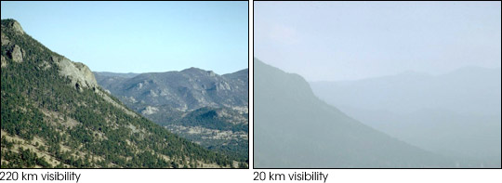
Mm⁻¹ - What are these weird units?
Visibility → How far one can see (distance)
Light extinction inversely proportional to 1/visibility → 1/distance
Distance unit conversions → 1000 m = 1 km = 0.001 Mm
σ_{ext} = 20 Mm⁻¹
σ_{ext} = 200 Mm⁻¹
(130 miles visibility)
(12 miles visibility)
Rocky Mountain National Park http://vista.cira.colostate.edu/views/

