Slide 1
Instruments/Measuring Aerosols
Elisabeth Andrews
CATCOS Aerosol Workshop, June 2016

Slide 2
Making aerosol measurements
Different instruments used to measure different particle properties.
→May need multiple instruments to answer science questions
→Wide range in complexity of aerosol instruments
→Instruments measure on different time scales (<seconds to >days)
Aerosol Property | Instruments
Mass | Filters, TEOM…
Composition | Filters, AMS…
Number | CPC
Size | SMPS, OPC…
Scattering | Nephelometer
Absorption | PSAP, Aethalometer…
Note: there are other aerosol properties that can also be measured (e.g., shape, mixing state, hygroscopicity, …) – those are not covered here!

Slide 3
Categories of aerosol measurements
In-situ
→Offline – time integrated sample over extended time (e.g., PM10)
→Online – ~continuous, ~real time measurement (e.g., aethalometer)
Remote
→Column – integrated through the atmosphere (e.g., AOD)
→Profile – function of altitude (e.g., Lidar)
In-situ instrument
Remote instrument
Particles collected/sensed inside instrument
Effect of particles sensed (typically sun or laser based)
Notes:
Could also split into active and passive. Passive is primarily for gases, typically uses adsorption; active uses pumps to pull air through something

Slide 4
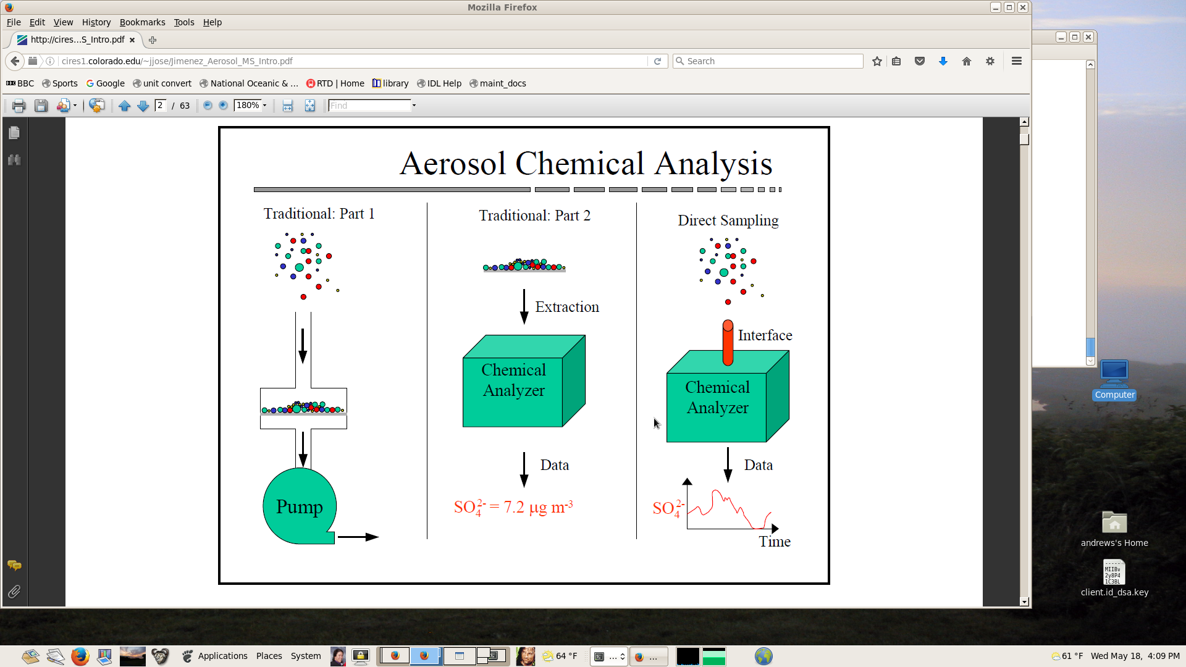
Categories of in-situ aerosol measurements
Offline Analysis
Online Analysis
AMS, XRF, PILS, EC/OC
→Particles collected on filter
→Filters extracted
→Extract sent through chemical analyzer
Bulk analysis
Integrated over time
→Particles directly sampled by chemical analyzer
Can be bulk or single particle
Higher time resolution than filters
From Jimenez AMS webpages

Slide 5
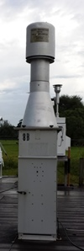
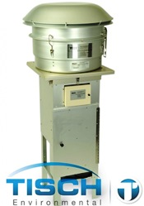
Aerosol Mass – offline method
1. In the lab
→Clean filter is weighed (M_{clean})
2. At the site
→Specially shaped inlet – size cut →Particles collected onto a filter
→Constant flow rate (Q_{sample})
→Sample time recorded (t_{sample})
3. In the lab
→RH equilibration of filter
→Sampled filter is weighed (M_{sample})
Volume of air = Q_{sample}
t_{sample}
PM10 = Particle mass
Volume
Particle mass = (M_{clean}-M_{sample})

Slide 6
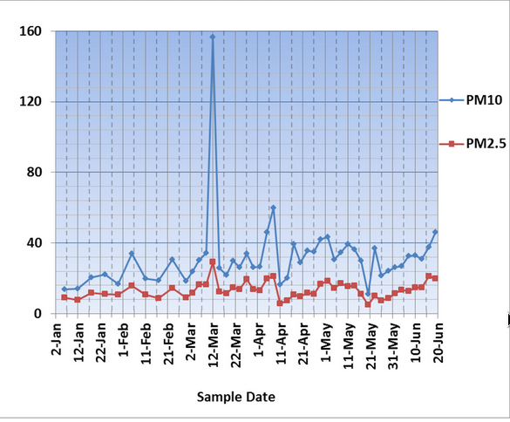
Aerosol Mass – Example offline data
Filter measurements typically collected over hours to days.
Plot shows data for ~6 months
Samples collected every 5-10 days
From Hadjimmitsis et al. 2013

Slide 7
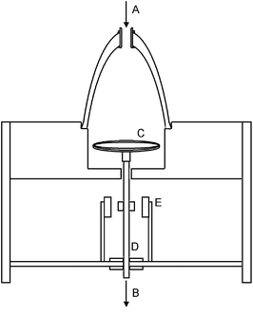
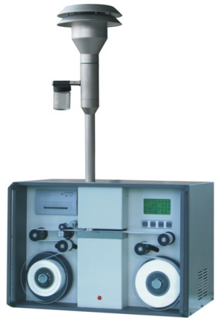
Aerosol Mass – Online methods
Tapered-Element Oscillating Microbalance (TEOM)
→Continuous real time measurement
→Particles collect on vibrating substrate
→Oscillation changes with mass
Beta Attenuation Monitor
(BAM)
→Hourly time measurement
→Particles collect on filter tape
→Beta ray penetration changes with mass
Inlet
Inlet
Vibrating
Substrate
Beta radiation source and detector
Electronics
Filter tape

Slide 8
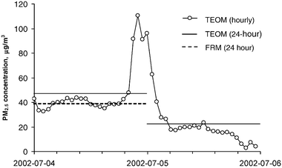
Aerosol Mass – Example online data
Plot shows data for ~2 days
Samples collected every hour
PM2.5 concentration (μg/m³)
Advantage of high frequency measurements:
→captures variability and exposure on shorter time scales
Disadvantage of high frequency measurements:
→more complex instrumentation – more scientist time, more cost

Slide 9
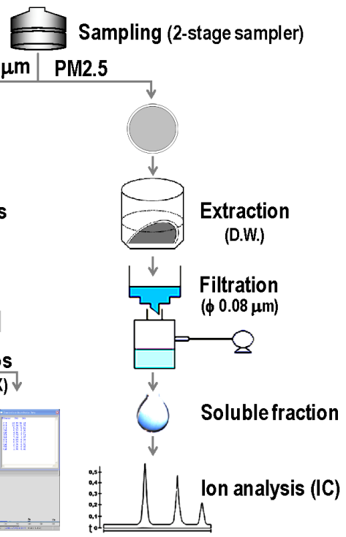
Aerosol chemistry – offline
Chemical analysis of filter samples can require multiple steps after sample collection.
Filter with aerosol particles collected on it.
Extract particles into liquid
Filter to remove non-soluble particles
Ion chromatograph
Inject soluble fraction into chemical analyzer

Slide 10
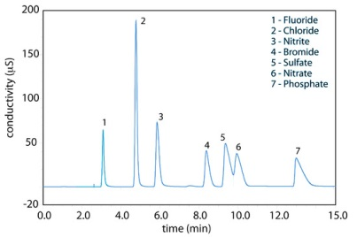
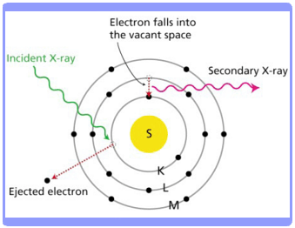
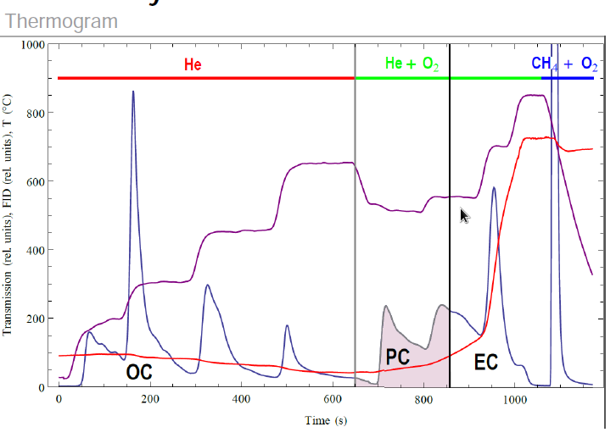
Aerosol chemistry – offline
Examples of chemical filter analysis methods:
→Inorganic ions (ion chromatograph)
→EC/OC (Thermogram)
→Elements (PIXE, XRF)
---Temperature
---Carbon as CO2

Slide 11
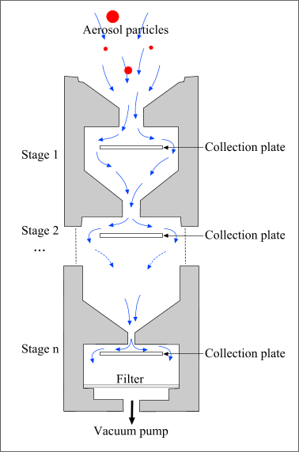
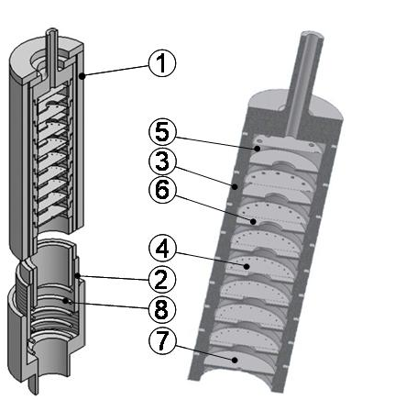
Aerosol chemistry – size-segregated (offline)
Cascade impactor
→Multiple levels
→Each levels collects particles of different size
→Substrates (filters) analyzed offline
Bulk measurement
May require long sampling times
Can also use for mass
From http://elte.prompt.hu
Smallest size cut typically <0.4 μm

Slide 12
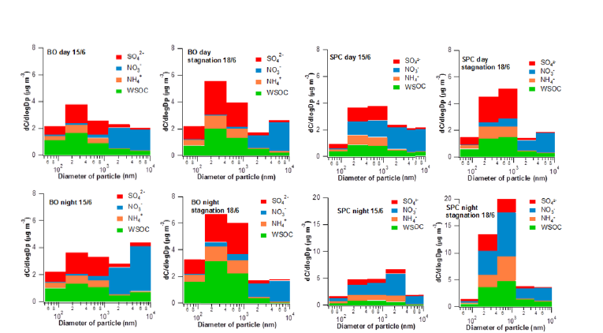
Aerosol chemistry – size segregated (offline)
Mass Concentration
From Sandrini et al., 2016
Diameter
Variations in chemistry and size distribution with time.
Smallest size typically <0.4 μm

Slide 13
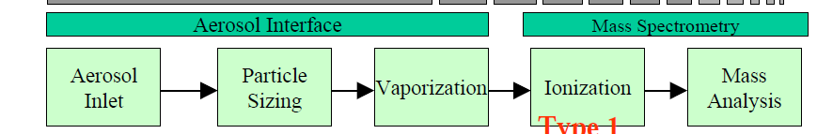
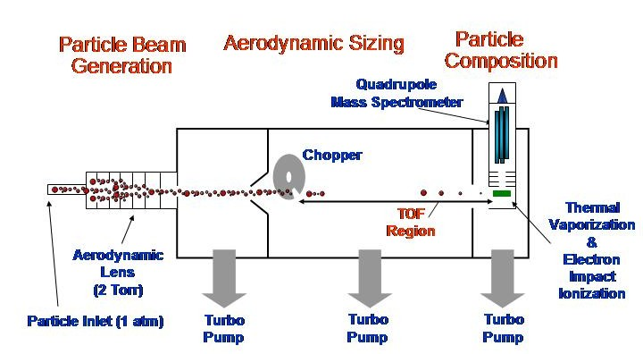
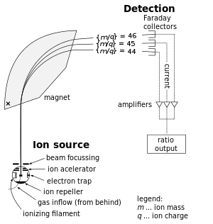
Aerosol Chemistry - Online
Aerosol Mass Spectrometry
From Max Planck Inst
From WIkipedia
Mass spectrometry (MS) is an analytical technique that ionizes chemical species and sorts the ions based on their mass-to-charge ratio.

Slide 14
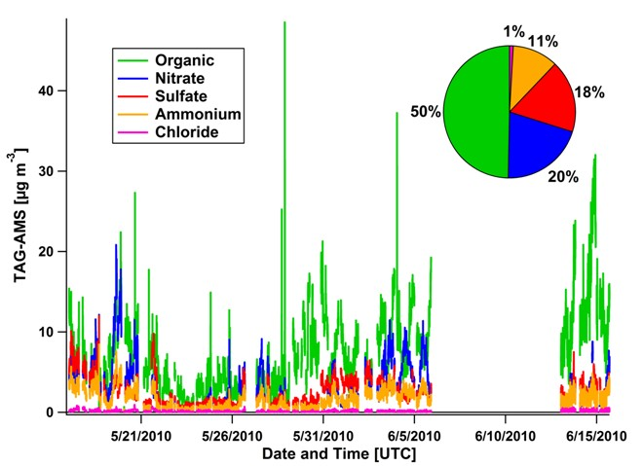
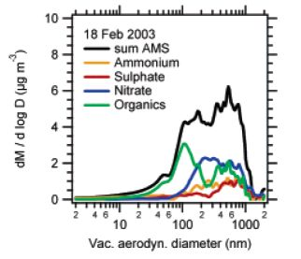
Aerosol Chemistry – Example online data
Bulk chemical composition
Size distribution of chemical composition
Time series of chemical concentration

Slide 15
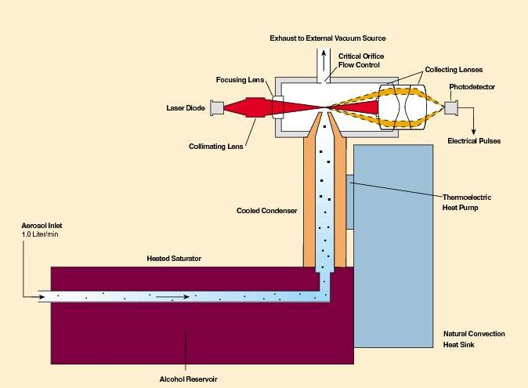
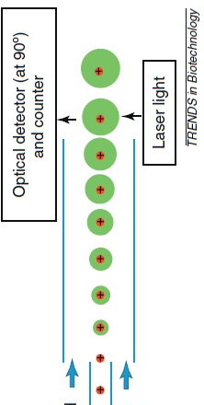
Aerosol Number – Online
Condensation Particle Counter
Minimum size ~0.01 μm
Laser
Photodetector
TSI Inc
→Particles exposed to supersaturated vapor
→Particles grow to size that can be optically detected
Minimum detection size related to instrument temperatures/supersaturations
Notes:
Size ran

Slide 16
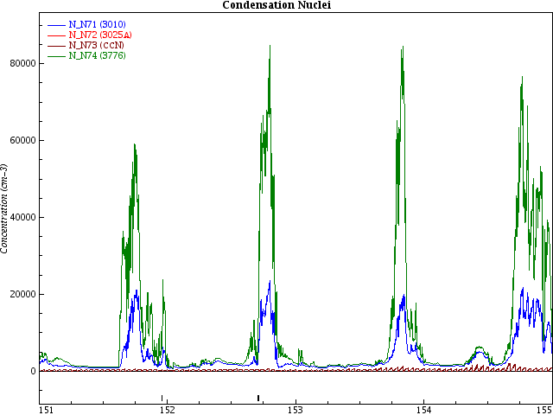
Aerosol Number – Example data
TSI 3010 dp> 0.01 μm
TSI 3776 dp> 0.004 μm
Number concentration (cm⁻³)
Nucleation
Gas phase
molecules
Molecular
Cluster
Detectable
Particle
Day of Year, 2016
Significant difference between two particle counters due to new particles formed by nucleation “secondary aerosol”

Slide 17
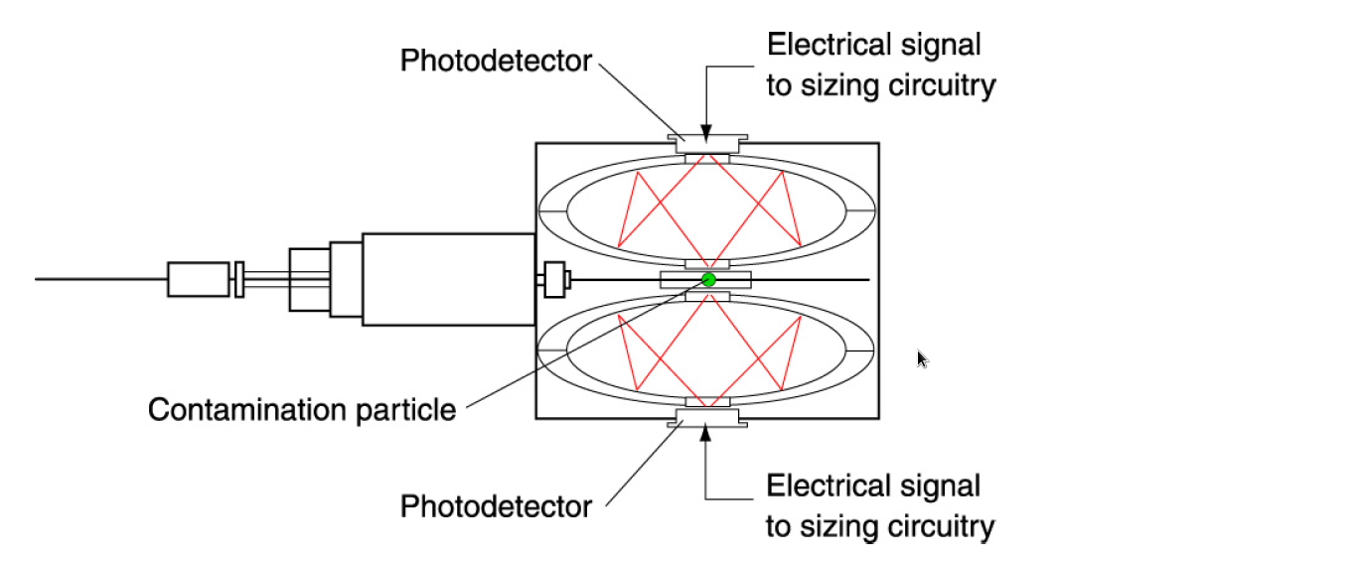
Aerosol Size Distribution – Optical Method
Optical Particle Counter
→Particles scatter light
→Amount of scattering related to size
→Calibrated with particles of known size
Light
source
Minimum size ~0.1 μm

Slide 18
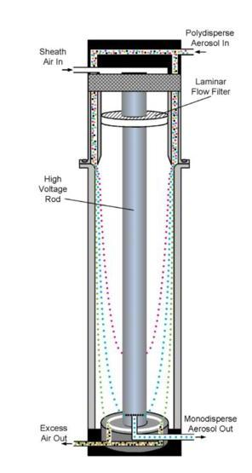
Aerosol Size Distribution – Electrical Mobility Method
Differential Mobility Analyzer (DMA)
→particles charged
→amount of charge depends on size
→voltage determines size exiting
→particles are counted
High voltage rod
DMAs with changing voltages are called:
SMPS (scanning mobility particle sizer)
or
SEMS (scanning electrical mobility sizer)
Size range ~0.01-1 μm
Particle counter

Slide 19
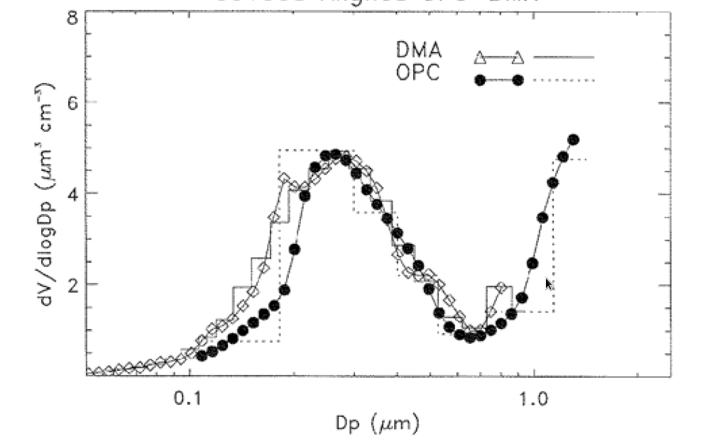
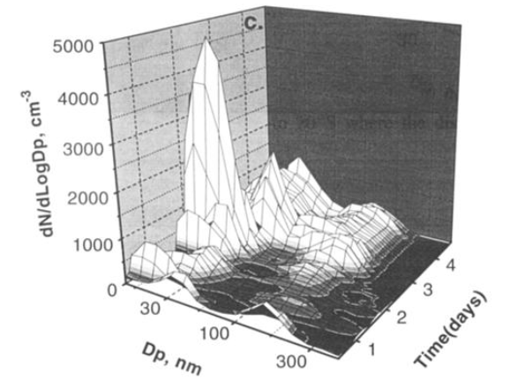
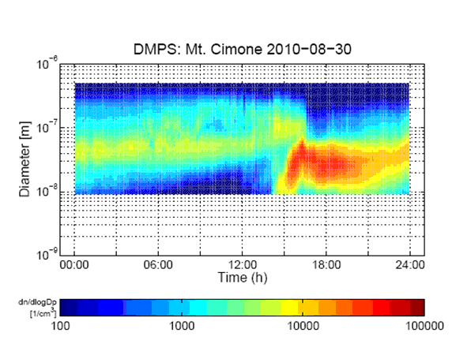

Aerosol Size Distribution – Example data
Size distributions change with time
From J. Hand
DMA
OPC
From Covert et al 1996
Merged volume size distribution data from OPC and SMPS
‘banana’ curve used to identify nucleation events

Slide 20
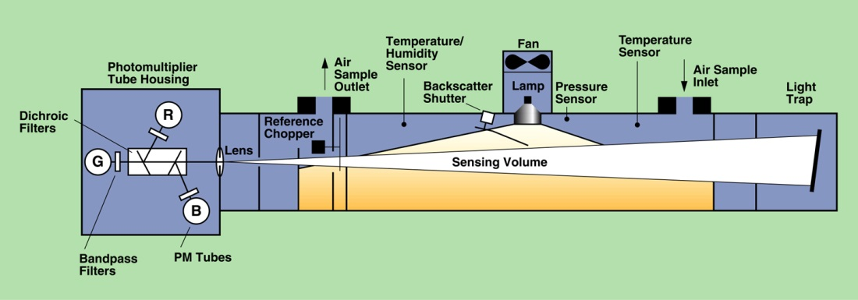
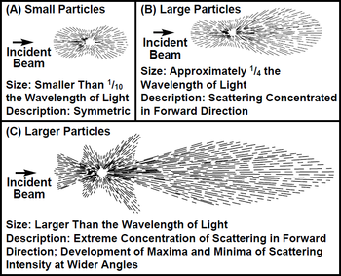
Aerosol Optical Properties - Scattering
Nephelometer
→particles scatter light in sensing volume
→photomultiplier tubes detect scattered light
Common options:
Multiple wavelength
Angular dependence of scattering
Calibrated with gas like CO2

Slide 21
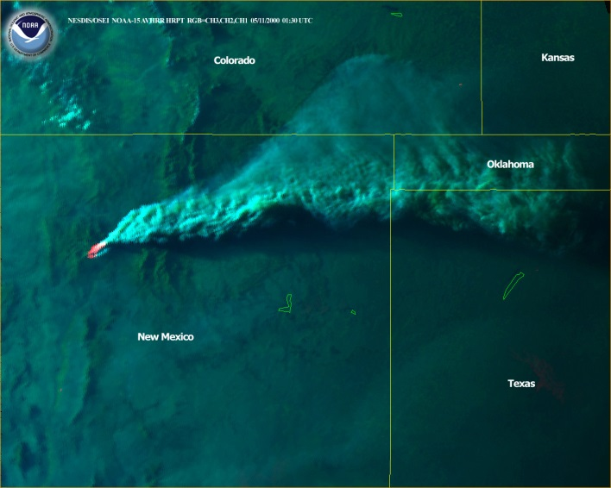
Aerosol Optical Properties – Example scattering data
Surface and airborne nephelometer measurements show passage of smoke plume.
AVHRR satellite image
scattering (Mm⁻¹)

Slide 22
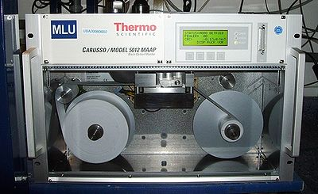
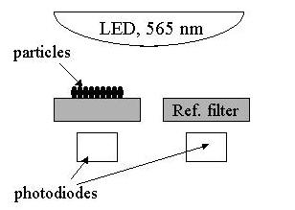
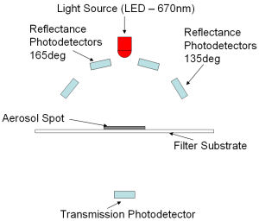
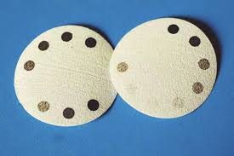
Aerosol Optical Properties - Absorption
Filter-based absorption measurements:
PSAP – Particle Soot Absorption Photometer
TAP – Tri-color Absorption Photometer
Aethalometer
MAAP – Multi-Angle Absorption Photometer
MAAP
Light source
These are on-line measurements
TAP filters

Slide 23
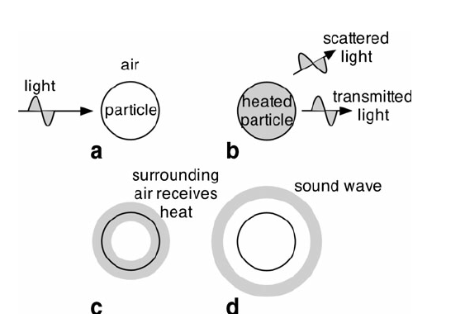
Aerosol Optical Properties - Absorption
Photo-acoustic Spectrometer
Light source
Particle absorbs light
Heating
1
2
From Arnott et al 2005
Pressure (sound) wave
Acoustical detection
3
4
The heated air expands, resulting in sound wave
→advantage: no scattering or filter effects to interfere with measurements
→disadvantage: can be sensitive to pressure changes, complicated!

Slide 24
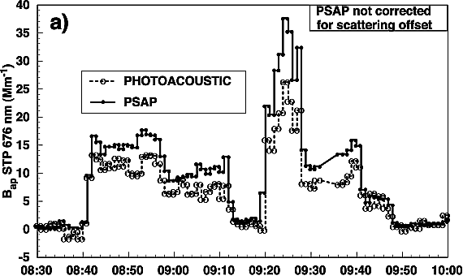
Aerosol Optical Properties – Example absorption data
From Arnott 2005
Filter-based PSAP and photo-acoustic spectrometer track each other.
PSAP > photo-acoustic because PSAP has scattering artifact

Slide 25
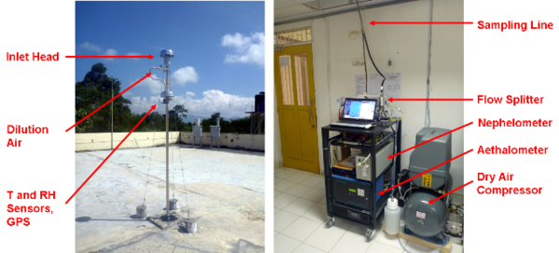
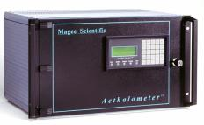
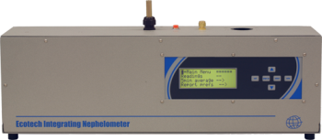
Aerosol Optical Properties – Pha Din
Measurements started, 2014
Aerosol light absorption
Aerosol light scattering
Aethalometer
Nephelometer

Slide 26
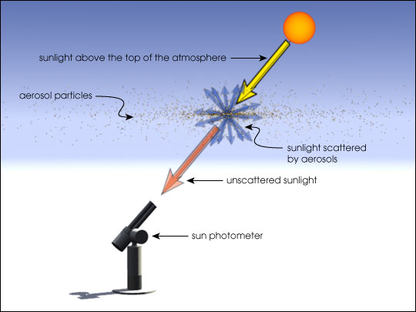
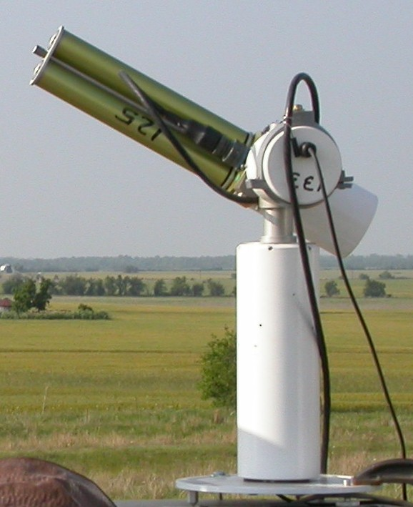
Remote sensing – Aerosol Optical Depth
Sunphotometer
→The Sun is the light source
→The atmosphere is the ‘sensing volume’
→Sun photometer points directly at sun
→Light detector measures how much solar radiation comes through atmosphere
As the aerosol increases, more light is scattered out of the direct solar beam → sun photometer measurement decreases.
Daytime measurement only

Slide 27
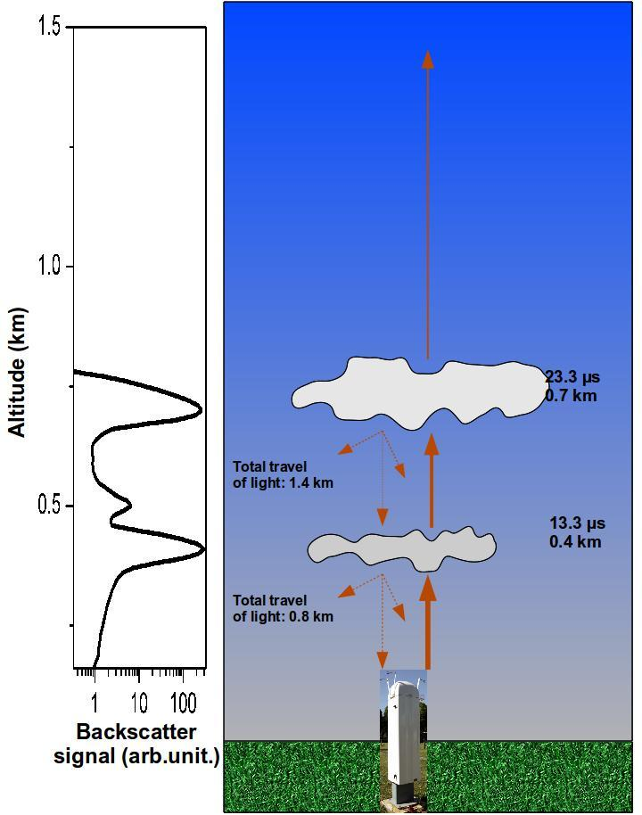
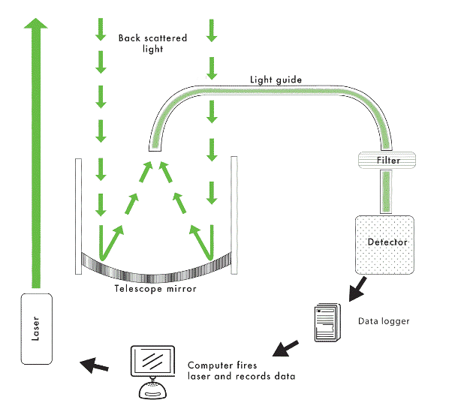
Remote sensing – Aerosol extinction profile
Lidar
→Pulsed laser is the light source
→The atmosphere is the ‘sensing volume
→Telescope detects backscattered light
Because laser is pulsed can use time of backscatter returns to determine height
Particles scatter light
Backscattered light
Pulsed laser

Slide 28
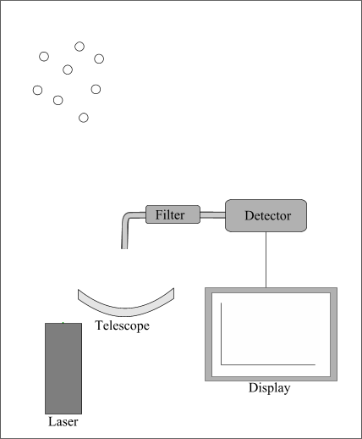
Remote sensing – Aerosol extinction profile
Lidar
→Pulsed laser is the light source
→The atmosphere is the ‘sensing volume
→Telescope detects backscattered light
Because laser is pulsed can use time of backscatter returns to determine height

Slide 29
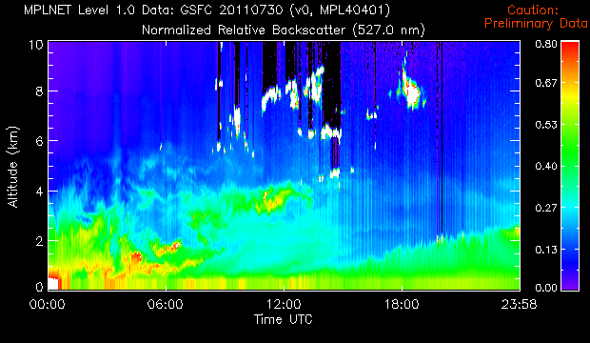
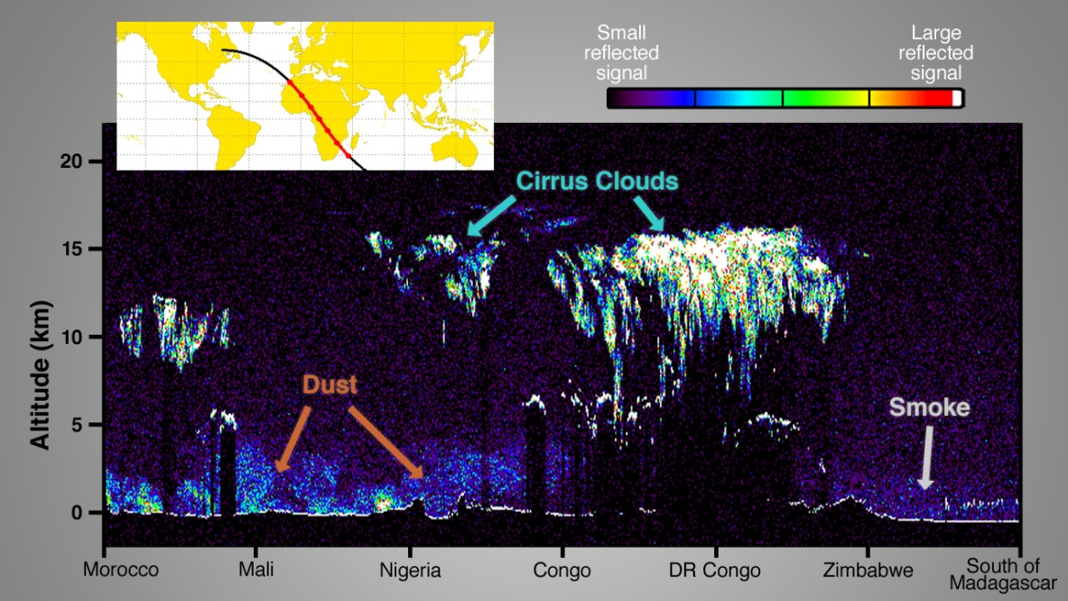
Remote sensing – Lidar example data
Surface-based lidar measures as function of time
From MPLNet lidar
Airborne/satellite lidar measures as function of distance
From NASA satellite lidar

Slide 30
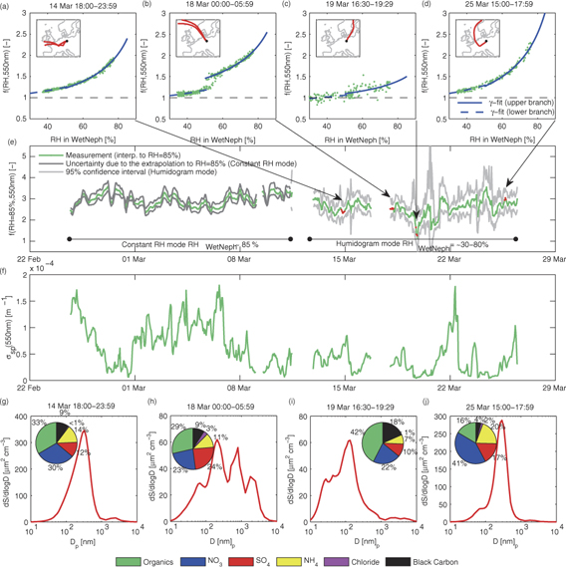
Aerosol Measurements – Putting them all together!
Source region and water uptake
Scattering
Chemistry and size
Zieger et al 2014

Slide 31
Many methods to measure different characteristics of aerosol particles
Multiple methods to measure the same aerosol characteristic
Choose methodology based on:
→science
→cost
→time

Slide 32
Unused slides

Slide 33
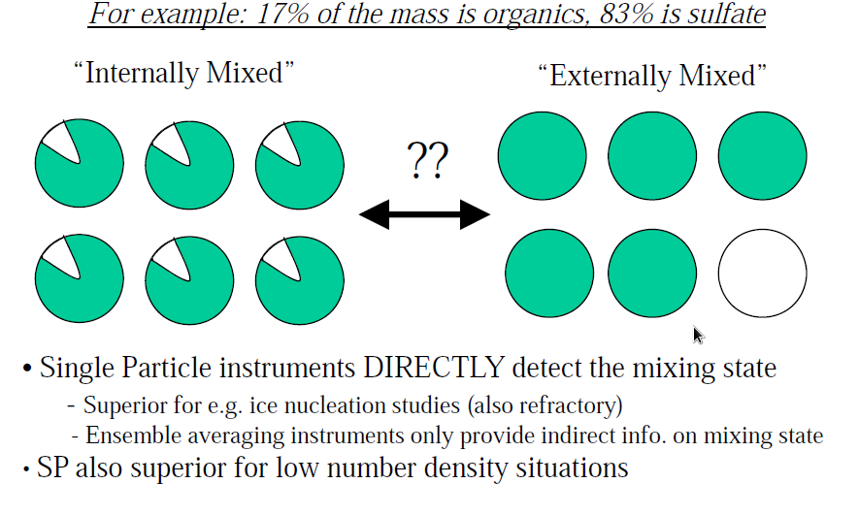
Aerosol chemistry – bulk vs single particle
From Jimenez AMS webpages

Slide 34
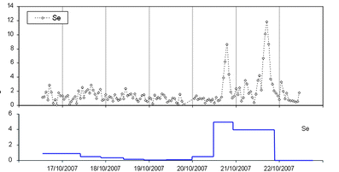
Hourly PIXE and 12 hourly filters
Sanchez de la Campa et al., 2011

Slide 35
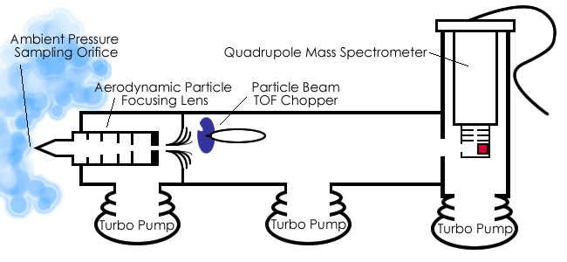
Extra stuff

Slide 36


Slide 37
NOAA Aerosol Rack at Mauna Loa, Hawaii
Provides size- and RH-controlled measurements of aerosol
  light scattering
  light absorption
  number concentration
Common, core design at NOAA-federated stations
Optional components: CCN, humidified nephelometry (f(RH)), SMPS, aerosol composition

