Slide 1
International aerosol networks:
Sharing the monitoring on aerosol
Elisabeth Andrews
CATCOS Aerosol Workshop, June 2016

Slide 2
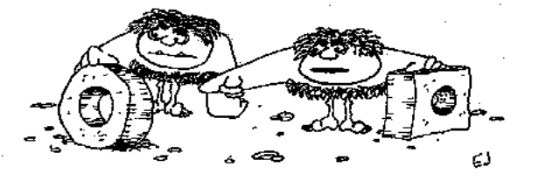
Advantages of a long-term “Aerosol Network”
→Shared expertise and protocols:
Measurement techniques
Sample treatment
Data treatment (archiving, quality control, corrections)
I have found this one works a lot better!
→Shared science enabled due to consistent data
Characterization of aerosol on regional scales
Site climatologies (e.g., Arctic, Mountain, etc.)
Global/Regional model comparisons (spatial coverage)
Opportunities for more collaborations
→long-term context for campaigns
→instrument intercomparisons

Slide 3

Examples of long-term “Aerosol Networks”?
Surface aerosol optical property networks:
ACTRIS, NOAA, CATCOS
Column aerosol optical properties
AERONET, SURF-RAD
Vertical profiles of aerosol extinction
ACTRIS, AD-NET, LALiNET
Surface aerosol mass and composition
ACTRIS, IMPROVE, CARE
GAW (Global Atmospheric Watch):
Database of sites and networks
Documention of suggested measurement protocols
https://gawsis.meteoswiss.ch/GAWSIS//index.html#/

Slide 4
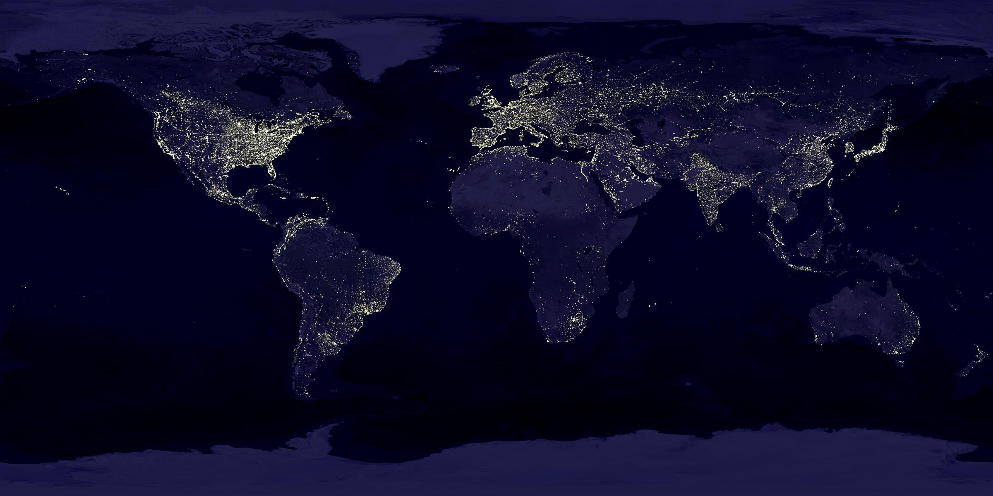
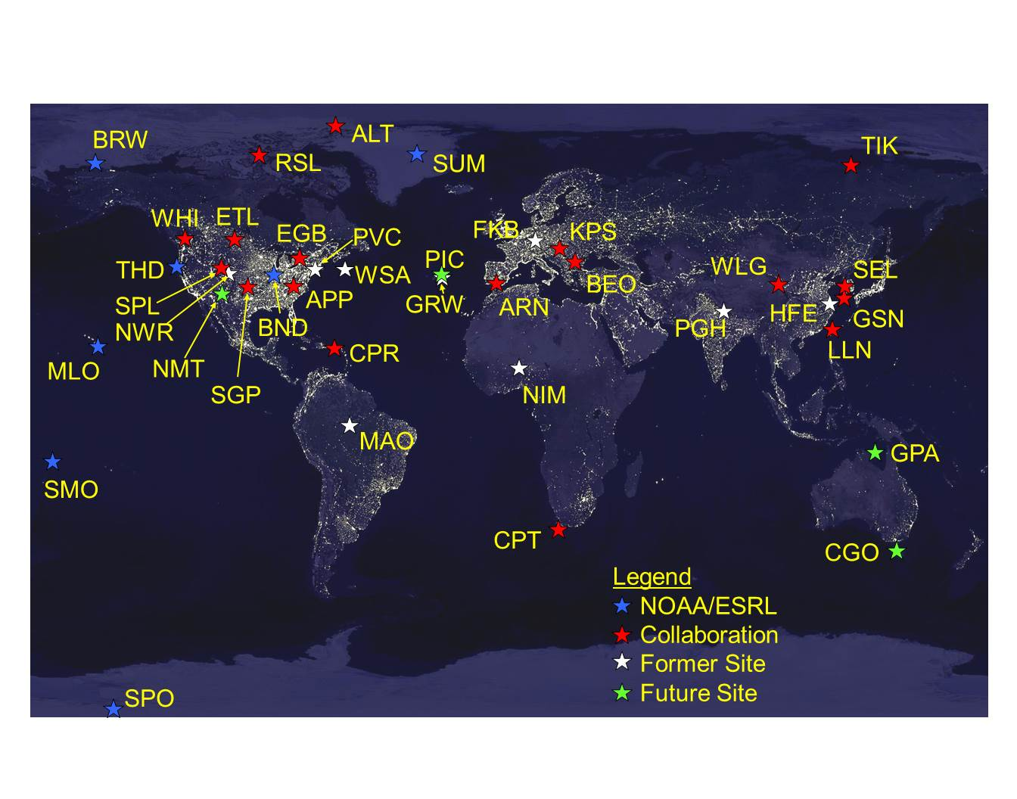
Networks evolve over time
New research priorities
New measurement tools
More science
Shared resources, collaborations
NOAA, 1972-1992
Background Aerosol
NOAA, 2016
Regional Aerosol

Slide 5
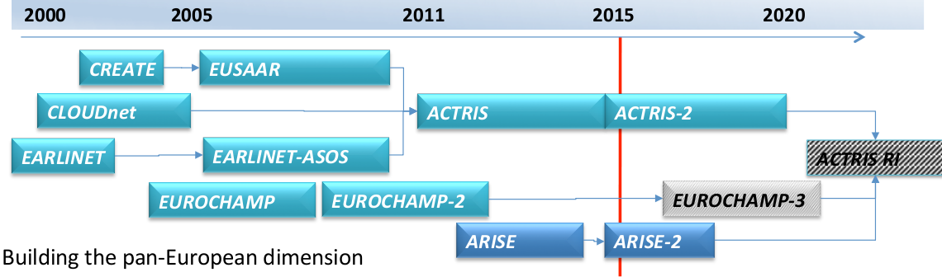
Networks evolve over time
ACTRIS Long-term Strategy: Integrate network of European ground-based stations for aerosols, clouds and gases.
Long‐term observations related to climate, air quality, and long‐range transport
Direct observation of atmospheric hazards
Notes:
Create – creating a combined data base of aerosol measurements
Eurochamp – atmospheric processes in chambers
Arise atmospheric dynamics

Slide 6
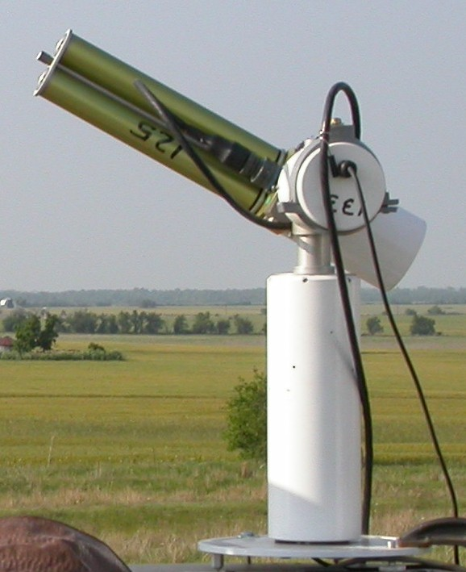
Aerosol Robotic Network (AERONET)
Coordinated by NASA
Measures Aerosol Optical Depth (AOD)
Retrieves other column aerosol properties (constraints)
Approximately 500 sites
Daytime, cloud-free measurements
Data freely available
http://aeronet.gsfc.nasa.gov/

Slide 7
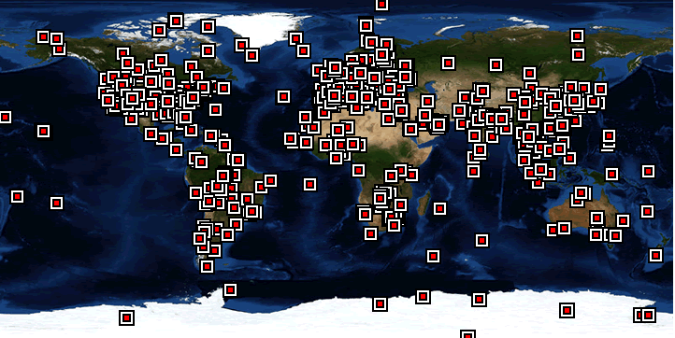
Aerosol Robotic Network (AERONET)
http://aeronet.gsfc.nasa.gov/

Slide 8
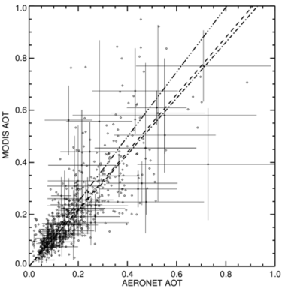
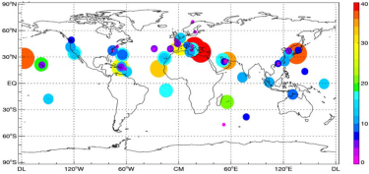
Aerosol Robotic Network (AERONET)
Uses of AERONET data
→model assimilation
→model validation
→satellite validation
→aerosol climatologies
Satellite (MODIS) and AERONET overlap
Satellite (MODIS)
From Geogdzhayev and Mischenko, 2015
AERONET

Slide 9
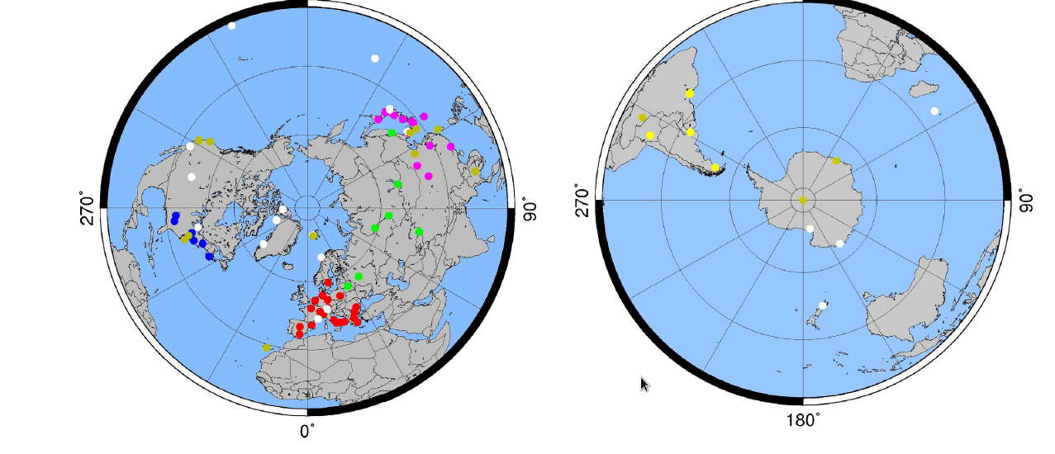
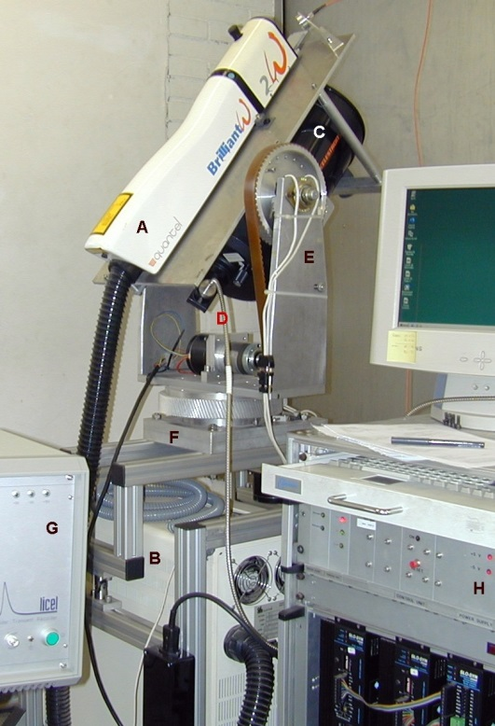
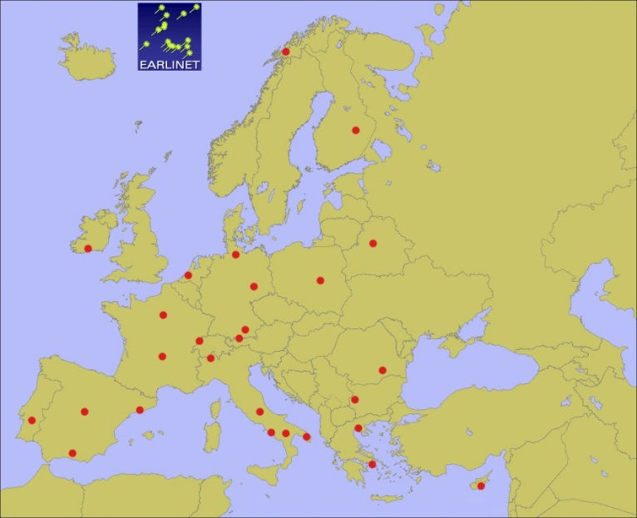
Lidar Networks
→Provide profiles of aerosol extinction and backscatter
Earlinet
AD-net
LALiNet
CISLiNet
MPLNET
NDACC
REALM
EARLINET

Slide 10
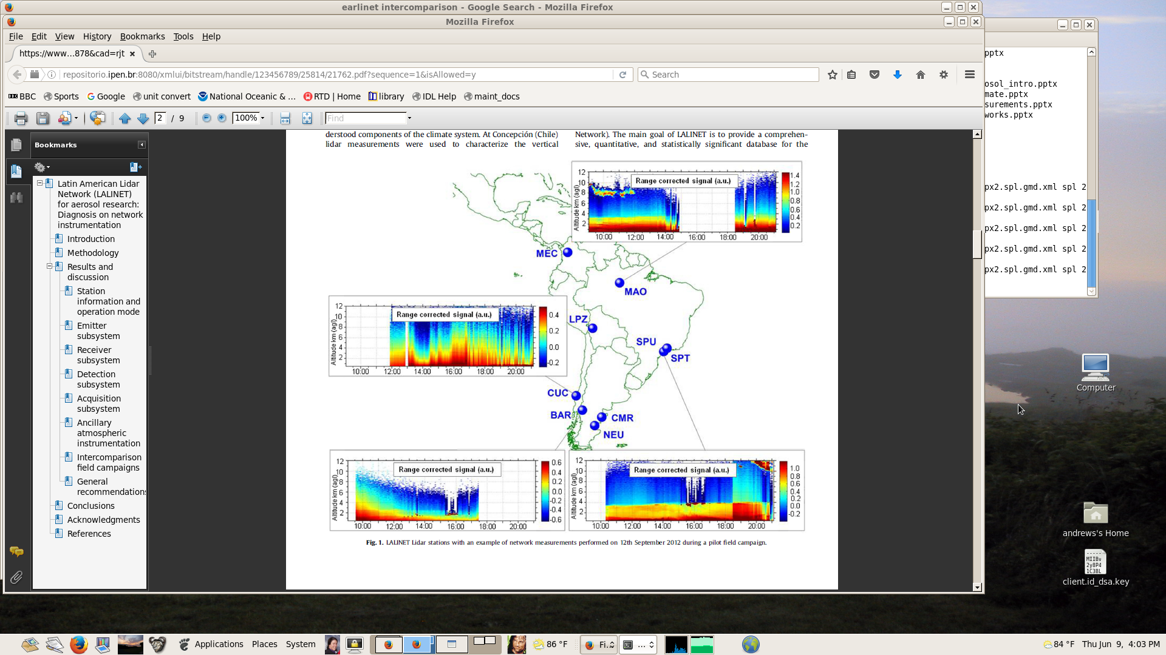
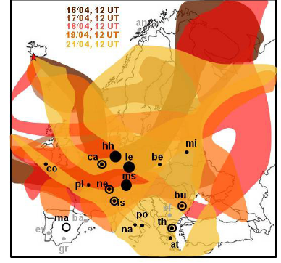
Lidar Networks
Uses of lidar network data
→model validation
→satellite validation
→aerosol climatologies
→forecasting (dust, volcano)
Earlinet – used to identify height/location of volcanic plume during Icelandic eruption
LALiNet – developing a climatology of aerosol profiles over South America

Slide 11
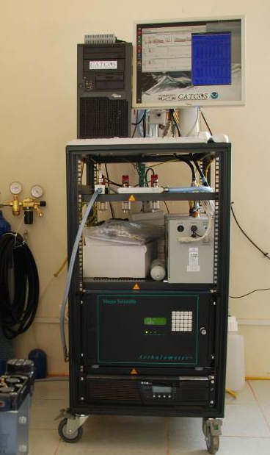
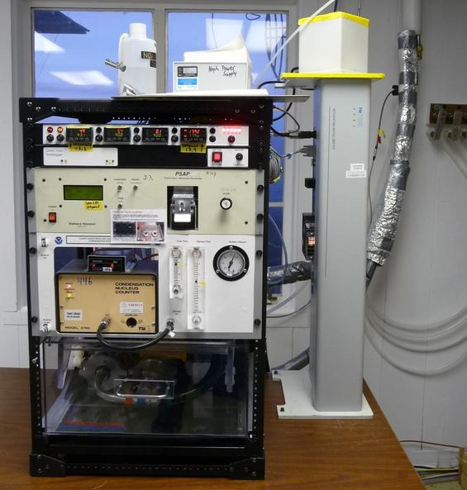
Surface aerosol optical property networks
Provides measurements of:
  Aerosol light scattering
  Aerosol light absorption
→Typically size and RH controlled
→Often multi-wavelength
→Some data sets are multi-decadal
Pha Din, Vietnam
Several Networks:
ACTRIS
NOAA collaborative
CATCOS
{IMPROVE}
Mauna Loa, USA

Slide 12
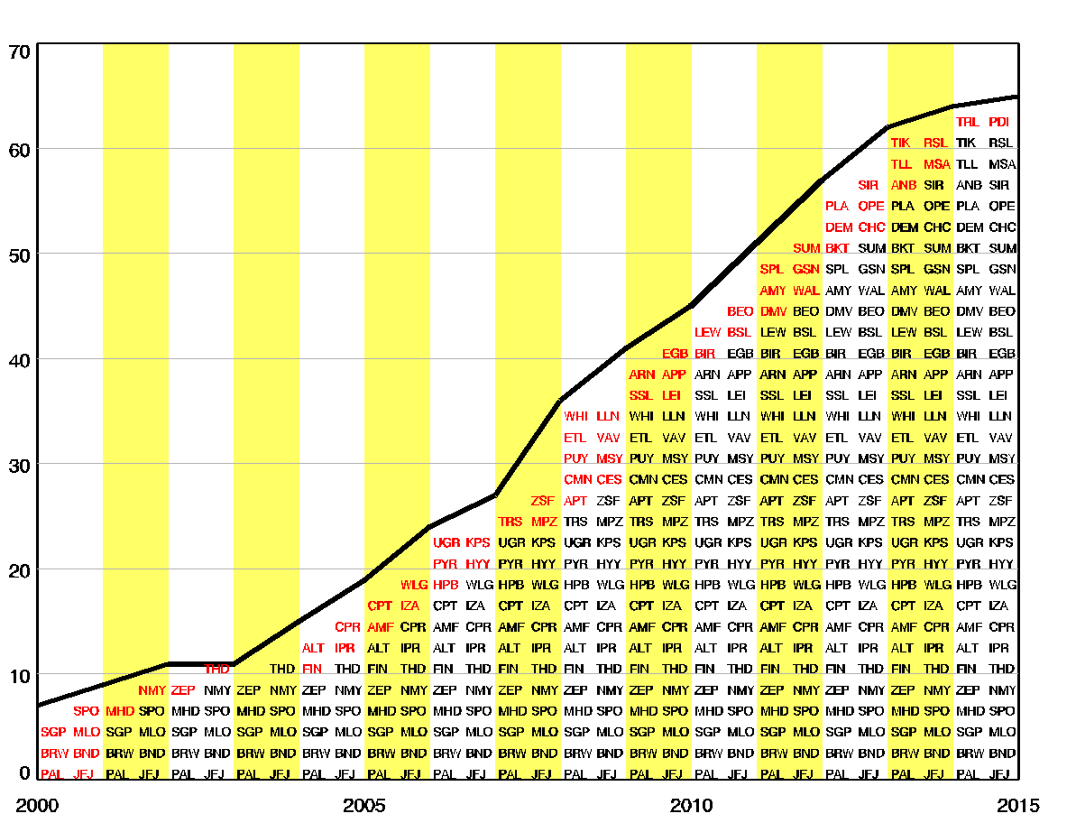
Surface aerosol optical property networks
Stations with absorption and/or scattering data between 2000 and 2015
Number of stations increasing by ~5/year
Data for more than 60 sites by 2015
Number of Stations
YEAR

Slide 13
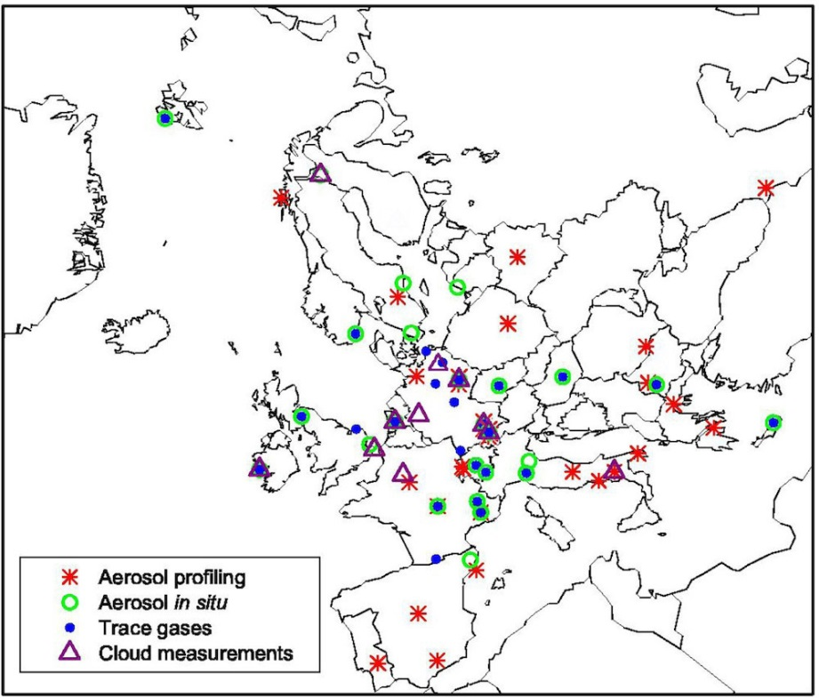
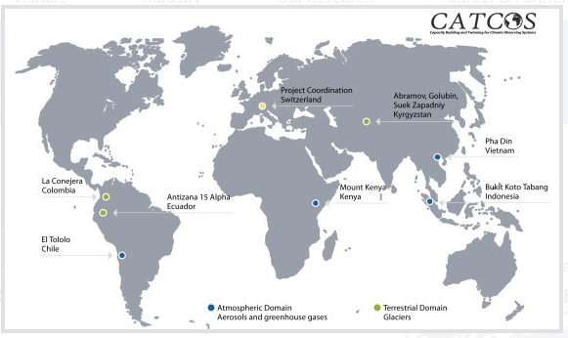
Surface aerosol optical property networks
NOAA Collaborative Network ~25 sites
Networks have different spatial density
All follow GAW recommended protocols
Collaborations exist among the networks
ACTRIS Network ~20 sites
CATCOS Network ~4 sites
Aerosol
in-situ sites

Slide 14
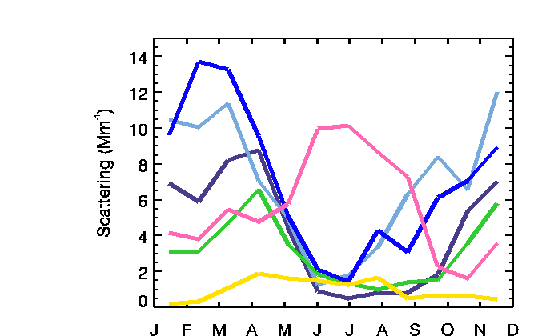
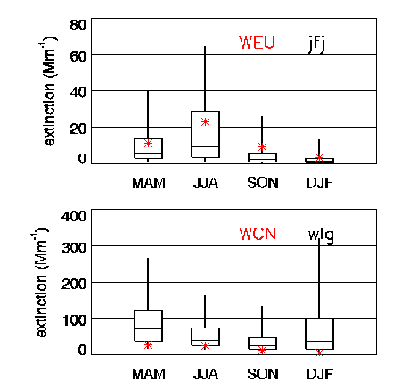
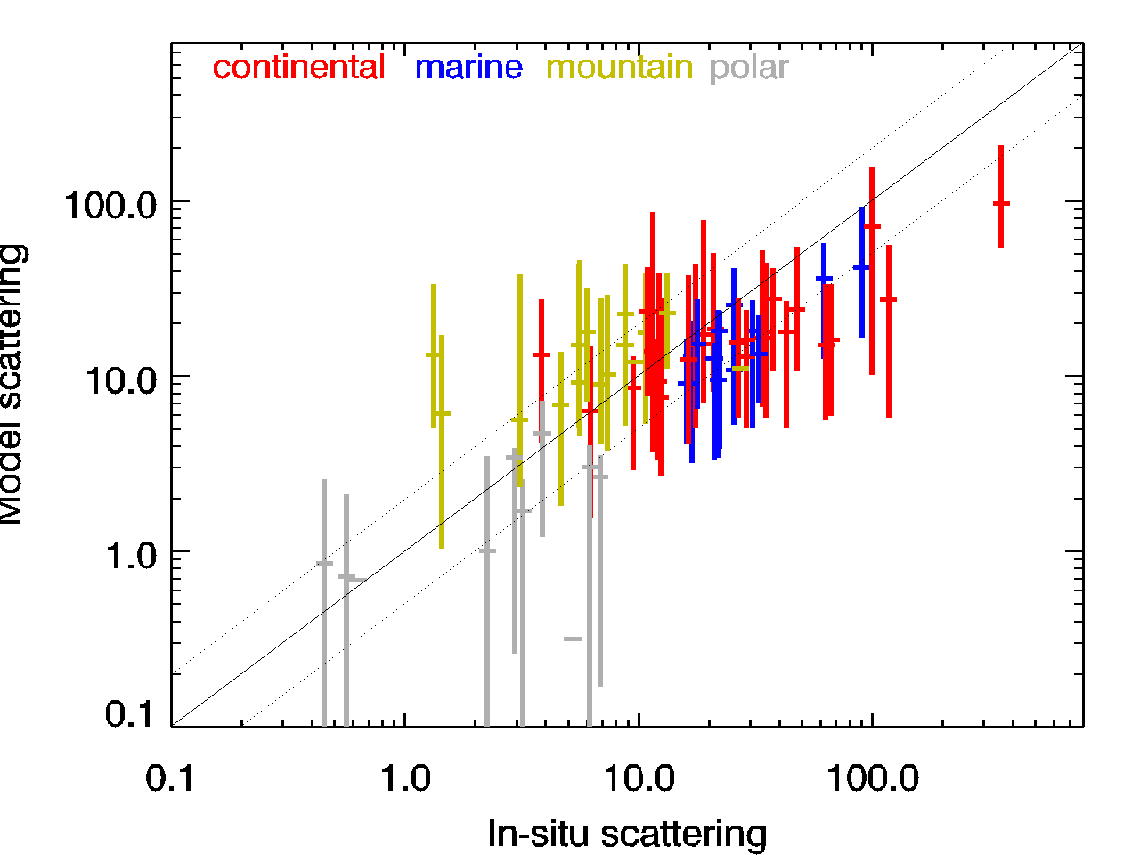
Surface aerosol optical property networks
Uses of optical property network data
→model validation
→satellite validation
→aerosol climatologies
Arctic aerosol climatology
ALT BRW PAL SUM TIK ZEP
Model scattering
Satellite/measurement comparison
*Calipso JFJ
Model/measurement comparison
*Calipso WLG
Model scattering
Measured scattering

Slide 15
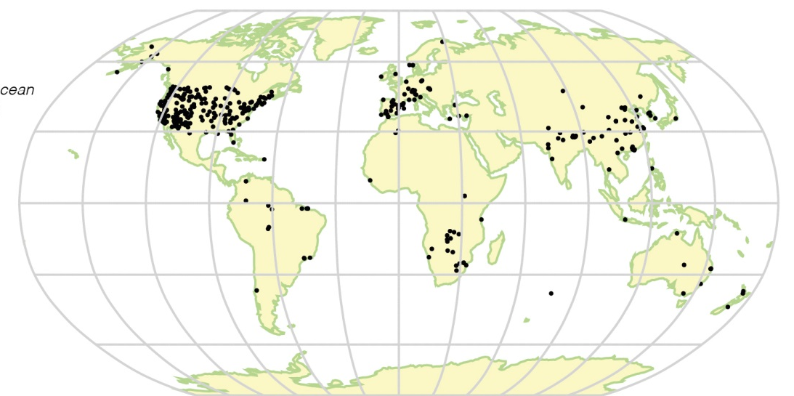
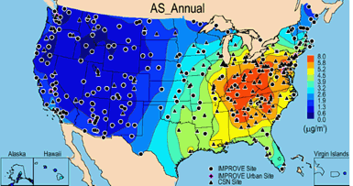
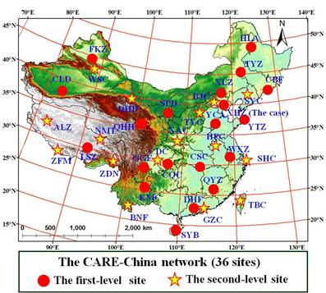
Aerosol mass/chemistry networks
Chemistry measurements primarily in USA, Europe, China
Varies what species are measured and size range
Measurement focus typically air quality/health
PM10 chemistry measurements cited in IPCC report

Slide 16
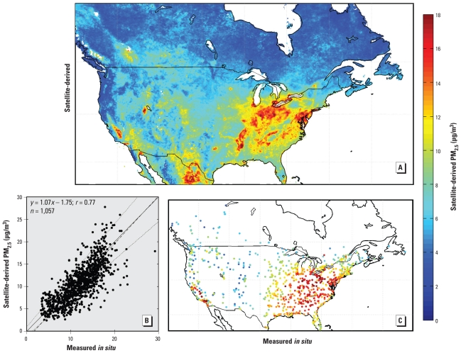
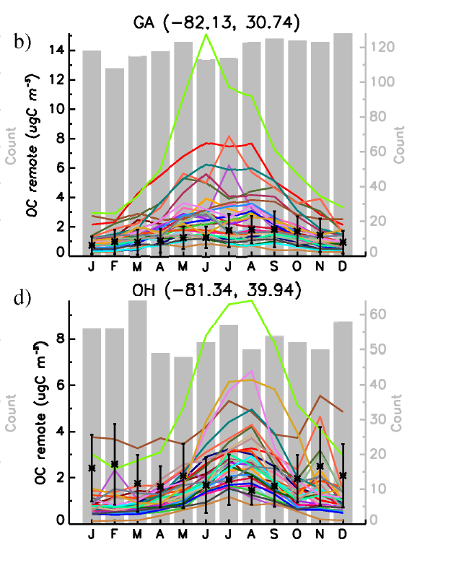
Aerosol mass/chemistry networks
Uses of mass/composition network data
→model validation
→satellite validation
→aerosol climatologies
Satellite/measurement comparison
Model/measurement comparison
Satellite PM2.5
Surface PM2.5
From van Donkelaar et al., 2010
From Tsigaridis et al., 2010

Slide 17
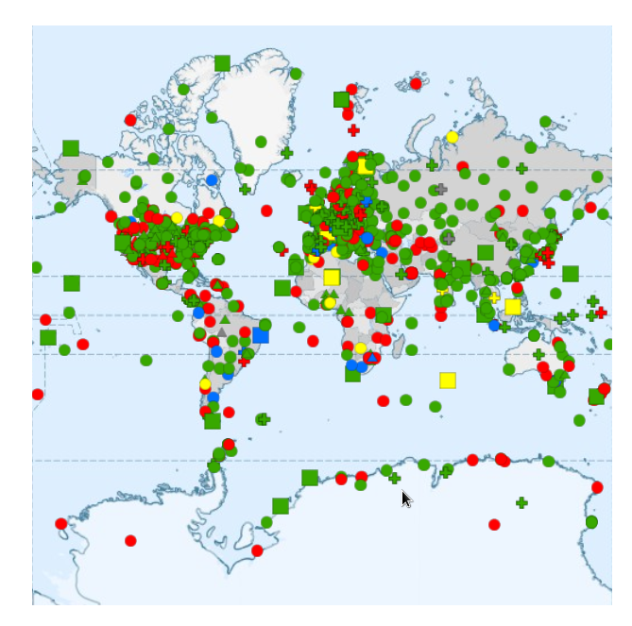
Surface aerosol networks and the big picture
GAW (Global Atmospheric Watch):
Searchable database
  Also gas and solar measurements
  Measurement type
  Location type (mountain, arctic)
  Network
  Many more options
https://gawsis.meteoswiss.ch/GAWSIS//index.html#/

Slide 18
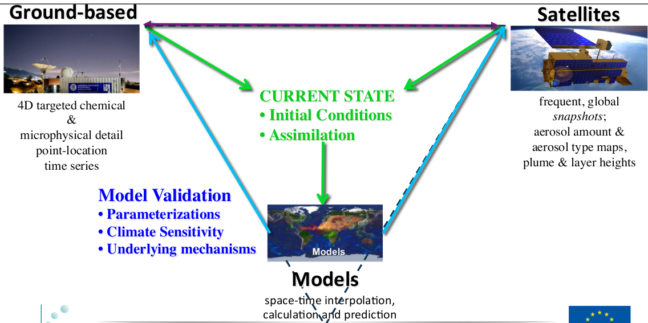
Surface aerosol networks and the big picture
Surface networks – provide details
Satellites – provide global context
Models – test understanding

Slide 19
UNUSED SLIDES

Slide 20
Symbiosis, Collaboration and the Long View
Compare data from NOAA and other networks in terms of extinction and RFE
NOAA scat+abs
NOAA scat+bscat+abs
Dry aerosol extinction
Radiative forcing efficiency
IMPROVE chem spec
IMPROVE chem spec
Assumed angular scat parameter
Extinction (Mm⁻¹)
RFE (W m⁻² AOD⁻¹)
Bondville, IL
(2001-2005)
Assumed β=0.27

Slide 21
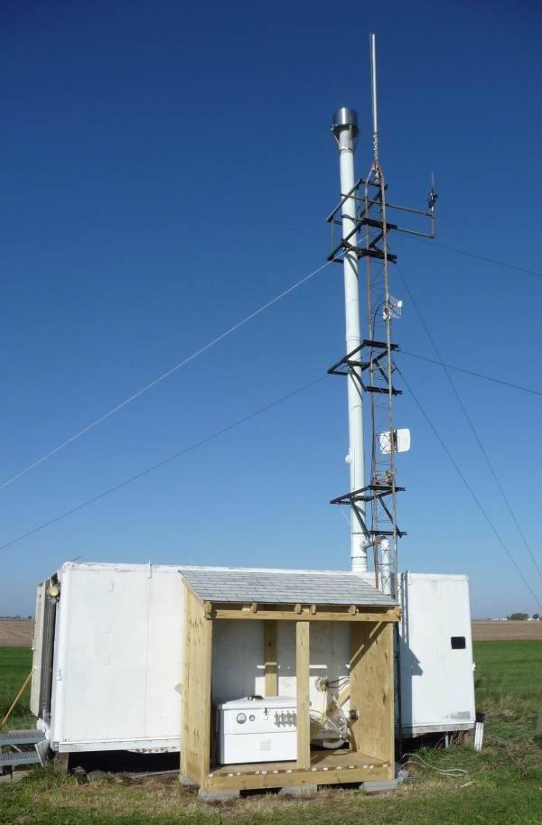
Aerosol group in NOAA/ESRL/GMD
→Characterize the means, variabilities, and trends of climate-forcing properties of different types of aerosols
→To understand the factors that control these properties.
Bondville, IL
Our approach:
→Standardized suite of measurements and protocols
→Globally distributed network (pristine and polluted sites)
→Long-term fixed and shorter-term “mobile” sites
Some applications:
Climate change calculations
Ground truth for remote sensing (e.g., satellites)
Evaluate/constrain models

Slide 22
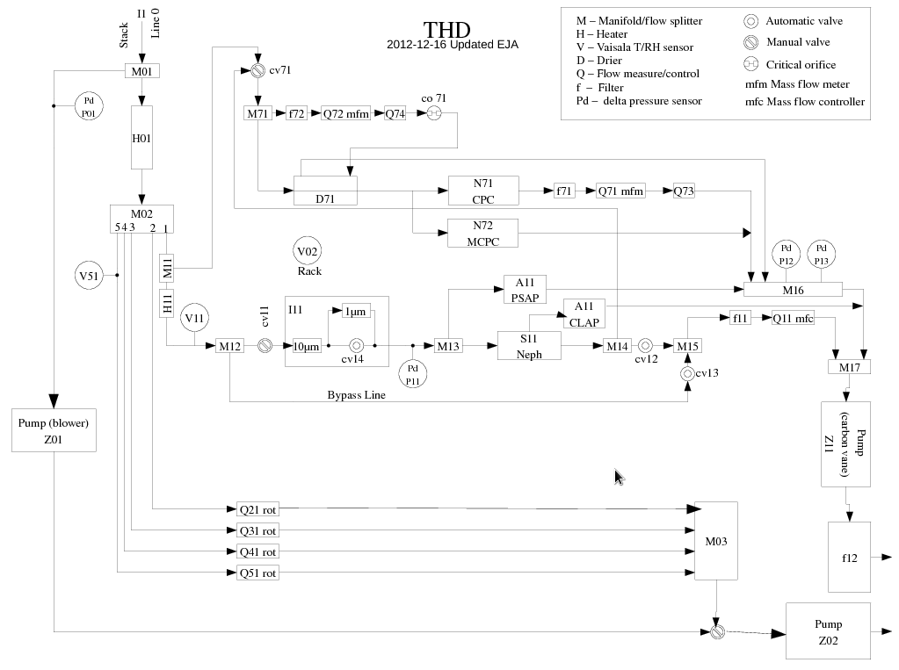
Long-term Remote Operations…
Daily data checks
Weekly QC
On-site tech training
Remote access
Annual visits
Tons of documentation

Slide 23
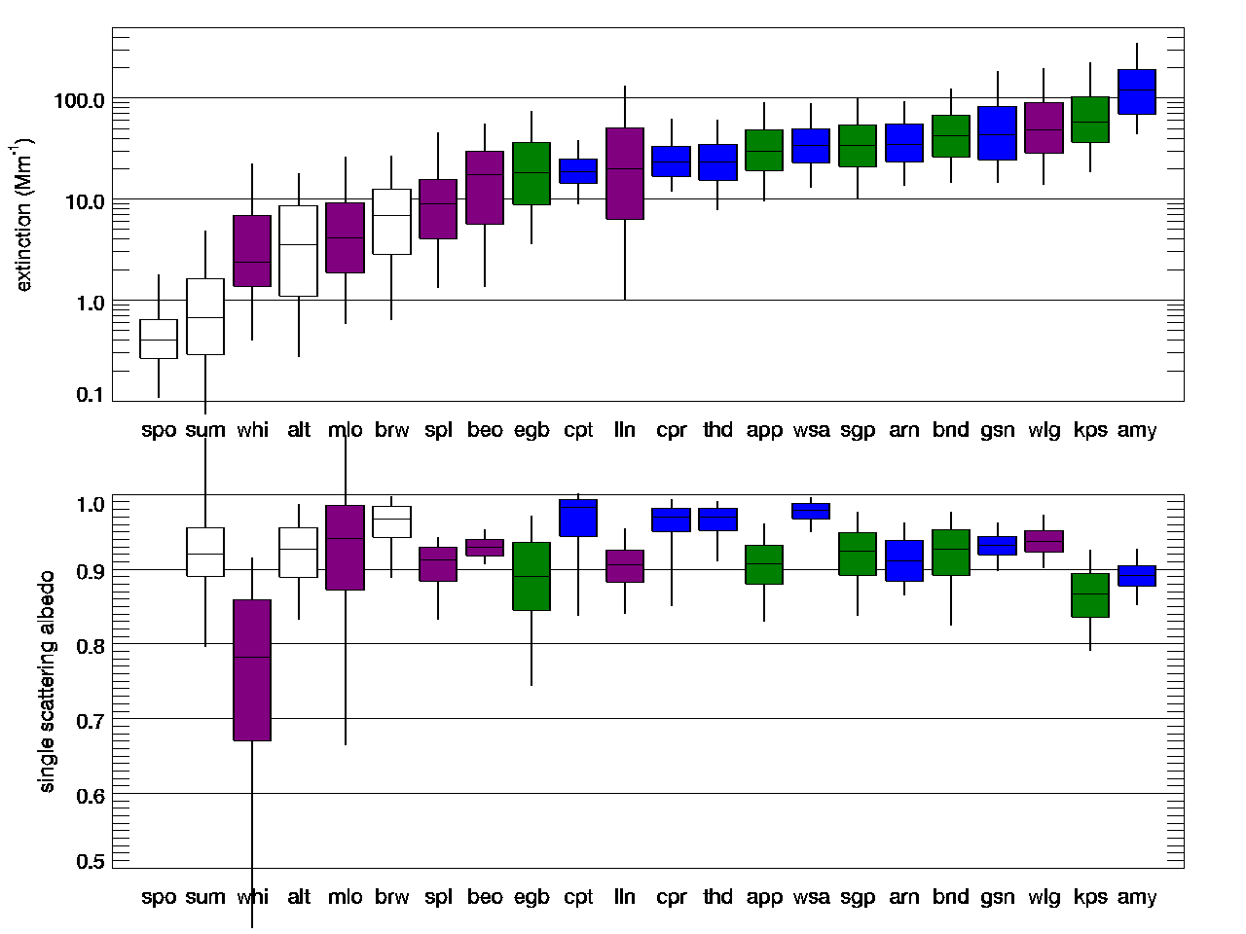
Aerosol Climatologies from NOAA Aerosol Network
light scattering (Mm⁻¹)
Large range in aerosol amount
No relationship between amount and “nature” of aerosol
Arctic
Mountain
Continental
Coastal
single-scattering albedo
→Important to measure regionally representative air masses
→Short field campaigns may not capture climatological variability.

