Slide 1
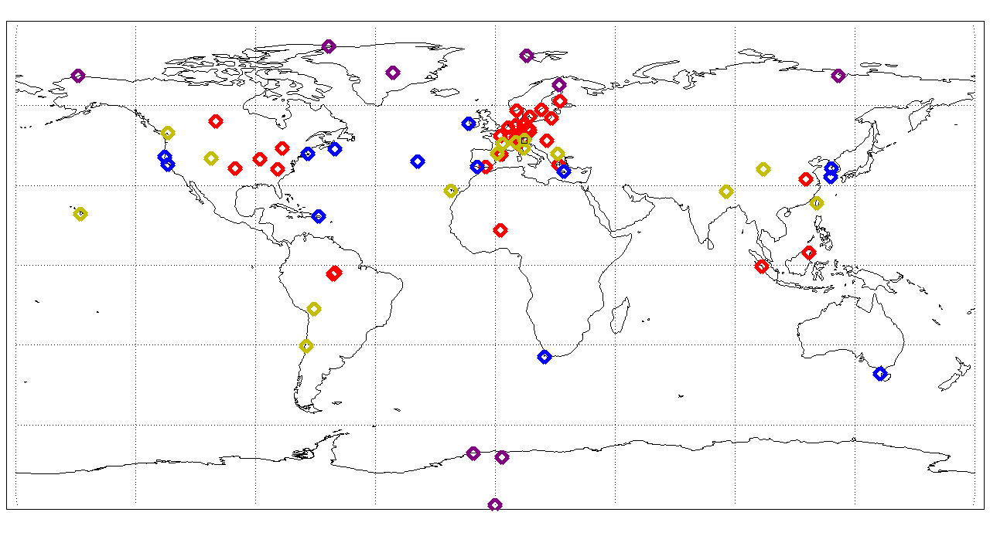
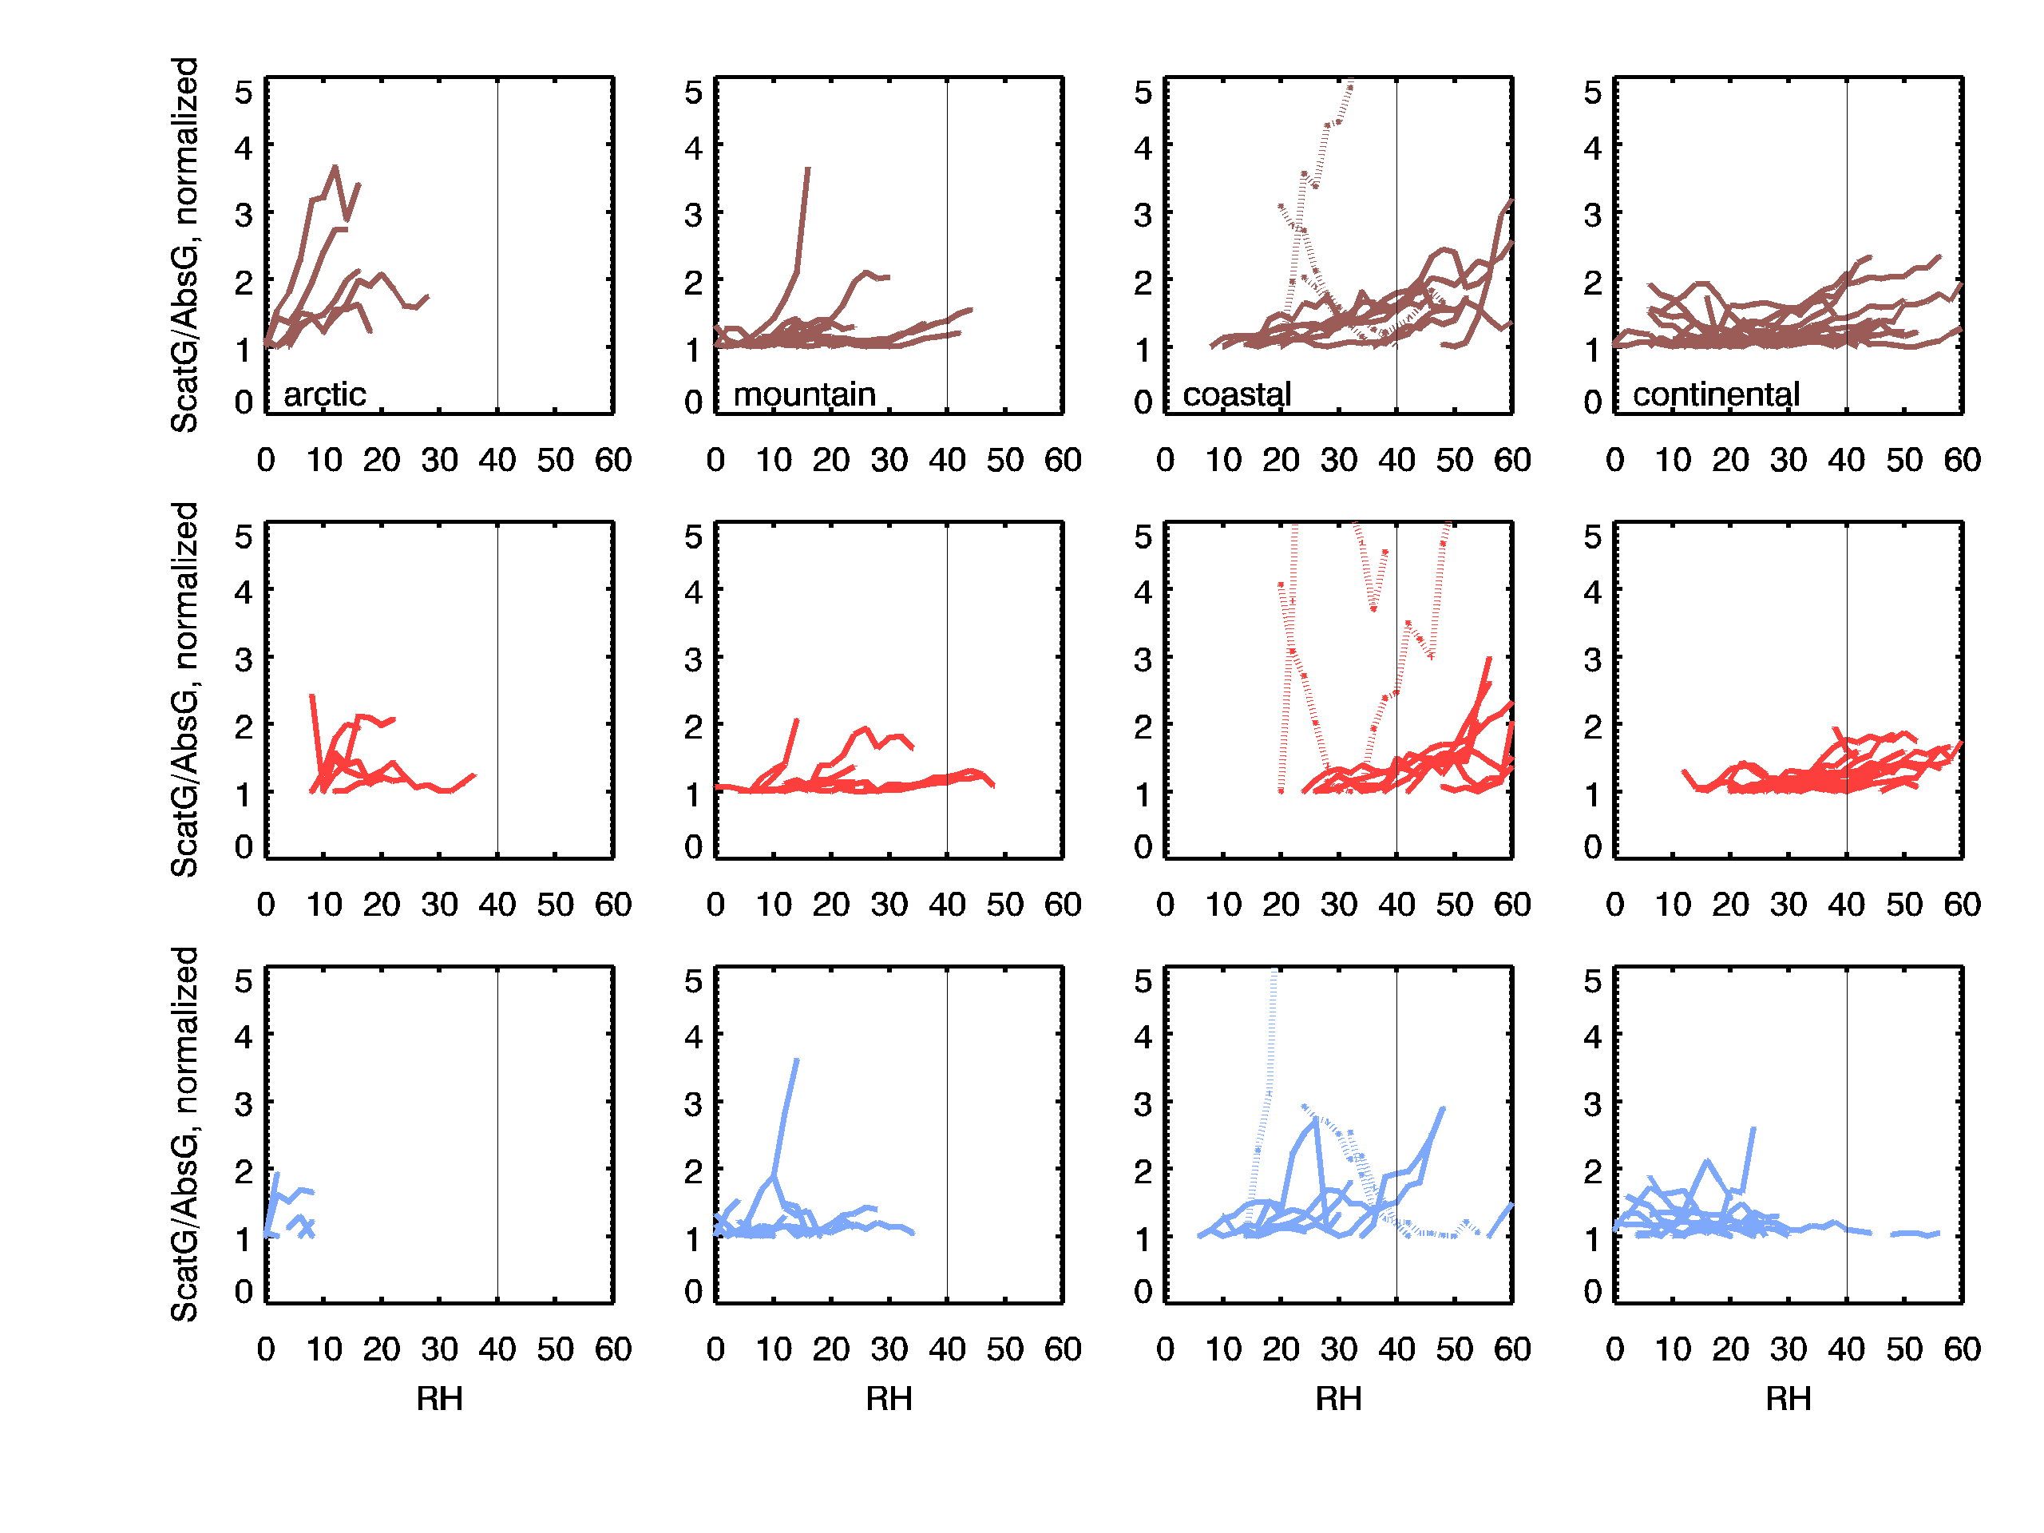
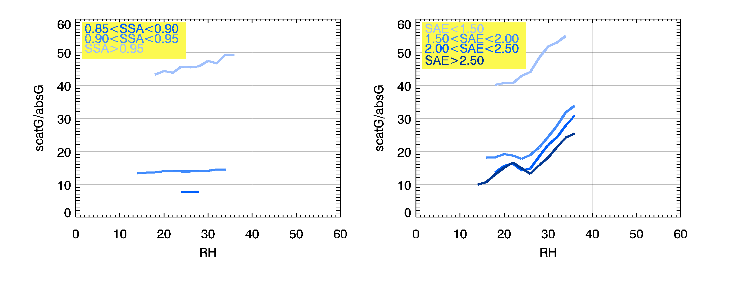
EGU – April 2018
The effect of aerosol water on particle light scattering at low relative humidity
E. Andrews¹, P. Zieger², G. Titos³, M. Burgos², M. Salter²
¹University of Colorado, USA, ²Stockholm University, Sweden, ³University of Granada, Spain
The radiative effect of aerosols is determined by the amount, size, shape and composition of the particles. These factors are, in turn, influenced by the amount of water associated with the particles.
GAW protocols for aerosol sampling recommend that measurements be made at low relative humidity (RH<30-40%) to minimize the effect of aerosol water and ensure comparability across measurement sites.
Here we present a comparison of long-term measurements of aerosol scattering at low RH as well as some lab and field measurements, which suggest that water can have a significant impact on optical measurements even at low humidity.
Lab and field measurements
Continental Aerosol
Marine aerosol – three pronged approach
Electrodynamic balance (EDB) data from sea water experiments
Mie calculations based on assumed(?) sea salt composition
Sea salt event data during field campaign at Ny-Alesund (Zieger et al., 2010)
Continental aerosol
Field measurements of aerosol composition, size distribution and hygroscopicity (HTDMA) in conjunction with Mie theory
Can this be compared with SGP neph and/or humidograph measurements somehow?
Marine Aerosol
Southern Great Plains (SGP), OK
At RH=40%, ~20% of scattering may be due to water associated with the sea salt aerosol. Aerosol deliquescence complicates the picture in the metastable region (45%<RH<75%)
At RH=40%, 10-18% of scattering may be due to water associated with the continental aerosol at SGP. The f(RH) changes with month due seasonal variability in aerosol composition and size.
A look at long-term surface site measurements
Observations
Scattering is divided by absorption and then normalized to minimize impact of air mass changes on scattering/RH relationship
Clean marine sites (dotted lines) have noisy scat/abs ratios
RH values tend to be higher in the summer than winter, so RH effect likely to be more important in summer.
General trend of increasing scattering with increasing RH, particularly in summer months at coastal sites.
Winter months are more likely to see a flat or decreasing relationship between scattering and increasing RH
IS MAP NEEDED??
Polar
Coastal
Continental
Mountain
72 surface sites making in-situ measurements
Variety of site types
Not all sites provide RH data
Polar sites have limited RH range
Utilized Level 2 scattering and absorption datasets from EBAS (ebas.nilu.no)
Segmented datasets by site type and season (winter: DJF; summer JJA)
Further segmented data by various optical properties (single scattering albedo (SSA) and scattering Angstrom exponent (SAE)
Evaluated response of scattering to nephelometer RH as a function of segmentation
Segregated by SSA
Segregated by SAE
Observations
Composition and size of the aerosol (represented by SSA and SAE) may impact scattering/RH relationship.
At both THD (marine) and SGP (continental), whitest aerosol (SSA>0.95) exhibits largest response to RH
At THD, response to RH increases as particle size decrease, while at SGP, size doesn’t affect RH response
Lack of consistent pattern indicates importance of auxiliary measurements (e.g., chemistry)
THD
THD
SGP
SGP
Conclusions
Water can and does influence aerosol scattering at low relative humidities (RH<40%)
Assumptions about ‘what is dry’ RH affect determination of the scattering enhancement effect (so-called f(RH))
Critical to maintain measurements below 40% RH, but 30% would be better – especially at marine sites
Acknowledgements:
These measurements would not be possible without the dedication of technical support staff at the field sites and cooperation of modelling groups.
Reference:
WMO/GAW Aerosol Measurement Procedures, Guidelines, and Recommendations, Report #227, 2016
Zieger et al., Atmos. Chem. Phys., 10, 3875–3890, 2010

