Slide 1
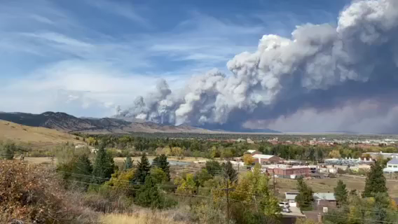

Aerosol optical properties during fresh and aged wildfire smoke events in Colorado
Elisabeth Andrews¹, Lauren Schmeisser¹, Patrick Sheridan¹, Gannet Hallar², Dan Jaffe³, James Sherman⁴
¹NOAA, ²University of Utah, ³University of Washington, ⁴Appalachian State University
Table
Mountain
October 2020, Boulder CO
July 2021, New York City
CSIRO, November 2022

Slide 2
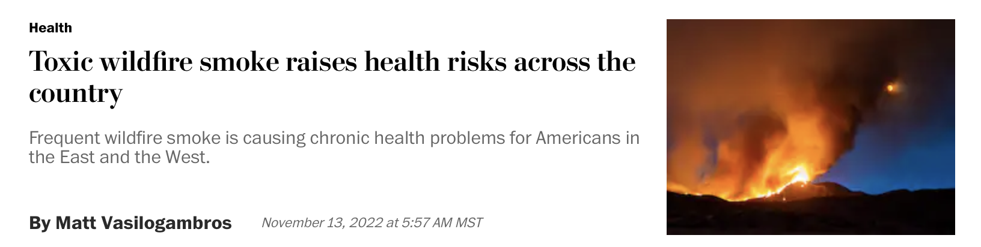
Motivation
Wildfires are predicted to increase with climate change (Jones et al., 2020).
Decrease air quality both near the fires and further away.
Understanding smoke properties and how they change with time:
  →improve AQ models
  →improve satellite detection algorithms

Slide 3

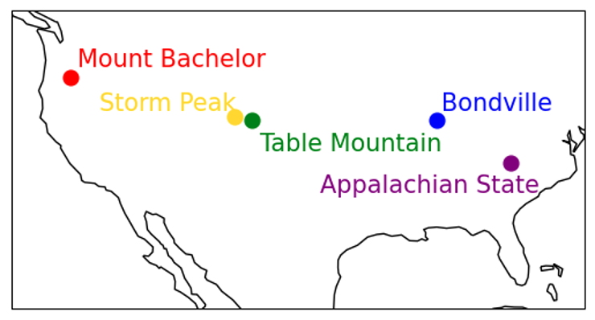
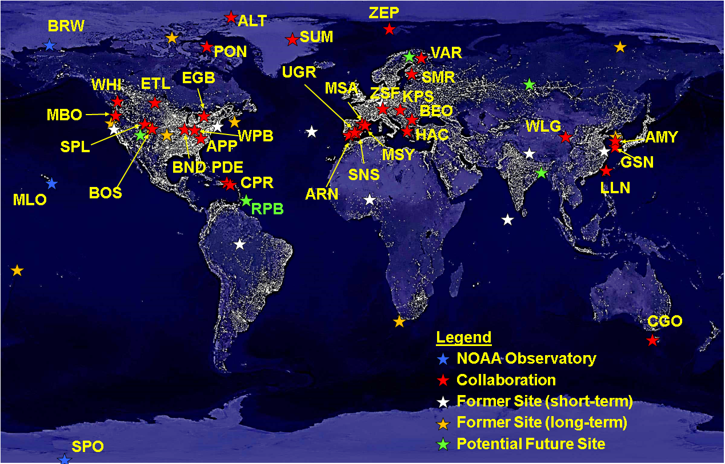
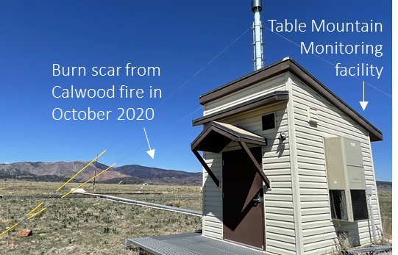
NOAA’s Table Mountain atmospheric monitoring site
WMO/GAW
NOAA Federated Aerosol Network (NFAN) in US
WPB
What can we learn about smoke aerosol from NFAN measurements in the US?
NOAA Federated Aerosol Network
~30 sites around world
Atmospheric monitoring building at Table Mountain
NFAN overview: Andrews et al., BAMS, 2019
Notes:
*WPB added in this year

Slide 4
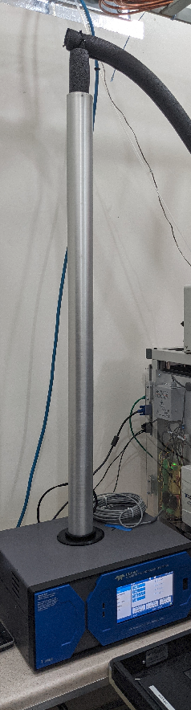
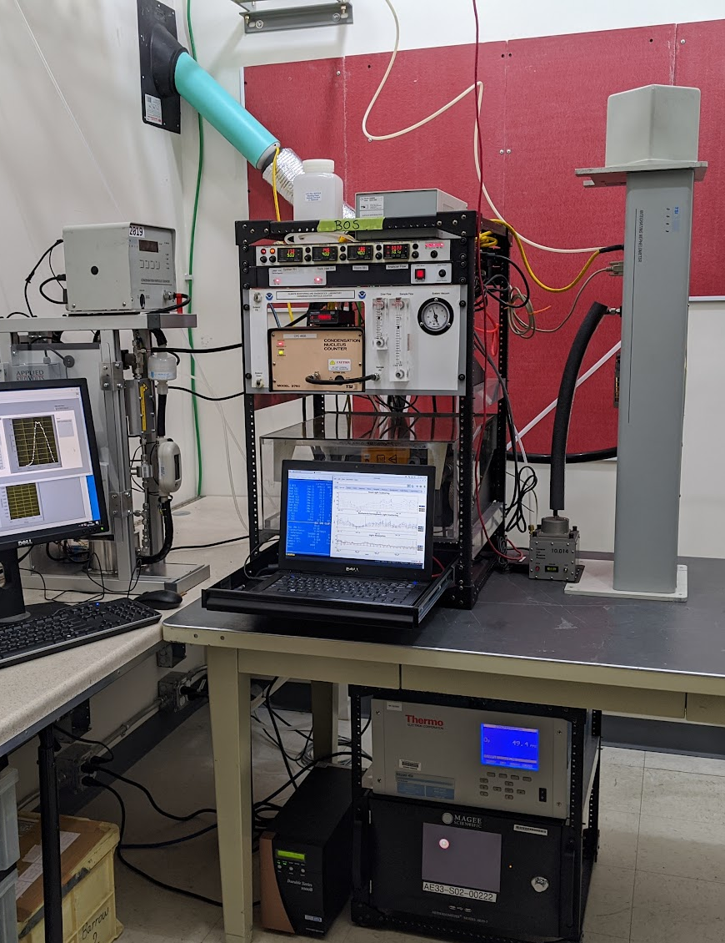
Aerosol sampling at Table Mountain (BOS) facility north of Boulder
All instruments located inside aerosol building at BOS
Sample from common inlet/flow splitter
Measurements made at low RH < 40%
Measurement start: September 2019
Analysis uses hourly-averaged data
Nephelometer – 3-λ aerosol scattering
CLAP – 3-λ aerosol absorption
Aethalometer – 7-λ aerosol absorption
CPC – number concentration
DMPS – number size distribution (10-800 nm)
T640 – aerosol mass concentration (PM1, PM2.5, PM10)
Ozone monitor – surface O₃ concentration
Picarro – CO, CO₂, CH₄, water vapor
Inlet/
splitter
CPC
NEPH
DMPS
CLAP
O₃
Picarro
CO, CO₂, CH₄, H₂O
T640
Aeth
BOS measures day/night, rain/cloud
Sampling at BOS started September 2019

Slide 5
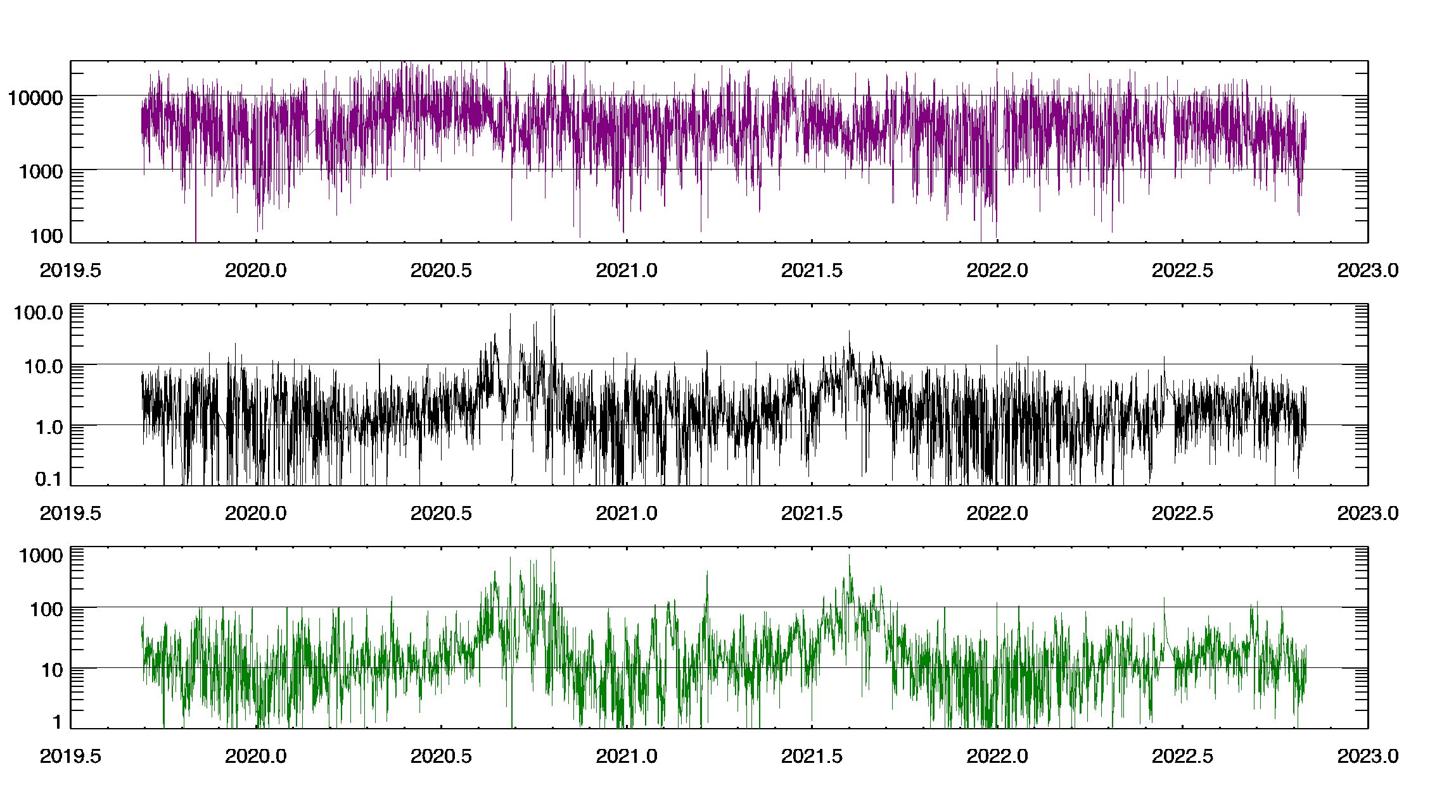
Aerosol time series at Table Mountain (BOS) – Aerosol amount
Aerosol number concentration does NOT peak during smoke events
Number Concentration
Aerosol Absorption Coefficient
Absorption, scattering coefficients highest in summer
Range is ~3 orders of magnitude
Similar temporal pattern
Aerosol Scattering Coefficient
Scattering when no smoke <30 Mm⁻¹
Covid
lockdown
Time series not long enough to identify a Covid lockdown effect
Note: y-axes are log scale
Notes:
Range in absorption & scattering is ~3 orders of magnitude
Range in number concentration is ~2 orders of magnitude

Slide 6
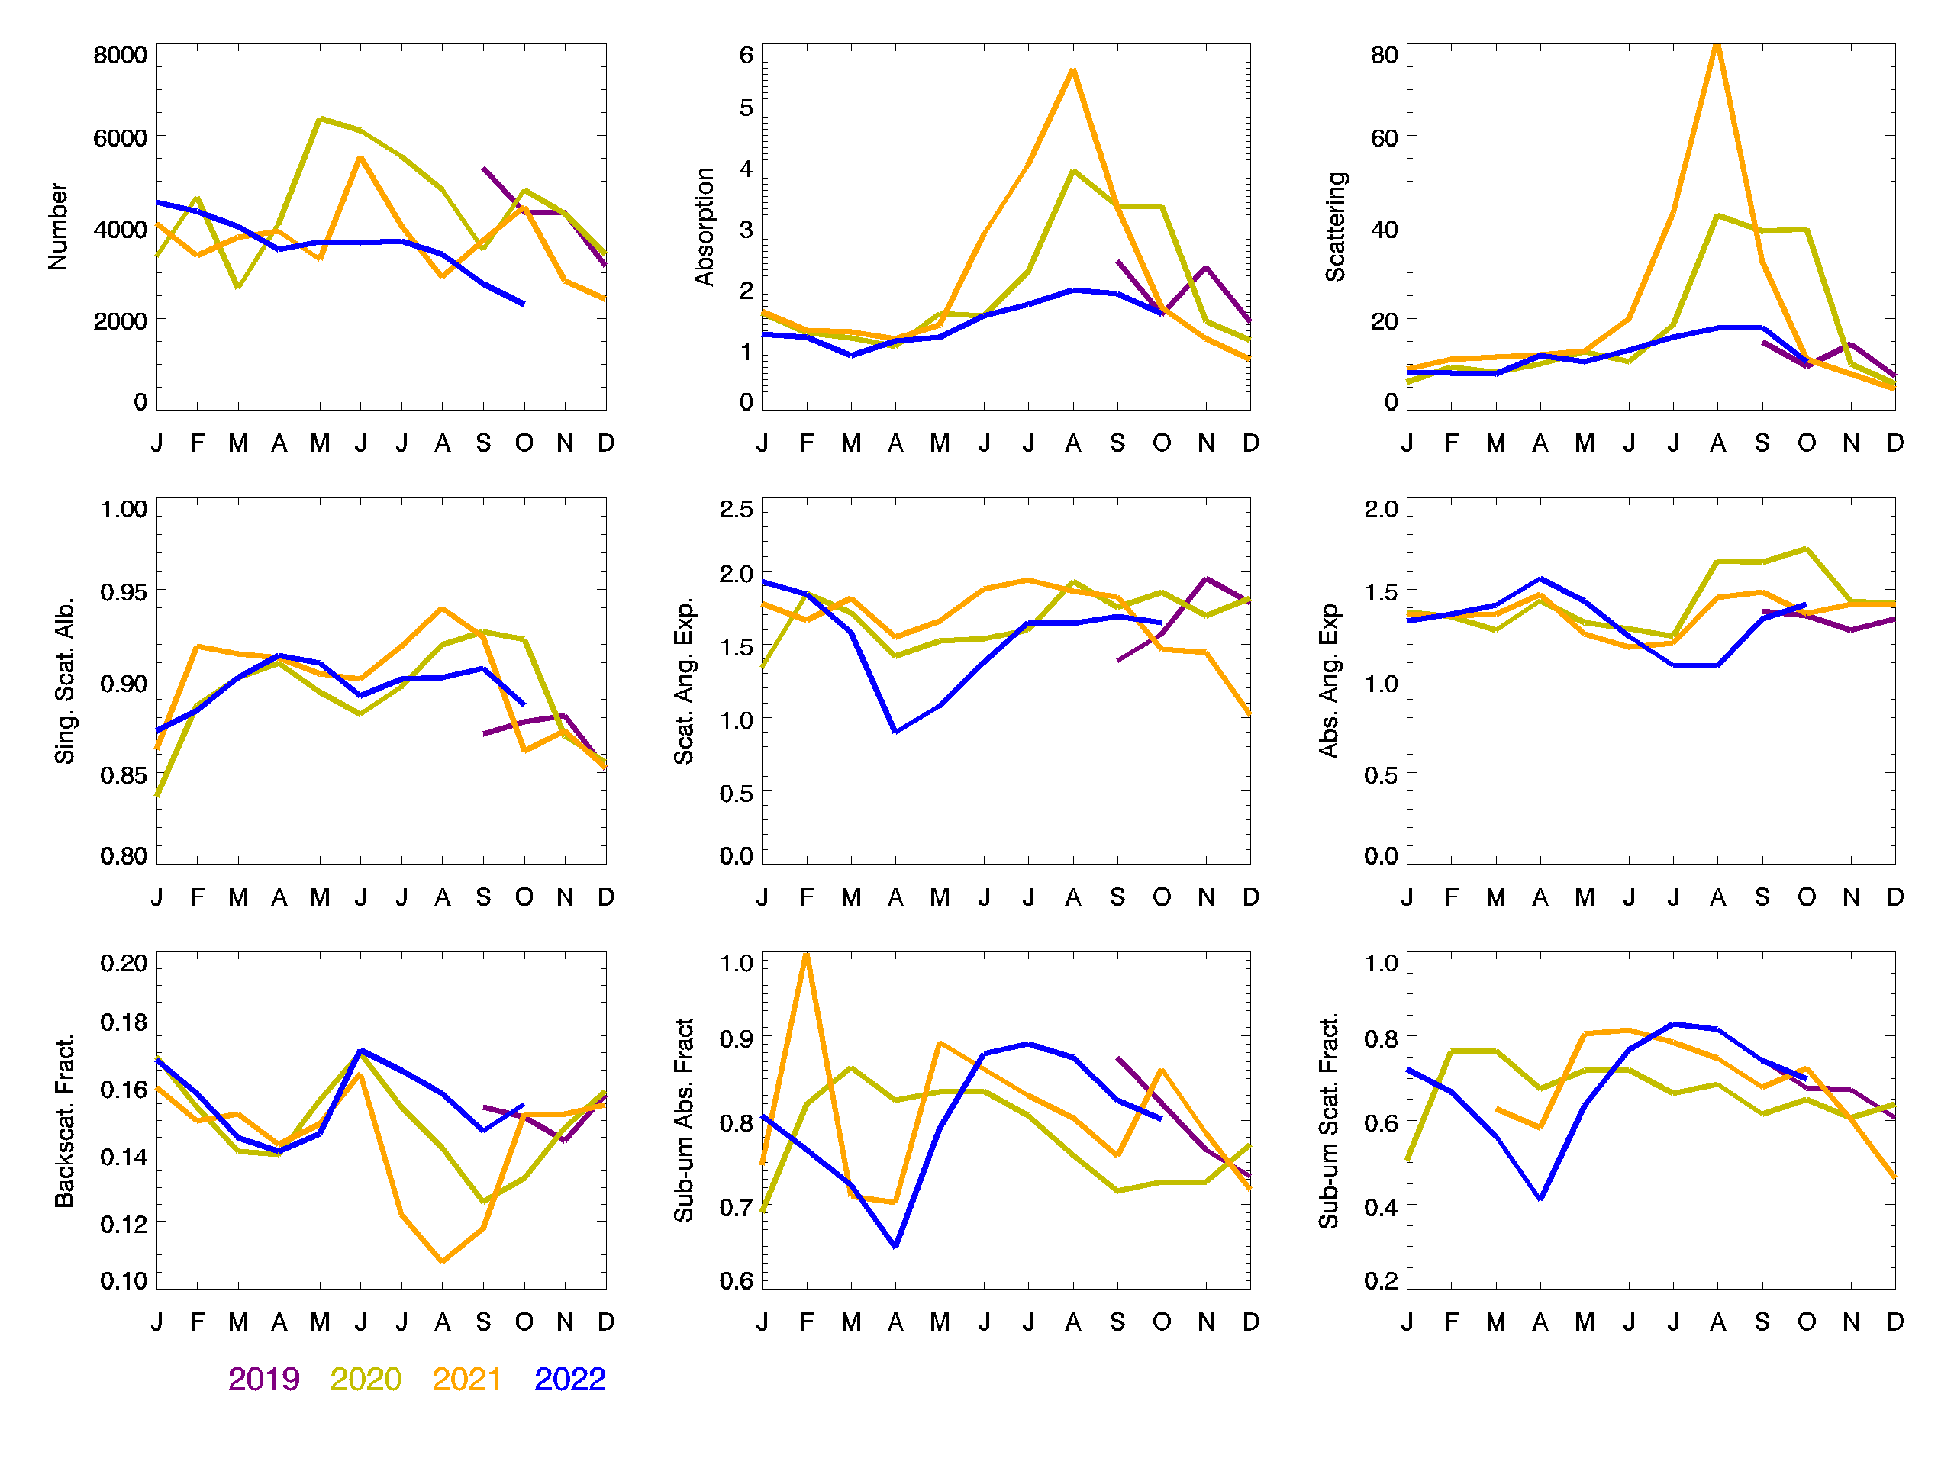
Aerosol interannual variability at Table Mountain (BOS)
Winter and spring exhibit approximately same scattering and absorption each year.
Interannual variability in absorption and scattering coefficients driven by fire influence.
→2019 – No significant fire impact
→2020 (Aug-Nov) - Local and regional fires
→2021 (June-Sept) – Regional fires
→2022 – No significant fire impact
SSA is higher during fire impacted periods – more reflective aerosol
BFR is clearly lower during fire impacted periods – shift to larger accumulation mode particles
Scattering and absorption Angstrom exponents are also higher during fire impacted periods (not shown) – suggests change in size and composition.
Absorption coefficient
Scattering coefficient
2019
2020
2021
2022
Single scattering albedo
Backscatter fraction
August is most impacted month.
Notes:
uses CLAP data for absorption,

Slide 7
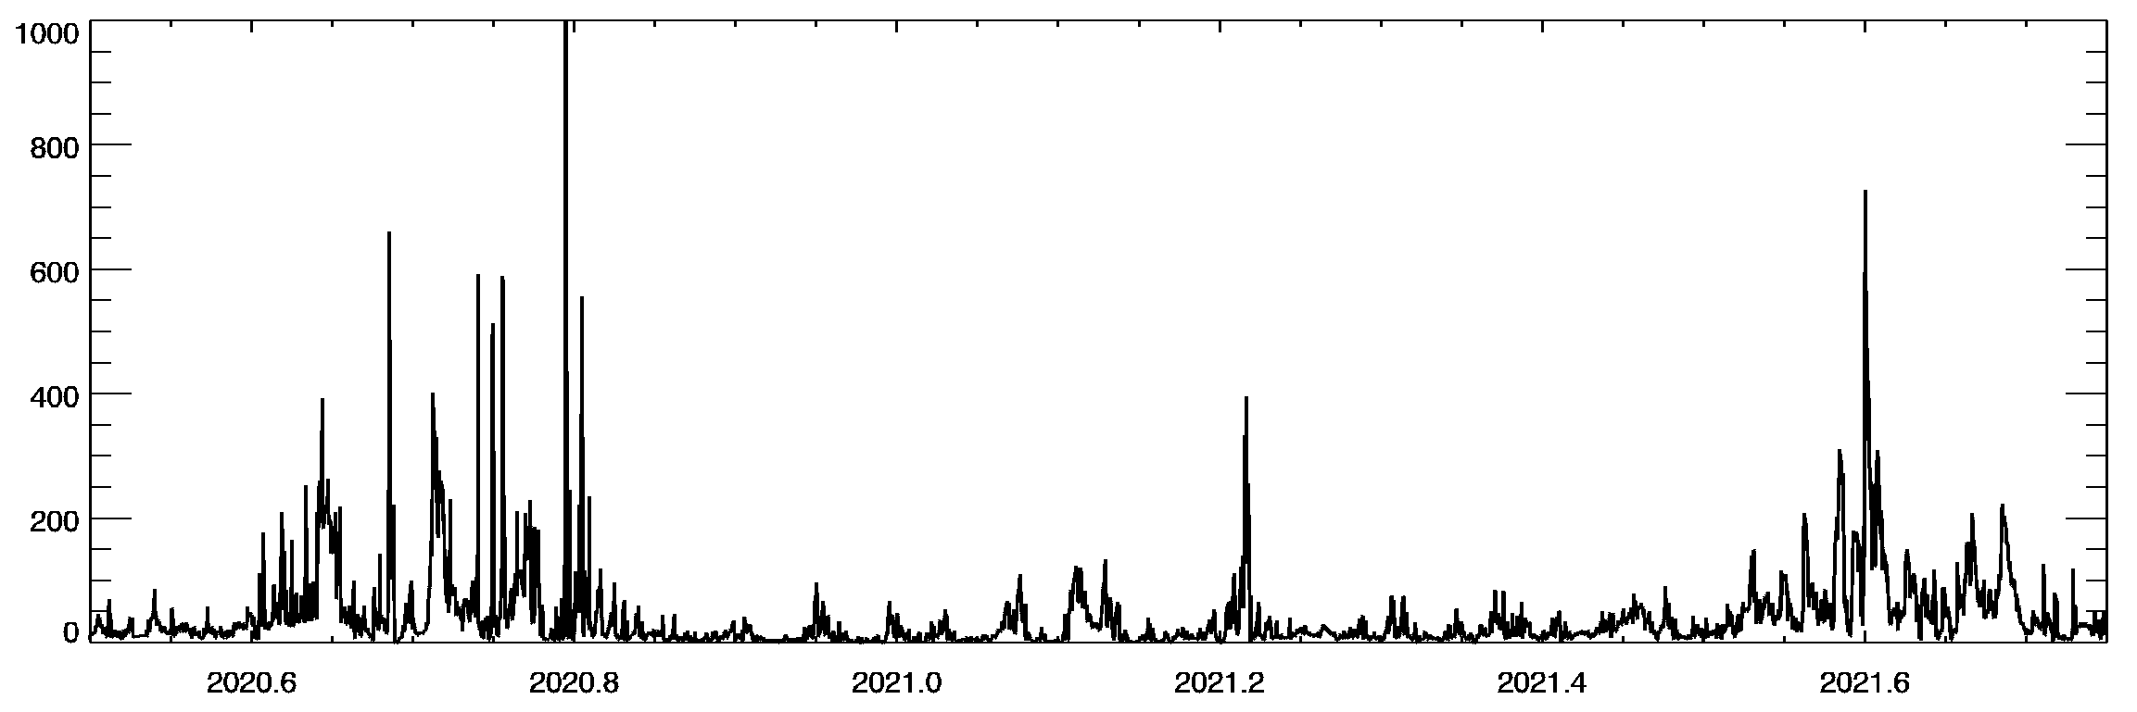
Differences in smoke sampled in 2020 and 2021 at Table Mountain
July 2020-Oct 2021
Scattering coefficient
smoke: scattering > 100 Mm⁻¹
2020
local and long range smoke transport
2021
dominated by long range smoke transport from US west coast
No smoke: scattering < 30 Mm⁻¹
Can we identify smoke events based on aerosol characteristics?
Are there differences in aerosol properties for different smoke events?
  interpret/validate satellite retrievals
  Evaluate air quality models simulations
Notes:
zoom in on smoke events. In what follows will first look at how smoke differs from non-smoke and then will try to identify different types of smoke. need more tools than just amount!

Slide 8
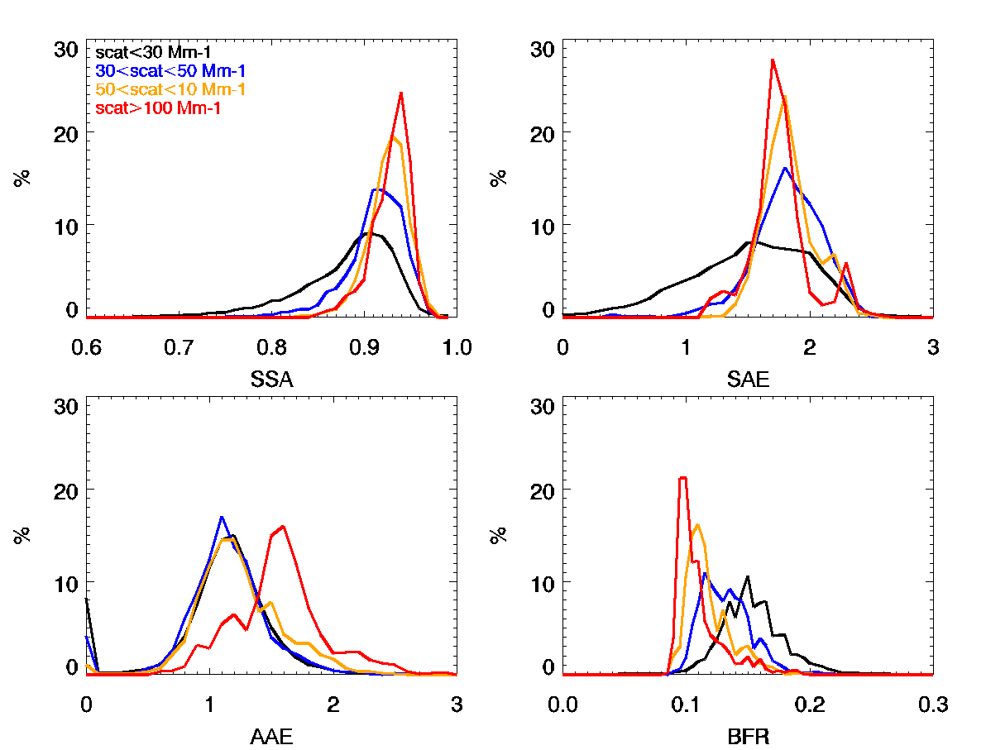
Shift in aerosol characteristics with increasing amount of aerosol (smoke) at BOS
More sub-um
Scattering < 30 Mm⁻¹ (no smoke)
30 < Scattering < 50 Mm⁻¹ (minimal smoke)
50 < Scattering < 100 Mm⁻¹ (some smoke)
Scattering > 100 Mm⁻¹ (smoke!)
less absorbing
Composition:
Less absorbing
More organic
Size:
Dominated by sub-um particles
Large sub-um particles
Frequency of Occurrence
Scattering Angstrom Exponent
Single scattering albedo
More organic
larger sub-um
Aerosol properties co-vary as smoke influence increases.
Can we learn more by studying co-variability of aerosol properties?
Absorption Angstrom Exponent
Backscatter fraction
Notes:
so we see that some aerosol characteristic appear to be co-varying. can we use that systematic variability to look at the data in a different way? uses aeth for AAE and SSA

Slide 9
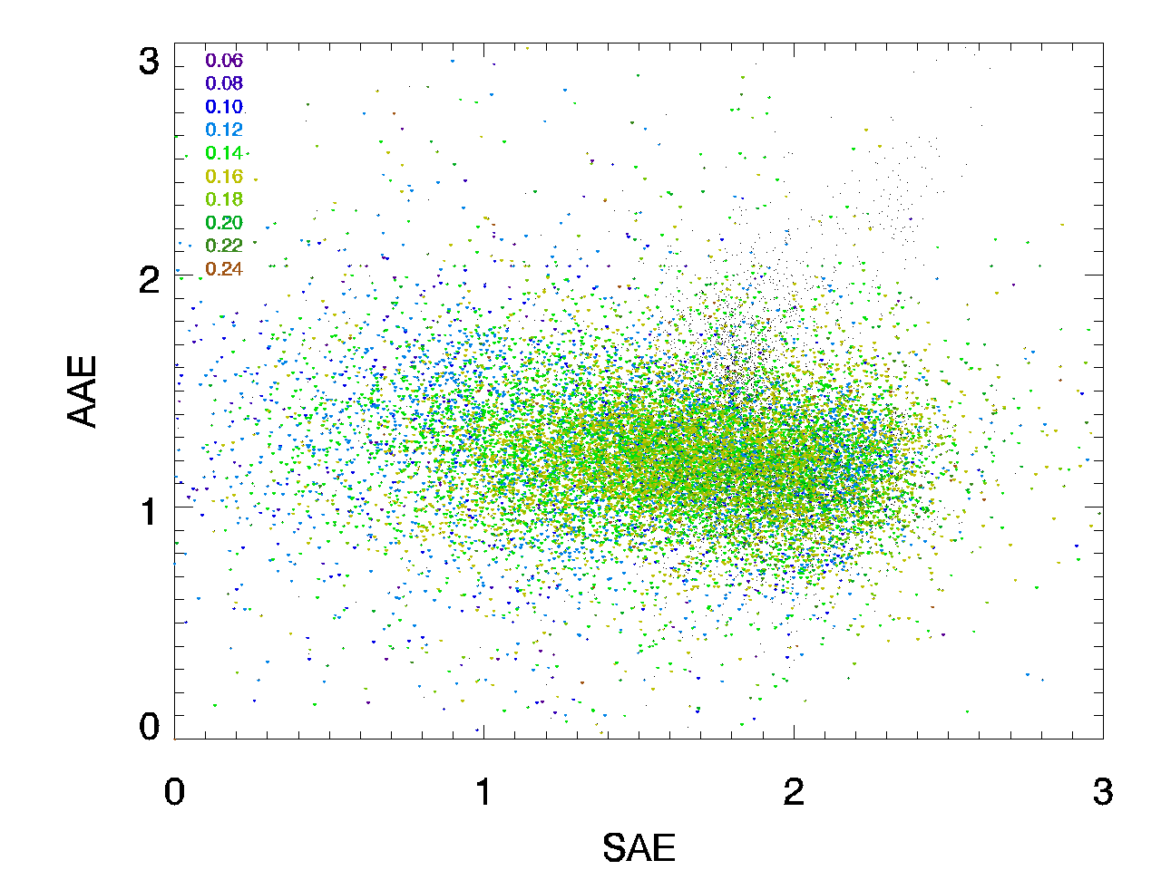
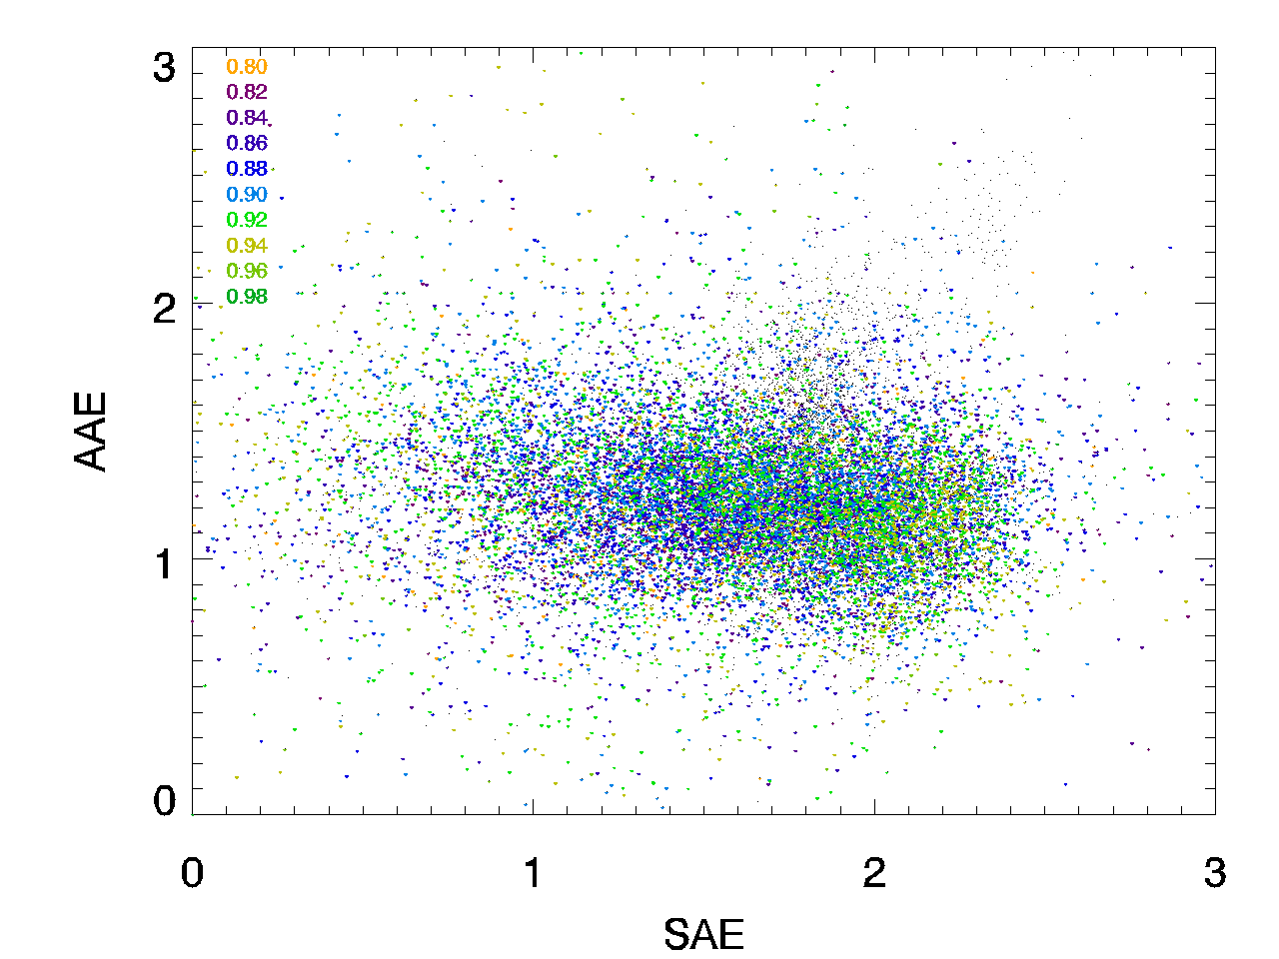
Scattering Angstrom exponent vs Absorption Angstrom exponent at BOS (no smoke)
Colored by BFR, 0.12<BFR<0.20
Colored by SSA, 0.88<SSA<0.92
strong BrC
0.06
0.08
0.10
0.12
0.14
0.16
0.18
0.20
0.22
strong BrC
0.82
0.84
0.86
0.88
0.90
0.92
0.94
0.96
0.98
dust
dust/BC/BrC
dust
dust/BC/BrC
mixed BC/BrC
mixed BC/BrC
Absorption Angstrom exponent
Absorption Angstrom exponent
BC/large particles
BC dominated
BC/large particles
BC dominated
large particles
low absorption
small particles
low absorption
large particles
low absorption
small particles
low absorption
Scattering Angstrom exponent
Scattering Angstrom exponent
Cappa 2016 matrix for insitu
Plots for scattering <30 Mm⁻¹ – no smoke
Table Mountain aerosol generally falls in the BC region of the matrix.

Slide 10
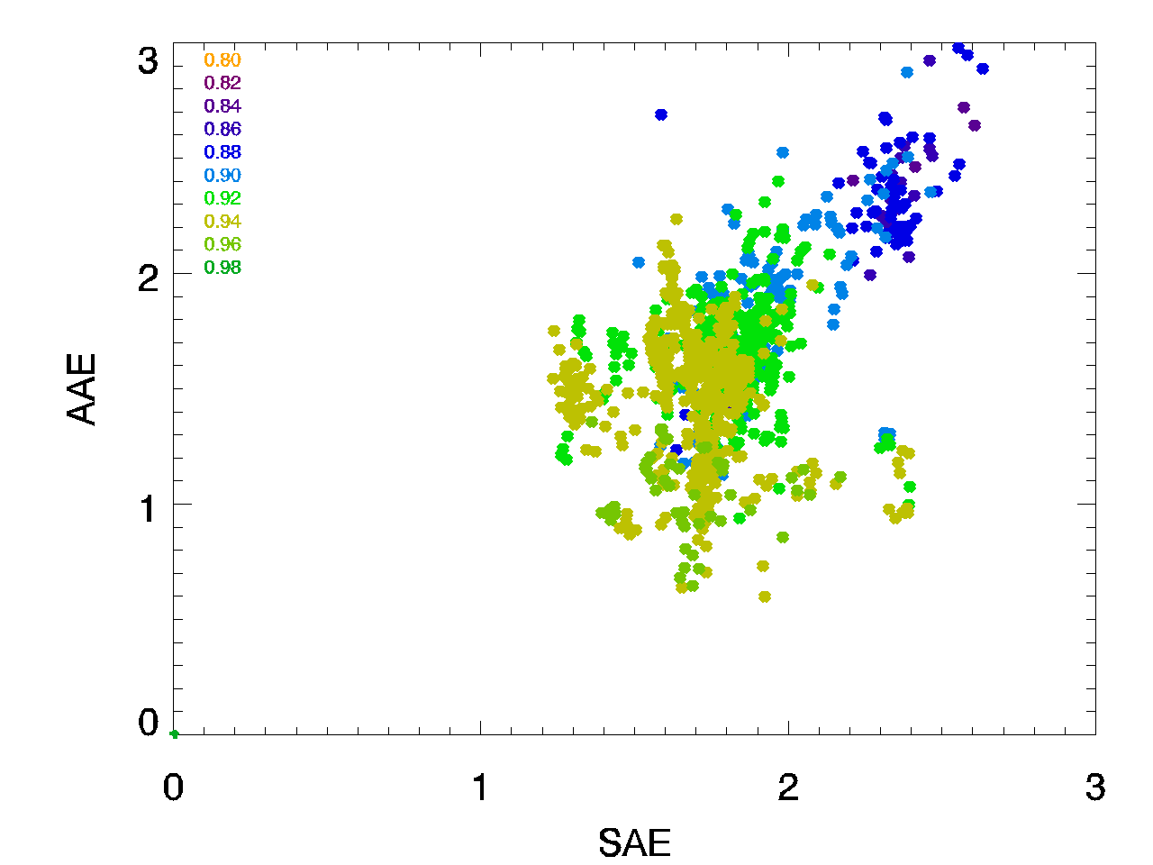
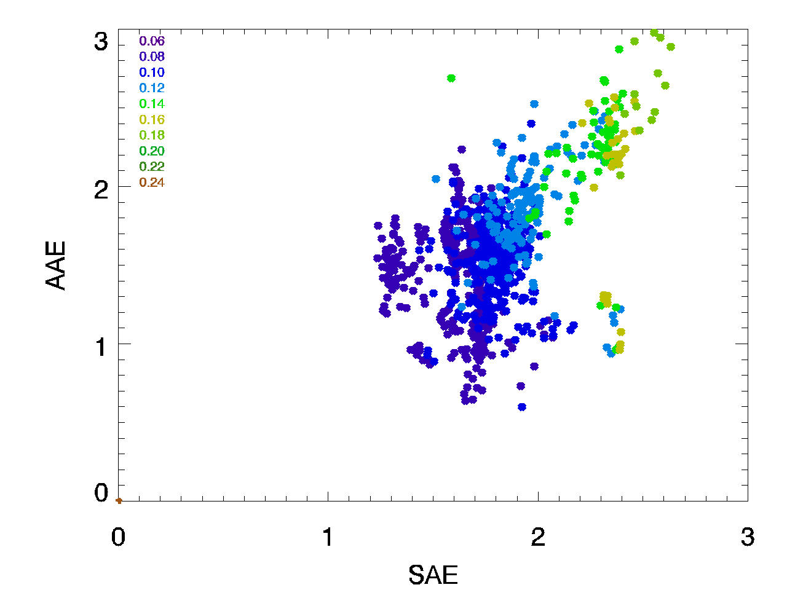
Scattering Angstrom vs Absorption Angstrom exponent at Table Mountain
Colored by BFR
Colored by SSA
strong BrC
strong BrC
0.06
0.08
0.10
0.12
0.14
0.16
0.18
0.20
0.22
0.82
0.84
0.86
0.88
0.90
0.92
0.94
0.96
0.98
dust
dust/BC/BrC
dust
more absorbing particles
smaller sub-um particles
dust/BC/BrC
mixed BC/BrC
mixed BC/BrC
Absorption Angstrom exponent
Absorption Angstrom exponent
BC/large particles
BC dominated
BC/large particles
BC dominated
large particles
low absorption
small particles
low absorption
large particles
low absorption
small particles
low absorption
Scattering Angstrom exponent
Scattering Angstrom exponent
Smoke aerosol mostly falls in different sector than ‘normal’ aerosol - more BrC.
When it overlaps ‘normal’ aerosol, smoke properties are different (smoke BFR lower & SSA higher)

Slide 11
Scattering Angstrom vs Absorption Angstrom exponent at Table Mountain
Colored by BFR
Colored by SSA
strong BrC
strong BrC
0.06
0.08
0.10
0.12
0.14
0.16
0.18
0.20
0.22
0.82
0.84
0.86
0.88
0.90
0.92
0.94
0.96
0.98
dust
dust
dust/BC/BrC
BFR>0.14
dust
SSA<0.90
dust
more absorbing particles
smaller sub-um particles
dust/BC/BrC
mixed BC/BrC
mixed BC/BrC
Absorption Angstrom exponent
Absorption Angstrom exponent
BC/large particles
BFR<0.12
BC dominated
BC/large particles
SSA>0.92
BC dominated
large particles
low absorption
small particles
low absorption
large particles
low absorption
small particles
low absorption
Scattering Angstrom exponent
Scattering Angstrom exponent
Is plume age a reason for the different smoke data clusters?

Slide 12
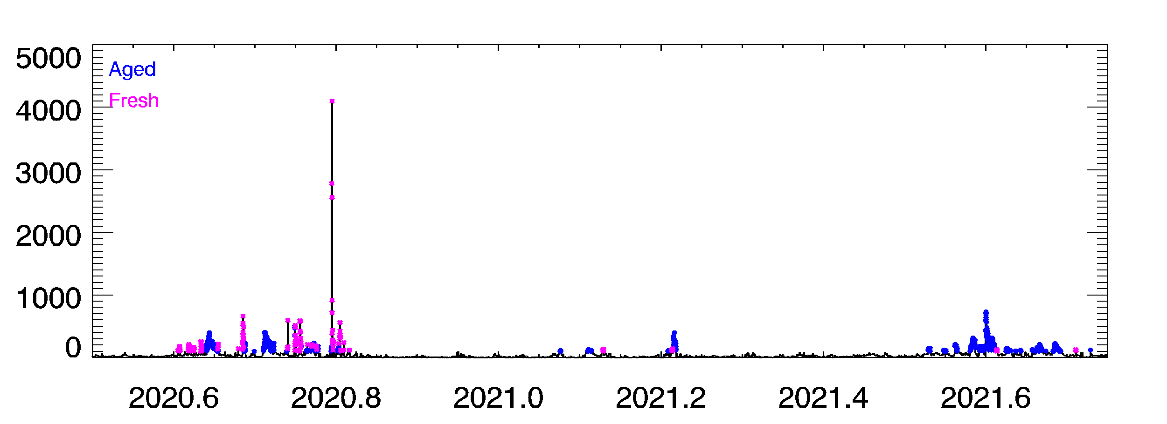
Fresh smoke vs ‘Aged’ smoke at Table Mountain
Can we come up with fresh vs aged smoke algorithm for longer Table Mountain time series?
FRESH:
Scattering > 100 Mm⁻¹
Bfr>0.13
AGED:
Scattering > 100 Mm⁻¹
Bfr<0.13
Correctly identifies 2020 fresh and aged events
Correctly identifies 2021 smoke as aged
Scattering coefficient

Slide 13
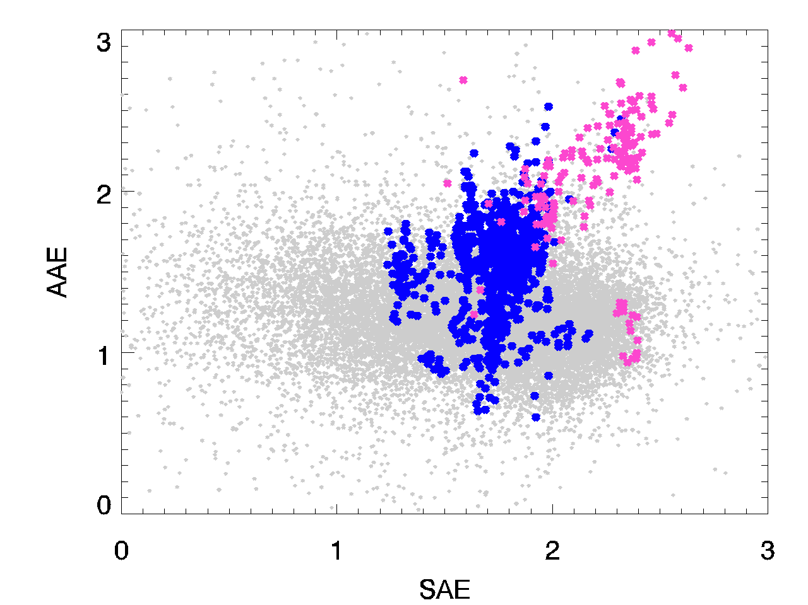
Does smoke identification algorithm work across NFAN sites?
Fresh and aged smoke at Table Mountain are (mostly0 in same position in AAE vs SAE matrix
BOS: 2020-2021 data
Troubling – March 20, 2021 event looks different.
Where do other sites fit on matrix?

Slide 14
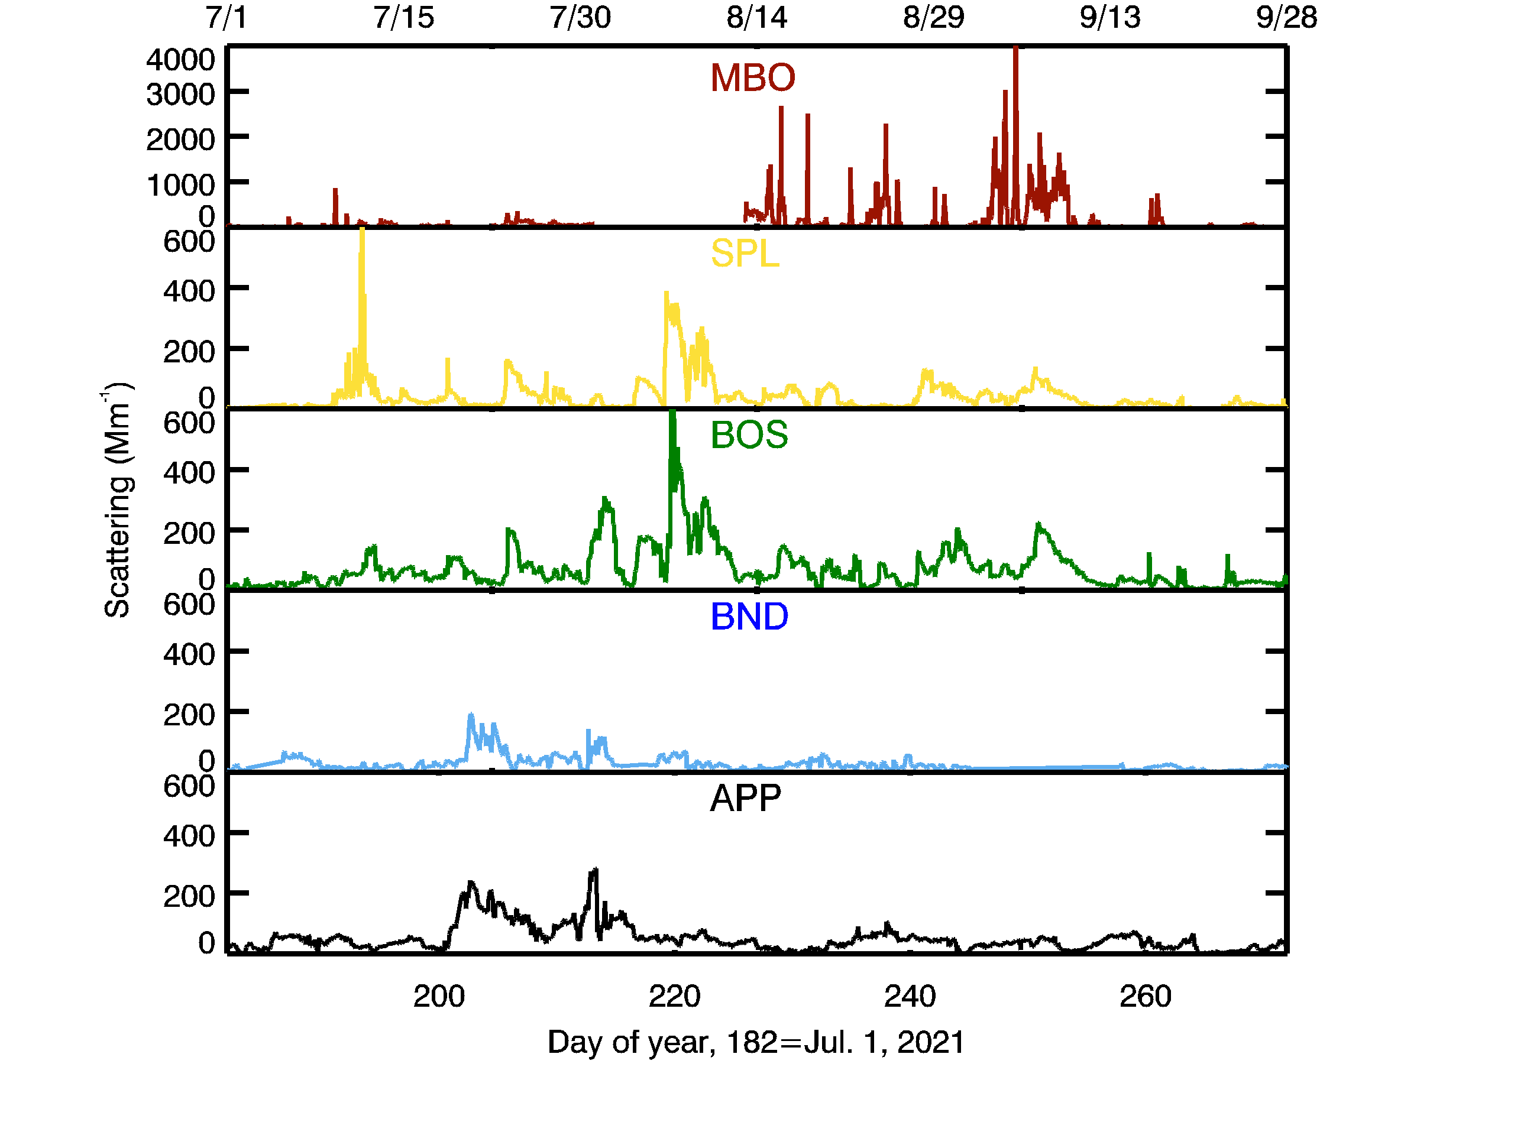
Does smoke identification algorithm work across NFAN sites?
missing
In 2021 all 5 sites were impacted by smoke.
MBO and SPL sampled both fresh and aged smoke
BOS, BND and APP sampled long range aged smoke.

Slide 15
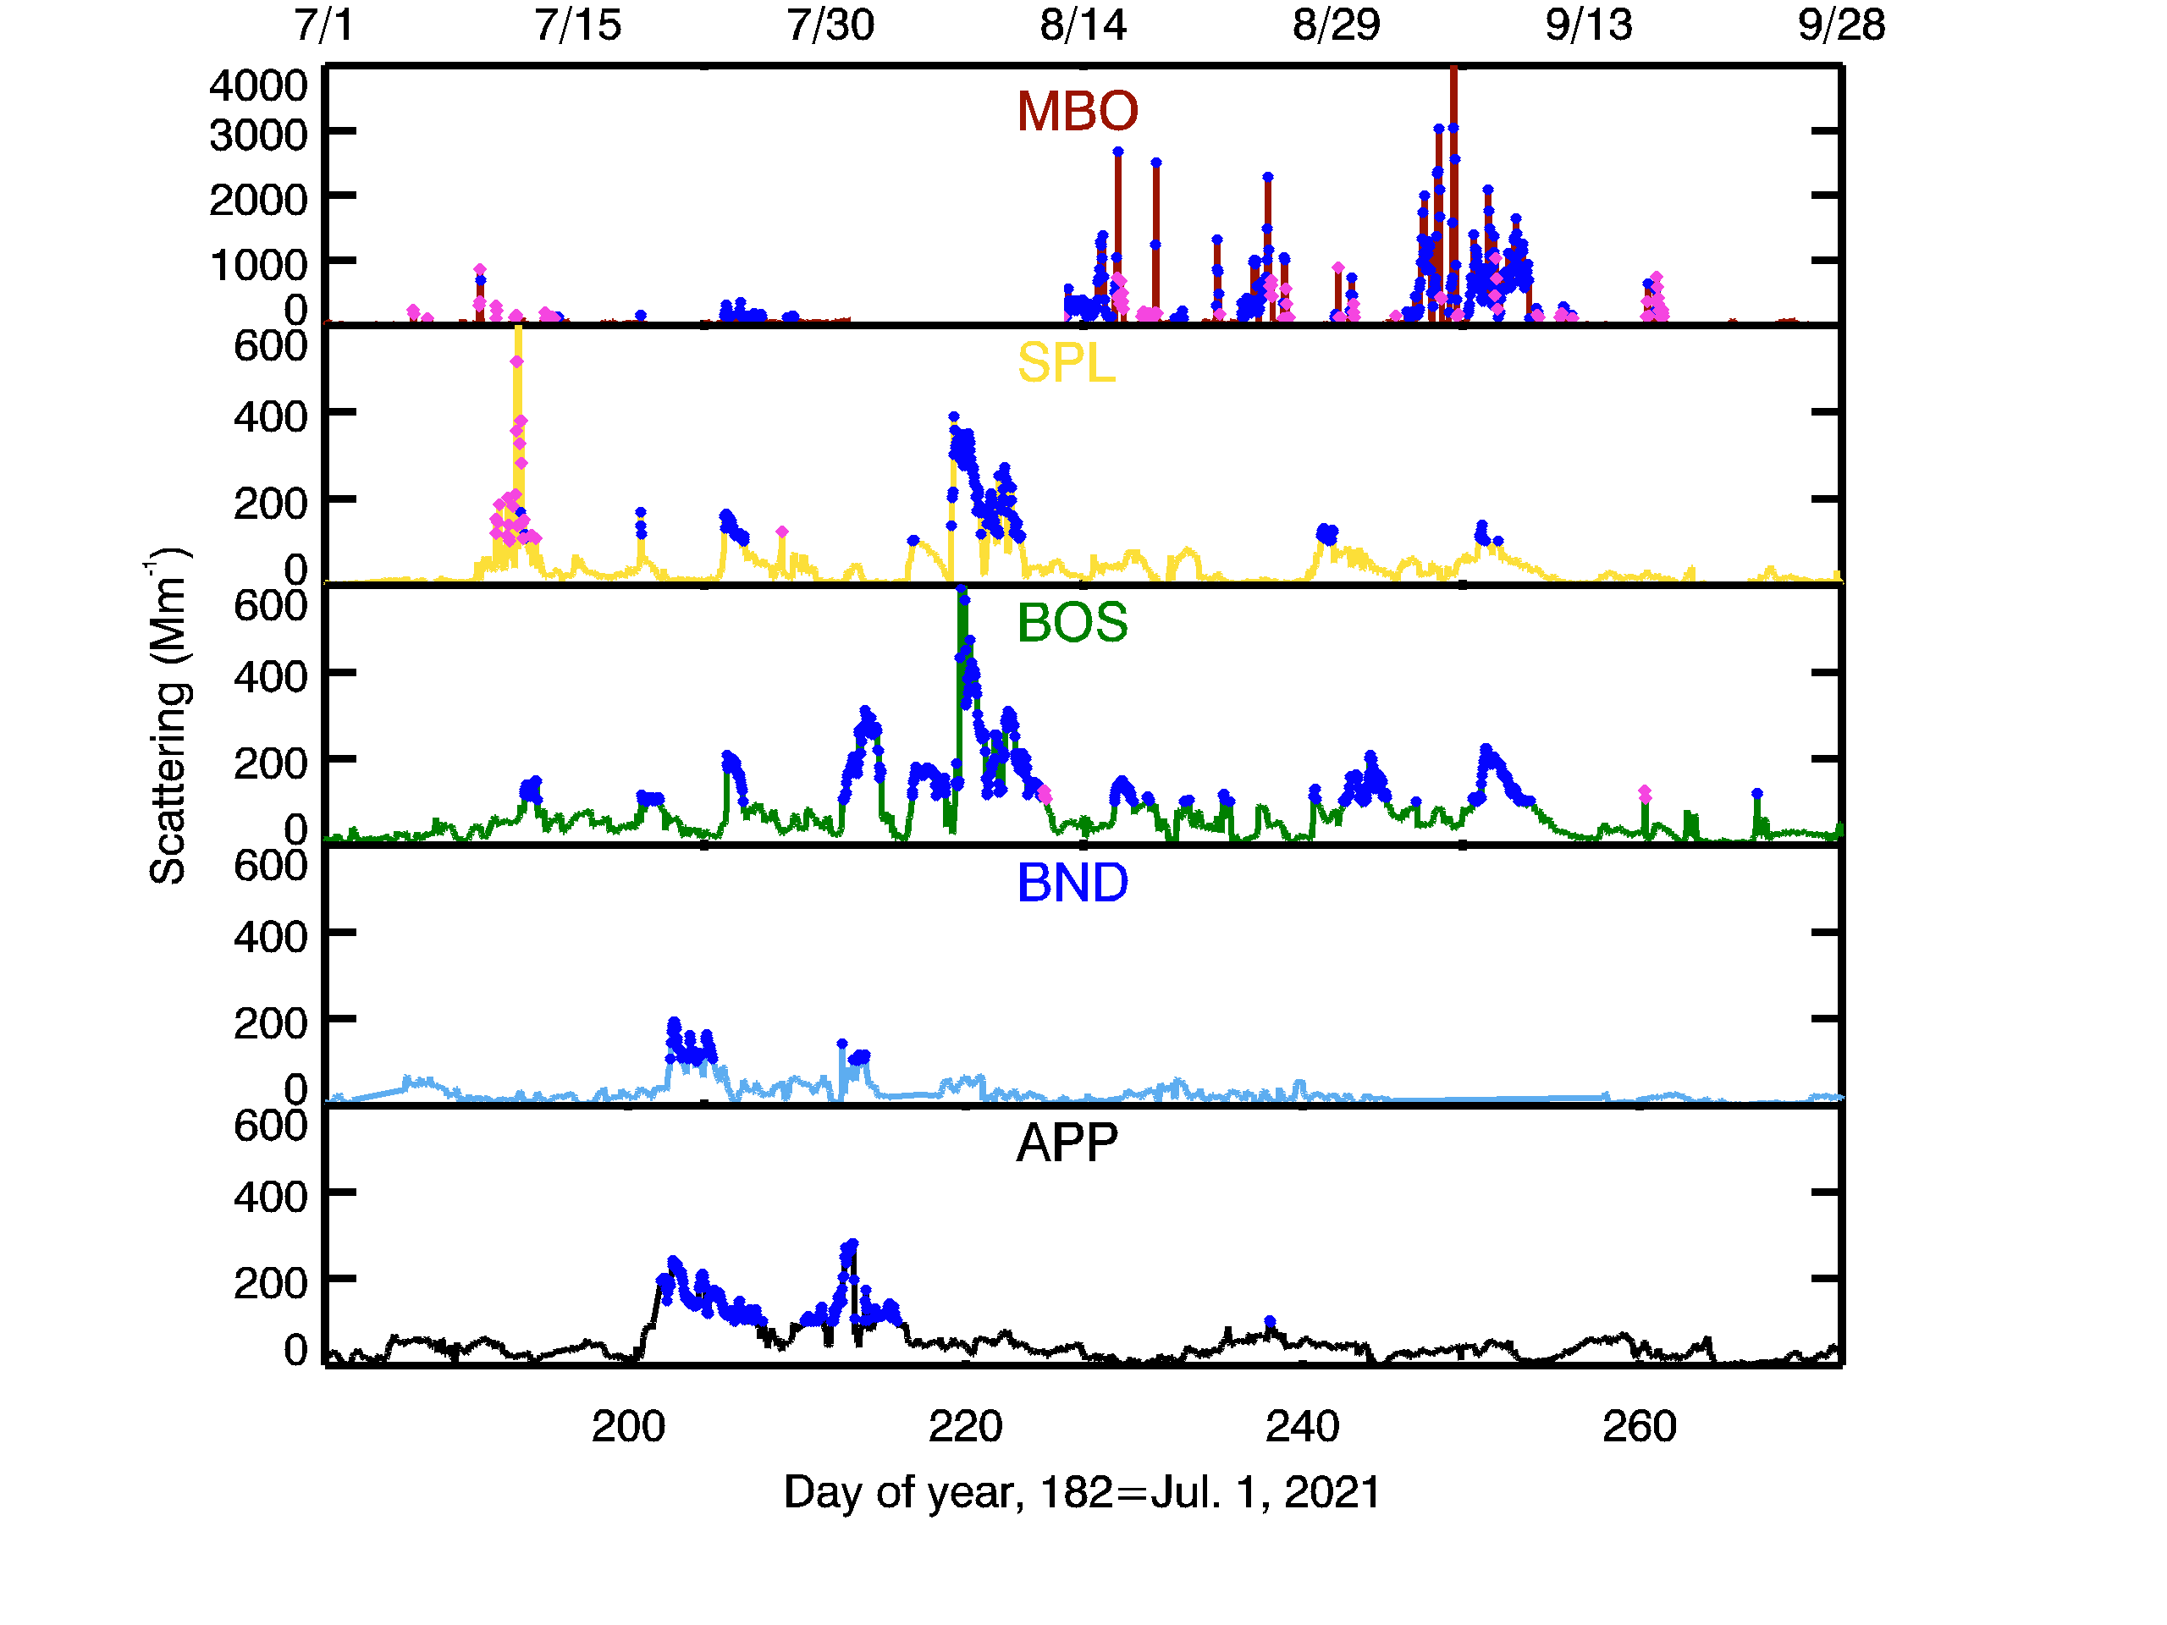
Does smoke identification algorithm work across NFAN sites?
Algorithm is promising for smoke age identification…
missing
AGED
FRESH
Algorithm:
MBO and SPL sampled fresh and aged smoke
BOS, BND, APP sampled aged smoke
Compare with NAAPS model

Slide 16
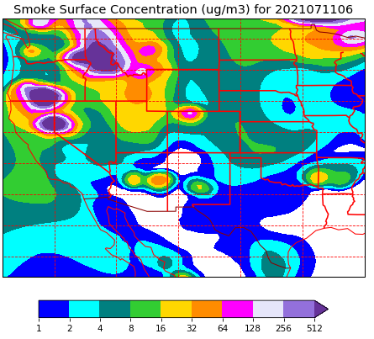
Morgan Creek fire
MBO
Scattering (Mm⁻¹)
MBO
SPL
SPL
BOS
https://www.nrlmry.navy.mil/aerosol
BOS

Slide 17
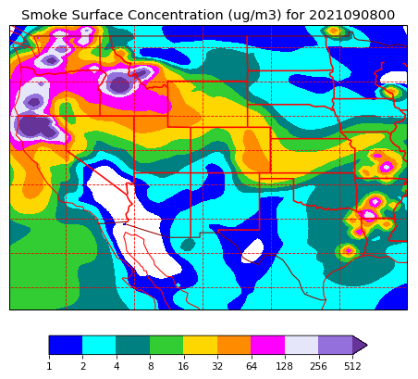
MBO
MBO
SPL
SPL
https://www.nrlmry.navy.mil/aerosol
BOS
BOS
Still seems promising for smoke age identification…
How does the matrix look?

Slide 18
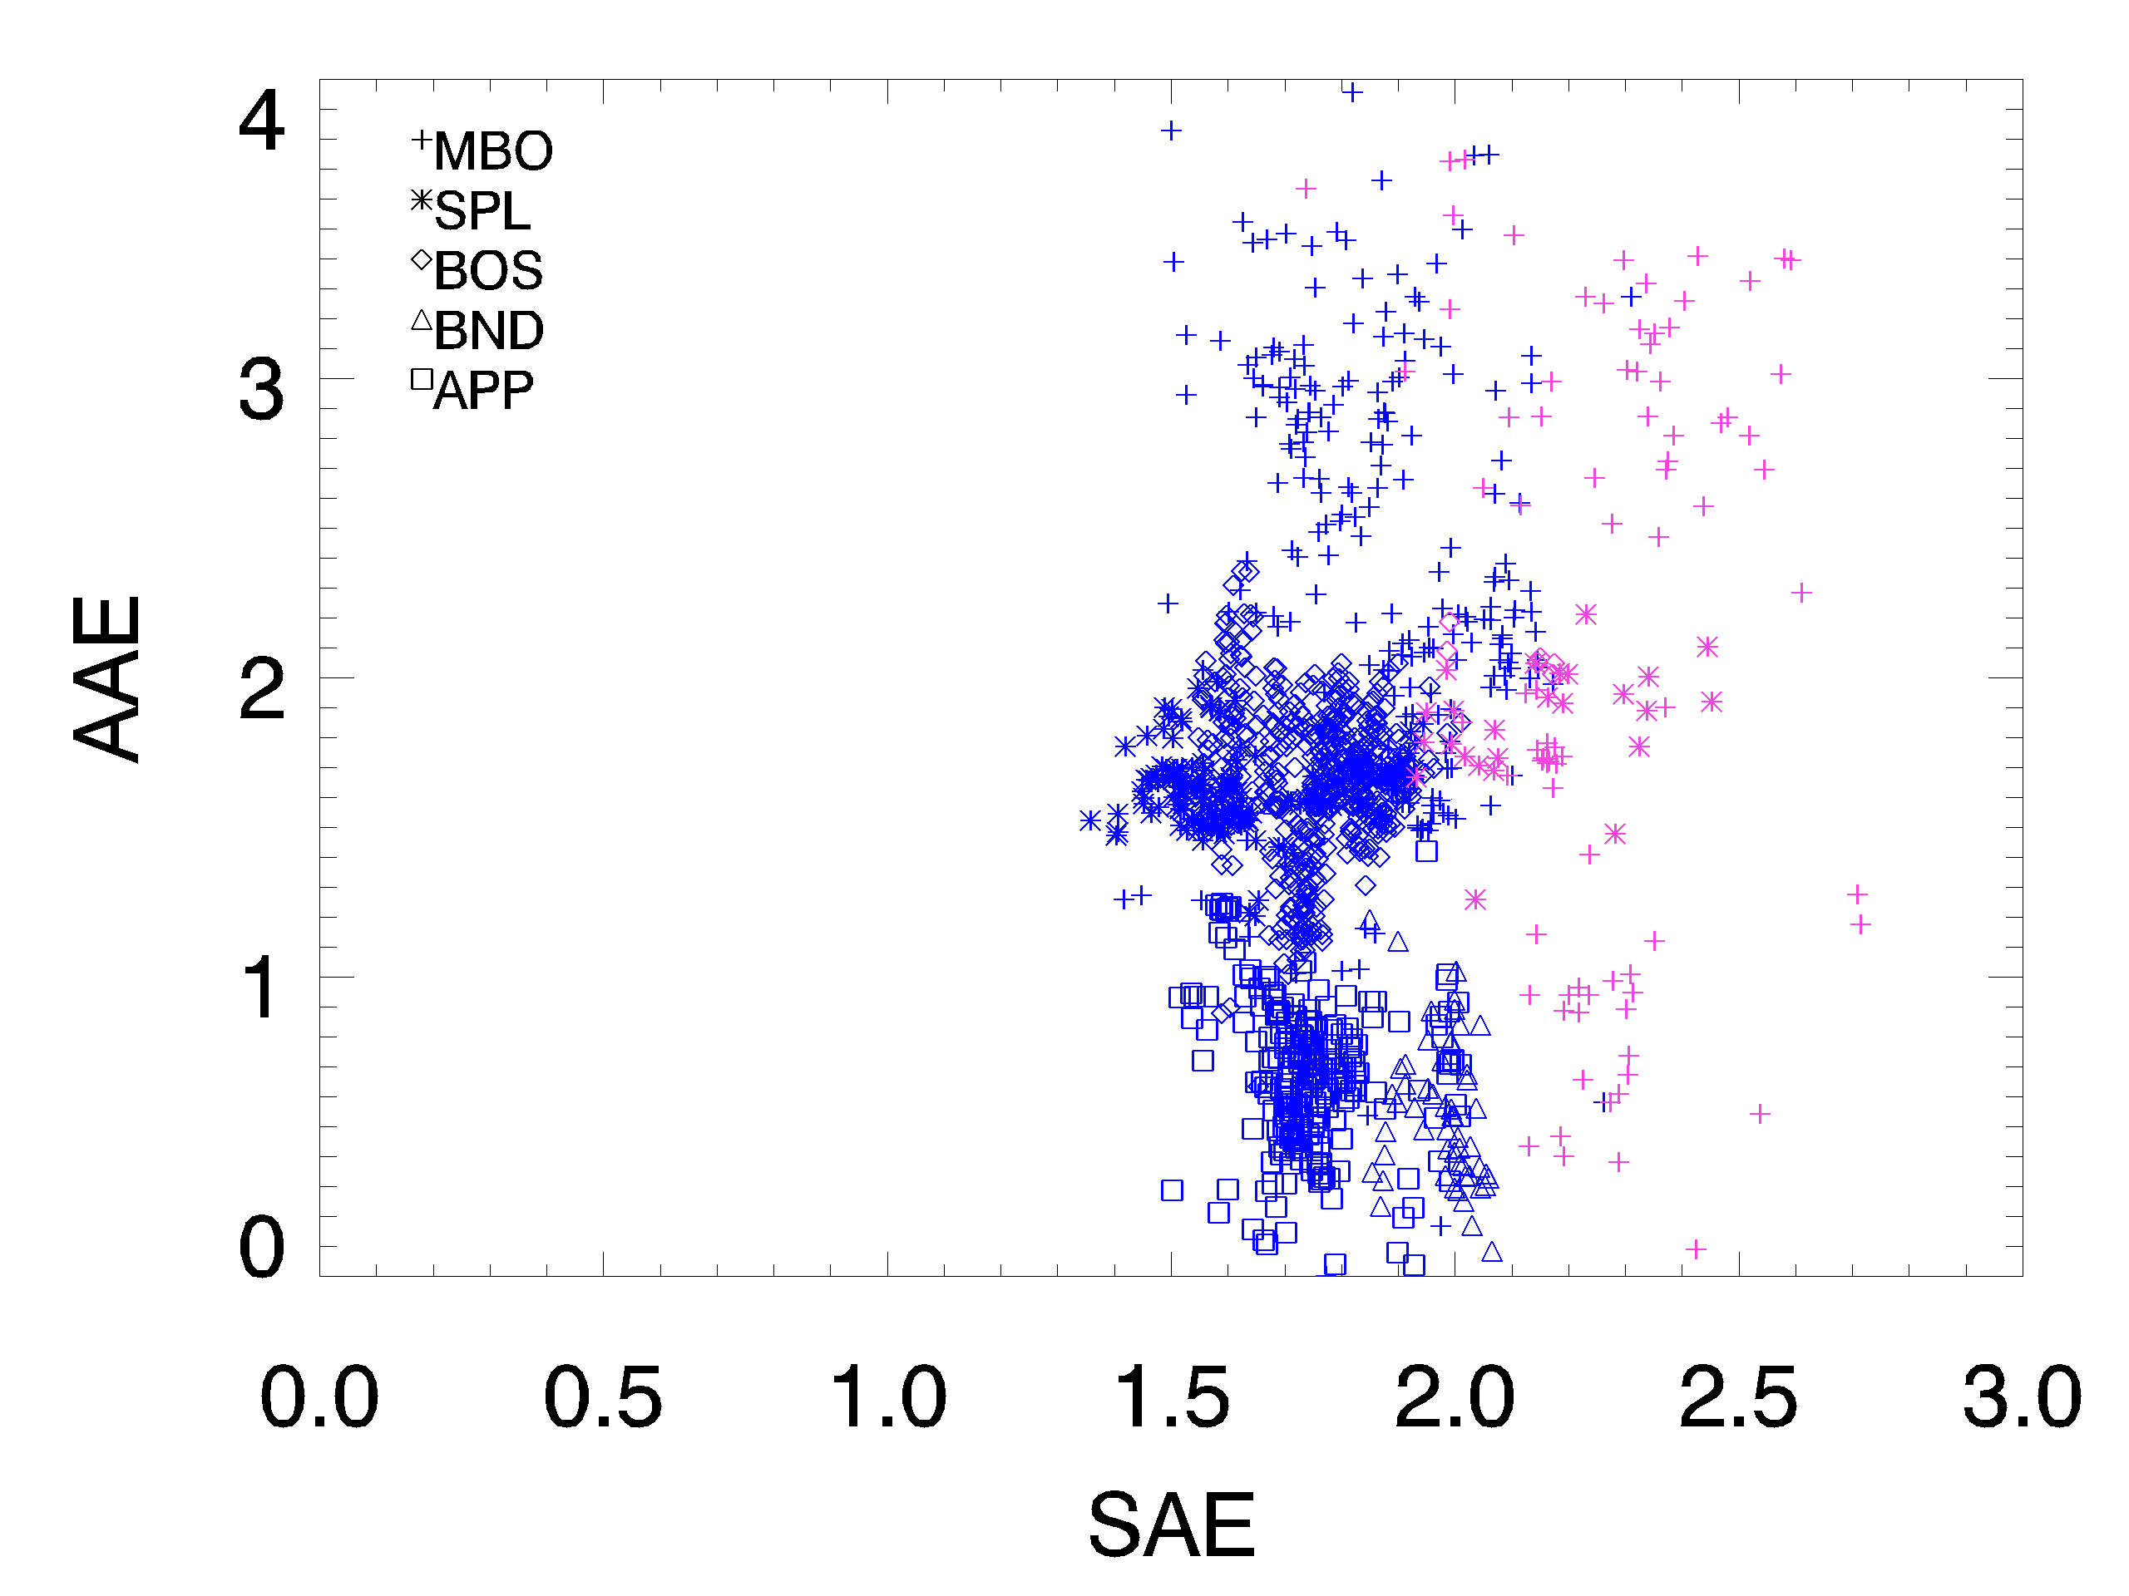
Does smoke identification algorithm work across NFAN sites?
Not so good!!
5 sites: 2021 data
BOS: 2020-2021 data

Slide 19
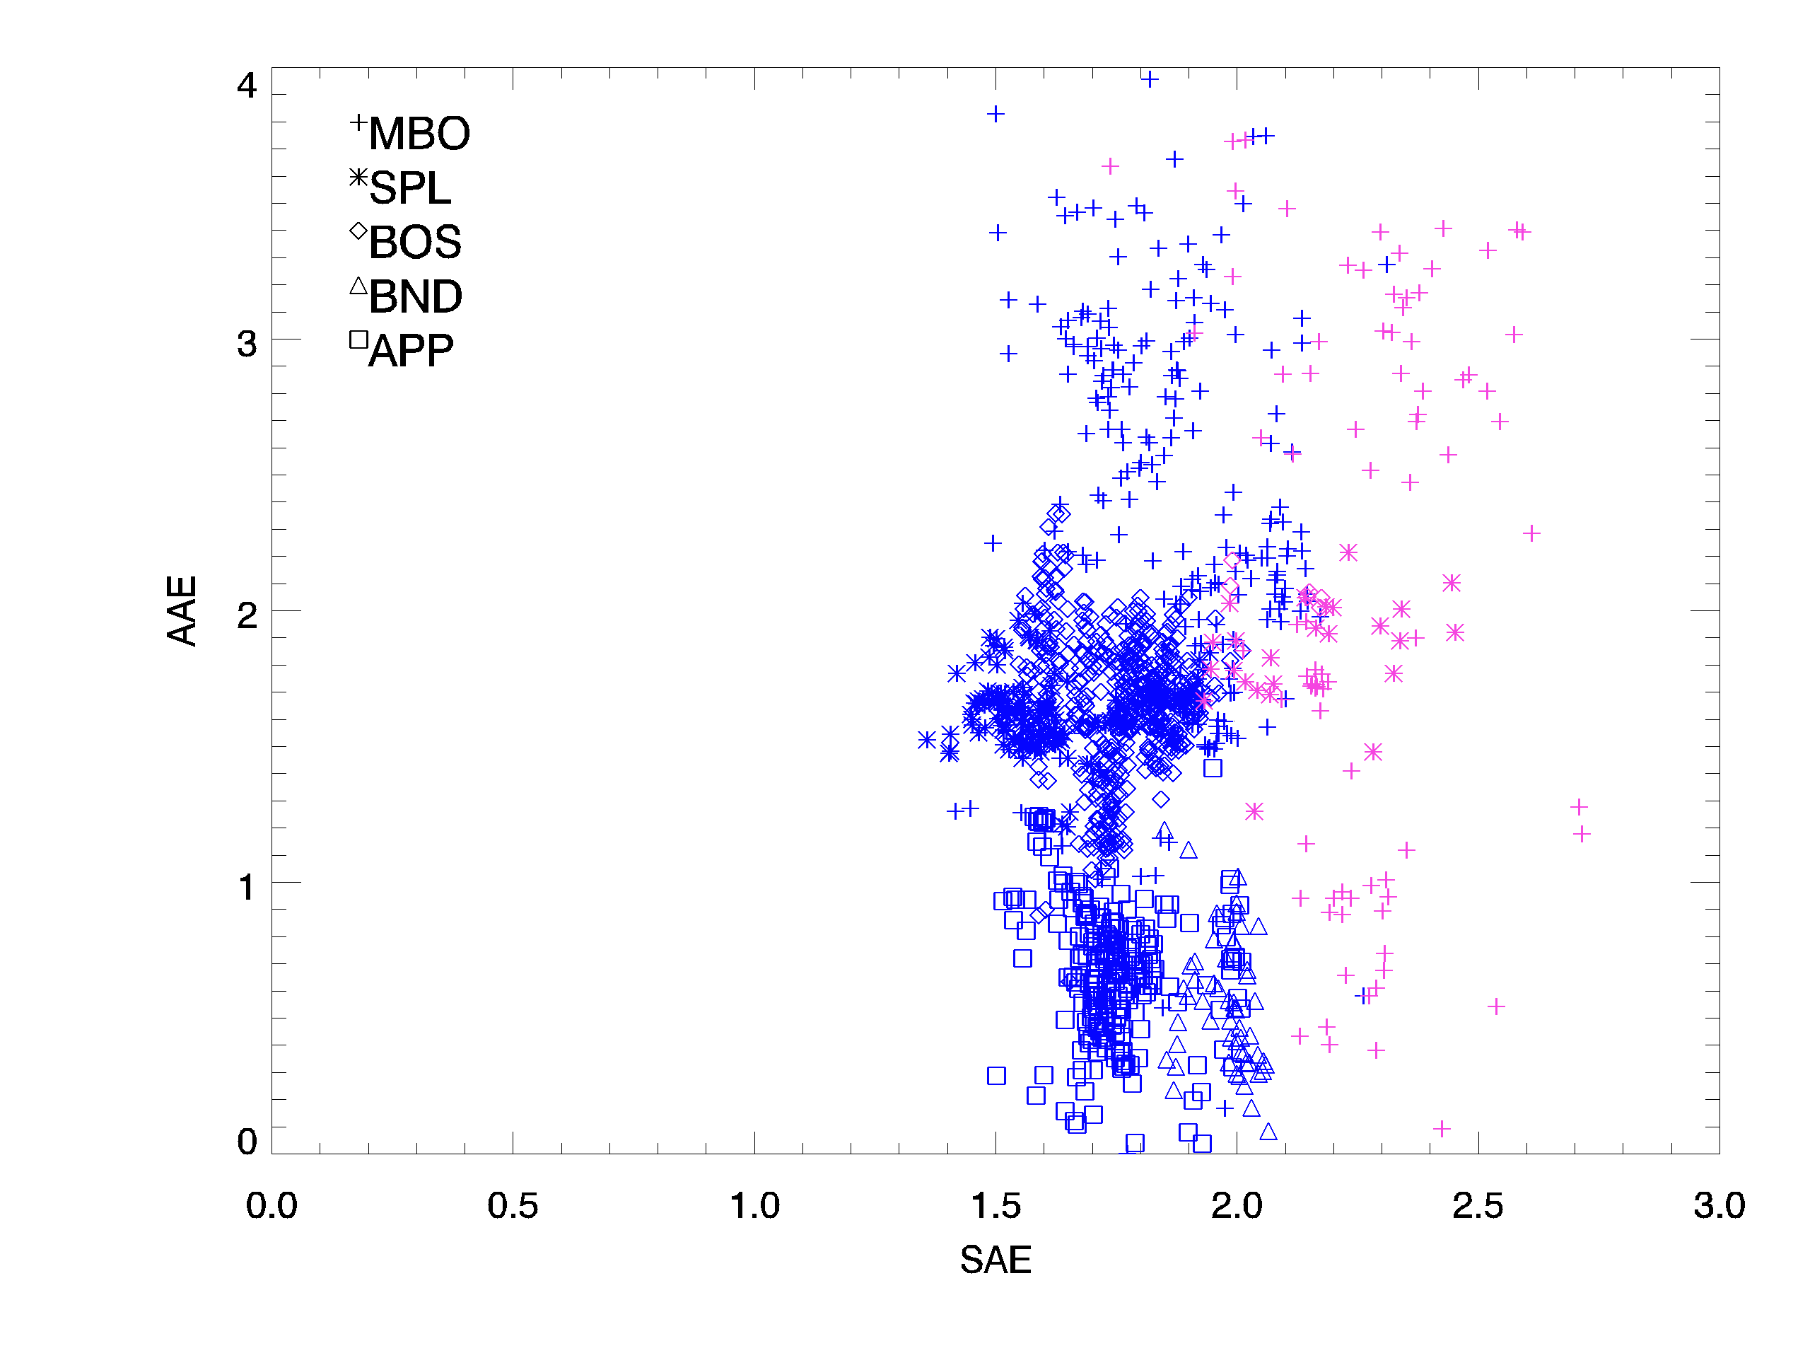
Does smoke identification algorithm work across NFAN sites?
strong BrC
Different pattern across NFAN sites.
SAE appears to separate fresh vs aged: SAE>2 →fresh smoke
Absorption Angstrom exponent
mixed BC/BrC
dust/BC/BrC
BC/large particles
BC dominated
Algorithm needs more work!
large particles
low absorption
small particles
low absorption
Note: y-axis goes to 4 not 3

Slide 20
Smoke algorithm considerations
Contributions from non-smoke aerosol more significant at BND, APP
Fires have different fuel types (grasses, trees, houses ☹…)
Fires burn with different efficiency
Atmospheric conditions during transport may be different → different processing
Difficult to define ”smoke”
Problem for remote sensing identification of smoke:
rely on assumed aerosol properties
non-continuous so evolution might be missed

Slide 21
Take-aways
NFAN measurements provide opportunity to study smoke aerosol optical properties across US.
At BOS, the interannual variability in aerosol amount appears to be driven by smoke events.
Smoke aerosol is clearly different from the ‘normal’ aerosol
→Size (more accumulation mode particles, dominated by sub-um particles)
→Less absorbing
→More organic
Working on algorithm to identify fresh vs aged smoke across NFAN network
→Table Mountain algorithm doesn’t work at other NFAN sites
→in progress…
Combined surface and satellite measurements may improve smoke identification (ongoing)

Slide 22
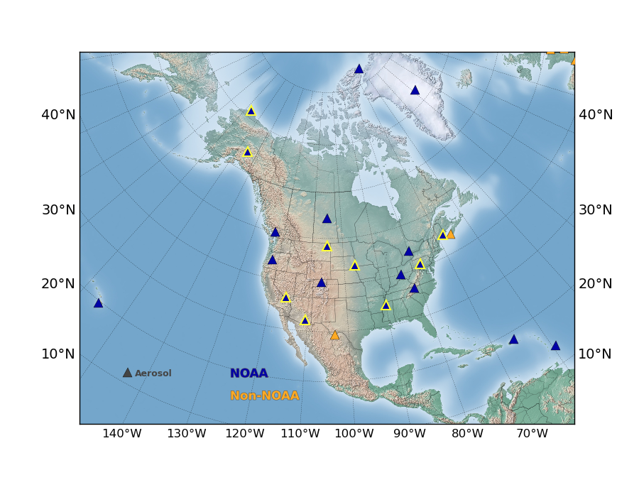
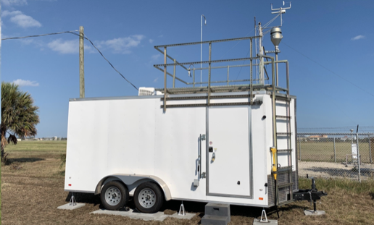
Big Picture and Future Vision
Continuous long-term aerosol observations are essential
Foundation for describing aerosol climatology
  Recognize anomalous aerosol events
  Identify trends (e.g., if there is a ‘new normal’ due to more fires)
  Unique and important dataset for evaluating models and satellite observations
Future vision
  Expanded and collocated measurement network to increase spatial coverage, particularly in the southwest U.S.
  Mobile laboratory to make targeted measurements of smoke plumes and other extreme aerosol events
NFAN
Proposed
Baylor University mobile aerosol trailer

Slide 23

Questions???

Slide 24
extra slides

Slide 25
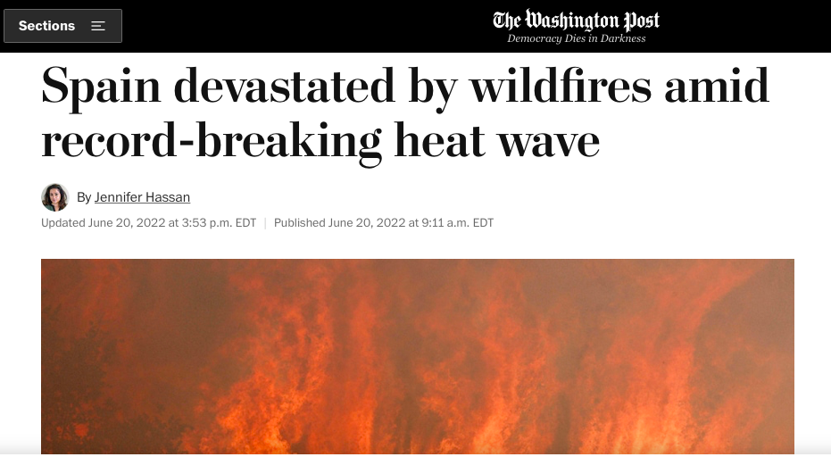

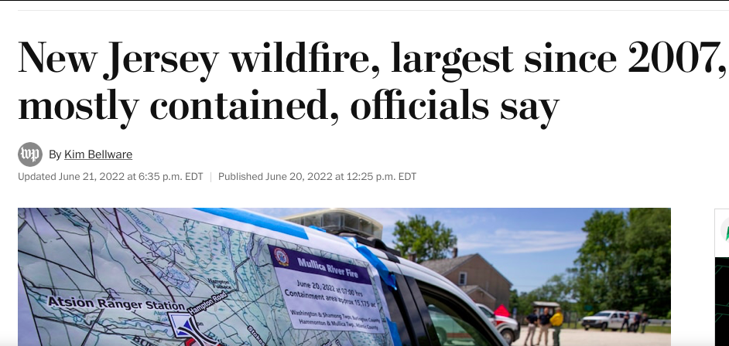
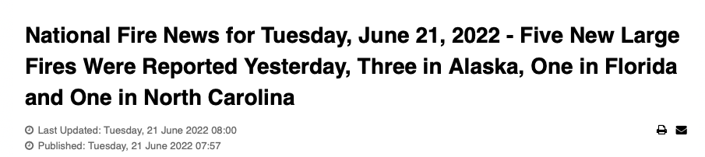
News articles this week!

Slide 26
Derived aerosol optical properties
Independent of amount of particles – dimensionless
Useful for comparing different sites, events
Provide information about particle ‘nature’ (chemistry/microphysics)
Backscatter fraction (BFR)
Scattering Ångström exponent (SAE)
Absorption Ångström exponent (AAE)
Single scattering albedo (SSA)
Angular dependence of scattering
wavelength dependence of scattering
SIZE
wavelength dependence of absorption
COMPOSITION
Relative amount of absorption
Do the aerosol properties for smoke differ from those of background air?
Notes:
not sure how familiar you are with these turms

Slide 27
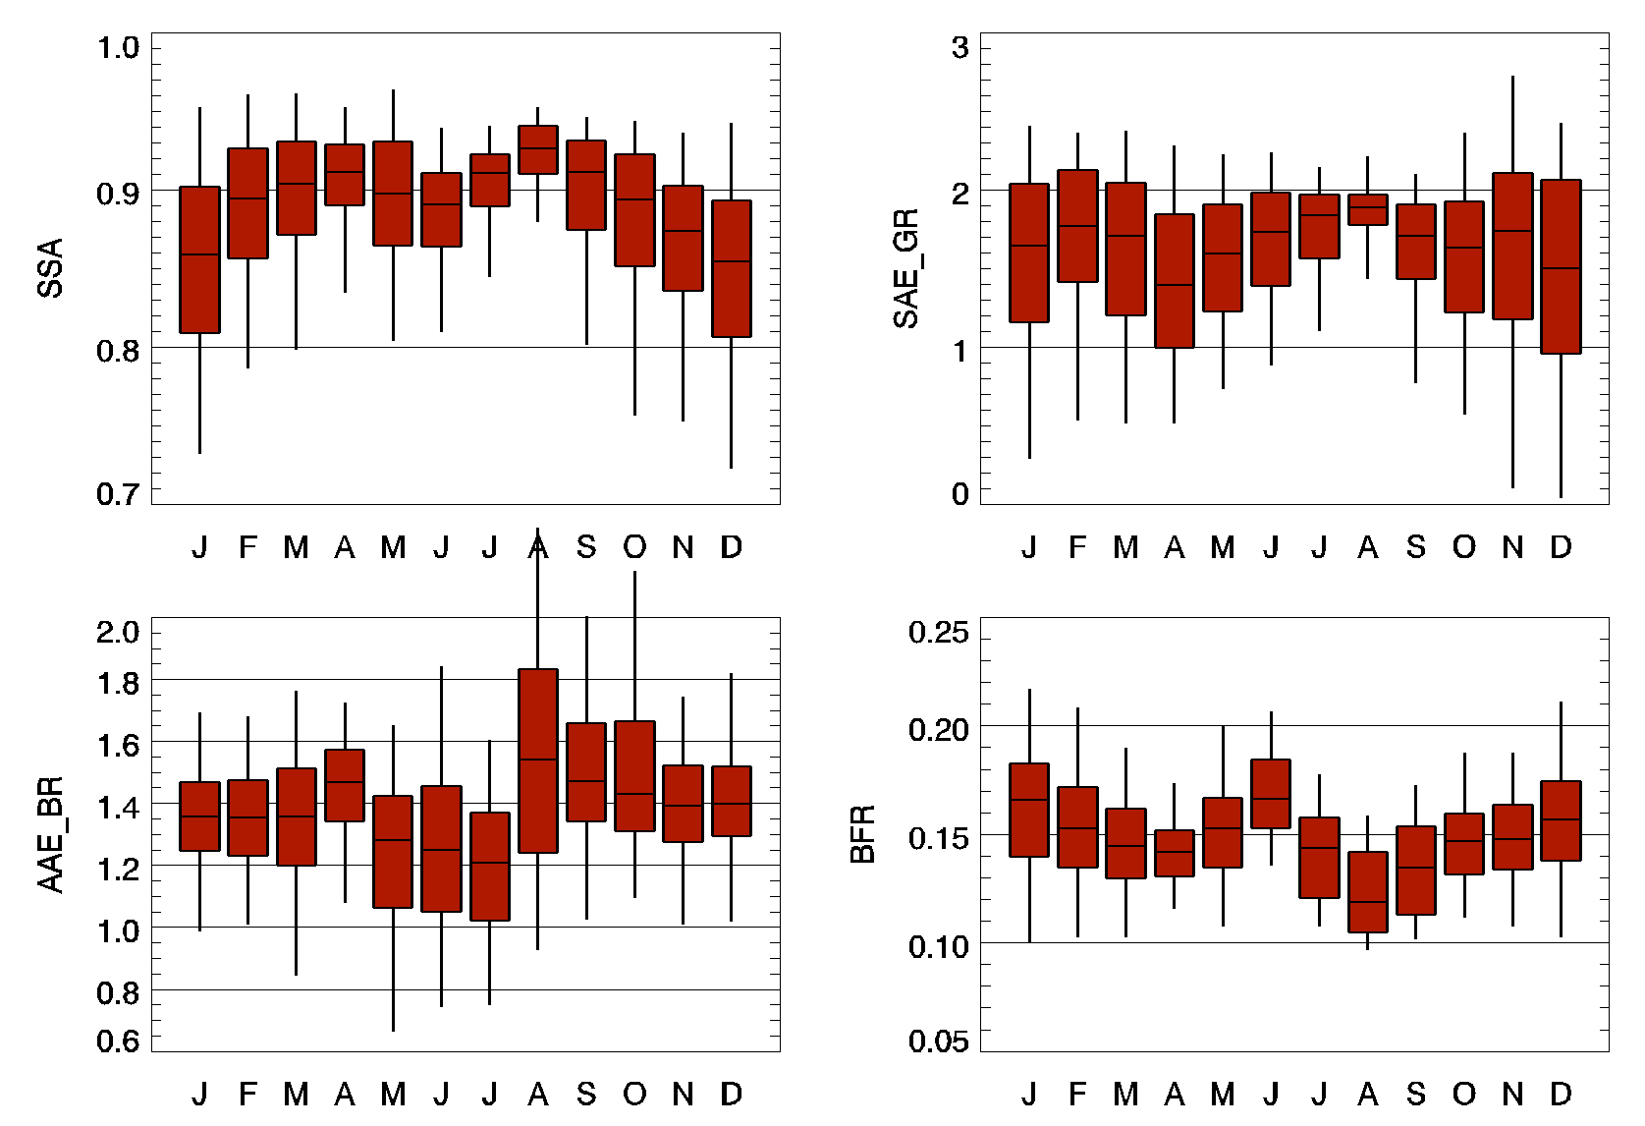
Aerosol ‘characteristics’ monthly climatology at Table Mountain (BOS)
August (smoky month)
→highest SSA
→highest AAE
→highest SAE
→lowest BFR
Single scattering albedo
Scattering Angstrom
Smoke Composition:
Less absorbing (SSA)
More organic (AAE)
Smoke Size:
Dominated by sub-um particles (SAE)
Shift in accumulation mode to larger sub-um particles (BFR)
Absorption Angstrom
Backscatter fraction
Notes:
interesting that 95 percentiles aren’t so clearly different in fire months. note: using clap for SSA and AAE not AETH

Slide 28
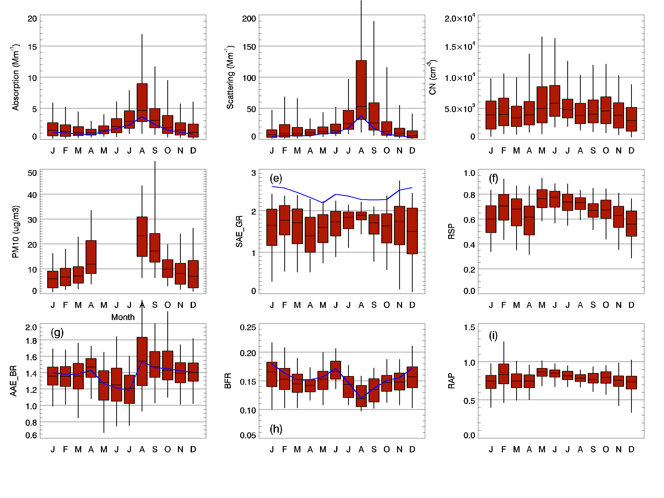
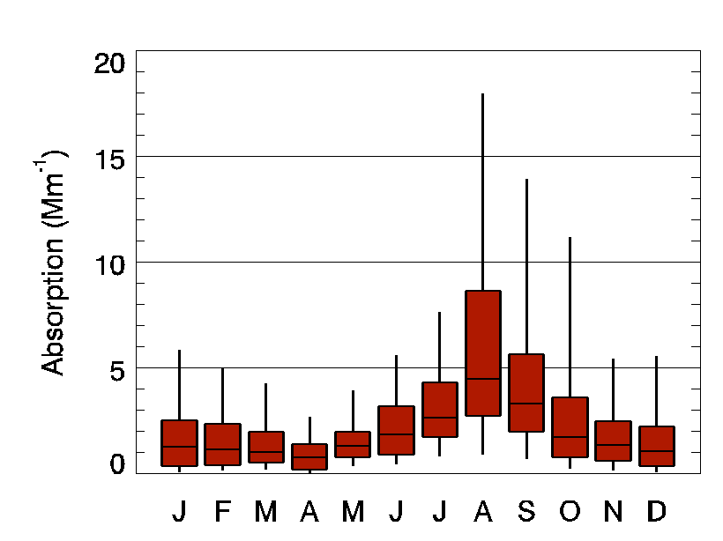
Monthly aerosol climatology at Table Mountain (BOS) facility north of Boulder
September 2019 – May 2022
Number concentration
Absorption coefficient
Scattering coefficient
95th percentile
Scattering and absorption in summer and fall are impacted by fires (especially August)
Fire impact visible in the 95th percentiles in scattering and absorption coefficient
Number concentrations are higher in springtime – no clear fire influence
75th percentile
Median
25th percentile
5th percentile
How consistent is this seasonal pattern?

Slide 29
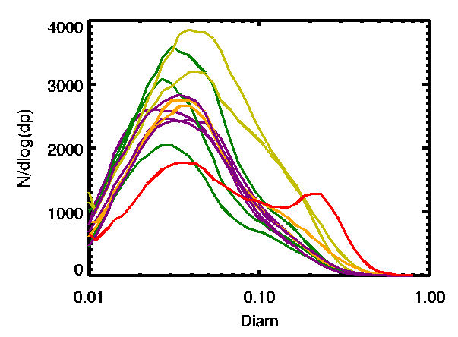
Aerosol size distribution monthly climatology at Table Mountain (BOS)
***RAW*** median aerosol size distribution data
August aerosol size distribution very different
More particles in accumulation mode.
Nov-Feb
Mar-May
Jun-Jul
August
Sep-Oct
Makes sense that calculated parameters related to size (BFR and SAE) are different for smoke events.

Slide 30
Shift in aerosol characteristics with increasing amount of smoke at BOS
More sub-um
Scattering < 30 Mm⁻¹ (no smoke)
30 < Scattering < 50 Mm⁻¹ (minimal smoke)
50 < Scattering < 100 Mm⁻¹ (some smoke)
Scattering > 100 Mm⁻¹ (smoke!)
less absorbing
Frequency of Occurance
Scattering Angstrom Exponent
Smoke composition:
Less absorbing
More organic
Smoke size:
Dominated by sub-um particles
Larger sub-um particles
Single scattering albedo
More organic
larger sub-um
Pink dots represent median of March 2021 mystery peak
→suggests it could be smoke
Absorption Angstrom Exponent
Backscatter fraction
Notes:
so we see that some aerosol characteristic appear to be co-varying. can we use that systematic variability to look at the data in a different way? uses aeth for AAE and SSA

Slide 31
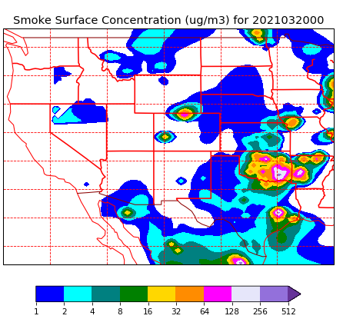
March 20 comparison with NAAPS model prediction
NAAPS = Navy Aerosol Analysis and Prediction System
NAAPS model
fire location from MODIS satellite retrievals
Smoke near Table Mountain on March 20, 2021.
https://www.nrlmry.navy.mil/aerosol
https://www.nrlmry.navy.mil/aerosol
Scattering coefficient
??
20 March

Slide 32
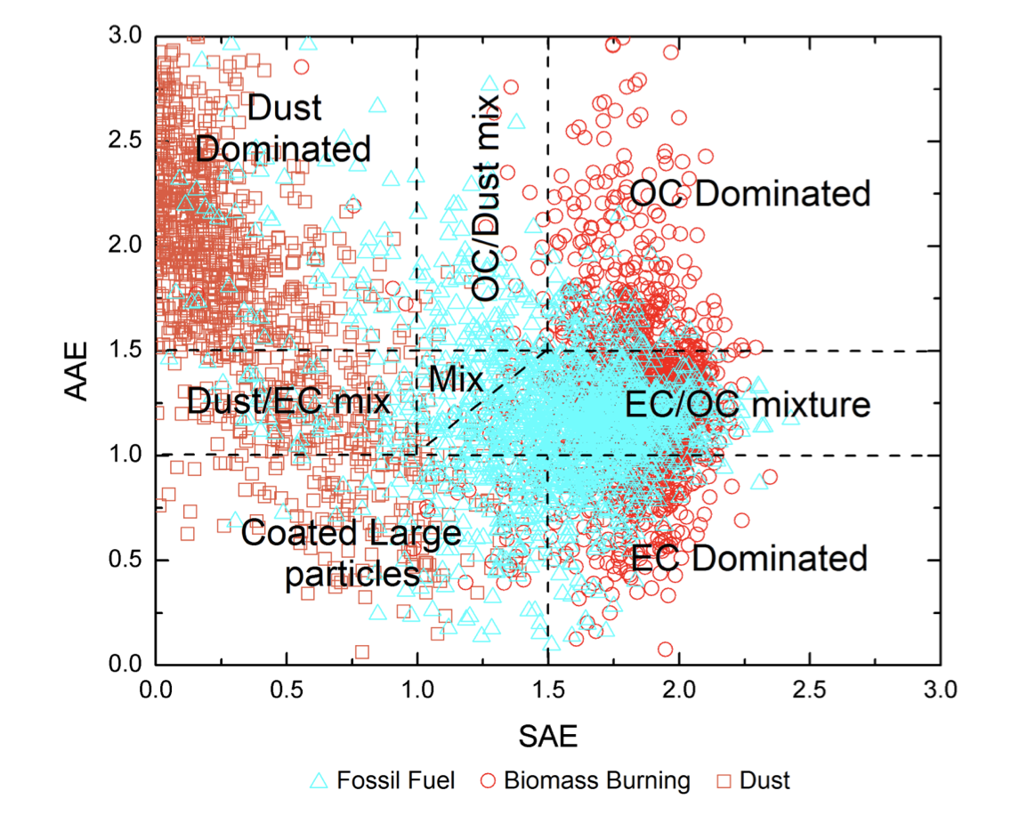
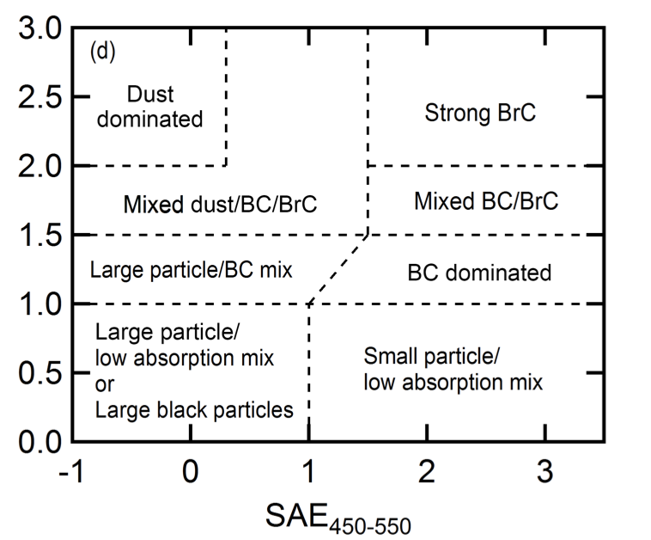
Using systematic variability to identify aerosol type
Co-variability of aerosol properties can provide more detailed information about aerosol type or composition.
combine with next?
column AAE
Absorption Angstrom exponent
Cappa et al., 2016
Cazorla et al., 2013
Column SAE
Scattering Angstrom exponent

Slide 33
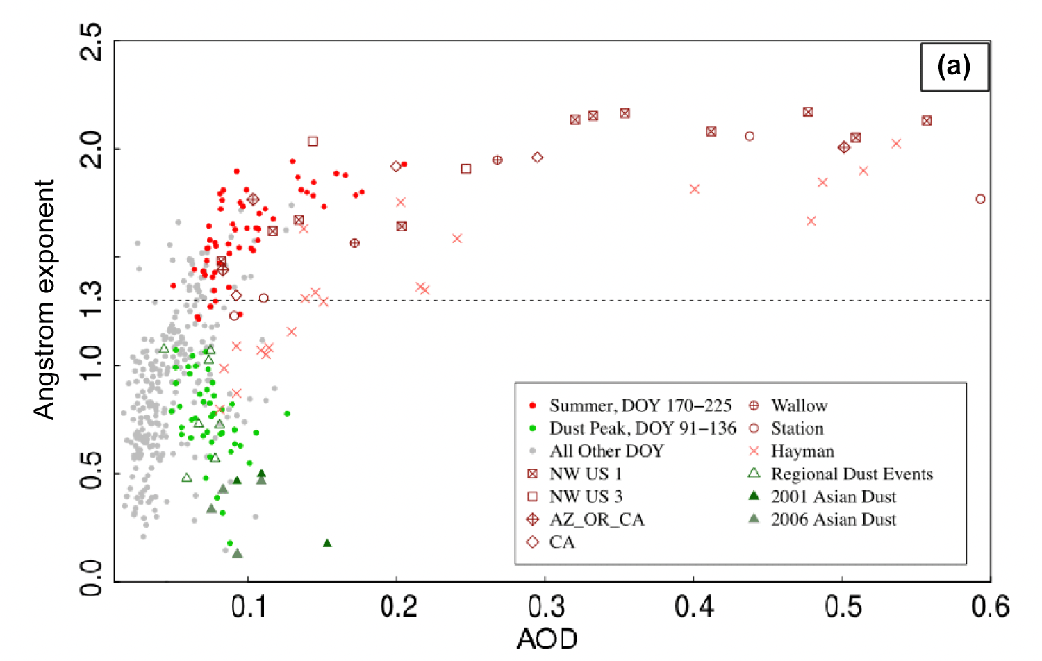
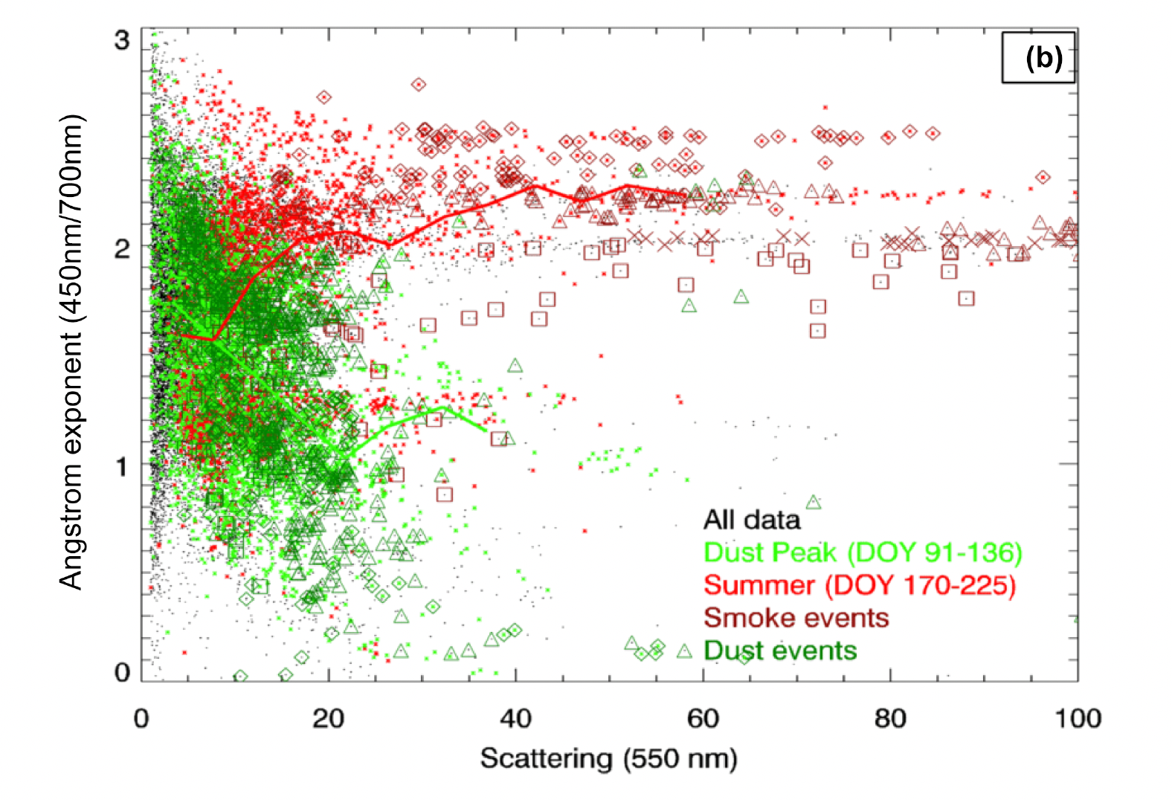
Using systematic variability to identify aerosol type
Systematic relationships can provide information about particle types and processes
→changes in source
→atmospheric processing
Storm Peak Laboratory, CO
Storm Peak Laboratory, CO
Remote sensing
In-situ
(Hallar et al., ACP, 2015)
Angstrom Exponent
Angstrom Exponent
AOD
Scattering coefficient
Smoke and dust exhibit different co-variability
Note: SPL is 150 km NW of Table Mountain
Notes:
simple way is plotting amount vs an aerosol characteristic kind of like we did in last plots. here see amount vs SAE and that known aerosol events (dust and smoke) look different. See this both in remote sensing data (left) and in-situ data (right).

Slide 34
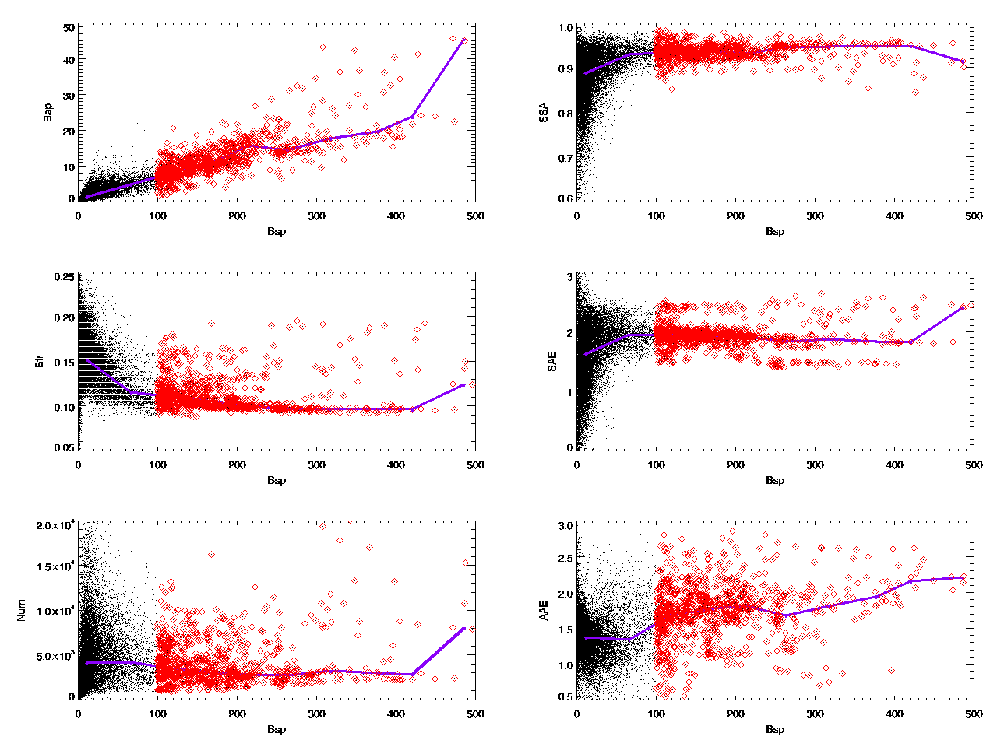
Using systematic variability to identify aerosol type at Table Mountain
Storm Peak Laboratory, CO
Table Mountain, CO
Scattering Angstrom Exponent
Scattering Angstrom Exponent
scattering > 100 Mm⁻¹
Scattering coefficient
Scattering coefficient
Scattering Angstrom exponent increases with scattering during smoke events
Table Mountain doesn’t exhibit a clear dust signal.
Notes: Plots cover different time periods for the 2 sites
Notes:
But – can also look at relationships between aerosol characteristics which might be more interesting/enlightening

Slide 35
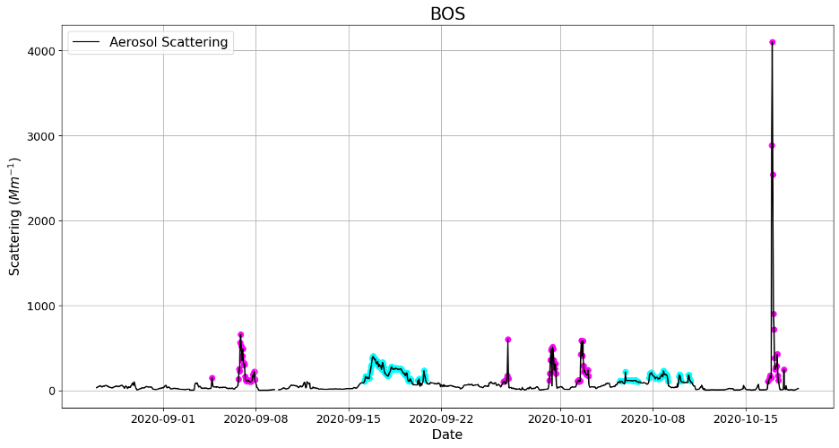
Fresh smoke vs ‘Aged’ smoke at Table Mountain
In 2020 Table Mountain sampled both fresh and aged smoke.
Fresh smoke often came from less than 100 km away.
Fresh local smoke plumes
Aged long range transport smoke
Scattering coefficient
BOS
1-Sept
8-Sept
15-Sept
22-Sept
1-Oct
8-Oct
15-Oct
Date, 2020

Slide 36
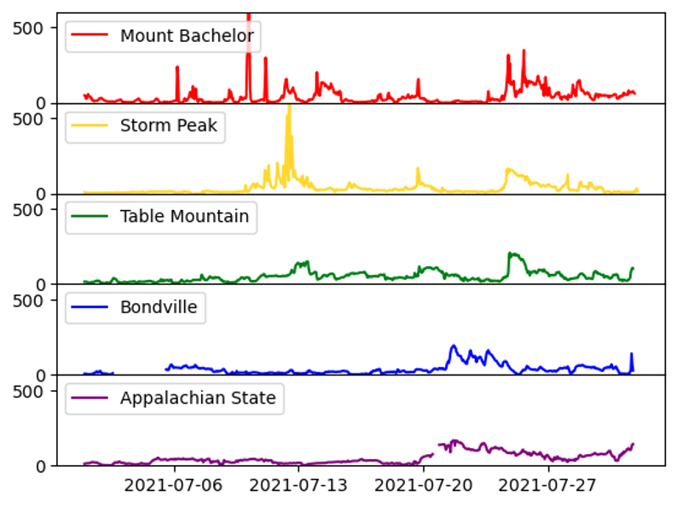
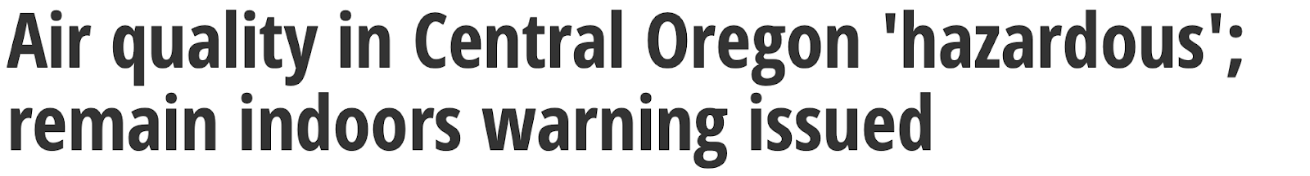

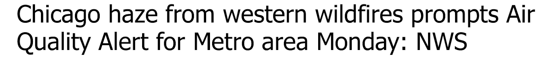
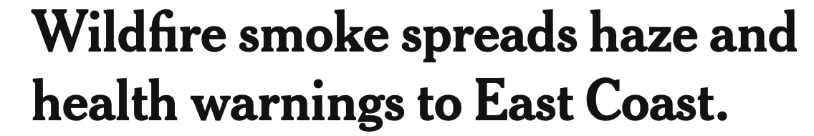
Smoke was observed across US in 2021
NOAA Federated Aerosol Network (NFAN) in US
Aerosol scattering coefficient
Aerosol scattering levels were 5-50x higher than ‘normal’ during some smoke events.

Slide 37
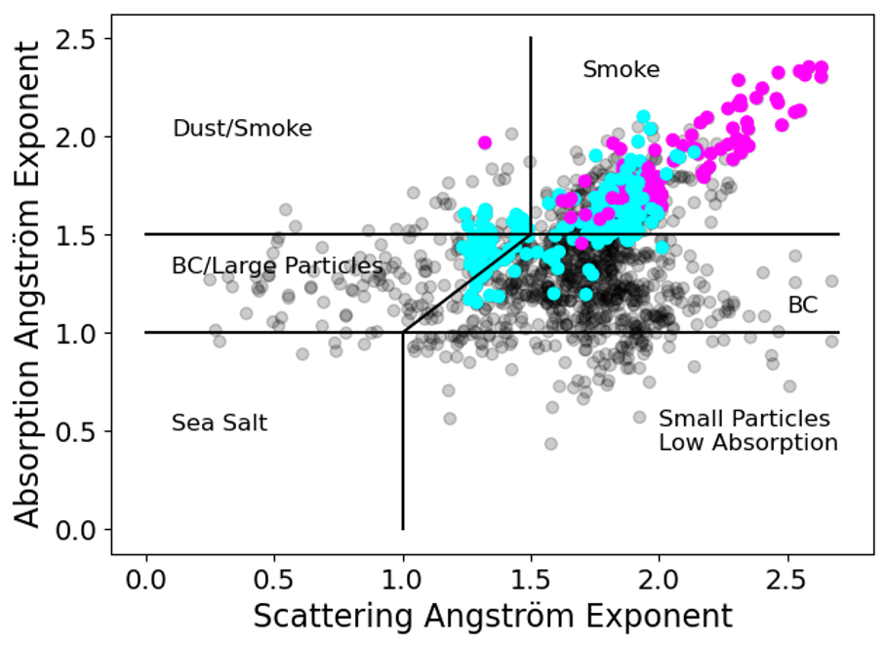
Fresh smoke vs ‘Aged’ smoke at Table Mountain
In 2020 Table Mountain sampled both fresh and aged smoke.
Fresh smoke often came from less than 100 km away.
Fresh and aged smoke events appear in different places on AAE vs SAE matrix
Fresh local smoke plumes
Aged long range transport smoke
strong BrC
dust/BC/BrC
mixed BC/BrC
BC/large particles
BC dominated
Scattering coefficient
large particles
low absorption
small particles
low absorption
Fresh smoke in BrC sectors
Aged smoke crosses BC/BrC sectors
1-Sept
8-Sept
15-Sept
22-Sept
1-Oct
8-Oct
15-Oct
Date, 2020

Slide 38
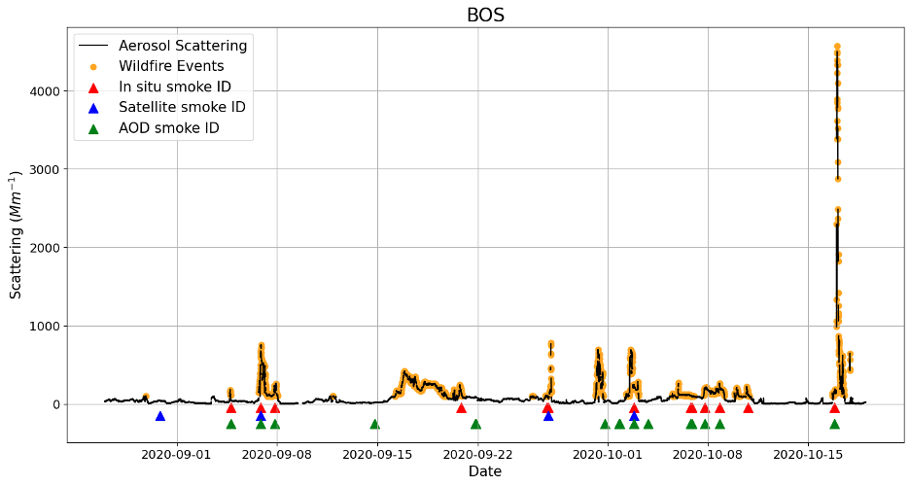
Improving satellite identification of smoke events
(work by Lauren Schmeisser)
Surface smoke events
Time series of scattering at BOS from nephelometer
Yellow dots smoke events
(scat > 100 Mm⁻¹)
something about satellite smoke masks? lauren stuff.
→Do different methods all identify the same smoke events?

Slide 39
Identification of smoke events at Table Mountain
Surface smoke events
Triangles indicate smoke identified and
are at satellite retrieval times.
In-situ from nephelometer at surface.
Satellites are NOAA-20 (J01) and NPP.
AOD from MFRSR at surface.
Surface methods see smoke, satellite does not
All three methods identify smoke
→Identification of smoke event changes with method.

Slide 40
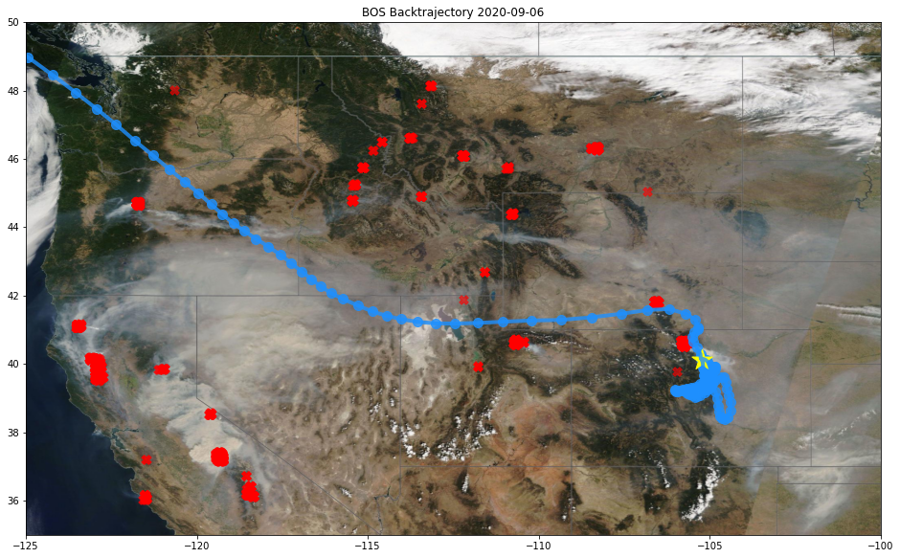
Identification of smoke events at Table Mountain
Surface smoke events
Surface methods see smoke, satellite does not
All three methods identify smoke
BOS

Slide 41
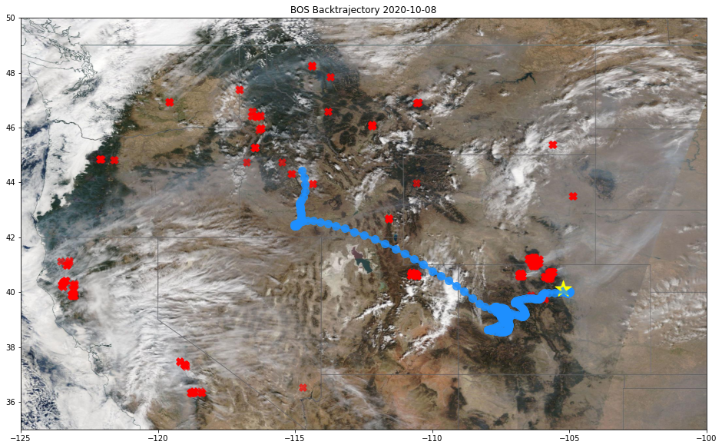
Identification of smoke events at Table Mountain
Surface smoke events
Surface methods identify smoke, satellite does not
All three methods identify smoke
BOS
Ongoing research!
Satellite gridding might cause smoke identification algorithm to miss smoke
Or assumptions about smoke properties? (We know they change!)
Or ???

Slide 42
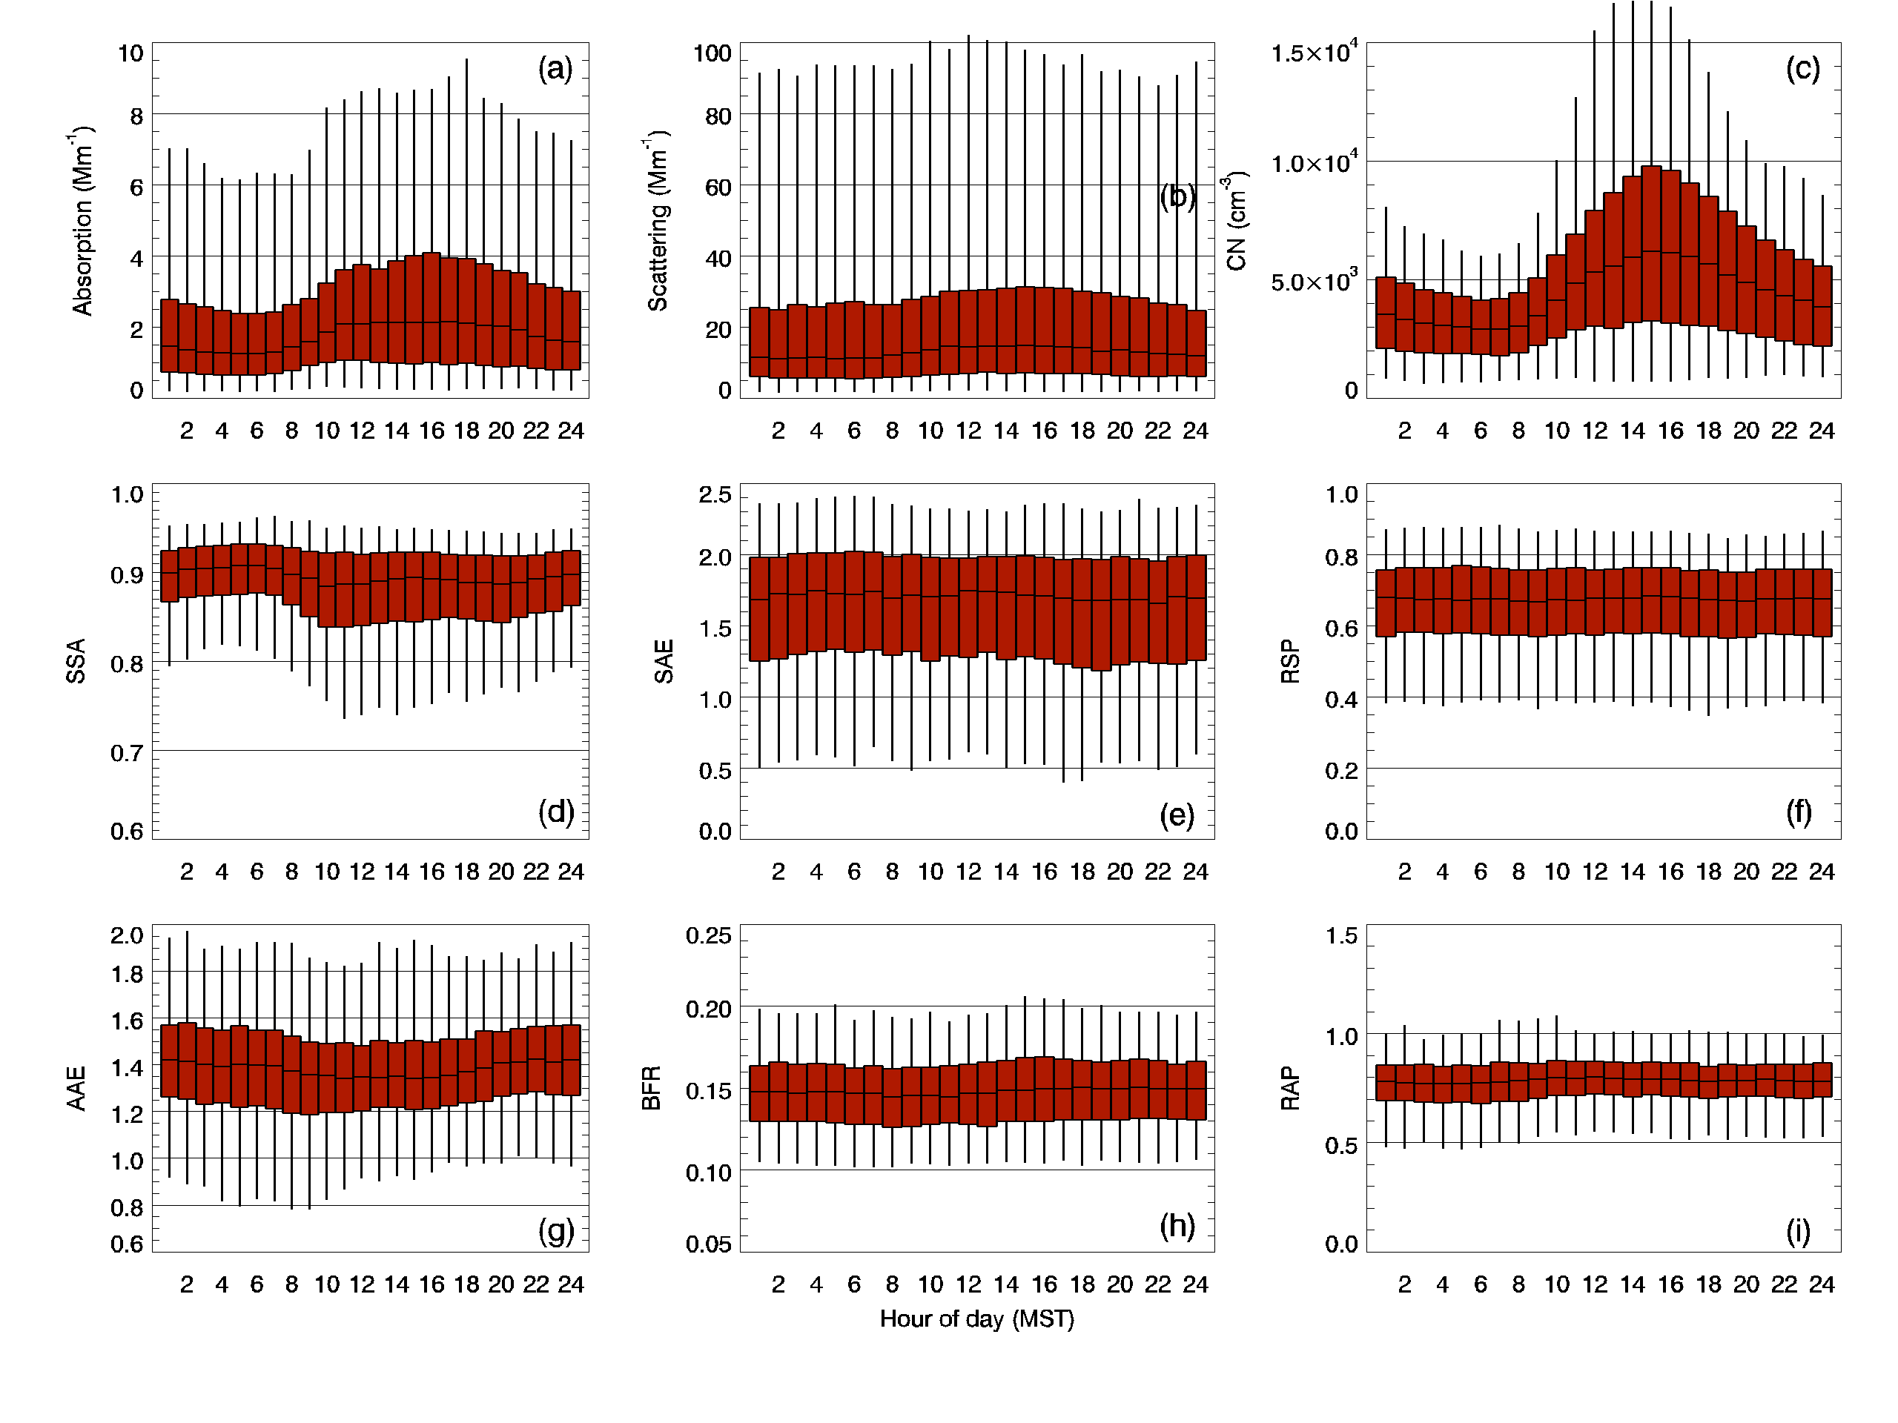

Slide 43
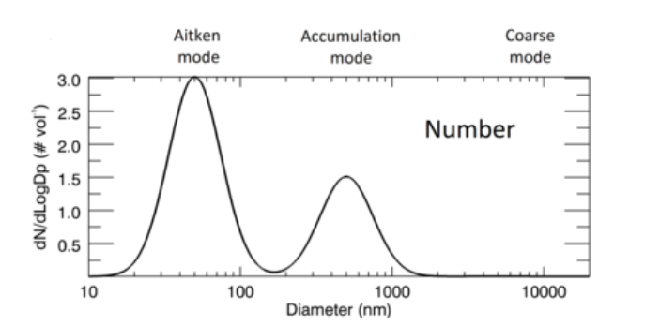
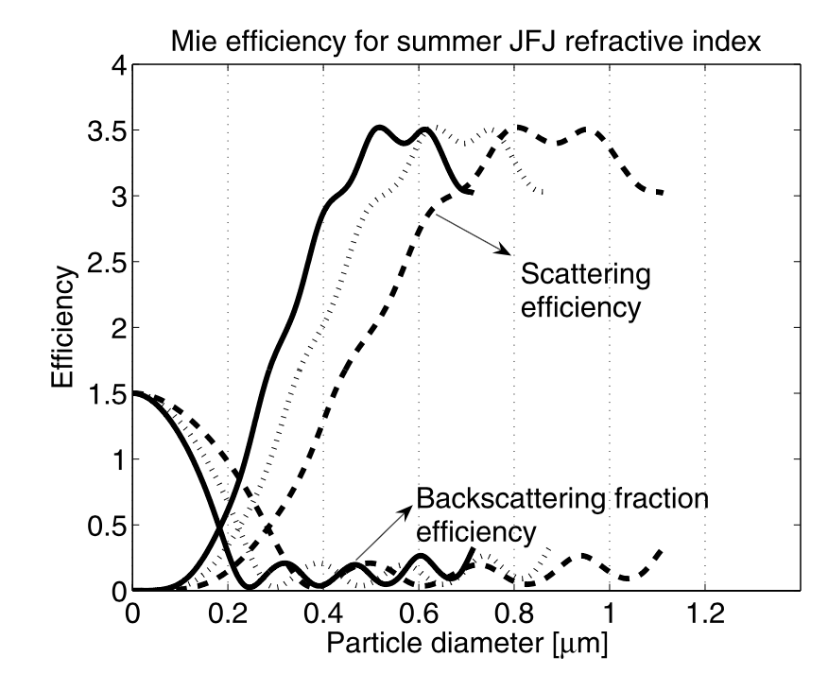
Derived aerosol optical properties
Backscatter fraction and scattering Ångström exponent
450 nm
550 nm
700 nm
Collaud Coen et al., JGR, 2007
BFR
SAE
Scattering efficiency
0.01 0.1 1.0 10
Diameter (um)
Diameter (um)
Wavelength dependence of scattering is function of particle diameter
Backscattering fraction (BFR) most affected by particles<0.3 um
Scattering Ångström exponent (SAE) by particles>0.5 um

Slide 44
Derived aerosol optical properties
Scattering Ångström exponent (SAE)
450 nm
550 nm
700 nm
Wavelength dependence of scattering is function of particle diameter
Scattering Ångström exponent (SAE) most affected by particles> 0.4-0.5 um
Scattering efficiency
Collaud Coen et al., JGR, 2007
SAE = - log(scat(λ=450)/scat(λ=700))
log(450/700)

Slide 45

Derived aerosol optical properties
Scattering Angstrom Exponent (SAE)
Volume (fine)/Volume (total)
Schuster, JGR, 2006
Scattering Angstrom exponent
SAE >2 → mostly small particles
SAE < 1 → more big particles (dust, sea salt…)

Slide 46

Derived aerosol optical properties
Backscattering fraction (BFR)
BFR=0.5
BFR=0.2
BFR=0.1
D=0.05 um
D=0.1 um
D=0.2 um
Smaller particles scatter light symmetrically.
Larger particles scatter more light forward than backward.
Backscattering fraction most affected by particles < 0.3 um
BFR = backscatter
total scatter
Other aerosol parameters related to backscatter fraction include upscatter fraction and asymmetry parameter.

Slide 47



Derived aerosol optical properties
Single Scattering Albedo (SSA)
0.3 < SSA < 1 → typical atmospheric values ~0.8-0.9
SSA ~ 0.4
SSA ~ 0.8
SSA ~ 1.0
Atmospheric particles can be mixtures of absorbing aerosol (black carbon) and scattering aerosol.
Particles with relatively more absorbing aerosol will have lower SSA.
SSA = scatter
scatter+absorb

Slide 48

Derived aerosol optical properties
Absorption Angstrom Exponent (AAE)
Particle with lots of organic
AAE = 3
Russell et al., ACP, 2010
Black Carbon AAE = 1
Absorption Angstrom exponent increases with organic mass fraction.
AAE = - log(abs(λ=450)/abs(λ=700))
log(450/700)

Slide 49

Shift in aerosol size distribution with increasing amount of smoke at BOS
Scattering < 30 Mm⁻¹ (no smoke)
30 < Scattering < 50 Mm⁻¹ (minimal smoke)
50 < Scattering < 100 Mm⁻¹ (some smoke)
Scattering > 100 Mm⁻¹ (smoke!)
Smoke Size:
Dominated by accumulation
Nov-Feb
Mar-May
Jun-Jul
August
Sep-Oct
‘No smoke’ looks like annual median size distribution
Smoke size distribution is very similar to August size distribution

Slide 50
https://www.earthdata.nasa.gov/learn/find-data/near-real-time/firms/active-fire-data
satellite
Aerosol
Radiative
Forcing
= f(aerosol amount, backscatter fraction, single scattering albedo)

Slide 51
Fresh
Aged
Dg~0.17 um
Smoke Composition:
Less absorbing
More organic
Smoke Size:
Dominated by sub-um particles
Shift in accumulation mode to larger sub-um particles
Dg~0.27 um

Slide 52
something about smoke age?
start with 2020 and lauren’s dates and time series then SAE vs AAE
AGED:
Scattering > 100 Mm-1
Bfr<0.13
FRESH:
Scattering > 100 Mm-1
Bfr>0.13
strong BrC
dust
dust/BC/BrC
mixed BC/BrC
Absorption Angstrom exponent
March 20 event
BC dominated
Why would fresh have more BrC??
large particles
low absorption
small particles
low absorption
Scattering Angstrom exponent

Slide 53

Notes:
uses CLAP data for SSA and AAE

Slide 54

Relationship between scat10 and PM10 as function of AOPs
Two populations in scat10/PM10 plot
Population#1 (smoke-influenced?):
High scattering: >50 Mm-1
SSA >0.92
BFR<0.12
1.75<SAE<2.0
AAE>1.5
Population#2 (“normal”)
SSA<0.92
BFR>0.12
SAE<1.5
1.0<AAE<1.75
smoke
PM10
PM10
→high loading smoke aerosol exhibits different scat10/PM10 relationship than other aerosol
PM10
PM10

Slide 55






Other systematic relationships
skip?? and go into smoke age?
scat>100 Mm⁻¹
colored by BFR
colored by AAE
colored by SSA
scat<30 Mm⁻¹
Best for separating smoke

Slide 56




SAE
BFR
SSA
SSA
CN
AAE
CN
AAE
BFR
SAE
BFR
SAE
SSA
BFR
CN
CN
AAE
SAE
AAE
SSA

Slide 57

AAE
SAE
SSA
what are brown points?
fix labels, axis (set xticks),
smaller symbols? or have later symbols in loop be smaller so can see earlier symbols?
Scat
CO
o3

Slide 58

ranges from 0.1-0.7 (I think it’s delta o3 and delta co), o3-35/CO-100 should increase with plume age
NOT SURE WHAT SHOULD USE AS BASELINE O3 – 30? 35? 40?
AAE
SAE
SSA
jaffe 2012 – modified combustion efficiency MCE = co2/(co+co2) 0.92 temperate, 0.80 boreal
Scat
CO
o3
decrease with age
increase with age

Slide 59


color by something else? BFR?
o3/co ratio? which should increase with age
Scattering < 30 Mm⁻¹ (no smoke)
30 < Scattering < 50 Mm⁻¹ (minimal smoke)
50 < Scattering < 100 Mm⁻¹ (some smoke)
Scattering > 100 Mm⁻¹ (smoke!)
Ozone increases with smoke
aged
fresh
aged
fresh
aged
fresh
Ozone lower in fresh smoke than aged smoke
However, a smaller number of studies, mainly in boreal regions, have found that O₃ is minimally enhanced or even depleted downwind of some biomass burning plumes (e.g. Tanimoto et al., 2008; Paris et al., 2009; Verma et al., 2009; Alvarado et al., 2010). The low O₃ production in these plumes was likely caused by low mixing ratios of NOx due to low emissions, sequestration of NOx as PAN, and/or a reduction in photochemical reactions (especially due to aerosol effects).

Slide 60

Scattering < 30 Mm⁻¹ (no smoke)
30 < Scattering < 50 Mm⁻¹ (minimal smoke)
50 < Scattering < 100 Mm⁻¹ (some smoke)
Scattering > 100 Mm⁻¹ (smoke!)
CO increases with smoke
CO higher with fresh, but also lower at scat=50 Mm-1 level
aged
fresh
aged
fresh

Slide 61

Mass Scattering Coefficient (MSC) at Table Mountain
MSC = scattering coefficient
mass concentration
y=3.81*m-3.00, R²=0.98
MSC values from Hand et al., 2007
Fine mode:
inorganic ~2.6 m²/g
organic ~3.9 m²/g
mixed~3.6 m²/g
biomass smoke > 6 m²/g
dust ~3 m²/g
Coarse mode
mixed ~1 m²/g
dust ~0.7 m²/g
smoke ---
Table Mountain aerosol does NOT exhibit increase in MSC for fine biomass smoke
MSC ~3.8 m²/g
PM1 scattering (Mm⁻¹)
PM1 mass conc (ug/m³)
y=2.87*m+8.03, R²=0.80
y=1.15*m+1.47, R²=0.51
Table Mountain does exhibit increase in MSC for coarse biomass smoke
MSC ~2.9 m²/g
PM10 scattering (Mm⁻¹)
PM10 mass conc (ug/m³)

Slide 62


Mass Absorption Coefficient (MAC) at Table Mountain
Don’t have reference measurement of absorbing aerosol mass
Can bound the range of MAC at Table Mountain based on literature
MAC =absorption coefficient
BC mass concentration
MAC~7.5 m²/g
5.8
Which absorption coefficient: CLAP or Aeth?
Where is CO2 data?
smoke
Spackman et al., 2008
MAC~23 m²/g
BC
CO
1
MAC
=
abs
CO
*
pure BC MAC=7.5 m²/g
(Bond&Bergstrom, 2006)
smoke MAC=26m²/g
(Mason et al., 2018)
Notes:
at BOS MMR is approx same as mass conc:
mass conc=MMR*p/RT, R=287J/kg-K, T=298K, P=85000 N/m2=85000=85000J/m3

