Slide 1
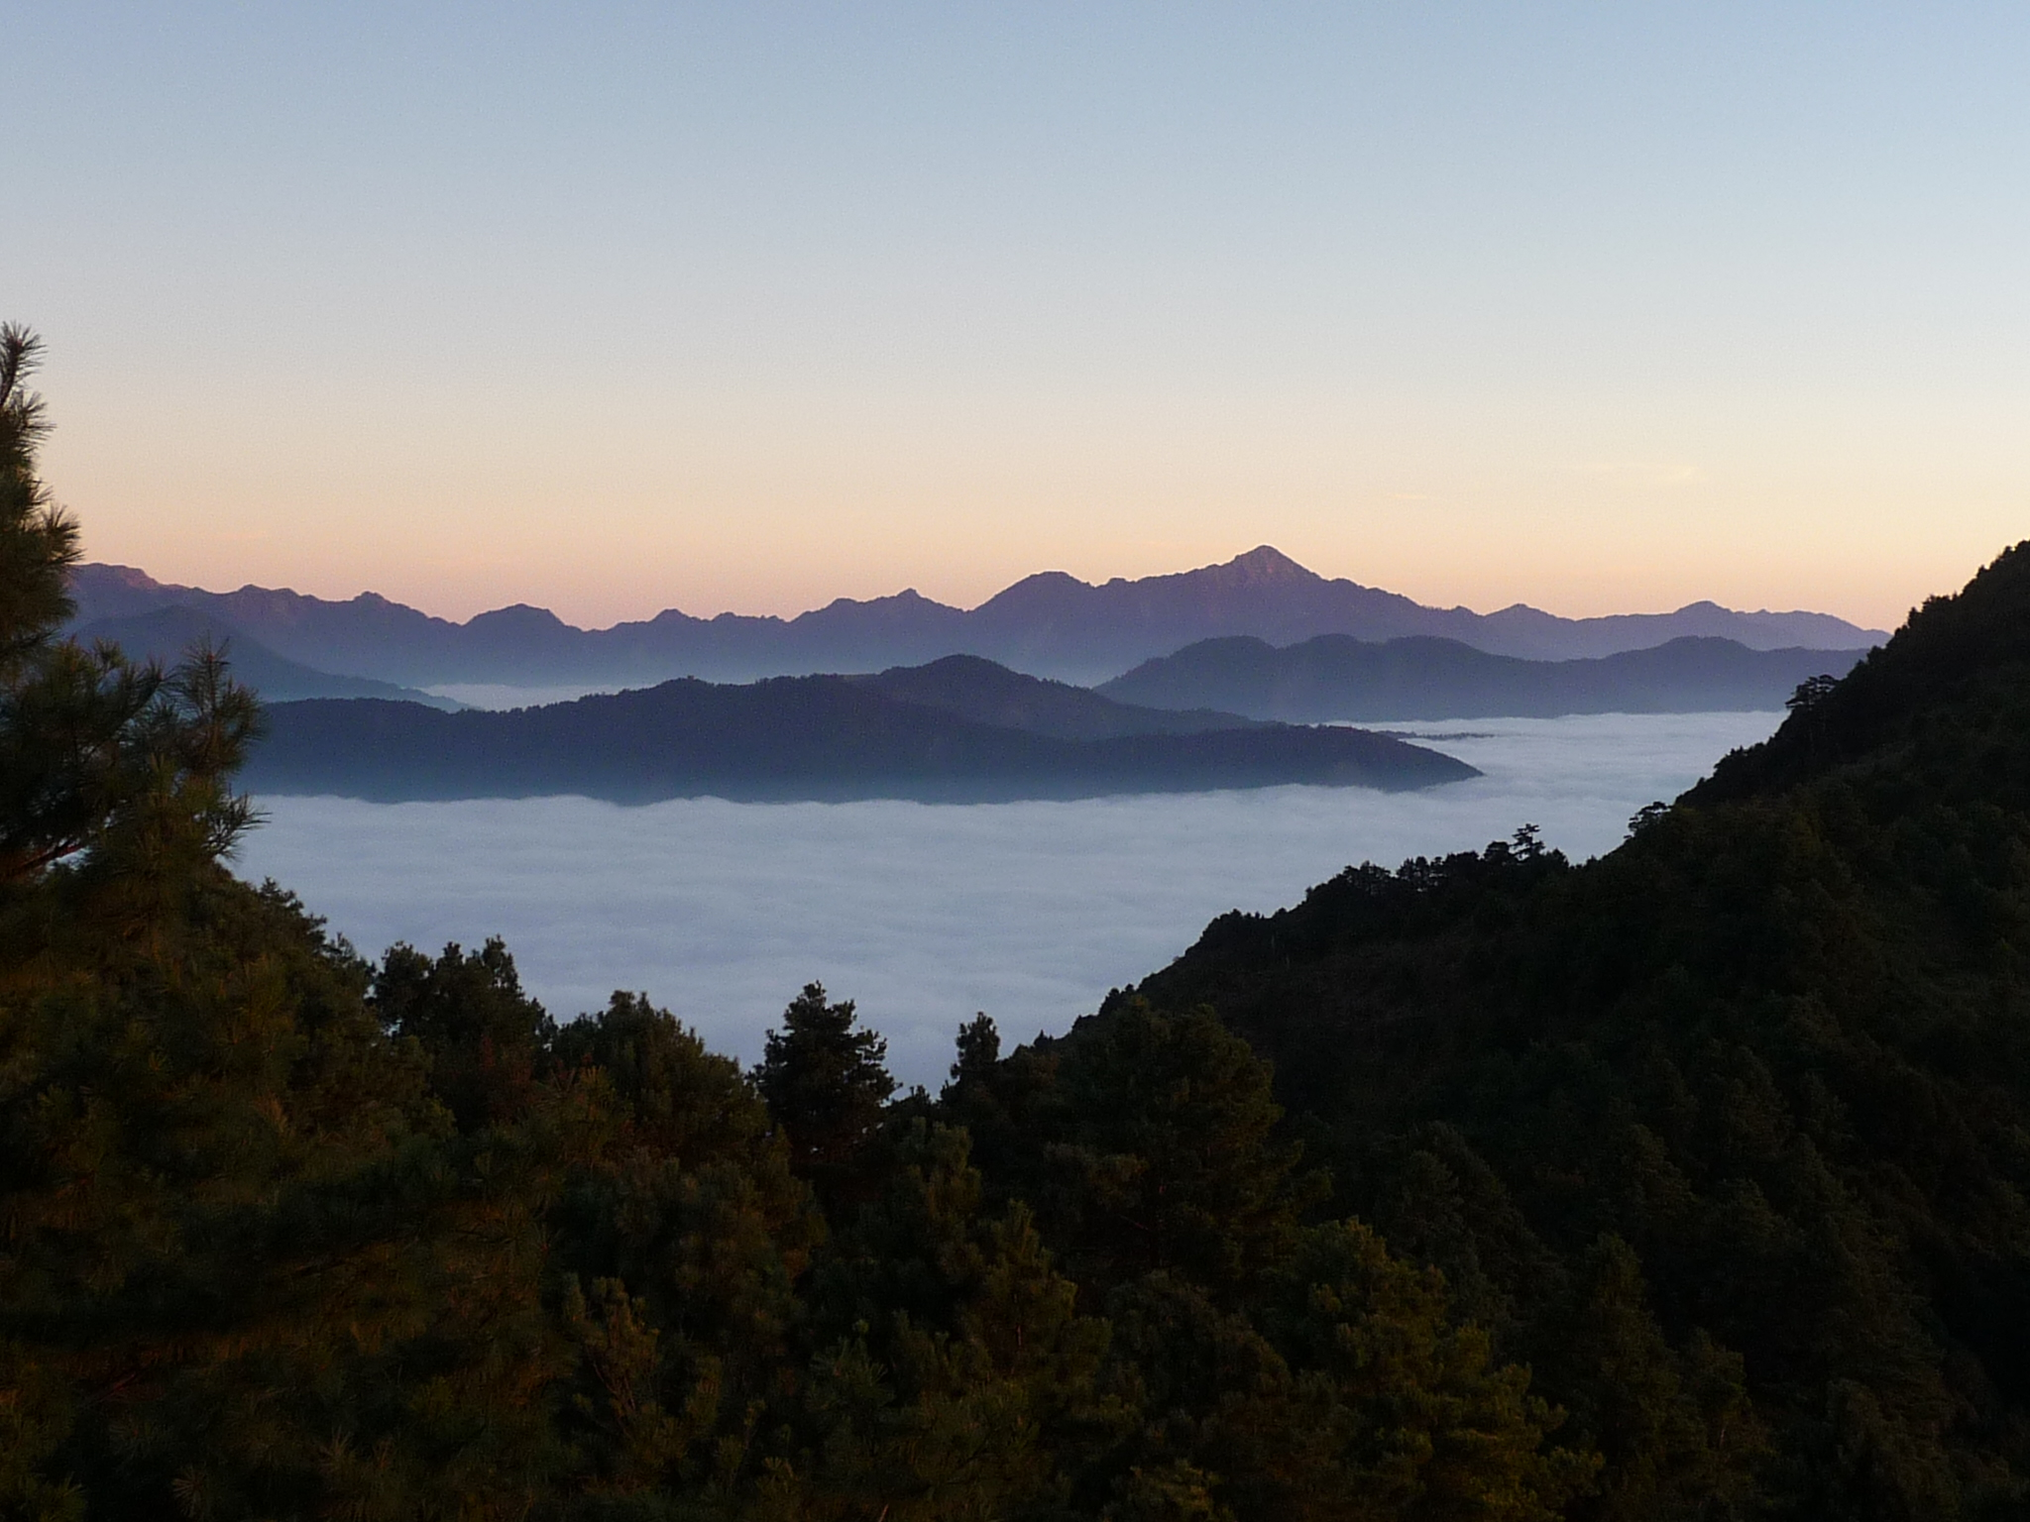
Aerosol Optical Properties
Using long-term atmospheric aerosol optical measurements to study climate
Elisabeth Andrews
CIRES, University of Colorado, Boulder
NOAA/Global Monitoring Division
Mt. Lulin, Taiwan

Slide 2
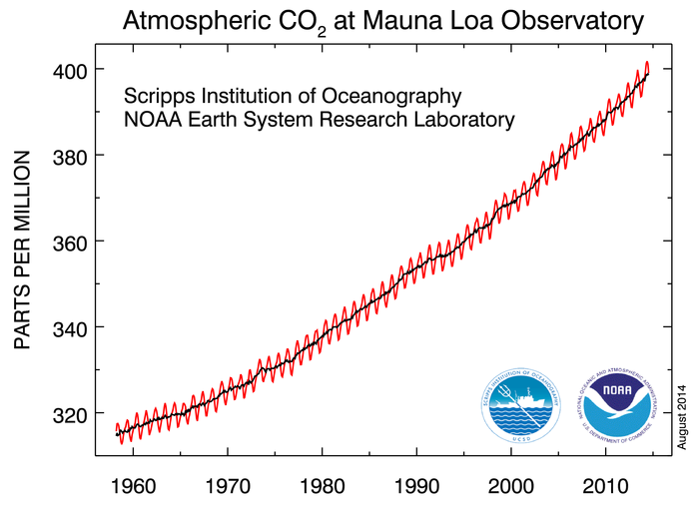
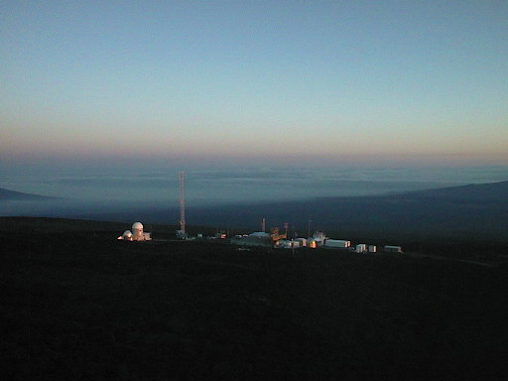
NOAA Global Monitoring Division
{Established 1973}
Objective: Long term measurements of background atmospheric constituents →climate change, ozone depletion and air quality.
Measurements:
Greenhouse gases
Ozone/ozone-depleting gases
Solar/thermal radiation
Aerosols
GMD
Mauna Loa, HI

Slide 3
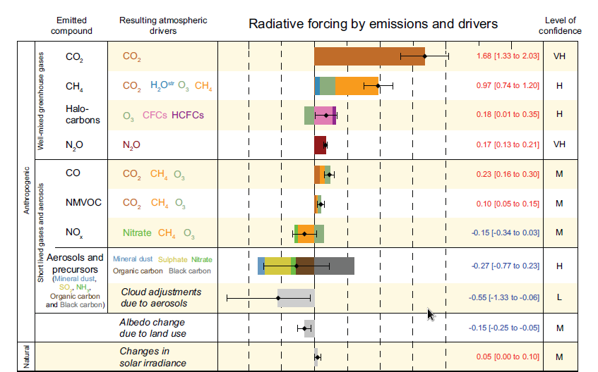
Factors influencing climate change
Gases
Aerosols
Cooling
Warming
From IPCC, 2013
Global averages based on models, measurements and theory.
Aerosols ‘contribute the largest uncertainty to the total radiative forcing estimate’.

Slide 4
Direct Aerosol Effect on Climate
Forward
scattering
particle
Surface cooling: sunlight is prevented from reaching the Earth’s surface
Atmospheric warming: energy is transferred as heat by absorbing particles.
Absorbing
particle
Backward
scattering
particle
Aerosol particles can also indirectly affect climate….

Slide 5
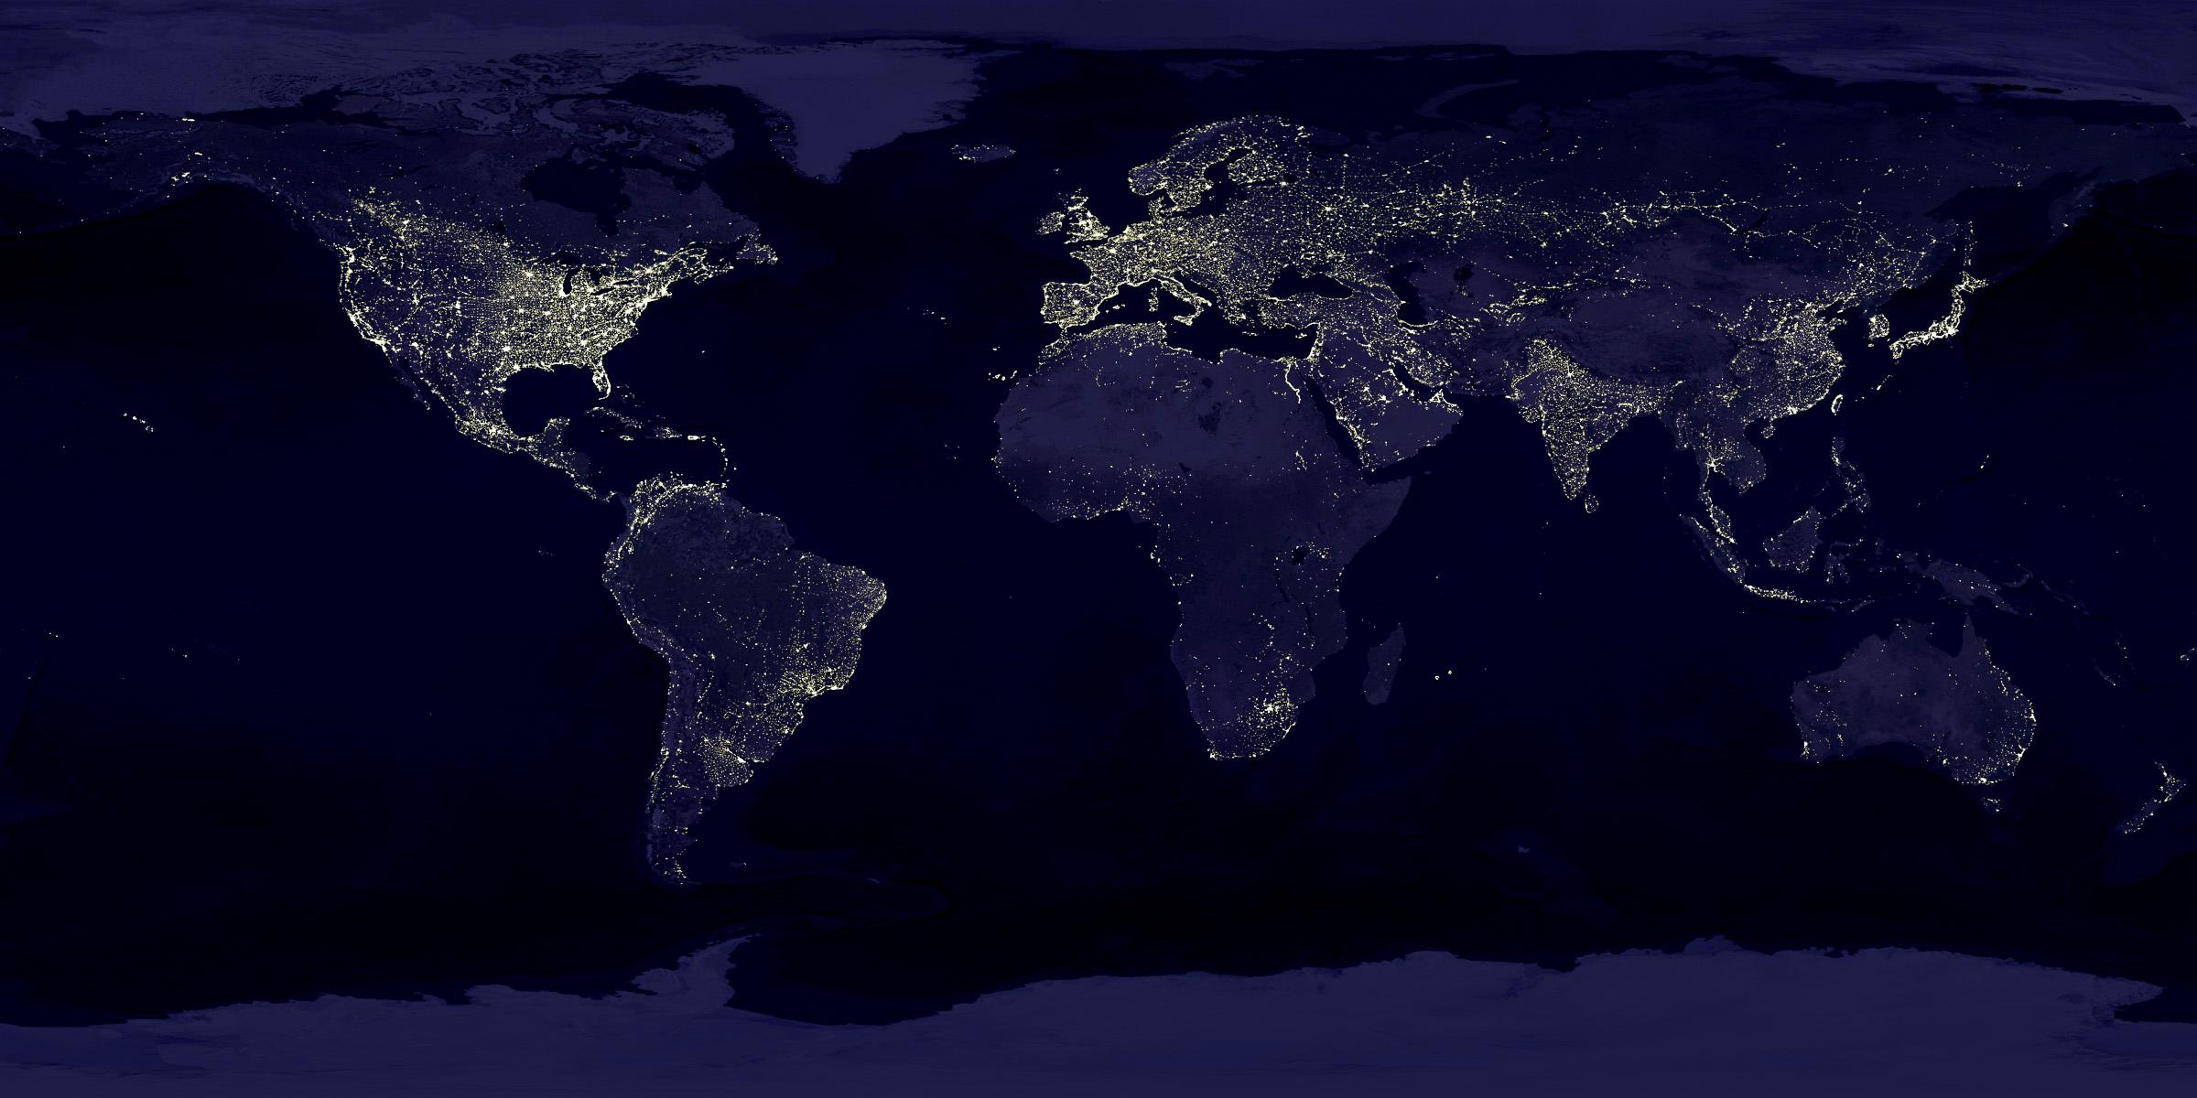
GMD’s Original 4 ‘baseline’ stations 1970s-1990s
BRW (1976)
MLO (1974)
SMO (1977)
These stations are far removed from human activities
➔ global background measurements
SPO (1974)
But…aerosol/climate effects happen where the particles are…

Slide 6
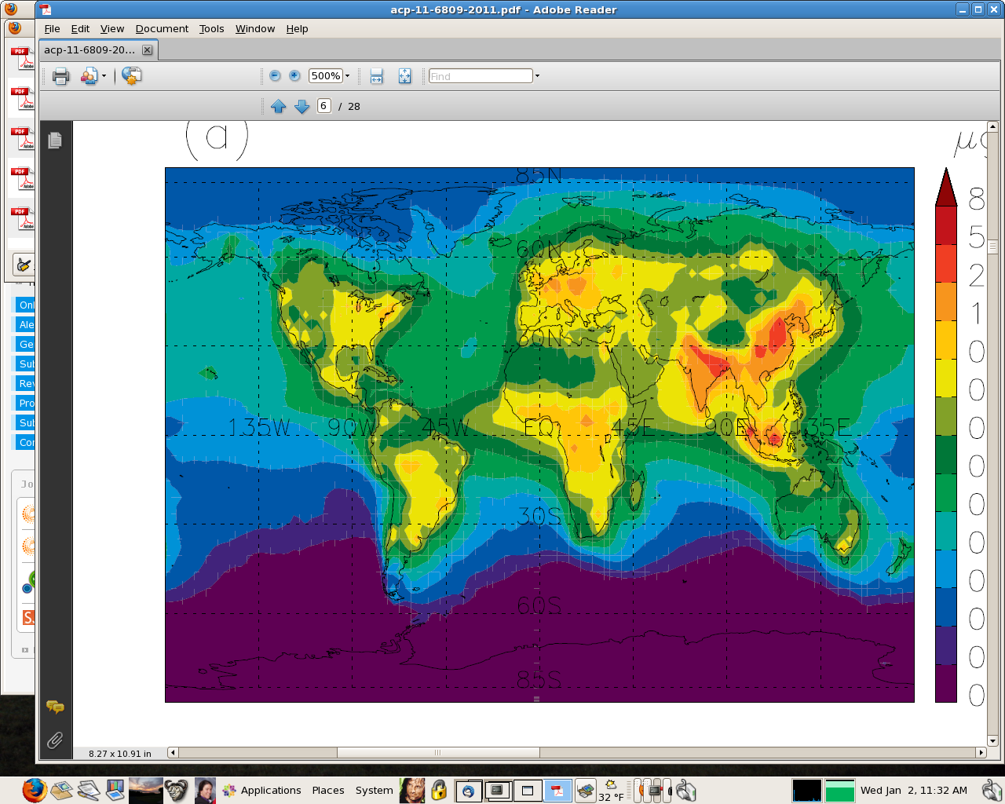

Where’s the aerosol?
BRW
MLO
SMO
Modeled black carbon
(from Skeie et al., 2011)
SPO
→not at NOAA’s baseline stations
Aerosol distribution is patchy due to source distribution and short residence times (order of 1 wk)
Notes:
Just 1 day, but gives indication of patchiness

Slide 7
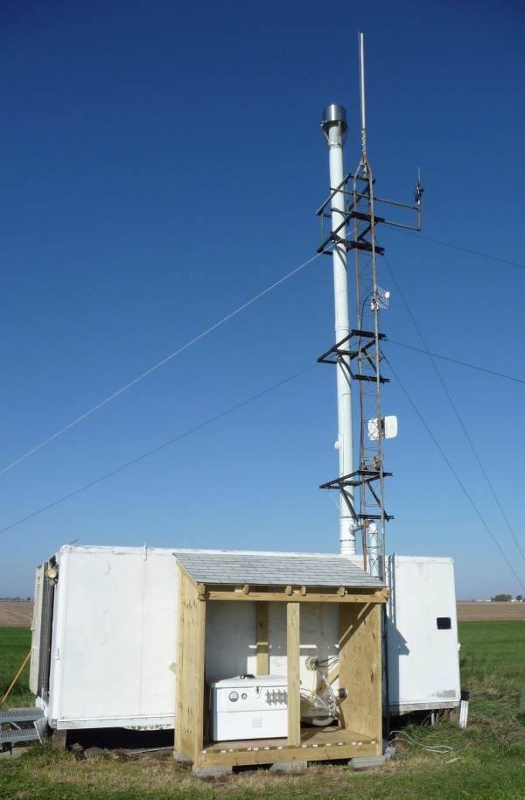
Aerosol group in NOAA/ESRL/GMD
→Characterize the means, variabilities, and trends of climate-forcing properties of different types of aerosols
→To understand the factors that control these properties.
Bondville, IL
Our approach:
→Standardized suite of measurements and protocols
→Globally distributed network (pristine and polluted sites)
→Long-term permanent and shorter-term “mobile” sites
Some applications:
Climate change calculations
Ground truth for remote sensing (e.g., satellites)
Evaluate/constrain models

Slide 8
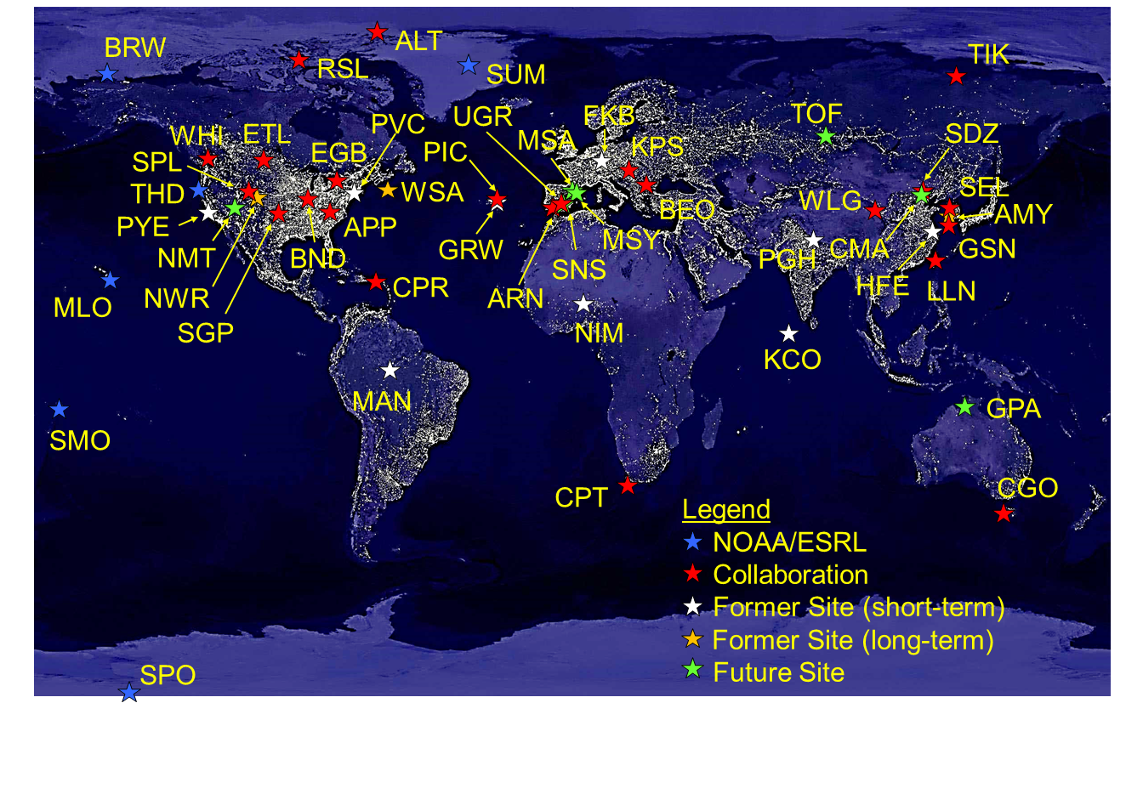
Long-term Collaborative Aerosol Network, 2016
CGO
Nov. 2015
→Wide range of environments and aerosol types
In Feb. 2017 we’ll be up to ~30 active sites.
Notes:
Started adding regional sites in the 1990s

Slide 9
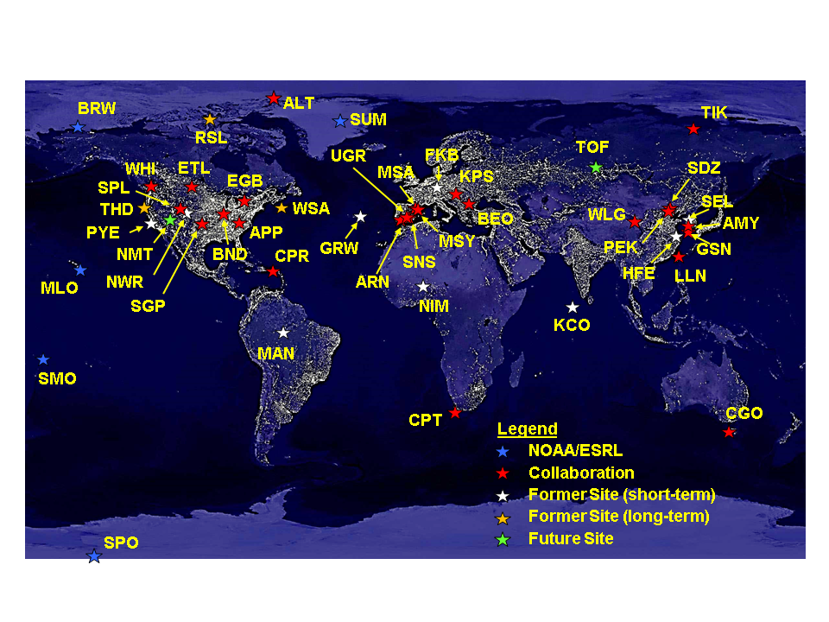
Long-term Collaborative Aerosol Network, 2017

Slide 10
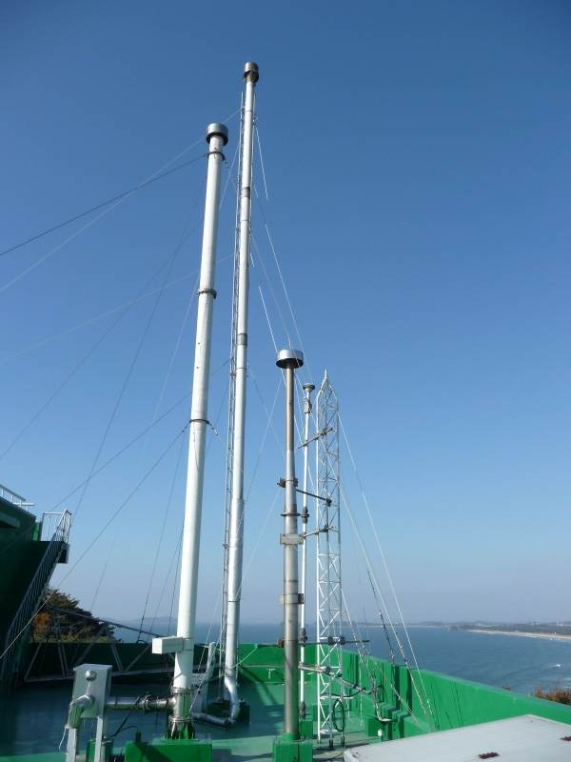
Surface Aerosol Sampling
10 meter high stack with rain hat
Pumps pull air through the stack and instruments
Super-isokinetic→ particle losses are minimized (except ultrafines)
Sample humidity <40% (heat and/or dilute)
Anemometer
(WS/WD)
Sample In
(~1000 lpm)
Stack
Heater
‘Sheath’ Airflow
(~850 lpm)
Anmyeon-do, S. Korea
Instrument
Rack (30 lpm)
Pump Box (carbon vane pump +blower)
Sample out (filtered)
Definitely not to scale!

Slide 11
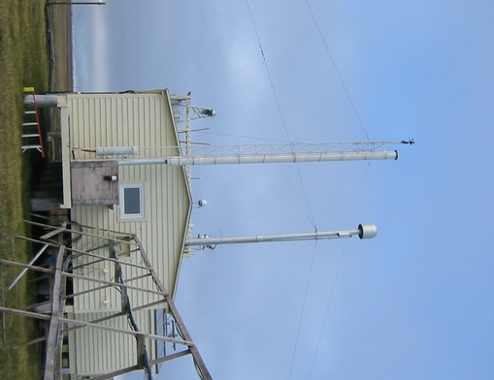
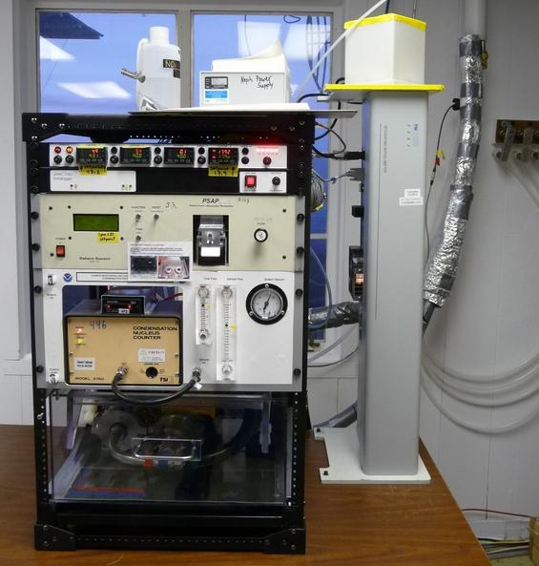
Surface Aerosol Sampling
Nephelometer
Scattering, backscattering
Inlet
PSAP
Absorption
CPC
Number
Pumpbox
Barrow, AK
Switched Impactors
Size cut (1 and 10 μm)
Measurements made at low RH (<40%) and 1 min frequency

Slide 12
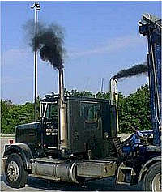
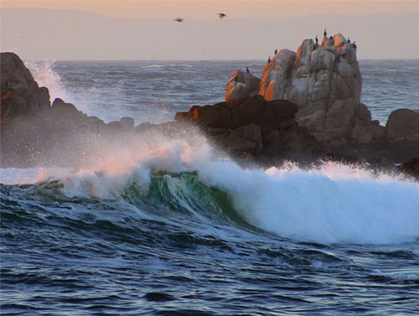
Measured Parameters
These properties depend on AMOUNT of Aerosol:
Light absorption, σ_{ap}
Light scattering, σ_{sp}
Back-scattering, σ_{bsp}
Light extinction, σ_{ext} = σ_{sp} + σ_{ap}
Number concentration, N_{CN}
Clean Region: 10 Mm⁻¹ < Light extinction
Polluted Region: Light extinction > 60 Mm⁻¹
Montseny: light extinction ~30 Mm⁻¹
South Pole: light extinction ~0.5 Mm⁻¹
Asia: light extinction ~ 100 Mm⁻¹

Slide 13
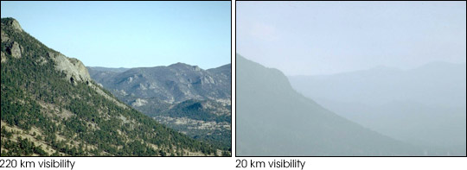
Mm⁻¹ - What are these weird units?
Visibility → How far one can see (distance)
Light extinction inversely proportional to visibility → 1/distance
Distance unit conversions → 1 km = 0.001 Mm
σ_{ext} = 20 Mm⁻¹
σ_{ext} = 200 Mm⁻¹
(120 miles visibility)
(12 miles visibility)
Rocky Mountain National Park http://vista.cira.colostate.edu/views/

Slide 14
Derived aerosol optical properties
DON’T depend on amount of particles – dimensionless
Useful for comparing different sites, events
Used in climate forcing calculations
Additional hints about particle ‘nature’ (chemistry/microphysics)
Backscatter fraction
Scattering Ångström exponent
Absorption Ångström exponent
Single scattering albedo
Angular dependence of scattering
size
Wavelength dependence of scattering
composition
Wavelength dependence of absorption
composition
Relative amount of absorption
Aerosol
Radiative
Forcing
= f(extinction, backscatter fraction, single scattering albedo)

Slide 15
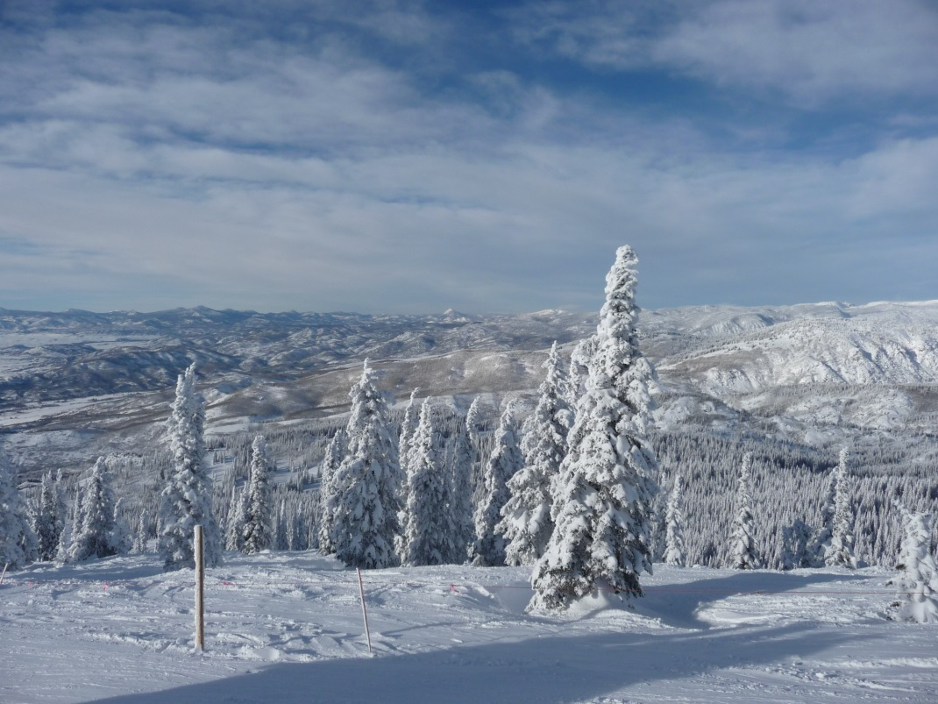

Time for fun!
Good long term data:
→consistent measurements (instruments and support)
→good documentation (sampling and instrument changes)
→regionally representative - local contamination removed
Climatology and trends in aerosol optical properties
Airborne measurements and satellite comparisons
Model-Measurement comparisons
Storm Peak, CO
Trinidad Head, CA

Slide 16
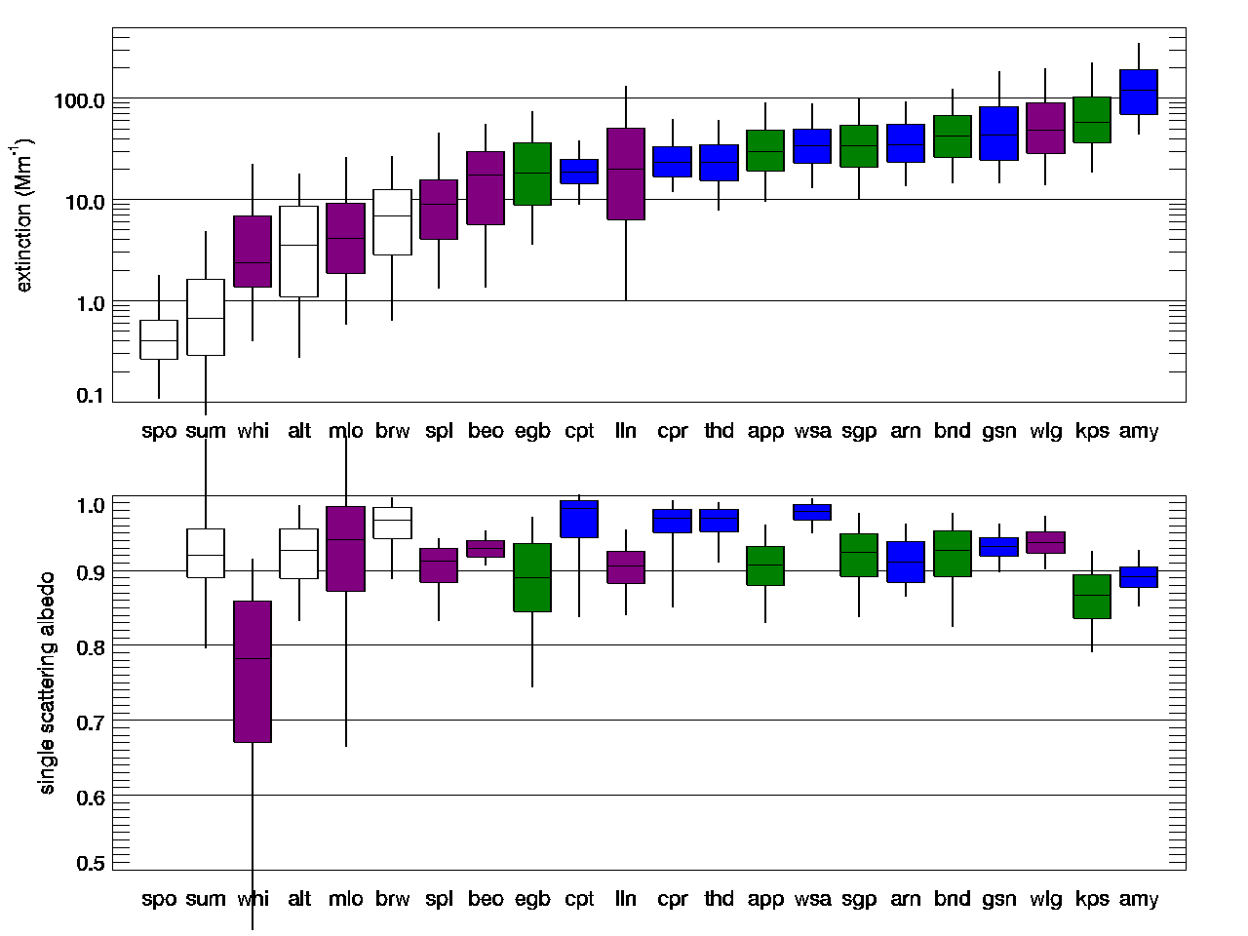
Annual climatology from NOAA Collaborative Network
scattering (Mm⁻¹)
Wide range in aerosol amount
No relationship between amount and “nature” of aerosol
Polar
Mountain
Continental
Coastal
single-scattering albedo
→Important to measure regionally representative air masses.

Slide 17
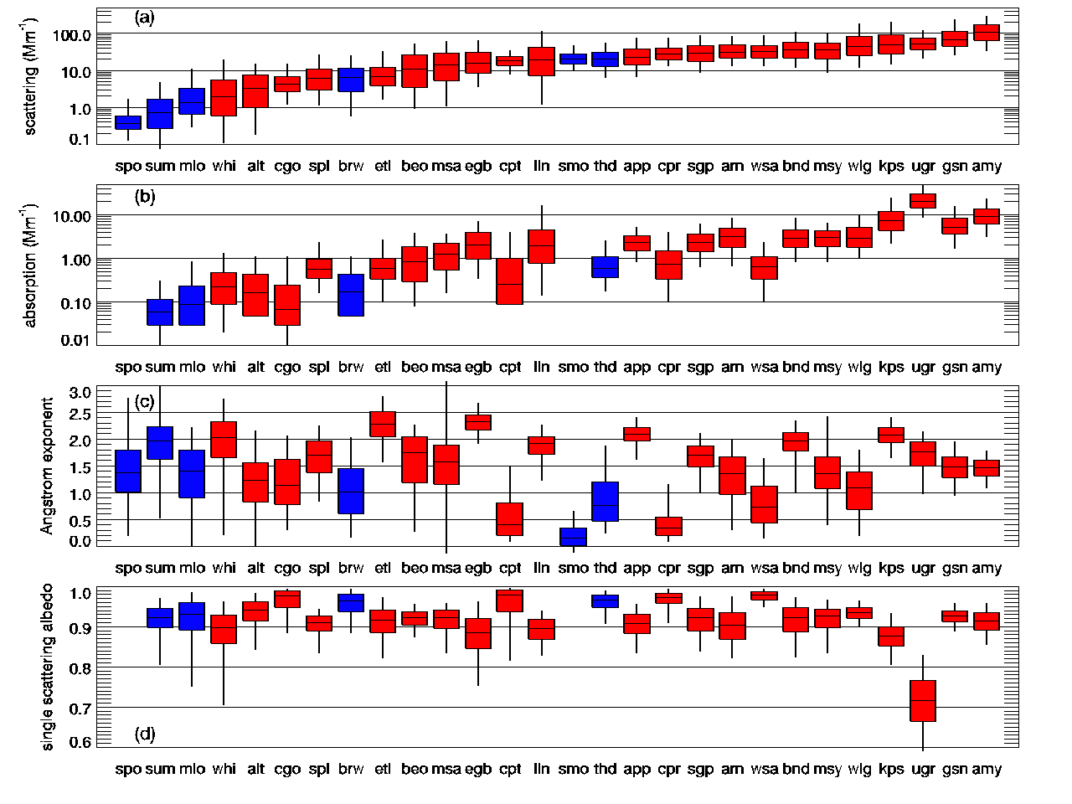

Slide 18
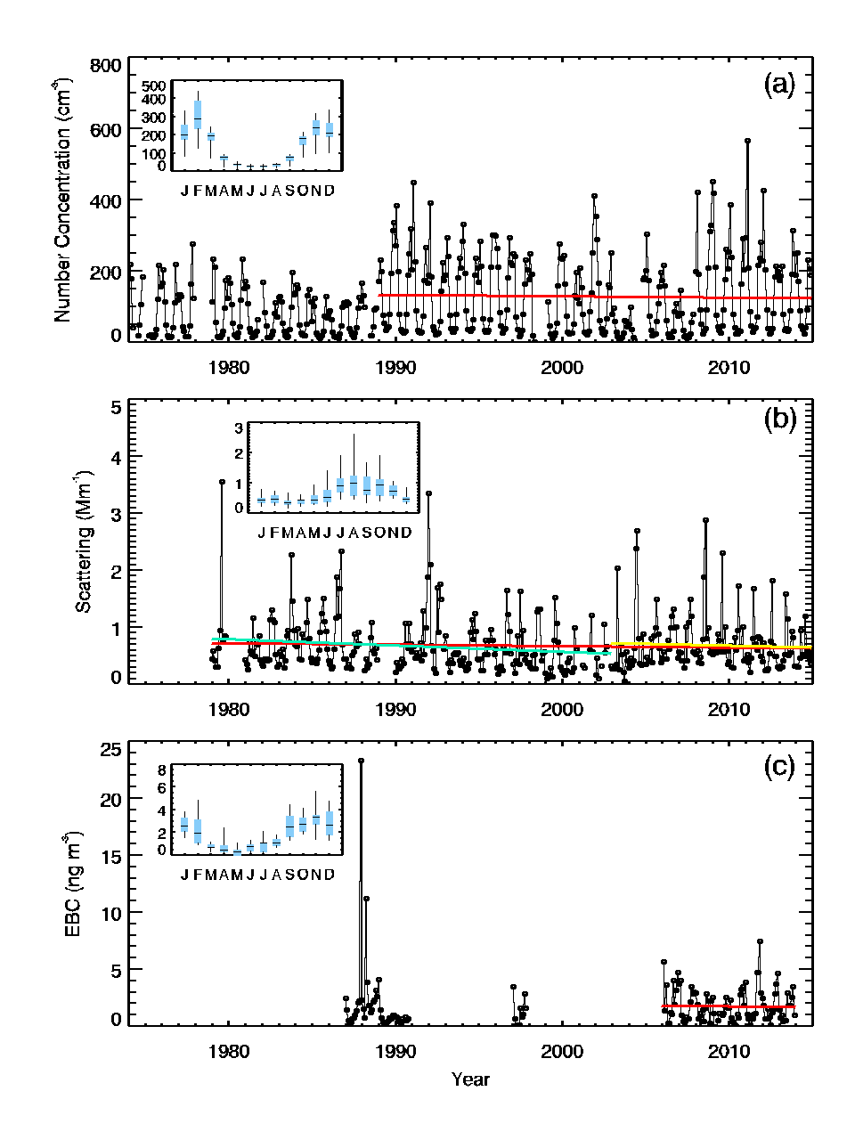
South Pole Aerosol Climatology: 1974 - 2014
Particle concentration instrument changed in ~1989
No statistically significant trends
Annual cycle in the different aerosol properties
Different parameters have different annual cycles → different sources/types of particles??
Particle concentration
Scattering
Black carbon
From Sheridan et al., 2015

Slide 19
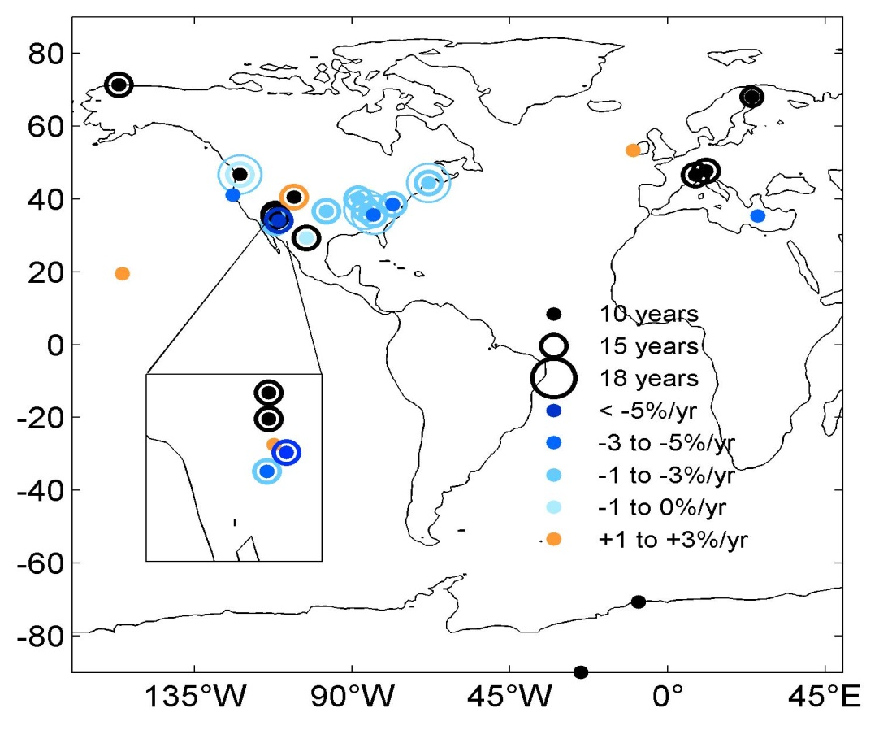
Long-term trends in aerosol properties
Trends in aerosol light scattering
Trends not spatially homogenous
→complex processes including emissions changes, transport, and transformation of aerosol particles.
Aerosol scattering has mostly decreased over last two decades in US
→approximately -2% year⁻¹
→due to air pollution control laws?
The three US sites that see increases are high altitude sites in west
→due to long-range Asian transport?
MLO
decreasing trends
increasing trends
statistically insignificant
SPO
(Figure from Coen Collaud et al., 2013)
Based on data sets with >8 years
Notes:
→global to regional cycling of atmospheric constituents and natural and anthropogenic changes
→validate past and present emission inventories
→to test validity of models at different scales.
This is particularly true for aerosol species in order to quantify the effectiveness of past emission abatement strategies implemented in various countries and the influence of these on aerosol radiative forcing.
Need 10++ yrs to do a trend (weatherhead et al., 1998) length depends on variance (noise) in data and autocorrelation – more autocorrelation means longer time series is required.

Slide 20
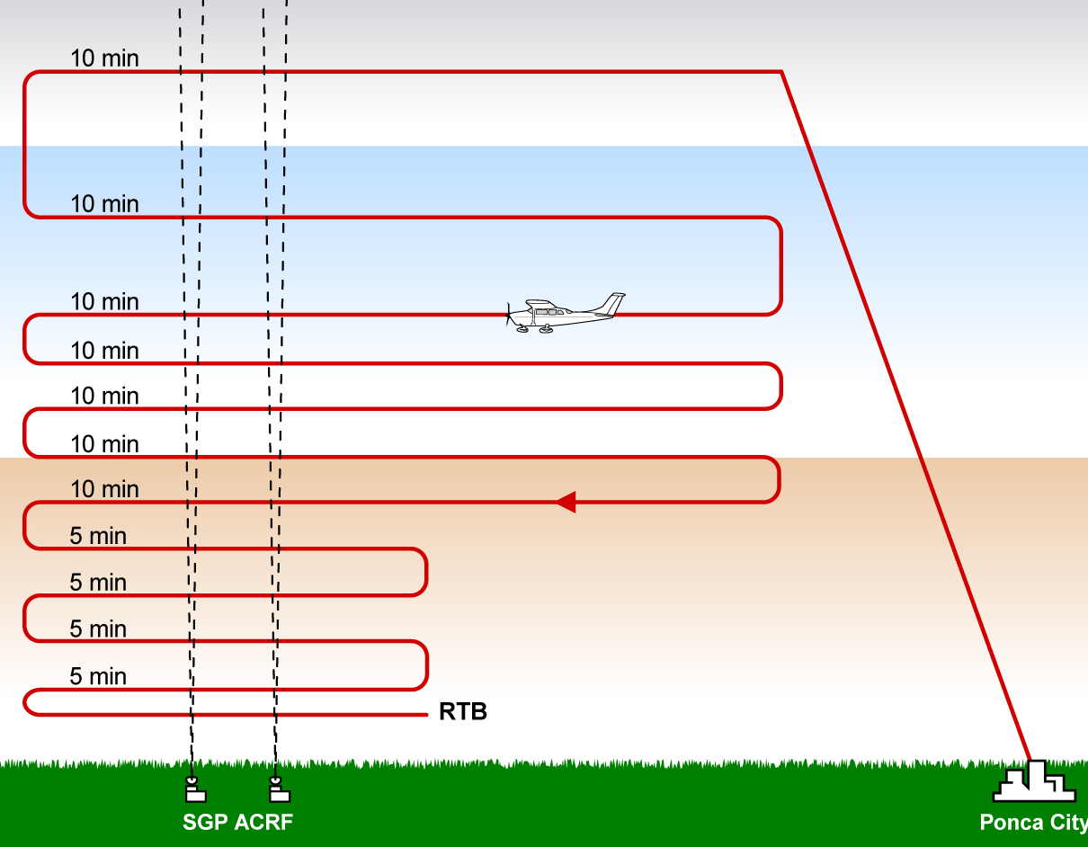
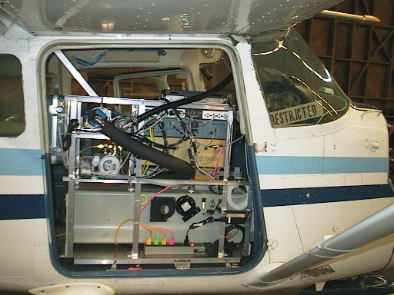
‘Long-term’ vertical Aerosol profiles
~600 profiles in OK over 8 yrs
~400 profiles in IL over 3 yrs
Aerosol Inlet
PSAP
Airport
Surface site
How well do surface measurements represent atmospheric aerosol aloft?
How do in situ measurements compare to remote sensing measurements?
Nephelometer

Slide 21
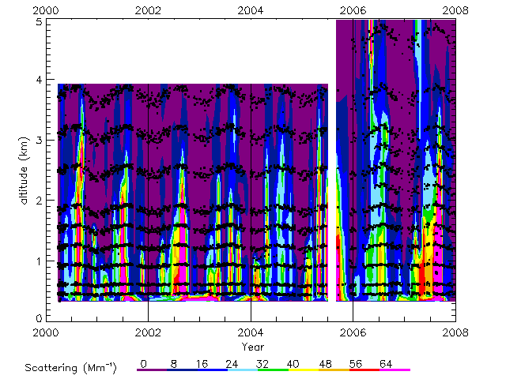
Climatology of light scattering – vertical profiles
(From Andrews et al., 2011)
Data from Southern Great Plains site in Oklahoma

Slide 22
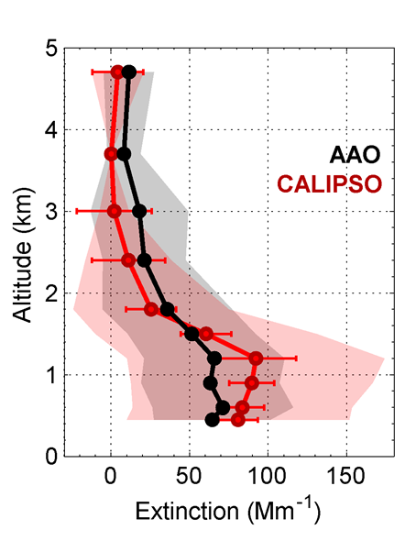
Satellite validation using in-situ aerosol profiles
Generally good agreement between airplane and satellite measurements
Satellite often overestimates extinction at lower altitudes.
→Possible issues with CALIPSO’s cloud screening algorithm
Satellite doesn’t really detect aerosol in clean(ish) conditions (20–25 Mm⁻¹).
→Provides guidance on CALIPSO’s ability to retrieve aerosol extinction at sites around the globe
Airplane
Satellite
(From Sheridan et al., 2012)
Mean extinction profiles; the shaded areas are the standard deviations.
Based on 28 overlap flights.
Data from Bondville site in Illinois
Notes:
Remote-sensing retrieval products cannot be considered reliable until they have been independently validated
→ In-situ aerosol measurements can be related back to physical standards; remotely-sensed aerosol properties can not be.

Slide 23
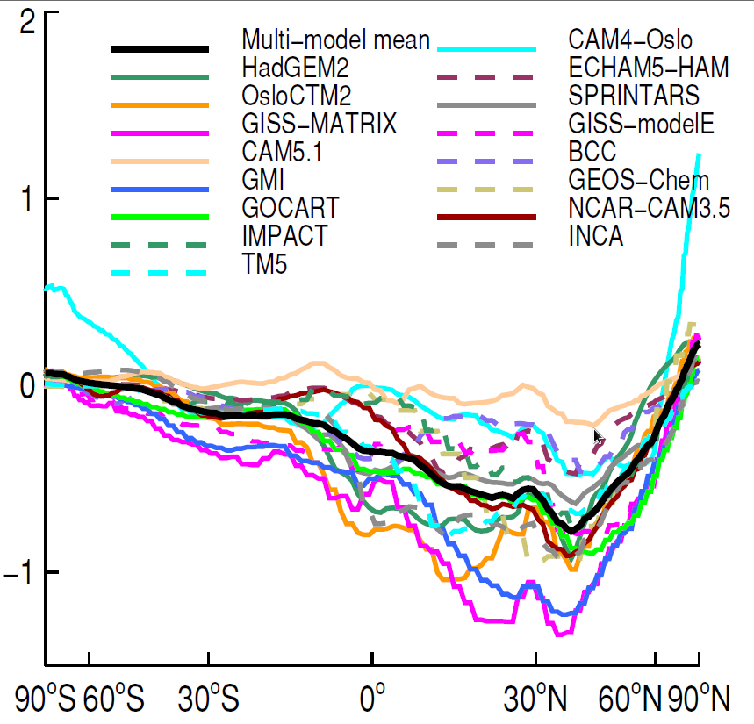
Why evaluate models?
  Models are used to predict climate forcing
  Models parameterize complex aerosol processes
  Aerosols are large source of model uncertainty
Direct Aerosol Forcing (W m⁻²)
Latitude
(from Myhre et al., 2013)

Slide 24

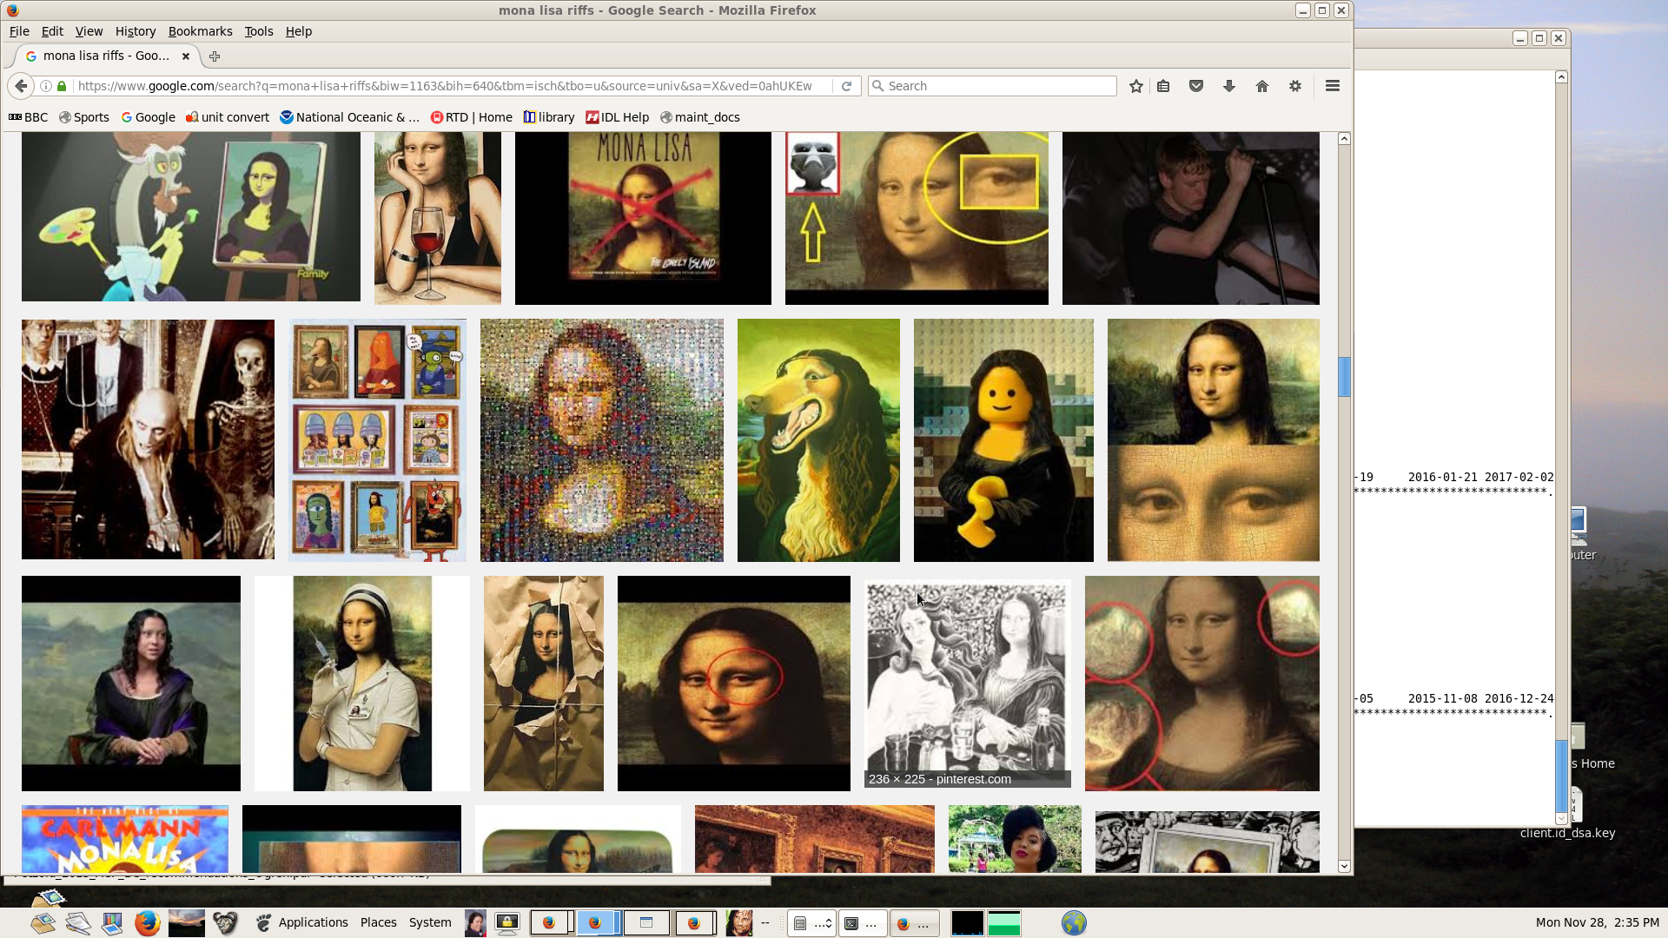
Why the model variability?
--emissions
--transport
--parameterization of atmospheric processes
→wet/dry deposition
→chemical transformation
→aerosol water interaction
→aerosol size and physical processes
--spatial resolution and topography
--assumptions about converting from chemical to optical properties

Slide 25
Models Used in this Analysis
Model name | Gridbox size | Output Year
TM5 | 3.0° x 2.0° | 2010
GEOS-Chem | 2.4° x 2.0° | 2010
CAM5 | 2.4° x 1.9° | 2010
ECHAM6-SALSA | 1.8° x 1.9° | 2010
GEOS5-Globase | 1.25° x 1° | 2010
GEOS5-MERRAero | 0.6° x 0.5° | 2010
OsloCTM2 | 2.8° x 2.8° | 2008
GOCART | 2.5° x 2.0° | 2006*
MPIHAM | 1.8° x 0.9° | 2006*
SPRINTARS | 1.1° x 1.1° | 2006*
Models all participate in ‘AeroCom’ project

Slide 26
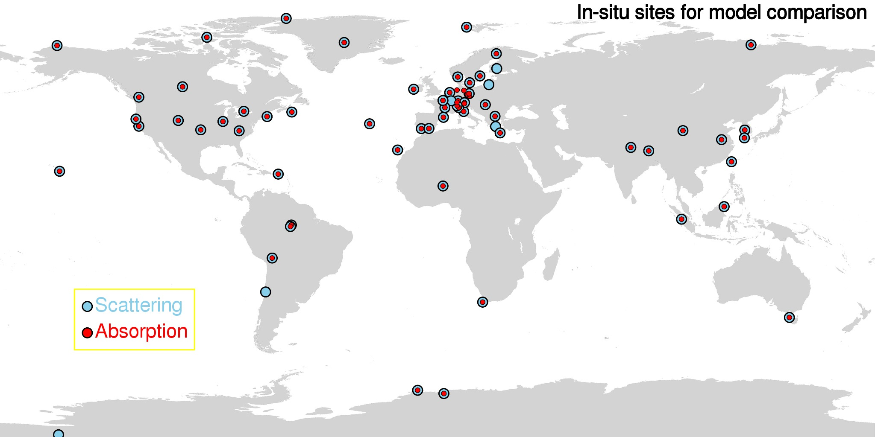
In-situ Measurement Sites
Sites with aerosol light scattering and/or absorption (~65 sites)
Fewer sites than AERONET
Gaps in S. America, Africa, Middle East, Russia, Asia

Slide 27
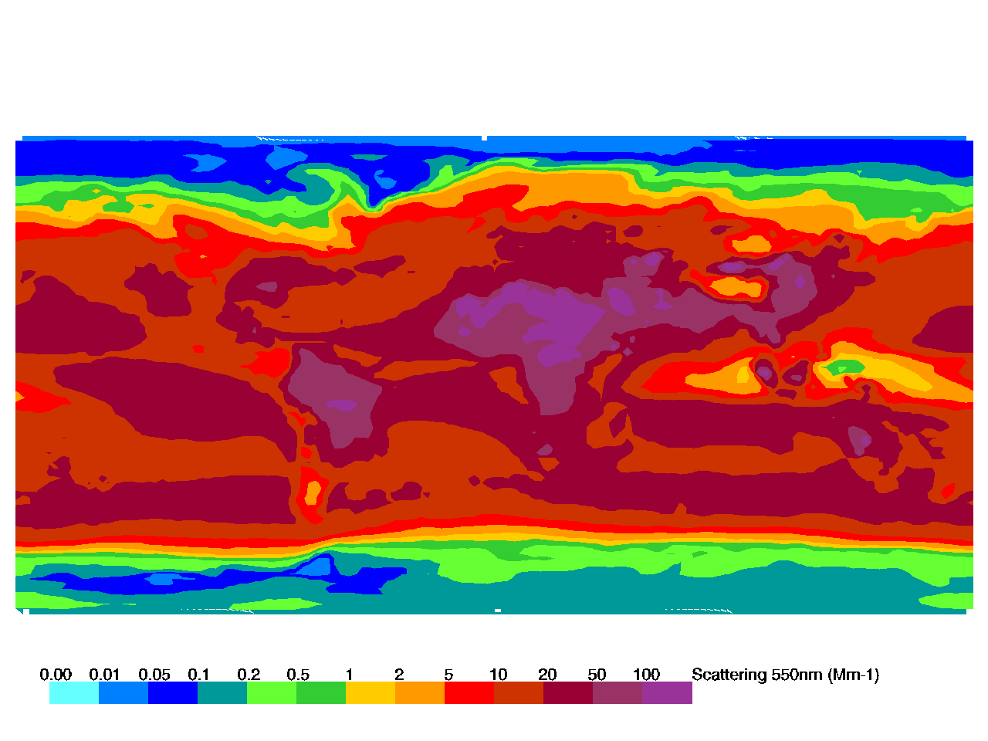
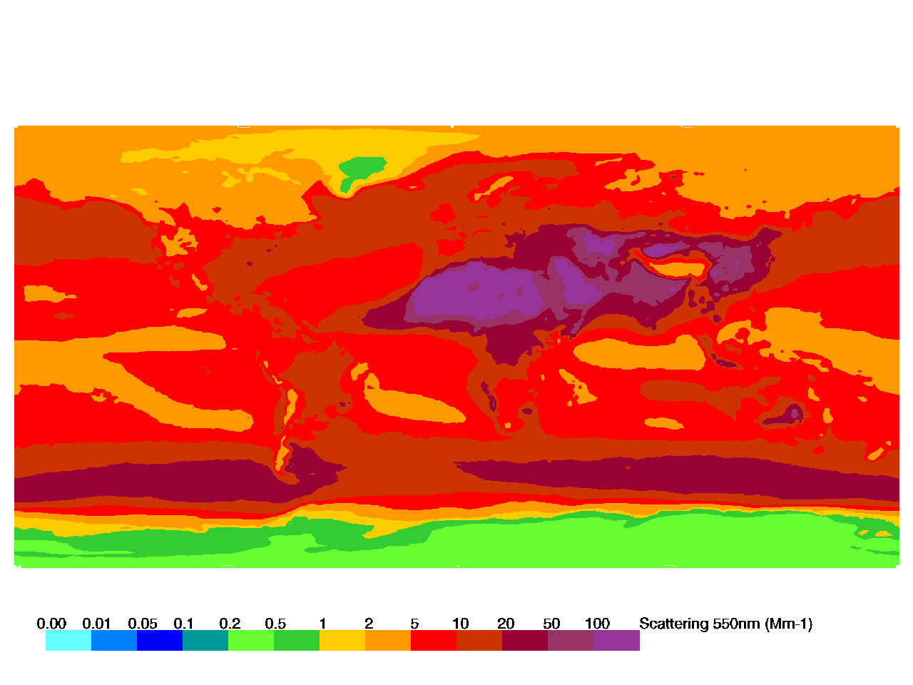
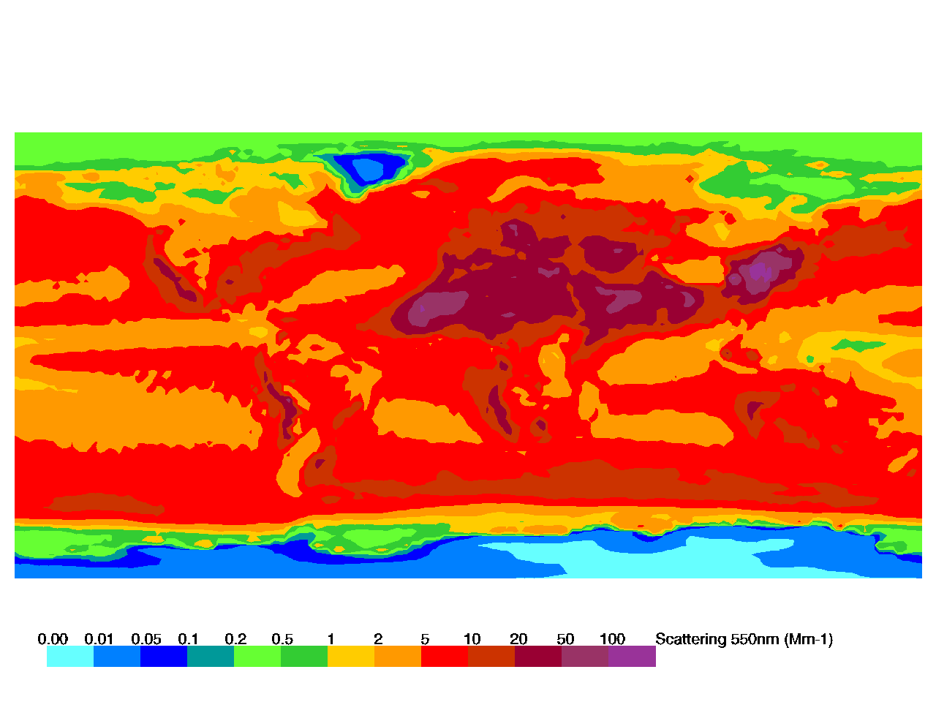
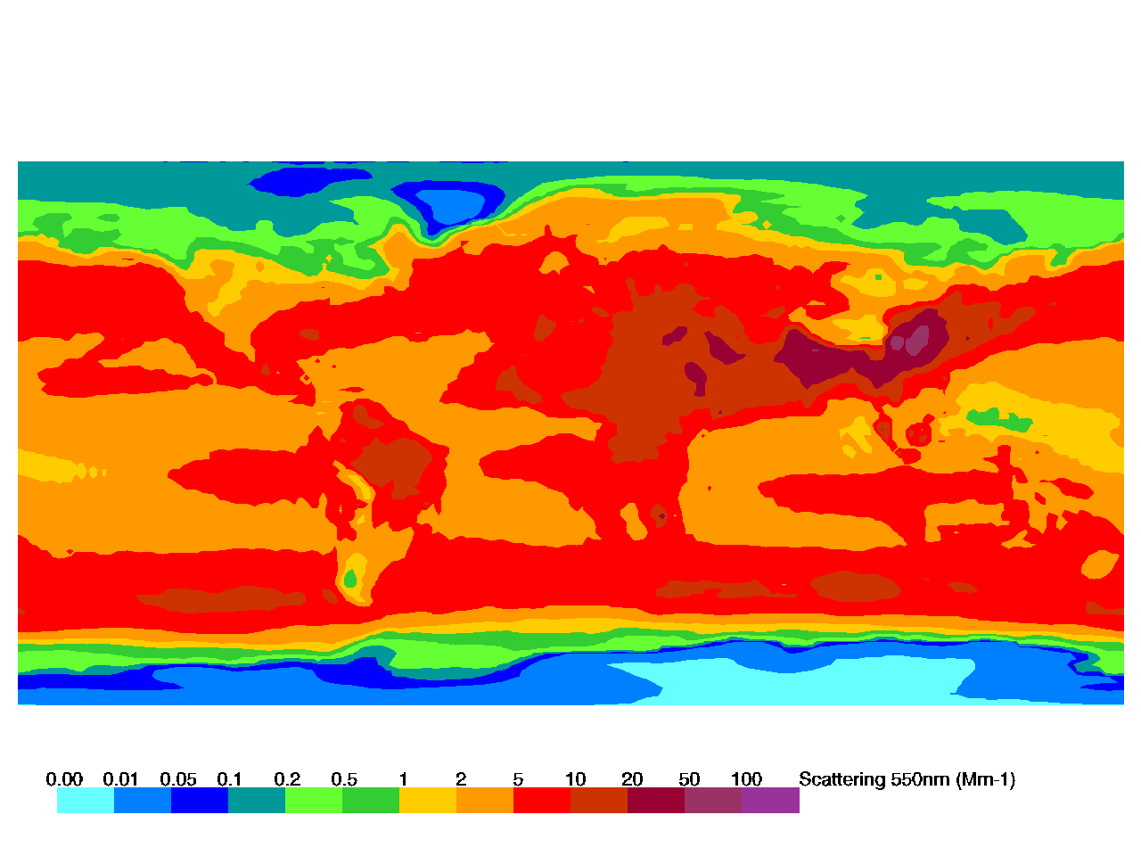
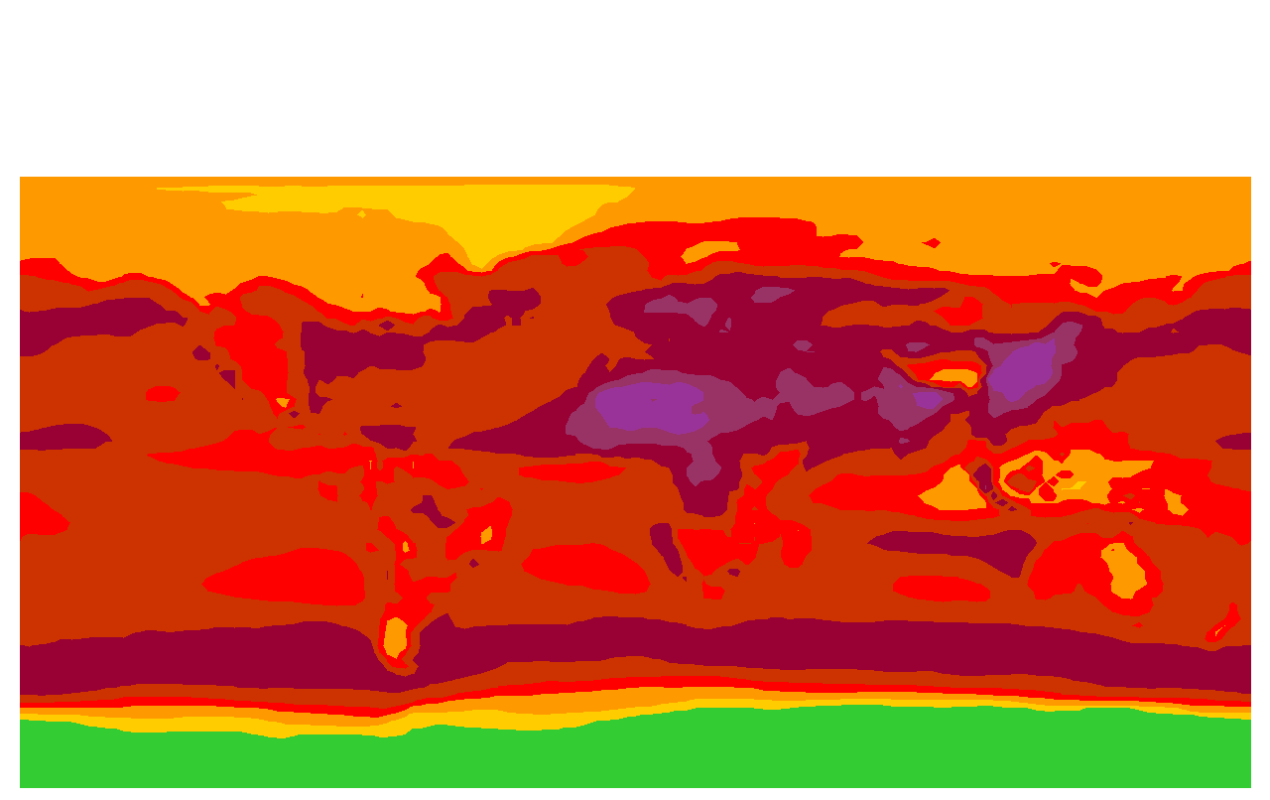
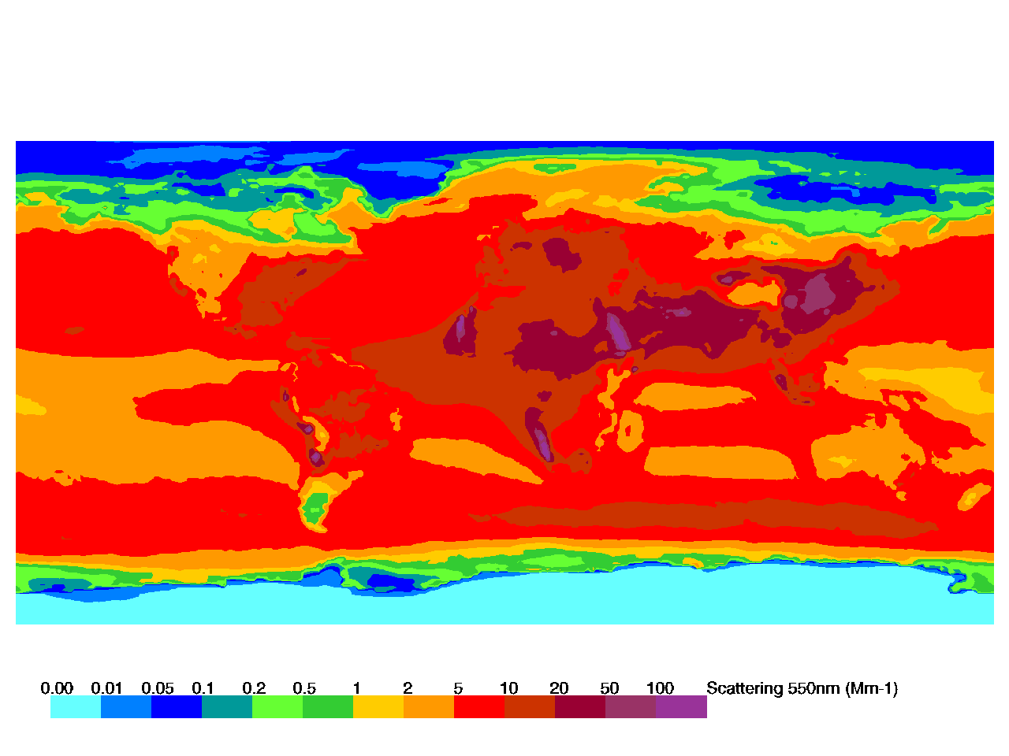
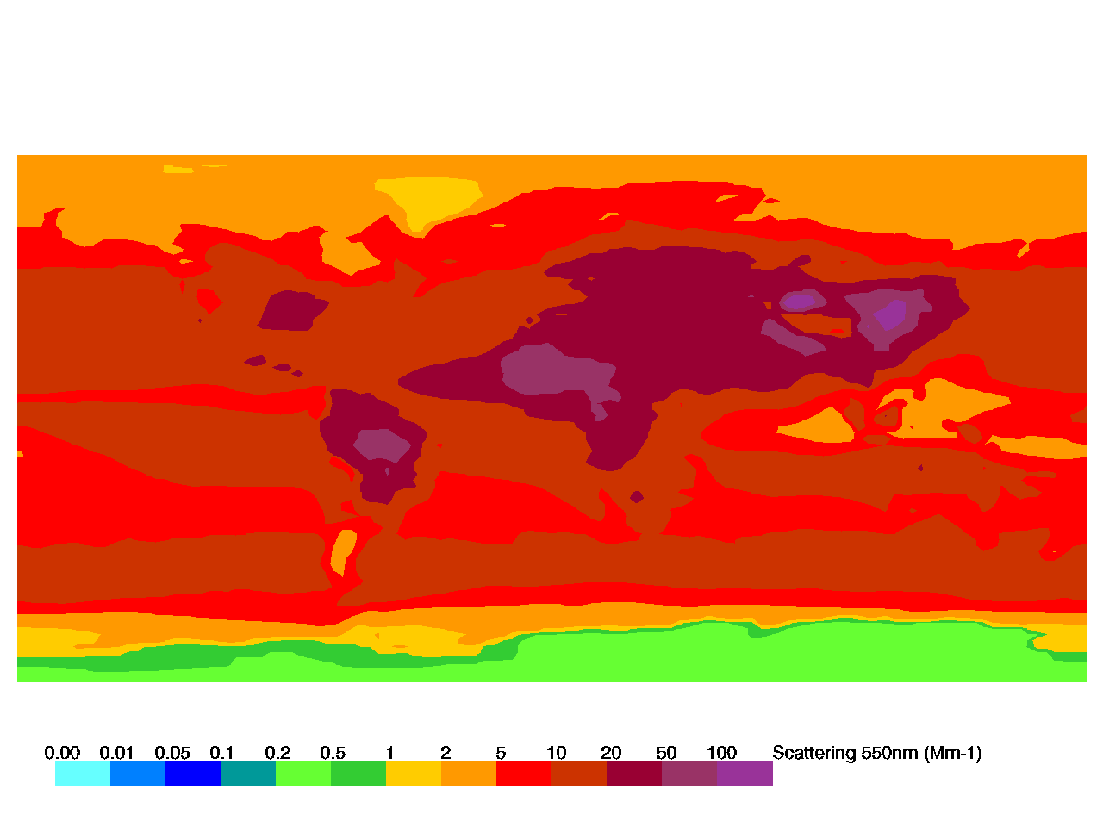
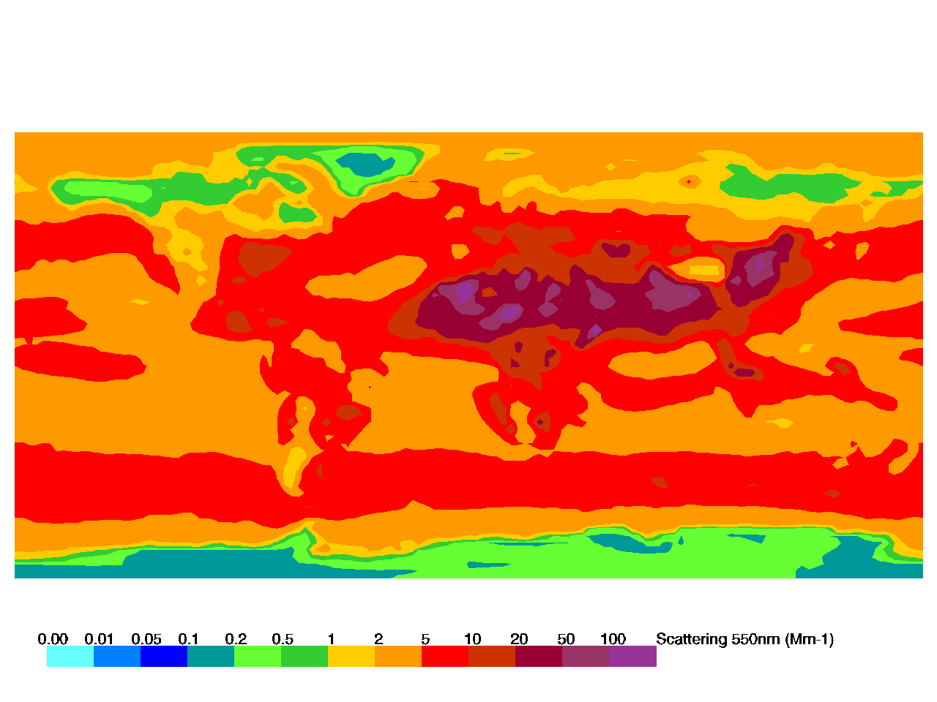
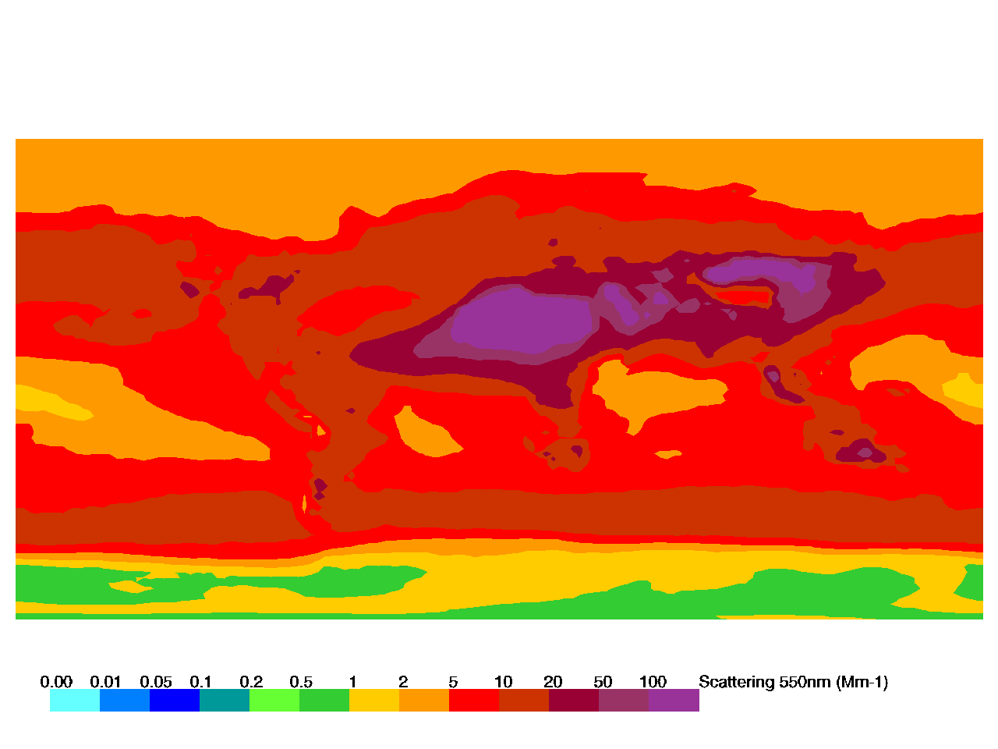
Aerosol Annual Climatology: Aerosol Scattering
CAM5-2010
GLOBASE-2010
MPIHAM-2006
ECHAM6-SALSA-2010
GEOS-CHEM-2010
SPRINTARS-2006
TM5_INSITU-2010
OSLO-CTM-2008
GOCART-2006
General pattern of scattering similar for models
Differences due to model input and conditions

Slide 28
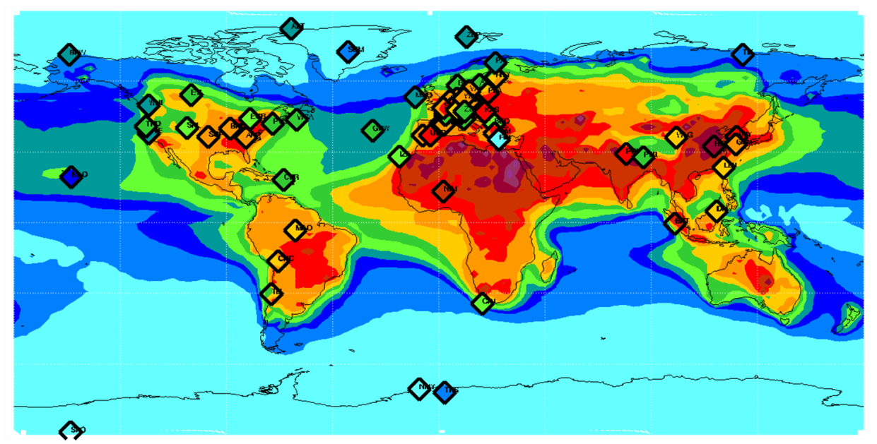
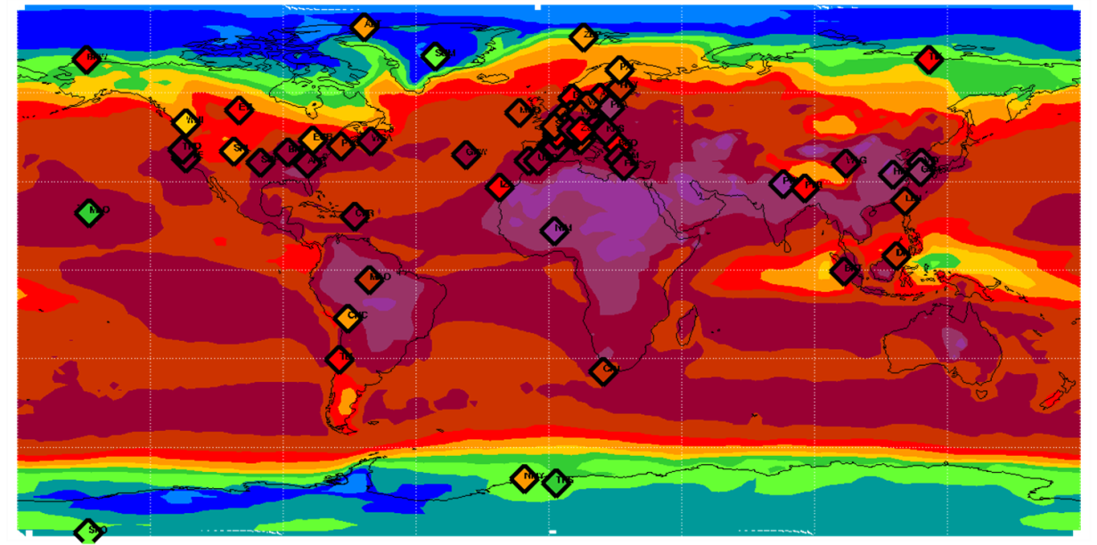
Aerosol Climatology: Big Picture
General pattern of absorption and scattering similar for models and in-situ measurements
Differences are observed for some sites
Absorption
Scattering
CAM5 output for AEROCOM P3 INSITU project

Slide 29
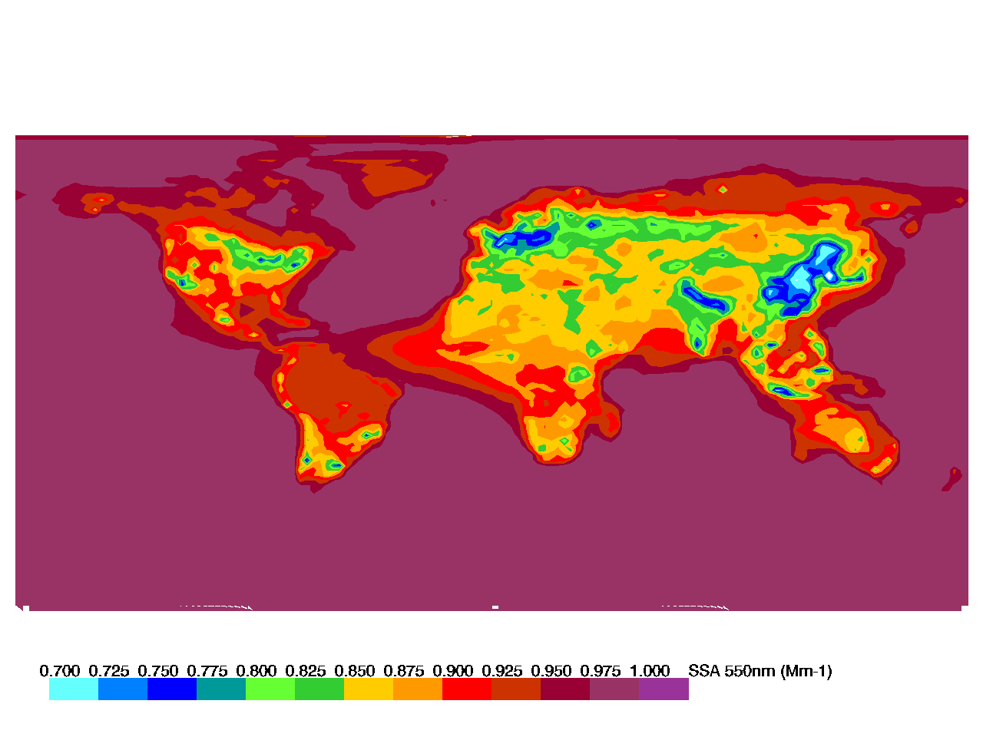
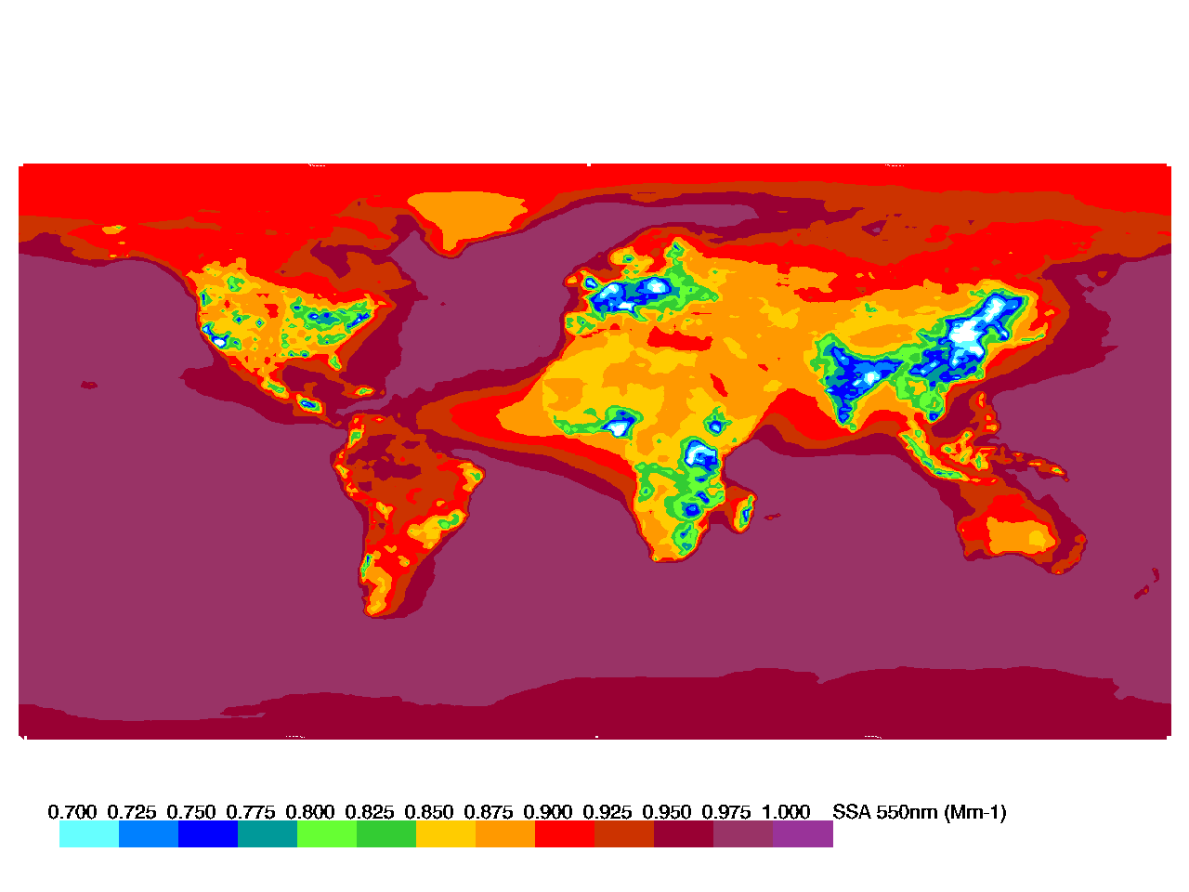
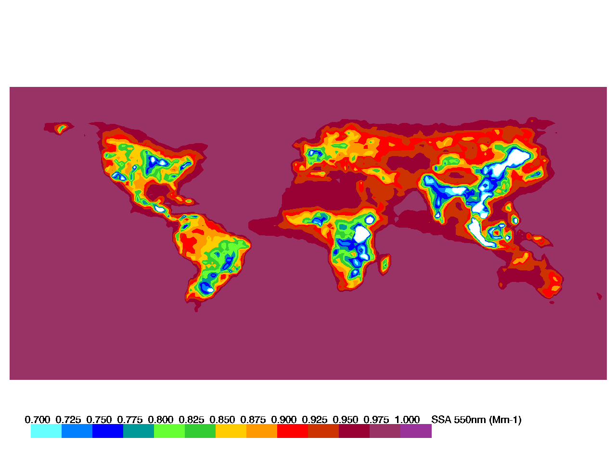
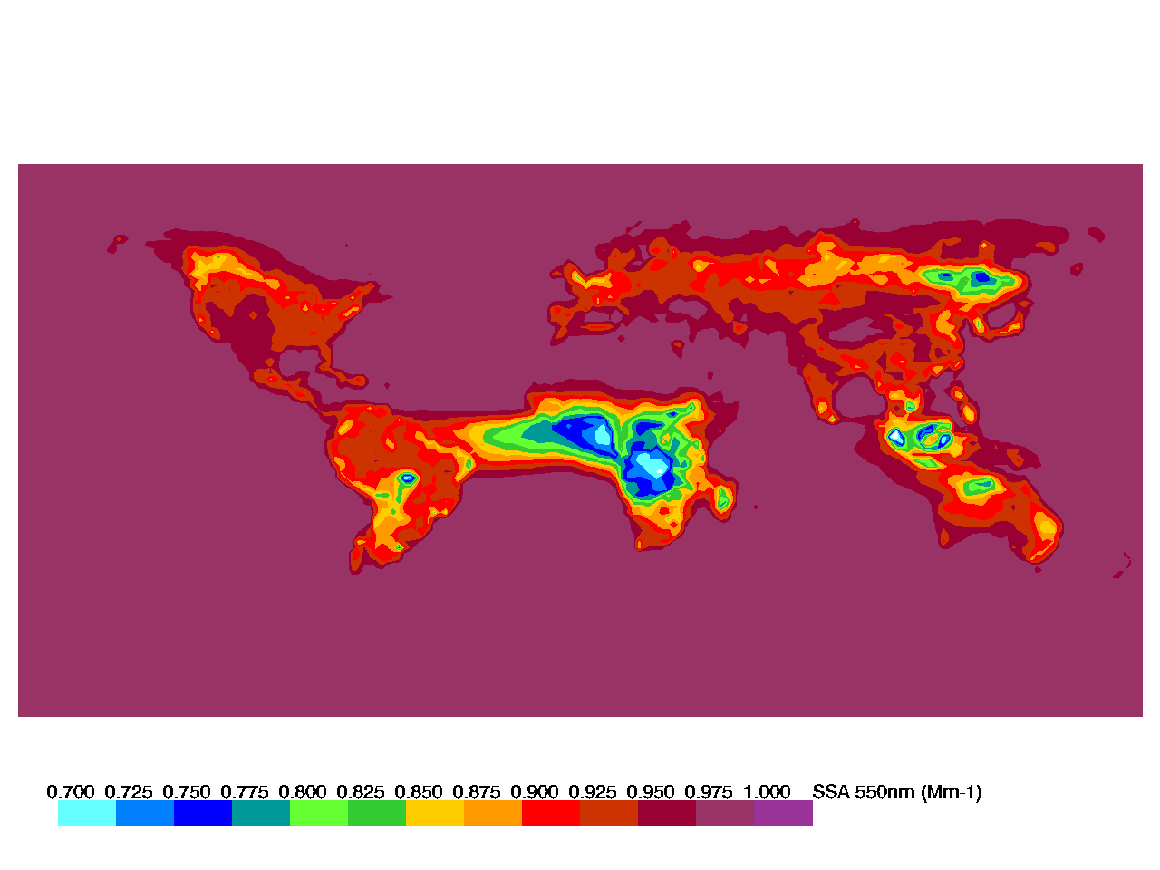
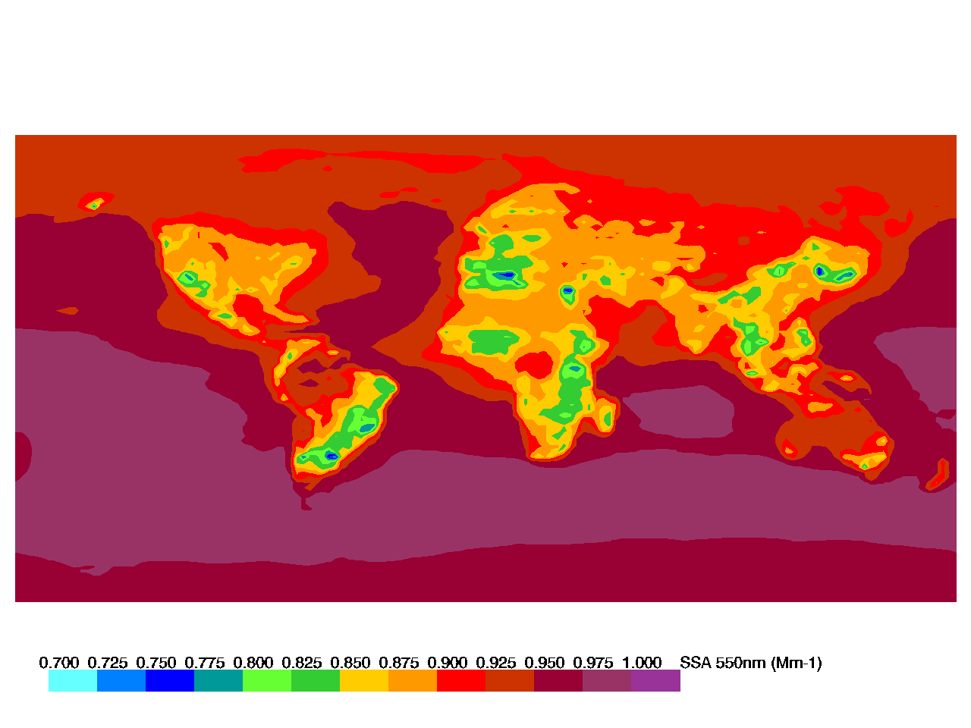
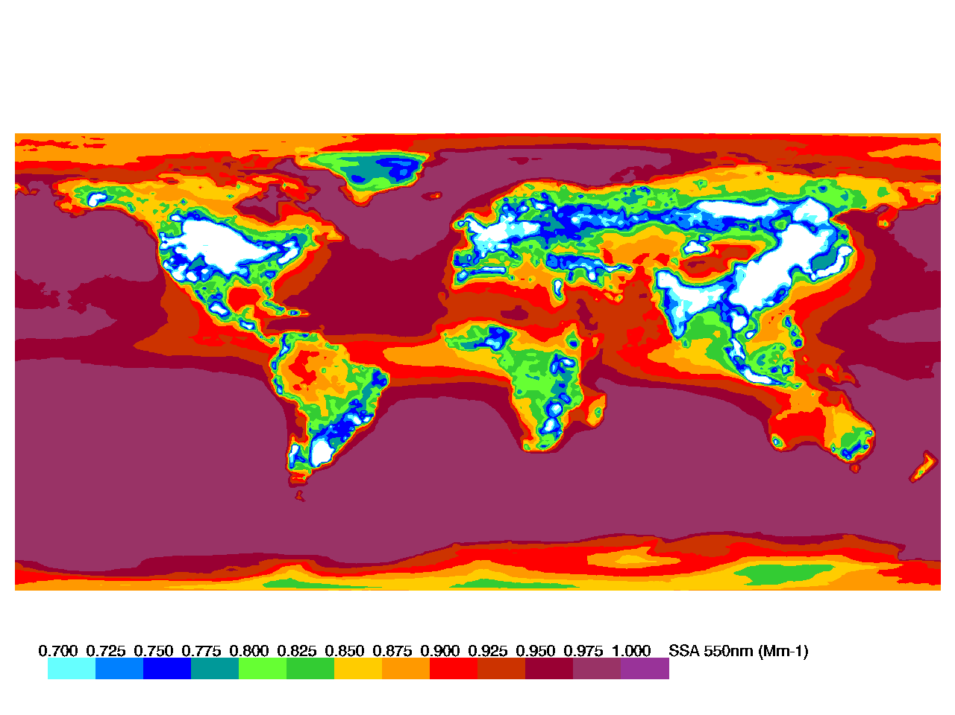
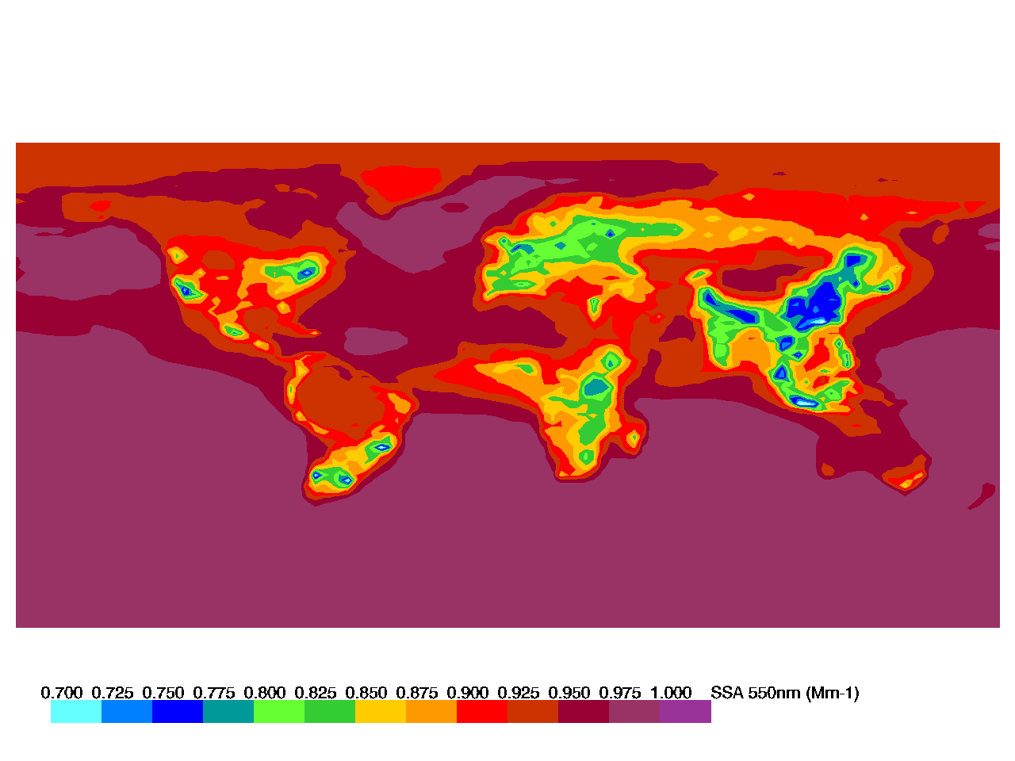
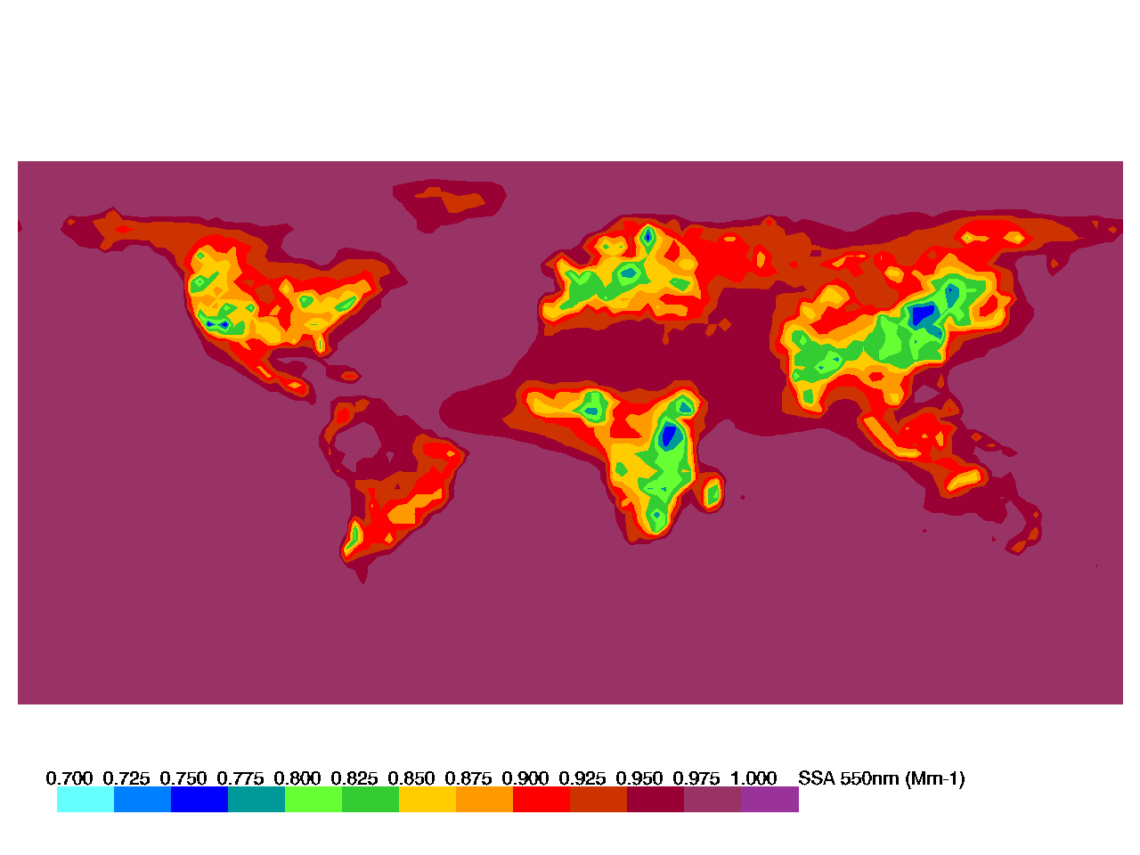
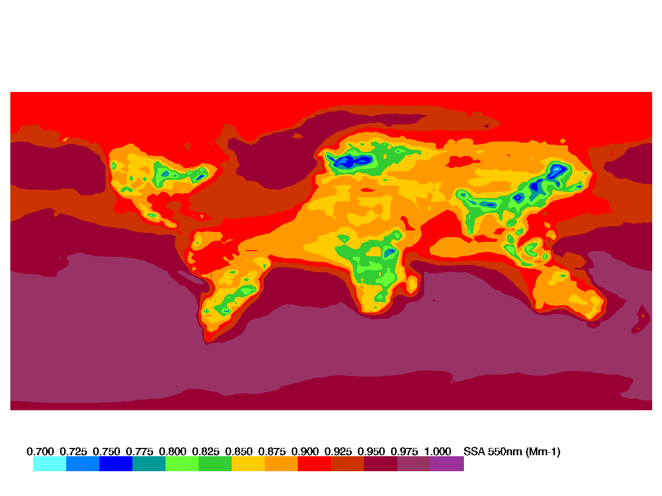
Aerosol Annual Climatology: Single Scattering Albedo
CAM5-2010
GLOBASE-2010
MPIHAM-2006
ECHAM6-SALSA-2010
GEOS-CHEM-2010
SPRINTARS-2006
lo
TM5_INSITU-2010
OSLO CTM-2008
GOCART-2006
Some models see much darker aerosol in some source regions
  Model emissions/processing?
  Aerosol mass to optical property parameterization?

Slide 30
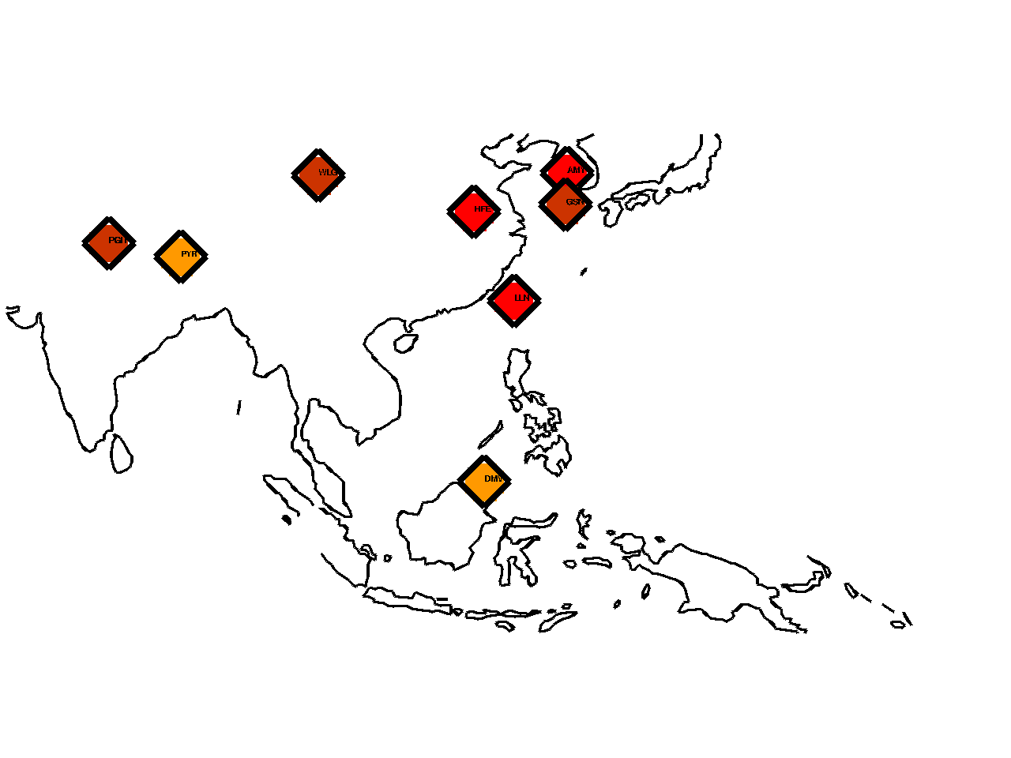
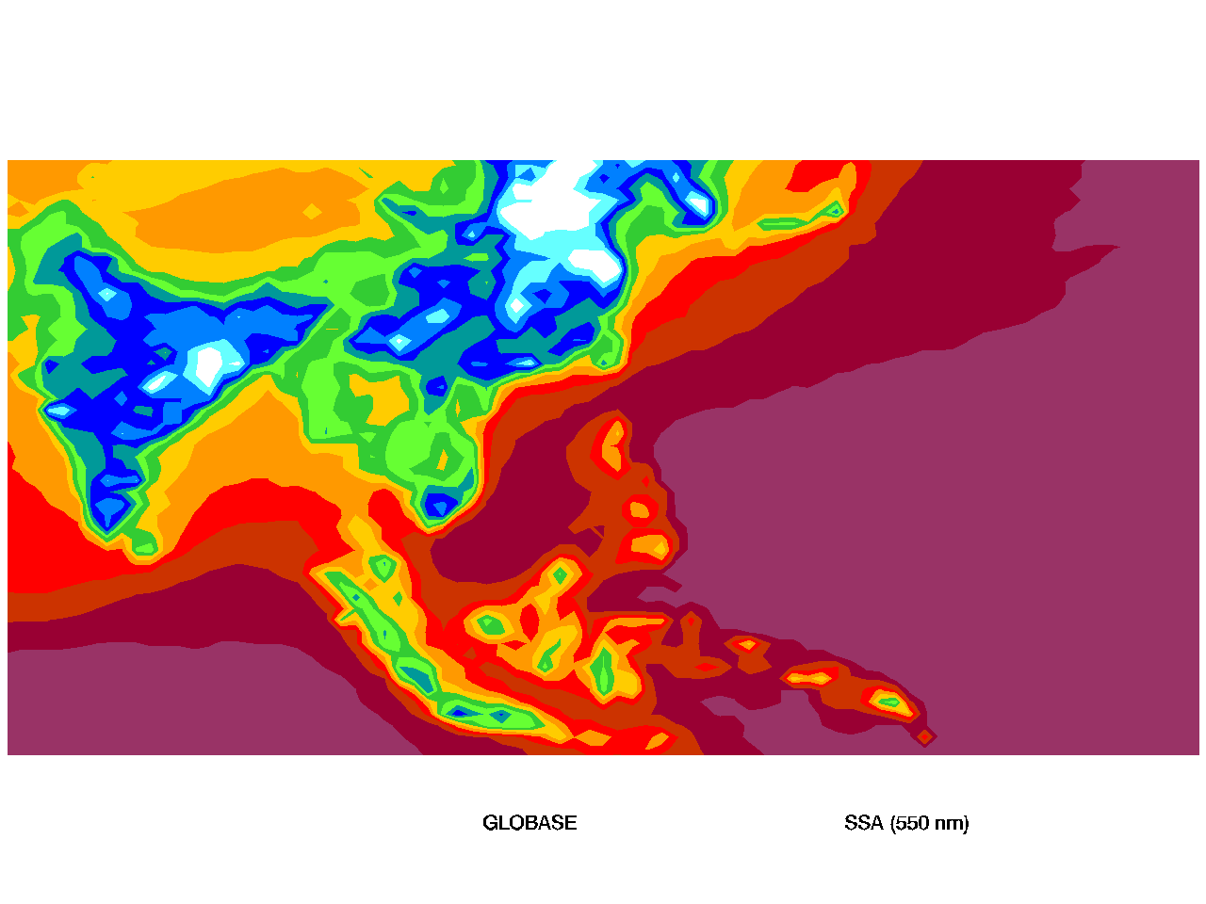
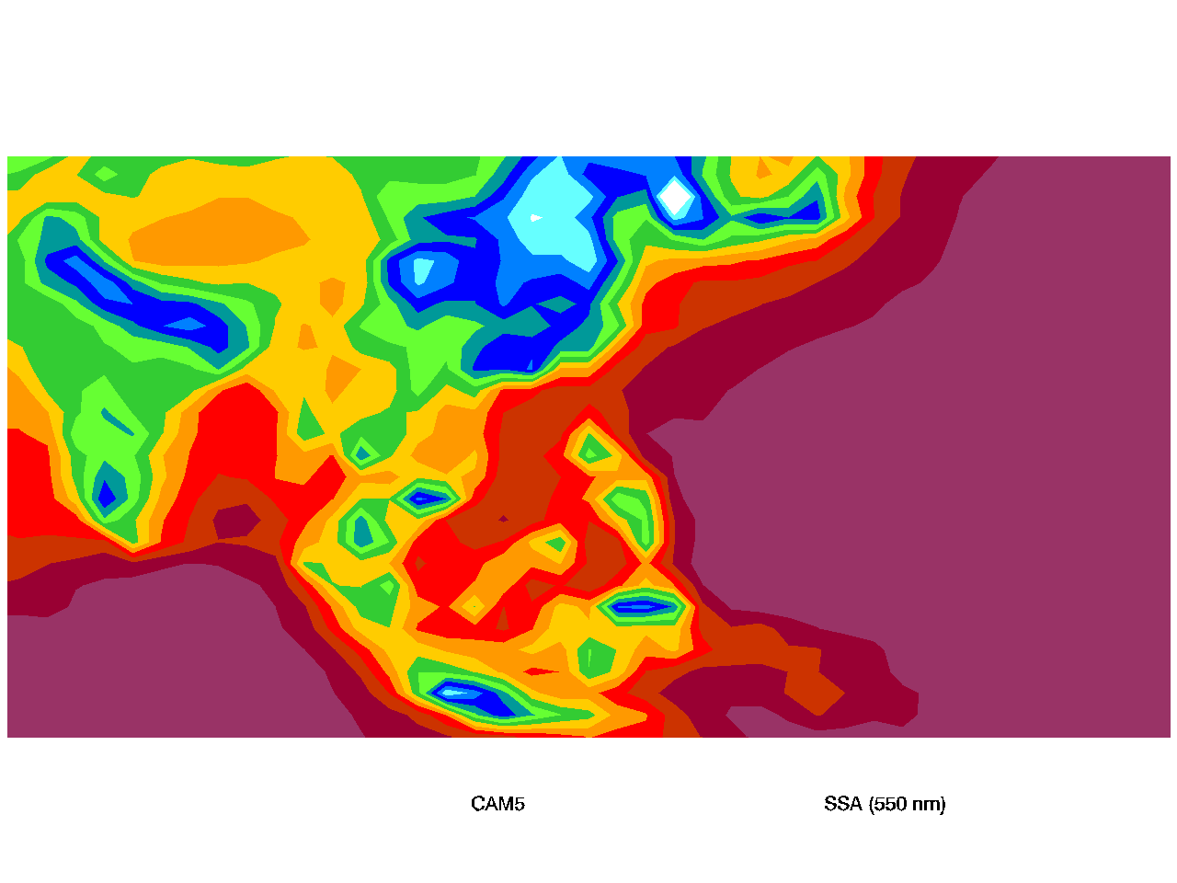







Aerosol Annual Climatology: Single Scattering Albedo
CAM5-2010
GLOBASE-2010
MPIHAM-2006
ECHAM6-SALSA-2010
GEOS-CHEM-2010
SPRINTARS-2006
TM5_INSITU-2010
OSLO CTM-2008
GOCART-2006
In Asia, most models simulate darker aerosol (lower SSA) than is observed by the in-situ measurements.
In-situ

Slide 31


Aerosol Annual Climatology: Absorption and Scattering
Model absorption
Model scattering
Measured absorption
Measured scattering
Models tend to over-predict absorption and scattering at mountain sites
Modeled absorption tends to be over-predicted
Scattering tends to be under-predicted (except at mountain sites)
More range (relatively) in model prediction of absorption than scattering
Vertical bar shows range of models, horizontal bar is measurement uncertainty based on Sherman et al. (2015), only 2010 model output (CAM5, ECHAM6-SALSA, GLOBASE, GEOS-CHEM, MERRAERO, TM5)

Slide 32


Aerosol Annual Climatology: SSA and Ångström exponent
Model SSA
SSA>0.85
Model Ångström exponent
Bigger particles
Darker particles
In-situ SSA
In-situ Ångström exponent
Model SSA tends to be lower (more absorbing) than in-situ SSA → partly driven by model under-prediction of scattering
Modelled Ångström exponents suggest larger particles than observed by in-situ measurements
Vertical bar shows range of model medians, horizontal bar is measurement uncertainty based on Sherman et al. (2015), only 2010 model output (CAM5, ECHAM6-SALSA, GLOBASE, GEOS-CHEM, MERRAERO, TM5)
.

Slide 33

Aerosol Seasonality: Scattering in the Arctic
Measurement median Model median
Seasonal comparisons can suggest indicate model processes to focus on.
For example: what is the modelled peak in summer at Barrow due to:
--Overestimating forest fire emissions?
--Underestimating removal processes?
Why are the models better in the European Arctic than the North American Arctic?
--Better transport details?
Notes:
Models appear to be doing better in European Arctic (PAL and ZEP) than in North American Arctic (ALT and BRW)

Slide 34
Aerosol ‘behavior’: Systematic variability
Systematic variability can provide information about how well the model is simulating aerosol aging processes, chemistry, sources, transport, etc.
For example, if models correctly simulate how two parameters co-vary but have the overall values wrong, then maybe they just need to tweak the emissions.
Alternatively, if models cannot simulate the observed co-variance then perhaps an atmospheric process (e.g., wet removal) is incorrectly parameterized.

Slide 35

Aerosol Behavior: Systematic Variability
In-situ data
Single Scattering Albedo
Darker (more absorbing)
Continental
Marine
Mountain
Arctic
Scattering Angstrom Exponent
Smaller

Slide 36






Aerosol Behavior: Systematic Variability
2010 Models
In-situ
SSA
Continental
Marine
Mountain
Arctic
Scattering Angstrom Exponent
Single Scattering Albedo
Model data exhibit similar overall relationships between SSA (chem) and SAE (size)
→general pattern of decreasing SSA with increasing SAE
→models tend to have darker, larger particles
Scattering Angstrom Exponent

Slide 37



Aerosol Behavior: Systematic Variability
Model
In-situ
Density of in-situ data
El Arenosillo, Spain (ARN)
Mt Waliguan, China (WLG)
Models and in-situ tend to agree at coastal sites (ARN)
Models tend to be darker than in-situ in Asia (WLG)
Mid-continental, rural sites may be hard to characterize this way (SGP)
Rural Oklahoma, USA (SGP)

Slide 38


Aerosol Behavior: Systematic Variability
Continental
Marine
Mountain
Arctic
Absorption Angstrom Exponent
NOAA network in-situ data only
Scattering Angstrom Exponent
Smaller
Relationships between aerosol optical parameters may indicate aerosol type/composition.
Cazorla et al., 2013; Schmeisser et al. (to be submitted)

Slide 39







Aerosol Behavior: Systematic Variability
Models
In-situ
AAE
SAE
Absorption Angstrom Exponent
Model data exhibit very different relationships between AAE and SAE
→differences amongst models
→differences between models and insitu
Scattering Angstrom Exponent

Slide 40



Conclusions
General:
→Lots of fun to be had with long-term data
  Climatologies, trends, remote sensing validation…
→Lots of in-situ data to be evaluated…more is always coming in…
Model evaluation
  →models tend to see lower scattering than observations
  →models tend to see darker, smaller aerosol than observations
  →models have varying success in reproducing observed seasonality and co-variance amongst aerosol optical properties
  →on-going research…stay tuned!
El Arenosillo, Spain
Gosan, South Korea
Cape Point,
South Africa

Slide 41

THANK YOU!
Acknowledgements
John A. Ogren, Patrick Sheridan, Jim Wendell NOAA/ESRL/GMD
Derek Hageman, Anne Jefferson CIRES, University of Colorado
and
Our collaborators and technicians from all over the place
Cape San Juan, PR

Slide 43
Extra stuff

Slide 44

What’s an Aerosol??
Definition: Particle or liquid suspended in a gas.
Aerosol Characteristics
Size
Composition
Shape
0.01-100 micron (human hair is ~100 micron diameter)
For our optical measurements we mostly care about 0.1-10 micron particles

Slide 45


Extreme examples of direct aerosol effects
Volcanic eruption
Dust storm in China
Aerosols reflecting light back to space
Shadowed – solar radiation isn’t getting through plume

Slide 46




Aerosol Optical Properties - Absorption
Filter-based absorption measurements:
PSAP – Particle Soot Absorption Photometer
TAP – Tri-color Absorption Photometer
Aethalometer
MAAP – Multi-Angle Absorption Photometer
MAAP
Light source
These are on-line measurements
TAP filters

Slide 47


Aerosol Optical Properties - Scattering
Nephelometer
→particles scatter light in sensing volume
→photomultiplier tubes detect scattered light
Common options:
Multiple wavelength
Angular dependence of scattering
Calibrated with gas like CO2

Slide 48

Satellite/measurement comparison of extinction
Remote-sensing retrieval products cannot be considered reliable until they have been independently validated.
In-situ aerosol measurements can be related back to physical standards; remotely-sensed aerosol properties can not be.
(From Andrews et al., 2011)
In-situ extinction
CALIPSO extinction
Measurements at high altitude (> 2km)
In-situ data are a point measurement, CALIPSO is a regionally averaged value.
Notes:
Statistical comparisons of long-term, in-situ extinction with space/time averaged satellite retrievals at altitude look pretty good.

Slide 49


Humidity Dependence of Aerosol Forcing
Some types of particles will interact with water, while others do not.
Depending on aerosol type, humidity can have strong influence on radiative forcing efficiency.
www.liquidimage.com
Clean Marine
Puerto Rico?
Polluted
Dust
Radiative forcing efficiency (W m⁻² AOD⁻¹)
Continental
Polluted Marine
Relative Humidity (%)

Slide 50


Aerosol Behavior: Systematic Variability
Model
In-situ
Density of in-situ data
Montseny,
Spain
Cabauw,
Netherlands
Lower loading corresponds to darker (and smaller) particles
→ preferential scavenging of large, scattering aerosol by clouds/precipitation?
The co-variance observed between SSA and scattering for in-situ data is not necessarily reproduced by model output
Notes:
Model curves (dashed lines). Model output tends to indicate lower SSA than in-situ data.
Note that shape of in-situ curve is often similar (APP, GRW), though not always (GSN)

Slide 51

Model/measurement comparison of number concentration
Barrow, AK
American Samoa
N (cm⁻³)
N (cm⁻³)
(From Spracklen et al., 2010)
Trinidad Head, CA
Observations
x
N (cm⁻³)
Modeled values, different assumptions
→Models must include secondary formation processes (e.g., nucleation) to correctly represent aerosol number concentrations.
→Models must correctly parameterize aerosol microphysics in order to properly simulate cloud formation and, hence, indirect forcing by aerosols.
Notes:
Black – primary emissions
Gray – primary +binary homogeneous nuc
Red – primary+ BHN + increased sulfate
Blue – primary+BHN+kinetic nucleation

Slide 52
Differences between surface and aircraft measurements -
Los Alamos fire
Smoke detected
Smoke detected aloft, but air is clear at surface
Cold front moves in
No smoke detected
4
4
3
4
3
alt (km)
2
alt (km)
1
3
2
alt (km)
1
0
2
light scattering (Mm⁻¹)
0
50
100
-1
150
0
scattering (Mm
)
1
0
50
100
150
scattering (Mm
-1
)
0
0
50
100
150
scattering (Mm
-1
)
Date
Data from Southern Great Plains site in Oklahoma

Slide 53



Airplane - Satellite comparison
Scattering (Mm-1)
6
20070828
20070915
5
Airplane
Satellite
Airplane
Satellite
4
Altitude (km)
3
2
1
Attenuated Backscatter (km⁻¹ sr⁻¹)
Satellite only detects aerosol above ~20 Mm⁻¹
Difficult to detect aerosol in clean places
Satellite data from CALIPSO, Airplane data for NOAA Cessna

Slide 54
Aerosol Forcing 101 (the primer)
What do we need to know? | WHY?
AEROSOL AMOUNT | Correlated with forcing
AEROSOL ‘DARKNESS’ | Determines the cooling/warming potential of particles
AEROSOL TYPE | Source identification/contribution
AEROSOL SIZE | Anthropogenic aerosol contribution Amount of incoming radiation lost to space
LOCATION | Aerosol forcing depends on the underlying surface and whether they are above or below clouds.

Slide 55

Aerosols and Clouds
Aerosol particles act as cloud nuclei
More particles =
→more cloud droplets
→smaller cloud droplets
→clouds more reflective – more cooling
→less rain?
Shiptracks image
(M. King)

Slide 56


Climatology of light scattering – vertical profiles

Slide 57


Systematic Variability
Systematic relationships can provide information about particle types and processes
Aerosol properties change with loading
→changes in source
→atmospheric processing
Spring
Summer
Fall
Winter
High loading = dominated by sea salt
Low loading – fog scavenging leaves small, dark particles?
Trinidad Head, CA
Notes:
One of those things

Slide 58

System Design Considerations
Representative Data
Particle losses minimized
Temperature and humidity control
Remote from large local sources
Data Contamination
Stack height
Pump filters
‘Clean air’ sectors
Data Stream
1-min average
Tranferred to NOAA every 6h
Remote access
Weekly data QC
Robust archiving
Lamont, OK

Slide 59

Long-term Remote Operations…
Daily data checks (station peeps+remote scientist)
Weekly quality control (data review and editing)
Remote access
Annual visits
Tons of documentation

Slide 60







Sources of Local Contamination at SPO
Sheridan et al., AAQR 2015

Slide 61

Aerosol Persistence
How well does a measurement at time ‘t’ represent a measurement at time t+Δt?
Δt=1 hour, r=0.96
Δt=3 hours, r=0.86
Scattering at t=t₀+Δt
Δt=12 hours, r=0.68
Δt=24 hours, r=0.57
Scattering at t=t₀
Colors represent density of points
IZA scattering

Slide 62

Autocorrelation Analysis
Lag autocorrelation relationships for aerosol light scattering at Bondville, IL (rural continental site) and Spitzbergen (Arctic site)
(Anderson et al., 2003)
Lag is the time between measurements being compared (Δt).
‘r’ is the lag autocorrelation statistic.

Slide 63


Applications of lag autocorrelation analysis
→constrain comparisons by identification of expected ‘best case’ agreement between different data sources
→determine whether data from different measurement platforms and models are internally consistent
→identify influence of atmospheric processes based on different time scales
Lag
12 h
3 h
1 h

Slide 64
















Lag Autocorrelation of mountain sites – Short term
Lag Coefficient ‘r’
Lag time (hr)

Slide 65






Model – Measurement comparison
Model#2
In-situ data
Model is better at middle of country (BND) than coast (THD) or Arctic (BRW)
→effects of sub-grid variability
Model tends to over predict annual cycle strength

