Slide 1
WMO GAW Greenhouse Gas Measurements: Quantifying the Main Driver of Climate Change (and so much more….)
Ed Dlugokencky¹ and Oksana Tarasova²
¹NOAA ESRL GMD
²WMO Global Atmosphere Watch

Slide 2
Role of GAW GHG in GCOS
GAW GHG program measures 3 ECVs
CO₂, CH₄, and N₂O → 93% of increased RF since 1990
GAW CO₂, CH₄, and N₂O networks are Baseline and Comprehensive Global Observing Networks of GCOS
Globally distributed
Long-term, high-quality, calibrated observations

Slide 3
GAW: Long-Term, Climate-Quality Observations of LLGHGs
Common standard scales
Central Calibration Laboratories
Centers to ensure data quality
Comparisons of standards and station audits
World Data Center: archive and distribute
Community committed to quality
Science-driven, quality objectives and recommendations
Comparisons of measurements

Slide 4
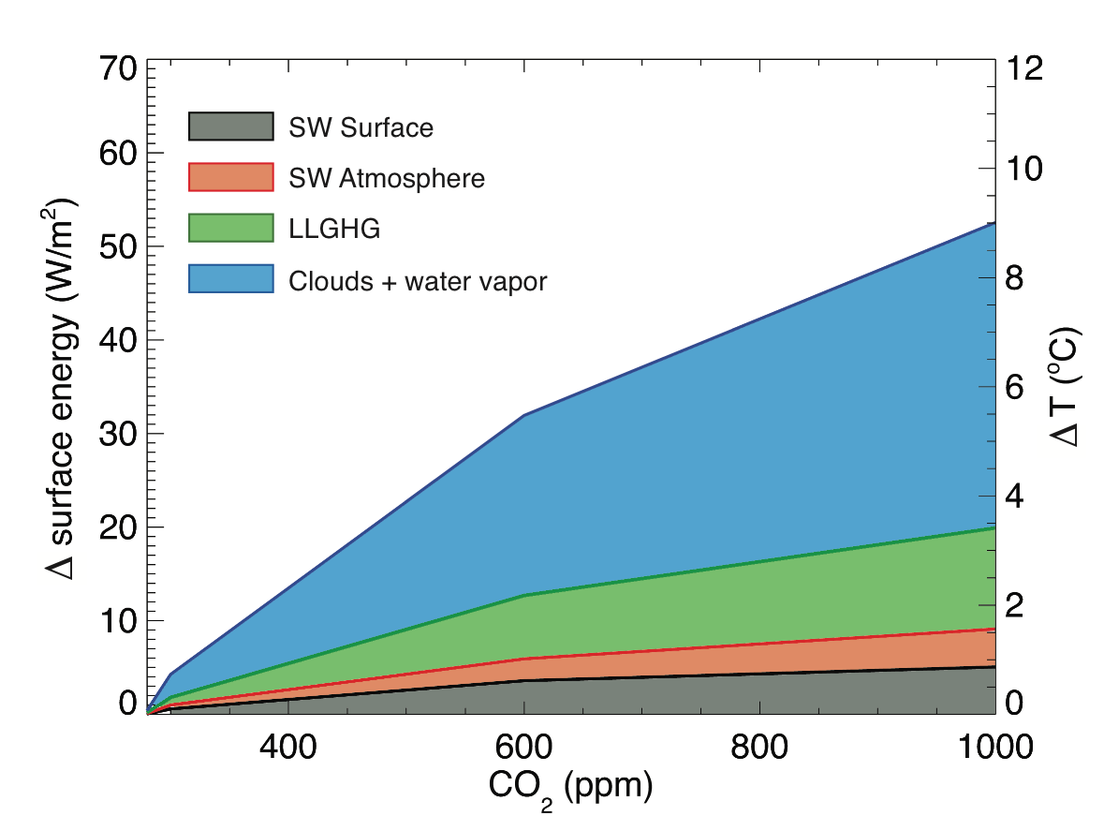
GAW GHG: Products
GHG Bulletins (summary of LLGHG observations)
Role of H₂O and clouds in climate change (No. 11): Water vapour and carbon dioxide (CO₂) are the major greenhouse gases (GHGs). CO₂ is the main driver of climate change. Water vapour changes largely happen as a response to the change in CO₂.
GHG Trends (CO₂ and CH₄): Hosted by NOAA
Data packages
Assimilation systems → Emissions

Slide 5
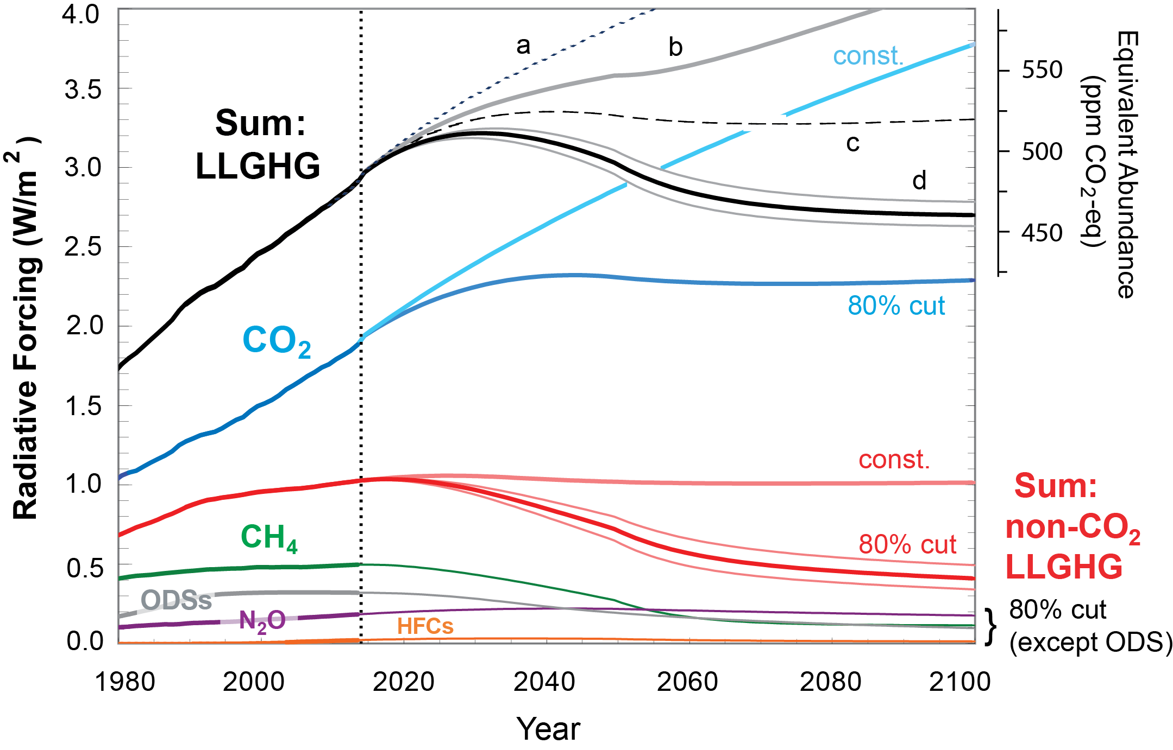
Radiative Forcing: 2.98 W m⁻² in 2015 (NOAA AGGI)
What emission reductions are necessary to stabilize it?
Montzka et al., Nature, 2010

Slide 6
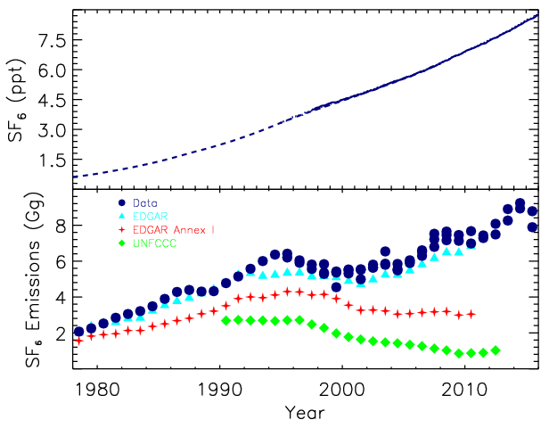
Emissions = d(GHG)/dt + (GHG)/τ
Simple case: SF₆, τ = 800-3200 yr
RF (2015) = 4.9 mW m⁻²
GWP₁₀₀ = 17,400

Slide 7
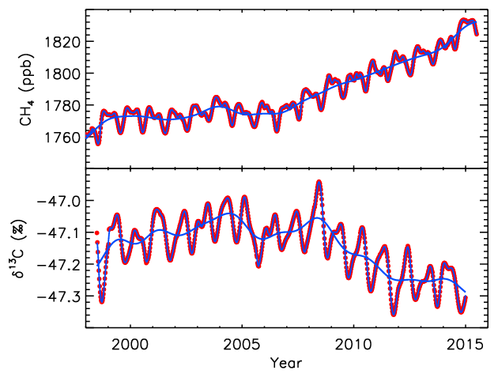
Globally averaged CH₄ and δ¹³C(CH₄)

Slide 8
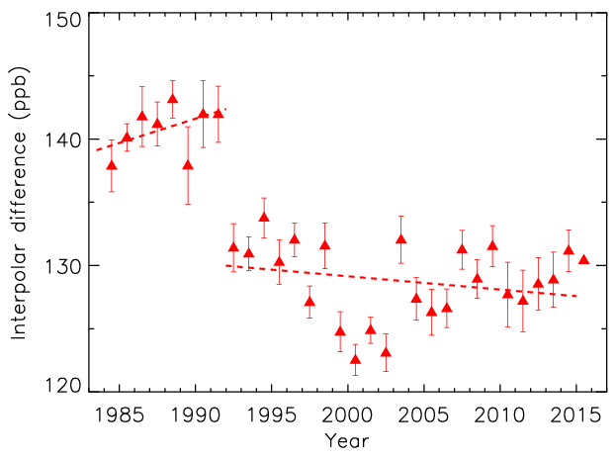
Source | Tg CH₄ yr⁻¹
Wetlands | 12.9 ± 1.1
Biomass Burning | 0.5 ± 0.1
Agriculture + Waste | 1.1 ± 0.4
Fossil Fuel | 6.5 ± 3.0
Other | 1.9 ± 2.3
Total | 23.1 ± 2.0
Economic collapse in fSU

Slide 9
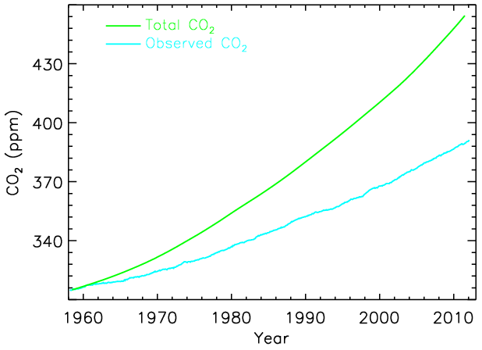
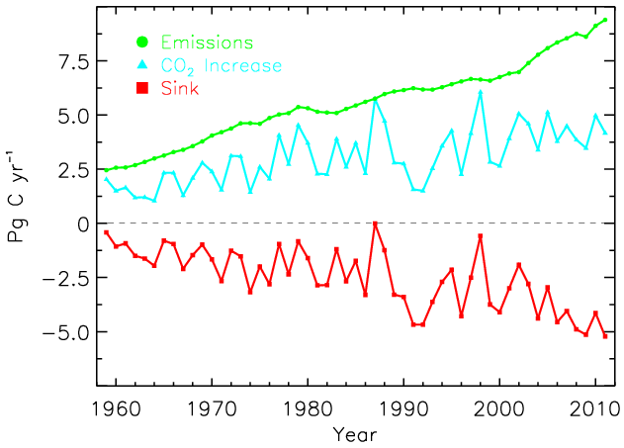
Budget of fossil fuel CO₂ emissions:
Fossil fuels
Partition sink between ocean and terrestrial biosphere using measurements of atmospheric O₂/N₂.

Slide 10
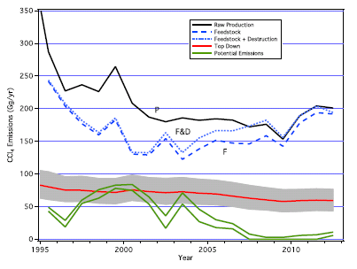
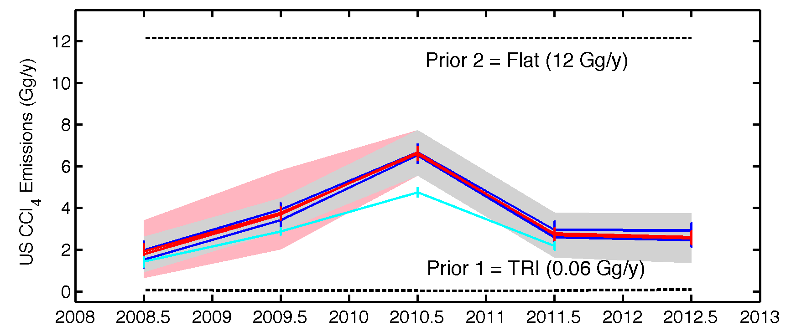
National Estimates of ODS emissions: CCl₄
Global CCl₄ Emissions:
Top-down not consistent with production/use balance.
US CCl₄ Emissions:
Inventory underestimates actual emissions by factor of ~30.
(Hu et al., PNAS, 2016)
For more: Friday, 11:45, presentation on IG³IS by Diane Stanitski

Slide 11
Take-Away Points
GAW in situ climate-quality observations provide key, irrefutable constraints
Current network suitable to constrain budgets at large spatial scales
Increased network density and improved transport models necessary for policy-relevant scale emissions estimates

Slide 12
Future
Ensure internal consistency among data contributed by partners
Encourage GAW participants to maintain a database management strategy
Expand the in situ LLGHG measurement network (tropics and climate-sensitive areas)
Aid validation of GHG retrievals from satellites
Encourage the development of improved atmospheric transport models

Slide 13
Extra slides

Slide 14
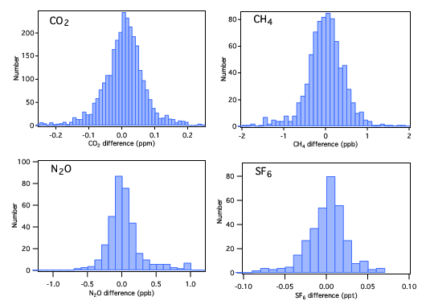
Propagation of standard scales by CCL: Differences between initial and subsequent calibrations more than 1 year later

Slide 15
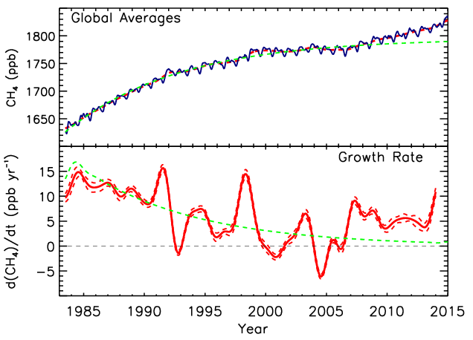
Lifetime ≈ 9.3 yr
[CH₄](t) = [CH₄]_{ss}-([CH₄]_{ss}-[CH₄]₀)e^{-t/τ}

Slide 16
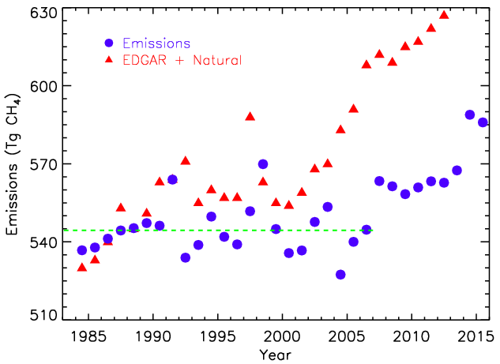
Emissions = d[CH₄]/dt + [CH₄]/τ
Lifetime (τ) = 9.1 yr
Trend = 0 ± 0.6 Tg CH₄ yr⁻¹
Average Emissions = 551 ± 15 Tg CH₄

Slide 17
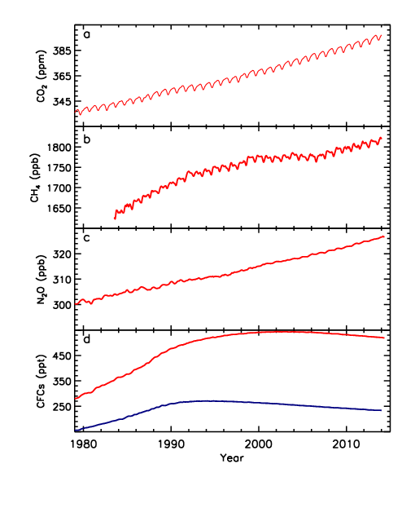
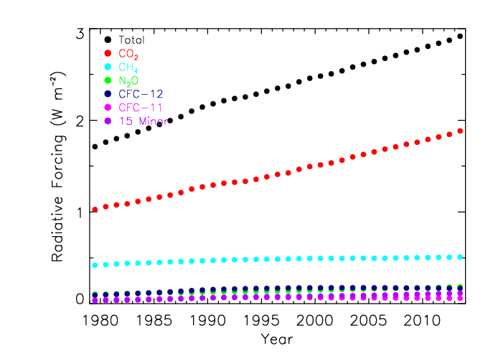
>95% of RF from 5 gases.

Slide 18
What do we learn from GAW GHG measurements?
Radiative forcing: 2.94 W m⁻² in 2014 (NOAA AGGI)
Multi-tracer constraint on sources and sinks
O₂/N₂ → CO₂ sink
δ¹³C(CH₄) → changing CH₄ budget
Atmospheric constraint on emission inventories
“…like dieting without weighing oneself”
Verify emissions mitigation (Montreal Protocol)
How are GHG budgets changing?
Climate feedbacks?

Slide 19
Remote Sensing
Never calibrated, only evaluated
Vertical profiles; Aircore (TCCON insufficient)
Sensor degradation over time
Potential biases (e.g., land - ocean)
“Short” deployment for satellites
Retrieve total column; strongest signals at surface
Different retrieval versions give very different results (e.g., in inversions)

Slide 20
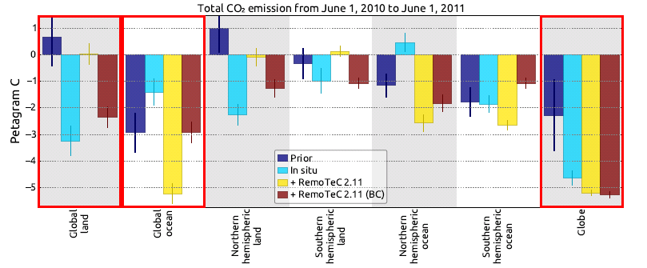

Slide 21
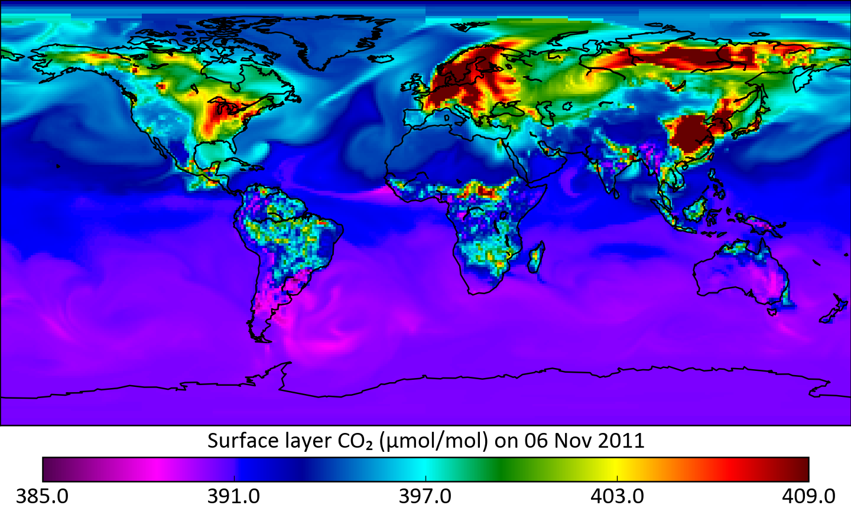
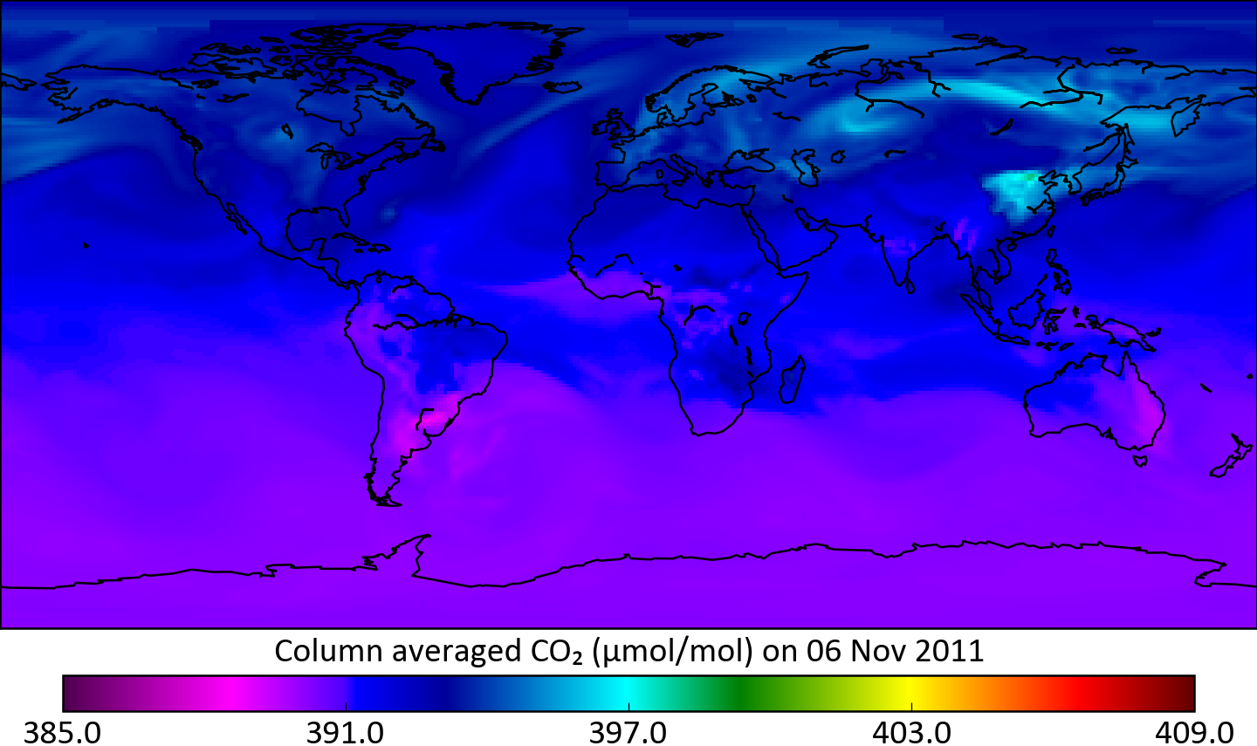

Slide 23
CO₂ and CH₄ Trends Webpage
Contribution to GAW by NOAA
Updated monthly
Plots of global averages
Table of annual increases
Table of globally averaged annual and monthly means

Slide 24
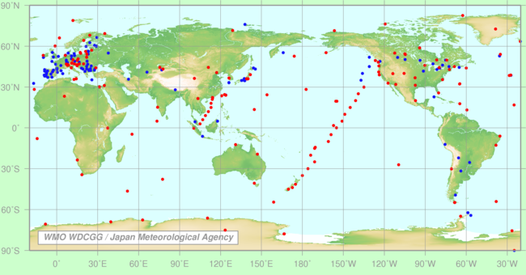
GAW GHG Network

Slide 25
GCOS Networks
Baseline global network: These consist of a limited number of selected locations that are globally distributed and provide long-term high-quality data records of key global climate variables as well as calibration for more comprehensive networks. They are usually funded from long-term operational budgets;
Comprehensive global network: These consist of the relatively dense global and regional (and, in some cases national) observing networks which are the basic building blocks of GCOS. The comprehensive networks provide observations at the detailed space and time scale required to fully describe the nature, variability and change of a specific climate variable. They are almost always funded from long-term operational budgets

