Slide 1
Update and expansion of the WMO X2004 CH₄ mole fraction scale
Ed Dlugokencky¹, Andrew Crotwell^{1,2}, Patricia Lang¹,
Kirk Thoning¹, and Brad Hall¹
¹NOAA Earth System Research Laboratory,
Global Monitoring Division, Boulder, CO, USA
²Also at University of Colorado, CIRES, Boulder, CO USA
(ed.dlugokencky@noaa.gov)

Slide 2
Outline
Reasons for changes
Ensure continental measurements are calibrated
Account for analytical non-linearity
New gravimetrically prepared 1° standards
6 standards in range 2200 to 5900 ppb
Combined with previous set (300 to 2600 ppb)
New 2° standards (390 to 5000 ppb)
Calibrated with gravimetrically-prepared 1°s
Propagate scale with response curve
How do you update your assigned values?

Slide 3
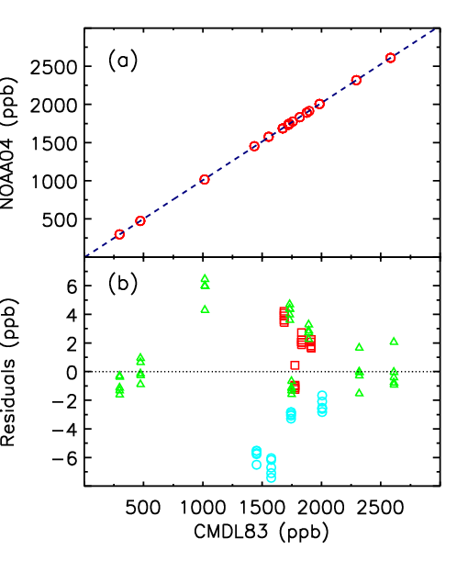
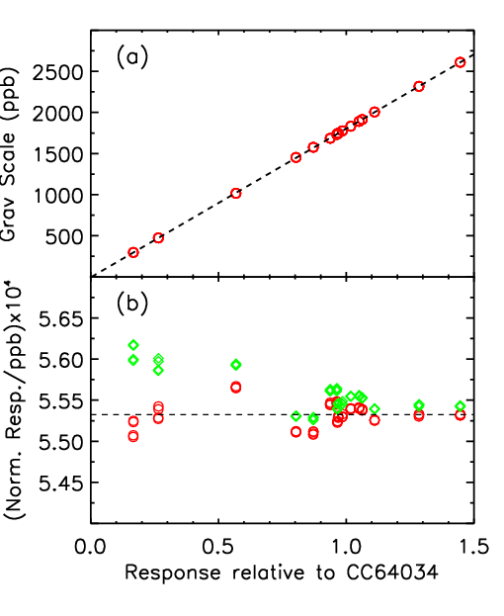
X2004 CH₄ Primary Standards
Source: Dlugokencky et al., JGR, doi:10.1029/2005JD006035, 2005.

Slide 4
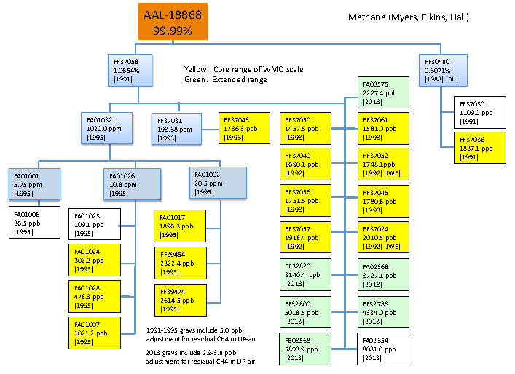

Slide 5
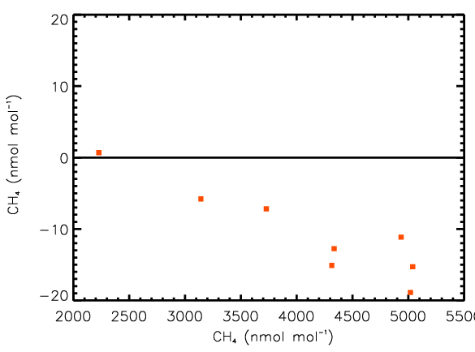
Status mid-June, 2013
Grav value – measured value
(Based on linear response to original 300 - 5760 ppb 1° standards)
5

Slide 6
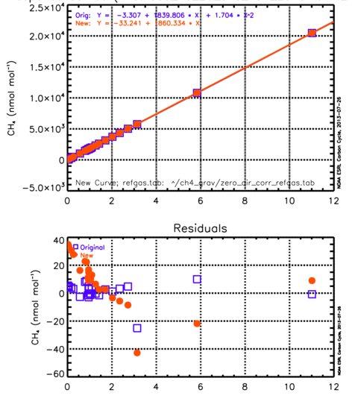
Tested:
- Different transfer methods
- Inclusion of 10 and 20 ppm standards
- Original 5.8 ppm standard was not consistent with others
5.8 ppm
Normalized Response

Slide 7
22 Primary Standards (X2004A)
Cylinder ID | Year Prepared | Assigned CH₄ (ppb) | Uncertainty* (ppb)
FA01024 | 1995 | 302.3 | 2.0
FA01028 | 1994 | 478.3 | 2.1
FA01007 | 1995 | 1021.2 | 2.5
FF37050 | 1993 | 1457.6 | 2.5
FF37061 | 1993 | 1581.0 | 2.3
FF37040 | 1992 | 1690.1 | 2.3
FF37043 | 1993 | 1736.3 | 3.6
FF37052 | 1992 | 1748.1 | 2.3
FF37056 | 1993 | 1751.6 | 2.3
FF37045 | 1993 | 1780.6 | 2.2
FF37036 | 1991 | 1837.1 | 2.4
FA01017 | 1995 | 1896.3 | 2.4
FF37057 | 1992 | 1918.4 | 2.4
FF37024 | 1992 | 2010.5 | 2.3
FB03575 | 2013 | 2227.1 | 1.8
FF39454 | 1995 | 2322.4 | 2.6
FF39474 | 1995 | 2614.5 | 2.7
FF32820 | 2013 | 3140.4 | 2.0
FA02368 | 2013 | 3727.1 | 2.2
FF32783 | 2013 | 4334.0 | 2.5
FF32800 | 2013 | 5018.5 | 2.7
FB03568 | 2013 | 5893.6 | 3.6

Slide 8
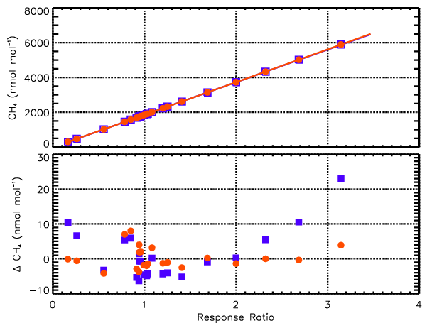
Fit to primary standards + residuals
$${CH}_{4}=c_{0}+c_{1}R^{c_{2}}$$

Slide 9
14 Secondary Standards
Cylinder ID | Year Prepared | Assigned CH₄ (ppb) | Uncertainty (ppb) (68% CI)
CB09868 | 2013 | 389.3 | 0.3
CB09893 | 2013 | 849.5 | 0.3
CB09867 | 2013 | 1236.6 | 0.3
CB09898 | 2013 | 1626.7 | 0.3
CB09871 | 2013 | 1797.1 | 0.4
CB09891 | 2013 | 1952.4 | 0.5
CB09804 | 2013 | 2090.6 | 0.3
CB09888 | 2013 | 2433.5 | 0.4
CB09899 | 2013 | 2865.3 | 0.6
CB09900 | 2013 | 3317.5 | 0.4
CB09895 | 2013 | 3762.8 | 0.5
CB09889 | 2013 | 4155.1 | 0.8
CB08856 | 2013 | 4568.9 | 0.8
CB10121 | 2013 | 4998.0 | 1.0

Slide 10
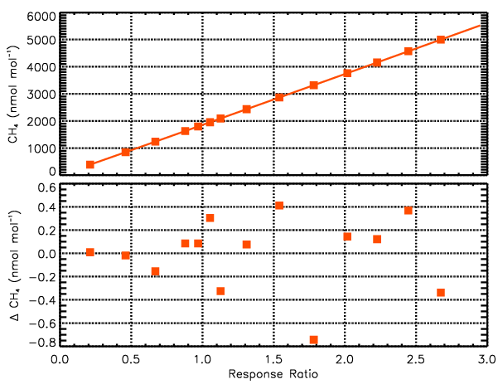
Fit to secondary stnds + residuals

Slide 11
Recalibration of historical secondary standards
All but 2 (of 21) archived in lab
Measured 4X each, 3 GC and 1 CRDS
Mean difference (2004A - 2004): -0.3 ± 0.3 ppb
All calibrations since 17 July, 2013 use RC
Non-linearity greater since October, 2013
Difference in tertiary standards (300-2600 ppb)
1983 to September, 2013: -0.4 ± 0.3 ppb
October, 2013 to present: -0.4 ± 1.9 ppb

Slide 12
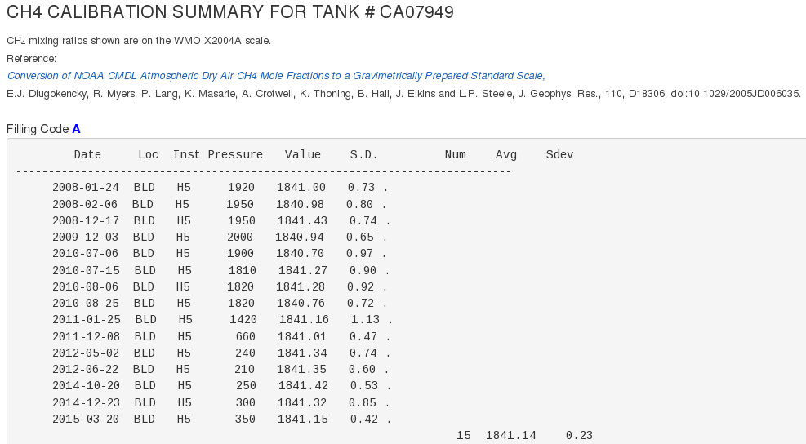
Converting from X2004 to X2004A
http://www.esrl.noaa.gov/gmd/ccl/refgas.html
12

Slide 13
CH₄: Summary and Conclusions
Transitioned from X2004 to X2004A scales
Expand scale with new gravs at 2200 to 5900 ppb
New secondary standards (390 to 5000 ppb)
Assigned values based on 6 response curves form primary standards
Non-linear response: modeled as power function
All historical secondary standards reassigned
Changes propagated to all calibrations from 1983 to present

Slide 14
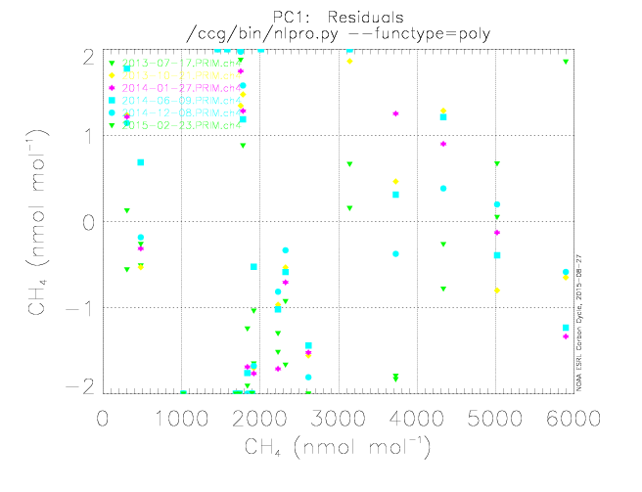
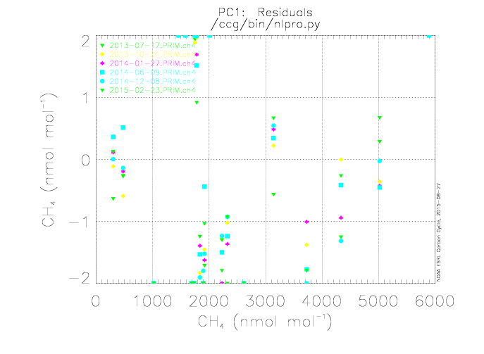

Slide 15
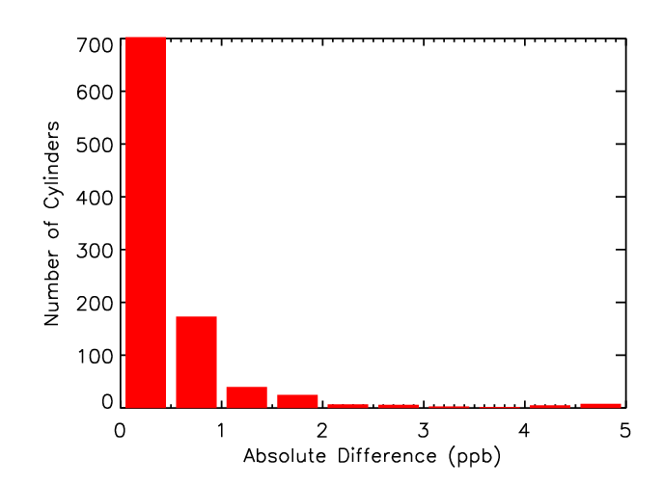
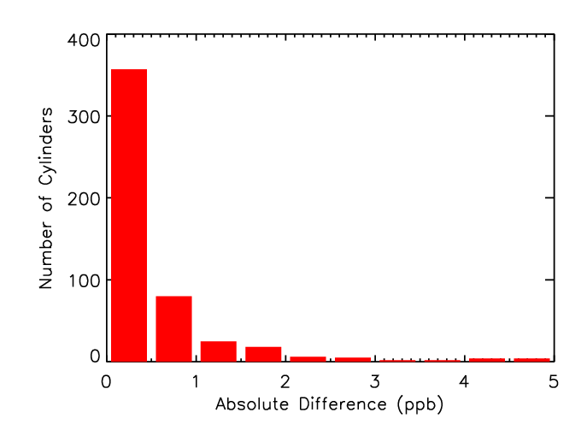
All standards
CH₄ CCL Goal:
Transfer scale to <±1 ppb
Recalibration: 6 mo or greater
Mean = 0.7 ppb
n = 963
91% are 0 to 1.0 ppb
Recalibration: 3 yr or greater
Mean = 0.6 ppb
n = 499
88% are 0 to 1.0 ppb

Slide 16
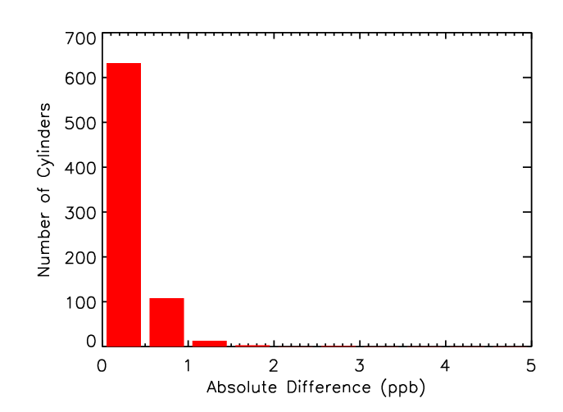
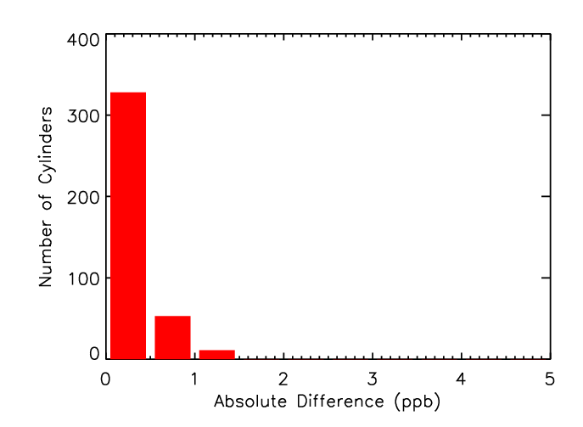
Ambient (1600-1900 ppb)
CH₄ CCL Goal:
Transfer scale to <±1 ppb
Recalibration: 6 mo or greater
Mean = 0.3 ppb
n = 757
98% are 0 to 1.0 ppb
Recalibration: 3 yr or greater
Mean = 0.3 ppb
n = 392
97% are 0 to 1.0 ppb
16

Slide 17
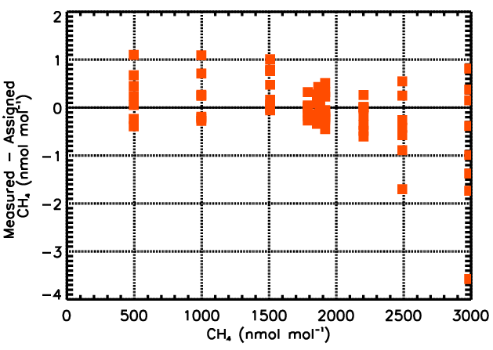

Slide 18
CH₄ Isotope Effects
ΔX ≈ – (X/1000)•¹³R_{std}• Δ(δ¹³R) – (X/1000)•4•²R_{std}• Δ(δD)
≈ – 0.020 ppb ‰⁻¹ for Δ(δ13R), and – 0.00011 ppb ‰⁻¹ for Δ(δD) at ~2 ppm CH₄

Slide 19
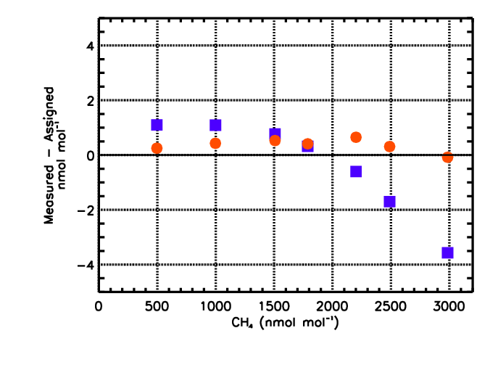
Long-term target tanks – 2011
reprocessed using response curve based on primaries

