Slide 1
What have we learned from three decades of atmospheric CH₄ measurements?
E. Dlugokencky¹, M. Crotwell^{1,2}, A. Crotwell^{1,2}, P.M. Lang¹, K.A. Masarie¹, L. Bruhwiler¹
¹NOAA ESRL GMD, ²CIRES,

Slide 2
Outline
NOAA CH₄ data
Quality control
Long term trends
Approach to steady state
Estimates of emissions
Interannual Variability
Eruption of Mt. Pinatubo
Renewed increase since 2007
Possible causes
Summary and Conclusions

Slide 3
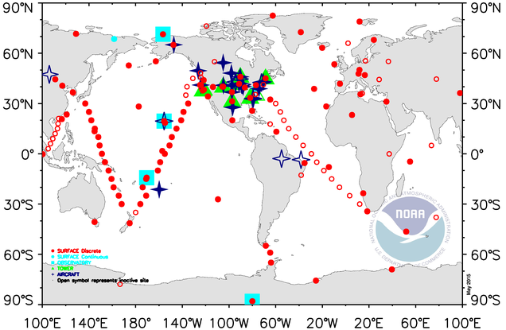
GMD Global Cooperative Air Sampling Network
*Weekly samples *Portable sampler *Analyzed by GC/FID
* Cooperative *Broad participation *www.esrl.noaa.gov/gmd/ccgg/iadv/

Slide 4
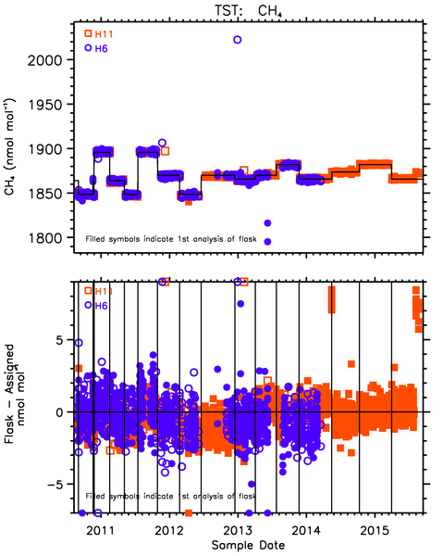
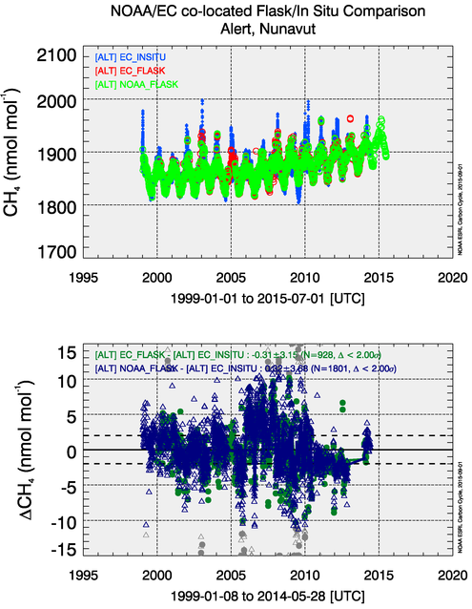
Quality Control

Slide 5
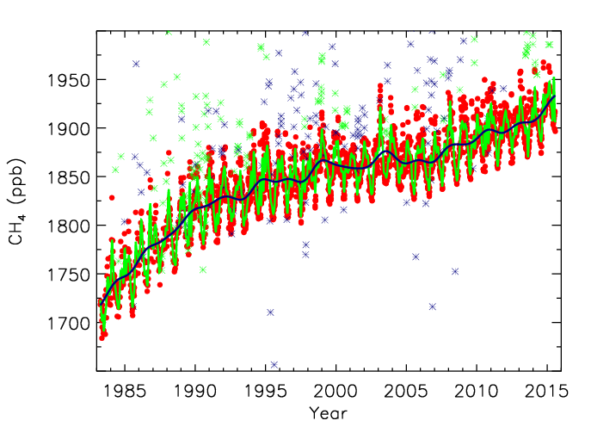
Barrow, Alaska

Slide 6
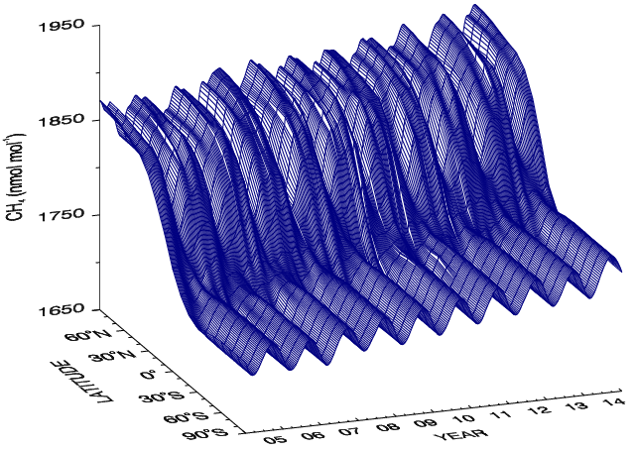

Slide 7
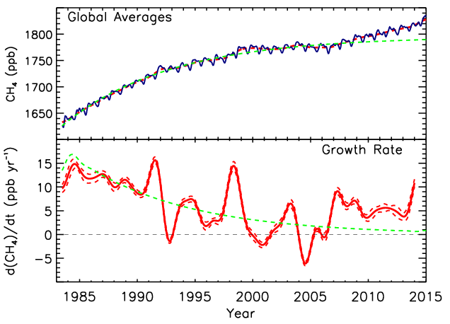
Lifetime ≈ 9.3 yr
[CH₄](t) = [CH₄]_{ss}-([CH₄]_{ss}-[CH₄]₀)e^{-t/τ}

Slide 8
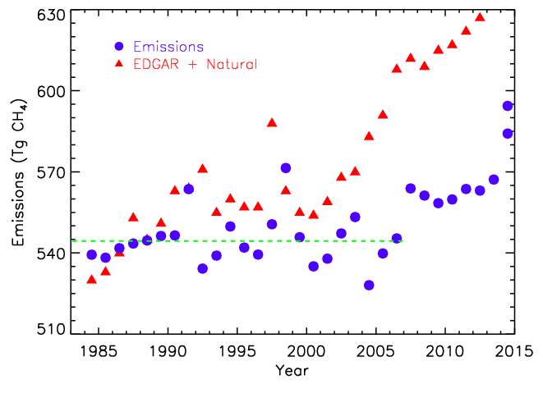
Emissions = d[CH₄]/dt + [CH₄]/τ
Lifetime (τ) = 9.1 yr
Trend = 0 ± 0.6 Tg CH₄ yr⁻¹
Average Emissions = 551 ± 15 Tg CH₄

Slide 9
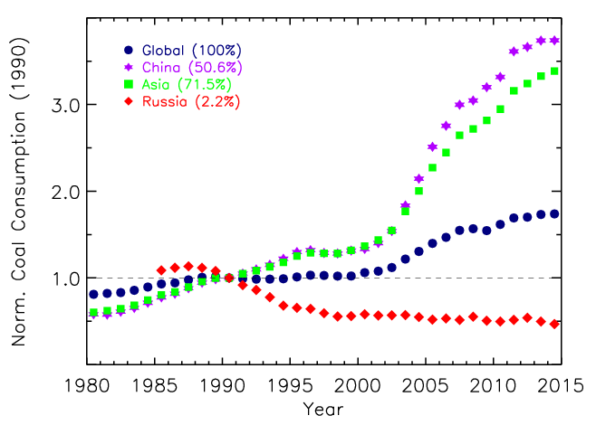
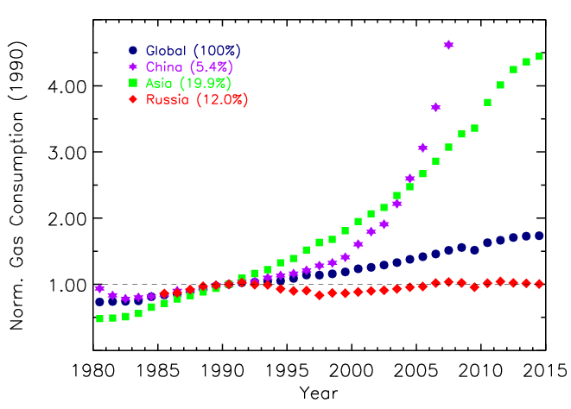
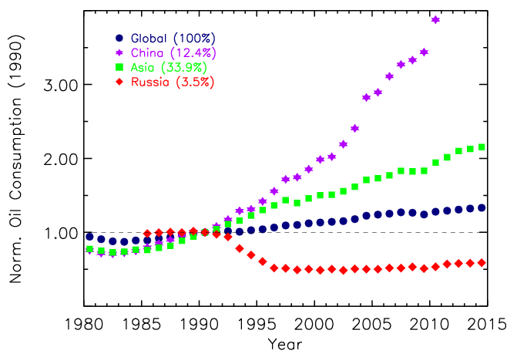
From BP Statistical Review of World Energy, 2015

Slide 10
1991: Pinatubo and the CH₄ Lifetime
Eruption: 15 June 1991
20 MT SO₂ oxidized to SO₄⁻²
3 to 5 km³ ash
Affects [OH] by affecting photochemistry:
Direct absorption of UV by SO₂
Scattering of UV by ash and aerosols
Dlugokencky, E. J., E. G. Dutton, P. C. Novelli, P. P. Tans, K. A. Masarie, K. O. Lantz, and S. Madronich (1996), Geophys. Res. Lett., 23(20), 2761–2764, doi:10.1029/96GL02638.

Slide 11
Chemistry (Largest term in CH₄ budget)
OH + CH₄ → CH₃ + H₂O
O₃ + hν (330 ≥ λ ≥ 290 nm) → O(¹D) + O₂
O(¹D) + H₂O → 2 OH
Rate of formation O(¹D) = j [O₃]
j = ∫F(λ) σ(λ) φ(λ) dλ
Also affected CO

Slide 12
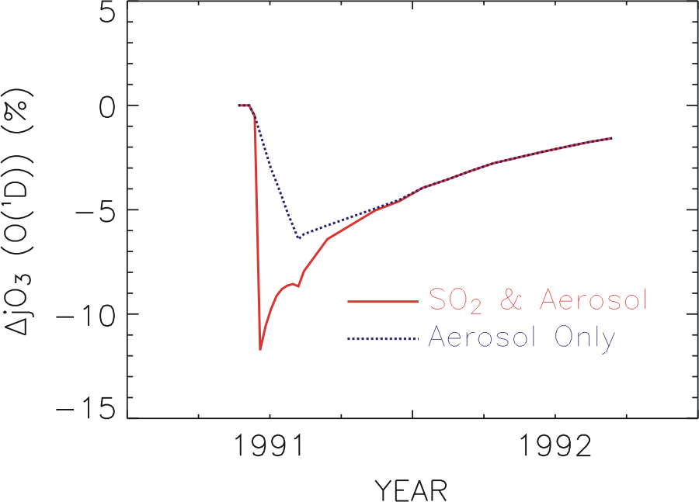
O₃ + hν (330 ≥ λ ≥ 290 nm) → O(¹D) + O₂
O(¹D) + H₂O → 2 OH
Rate of formation O(¹D) = j [O₃]

Slide 13
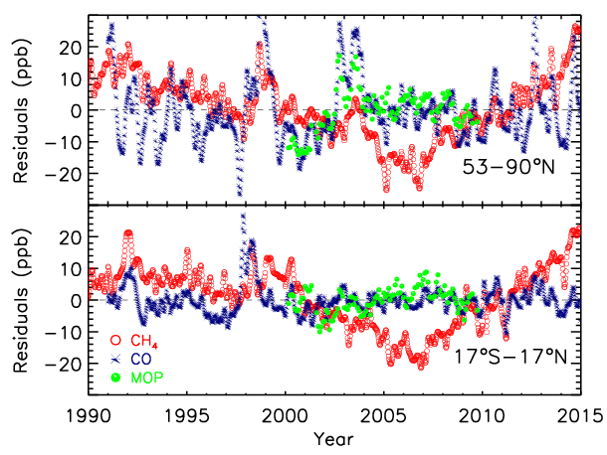
Louisa Emmons NCAR

Slide 14
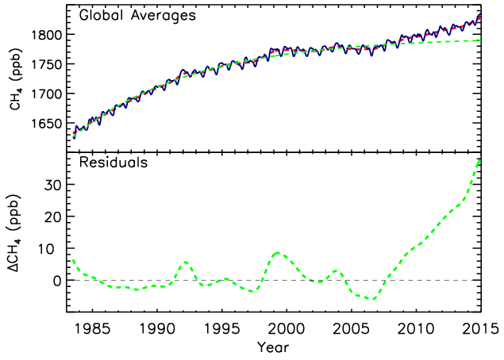
Trend - SS

Slide 15
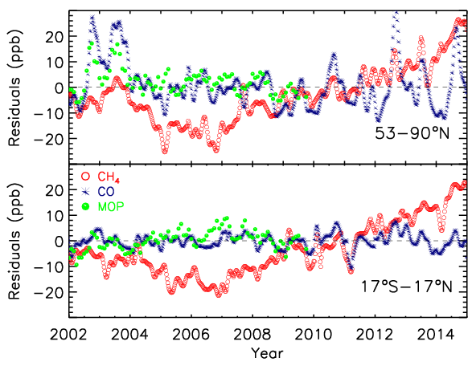
Louisa Emmons NCAR

Slide 16
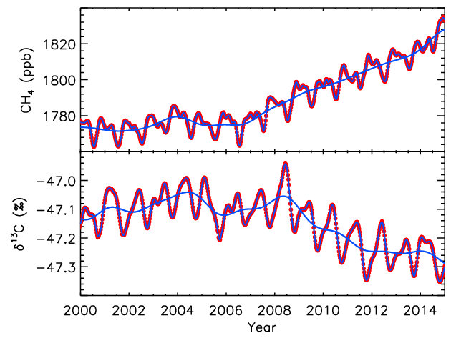
Globally averaged CH₄ and δ¹³C(CH₄)
Sylvia Michel, INSTAAR

Slide 17
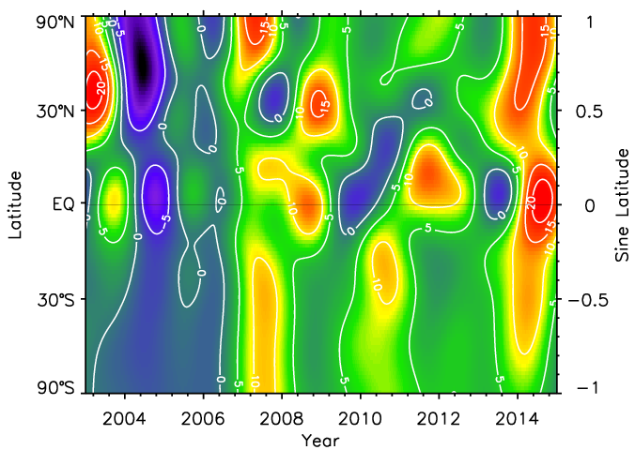

Slide 18
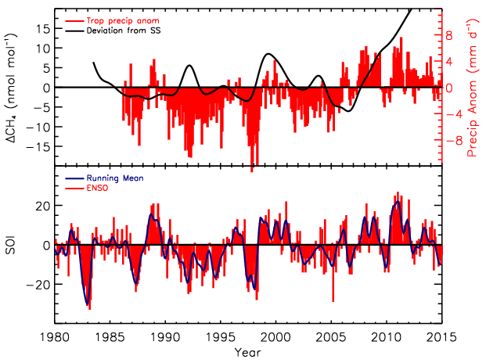
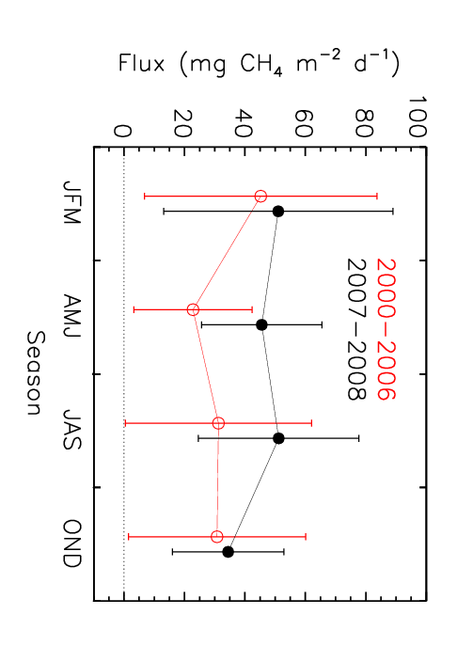
Precipitation anomalies in tropical wetlands. (Source: GPCP)
SOI: Australian BoM
Increased Amazon CH₄ fluxes in wet years.
Consistent with decrease in δ¹³C of CH₄

Slide 19
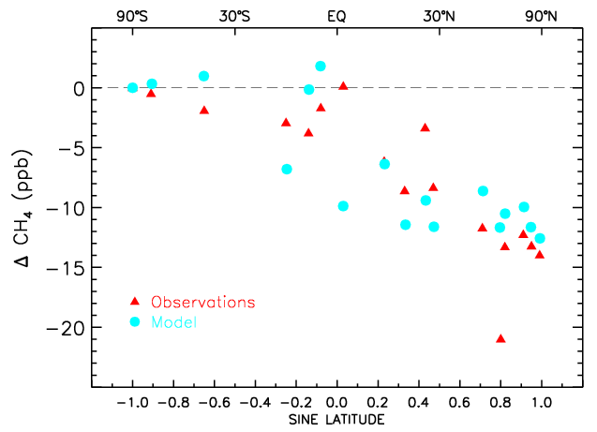
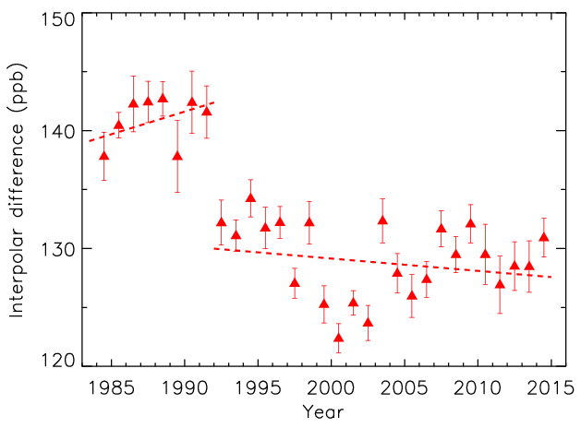
Late-1990s - mid-1980s
No measureable change in Arctic CH₄ emissions.
Dlugokencky, E. J., et al.,Geophys. Res. Lett., 30(19), 1992, doi:10.1029/
2003GL018126, 2003.
Interpolar difference (53-90°)

Slide 20
Summary and Conclusions
No trend in global emissions: 1984-2006
Emissions from some sectors changing
Changes in WL emissions may have masked increased anthropogenic emissions
Much to learn from IAV
Increased GR and emissions since 2007
Changes in tropical precipitation (ENSO)
δ¹³C (CH₄) indicates microbial source
2014: CH₄ GR surged (~12 ppb)
Globally warm, Amazon wet, but reasons unclear

Slide 21
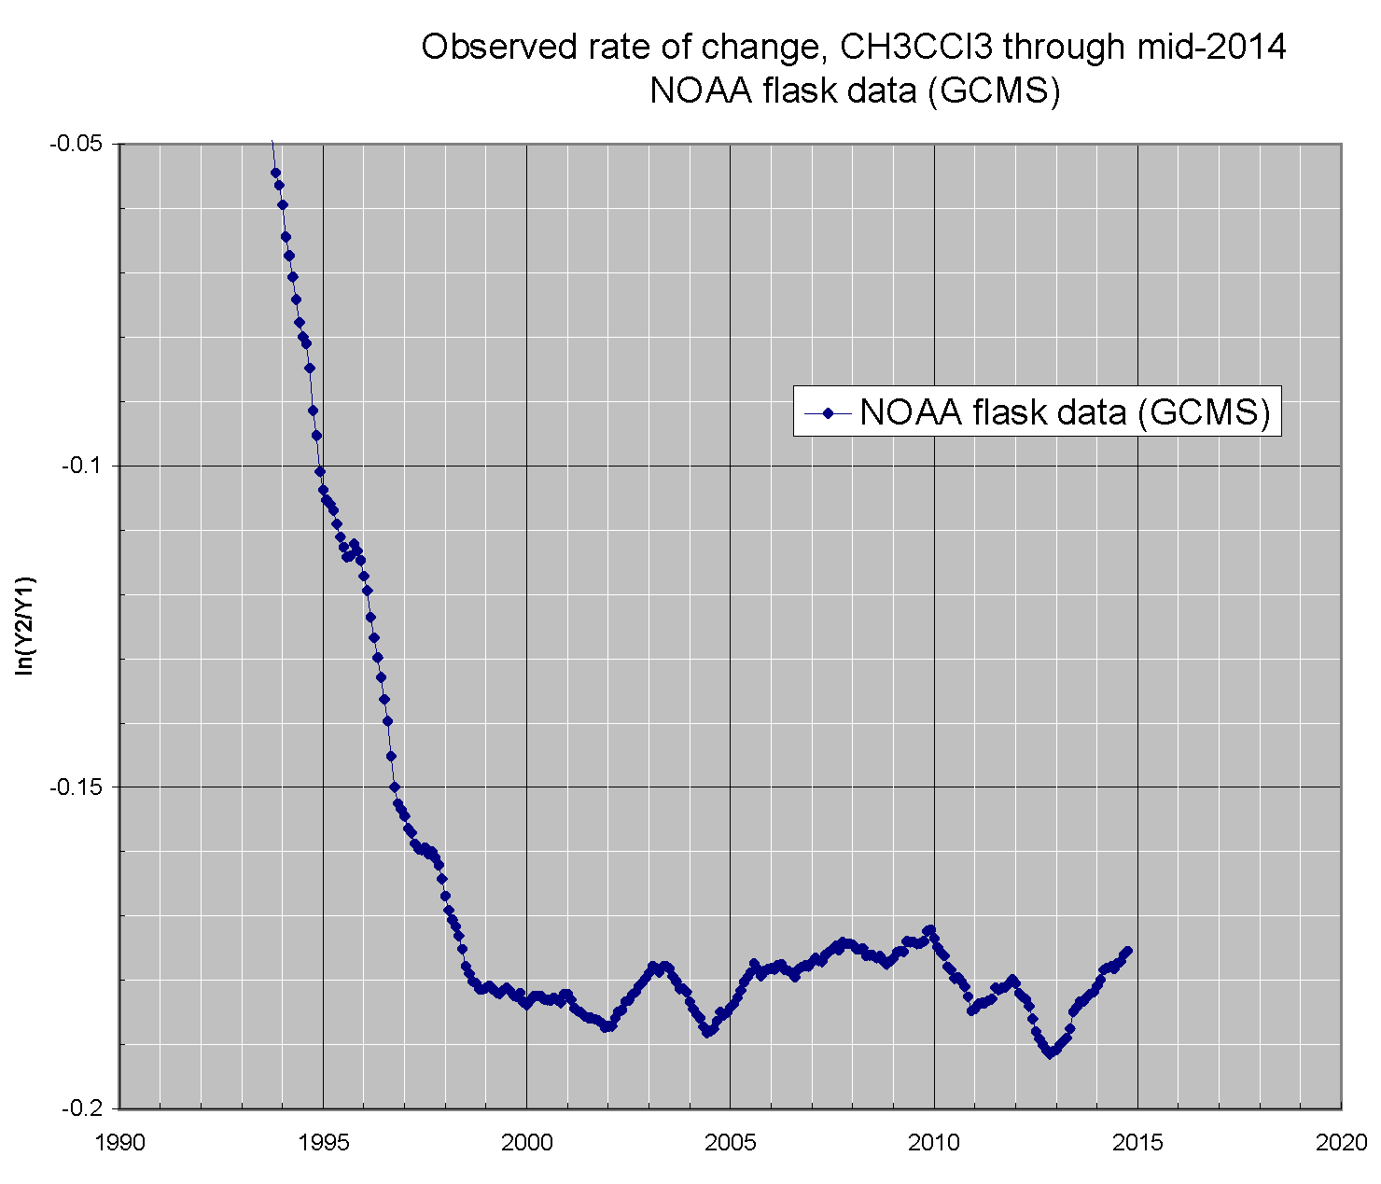

Slide 22
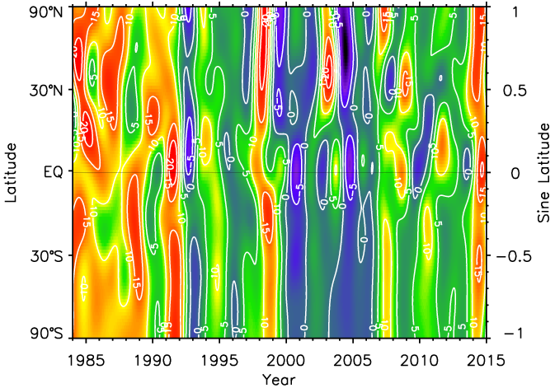

Slide 23
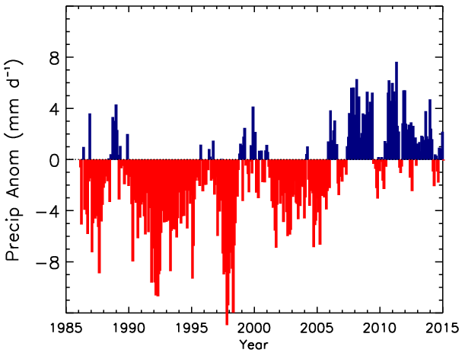
Base: 1961-1990

Slide 24
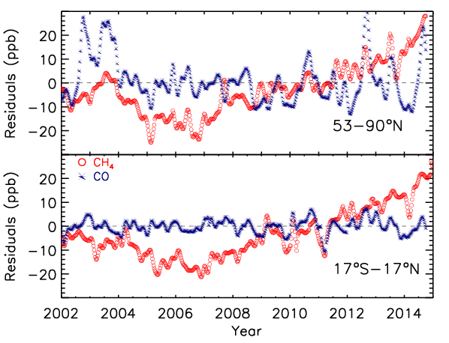

Slide 25
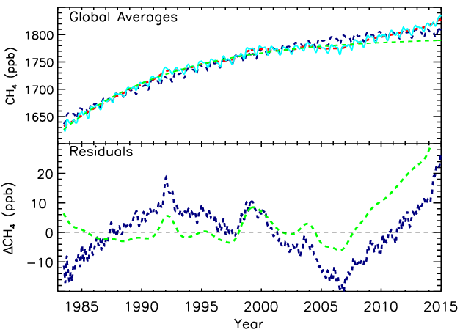

Slide 26
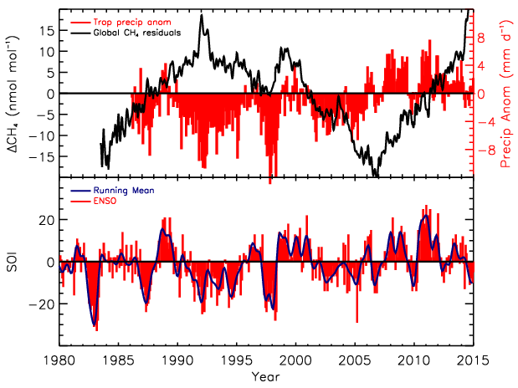

Slide 27
Possible changes to CH₄ emissions
Rice: changing water management ↓
FF sector: decreased venting and flaring ↓
Emissions mitigation: M2M ↓
FF emissions: hydraulic fracturing ↑
Arctic permafrost and hydrates ↑

Slide 28
Global CH₄ Budget by Source
Source | Bousquet (Tg/yr) | IPCC Range (Tg/yr)
Anthropogenic
Energy | 110±13 | 74-106
Enteric fermentation | 90±14 | 76-92
Rice agriculture | 31±5 | 31-112
Biomass burning | 50±8 | 14-88
Waste | 55±11 | 35-69
Natural
Wetlands | 147±15 | 100-231
Termites | 23±4 | 20-29
Oceans | 19±6 | 4-15
Total | 525±8 | 503-610
Sinks | Bousquet (Tg/yr) | IPCC (Tg/yr)
Troposphere | 448±1 | 428-511
Stratosphere | 37±1 | 30-45
Soil | 21±3 | 26-34
Total | 506 | 492-581
Bousquet et al., 2006, Nature, 443, 439-443, doi:10.1038/nature05132.

