Slide 1
NOAA ESRL GMD Carbon Cycle GHG Measurement Program
Ed Dlugokencky

Slide 2
Projects
Tall towers - N American focus
Aircraft Vertical Profiles - N American focus
Observatory - Global background focus
Cooperative global air sampling network
Constrain large scale GHG budgets
Weekly discrete air samples
Analyzed in Boulder
CO₂ (+iso), CH₄ (+iso), N₂O, SF₆, CO, H₂
Suite of ODSs (PFPs (i.e., tower and VP) only)
Suite of NMHC (CU INSTAAR)

Slide 3
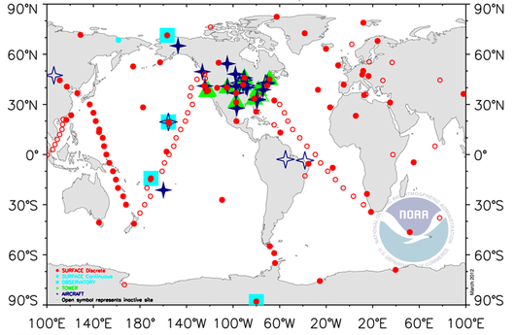

Slide 4
Analytical
Species | Current Χ | Technique | Repeatability
CO₂ | 400 ppm | NDIR | 0.03 ppm
CH₄ | 1900 ppb | GC/FID | 1.0 ppb
N₂O, SF₆ | 328 ppb 8.8 ppt | GC/ECD | 0.3 ppb, 0.03 ppt
CO | 100 ppb | VUV-RF | 0.7 ppb
H₂ | 500 ppb | GC/PD-HeID | 0.3 ppb
*δ¹³CO₂ | -8.5‰ | IRMS | 0.01‰
*δ¹³CH₄ | -47.2‰ | GC/IRMS | 0.04‰
Quantity: “amount of substance ratio”
Unit: dry-air mole fraction
*University of Colorado, INSTAAR; isotope ratios in “per mille”

Slide 5
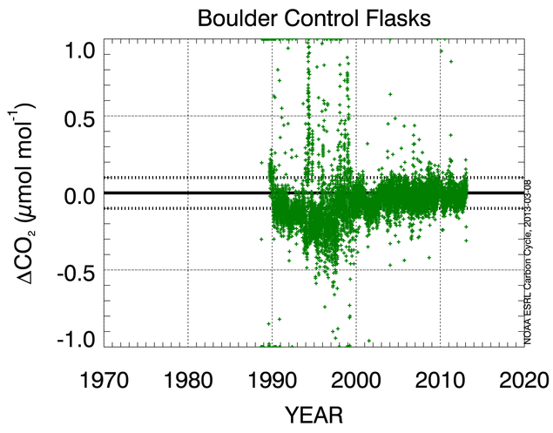
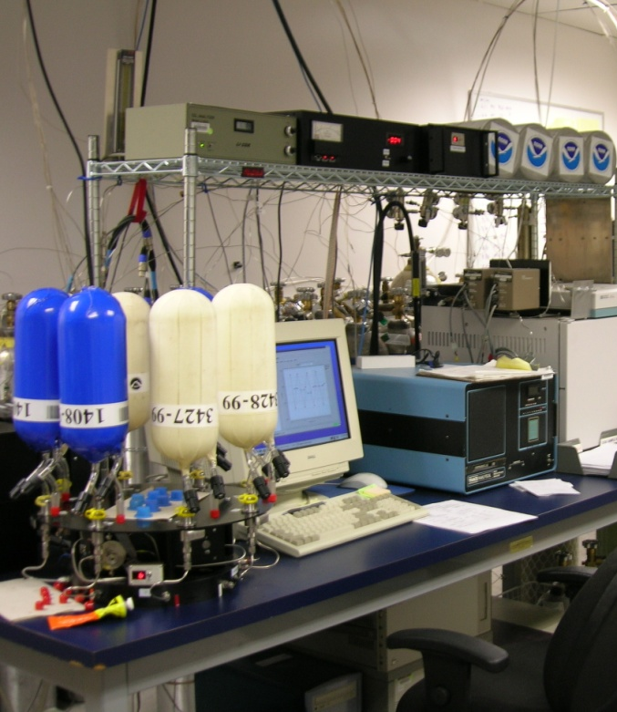
Quality Control
Analysis of flask-air filled from a calibrated cylinder
±0.1 ppm
-0.06 ± 0.12 ppm (entire record)
-0.03 ± 0.06 ppm (since 2000)

Slide 6
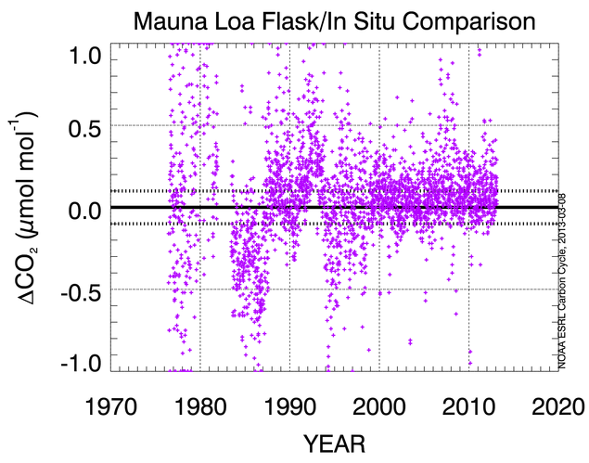
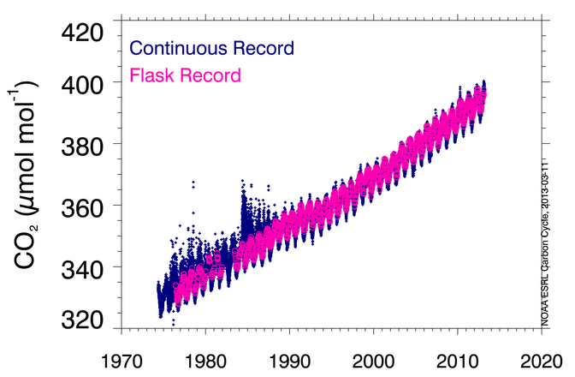
Co-located comparison at Mauna Loa
How well do we propagate our standard scale?
Flask minus Continuous
0.04 ± 0.27 ppm (entire record)
0.07 ± 0.13 ppm (since 2000)

Slide 7
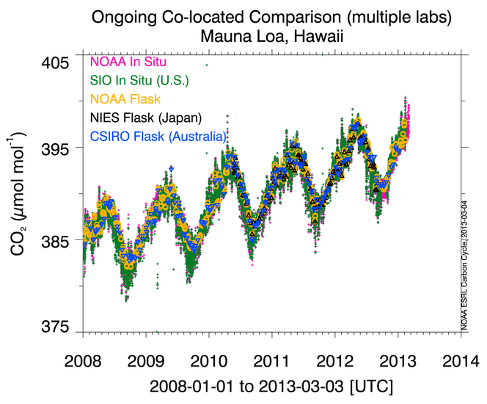
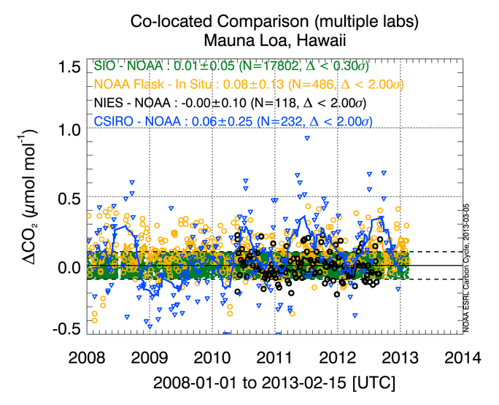
Comparison with other labs at NOAA site: Mauna Loa

Slide 8
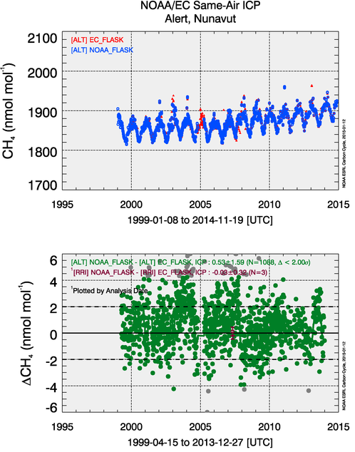
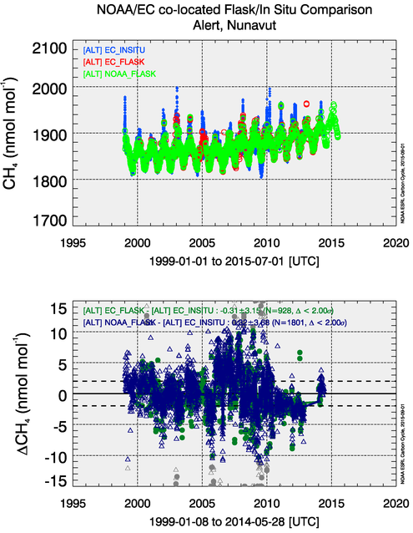
Quality Control
Comparison of NOAA and EC data at ALT

Slide 9
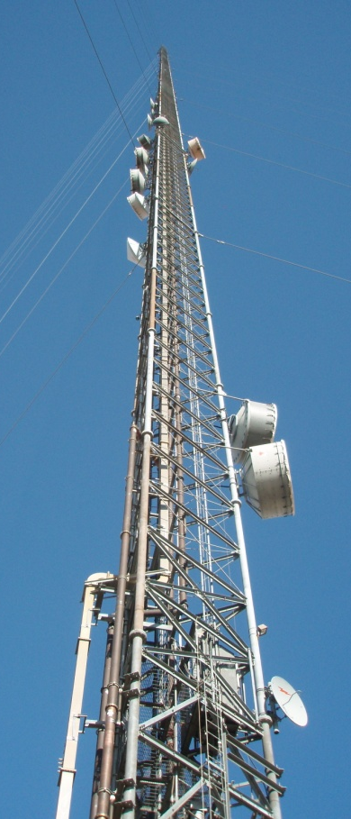
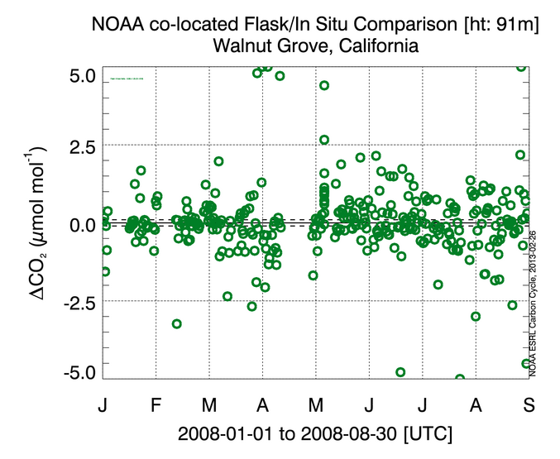
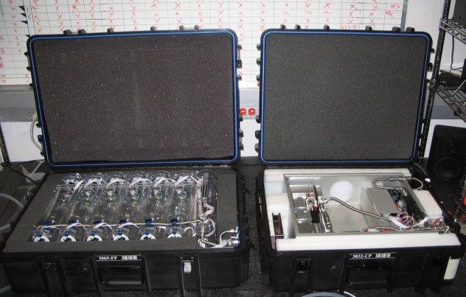
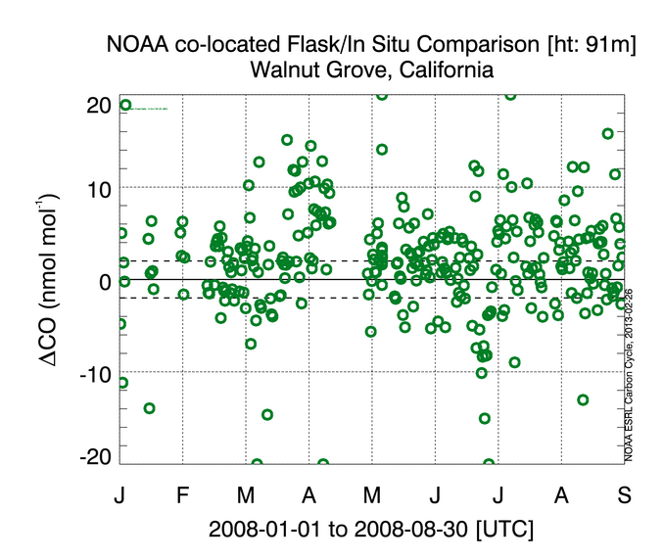
Complementary comparisons
Detecting problems using other species
Flask minus Continuous
H-1211
HFC-134a
Data courtesy of
A. Andrews (NOAA)
Courtesy: Steve Montzka

Slide 10
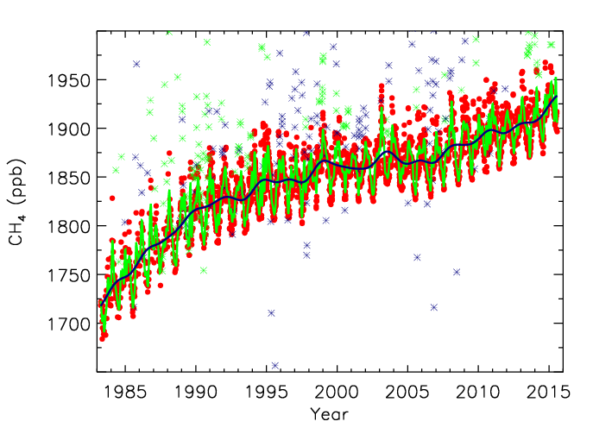
Barrow, Alaska

Slide 11
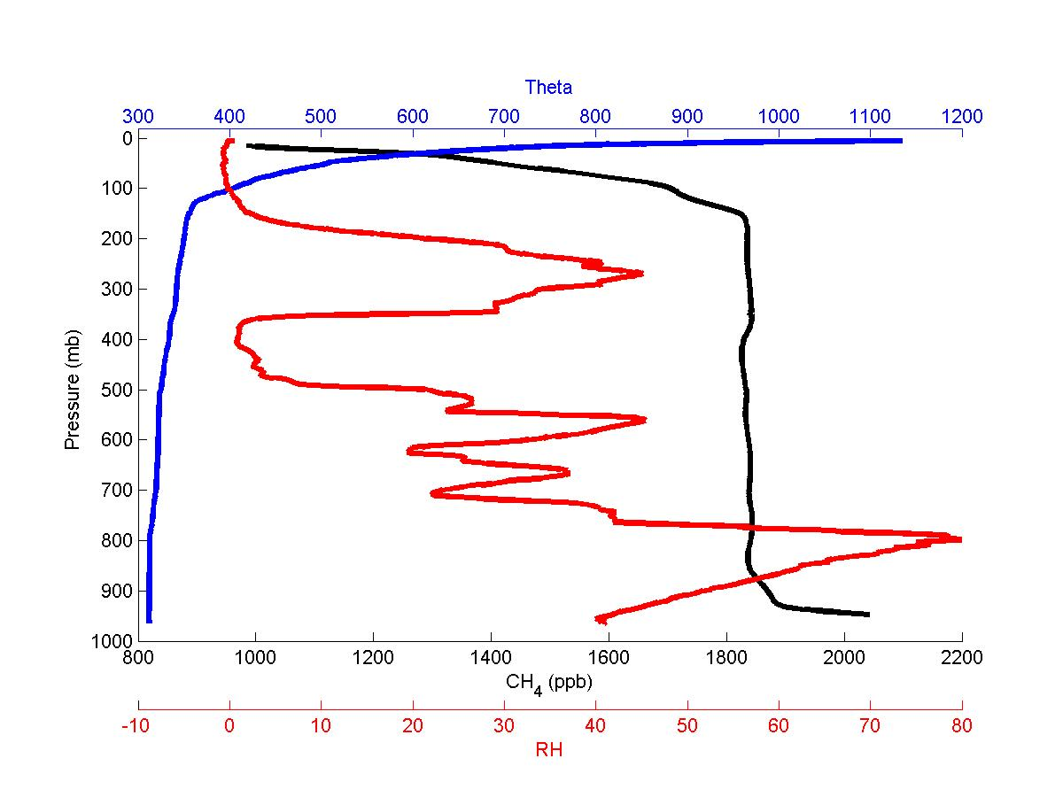

Slide 12
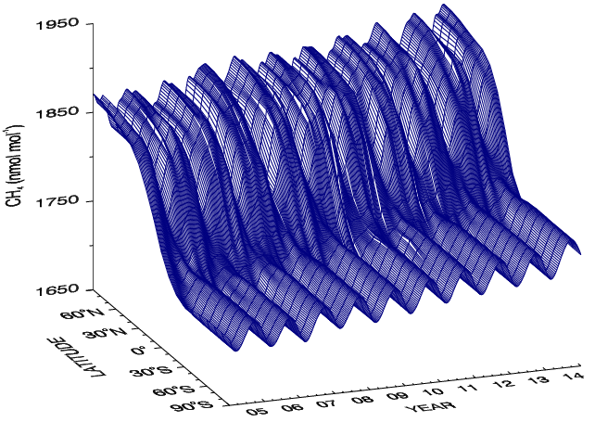

Slide 13
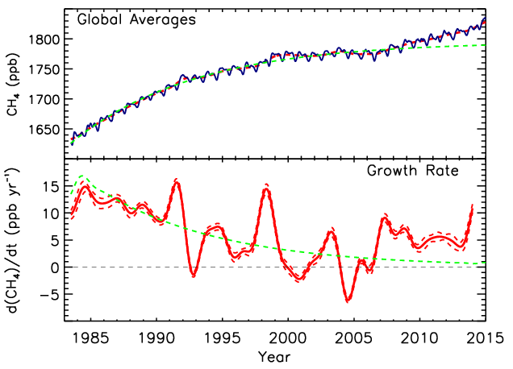
Lifetime ≈ 9.4 yr
[CH₄](t) = [CH₄]_{ss}-([CH₄]_{ss}-[CH₄]₀)e^{-t/τ}

Slide 14
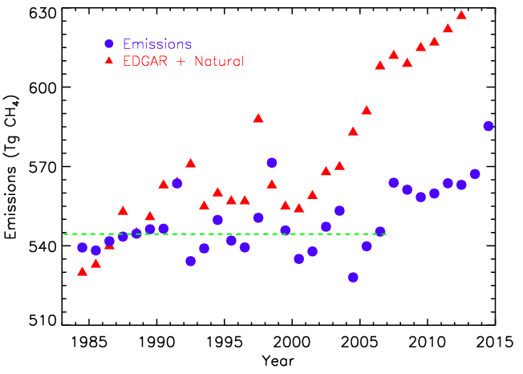
Emissions = d[CH₄]/dt + [CH₄]/τ
Lifetime (τ) = 9.1 yr
Average Emissions = 550 ± 13 Tg CH₄
Trend = 0 ± 0.6 Tg CH₄ yr⁻¹

Slide 15
Pinatubo and Chemistry (Largest term in CH₄ budget)
OH + CH₄ → CH₃ + H₂O
O₃ + hν (330 ≥ λ ≥ 290 nm) → O(¹D) + O₂
O(¹D) + H₂O → 2 OH
Rate of formation O(¹D) = j [O₃]
j = ∫F(λ) σ(λ) φ(λ) dλ
Also affected CO

Slide 16
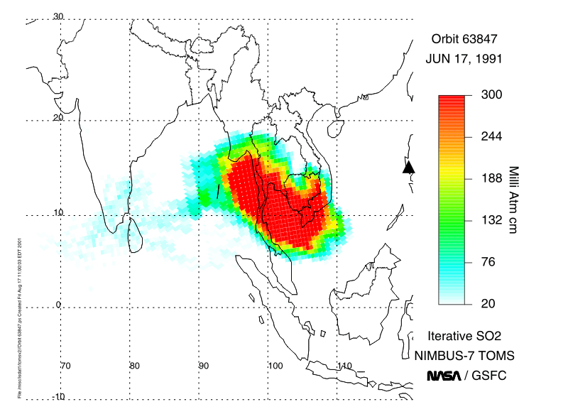
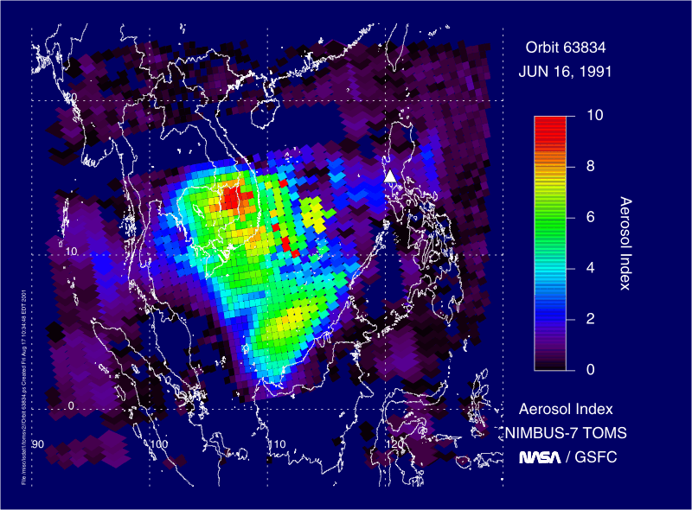
Eruption of Mt. Pinatubo: 15 June, 1991
AI < 0.1 means clear sky; AI > 4 obscures mid-day sun

Slide 17
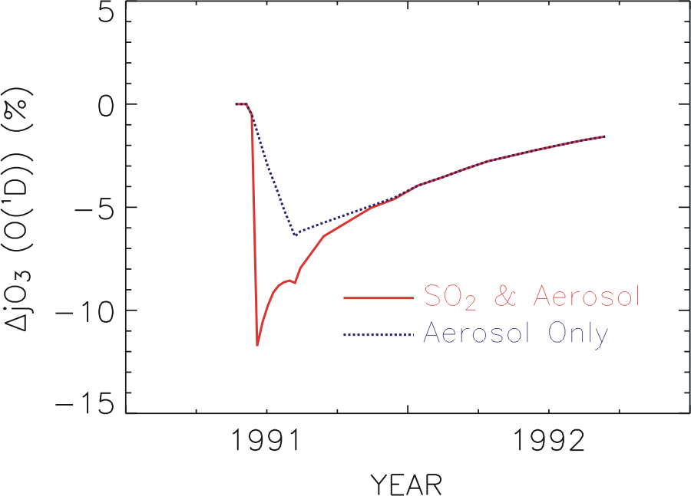
O₃ + hν (330 ≥ λ ≥ 290 nm) → O(¹D) + O₂
O(¹D) + H₂O → 2 OH
Rate of formation O(¹D) = j [O₃]

Slide 18
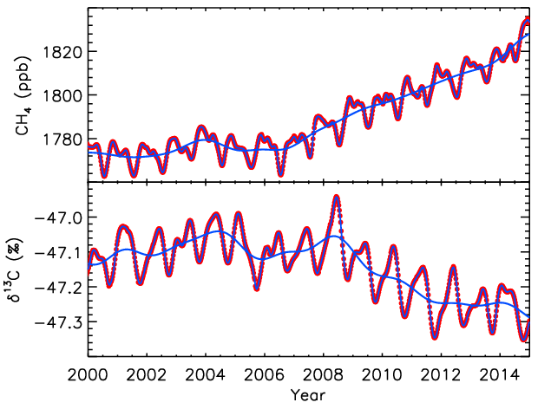
Globally averaged CH₄ and δ¹³C(CH₄)
Sylvia Michel, INSTAAR

Slide 19
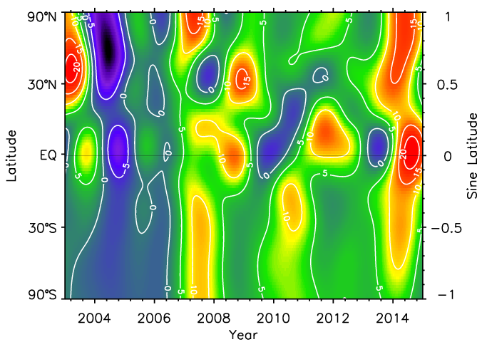

Slide 20
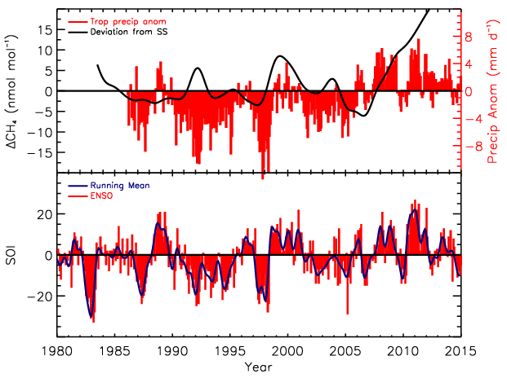
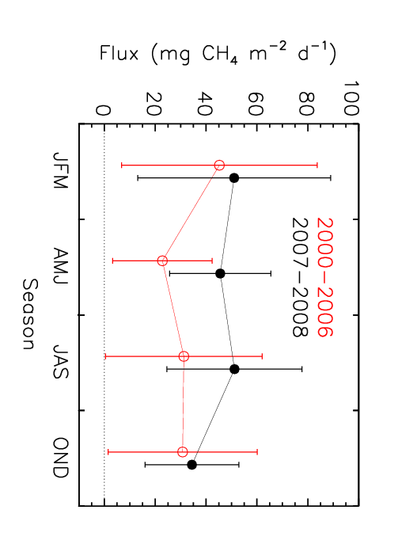
Precipitation anomalies in tropical wetlands. (Source: GPCP)
SOI: Australian BoM
Increased Amazon CH₄ fluxes in wet years.
Consistent with decrease in δ¹³C of CH₄

Slide 21
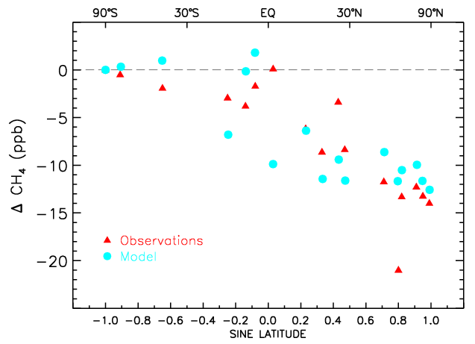
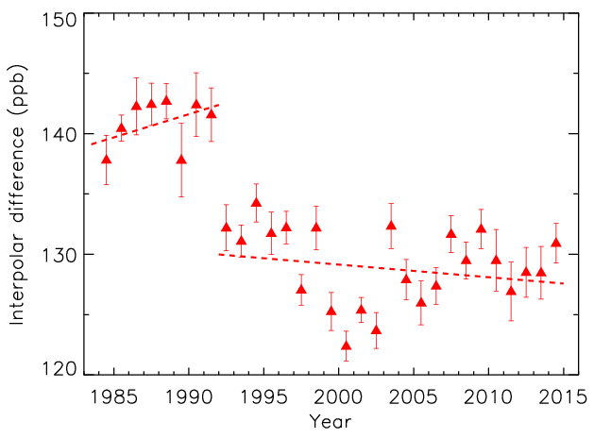
Late-1990s - mid-1980s
No measureable change in Arctic CH₄ emissions.
Interpolar difference (53-90°)

Slide 22
Summary
NOAA’s Global Cooperative Air Sampling Network is invaluable for understanding large scale features of global budgets of LLGHGs
No trend in total global emissions 1984-2006
Change in budget since 2007
Much to learn studying IAV

Slide 23
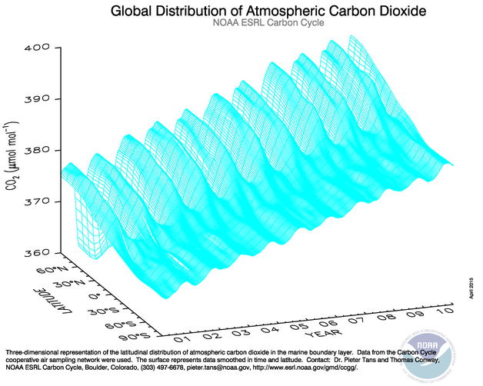

Slide 24
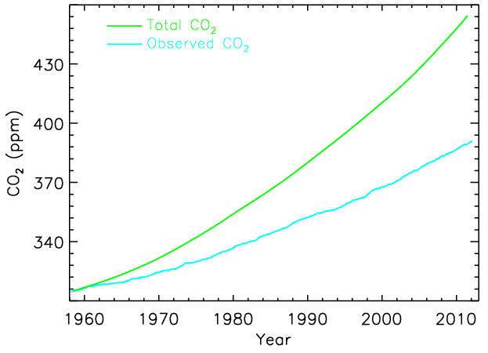
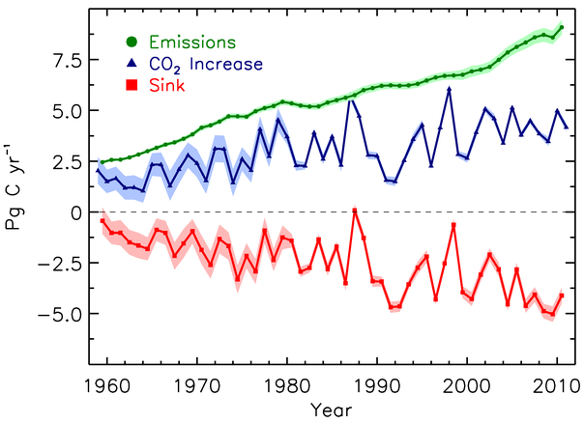
CO₂ - Constraining its budget
AF ~ 45% (trend ≡ -0.16)
Suggests increasing sink

Slide 25
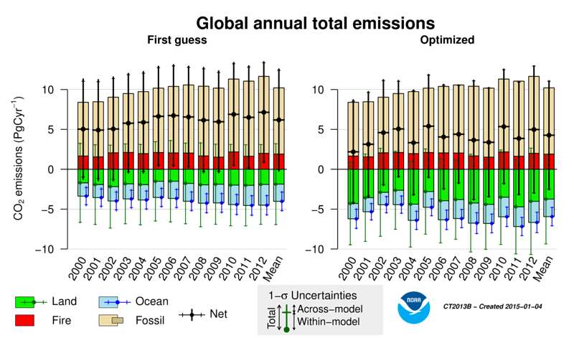

Slide 26
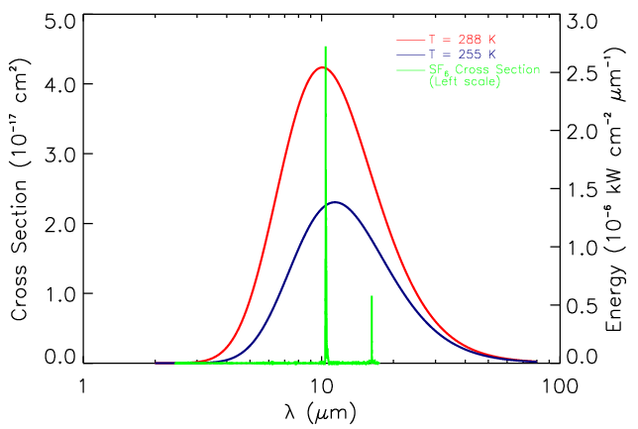

Slide 27
