Slide 1
SAG role in improving usefulness of GHG data at WDCGG
Is there a role for the GHG SAG? If so:
Are metadata reasonable?
Is there a clear path to a known standard scale?
Conversion factor, w/ uncertainty, if not WMO scale?
Unit of measurement? Dry air?
Encourage submission of uncertainties; if not, are metadata sufficient to estimate them?
Are flags and flagging scheme well-documented?
Are data are at scientifically useful frequency?
Are data reasonable?
Decreasing CH₄ trend since 2008? Not reasonable.
Should sites/programs/data-sets be graded?
How do we approach representativeness (site met., TOD of sampling, etc.)?
Are SAG and WMO GAW receptive to Global GHG Reference Network?

Slide 2
SAG role in improving data & metadata at WDCGG?
Role of SAG vs role of QA/SAC or “infrastructure groups”?
Science and observations are intimately linked - WMO need to recognize that!
Committee to review data: include SAG members + community
Notify data providers?
Data tiers? If so, based on what criteria?
More difficult issue: Assess representativeness of the site/data?
Comparisons with model output?
Help WDC choose subset of sites for global/zonal averages

Slide 3
Quality Assurance Science Activity Centres (QA/SACs)
QA/SACs are responsible for the development and implementation of the quality assurance (QA) system in the GAW programme for specific atmospheric parameters.
Terms of Reference for GAW Quality Assurance/Science Activity Centres (QA/SACs):
* Provide an operating framework for GAW quality assurance activities and calibration
facilities for a specific variable and geographical area of responsibility (world, regional, national).
* Coordinate the activities of WCCs and RCCs.
* Provide advice and support for the local QA system at individual GAW sites.
* Co-ordinate instrument calibrations and inter-comparisons and other measurement activities.
* Perform or oversee regular system audits at GAW sites.
* Provide training, long-term technical help, and workshops for station scientists and technicians.
* Promote the scientific use of GAW data, and encourage and participate in scientific collaboration.

Slide 4
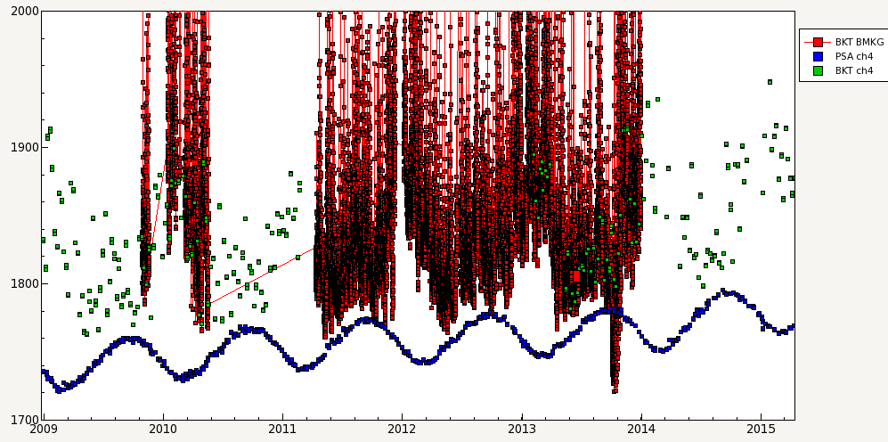
Misassigned standard value
CH₄ (ppb)
Year

Slide 5
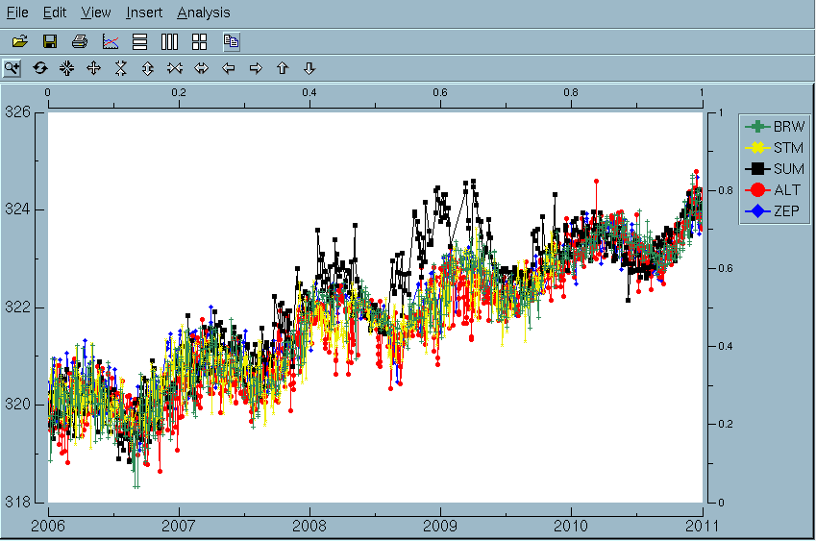
N₂O contamination at SUM
Prepared with dv

Slide 6
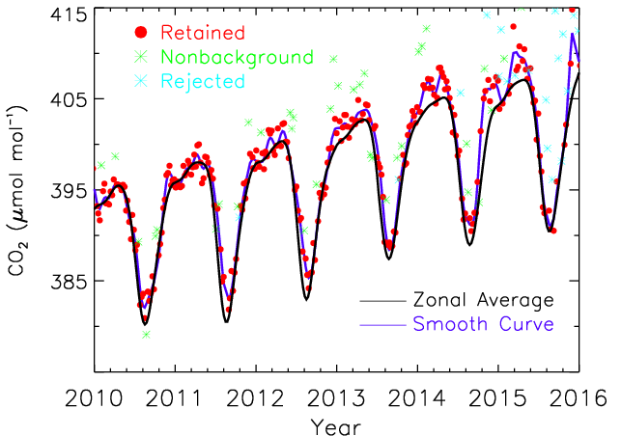
CO₂ contamination at ICE: Leak in inlet line

