Slide 1
Practical Examples of QA/QC of NOAA GHG Observations
Ed Dlugokencky
NOAA ESRL GMD

Slide 2
Rough Outline
Definitions and introduction
Importance of Data Management System
Quality Assurance
Quality Control
Selection for background
Measurement uncertainty estimates

Slide 3
Practical Definitions
Quality Assurance: procedures used to assure quality of measurements
  Analytical methods that are inherently precise
  Standards (a common SI-traceable scale)
  Target cylinders (assess quality over weeks to years)
  Comparisons (ensure compatibility with other GAW partners)
Quality Control: scrutinizing products (measurements and raw data) to ensure they meet expectations
  Plotting data (do data make sense?)
  Checking raw data (are there anomalies in measurement process?)

Slide 4
Why the Need for QA/QC?
GAW is a science-driven community
  need meaningful trends, spatial patterns, and t-derivatives
Spatial coverage is important, particularly in tropics
  need to merge data from different laboratories

Slide 5
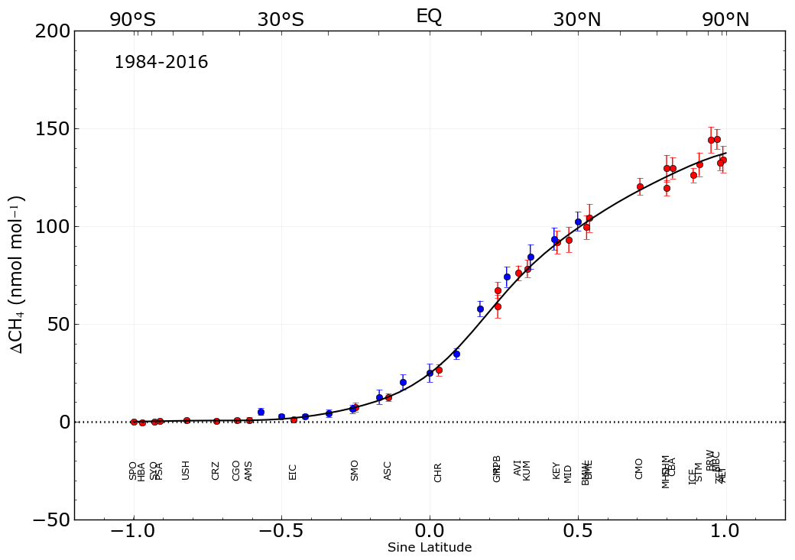
Notes:
Differences in annual means between each site and South Pole (with SD). Green ovals show sites at comparable latitude, but different longitude (Pacific vs Atlantic Oceans). In N Pacific, western sites near Alaska are ~10 ppb greater than Atlantic site near west coast of Ireland. In northern tropics, the Pacific site (Guam) is about 10 ppb lower than the Atlantic site at Barbados.

Slide 6
Compatibility Defined:
The scientifically-determined maximum bias among monitoring programs that can be included without significantly influencing fluxes inferred from observations with model
  Compatibility is assessed by comparing measurements of ambient air at a common site (examples to follow)
  Compatibility is not met based solely on manufacturers’ specifications, uncertainties of standards, agreement with CCL in RRs, nor DQOs

Slide 7
GAW Compatibility Targets
(GAW Report No. 229; 2015 GGMT)

Slide 8
Data Management
High quality measurements require acquisition and storage of numerous data (e.g. voltages, time, standard gases, wind speed and direction, flow rates, temperatures, pressures….)
The measurement process must be transparent and credible
Measurements must be accessible to users
Standard gases drift, so corrections will be applied to the data (raw data must be stored)
For a long term monitoring program the amount of data is open ended (a strategy that works for one year might not work for 10 or 20 years)

Slide 9

Data Flow
Analyzers
Operating Mode
Flask-air
Semi-continuous
Calibration
System
Control
Sample
Data
Data
Acquisition
Engineering
Data
Hardware
Raw Data
Software
Data
Standard Gas
Lookup
Data
Processing
Data
Editing
Internal Scale
Linked to Absolute Scale
Compatibility (RR, ICP)
Reprocess
Processed
Data
Data
Selection
Averaged
Data
Notes:
Specific to NOAA program’s needs.

Slide 10
DAQAS
Data Acquisition and Quality Assurance System
Technically-sophisticated, customizable RDBMS
  Developed with funding from UBA
  Recently updated by DBMS professionals
Available to all WMO GAW participants
Technical assistance available
  Dr. Ludwig Ries (ludwig.ries@uba.de)
  Commercial DB developers in Germany (with cost)
Spreadsheets are not the answer
Notes:
This is a great option. Within BMKG, you likely have sufficient DB expertise to implement such a scheme with no costs outside your own IT professionals.

Slide 11
Practical Quality Assurance
Short link to SI-traceable standards maintained by CCL
  GAW Round Robin comparisons of standards hosted by CCL
Test flasks (one pair analyzed every analysis day)
Target cylinders (flask-air and in situ systems)
  Short-term (near ambient and measured frequently)
  Long-term (wide range of X and measured 3x/year)
Comparisons with other GAW labs
  Same air (flask-air sample shared by two labs)
  Co-located (flask-air and in situ measurement at site)

Slide 12
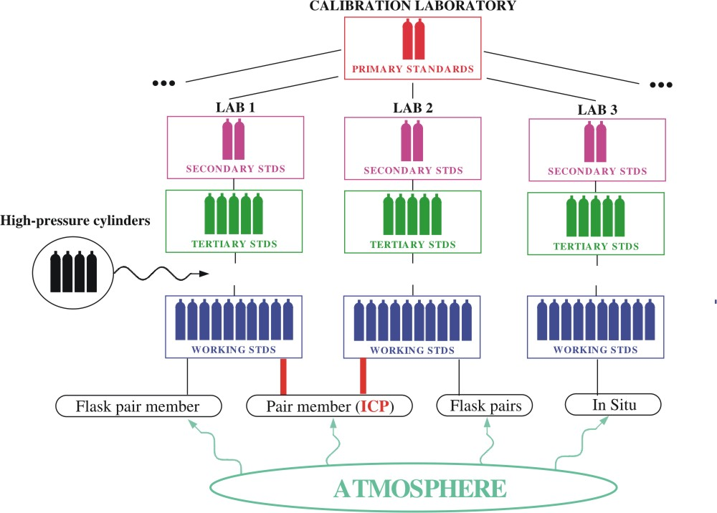
Maintaining Standard Scales
Notes:
Roughly shows standards hierarchy from CCL to each lab. Not quite right in its details, but shows the general scheme used in GAW. All standards trace back to a common scale. Each GAW laboratory should maintain a its own high level standards purchased from the CCL, then propagate them to working level standards for their measurement labs.

Slide 13
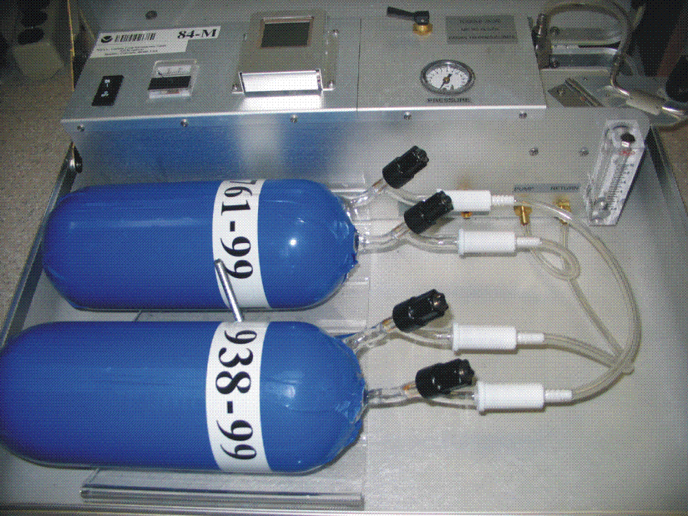
Flask-air sampling
Notes:
Since will discuss QA/QC of flask-air sampling, example of NOAA’s portable sampler. Two flasks flushed in series with a battery powered pump until volumes replaced about 10 times, then pressurized to small over-pressure, ~4 psia.

Slide 14
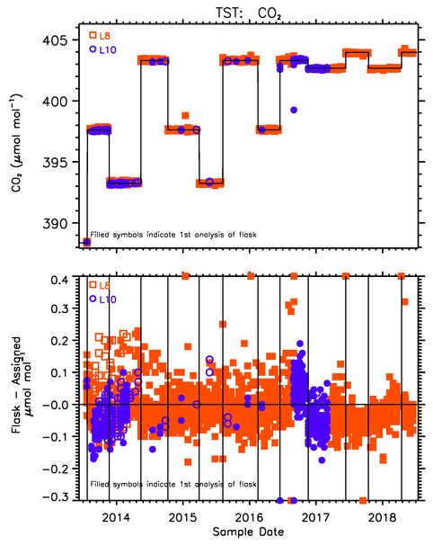
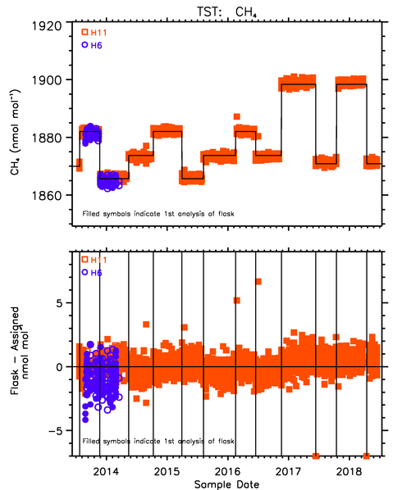
Test Flasks
Avg = -0.43 ± 3.75 ppb n=2148
Avg = 0.01 ± 0.19 ppm n=2030
Notes:
Test flasks are QA method closest to actual air samples. Here for CO2 and CH4; average differences between measured and values assigned to the cylinder air used to fill the test flasks are small, but more variable than we’d hope for.

Slide 15
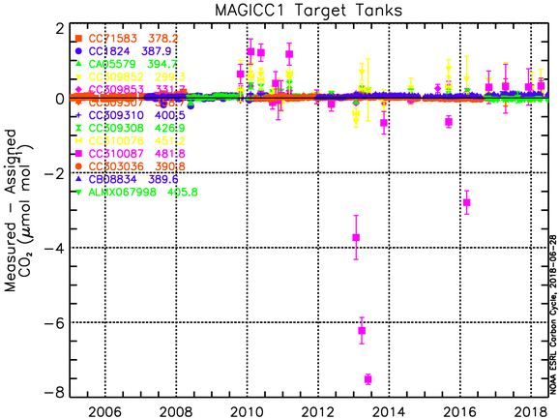
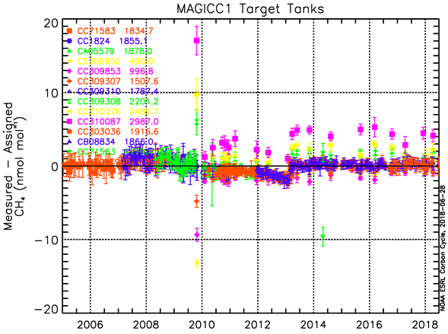
Measurements of target cylinders on flask-air analysis system
Short-term: are ~ambient values
Long-term CO₂: 299 – 482 ppm
Long-term CH₄: 496 – 2987 ppb
Ambient = -0.02 ± 0.02 ppm
Ambient = 0.14 ± 0.37 ppb
Notes:
We use various target cylinders, long- and short-term. Long-term cover a much wider range; we believe we will see analytical problems at the extremes of our measurement range before near ambient.

Slide 16
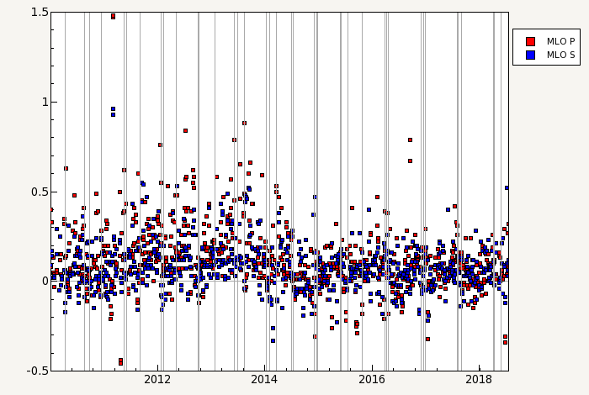
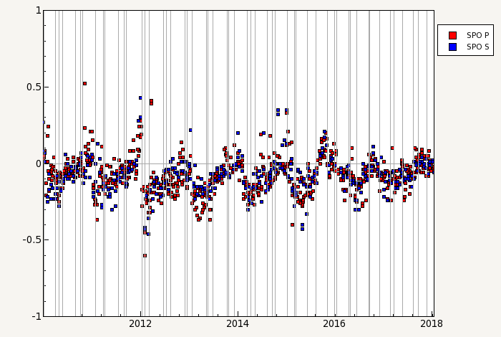
Internal comparison of CO₂ in flask-air and from in situ analyzer
Storage issue is clear at SPO
Mauna Loa
South Pole
ΔCO₂ (ppm)
ΔCO₂ (ppm)
Notes:
Alternatively, we can compare our flask-air samples with in situ measurements, in this case at Mauna Loa and South Pole. The saw-tooth pattern at SPO indicates a storage effect. Flasks with longer storage times see loss of CO2 through preferential diffusion (relative to N2 and O2) through the flask O-ring seal.

Slide 17
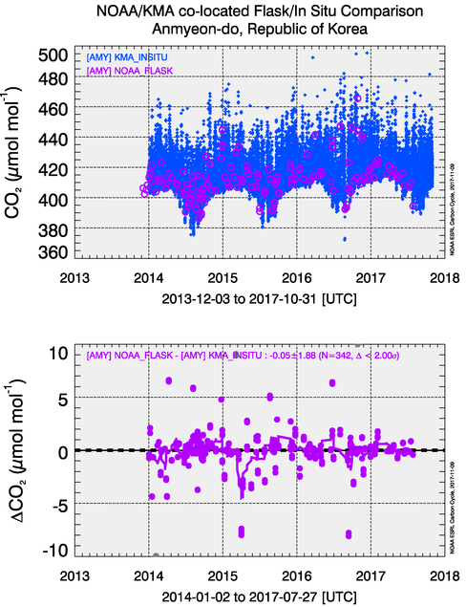
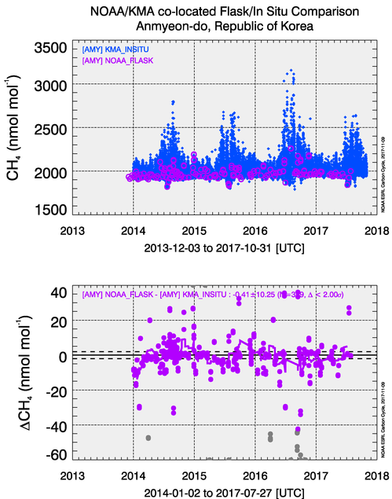
Co-located Comparison: Flask-air/in situ
Notes:
Examples of comparisons with out colleagues at KMA; CO2 and CH4 at AMY.

Slide 18
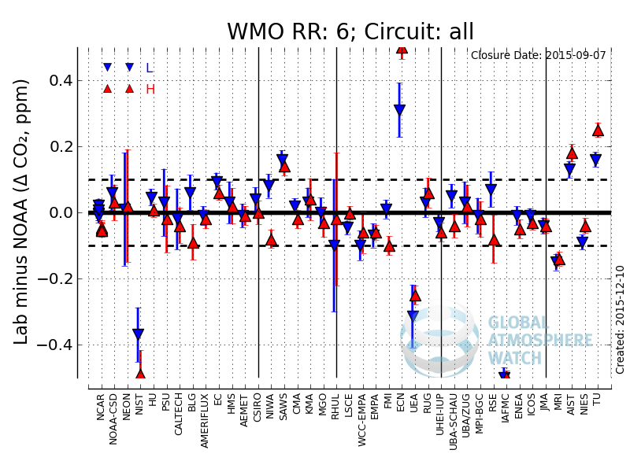
Notes:
Much less frequent comparisons of standards are still quite useful, but only to check scale, not atmospheric measurements.

Slide 19
Quality Control: In situ Measurements
Automated algorithms
  GC parameters: BL code, RT, A/H, Δresponse
  Continuous analyzer: analyzer T and P stab., inlet P
Visual inspection of data
  Are measured values reasonable?
  Are QA data as they should be (e.g., target tanks)?

Slide 20
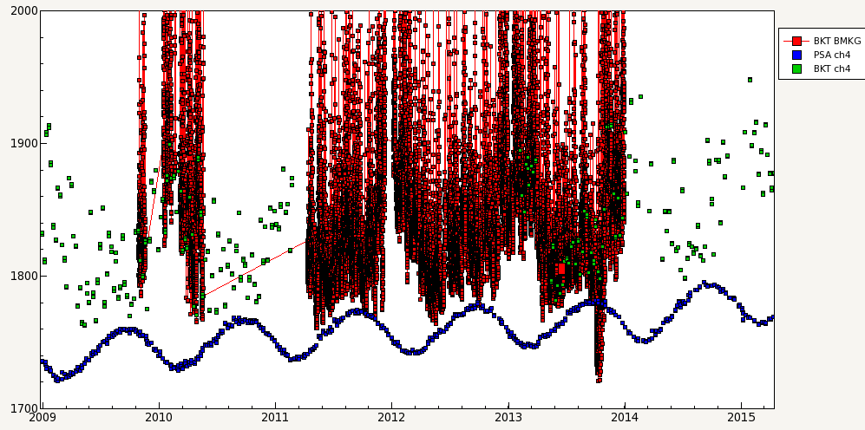
Notes:
Here, with CH4 from BKT, is an example of “are the data reasonable?” There is a period in autumn 2013 when they are significantly lower than flask-air samples from an Antarctic site (PSA) and clearly not reasonable.

Slide 21
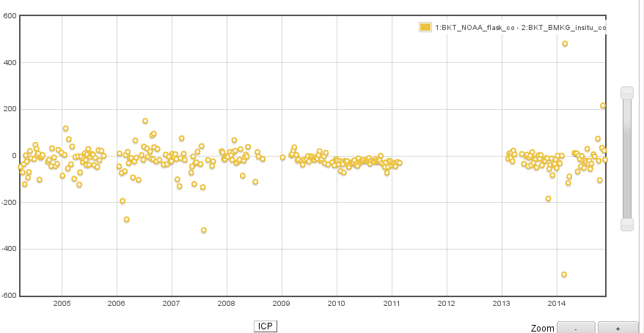
Avg. ΔCO = -18 ppb (-5 to -35 ppb); n=312
ΔCO NOAA-BMKG (ppb)
For CO₂ (-13 ppm; n=47) and CH₄ (-26 ppb; n=57), too few comparisons for meaningful average.
Notes:
Difference between in situ CO (BMKG) and flask-air samples (NOAA).

Slide 22
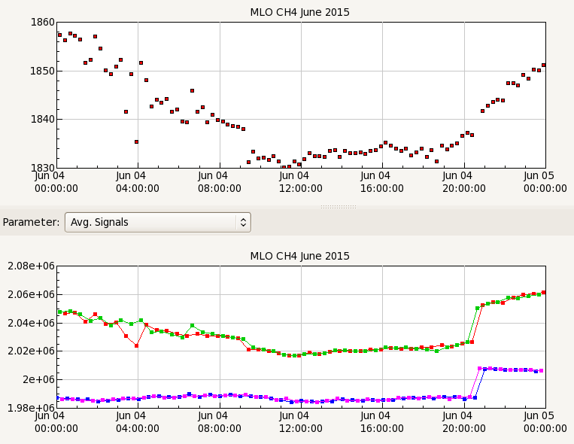
Samples
Standards
Notes:
In situ data: what do you look for? Bottom panel shows raw instrument response. Something is clearly wrong in circled region. Automated algorithm flagged these data.

Slide 23
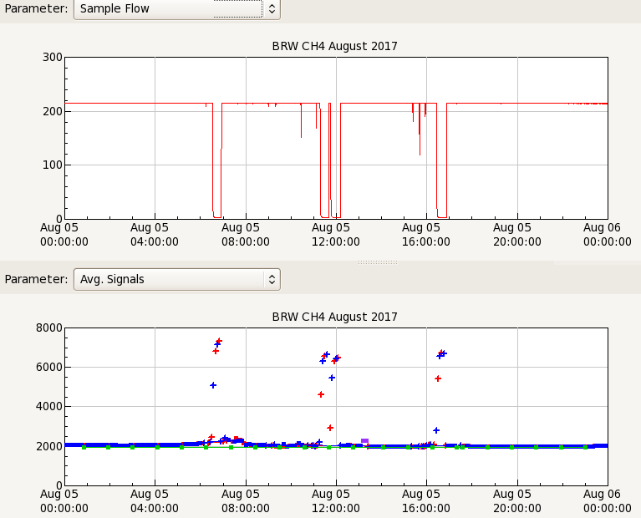
Sample flow rate to the analyzer.
Cryogenic drying trap likely froze.
Raw 30-s averages with flags (+).
Notes:
Various engineering data showed problems on Aug. 5, but it was clear that flow to analyzer was stopped or slowed at various times resulting in erroneous readings. Data were flagged by algorithm (+’s). Analyzer pressures and other parameters were also too low.

Slide 24
Quality Control: Flask-air Data
Identify and flag sampling issues, add flag:
  Pair agreement criteria (CO₂ flag: +.. and -..)
  Low flow rate (and P) during analysis
  Locally contaminated
Identify and flag analysis issues, add flag:
  Operator errors
  Delay in analysis of N₂O (special case)
  Noisy analyzer signal or other glitch

Slide 25
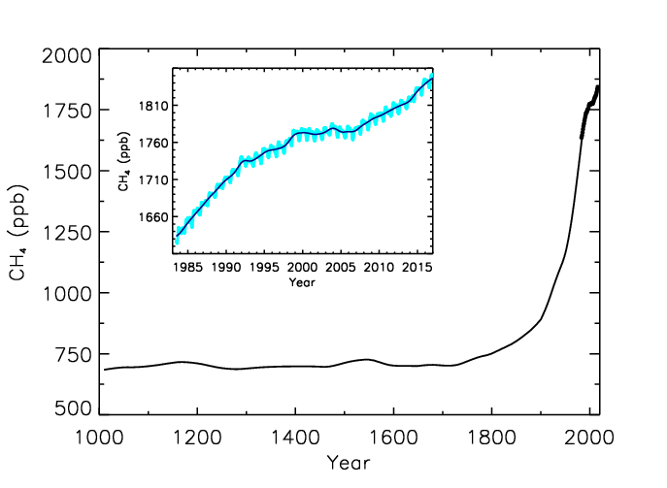
Step 1: Do the data make sense?
Results from study of oil and NG producing regions in Colorado
What’s wrong?
Units: “ppmv” inappropriate
Magnitude: Have not seen 1.1 ppm since 1940s
Clear measurement issues
Ice core record of CH₄
Notes:
A report by the state of Colorado used CH4 measurements by a commercial measurement lab. Bad idea! This lab measured values that had not been seen on Earth for decades, and the report erroneously reached incorrect conclusions about CH4 emissions from oil and gas exploitation.

Slide 26
Sampling Issues
Clues in metadata
  Sample pressures
  Wind direction and speed
Clues in data
  For flask-air samples, pair agreement
  Clear contamination in one or more species
  Are data consistent with site location (e.g., latitude)

Slide 27
Barriers to perfect sampling at NOAA
Lack of site visits
Insufficient training or disinterested observer
Site staff turn-over
Changes to sampling system: repositioning intake
Logistics issues (gaps in data)
Notes:
Perfect sampling: representative air sampling at required frequency.

Slide 28
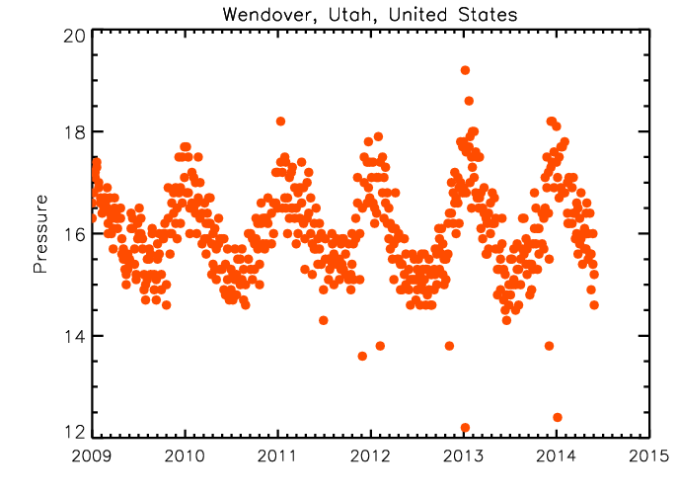
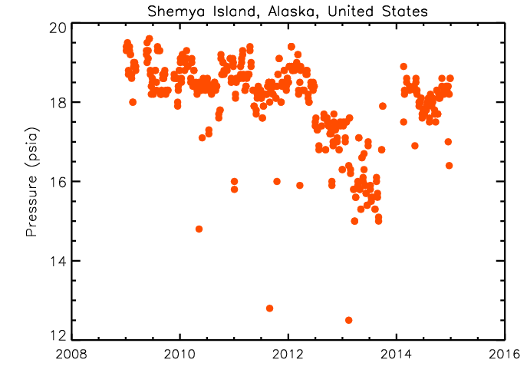
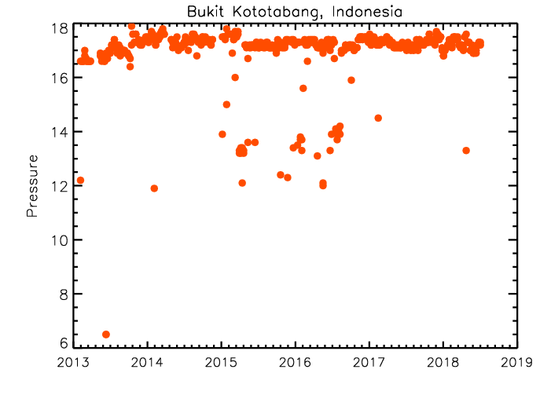
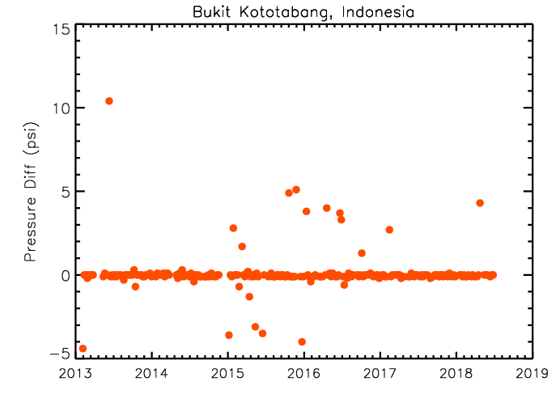
Sampling Issues: Flask Pressure (psia)
Notes:
Pressure in flasks during analysis (measured at room T) is a good diagnostic of sample quality. Variations in UL are from seasonal T fluctuations, with more air collected , so all is fine. UR: the pump in the sampler began failing and Ps decreased until sampler was replaced. LL: actual Ps in samples from BKT. Some are very low. LR: difference in Ps between samples collected in series. Should be the same, but not sure why they are not.

Slide 29
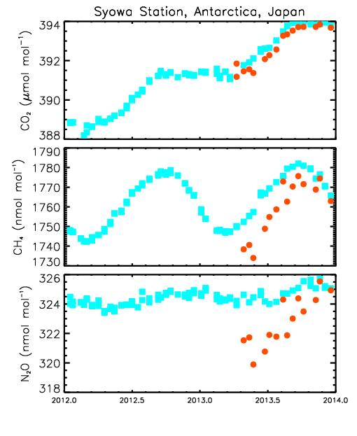
Sampling:
Failure of pump in PSU (SYO: Antarctica)
*Also incomplete flushing through operator error
Notes:
At SYO, pump began failing, flow rate was too low, and flasks were not flushed sufficiently. Result was large difference between members of flask pairs. (Note: “fill gas” very low in these gases when flasks are shipped to site, so incomplete flushing revealed as large dufference in measured values.)

Slide 30
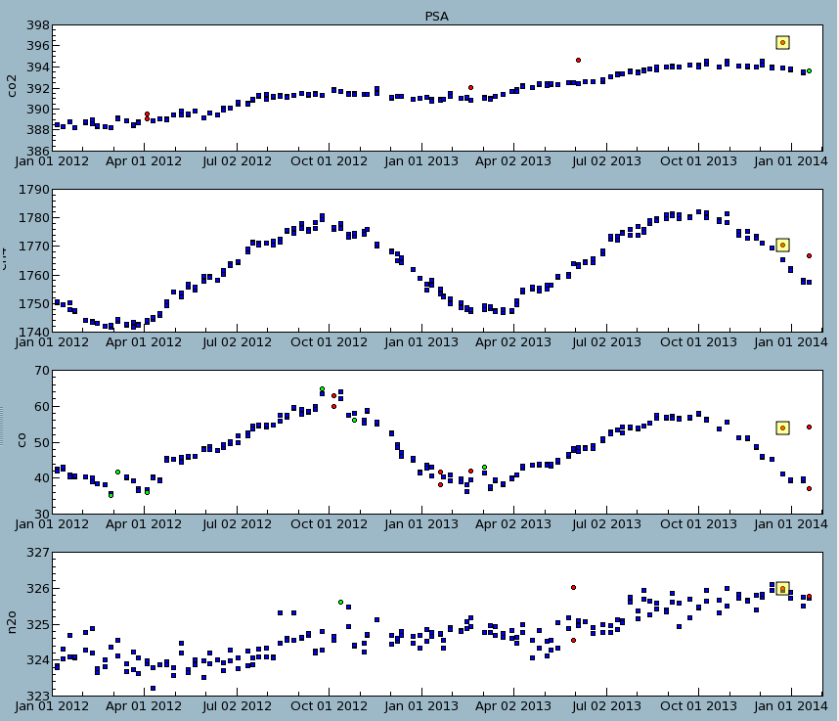
Sampling Issues:
One member contaminated (PSA: Antarctica)
CO₂ (ppm)
CH₄ (ppb)
CO (ppb)
N₂O (ppb)
Prepared with “flask flagging” in pydv

Slide 31
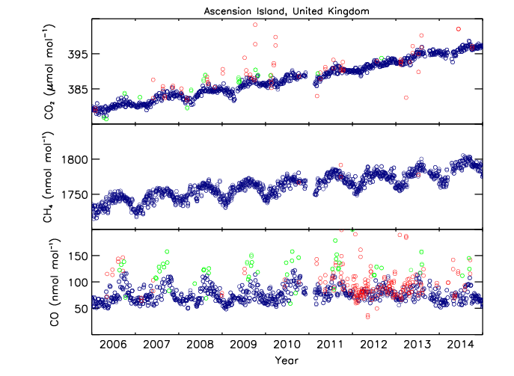
Sampling Issues (ASC):
Changed sampling location and operator
Notes:
When the sampling location and operator were changed at Ascension (arrow), we started seeing many more bad samples for CO, contaminated by engine exhaust.

Slide 32
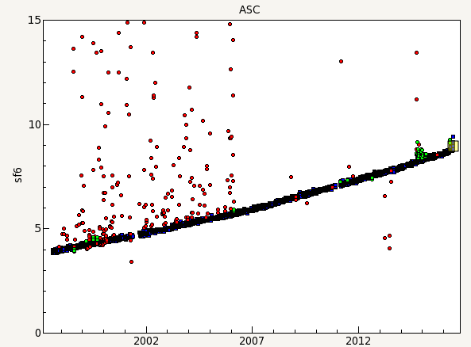
Sampling Issues (ASC):
Changed sampling location and operator
(ppt)
Notes:
Also at ASC; see on again/off again problems with SF6 contamination.

Slide 33
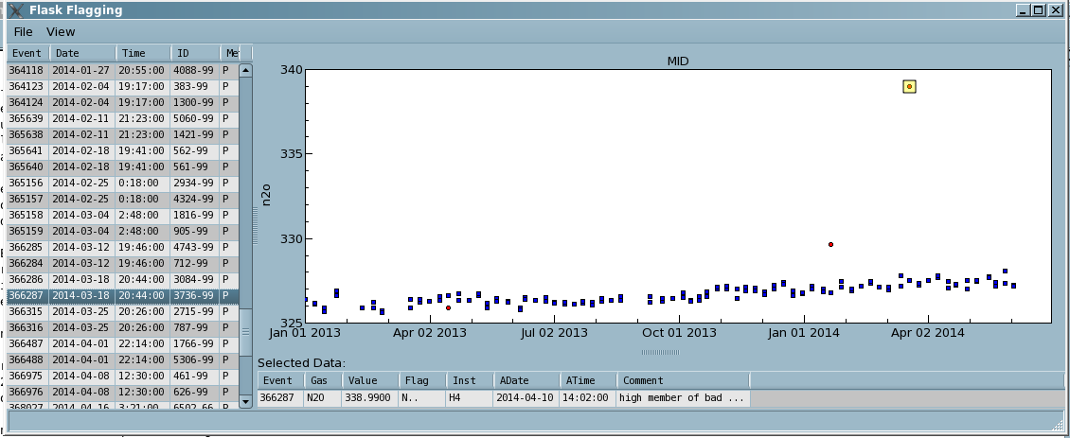
Sampling Issues:
Single N₂O outlier (Plotted w/ DB tool)
Prepared from pydv – “Flask Flagging”
Notes:
See gross outliers for N2O, usually in one flask of pair. We’ve determined it is something happening in the flask or during sampling (not analytical), but process unknown.

Slide 34
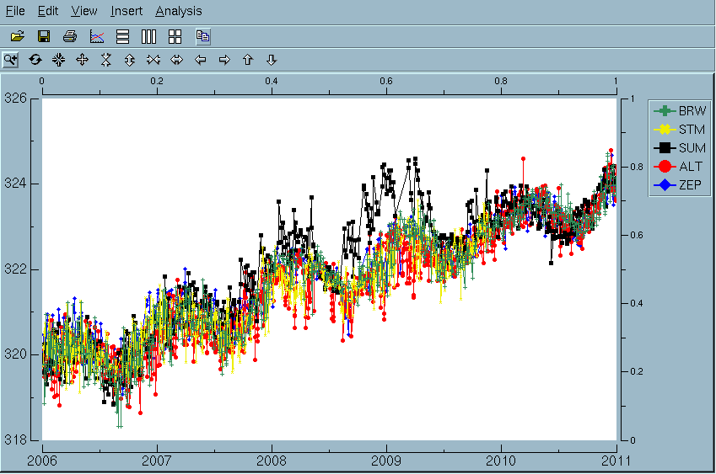
Sampling Issues:
N₂O contamination at SUM: Greenland
High northern latitude sites.
N₂O (ppb)
Prepared with dv
Notes:
N2O contamination from Greenland samples. Likely cause: recreational use of N2O!

Slide 35
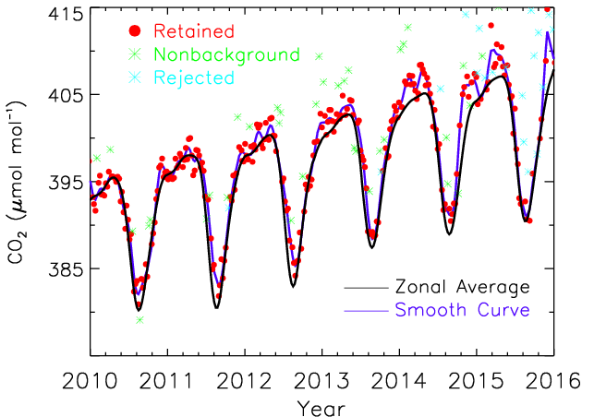
Sampling Issues:
CO₂ contamination at ICE: Leak in inlet line
Notes:
At Iceland, observers moved intake (without discussing with us) and it resulted in years of subtly contaminated samples. Heartbreaking!

Slide 36
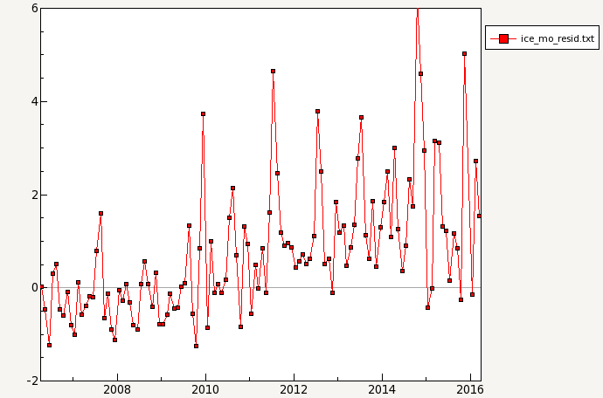
Sampling Issues:
CO₂ contamination at ICE
ΔCO₂ (ppm)
Screen shot from PYDV-Grapher
Notes:
Another way of looking at contamination from Iceland samples, by subtracting curve fitted to data.

Slide 37
Analysis Issues: Methods
CO₂: NDIR
  Calibrated with 3 standards
CH₄: GC FID
  Calibrated with single standard
N₂O/SF₆: GC ECD
  Instrument response calibrated offline with 8 standards relative to a reference
  Samples measured relative to a reference.
CO: VUVRF
  As for N₂O but with 6 standards and “zero”
H₂:GC PDID
  Calibrated with single standard

Slide 38
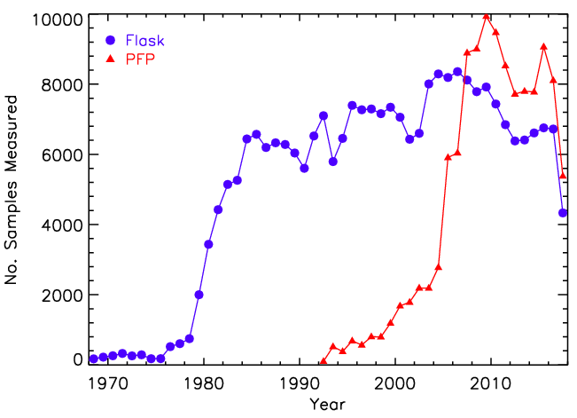
Analysis: ~15000 Samples Analyzed yr⁻¹
Each raw file scrutinized for each species measured
PFP
2.5 L flask

Slide 39
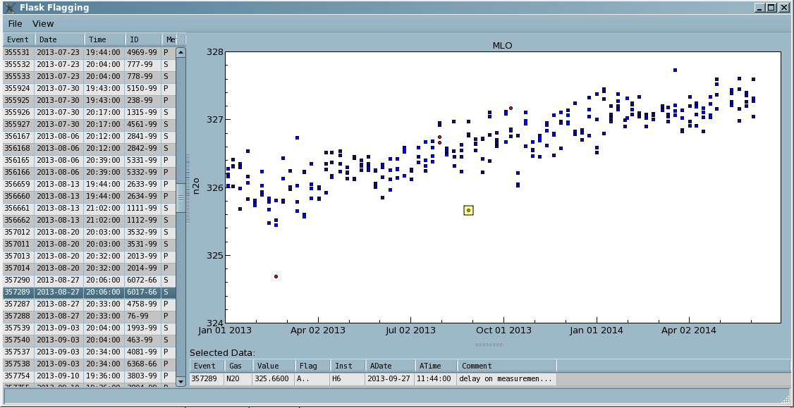
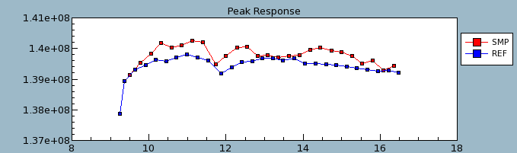
Analysis Issues:
Impact of analysis delay on N₂O (DB tool)
Allows addition of flag to DB
Peak Area
Time of day
Notes:
ECD response is sensitive to composition of gas inside. Small changes in timing of sample injection affect composition inside detector, which affects the response (peak area).

Slide 40
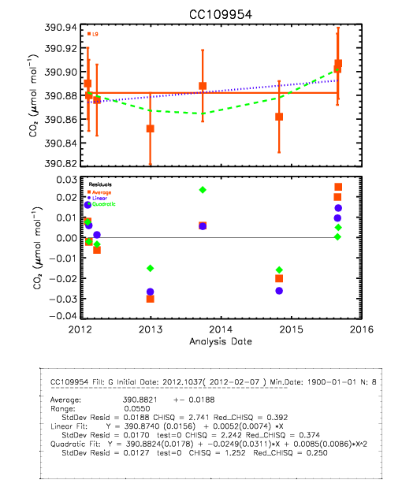
CO₂ Standards:
Change to assigned value or drift -> reprocess
Notes:
Since standards drift over time, we need to track drift and reprocess data to account for the drift. Need proper DBMS to do this. Very important!

Slide 41
Selection For Background
Historically: Ensure air samples represent large, well-mixed volumes of the atmosphere
  Became complicated w/ continental sites
For CH₄, done manually based on other species
For CO₂, N₂O, and SF₆, filtering used (values outside n σ of curve fit flagged .X.)
  Applied differently for different species
  Should same approach be applied to BG and non-BG sampling sites?

Slide 42

Filtering Data: CCGVU
Function fitted to data:
  Typically quadratic polynomial + 4 harmonics
Calculate residuals (data – fn)
Residuals filtered twice with low-pass filters
  Capture IAV in trend and seasonal cycle
  Filter cutoffs: 80 d and 667 d

Slide 43
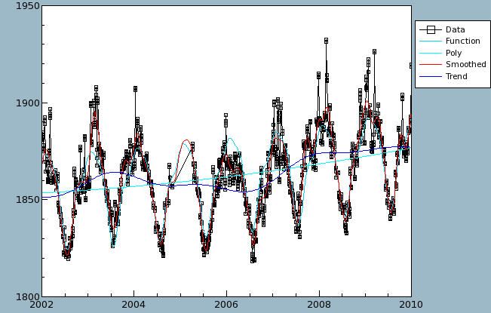
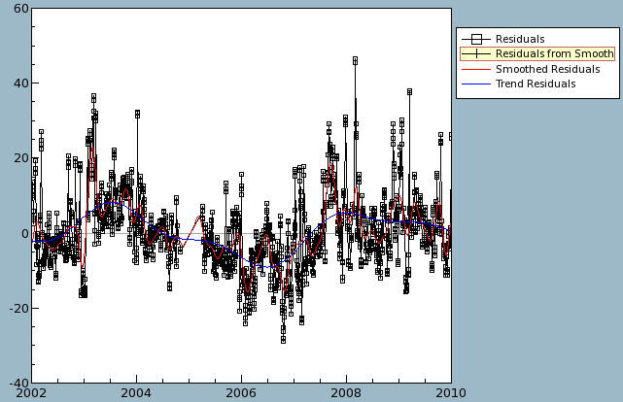
Filtering Data
CH₄ at ALT: data on left and residuals on right
Images from CCGVU in pydv.
Notes:
Using a curve fitted to data to select for background (statistical method).

Slide 44
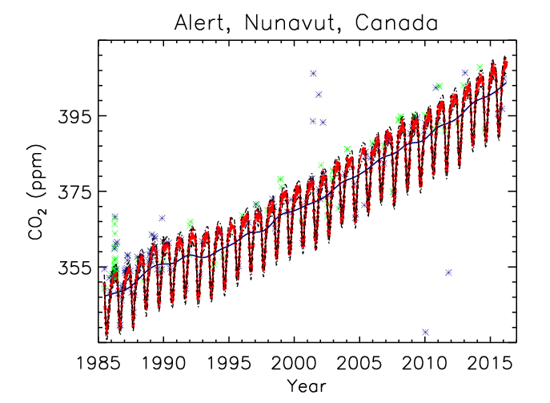
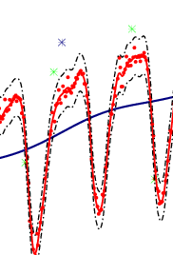
Selection: Statistical filtering
Notes:
Filtering for site in Canada.

Slide 45
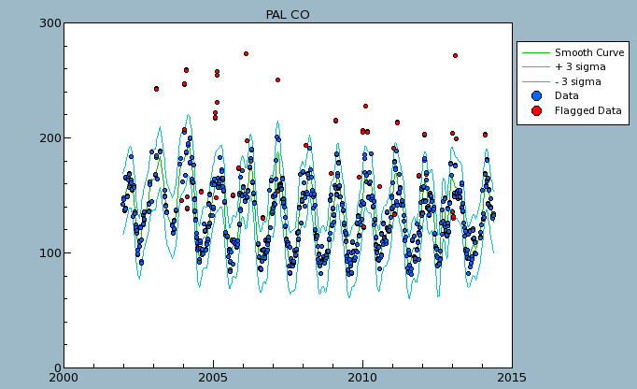
Selection:
Failure of statistical filtering
CO (ppb)
Notes:
In some cases, filtering method flags data that ARE background, as shown here for CO.

Slide 46
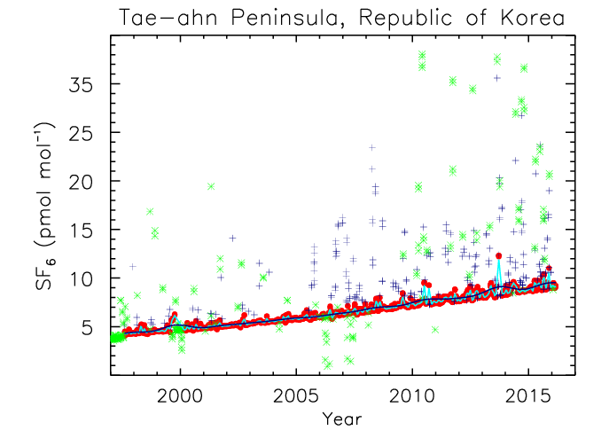
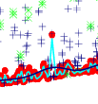
Selection:
Failure of statistical filtering
Notes:
Example for SF6: using a “stiffer” fit, can eliminate inappropriate flagging of background data.

Slide 47
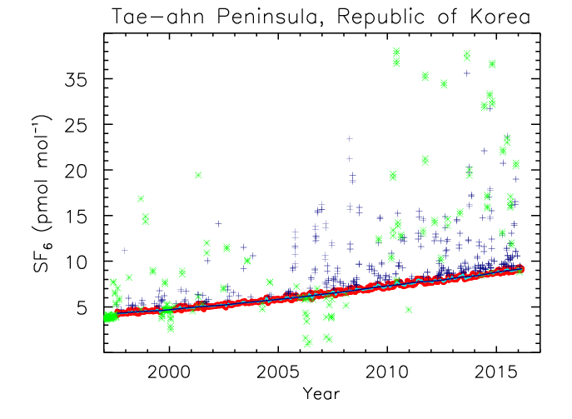
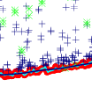
Selection:
Failure: correct with stiff fit

Slide 48
Uncertainties of NOAA GHG Measurements From Discrete Air Samples

Slide 49
Outline
Species covered: CO₂, CH₄, N₂O, and SF₆
Uncertainties on measurements of flask-air
  Assessing major components of uncertainty (u_{i})
  Other terms, when required
Uncertainties on zonal means
  Network contribution
  Potential bias contribution

Slide 50
u² = u_{st}² + u_{lt}² + u_{sp}² + ….
Short-term variability (repeatability)
  Test flasks (mean σ)
  Calibrations, targets, cal/ref stability (mean σ)
  Sample-pair agreement
Long-term variability (reproducibility)
  Test flasks and surveillance cylinders (σ ΔΧ)
  Co-located comparisons (NOAA observatories)
Scale propagation
  Reproducibility as reported on certificates

Slide 51
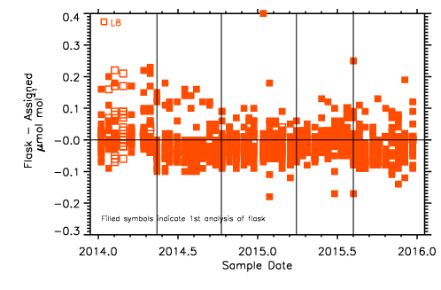
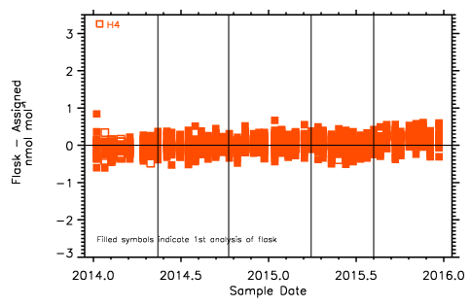
Repeatability: Daily TEST Flasks (since 1988)
CO₂ (σ = 0.07 ppm)
σ → mean SD for each fill date.
N₂O (σ = 0.21 ppb)
Notes:
Evaluating repeatability from test flask data.

Slide 52
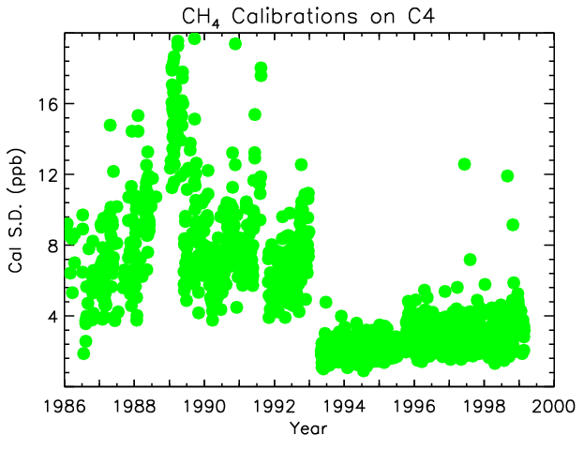
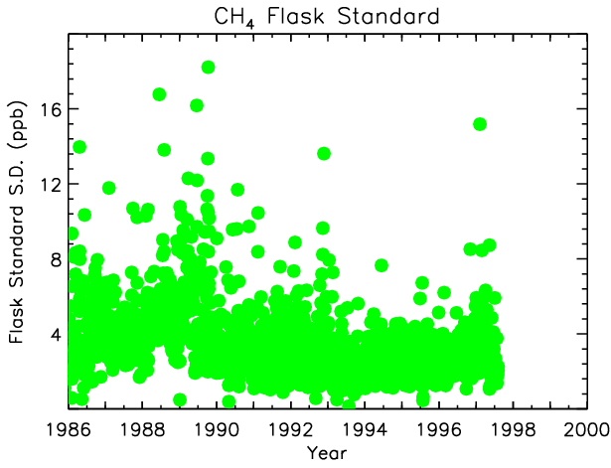
Repeatability: Cals/Standard (CH₄)
(C4)
Notes:
Evaluating repeatability with repeated measurements of same air (reference, standard, or unknown cylinder during calibration).

Slide 53
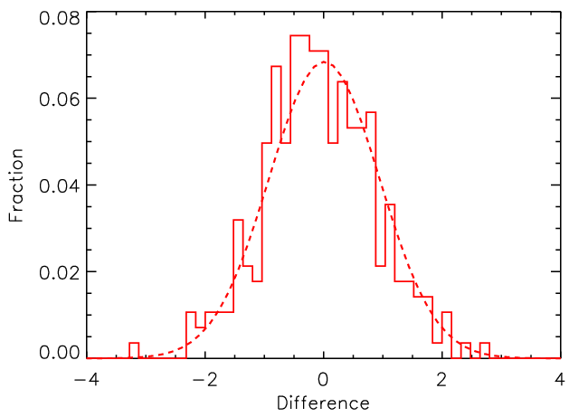
Repeatability: Pair Difference, CH₄ (SPO)
(2014-2015)
Mean diff = 0.01 ± 0.80 ppb
Mean |ΔX| = 0.7 ppb (σ= 0.5 ppb)
Notes:
Repeatability: evaluate with SD of differences between pairs of samples.

Slide 54
Uncertainty Contributions (2014-15)
(1 σ)
 | CO₂ (ppm) | CH₄ (ppb) | N₂O (ppb) | SF₆ (ppt)
Instrument | L8 | H11 | H4 | H4
TST (S.D.) | 0.07 | 0.73 | 0.21 | 0.04
Avg |pair diff| (SPO) | 0.06 | 0.65 | 0.20 | 0.03
Ref./Std stab. (S.D.) |  | 0.73 | 0.23 | 0.04
Cals (S.D.) | 0.02 | 0.62 | 0.18 | 0.03
Scale prop. | 0.03 | 0.5 | 0.12 | 0.01
Avg FL - IS (MLO) | 0.06±0.13 | -0.03±2.1 | n/a | n/a
norm. TST (σΔΧ) | -0.01±0.07 | -0.03±0.73 | 0.03±0.23 | 0.01±0.04
norm. TGT (σΔΧ) | 0.03±0.03 | 0.2±0.3 | -0.1±0.1 | 0.005±0.01
u (68% CL) | 0.08 | 0.9 | 0.26 | 0.04
Notes:
Examples of uncertainties from combining various uncertainty terms.

Slide 55
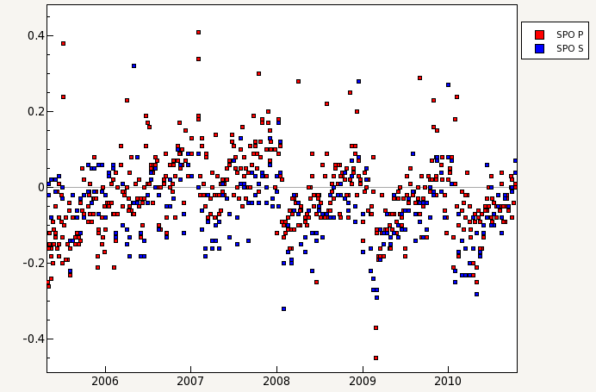
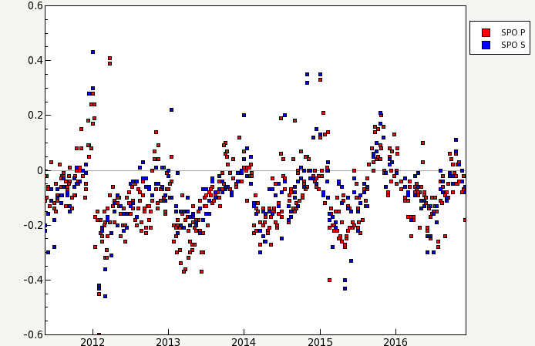
Site-specific components excluded: SPO CO₂ storage effect
Differences: Flask - in situ
Notes:
Some components of uncertainty are difficult to account for!

Slide 56
Other Contributions to Uncertainty
CO₂ Corrections (vary with analysis system)
Date Range | Reason | Magnitude
1968-01 - 1975-04 | P-broadening | 3.5-4.5 ppm
1975-04 - 1977-11 | P-broadening; bias | 2.5-3.25 ppm; -0.45 ppm
1977-11 - 1978-08 | P-broadening; NDIR drift | 2.5-3.25 ppm; ≤1.6 ppm
Pre-1978 | Analyzer nonlinearity | Up to 0.3 ppm
1978-09 - 1979-01 | P-broadening | 2.5-3.25 ppm
1979-02 - 1982-04 | Toepler pump contamination | Site specific: -1 to -0.38 ppm
1980-05 - 1999-12 | Analyzer system bias | 0.1-0.24 ppm
1979-28 - 1980-07 | CO₂ growth in flasks | Site specific: -3.2 ppm
Sampling method:
Hand aspirated (1968 to mid-1981) vs compressor package (1981 - present)
Evaluation is difficult
Flask Type:
Greased vs O-ring sealed; Flask volume
Notes:
Older NOAA data have many corrections and many more uncertainty terms.

Slide 57
CO₂ Flask-air Measurement Uncertainty (~1975)
Term | u (1 σ)
Repeatability (pair diff) | 0.3 ppm
Reproducibility (guess) | 0.3 ppm
Scale transfer | 0.05 ppm
P-broadening | 0.2 ppm
Analyzer bias | 0.2 ppm
Hand aspirated | 0.1 ppm
Greased flasks | 0.1 ppm
u (68% CL) | 0.5 ppm
Komhyr et al., 1985: uncertainty = 0.2 to 0.3 ppm

Slide 58
Questions?

Slide 59
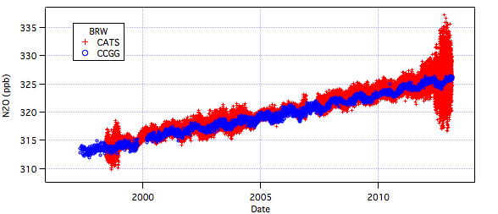


Slide 60





