Slide 1
NOAA Carbon Cycle GHG Measurement Programs
Ed Dlugokencky

Slide 2
Projects
Tall towers - N American focus
Aircraft - N American focus
Observatory - Global background focus
Cooperative global air sampling network
Constrain large scale GHG budgets
Weekly discrete air samples
Analyzed in Boulder
CO₂ (+iso), CH₄ (+iso), N₂O, SF₆, CO, H₂
Suite of NMHC

Slide 3
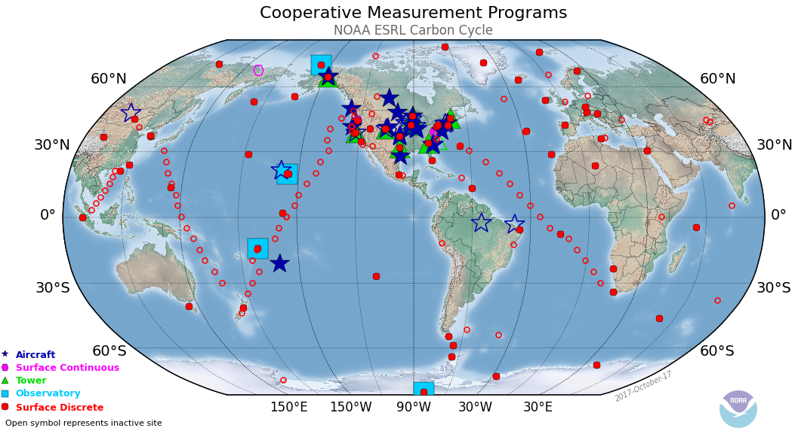

Slide 4
Analytical
Species | Current Χ | Technique | Repeatability
CO₂ | 407 ppm | NDIR | 0.06 ppm
CH₄ | 1900 ppb | GC/FID | 1.0 ppb
N₂O, SF₆ | 330 ppb 9.3 ppt | GC/ECD | 0.3 ppb, 0.03 ppt
CO | 100 ppb | VUV-RF | 0.7 ppb
H₂ | 500 ppb | GC/PD-HeID | 0.3 ppb
*δ¹³CO₂ | -8.5‰ | IRMS | 0.01‰
*δ¹³CH₄ | -47.3‰ | GC/IRMS | 0.04‰
Quantity: “amount of substance ratio”
Units: dry-air, mole fraction
*University of Colorado, INSTAAR; isotope ratios in “per mille”

Slide 5
Sampling at BKT
Started in January, 2004
Always a difficult site for CO and CO₂
Data for CH₄ and other species are good
Terminated in February, 2011
Drastic cut in NOAA funding resulted in many sites being terminated
Restarted in February, 2013
With urging from BMKG
Problematic for CO₂ at start-up
Significantly improved, since

Slide 6
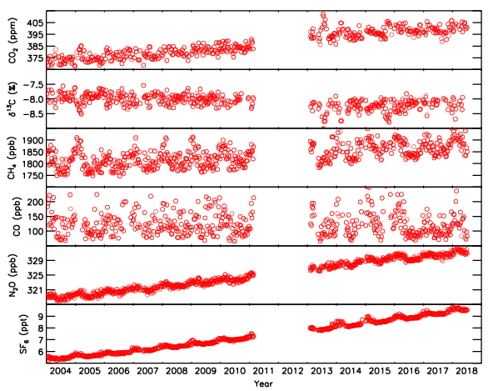
BKT

Slide 7
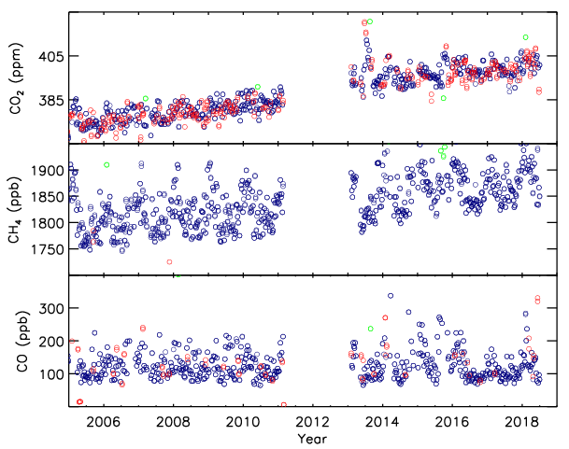
Volcanic emission?

Slide 8
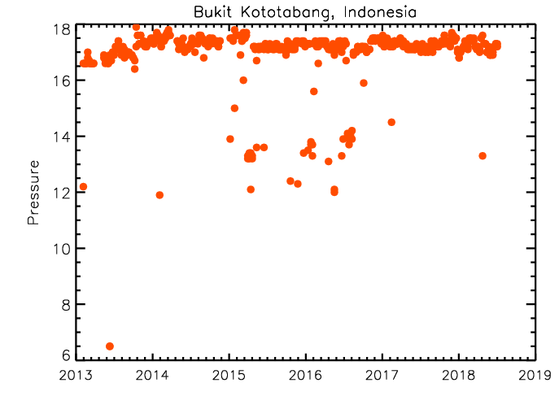
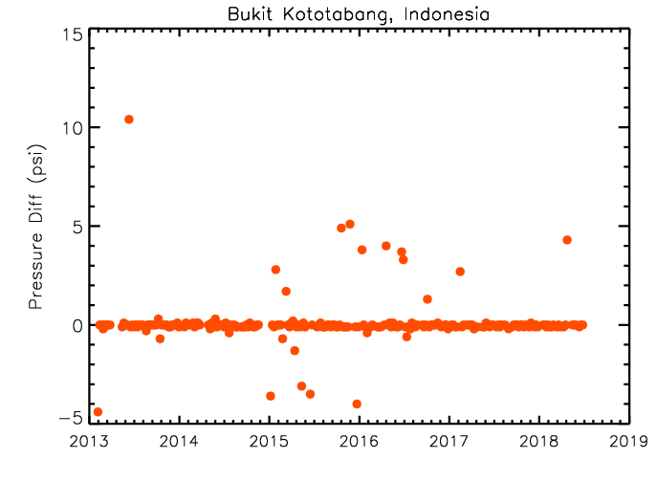
Low P in some samples during analysis; much improved since 2015.
Please write observer’s name, flow rate, V, and P on sample sheet.
Pressure (psia)

Slide 9
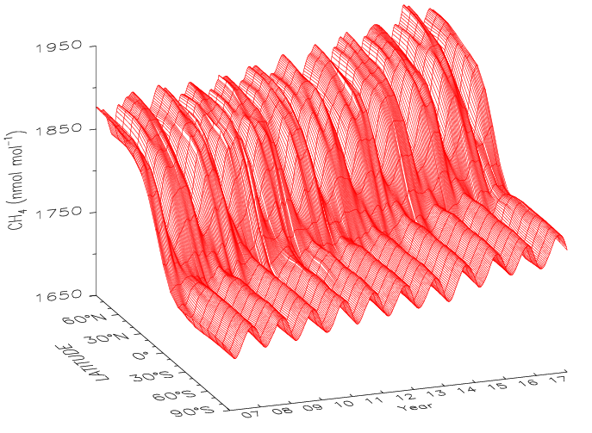

Slide 10
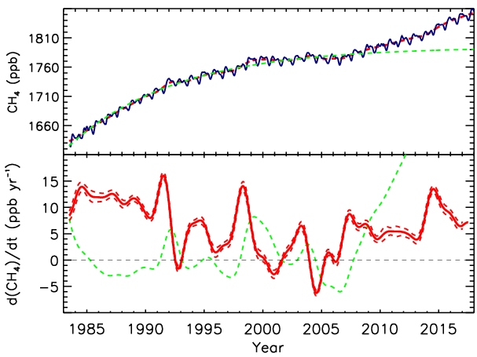
Lifetime ≈ 9.2 yr
[CH₄](t) = [CH₄]_{ss}-([CH₄]_{ss}-[CH₄]₀)e^{-t/τ}

Slide 11
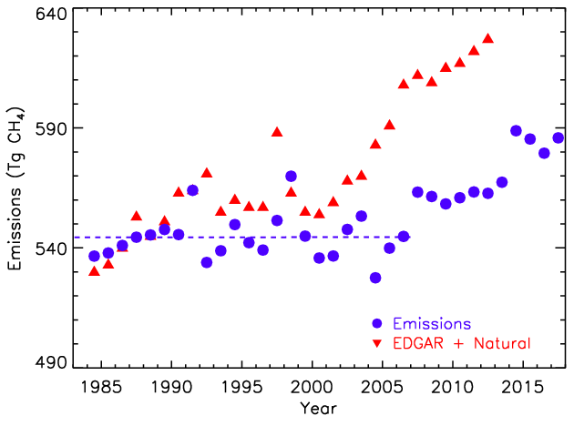
Emissions = d[CH₄]/dt + [CH₄]/τ
Lifetime (τ) = 9.1 yr
Average Emissions = 550 ± 13 Tg CH₄
Trend = 0 ± 0.6 Tg CH₄ yr⁻¹

Slide 12
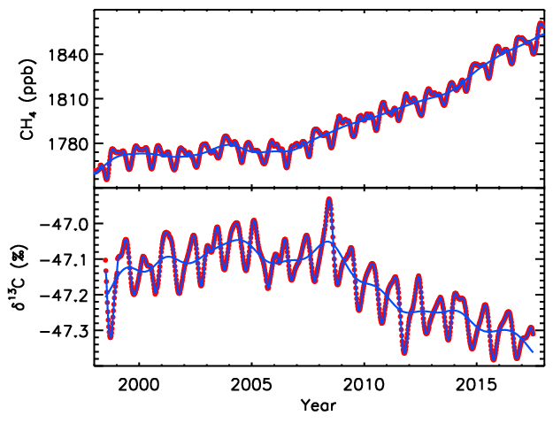
Globally averaged CH₄ and δ¹³C(CH₄)
Sylvia Michel, INSTAAR

Slide 13
Pinatubo and Chemistry (Largest term in CH₄ budget)
OH + CH₄ → CH₃ + H₂O
O₃ + hν (330 ≥ λ ≥ 290 nm) → O(¹D) + O₂
O(¹D) + H₂O → 2 OH
Rate of formation O(¹D) = j [O₃]
j = ∫F(λ) σ(λ) φ(λ) dλ
Also affected CO

Slide 14
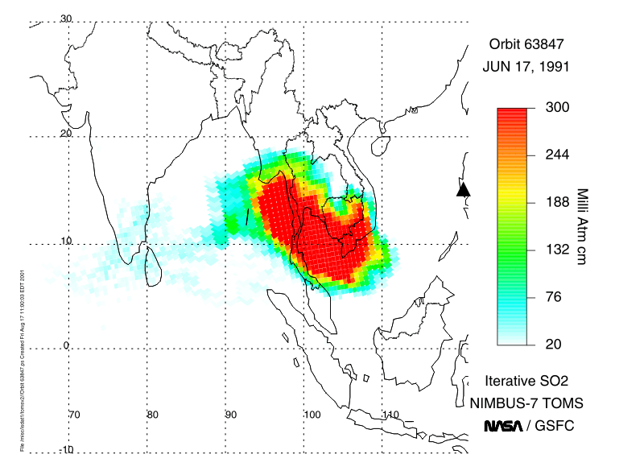
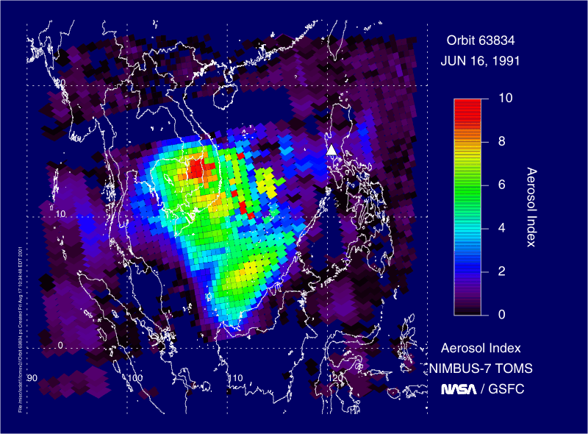
AI < 0.1 means clear sky; AI > 4 obscures mid-day sun

Slide 15
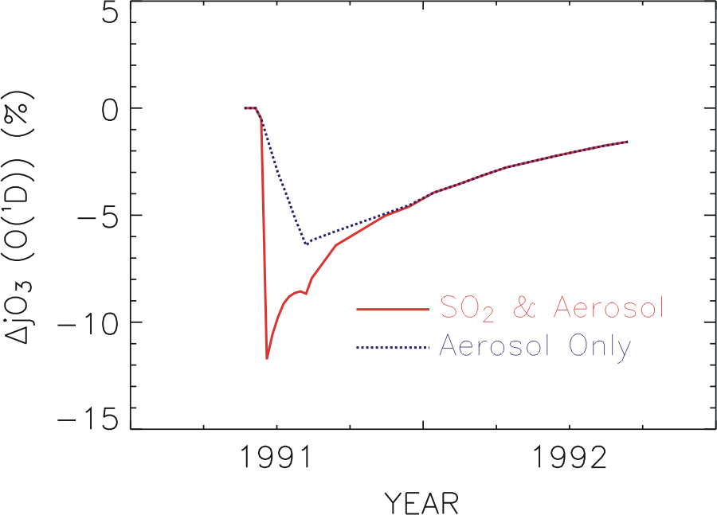
O₃ + hν (330 ≥ λ ≥ 290 nm) → O(¹D) + O₂
O(¹D) + H₂O → 2 OH
Rate of formation O(¹D) = j [O₃]

Slide 16
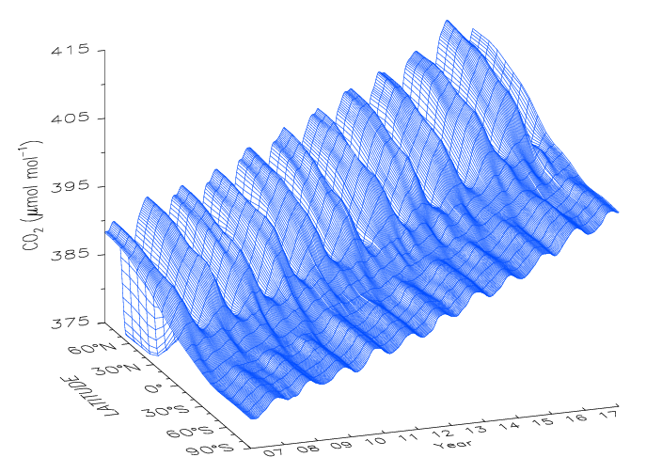

Slide 17
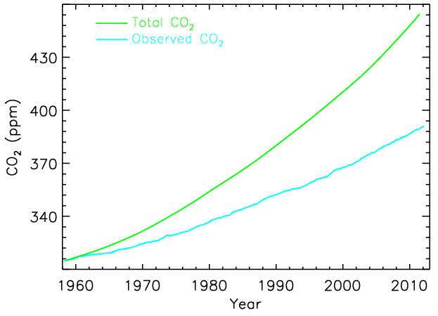
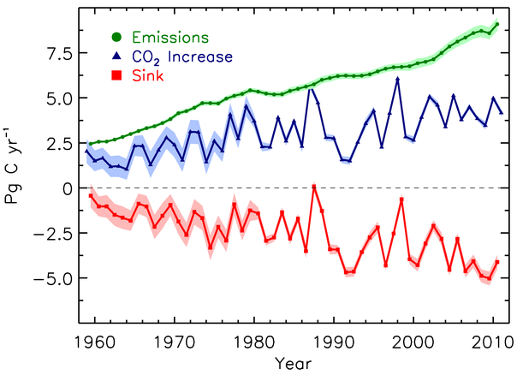
CO₂ - Constraining its budget
AF ~ 45%

Slide 18
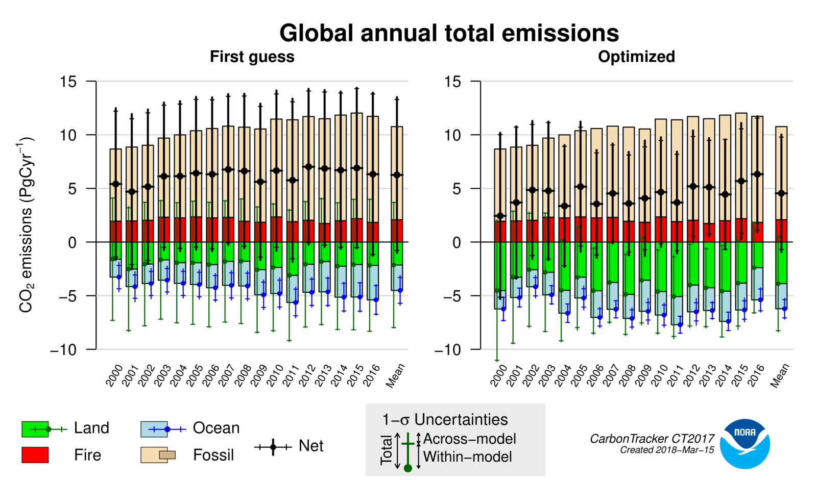
www.esrl.noaa.gov/gmd/ccgg/carbontracker/

Slide 19
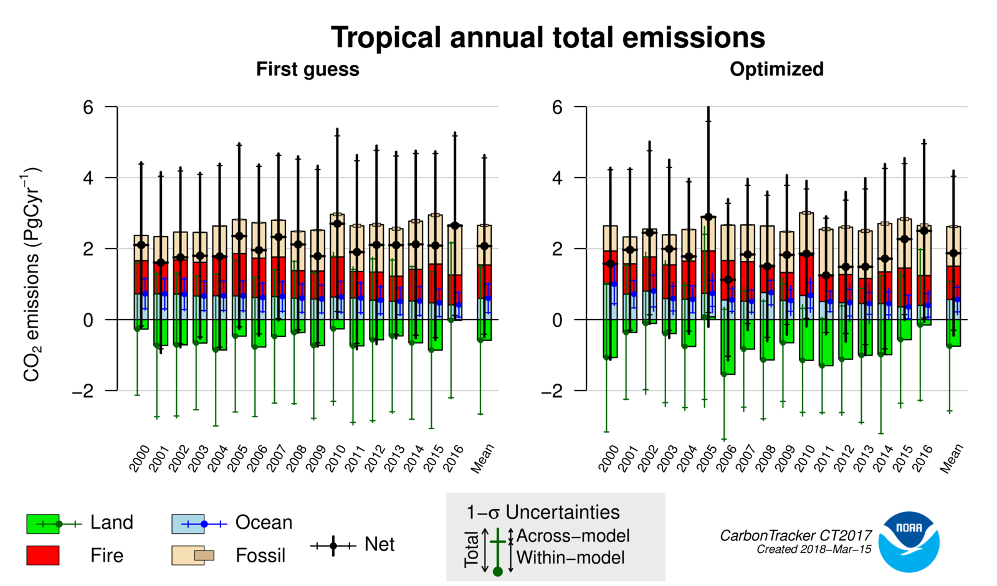
www.esrl.noaa.gov/gmd/ccgg/carbontracker/

Slide 20
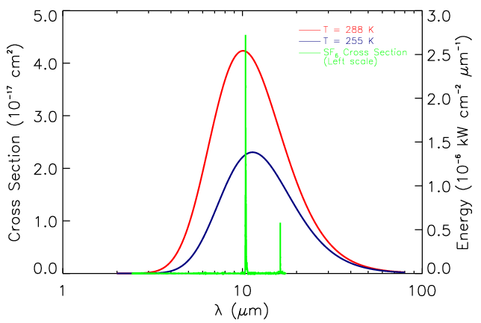

Slide 21
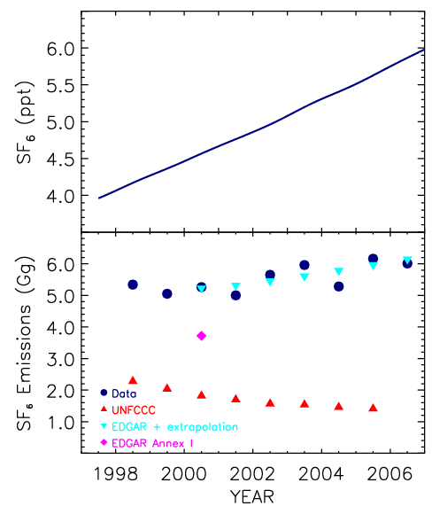

Slide 22
Summary
We (NOAA and BMKG) collaborate to produce data that provide the strongest constraints on LLGHG emissions
NOAA thanks BMKG for their continued collaboration
Questions?

