Slide 1
A look at early v10 MIP results
Andy Jacobson ^{1,2}, David Baker ³, Sourish Basu ⁴, Michael Bertolacci ⁵, Frédéric Chevallier ⁶, Noel Cressie⁵, Sean Crowell ⁷, Feng Deng ⁸, Junjie Liu ⁹, Scot Miller ¹⁰, Andrew Schuh ³, Brad Weir ⁴, Andrew Zammit-Mangion⁵
University of Colorado Boulder
NOAA Global Monitoring Laboratory
Colorado State University
University of Maryland
University of Wollongong
Laboratoire des Sciences du Climat et de l’Environnement
University of Oklahoma
University of Toronto
Jet Propulsion Laboratory
Johns Hopkins University
Thanks to Heather Cronk, Chris O’Dell, Ken Schuldt, Kirk Thoning
Notes:
I want to extend special thanks to Heather Cronk who quickly turned around flux submissions for this talk, and to Chris O'Dell for updating the data used to make signal plots.
Ken Schuldt and Kirk Thoning were instrumental in web site support.

Slide 2
A look at early v10 MIP results
Andy Jacobson ^{1,2}, David Baker ³, Sourish Basu ⁴, Michael Bertolacci ⁵, Frédéric Chevallier ⁶, Noel Cressie⁵, Sean Crowell ⁷, Feng Deng ⁸, Junjie Liu ⁹, Scot Miller ¹⁰, Andrew Schuh ³, Brad Weir ⁴, Andrew Zammit-Mangion⁵
University of Colorado Boulder
NOAA Global Monitoring Laboratory
Colorado State University
University of Maryland
University of Wollongong
Laboratoire des Sciences du Climat et de l’Environnement
University of Oklahoma
University of Toronto
Jet Propulsion Laboratory
Johns Hopkins University
Thanks to Heather Cronk, Chris O’Dell, Ken Schuldt, Kirk Thoning
Status of submissions
Signal and flux changes from B9 to B10
Withheld data results
Comparison of experiments
Comments on Africa

Slide 3
Submission status
Modeling Group | Fluxes | ObsPack data | TCCON data | OCO-2 data | Notes
CAMS | ✅ | ✅ | ✅ |  | OCO-2 eval underway
Baker CSU | ✅ | ✅ |  |  | TCCON and OCO-2 eval underway
Schuh CSU | ✅ | ⚠️ |  |  | End effects; Eval came in too late
CT | ⚠️ | ⚠️ | ⚠️ | ⚠️ | bug in 2020, recomputing
Oklahoma U | ✅* |  |  |  | OG expt and eval data underway
WOMBAT | ✅ | ✅
U Toronto | ✅ | ✅ | ✅
CMS-Flux
TM5-4DVAR
Johns Hopkins
LoFi |  |  |  |  | not a traditional assimilation
v10 MIP flux results shown here are the average of CAMS, Baker, OU, CSU, WOMBAT, UT (except for OG which has no OU submission)
Notes:
This is the current state of v10 MIP submissions. We have six groups reporting fluxes, and four supplying ObsPack evaluation data. Many of us are delayed by slow computing, which at least in the case of NOAA systems is due to the active tropical cyclone season.

Slide 4
Accessing results
V10 MIP web site: https://gml.noaa.gov/ccgg/OCO2_v10mip
Download page for gridded fluxes, evaluation data co-samples, flux plots, template submission files, FF emissions, etc.: https://gml.noaa.gov/ccgg/OCO2_v10mip/download.php
Submitting results
See protocol for required formats:
https://drive.google.com/file/d/1UulfoVoSqJIKACNa9N6vcVN34LRR_JxW/view
Fluxes to Heather Cronk: heather.cronk@colostate.edu
ObsPack data to Andy Jacobson: andy.jacobson@noaa.gov
TCCON data to Sourish Basu: sourish@umd.edu
OCO-2 data to Abhishek Chatterjee: abhishek.chatterjee@jpl.nasa.gov
Notes:
These are instructions on how to access v10 MIP results, and how to submit them.
I will send these slides out so you can have these details at hand.

Slide 5
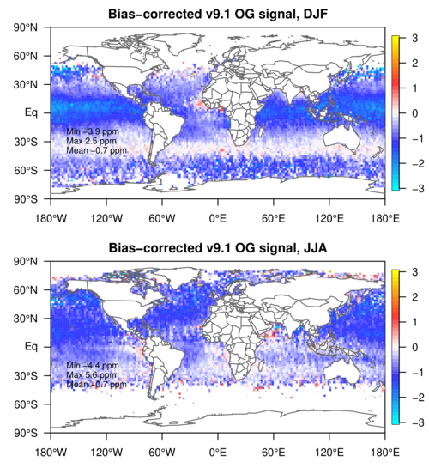
The OCO-2 signal: B9.1 OG retrievals minus CO₂ reference; OG response
Global Ocean
SIGNAL: concentration space
RESPONSE: flux space
Notes:
Signal definition: OCO-2 retrievals minus CO2 reference. Reference is average of 3 or sometimes 4 semi-operational inverse models assimilating in situ measurements. These maps gridded at 2x2 degrees. On the left, I show stacked maps of multi-year mean DJF (top) and JJA (bottom).
I will be saying DJF instead of northern-hemisphere winter and JJA instead of northern-hemisphere summer.
Idea of signal is to look at the new information that models assimilating IS obs would be expected to interpret. The v9 OG signal is not complex, since it is universally negative in all seasons and around the globe. The negative signal yields very large ocean uptake by OG inversions compared to IS and priors. Unfortunately, other signal patterns are not this easy to interpret.

Slide 6
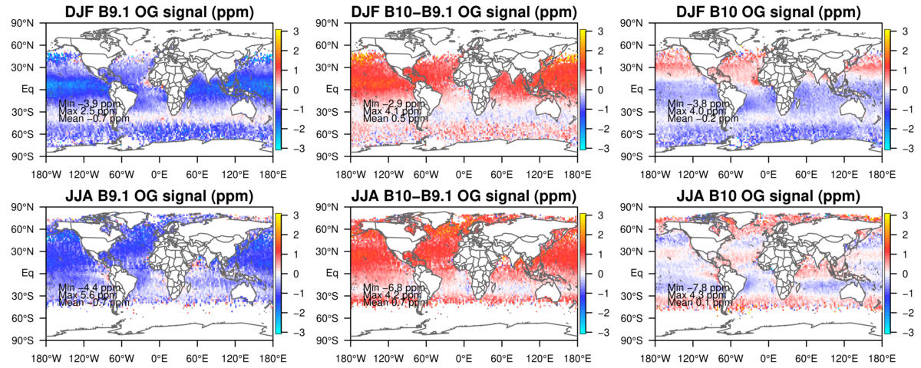
The OCO-2 signal: OG signal changes B9.1 to B10
B9.1
+
change
=
B10
Notes:
This plot shows the change in signal from B9 to B10. The top row is DJF, the bottom row is JJA. The leftmost column is the B9 signal as we saw in the previous slide, the middle column is the change B10 minus B9, and the rightmost column is the resulting B10 signal.
OG retrievals raised XCO2 by 0.5 to 0.7 ppm averaged across the worlds oceans, and by around 1-1.5 ppm in large areas north of the equator. Changes south of the equator are smaller. This results in a signal much closer to zero when globally averaged. I’ll be showing and discussing these B10 maps on the next slide.

Slide 7
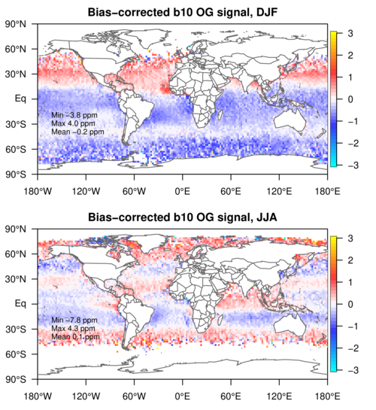
The OCO-2 signal: B10 OG retrievals minus CO₂ reference; OG-IS response
SIGNAL: concentration space
Notes:
The B10 OG signal averaged across the globe is small, but seasonal interhemispheric differences are striking.
The DJF signal is saying that the northern hemisphere has a larger wintertime source in the northern hemisphere than the reference. This signal is uniformly distributed in the zonal direction and has broad meridional scales. That it’s well mixed suggests a broad source, basically hemispherically distributed.
The JJA signal on the other hand shows 5 alternating red and blue stripes. Again these are well-mixed zonally, suggesting sources or sinks that are broadly distributed zonally and not in one particular basin or continent.
The transition from DJF to JJA is striking. It's difficult to change XCO2 on these scales so quickly from fluxes alone, especially since the interhemispheric exchange time is about a year.

Slide 8
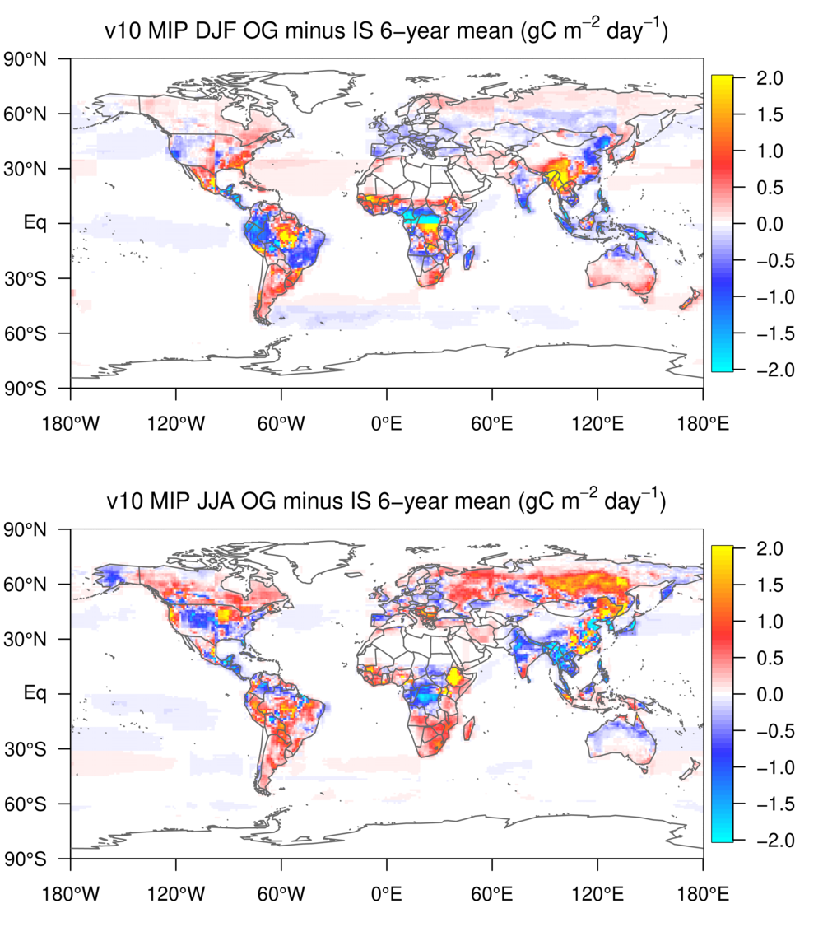
The OCO-2 signal: B10 OG retrievals minus CO₂ reference; OG-IS response
SIGNAL: concentration space
RESPONSE: flux space
Notes:
Here on the right is the flux response to this signal from the 6 available v10 MIP inversions. The top figure is the long-term mean flux difference between OG and IS inversions for DJF, and the bottom is the same for JJA.
The OG data drive big differences on land because the terrestrial biosphere has the biggest leverage to change XCO2. In DJF the biggest flux differences are in the tropics and southern hemisphere, but in JJA we see a notable source relative to IS in higher northern latitudes, in both Asia and America.

Slide 9
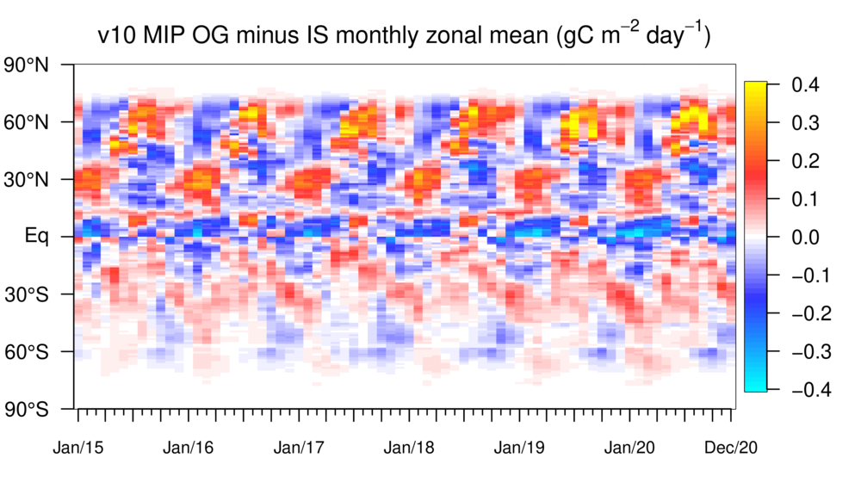
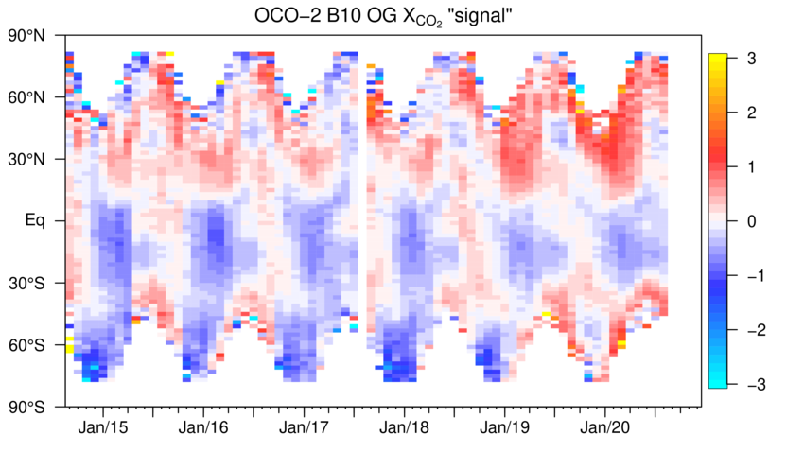
The OCO-2 signal: B10 OG retrievals minus CO₂ reference; OG-IS response
SIGNAL: concentration space
RESPONSE: flux space
Notes:
The B10 OG signal averaged across the globe is small, but seasonal interhemispheric differences are striking. I’m now showing latitude-time Hovmuller diagrams of zonally-averaged OG signal (left) and flux response (right). Each pixel is a zonal mean.
A repeated cycle of seasonal flux response is quite clear. This is driven both by the OG bias relative to the CO2 reference and by the seasonal distribution of available retrievals. This is characterized by patterns of enhanced and reduced uptake propagating polewards from the tropicsl in both hemispheres.
Just yesterday we discovered a discontinuity in the signal starting in 2019. This is probably an issue with the CO2 reference, and not the OCO-2 retrievals because it shows up also in LN signal plots. This is under investigation.

Slide 10
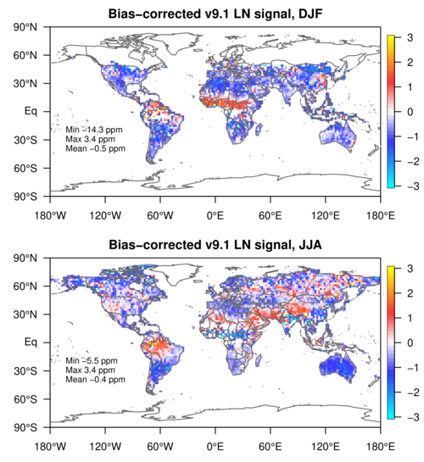
The OCO-2 signal: B9.1 LN retrievals minus CO₂ reference; LNLG-IS response
SIGNAL: concentration space
Notes:
V9 land nadir signal was largely negative except in tropical regions, although the area of positive signal moves north in the NH summer season. Magnitudes are relatively large, with broad continental areas having signal of plus-or-minus 1 to 2 ppm.

Slide 11
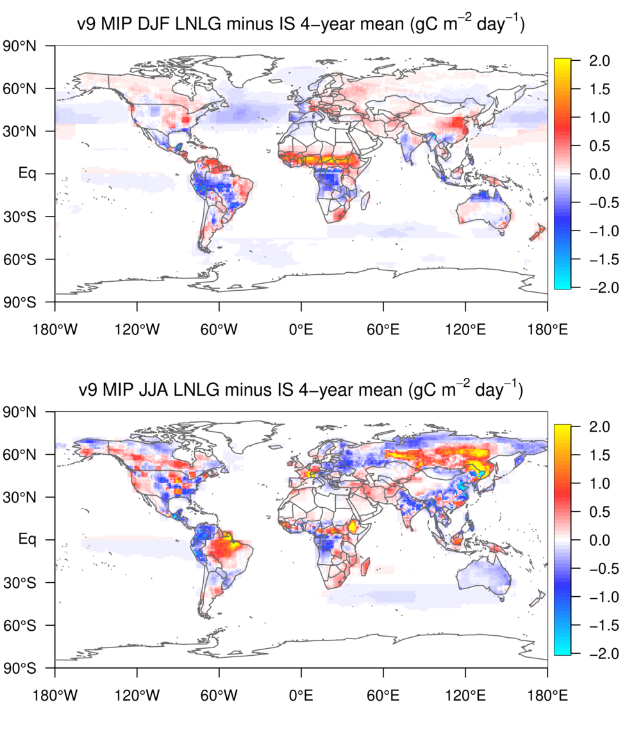
The OCO-2 signal: B9.1 LN retrievals minus CO₂ reference; LNLG-IS response
SIGNAL: concentration space
RESPONSE: flux space
Notes:
On the right we have the difference in 4-year mean seasonal fluxes between v10MIP LNLG and IS experiments. The top is for DJF and the bottom is for JJA.
The broad areas of negative signal do not map onto broad areas of negative flux difference. Instead we see intense regional positive-negative dipoles in the tropics and southern extratropics, for both seasons, and a notable source in eastern Asia and probably throughout N. America too.

Slide 12
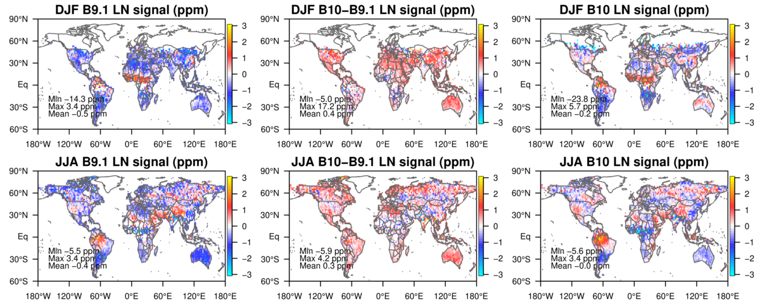
The OCO-2 signal: LN signal changes B9.1 to B10
B9.1
+
change
=
B10
Notes:
This is again the change from B9 to B10 but now for land nadir retrievals, with DJF in the top row and JJA in the bottom row.
The change from B9 to B10 mostly added XCO2 across the globe, and this reduced the strong negative signal in B9 to something more mixed over land in B10.
However, many of the features in B9 and B10 are quite similar, such as the African and S. American high signals. The south and central American high/low dipole is actually stronger, and the African seasonality is also stronger with a deeper negative signal than B9.

Slide 13
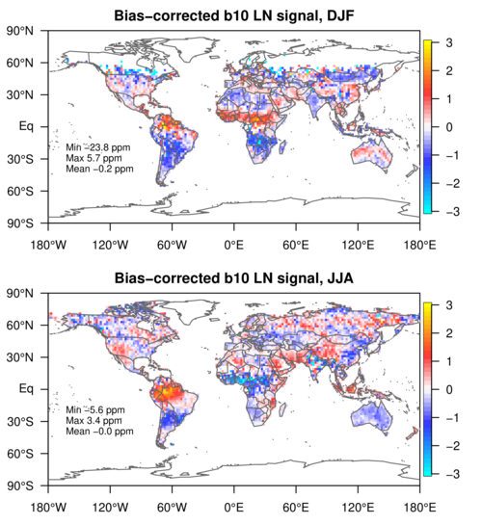
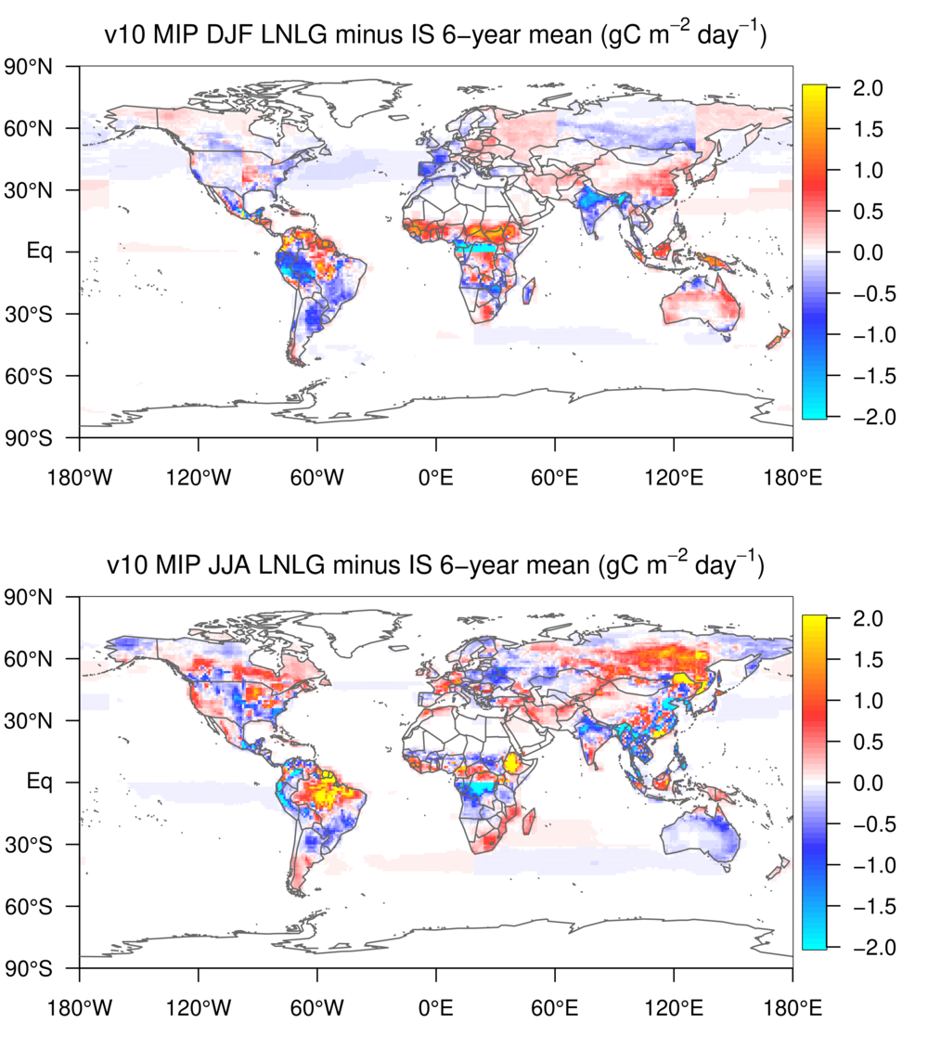
The OCO-2 signal: B10 LN retrievals minus CO₂ reference; LNLG-IS response
SIGNAL: concentration space
RESPONSE: flux space
Notes:
Here on the left is again the B10 land nadir signal by season. The right is B10 MIP flux differences, LNLG minus IS as a six-year average for the DJF (top) and JJA (bottom) seasons.
Again the tropical and southern extratropical land regions have an intense flux response with a mixture of positive and negative zones, closely spaced. Amazonia shows up as a notable source in LNLG relative to IS, and of course we still have the DJF African source. Northern extratropical responses are also quite strong, with high latitudes again showing as a relative source during JJA, especially in Asia.

Slide 14
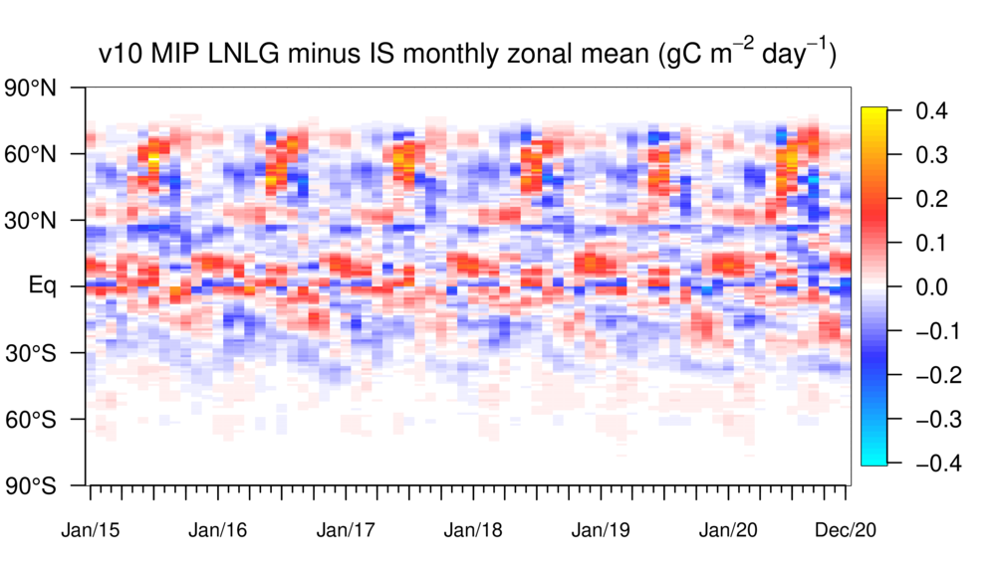
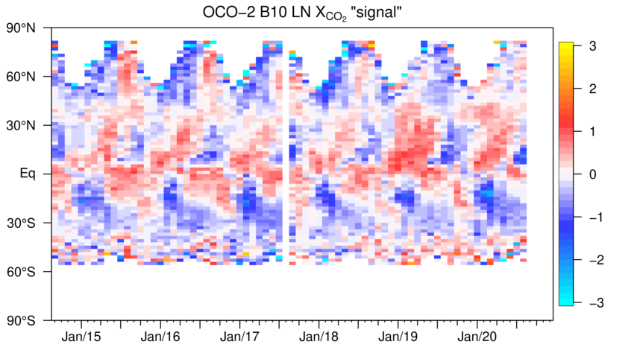
The OCO-2 signal: B10 LN retrievals minus CO₂ reference; LNLG-IS response
SIGNAL: concentration space
RESPONSE: flux space
Notes:
These time-latitude diagrams of zonal mean signal and flux again show very regular changes to the seasonality of fluxes. There’s also a suggestion of poleward propagation of these flux responses, visible as anomalies in both hemispheres sloping to the right.
The timing is such that in northern extratropical zones, the LNLG simulations suggest a reduction in the magnitude of the terrestrial seasonal cycle.

Slide 15
The OCO-2 signal: B10 LN retrievals minus CO₂ reference; LNLG-IS response
Notes:
While the regularity of those seasonal flux differences is striking, we also should recognize that they’re not particularly large. The right side now shows the climatology of northern midlatitude fluxes from the IS (top) and LNLG (bottom) experiments. The northern midlatitudes are defined here as 23.5 to 67.5 N. You can see the summertime growing season is not as deep in the LNLG experiment. The size of this reduction is about 6%.

Slide 16
Evaluation using withheld IS data - CAMS, Baker, UT, WOMBAT
V9 (10 models)
Notes:
We turn now to evaluation using ObsPack data.
This is the summary figure from the v9 MIP for performance of those experiments against withheld in situ measurements. The quantity being analyzed is the normalized rmodel esiduals and here I show global means (top panel), representing overall bias, and the reduced chi-squares in the lower panel again as a global mean.
As a reminder, the v9 IS simulations were largely unbiased against the withheld obs, and had chi-squares reasonably close to 1. The LN, LG, and LNLG experiments were all biased low and had significantly elevated chi-squares. OG and the kitchen sink experiment were mostly unbiased but had elevanted chi-squares. Of the experiments assimilating OCO-2 retrievals, the kitchen sink performed best against the withheld data.

Slide 17
Evaluation using withheld IS data - CAMS, Baker, UT, WOMBAT
V9 (10 models)
V10 (4 models)
Notes:
We have 4 v10 MIP models reporting ObsPack data, so these are very preliminary. The low-n is reflected in larger error bars, at least for the top panel.
IS again performs well in the v10 MIP with low bias and chi-square consistent with the expectation of 1.0. The OCO-2 experiments are all better than v9 in terms of bias and chi-square, although the LNLG might again be biased low (there’s a lot of model-to-model difference in this). Again the kitchen sink experiment performs best in bias and chi-square for experiments assimilating OCO-2 retrievals.

Slide 18
Evaluation using non-assimilated data: ATom v9: 10 models v10: 4 models CAMS, Baker, UT, WOMBAT
v9
v10
Notes:
This is a comparison of the v9 MIP performance against ATom profiles. You should have seen this figure before, as a version of this is featured in Hélène’s paper. I took the transects from all the ATom campaigns and binned them by latitude and altitude. What is shown here are the mean residuals, which you can interpret as model bias.
IS is slightly biased high, LNLG is biased more significantly low, and OG is biased significantly high in the extratropics. The Kitchen Sink experiment is a mixture of the previous three, but with stronger tropical low biases. All experiments suffer from a common high bias in the Arctic stratosphere, which could be due either to initial conditions or to standing transport biases.

Slide 19
Evaluation using non-assimilated data: ATom v9: 10 models v10: 4 models CAMS, Baker, UT, WOMBAT
v9
v10
Notes:
Again the v10 MIP simulations do better than v9, which is consistent with smaller signal magnitudes. The IS performance is strikingly similar between the two MIP versions.
The LNLG experiment does well with a smaller negative bias than v9. OG remains negatively biased. LNLGIS is at least as good as IS, if not better.
The v10 MIP LNLGOGIS (not shown) inherits the overall negative bias of OG.

Slide 20
Differences among v10 MIP experiments
v9
v10
Expt | All Land (PgC/yr) | All Ocean (PgC/yr)
Prior | -0.95 | -2.13
IS | -2.39 | -1.92
LNLG | -2.04 | -2.21
LNLGIS | -1.69 | -2.57
LNLGOGIS | -1.52 | -2.64
OG | -1.17 | -2.86
Notes:
This is a comparison among the v10 MIP experiments on broad spatial scales. Here are bar charts of annual fluxes for global land on top and global ocean below. The 6-year means from the experiments for these regions are shown in the table.
All OCO-2 experiments reduce the global land sink compared to IS, and increase the global ocean sink. OG is probably the outlier here, with a 1.2 Pg land sink and nearly 3 PgC/yr ocean sink.
Oddly, LNLGIS and the kitchen sink experiment do not average the IS and LNLG results. Instead the land-ocean partition is increased over both LNLG and IS when all three data types are assimilated.

Slide 21
Differences among v10 MIP experiments
v9
v10
Expt | Tropical Land (PgC/yr) | Tropical Ocean (PgC/yr)
Prior | 0.06 | 0.54
IS | 1.21 | 0.56
LNLG | 1.87 | 0.63
LNLGIS | 1.92 | 0.38
LNLGOGIS | 1.25 | 0.05
OG | 0 | 0
Notes:
The tropics are another broad region of interest. These plots show the tropical land and tropical ocean annual fluxes.
All OCO-2 experiments except OG increase the tropical land source. The El Nino signal of a larger land source and smaller ocean source in 2015-2016 is pretty clear. The IS and LNLG experiements show the largest land recovery signal.
Assimilation of OG data removes the tropical ocean source. We have extremely high confidence in the existence of this source, from theory, models, and direct measurements.

Slide 22
Differences among v10 MIP experiments
v9
v10
Expt | Brazil Land (PgC/yr) | China Land (PgC/yr)
Prior | 0.04 | -0.13
IS | -0.53 | -0.91
LNLG | 0.34 | -0.54
LNLGIS | 0.50 | -0.80
LNLGOGIS | 0.78 | -0.30
OG | -0.14 | -0.71
Notes:
As some of you may know, we now also produce country-level flux estimates, and these are equivalent diagrams for Brazil (top) and China (bottom). This is in part to support the Global Stocktake Initiative to which OCO-2 is contributing.
All experiments assimilating LN or LG turn Brazil from an inferred sink to an inferred source. Likewise, the estimated sink for China is reduced by almost 50% when LN or LG data are assimilated. This highlights the sensitivity of flux results to smaller scales.

Slide 23
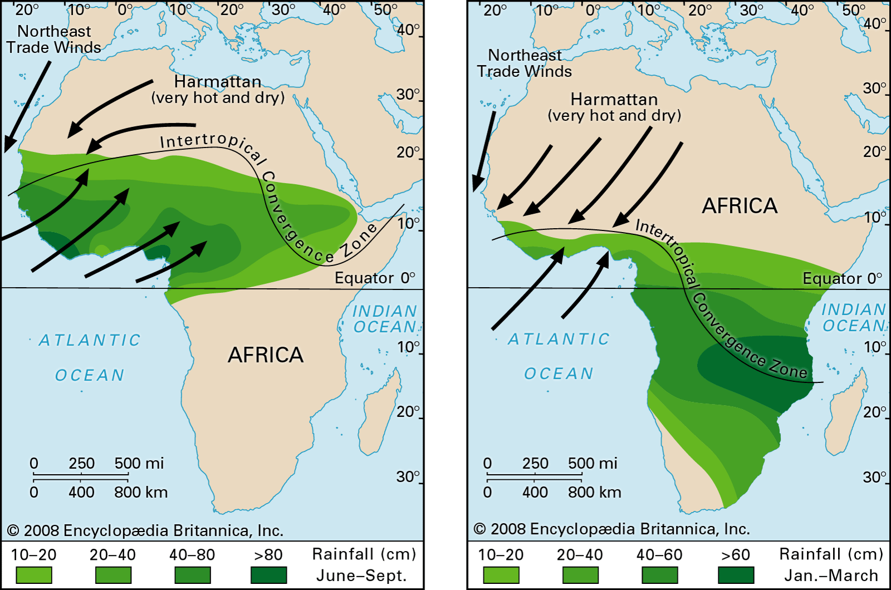
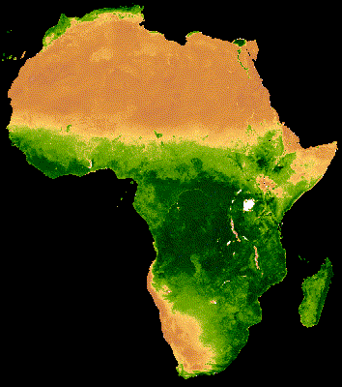
The West African Monsoon
Annual cycle of the ITCZ
MODIS NDVI 20-year climatology
June-Sept
Jan-March
Notes:
I now turn to some comments on the African signal.
The climatology of tropical Africa is dominated by the seasonal excursions of the Inter-Tropical Convergence Zone. In the NH summer, this band of convection moves north across the continent and brings rains. This is often called the West African monsoon. In the NH winter, the ITCZ moves south and a climatological northeasterly wind sets up, blowing hot and dry air off the Sahara desert. This is the Harmattan wind.

Slide 24
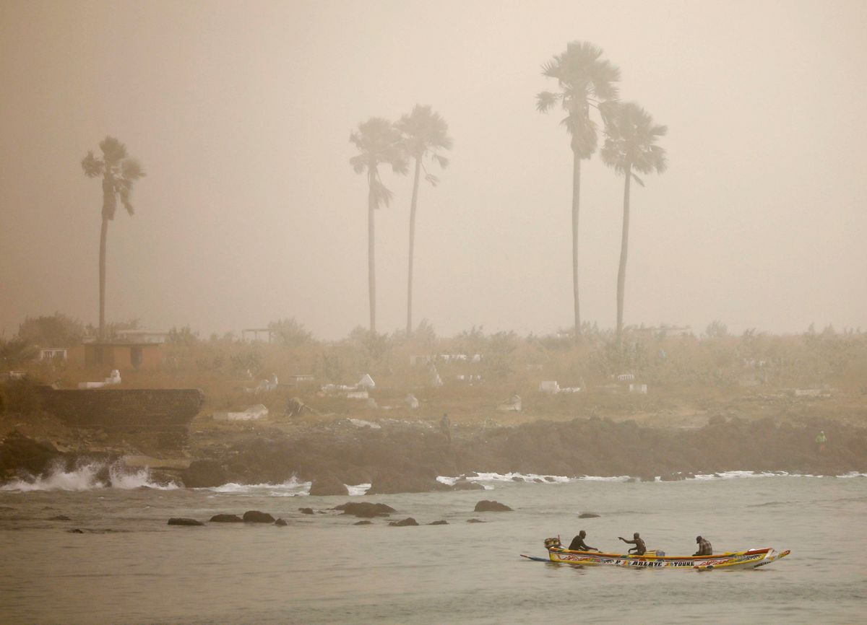
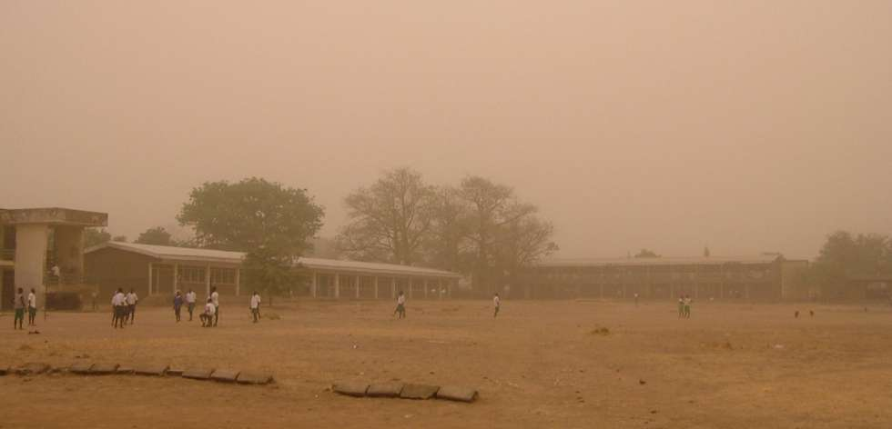
Harmattan dust
boreal winter
Dakar, Senegal
February 18, 2021
Credit: REUTERS/Zohra Bensemra TPX
Northern Nigeria
November 2018
Credit: Adaobi Onyeakagbu
Notes:
In the Harmattan season, dust blown off the desert creates a perpetual haze. Here we see pictures of two typical situations. Dakar Senegal is on the far west tip of West Africa, and northern Nigeria is in the northeast part of the domain.
You can see a distinct reddish tint to the photo from Nigeria. Close to the source, this is the color of the soil aerosols which are suspended in the air. As you get farther away, the larger particles fall out and the haze becomes less colored, as it is in Dakar.

Slide 25
Measured, modeled, and retrieved AOD over Africa
AOD
Major aerosol sources
Biomass burning
Industrialization
Harmattan dust
~780,000 premature deaths annually in Africa due to air pollution. Of these ~71% are due to natural sources (Bauer et al. 2019).
MODIS
GISS-MATRIX model
Bauer et al. (2019) https://doi.org/10.1029/2018JD029336
Notes:
Susanne Bauer and colleagues analyzed aerosol measurements, models, and retrievals over Africa. In their 2019 paper, they claim that about 800,000 excess deaths per year can be attributed to poor air quality over the continent.
Aerosol sources include biomass burning, industrialization, and of course natural dust such as that from the Harmattan. The Bauer et al study claims that 71% of those excess deaths are due to natural sources of aerosols.
The panels here show MODIS retrieved AOD and model simulated AOD for DJF, MAM, JJA, SON left to right.

Slide 26
Measured, modeled, and retrieved AOD over Africa
OCO-2 posterior
(B10 from 10s)
AOD
Major aerosol sources
Biomass burning
Industrialization
Harmattan dust
~780,000 premature deaths annually in Africa due to air pollution. Of these ~71% are due to natural sources (Bauer et al. 2019).
MODIS
GISS-MATRIX model
Bauer et al. (2019) https://doi.org/10.1029/2018JD029336
Notes:
I extracted the posterior AOD from OCO-2 10second average files and compiled a climatology which I show here. You see similar patterns, but it's the overall magnitude which caught my eye. These are not the same color scales.

Slide 27
Measured, modeled, and retrieved AOD over Africa
OCO-2 posterior
(B10 from 10s)
AOD
Major aerosol sources
Biomass burning
Industrialization
Harmattan dust
~780,000 premature deaths annually in Africa due to air pollution. Of these ~71% are due to natural sources (Bauer et al. 2019).
MODIS
GISS-MATRIX model
Bauer et al. (2019) https://doi.org/10.1029/2018JD029336
Notes:
If I plot the maps on the same color scale it becomes immediately evident that OCO-2 AOD is much lower than the various Bauer et al. estimates. However, this is completely as expected. The OCO-2 retrievals are supposed to be clear-sky and use a filter on posterior AOD so that no retrieval with AOD greater than 0.25 gets through.
This raises two questions. How representative are these successful retrievals? Is it common to have aerosol-free scenes? And what is the covariance between AOD and XCO2? We know that if undetected aerosols are in the scene, they should lengthen the optical path and increase CO2 absorption. What if there's only a little aerosol? Does that also impact XCO2?

Slide 28
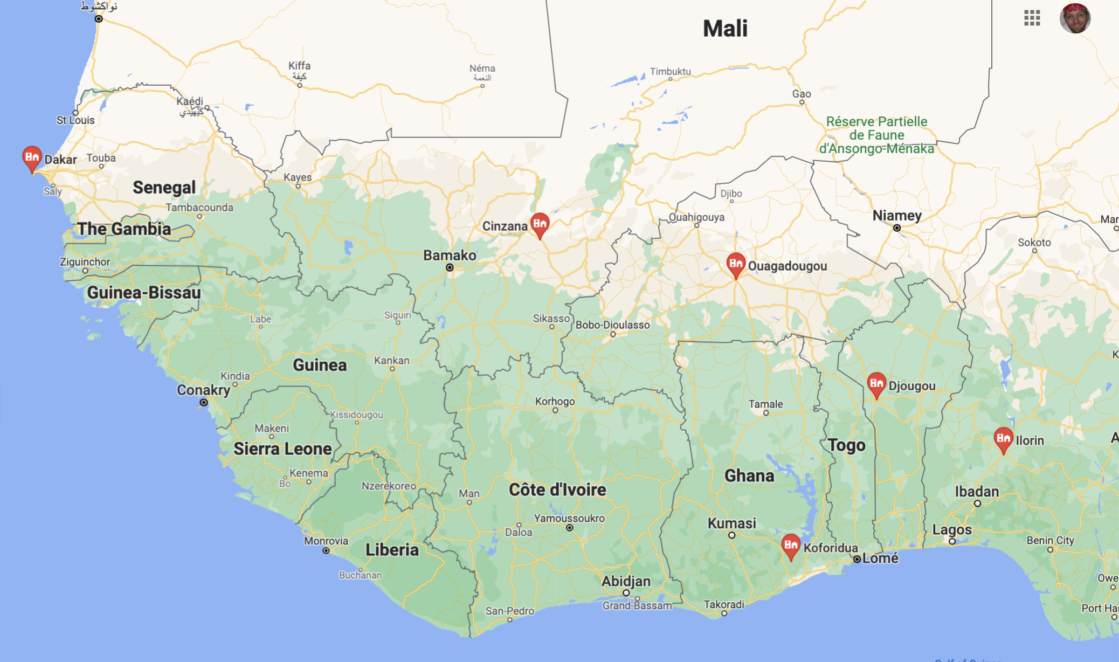
Aeronet AOD over Africa
Red line is 0.25, the OCO-2 filtering threshold for posterior AOD.
Using 675 nm
Dakar is right on the coast, might have cleaner marine air.
Fraction under 0.25
 | DJF | MAM
Dakar | 55% | 18%
Cinzana | 48% | 12%
Ouagadougou | 42% | 9%
Koforidua | 2% | 18%
Djougou | 5% | 7%
Ilorin | 3% | 10%
Notes:
Chose AERONET stations based on data availability and duration.
Wish we had AERONET stations in the southwest part of this domain.

Slide 29
Aeronet AOD over Africa
Red line is 0.25, the OCO-2 filtering threshold for posterior AOD.
Using 675 nm
Fraction under 0.25
 | DJF | MAM
Dakar | 55% | 18%
Cinzana | 48% | 12%
Ouagadougou | 42% | 9%
Koforidua | 2% | 18%
Djougou | 5% | 7%
Ilorin | 3% | 10%
Average | 48 (3)% | 12%
AERONET data providers: Rachel Pinker, Didier Tanré, Jean-Louis Rajot, Philippe Goloub
Notes:
Plots arranged in general geographic location of sites.
Interesting to see later peak in northern tier.
B10 LN signal is stronger in MAM than DJF anyway!
Number of AERONET retrievals for which AOD < 0.25 shown in table. Strong meridional gradient in AOD for DJF, overall agreement in MAM.

Slide 30
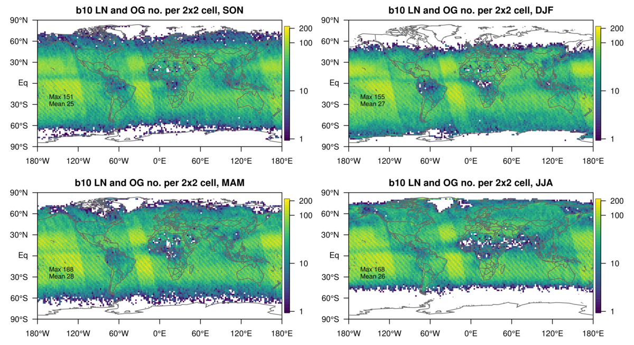

Slide 31
Summary
Globally-integrated B10 biases are smaller than those in B9.1
  Seasonal and regional variability is a concern
Seasonality of flux response to different data types is clear
  Equator-to-pole propagating waves of signal and flux response
  Is the NH seasonal cycle smaller than we think?
LNLGIS and LNLGOGIS evaluate better against withheld data
  Interplay of data types is complex
  Some odd fluxes…these may not be the best simulations
What is the posterior covariance between AOD and X_{CO2}?
Number of successful retrievals in the tropics is very low
  As expected due to aerosol and cloud screening
  Do they represent unusual conditions or are they representative of regional X_{CO2}?

Slide 33
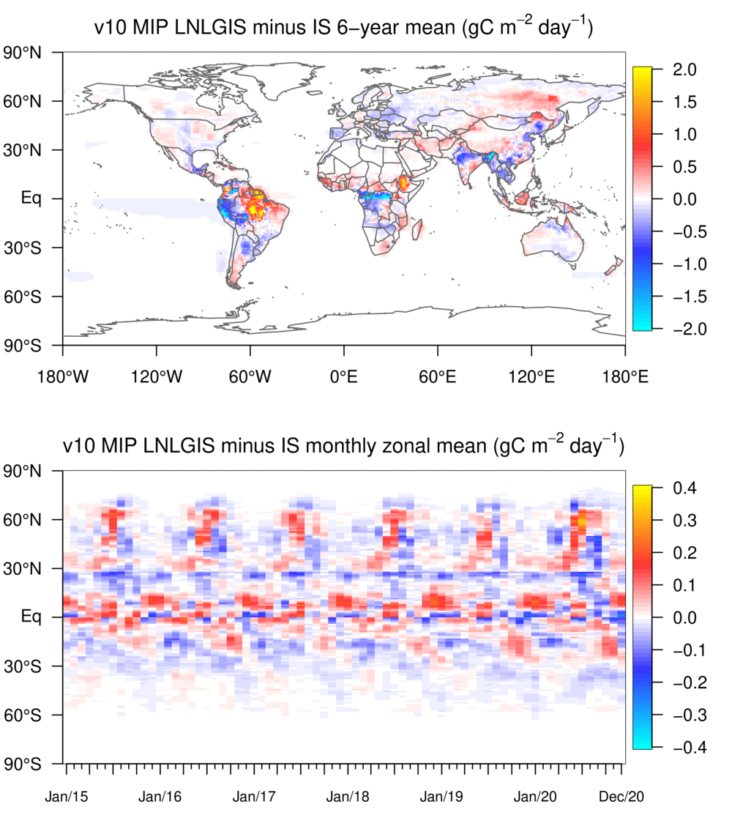
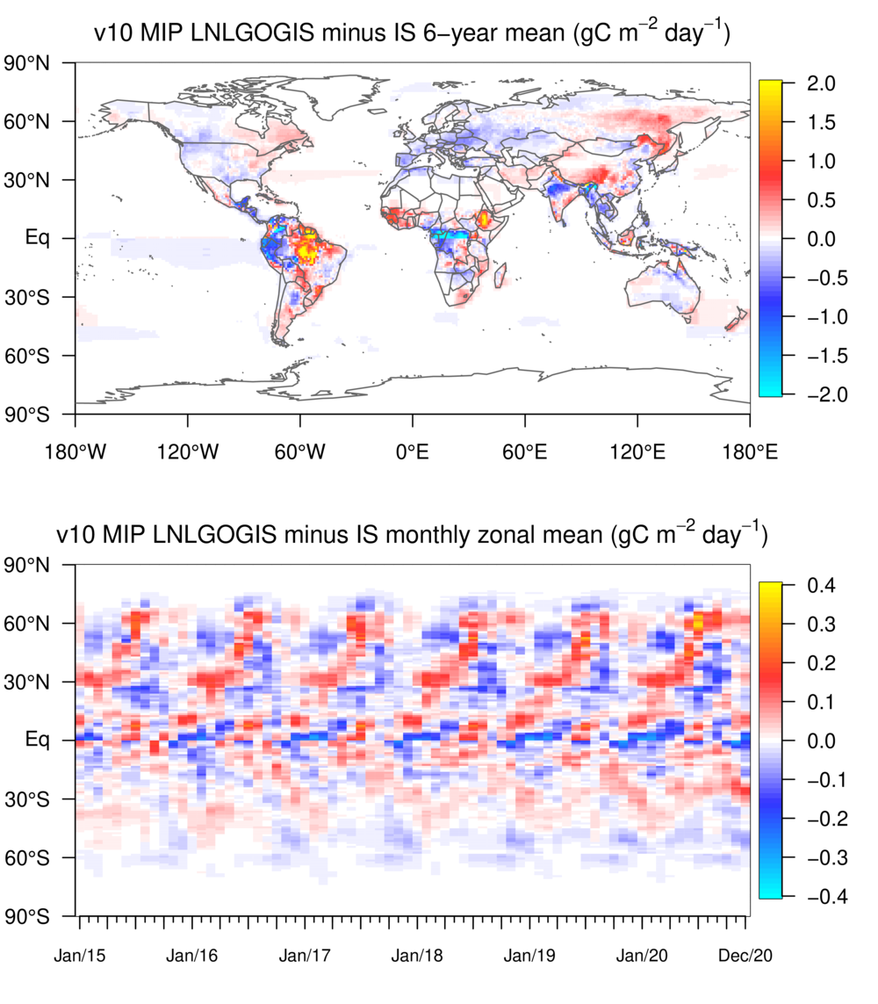

Slide 34
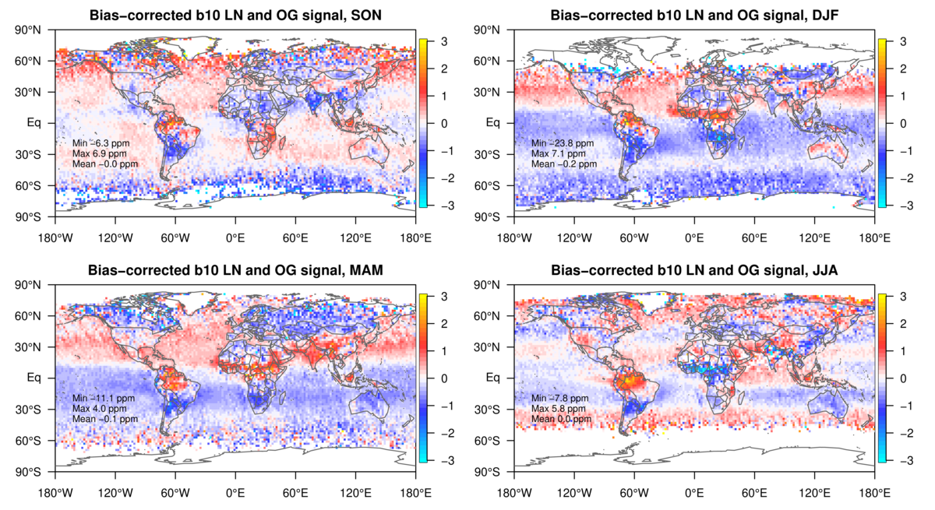

Slide 35


Slide 36
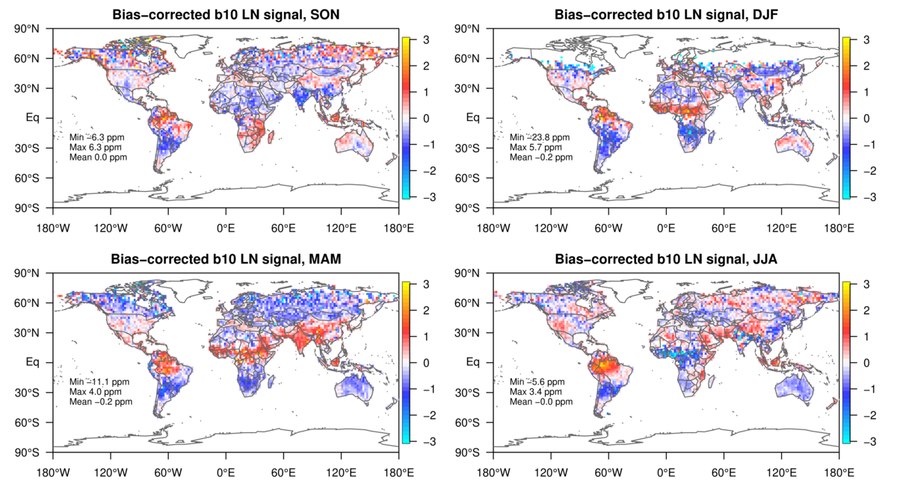

Slide 37
