Slide 1
NESDIS-Global Monitoring Laboratory
NUCAPS – CT2019B CO2
Focus Days comparison
Andy Jacobson presenting
Entire team has contributed
NESDIS-GML
Quarterly workshop
June x, 2021

Slide 2
NUCAPS Focus Days compared to CT2019B
SNPP and NOAA-20
  2018-06-15
  2018-09-16
  2018-12-15
  2019-01-15
NUCAPS – CT2019B residuals, in ppm CO₂
Following on satisfactory 3-way comparison: ATom measurements, NUCAPS retrievals, CT2019B
Averaging kernels not available, so we show discrete pressure levels.
Thermal IR retrievals: most-signal/least-prior in the 300-500 hPa range
Retrieval performance questions
  Land vs ocean
  Seasons
  Latitude

Slide 3
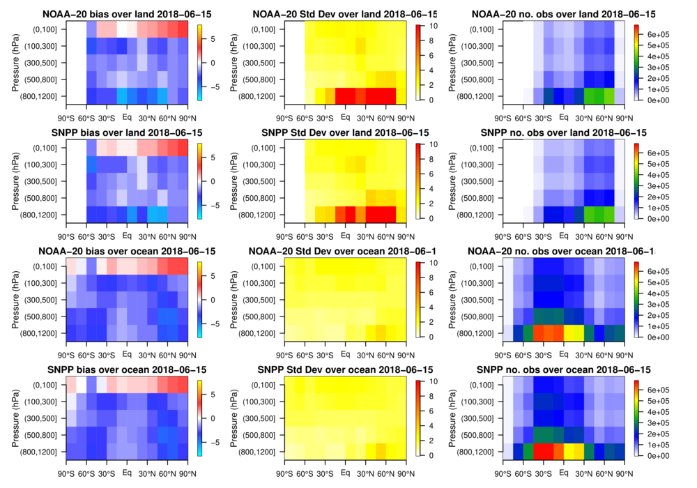
2018-06-15

Slide 4
2018-06-15

Slide 5
2018-06-15
Bias
-8 to +8 ppm
Standard
Deviation
0-10 ppm
No. Obs
0-600,000

Slide 6
2018-06-15
NOAA-20 →
SNPP →
NOAA-20 →
SNPP →

Slide 7
2018-06-15
Retrievals over land
Retrievals over ocean

Slide 8
2018-06-15

Slide 9
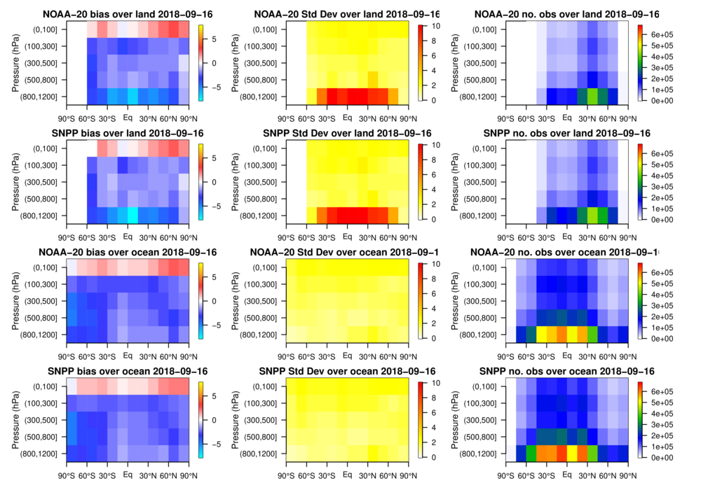
2018-09-16

Slide 10
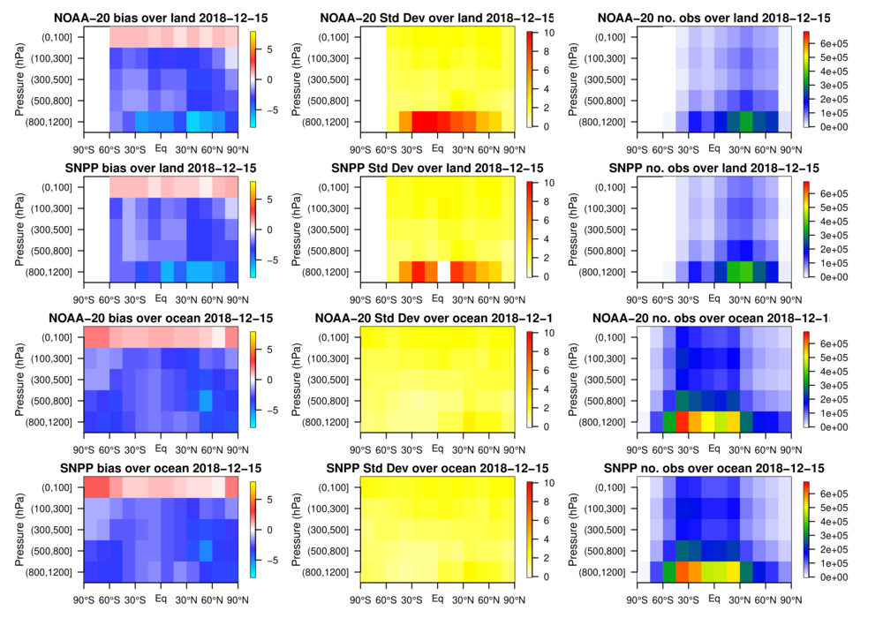
2018-12-15

Slide 11
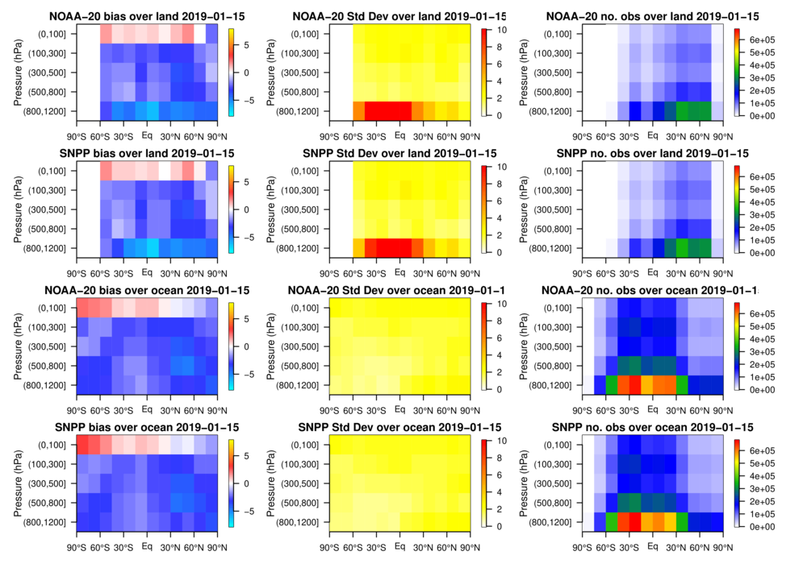
2019-01-15

Slide 12
2019-01-15
Conclusions
Bias
Overall negative bias in NUCAPS CO₂ except at highest levels
          Around 2 ppm
          No seasonal dependence
          No platform dependence
          Slightly better at lower latitudes
          Worse near surface for land
Variability
High variance in lowest layers, but only over land
Summary
No platform or seasonal effects detected
Overall negative bias
Land vs. ocean effects are detectable near surface
Different from OCO-2
Next Steps
Looking forward to averaging kernels

Slide 14
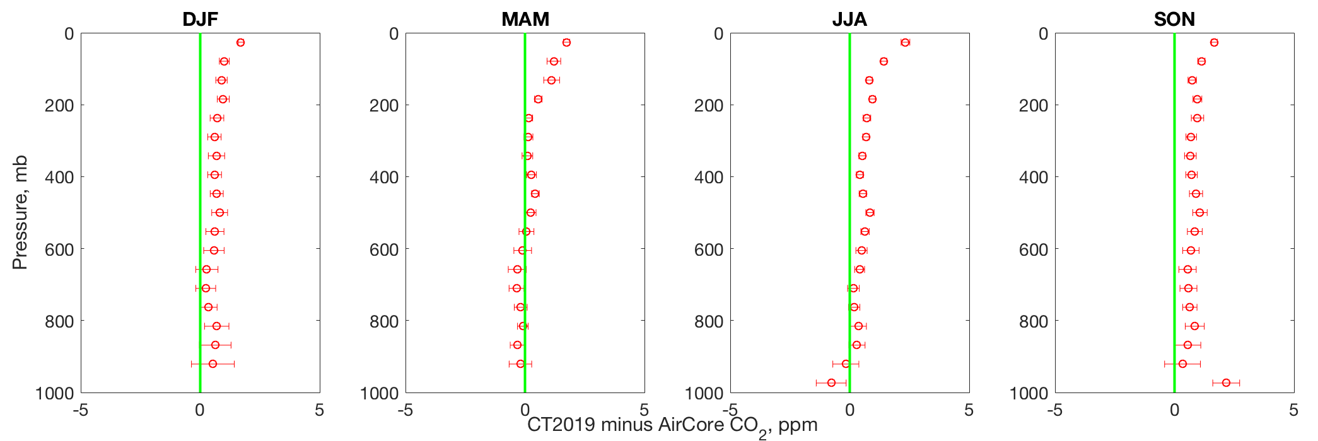
CarbonTracker (CT2019) evaluation of stratospheric CO₂ using AirCores
NOAA CCGG aircraft network altitude ceiling
Aircraft network altitude ceiling
CarbonTracker is NOAA’s CO₂ inverse modeling framework for mole fraction, flux estimation (Jacobson et al., 2020; http://www.carbontracker.noaa.gov)
CT assimilates routine NOAA CCGG Aircraft Network flask CO₂ measurements to ~12-13 km MSL
AirCore samples from 2009-2020 extend to ~30km MSL, provide some of the only routine GHG measurements in UT/LS for model evaluation
Notes:
-Taking a look at seasonal comparisons to CT2019 for all of our historical AirCore samples available from 2009-2020, we see a consistent stratospheric bias throughout the column of 1-2 ppm.
-So the AirCore may help to better inform model stratosphere, assign model-data-mismatch information to UT/LS data for future assimilation

