Slide 1
Global Land GPP from the Terrestrial Photosynthesis State Estimate
Andrew R. Jacobson^{1,2}, Aleya Kaushik^{1,2}, Andrew Schuh³, Ian Baker³, and David Munro^{1,2}
1. CIRES University of Colorado Boulder
2. NOAA Global Monitoring Laboratory
3. CIRA, Colorado State University
Introduction to the TPSE
Testing TPSE using an OSSE framework
Assimilation of FLUXNET2015 eddy covariance data
Exploration of solar-induced fluorescence (SIF) data

Slide 2
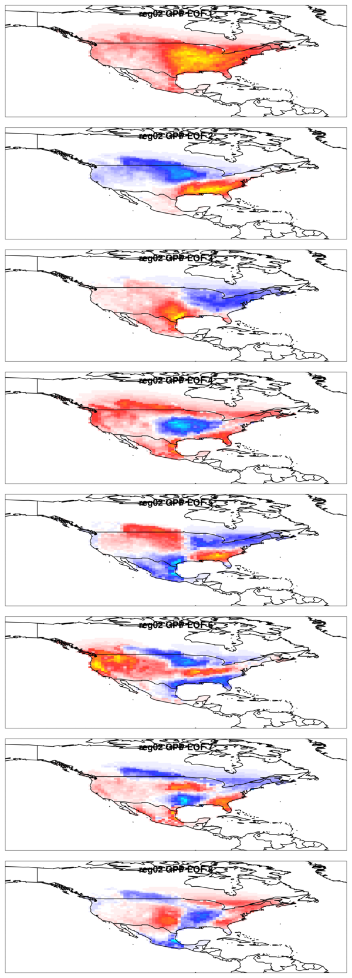
The Terrestrial Photosynthesis State Estimate (TPSE)
Leading EOFs of MsTMIP v2.0 GPP over
TransCom region 2 (N. America temperate)
GPP represented as the weighted sum of spatial patterns
Derived from EOFs of MsTMIP simulations
Compact basis set
The state vector is time-varying amplitudes of each pattern
Full-rank Kalman filter
  Linear dynamics (modified persistence)
Estimates differences from CASA-derived GPP
Full characterization of uncertainties for arbitrary regions
  Grid cells
  Countries
  Ecoregions
Intended as prior for CarbonTracker

Slide 3
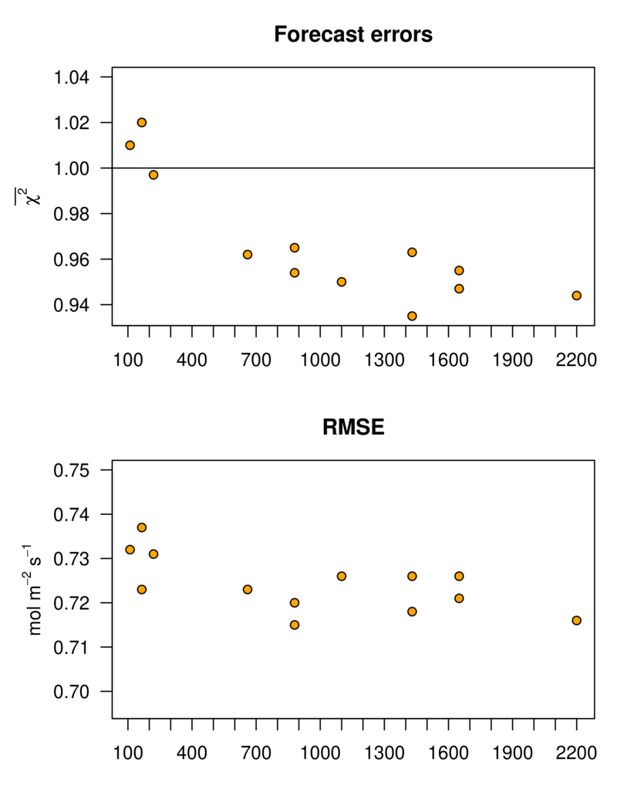
TPSE Simulation Experiment
To tune Kalman filter parameters, determine no. modes,
and to evaluate performance
Artificial truth is SiB4
Starting guess is GFED4.1s GPP (= NPP x 2)
Using basis set derived from MsTMIP
Synthetic measurements
  Observations are grid cell SiB4 GPP
  4 μmol m⁻² s⁻¹ random noise added
  200 synthetic observations per month
  Randomly distributed over all land points
120 modes per Transcom region

Slide 4
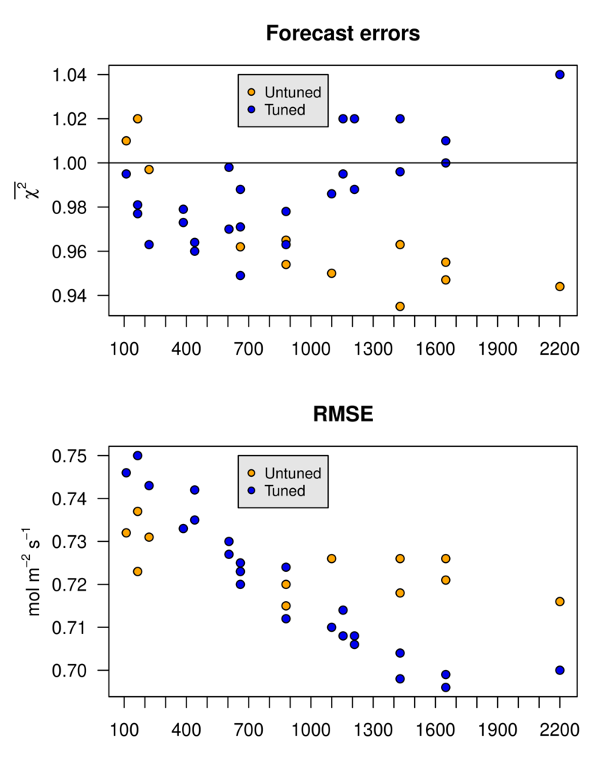
TPSE Simulation Experiment
To tune Kalman filter parameters, determine no. modes,
and to evaluate performance
Artificial truth is SiB4
Starting guess is GFED4.1s GPP (= NPP x 2)
Using basis set derived from MsTMIP
Synthetic measurements
  Observations are grid cell SiB4 GPP
  4 μmol m⁻² s⁻¹ random noise added
  200 synthetic observations per month
  Randomly distributed over all land points
120 modes per Transcom region

Slide 5
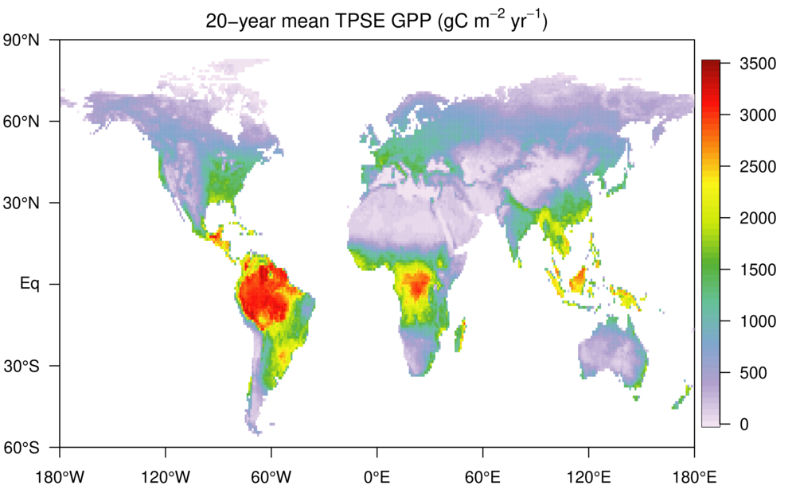
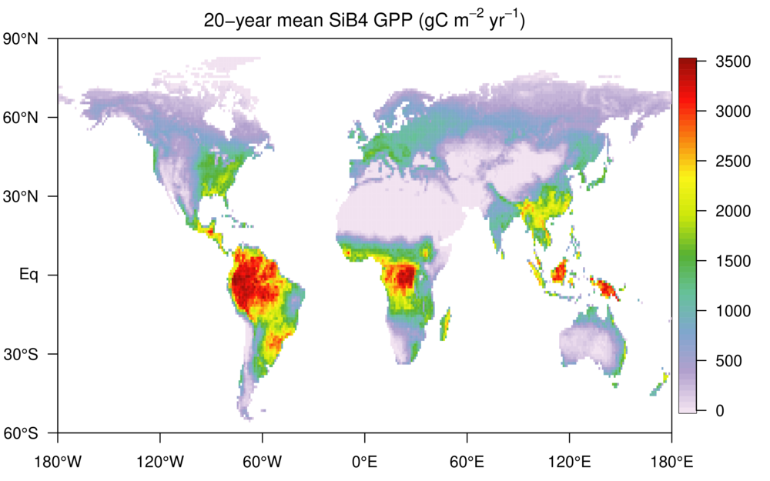
TPSE Simulation Experiment
To tune Kalman filter parameters, determine no. modes,
and to evaluate performance
Artificial truth is SiB4
Starting guess is GFED4.1s GPP (= NPP x 2)
Using basis set derived from MsTMIP
Synthetic measurements
  Observations are grid cell SiB4 GPP
  4 μmol m⁻² s⁻¹ random noise added
  200 synthetic observations per month
  Randomly distributed over all land points
120 modes per Transcom region

Slide 6
TPSE Simulation Experiment
To tune Kalman filter parameters, determine no. modes,
and to evaluate performance
Artificial truth is SiB4
Starting guess is GFED4.1s GPP (= NPP x 2)
Using basis set derived from MsTMIP
Synthetic measurements
  Observations are grid cell SiB4 GPP
  4 μmol m⁻² s⁻¹ random noise added
  200 synthetic observations per month
  Randomly distributed over all land points
120 modes per Transcom region
Histograms of 264 months of TPSE minus SiB4. Actual differences shaded in tan. Interpreted as a normal distribution in red curve.
Criterion: analytical uncertainties (blue) match actual (red).
Criterion: Bias is within error bounds.
USA includes Alaska and Hawaii

Slide 7
FLUXNET2015 assimilation
Performance against withheld data
80 modes/region
Performed 1997 – 2015
Starts from GFED4.1s GPP estimate
FLUXNET2015 dataset
(Pastorello et al. 2020)
  Ends in 2014
  Required significant QC
17220 monthly GPP measurements
  16406 assimilated, 814 withheld
  1991-2014, 206 sites
Observational uncertainties include
  Empirically-determined MDM error
  FLUXNET estimate of GPP uncertainty
Most RMSE is random variability, but there are systematic biases in all models.

Slide 8
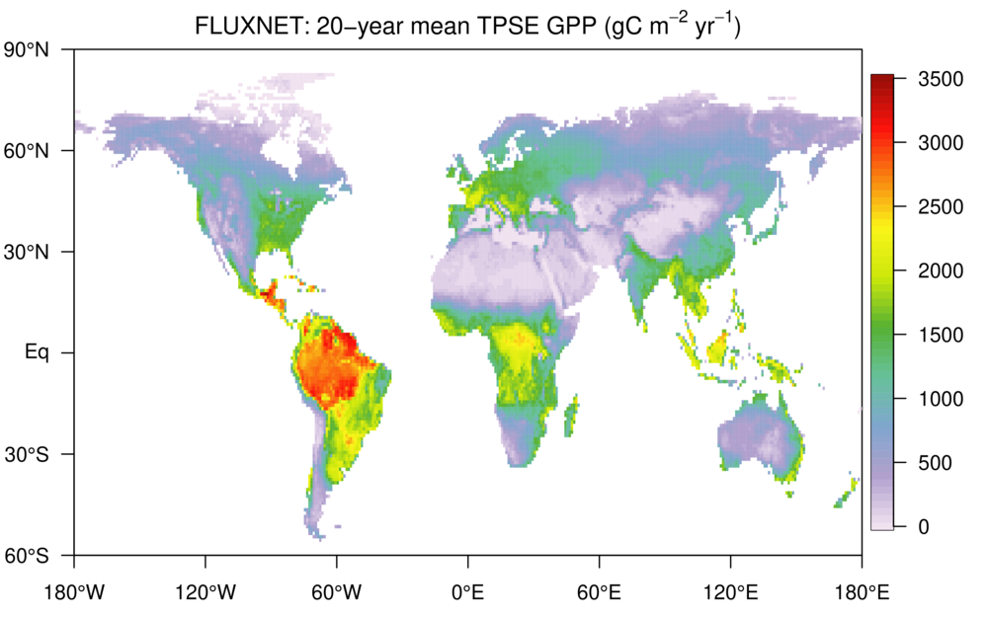

FLUXNET2015 assimilation
80 modes/region
Performed 1997 – 2015
Starts from GFED4.1s GPP estimate
FLUXNET2015 dataset
(Pastorello et al. 2020)
  Ends in 2014
  Required significant QC
17220 monthly GPP measurements
  16406 assimilated, 814 withheld
  1991-2014, 206 sites
Observational uncertainties include
  Empirically-determined MDM error
  FLUXNET estimate of GPP uncertainty

Slide 9
FLUXNET2015 assimilation
80 modes/region
Performed 1997 – 2015
Starts from GFED4.1s GPP estimate
FLUXNET2015 dataset
(Pastorello et al. 2020)
  Ends in 2014
  Required significant QC
17220 monthly GPP measurements
  16406 assimilated, 814 withheld
  1991-2014, 206 sites
Observational uncertainties include
  Empirically-determined MDM error
  FLUXNET estimate of GPP uncertainty
Amazon
Santarem K67 flux tower, Brazil

Slide 10
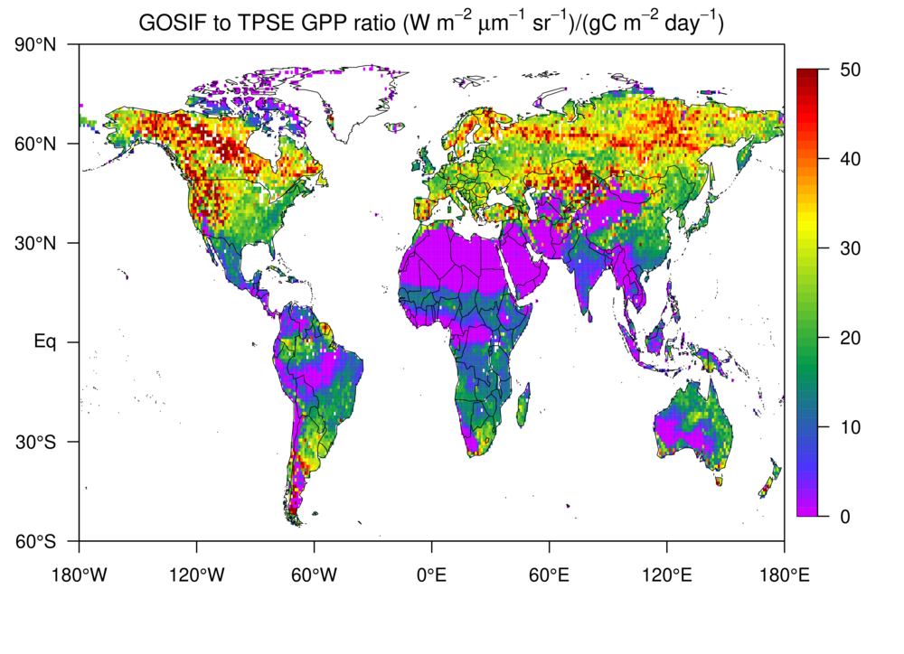
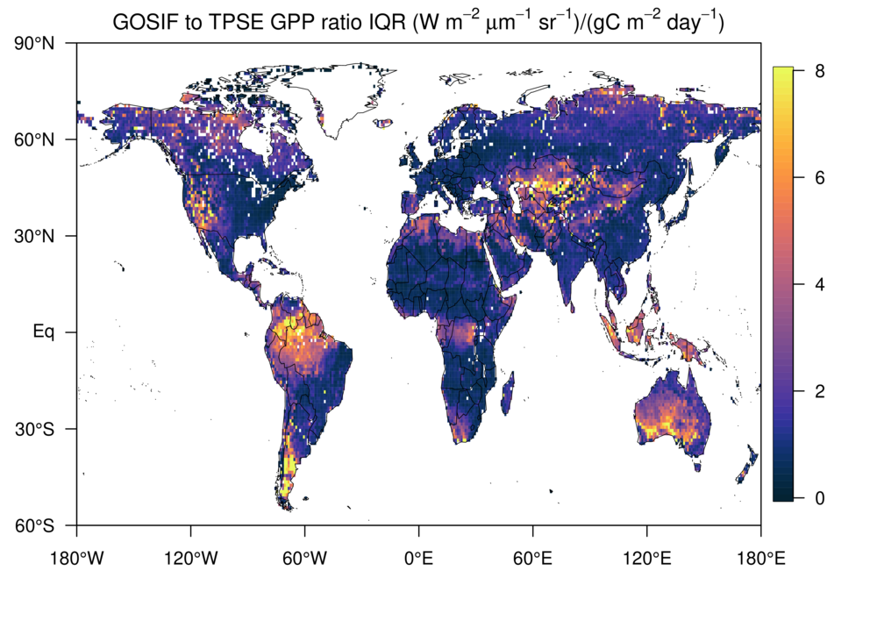
SIF
How variable is the GPP:SIF ratio?
Reference slopes:
16.7 Sun et al. (2017)
23.4 GOSIF-GPP
(Li and Xiao, 2019)
TPSE GPP to GOSIF suggests higher ratios at higher latitudes
Constant ratio would aid in assimilating SIF
Slope
Slope
Uncertainty

Slide 11
Summary and next steps
Full uncertainty characterization allows use as a genuine prior and for hypothesis testing
Continued cleanup of eddy covariance data
Slight positive bias – does not hit minimum GPP
Sequential assimilation: GOSIF product using additional “nuisance parameters” involving relationship between GPP and SIF
Sequential assimilation: atmospheric tracers carbonyl sulfide, CO₂

Slide 13
TPSE Simulation Experiment
To tune Kalman filter parameters, determine no. modes,
and to evaluate performance
Artificial truth is SiB4
Starting guess is GFED4.1s GPP (= NPP x 2)
Using basis set derived from MsTMIP
Synthetic measurements
  Observations are grid cell SiB4 GPP
  4 μmol m⁻² s⁻¹ random noise added
  200 synthetic observations per month
  Randomly distributed over all land points
120 modes per Transcom region
USA includes Alaska and Hawaii

Slide 14
FLUXNET2015 assimilation
80 modes/region
Performed 1997 – 2015
Starts from GFED4.1s GPP estimate
FLUXNET2015 dataset
(Pastorello et al. 2020)
  Ends in 2014
  Required significant QC
17220 monthly GPP measurements
  16406 assimilated, 814 withheld
  1991-2014, 206 sites
Observational uncertainties include
  Empirically-determined MDM error
  FLUXNET estimate of GPP uncertainty

Slide 15
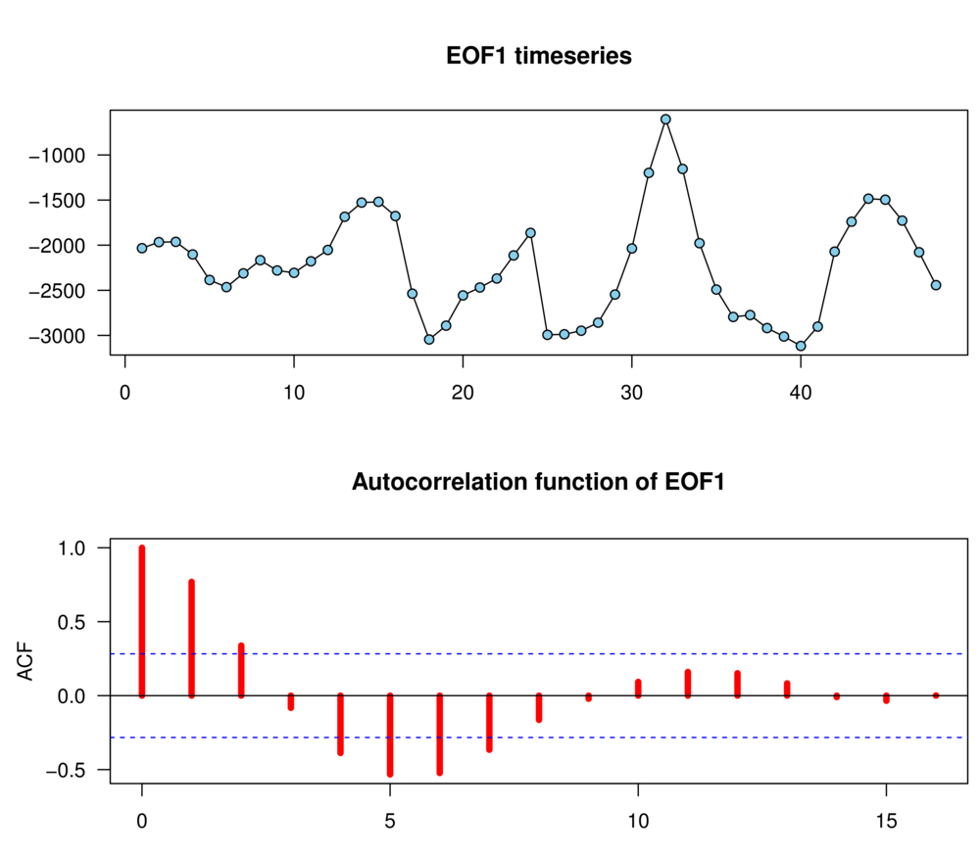
Each mode is characterized by a timescale and a variance
Variance is how strongly the mode is expressed by models
CT-Next estimates the amplitude of a “mode”.
Modes are generally EOFs, which are
efficient ways to summarize a field
Modes have fixed spatial patterns
The amplitude of a mode is a continuous variable
Modified persistence: Once activated, a mode decays away towards zero with a timescale diagnosed from models…unless data says otherwise.
This mode’s timescale is about 2.5 months

Slide 16
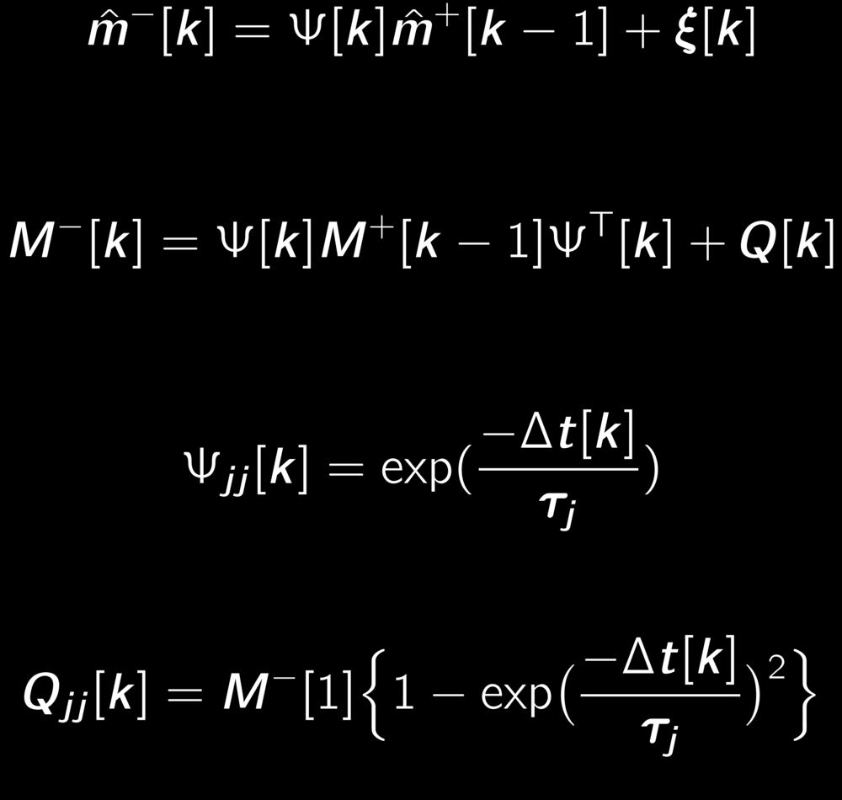
Modified persistence dynamics in Kalman filter
Time propagation of parameters
Real time propagation
Real prior covariance
Real process uncertainty
Time propagation of covariance
Time propagation
operator
Process uncertainty
Spiesberger et al. (1997), Jacobson (2001)

Slide 17
CarbonTracker-Next structure
Terrestrial GPP state estimate: GPPSE
Kalman filter with fully-characterized errors
Basis set: MsTMIP EOFs
State vector: EOF amplitudes, nuisance parameters
Constraints: SIF, OCS, NIRv,eddy covariance
Prior: CASA-GFED 2xNPP
Terrestrial respiration:
cp3 model
Simplified carbon pool model
State vector: spatially-varying constants
Prior: initially fitted to CASA respiration
Driven by inputs from GPPSE
Ocean pCO₂:
Surface carbon state estimate (SCSE)
Kalman filter with fully-characterized errors
Basis set: CMIP5 EOFs
State vector: EOF amplitudes,
Constraints: SOCAT gridded 1x1
Goals
Meaningful uncertainties
Flexible scales & model DOFs
Use of wider array of observational constraints
Better links to process-based models
CT-Next
Real uncertainties!
Sequential refinement of priors from 3 component models
State space is same as prior models
First place CO2 measurement data are applied

Slide 18
CarbonTracker-Next structure
Terrestrial GPP state estimate: GPPSE
Kalman filter with fully-characterized errors
Basis set: MsTMIP EOFs
State vector: EOF amplitudes, nuisance parameters
Constraints: SIF, OCS, NIRv, eddy covariance
Prior: CASA-GFED 2xNPP
Terrestrial respiration:
cp3 model
Simplified carbon pool model
State vector: spatially-varying constants
Prior: initially fitted to CASA respiration
Driven by inputs from GPPSE
Ocean pCO₂:
Surface carbon state estimate (SCSE)
Kalman filter with fully-characterized errors
Basis set: CMIP5 EOFs
State vector: EOF amplitudes,
Constraints: SOCAT gridded 1x1
CT-Next
Real uncertainties!
Sequential refinement of priors from 3 component models
State space is same as prior models
First place CO2 measurement data are applied

Slide 19
CarbonTracker-Next structure
Terrestrial GPP state estimate: GPPSE
Kalman filter with fully-characterized errors
Basis set: MsTMIP EOFs
State vector: EOF amplitudes, nuisance parameters
Constraints: SIF, OCS, NIRv,eddy covariance
Prior: CASA-GFED 2xNPP
Terrestrial respiration:
cp3 model
Simplified carbon pool model
State vector: spatially-varying constants
Prior: initially fitted to CASA respiration
Driven by inputs from GPPSE
Ocean pCO₂:
Surface carbon state estimate (SCSE)
Kalman filter with fully-characterized errors
Basis set: CMIP5 EOFs
State vector: EOF amplitudes,
Constraints: SOCAT gridded 1x1
Can easily adapt regional scales and overall model DOFs
Full Bayesian characterization of uncertainties
Use of SIF, OCS, NIRv, pCO₂, and eddy covariance data (CO, ¹⁴CO₂ down the road)
GPP and respiration modeled separately
CT-Next
Real uncertainties!
Sequential refinement of priors from 3 component models
State space is same as prior models
First place CO2 measurement data are applied

