Slide 1
Withheld in situ measurements for evaluating OCO-2 models
Andy Jacobson ^{1,2}, David Baker ³, Sourish Basu ⁴, Michael Bertolacci ⁵, Frédéric Chevallier ⁶, Noel Cressie⁵, Sean Crowell ⁷, Feng Deng ⁸, Matthew Johnson ¹², Junjie Liu ⁹, Zhiqiang Liu ¹¹, Scot Miller ¹⁰, Andrew Schuh ³, Brad Weir ⁴, Andrew Zammit-Mangion⁵, Ning Zeng ¹¹
University of Colorado Boulder
NOAA Global Monitoring Laboratory
Colorado State University
University of Maryland
University of Wollongong
Laboratoire des Sciences du Climat et de l’Environnement
University of Oklahoma
University of Toronto
Jet Propulsion Laboratory
Johns Hopkins University
University of Maryland
NASA Ames Research Center
Thanks to Heather Cronk, Chris O’Dell, Ken Schuldt, Kirk Thoning
MIP website tools: website
Standard analysis products

Slide 2
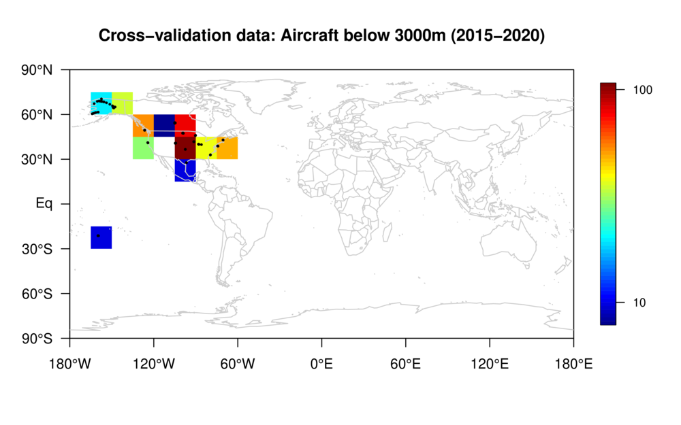
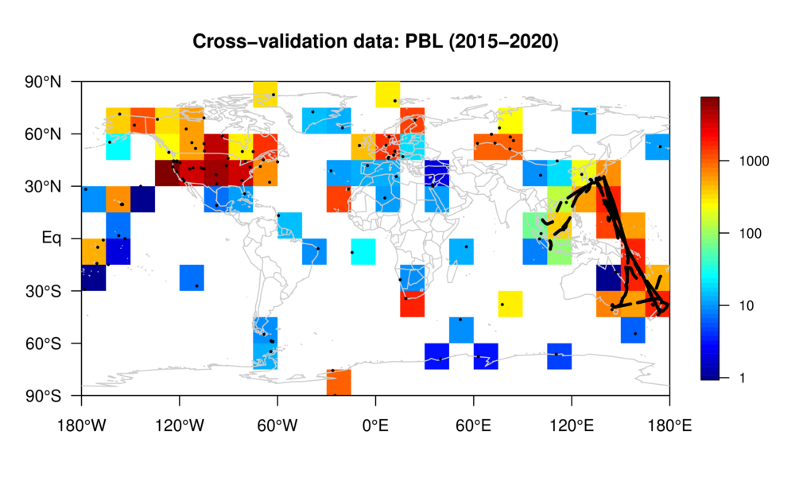
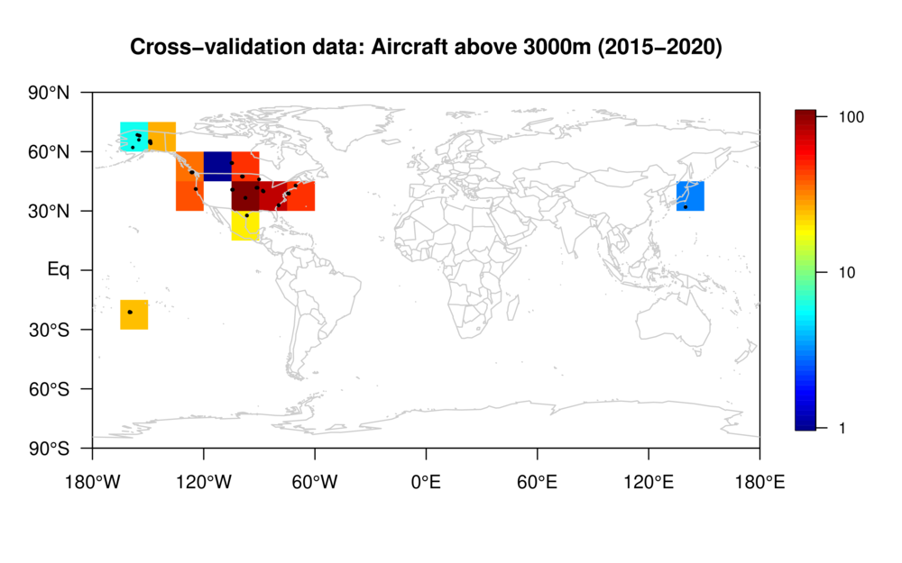
Withheld in situ measurements
GLOBALVIEW+ v8: 66 labs, 30.2M measurements 1957-2022
About 5% of assimilation-quality measurements marked for cross-validation in GLOBALVIEW+
  Each with MDM
  Careful attention to independence
  Still reflects in situ network
53533 withheld measurements 2015-2020
Here, 15° x 15° grid cells for PBL and two aircraft levels
Used to evaluate OCO-2 MIP and GCP models

Slide 3
All assimilable in situ measurements
(including some that were assimilated in IS, LNLGIS, and LNLGOGIS)

Slide 4
Evaluation using withheld IS data

Slide 5
Evaluation using non-assimilated data: ATom

Slide 6
CT2022 minus AirCore

