Slide 1
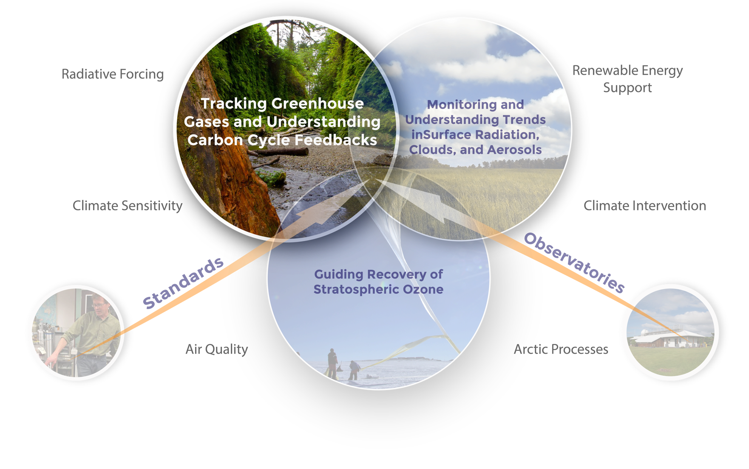
Theme 1: Tracking Greenhouse Gases and Understanding Carbon Cycle Feedbacks
`

Slide 2
Take Home Messages
We are creating an unassailable and well-documented record of greenhouse gases.
We try to help society deal with the climate problem:
  Create a quantitative record of climate forcing.
  Quantify and diagnose the response of the natural carbon cycle and greenhouse gas budgets to climate change.
  Evaluate potential “surprises” and give early warning if warranted.
  Support mitigation by providing objective and transparent verification of emissions.
Close relationships between measurers and modelers have kept us at the forefront of carbon science and are crucial to continued success.
GMD anchors the global and US atmospheric carbon observing network. We have established ongoing comparisons with all of the major laboratories. We rely on partnerships with other labs and institutions.
We have just begun to reap the scientific rewards of our investment in North American monitoring – multiple-species analysis will provide critical process constraints and enable improved source attribution.
“Science-driven monitoring of the atmosphere, responding to societal needs”

Slide 3
Outline
Tracking Greenhouse Gases at the Global Scale
Understanding Carbon Cycle Feedbacks
Satellite Retrieval and Model Evaluation
Monitoring Greenhouse Gases in the Upper Atmosphere
Intensive Field Campaigns and Capacity Building
Looking Forward

Slide 4
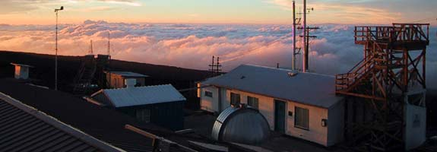
Tracking Greenhouse Gases at the Global Scale
Mauna Loa Observatory: Photograph by Forrest Mims III

Slide 5
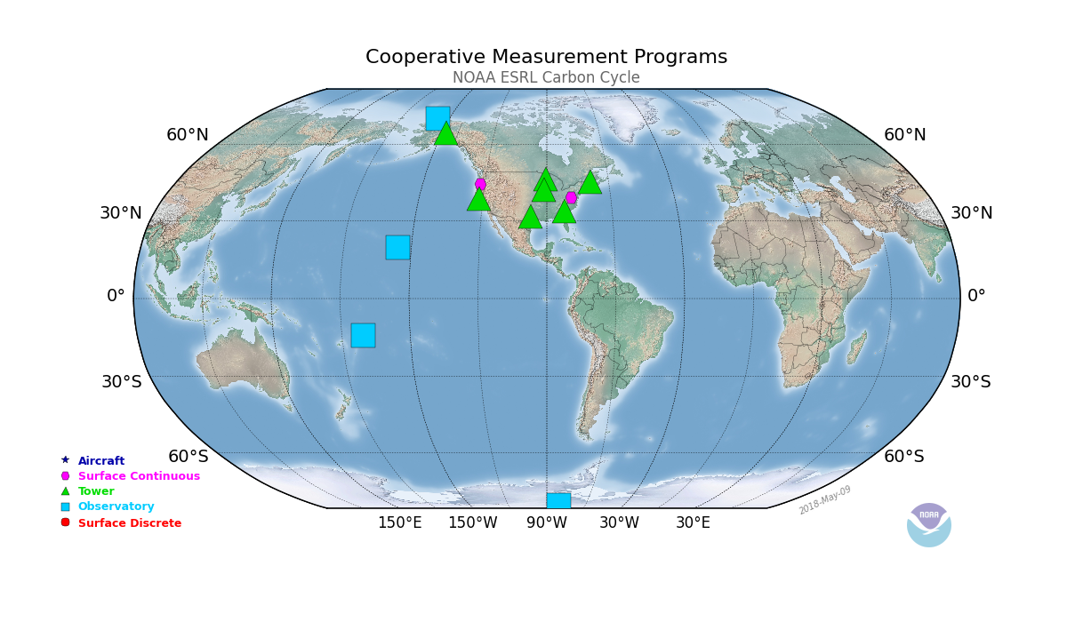
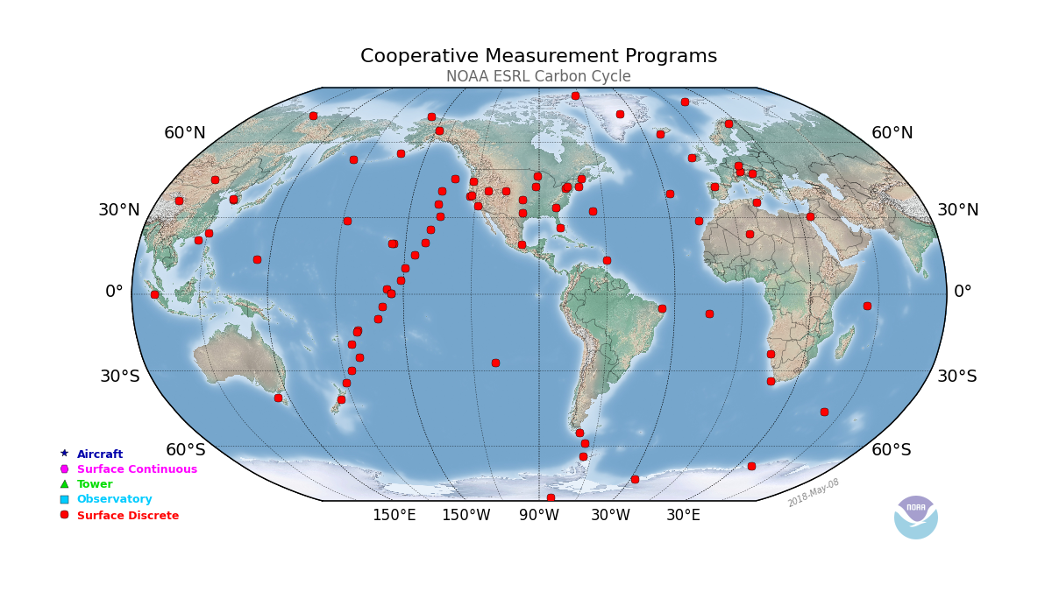
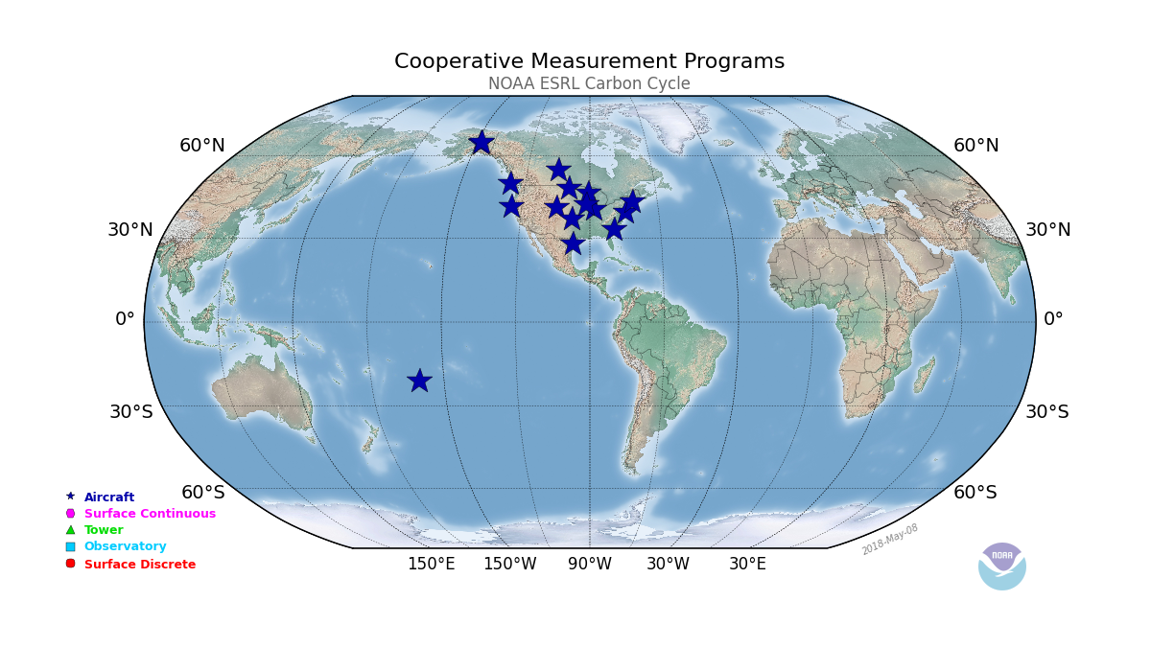
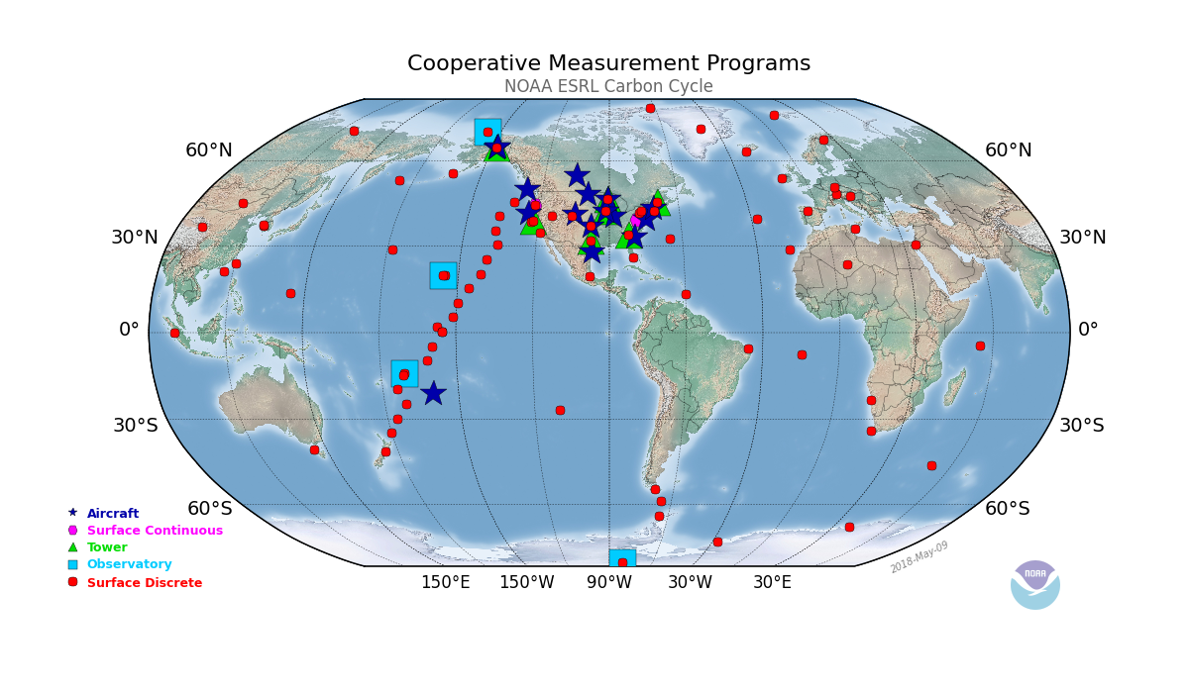

NOAA Global Greenhouse Gas Reference Network
e
Aircraft
Surface Continuous
Tower
Observatory
Surface Discrete
e
Data are carefully calibrated relative to WMO scales
Intra-laboratory and cross laboratory comparisons with other labs ensure data compatibility
Whole air samples are analyzed for many species
Many partners!

Slide 6
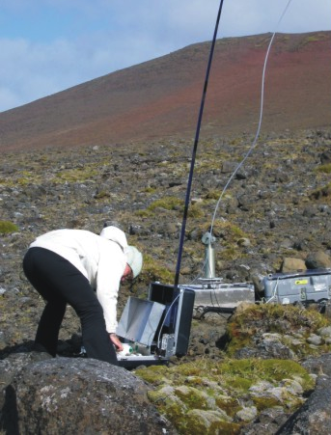
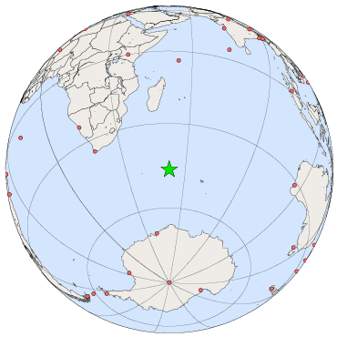
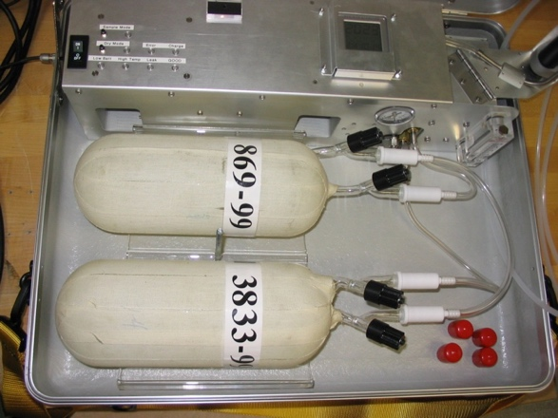
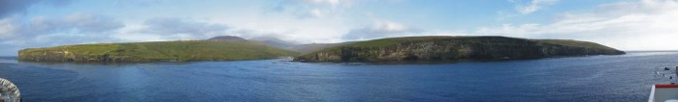
Air sampling at Crozet Island
Weekly whole air samples capture the variability at remote sites.
Local sources and sinks are avoided.

Slide 7
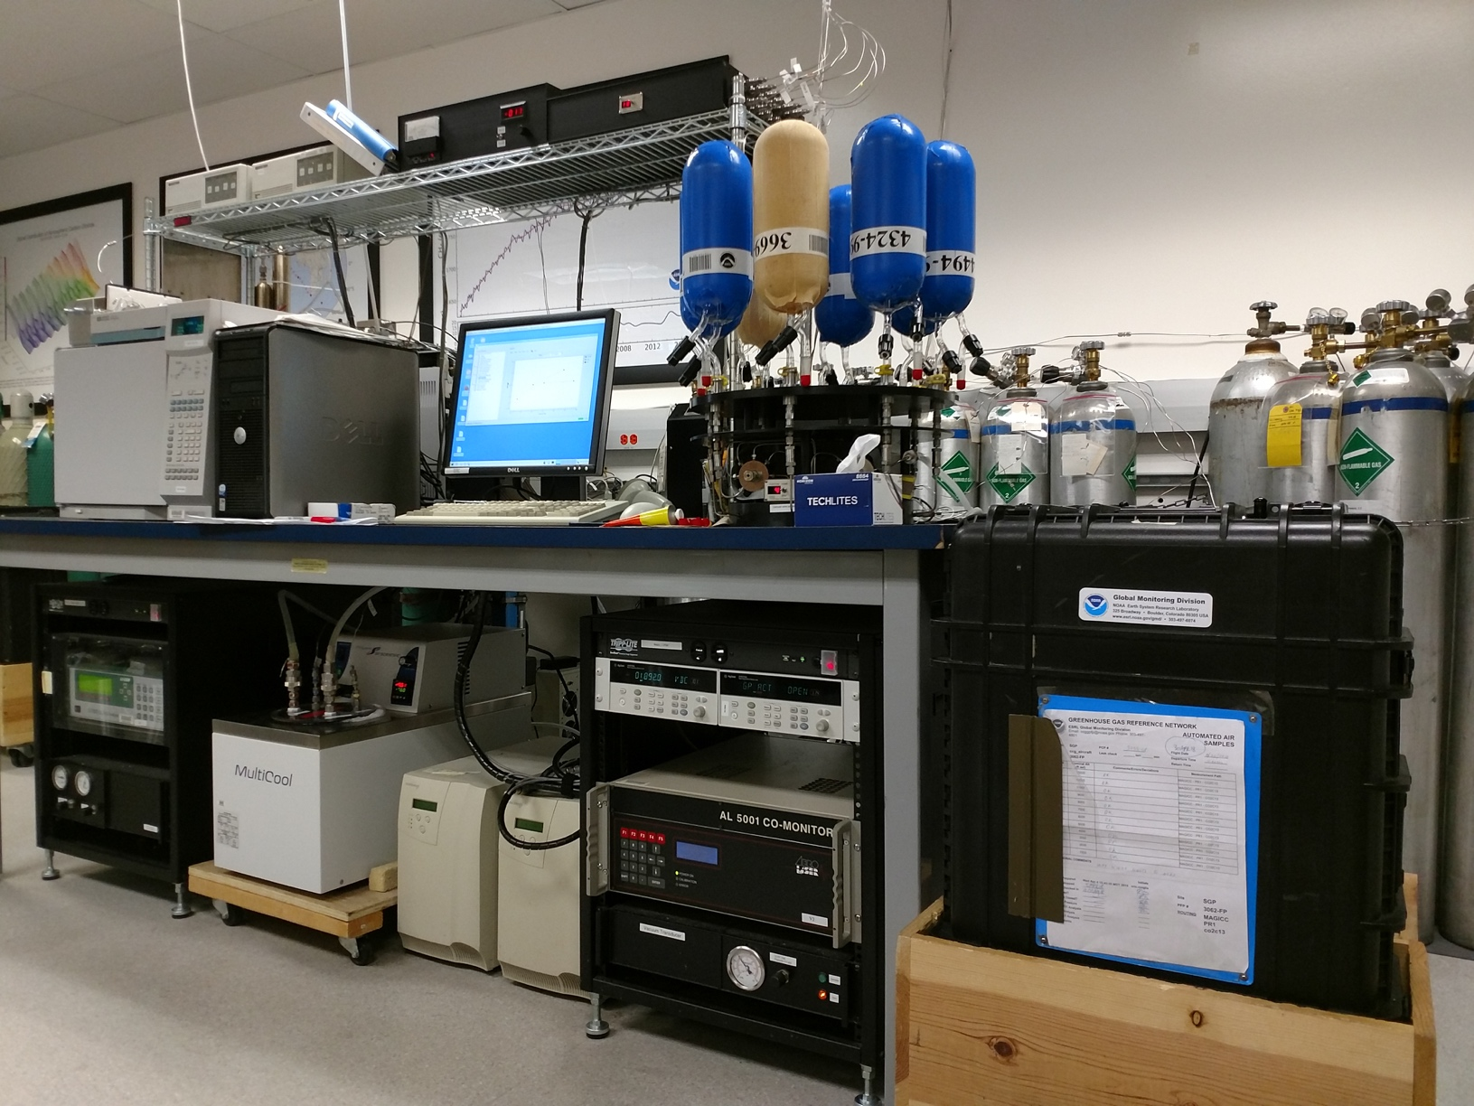
Measurement of Atmospheric Gases that Influence Climate Change (MAGICC) Whole Air Sample Analysis System
Calibration Gases
Presentation by Brad Hall
Manually Sampled Flasks
Programmable Flask Packages
WMO compatibility goals for remote sites:
  CO₂: ±0.10 ppm Northern Hemisphere
  ±0.05 ppm Southern Hemisphere
  CH₄: ±2 ppb
  N₂O: ±0.10 ppb

Slide 8
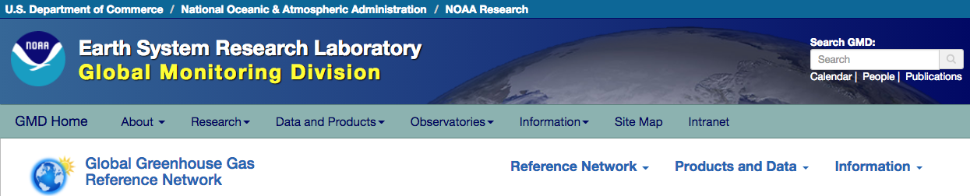
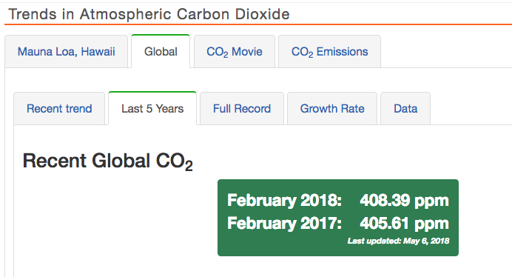
Global Means computed from the Marine Boundary Layer data are publically posted with minimal delay.
GMAC presentation by Ed Dlugokencky

Slide 9
Global Mean Values for the Major Long-Lived Greenhouse Gases
Presentation by Steve Montzka

Slide 10
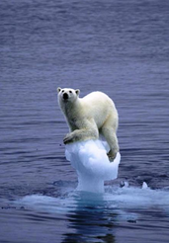

NOAA Annual Greenhouse Gas Index
As of 2016, radiative forcing from anthropogenic greenhouse gases is up by 40% over 1990 levels.
Earth’s Surface: 510.1 trillion m²
3 W/m² over Earth’s Surface ≈ 4.8×10²² Joules of Energy per year
⇒ enough to melt 60% of Greenland’s ice in one year
⇒ enough to heat 100m of ocean 0.32°C in one year
Notes:
How much is 3 Wm-2 for the entire earth?
3 * 510 10^12 * 3.15 10^7 = 4.8 10^22 joules of energy in one year.
If all of that could be used to heat the upper 100 m of the oceans, the heating would be in one year
4.8 10^22 / (360 10^12 *100 * 10^6 *4.2) = 0.32 deg K
[4.2 J/K/g water, 10^6 converts from m3 to cm3]
Lets melt ice instead.
4.8 10^22 / (33 J/g / 0.917 g/cm3) = 1.6 10^21 cm3 of ice, or 1.6 10^6 km3.
Total ice volume is ~33 10^6 km3, of which Greenland has 2.6 10^6 km3.
Almost 60% of Greenland's ice in one year...

Slide 11

Understanding Carbon Cycle Feedbacks
Grand Challenge: Carbon Feedbacks in the Climate System
What biological and abiological processes drive and control land and ocean carbon sinks?
Can and will climate-carbon feedbacks amplify climate changes over the 21st century?
How will highly-vulnerable land and ocean carbon reservoirs respond to a warming climate, to climate extremes, and to abrupt changes?
https://earthobservatory.nasa.gov/Features/CarbonCycle/

Slide 12
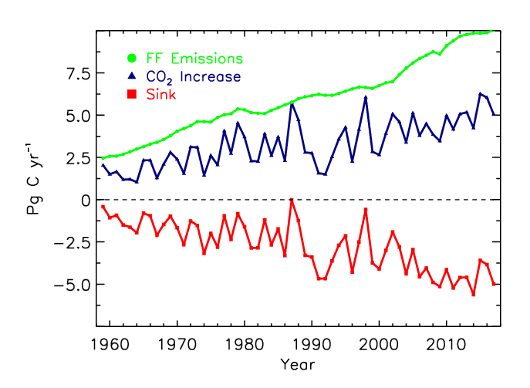
Global carbon sinks are increasing
Carbon sinks keep increasing as fossil fuels keep rising. Global C uptake now ~4 PgC/yr.
~45% of fossil fuel emissions are still taken up by sinks.
Year-to-year variability driven by land uptake. We cannot yet attribute land uptake to specific processes.
Ballantyne et al., Nature, 2012, updated
GMAC presentation by Ed Dlugokencky

Slide 13
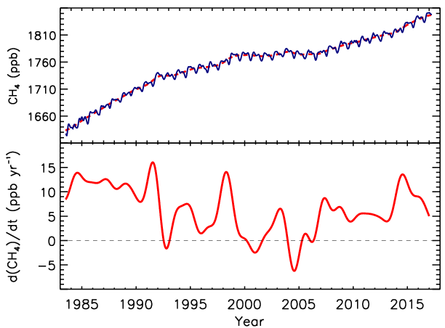
Globally averaged CH₄ and its growth rate
Biomass burning/ENSO
ENSO
Collapse of USSR
GMAC Presentation by Lori Bruhwiler
CH₄ data from Ed Dlugokencky

Slide 14
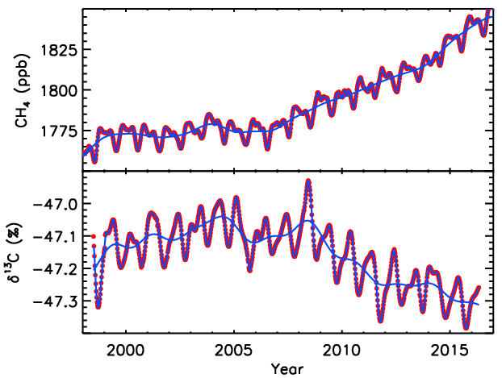
CH₄ from Fossil Fuels?
Not consistent with fossil fuel source
Must be microbial source
Source: INSTAAR

Slide 15
Estimating Emissions and Removals
https://earthobservatory.nasa.gov/Features/CarbonCycle/

Slide 16
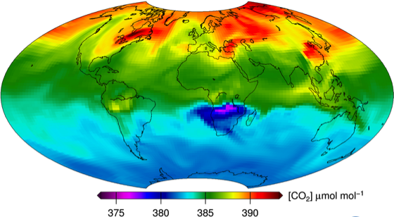
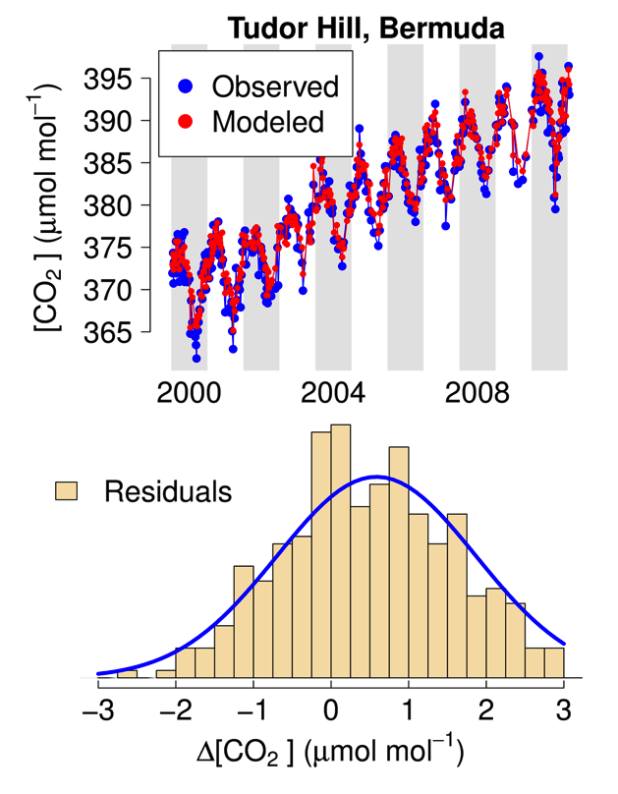
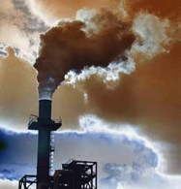

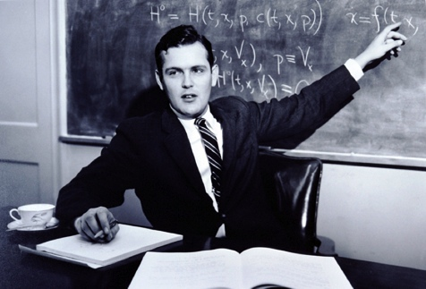

We measure atmospheric abundance of GHGs, but we want information about emissions and sinks:
Simulated atmospheric transport is our largest source of error – strong links with NOAA’s weather enterprise
Data Assimilation/Inverse Modeling
emissions
atmospheric transport
observations
optimal estimation
Courtesy of Andy Jacobson
Notes:
CT CO2 slides courtesy of Andy Jacobson

Slide 17
Observational Constraints on the Global Atmospheric CO₂ Budget
Pieter P. Tans, Inez Y. Fung, Taro Takahashi
“…a large amount of the CO₂ is apparently absorbed on the continents by terrestrial ecosystems.”
1439 citations!

Slide 18
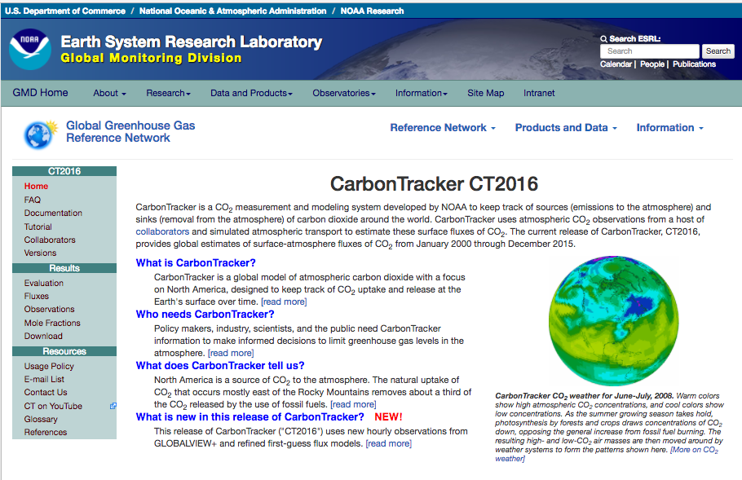
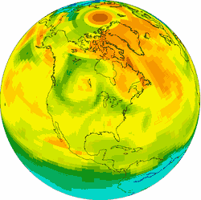
GMAC Presentation by Andy Jacobson

Slide 19
  NOAA’s CarbonTracker provides up to date estimates of regional carbon fluxes
Global
Optimized Annual Total Emissions
North American
Optimized Annual Total Emissions
Globally land and ocean absorb 46.6% of fossil fuel emissions for the period 2000-2015.
Total Uptake: 0.56±1.29
Fossil Fuel: 1.74±0.02

Slide 20
CarbonTracker – Impact of 2015/2016 El Niño
CT2017 is the first CarbonTracker release to simulate impacts of a large El Niño.
In 2015 and 2016, we find about 1.2 PgC/yr extra CO₂ in the atmosphere due to this event.

Slide 21
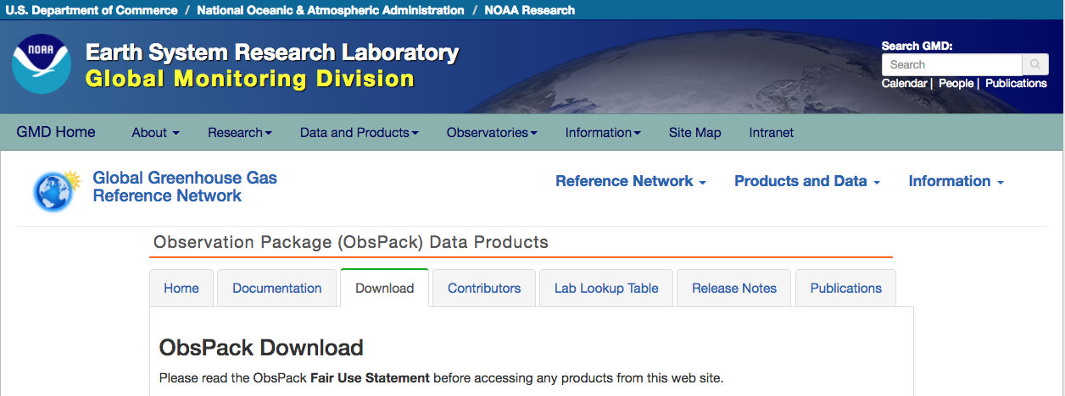
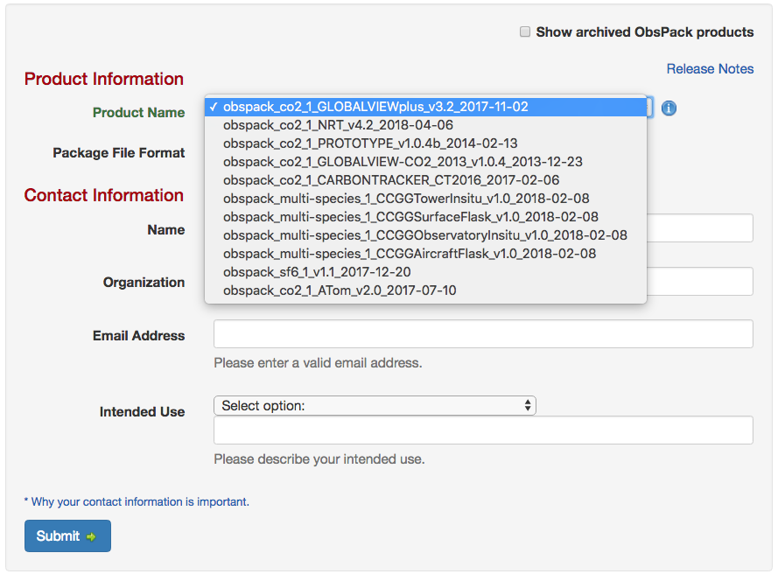
All of the GGGRN CO₂, CH₄, N₂O, SF₆ data are archived and available in ObsPack format
Near-real time products support OCO-2 retrieval evaluation and data analysis
GLOBALVIEWplus products are a multi-laboratory community product
Campaign ObsPacks are available, e.g. ATom, ACT-America

Slide 22
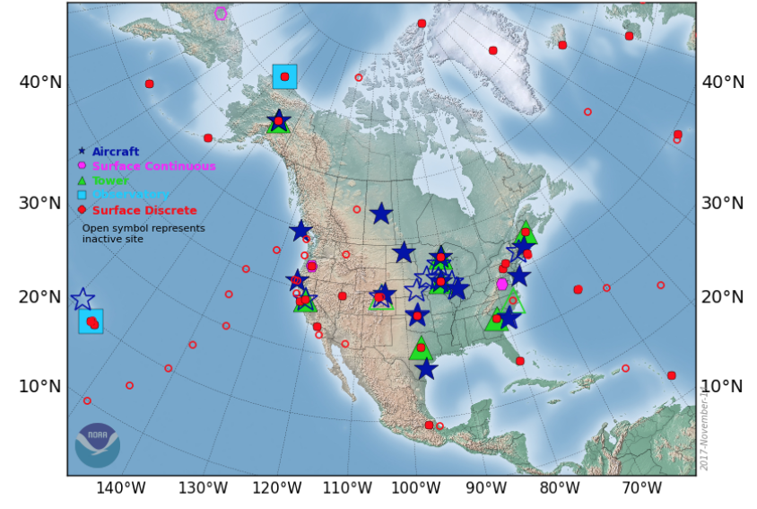




Moving from Global to Regional Scales

Slide 23
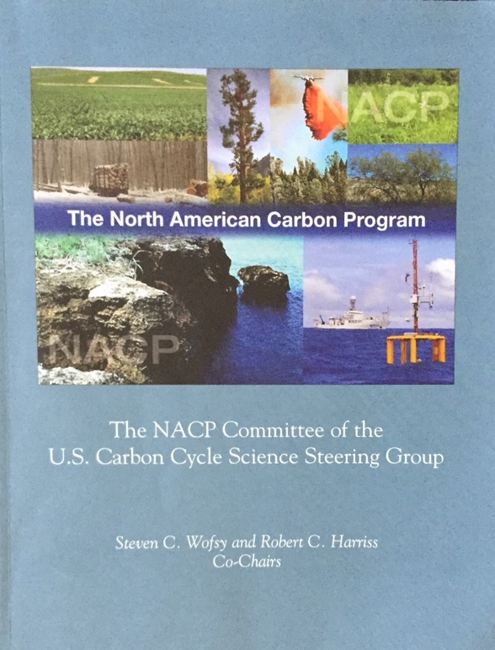
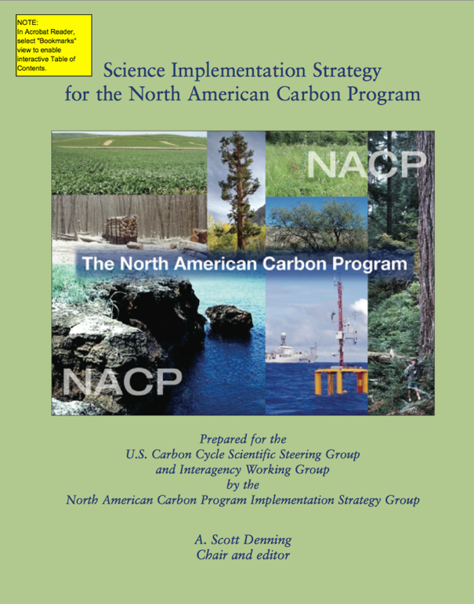

North American Carbon Program: A US Inter-Agency Effort
“Consider uptake of CO₂ due to woody encroachment… 0.12 GtC/yr… spread out over an area the size of Texas, the annual mean decrease of CO₂ in the column would be 0.11 ppm/day…The associated depletion in atmospheric CO₂ over 1000 km could be 0.6 ppm in the lowest 3 km, comparable to the CO₂ from fossil fuels…A total of 30 sites for North America are anticipated...Vertical profiles should be obtained at frequency of every other day…”
  - 0.1 ppm measurement comparability to resolve the signal of important processes

Slide 24
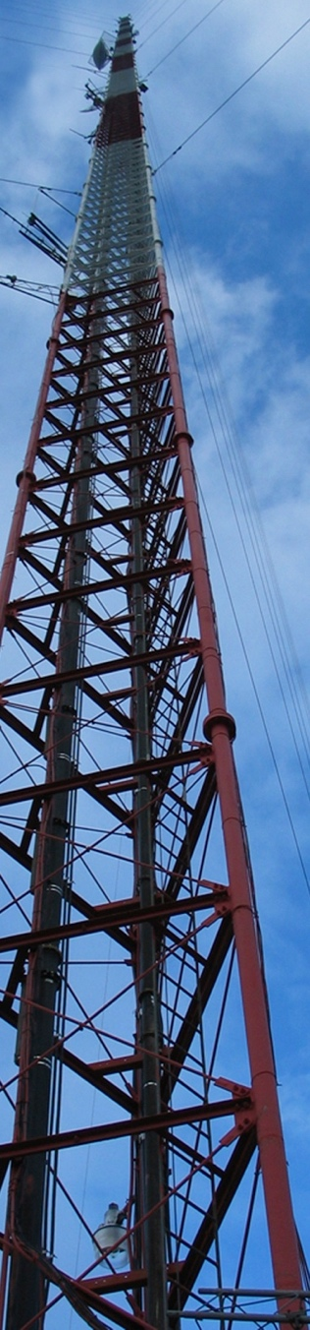
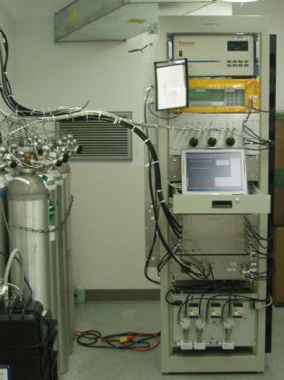
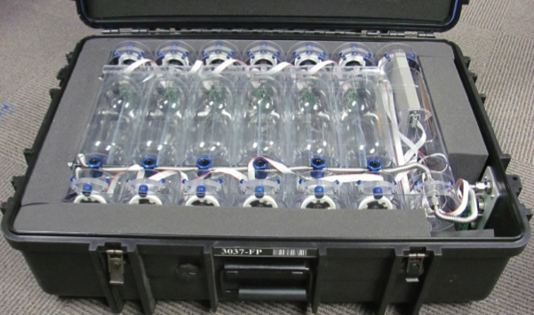
Tall tower in situ and flask sampling:
All NOAA tall tower sites have continuous CO₂ and CO and flask measurements (every other day sampling, Δ¹⁴CO₂ 3x per week)
Three sites also have continuous CH₄
Additional mountaintop sites have continuous CO₂ and/or flask
Many partners!
Tall tower program PI: Arlyn Andrews

Slide 25
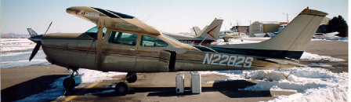
Aircraft sampling with “Programmable Flask Packages”
Nominal schedule 2 flights per month
Most aircraft max altitude 6000 to 8000 masl
Twelve flasks per package
Flasks measured for CO₂, CH₄, CO, N₂O, SF₆, H₂, stable isotopes of CO₂ and sometimes CH₄, Δ¹⁴CO₂ (subset of samples), hydrocarbons ethane (starting in 2015), halocarbons
Aircraft program PI: Colm Sweeney

Slide 26
  The past decade has seen major expansion of the North American atmospheric carbon observing system:
2005
2015
  Growth of surface network has exceeded expectations >100 sites in 2015/2016
  NOAA aircraft network: 14 sites profiling up to ~8 km once or twice per month

Slide 27
  Many different laboratories are providing data, with different levels of quality assurance and stability of funding:
  Data Providers
    In Situ:
    NOAA Earth System Research Laboratory Global Monitoring Division (A. Andrews, E. Dlugokencky, K. Thoning, C. Sweeney, P. Tans)
    Environment and Climate Change Canada (D. Worthy)
    Penn State University (N. Miles, S. Richardson, K. Davis)
    NCAR (B. Stephens)
    Oregon State University (B. Law, A. Schmidt)
    Lawrence Berkeley National Lab (S. Biraud, M. Fischer, M. Torn)
    Earth Networks (C. Sloop)
    California Air Resources Board (Y. Hsu)
    Harvard University (J. W. Munger, S. Wofsy)
    U of Minnesota (T. Griffis)
    Scripps (J. Kim, R. Keeling, R. Weiss)
    NASA JPL (C. Miller, K Verlhulst)
    Remote Sensing:
    TCCON (D. Wunch, P. Wennberg, G. Toon)
    GOSAT-ACOS (C. O’Dell)
    OCO-2 team
2015
Comparability among datasets is crucial for flux estimation and trend detection.

Slide 28
What do the data tell us?

Slide 29

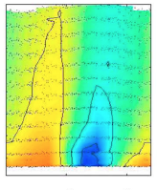


Average Seasonal Cycle of CO₂ above Homer, Illinois:
∆CO₂, ppm
Sweeney et al., JGR, 2015

Slide 30
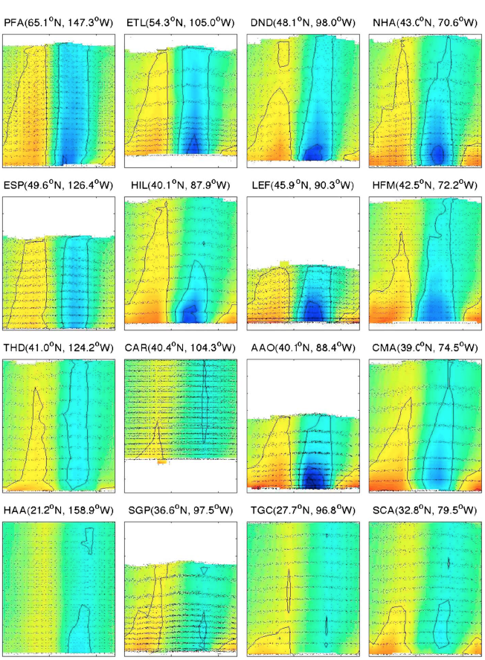
Annual CO₂ Climatology above North America, from Sweeney et al., JGR, 2015:
Poker Flat, Alaska
Wisconsin
∆CO₂, ppm
Hawaii
South Carolina

Slide 31
Multi-species profiles provide powerful constraints on flux estimates:
Eastern USA (NHA)
Nov 2005
Strong anthropogenic influence
Surface uptake
Multiple species aid in quantitative source attribution for carbon gases.
Courtesy of Steve Montzka

Slide 32
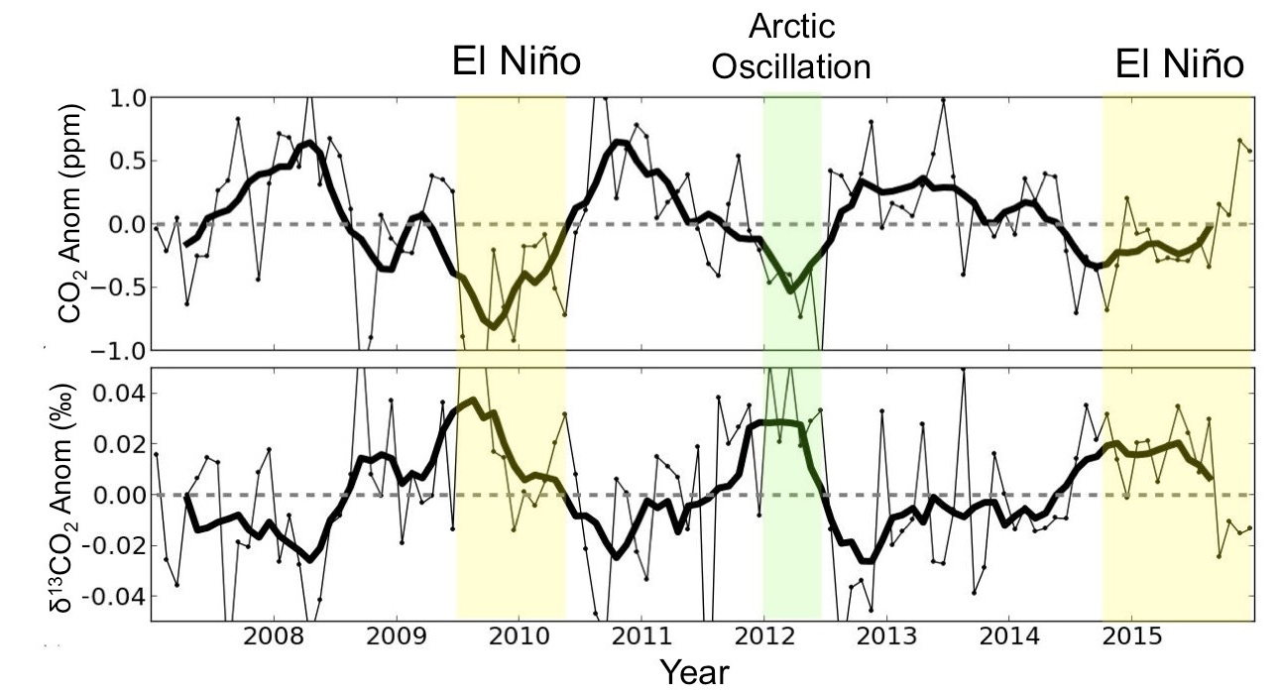
  CO₂ and ¹³CO₂ anomalies over North America are correlated with large-scale climate anomalies:
Monthly anomalies (thin lines) of atmospheric CO₂ and δ¹³CO₂ averaged across North American sampling sites.
δ¹³CO₂ provides information about how plants respond to drought stress.
GMAC Talk by Lei Hu
Poster by Ivar van der Velde

Slide 33
  Radiocarbon over North America shows decreasing trend due to global fossil fuel emissions and local depletion due to local fossil fuel sources:
10 ppm C_{ff}
Altitude > 3.5 km
Altitude > 3.5 km
Most Polluted Sites
GMAC Presentations by John Miller and Sourish Basu
33

Slide 34
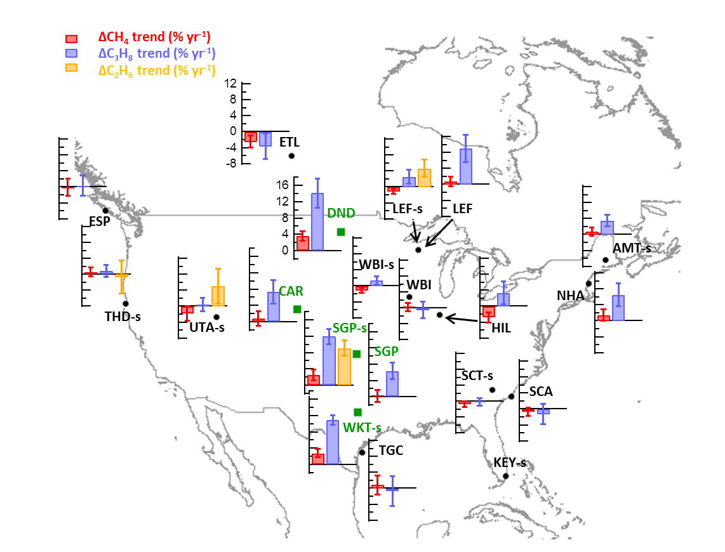
  Methane and Hydrocarbon trends over North America:
10%/yr
GMAC Presentation by Xin Lan
Methane trends are only observed at a few sites near oil and gas development
Increasing propane and ethane trends are observed at many sites

Slide 35
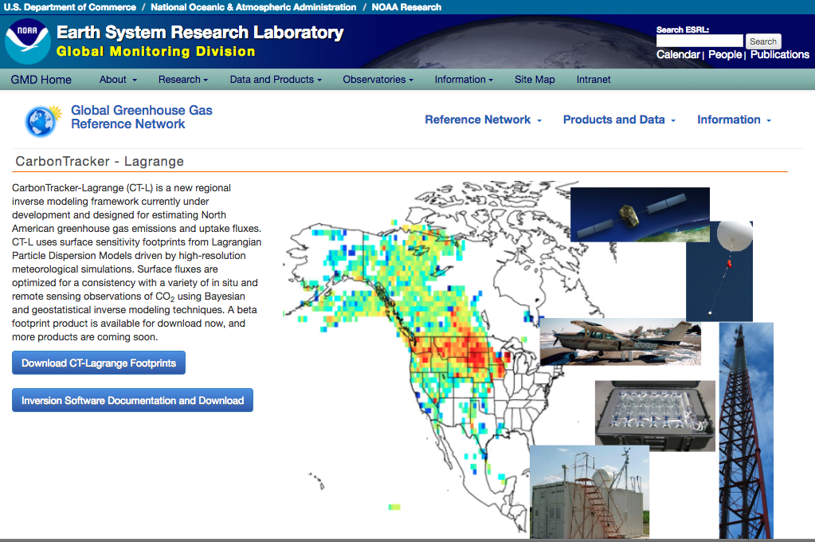
http://www.esrl.noaa.gov/gmd/ccgg/carbontracker-lagrange/

Slide 36
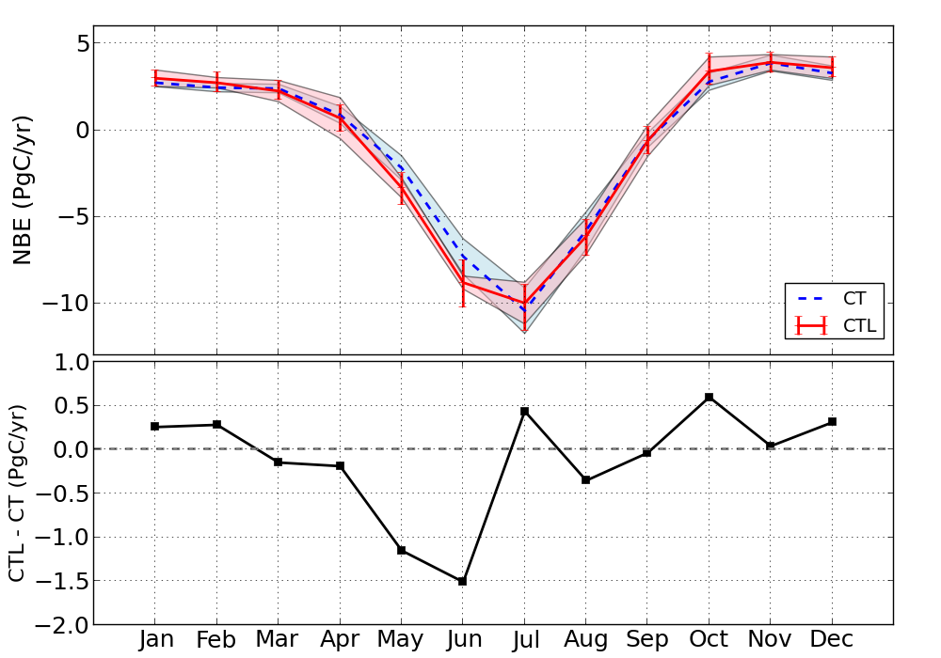
CT Lagrange versus CT2016 Fluxes: Long-term Mean
Multi-Year Monthly Averages (2007 – 2015)
GMAC Presentation by Lei Hu
CarbonTracker v2016 (CT)
CarbonTracker-Lagrange(CTL)
CT2016: -0.56±1.29 PgCyr⁻¹
CT-L: -0.70±0.92 PgCyr⁻¹
Net biospheric uptake is similar despite very different atmospheric transport models

Slide 37
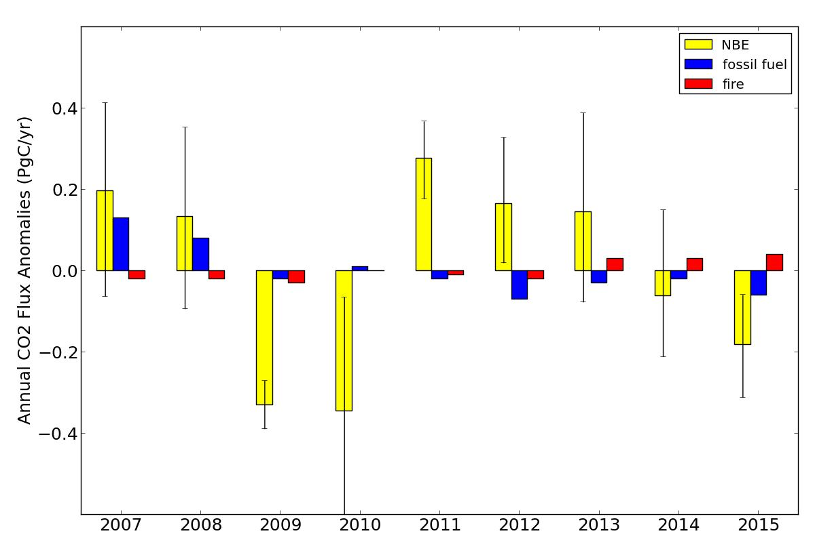
CT-L terrestrial CO₂ fluxes show emergent and persistent response to ENSO
La Niña
El Niño
El Niño
GMAC Presentation by Lei Hu

Slide 38
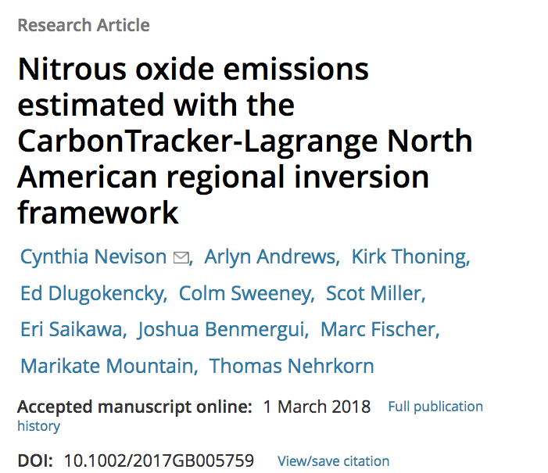
Recent papers using the CarbonTracker-Lagrange Framework highlight our close and mutually beneficial relationships with academic researchers.

Slide 39
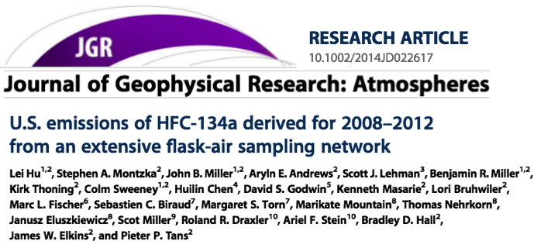
We plan to collect top-down emissions estimates from all of these studies and make them available for download.

Slide 40
Satellite Retrieval and Model Evaluation

Slide 41
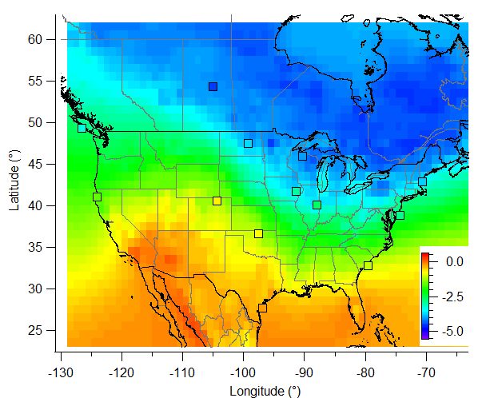
Long-term mean summer total column ΔXCO₂ from CT2015
Column ΔXCO₂
constructed from aircraft & tower data
Xin Lan et al., ACP, 2017
The challenge for satellite column CO₂ sensors:
Mass balance: on average, the total column enhancement of CO₂ downwind of the U.S. is ~0.7 ppm for 1.4 Gton C/yr of emissions.
For a 20% reduction in emissions, column would change by ~0.14 ppm.

Slide 42
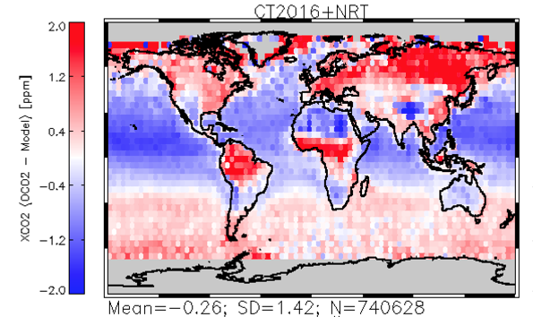
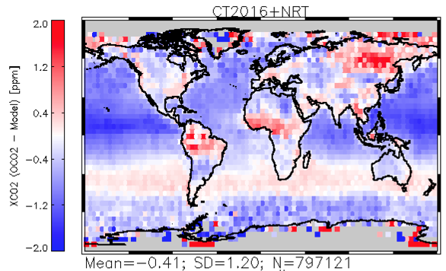
OCO-2 Retrieval Evaluation
OCO-2 V7
OCO-2 V8
CarbonTracker-NearRealTime is one of a suite of models used to evaluate and bias-correct OCO-2 retrievals
CarbonTracker-NRT work is funded by NASA OCO-2 project and enables quick evaluation of retrievals and assessment of information content
The CarbonTracker Team prepares observations and provides to all the other modeling teams along with information about CarbonTracker data selection and weighting
GMAC Presentation by Andy Jacobson

Slide 43
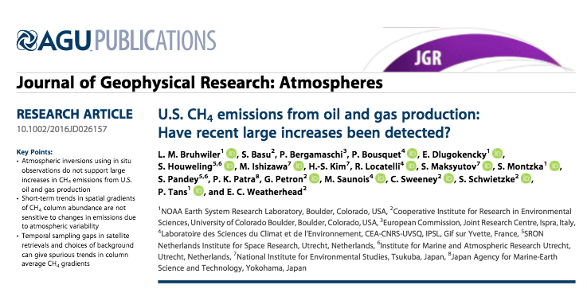
Temporal sampling biases cause apparent relative trends.
Choice of inappropriate background contributes to spurious trend
Additional aircraft profile data would enable reliable trend detection

Slide 44
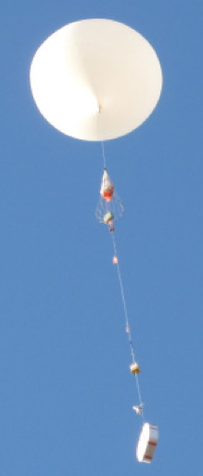
Monitoring Greenhouse Gases in the Upper Atmosphere
photo credit: Patrick Cullis (patrick.cullis@noaa.gov)

Slide 45
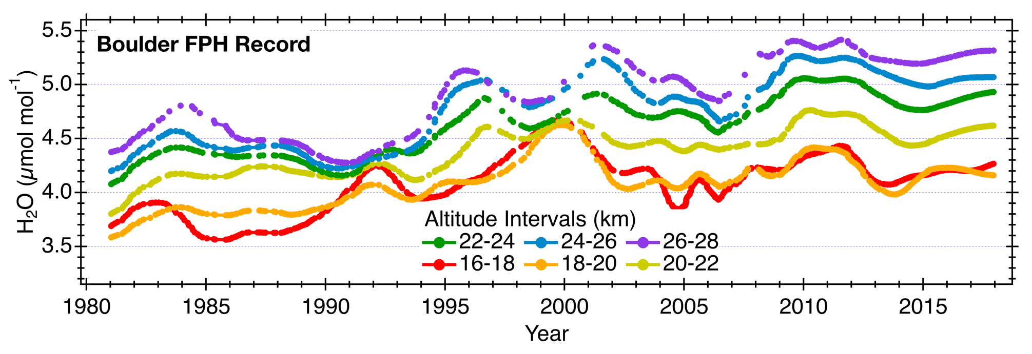
Long-Term Monitoring of Upper Troposphere/Lower Stratosphere (UTLS) Water Vapor
Boulder Frost Point Hygrometer Record
Hurst et al. (2011) updated
Net increase in UTLS water vapor: Positive climate forcing feedback
• Strong absorber of outgoing long wave radiation, weak thermal emission to space
• Climate change warms the tropical tropopause layer, increasing UTLS water vapor
• Additional UTLS water vapor absorbs more outgoing long wave radiation
Changes in UTLS water vapor have a significant impact on surface temperatures
• The ~1 𝜇mol mol⁻¹ (~25%) increase in [UTLS water vapor] between 1980 and 2000 would
have enhanced the rate of surface warming in the 1990s by ~30%
Solomon et al. (2010)
GMAC Presentation by Dale Hurst

Slide 46
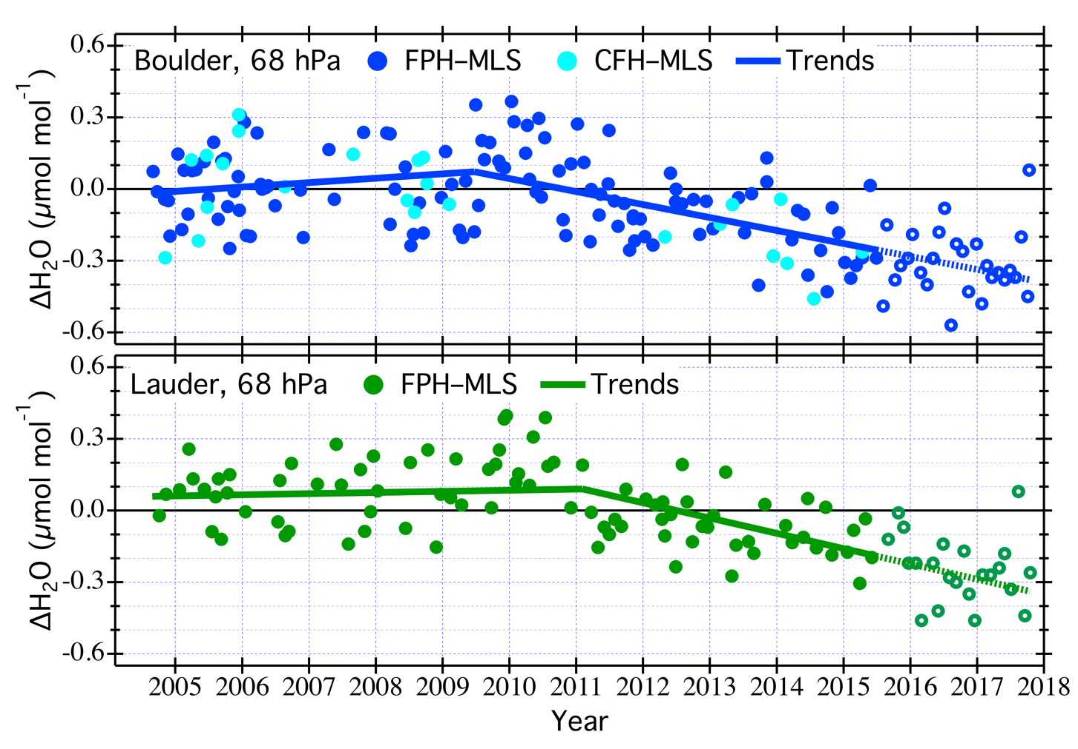
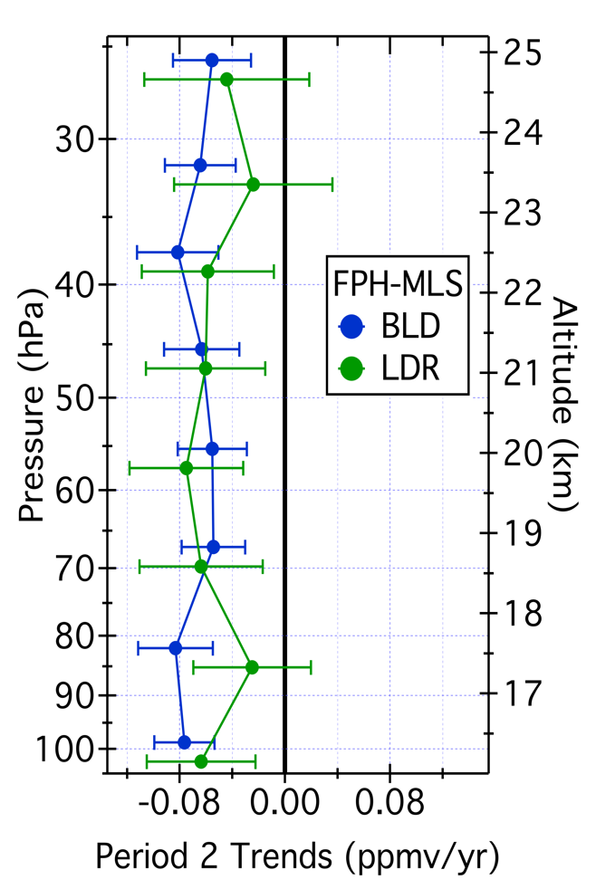
Long-Term Monitoring of UTLS Water Vapor
Validation of Satellite-Based Measurements
Satellite-based instruments provide near-global coverage but are
susceptible to biases and/or drifts in their measurements
Differences in Coincident Measurements: FPH-MLS
Post-breakpoint Trends
Statistical Breakpoints
updated from Hurst et al. (2016)
Notes:
Satellite-based instruments provide measurements with high spatiotemporal resolution and near-global coverage, but there are often concerns about measurement biases and how they might change with time. Balloon-borne frost point hygrometer measurements have stable accuracy over decades, permitting assessments of biases and drifts in satellite measurements. Recent assessment of Aura MLS water vapor measurements over Boulder and Lauder, NZ, reveals significant drifts in MLS retrievals on the order of 0.06 ppmv yr-1 (1.5% yr-1) at both sites during the last 7-8 years. Lines showing trends in FPH-MLS differences end at 2015.5 because this was the end of analysis period published in 2016 paper. “X” markers update the differences through 2017, however the trend lines have not been re-calculated. Error bars on post-breakpoint trends are 95% confidence intervals.

Slide 47
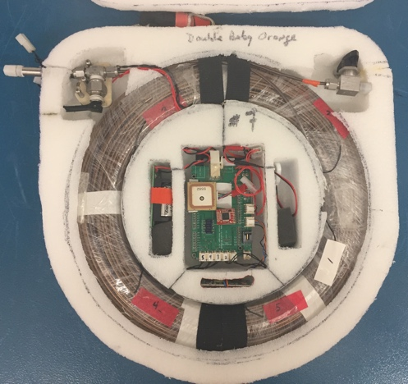
AirCore for Surface to Stratosphere GHG Sampling: CO₂, CH₄, CO
> 70 flights starting in 2012
  New twin AirCore provides paired sampling to ensure repeatabilty
OCO-2 Science Team
  Direct comparison with TCCON & OCO-2 underflights
  Improved stratospheric prior
Analysis of stratospheric Mean Age as a tracer of the Brewer-Dobson circulation
Evaluation of stratospheric simulations in CarbonTracker and other models
GMAC Poster by Colm Sweeney
Notes:
Karion, A., C. Sweeney, P. Tans, and T. Newberger. "Aircore: An Innovative Atmospheric Sampling System." Journal of Atmospheric and Oceanic Technology 27, no. 11 (Nov 2010): 1839-53.

Slide 48
Intensive Field Campaigns & Capacity Building

Slide 49



GMD Participation in Intensive Measurement Campaigns Leverages and Complements our Monitoring Efforts
ECO
East Coast Outflow
LA Megacities
NASA DC-8
NSF HIAPER GV
NOAA Twin Otter
Notes:
What about other campaigns Barnett, Gaby Oil and Gas, Mobile Lab

Slide 50








GMD’s footprint on oil & gas methane research in N. America
Notes:
11 papers alone from RPSEA study
Collaborators: academia, private, NGO

Slide 51


Brazilian Replica of the NOAA Flask Analysis Lab:
Luciana V. Gatti , Andrew Crotwell, Kirk Thoning, Ed Dlugokencky, John B. Miller , and many others

Slide 52


10+ year collaboration has enabled creation of aircraft network and new insights into Amazonian fluxes.

Slide 53
Looking forward

Slide 54



1) Expand the network through partnerships and Links with Regional Networks and other parts of NOAA
Regional networks
Current Tall Towers
Current Aircraft
Future Tower & Aircraft
Obtaining tower leases through the federal government is cost prohibitive and slow. Better to work with partners whenever possible.
Opportunities exist to strengthen ties with regional monitoring efforts already underway: California Air Resources Board, Earth Networks, Baltimore/DC, Oregon State University, Penn State University
Expand the global network through increased atmospheric sampling on ships
Notes:
N

Slide 55




2) Increase radiocarbon sampling to constrain estimates of fossil fuel CO₂ emissions
5000 Δ¹⁴CO₂ measurements per year will allow us to determine fossil fuel CO₂ emissions using atmospheric data and improve estimates of biological emissions and removals.
The new U of CO/INSTAAR building was designed with laboratory infrastructure to host a dedicated accelerator mass spectrometer facility.
GMAC Presentation by Sourish Basu

Slide 56





3) Commercial Aircraft Measurements of CO₂, CH₄ and H₂O
Japanese and European programs already exist for a limited number of long-haul aircraft (5 CONTRAIL and 10 IAGOS aircraft):
IAGOS
CO₂/CH₄/H₂O Analyzer:
~30 kg
The US National Weather Service has a regional commercial aircraft program to measure water vapor:
These systems use 10-20 year old technology. A next-generation commercial aircraft greenhouse gas analyzer would provide reliable measurements in a lightweight and compact package for deployment on regional jets.
3.5 kg
137 aircraft
>1000 profiles per day

Slide 57




*Route maps shown are examples only to illustrate what type of coverage is possible. The airlines have not been contacted with regard to this project.
Science Priorities
  Vulnerable Carbon Reservoirs
    Arctic: Track Emissions from Permafrost Release
    Amazon: Monitor Uptake from Tropical Forests
  Carbon Accounting for Decision Support
    CONUS
Estimated Cost: < $10M per year
5 year goal: Implementation on 10 aircraft covering CONUS and Alaska
10 year goal: Establish international partnerships to extend coverage over Arctic and Amazon.

Slide 58























GMD’s Role in an Integrated Greenhouse Gas Observing System
GOSAT
OCO-2
Sentinel 5p
OCO-n
PRESENT
2014 …
2038 …
2009 …
2018 …
GOSAT-2
OCO-3/ISS
GEOCarb
MERLIN
NEAR FUTURE
2018
2019
2021
2021
AirCore
CAAOS

Slide 59
Take Home Messages
We are creating an unassailable and well-documented record of greenhouse gases.
We try to help society deal with the climate problem:
  Create a quantitative record of climate forcing.
  Quantify and diagnose the response of the natural carbon cycle and greenhouse gas budgets to climate change.
  Evaluate potential “surprises” and give early warning if warranted.
  Support mitigation by providing objective and transparent verification of emissions.
Close relationships between measurers and modelers have kept us at the forefront of carbon science and are crucial to continued success.
GMD anchors the global and US atmospheric carbon observing network. We have established ongoing comparisons with all of the major laboratories. We rely on partnerships with other labs and institutions.
We have just begun to reap the scientific rewards of our investment in North American monitoring – multiple-species analysis will provide critical process constraints and enable improved source attribution.
“Science-driven monitoring of the atmosphere, responding to societal needs”

