Slide 1
Operation and application of aerosol measurement system –
Temporal, spatial and systematic patterns in aerosol properties at Anmyeon-do (AMY)
Dr. Elisabeth (Betsy) Andrews
NOAA/ESRL/Global Monitoring Division
Boulder, CO USA
November, 2013

Slide 2
Talk Outline
→Overview of NOAA collaborative aerosol network
→Description of collaborative aerosol measurements at Anmyeon-do (AMY)
→Temporal climatology of aerosol properties at AMY
→Systematic relationships between aerosol properties at AMY
→Preliminary air mass analysis and relationship to aerosol properties at AMY
→Future work

Slide 3
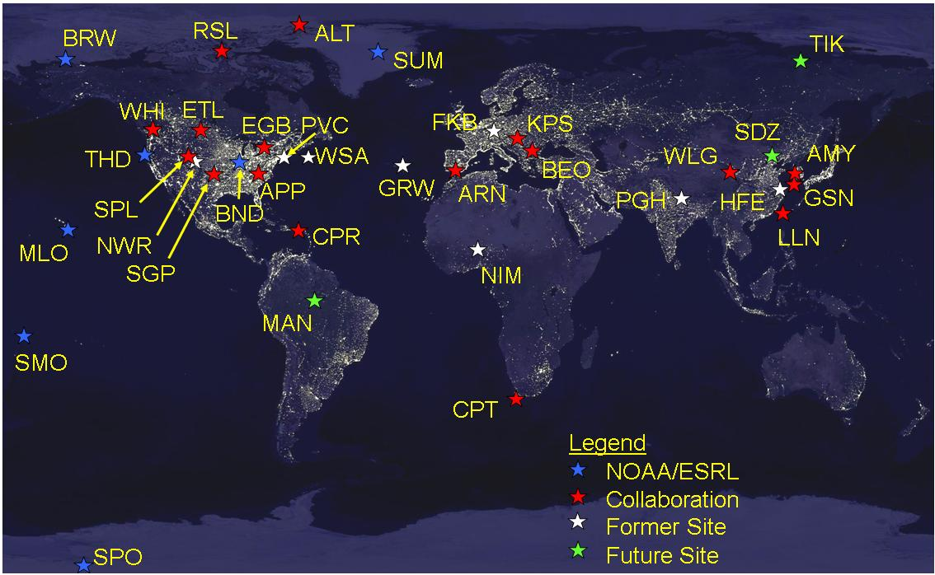
Motivation and collaborative network picture
Detect changes (i.e., trends, cycles) in the long-term global aerosol background
Characterize climate-forcing properties of aerosol types on regional scales
6 NOAA observatories
18 collaborations (including AMY!)
Original 4 NOAA baseline observatories

Slide 4
Advantages of a Collaborative Network
→Ensure measurement comparability – measurements made the same way
→Economies of time and scale – no need to reinvent the wheel
Examples of science that can be done with network data
Climate forcing and climatology as a function of location
Satellite and Model evaluation/validation
Long term (>10 years) trends
→changes due to pollution control policies
→climate change
Spatial/Temporal variability studies
→useful for comparing data on different time or spatial scales, e.g.,
→model grid vs point measurement
→satellite AOD vs surface AOD

Slide 5
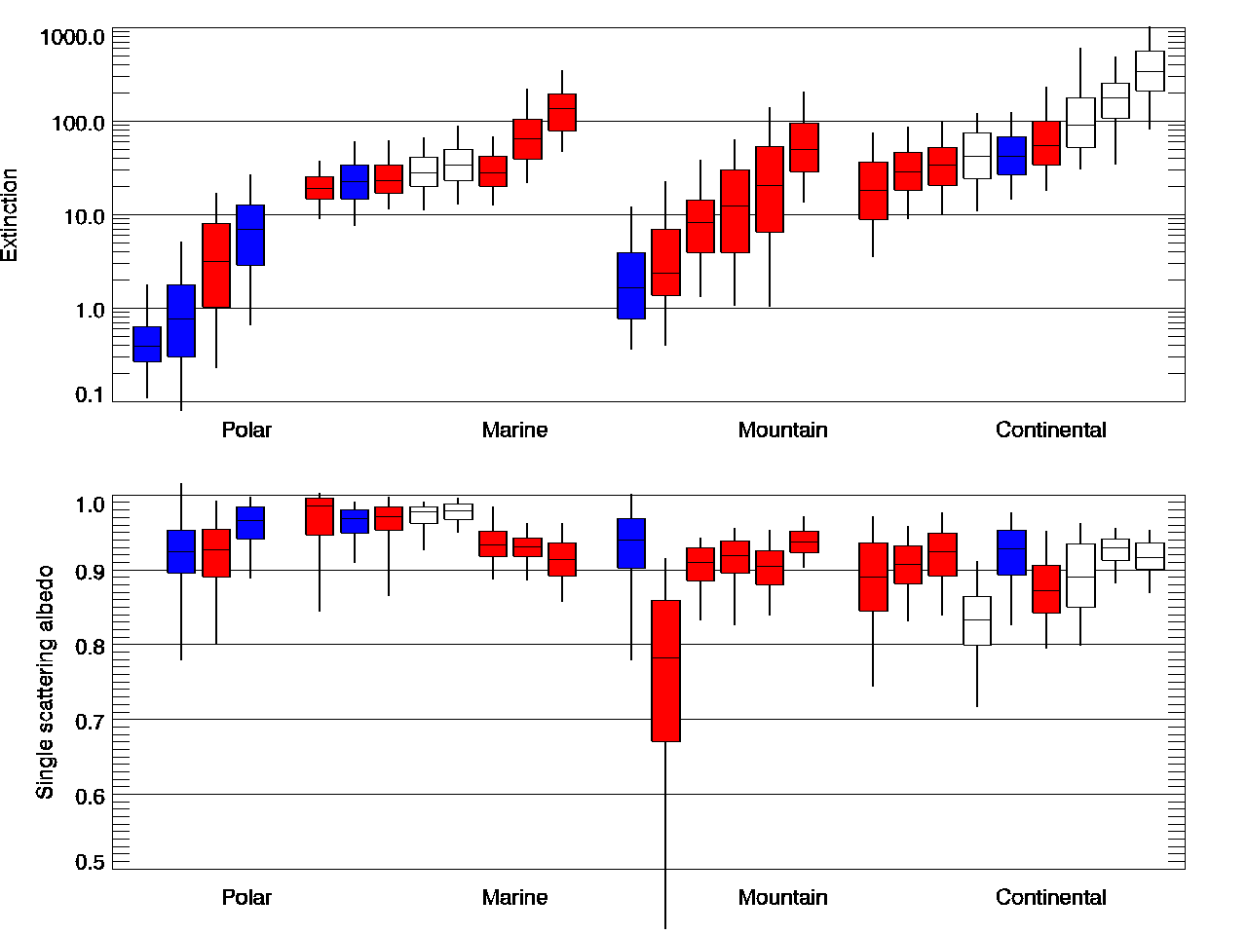
Annual climatology from the NOAA collaborative network
GSN
AMY
→aerosol amount
→visibility
→Aerosol optical depth (AOD)
Polar
Marine
Mountain
Continental
Relative amount of absorption
NOAA sites
Collaborators
Closed sites
Polar
Marine
Mountain
Continental

Slide 6
Autocorrelation Analysis – Marine sites
day
week
month
year
Correlation coefficient r(k)
Compares “persistence” - i.e., how quickly a property changes with time.
Useful when trying to compare measurements on different temporal or spatial scales.
Example: comparing night time aerosol measurements from a satellite with daytime measurements from AERONET sensor
t=0
t=12

Slide 7
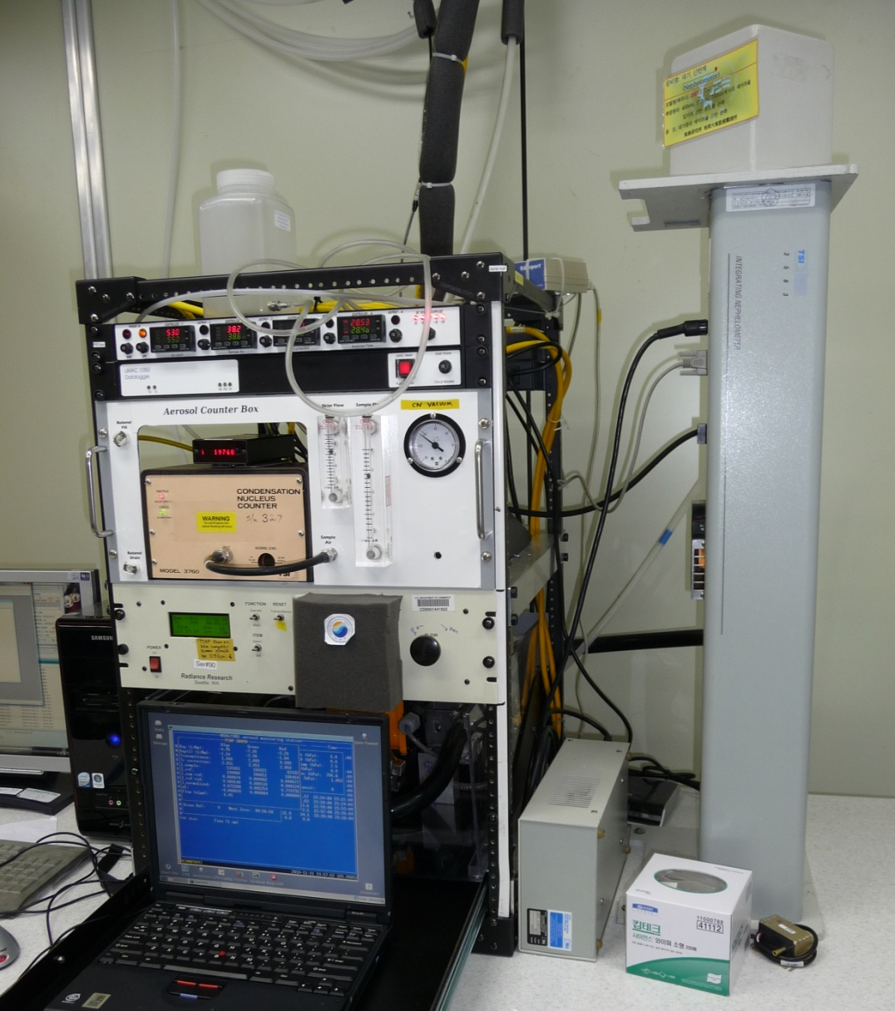
KMA/DUST aerosol system at AMY
Nephelometer
(spectral scattering and backscattering )
Same design at NOAA sites and collaborator sites
Follow GAW protocols
Particle counter
(number concentration)
Switched Impactors
(Dp<10 μm and Dp<1 μm )
Absorption
Photometer
(spectral absorption)
Ångström Exponents, Asymmetry Parameter, Single Scattering Albedo, Radiative forcing

Slide 8
Parameters controlling aerosol forcing
ΔF average aerosol forcing at top of atmosphere (TOA)
δ aerosol optical depth
D daylight fraction
S₀ solar constant
T_{at} atmospheric transmission
A_{c} cloud fraction
R_{s} surface albedo
aerosol single scattering albedo
(from nephelometer and PSAP)
average aerosol up-scatter fraction
(from nephelometer backscatter fract)
ΔF/δ = Top of Atmosphere Radiative Forcing Efficiency
Source: Haywood and Shine (1995)

Slide 9
Parameters from aerosol system
Extensive Properties – depend on amount of aerosol:
Scattering
Absorption
Extinction (= scattering + absorption)
Number concentration (CN)
Intensive Properties – depend on character of aerosol:
Absorption Angstrom exponent – ‘type’ of absorbing particles
→AbsAngst ~ 1 suggests elemental carbon
→AbsAngst >1 suggests organics
→AbsAngst >1.5 + SSA increasing with wavelength suggests dust
→AbsAngst < 1 suggest BC core with coating
Scattering Angstrom exponent - size of particle
→ScatAngst < 1.5 suggests dust (or sea salt)
→ScatAngst > 2 suggests pollution aerosol

Slide 10
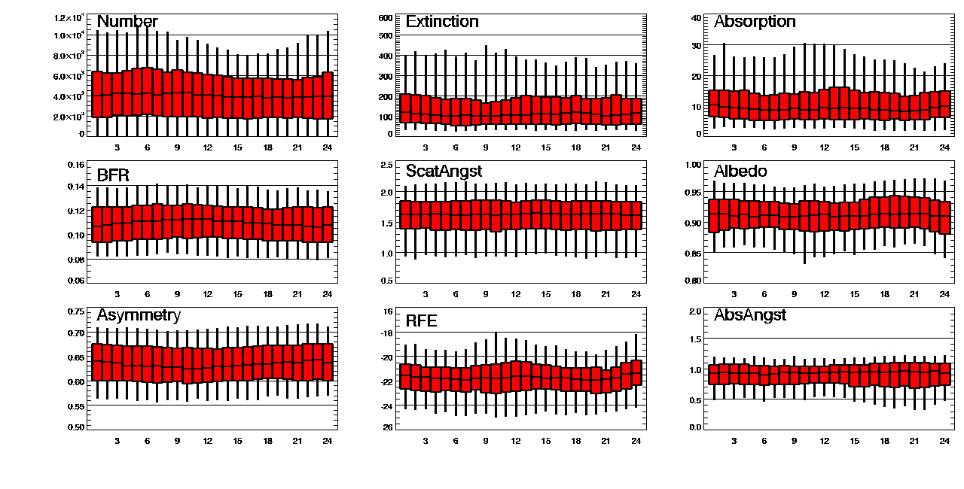
Diurnal climatology at AMY (Nov 2011 – Sept 2013)
→Minor diurnal variation observed in some aerosol properties
Notes:
Extinction=scattering+absorption
Box-whiskers represent 5th, 25th, median (50th), 75th and 95th percentiles.
Time is in UTC, vertical yellow bar indicates local noon.
Measurements are made at low RH and have standard corrections applied.
Notes:
Not much diurnal cycle except in CN. Maybe also see it in back scatter fraction which is sensitive to smaller particles.

Slide 11
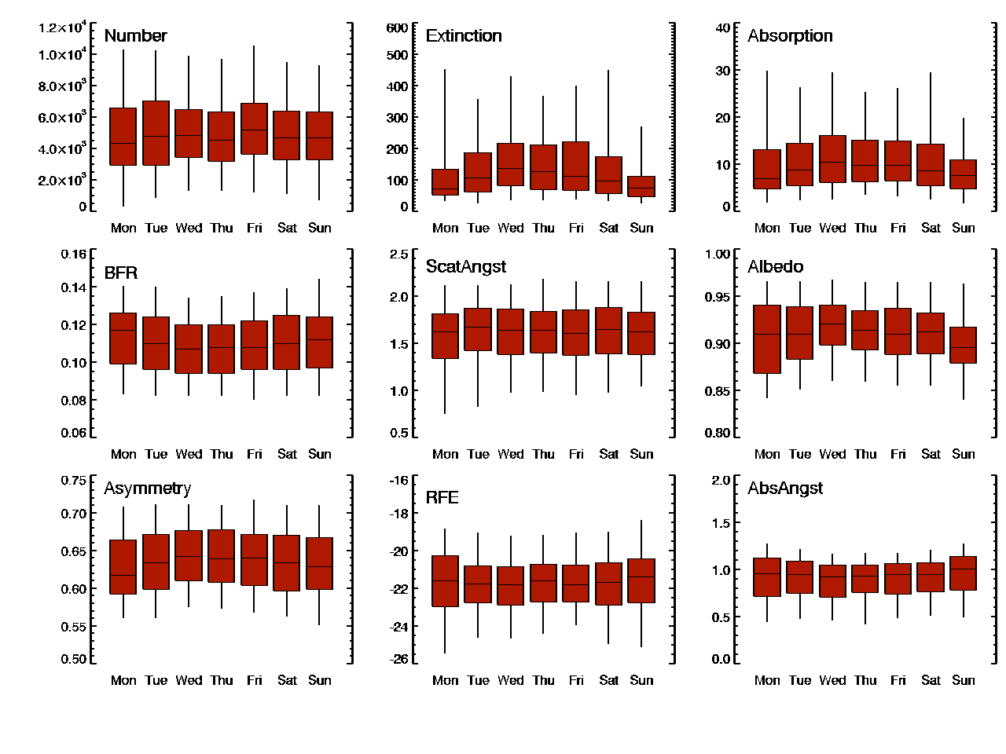
Weekly climatology at AMY (Nov 2011 – Sept 2013)
→Some weekly variation observed in aerosol properties
Timing of AMY extinction and absorption weekly cycle consistent with observations by Murphy et al. (2008) for multiple sites in US.

Slide 12
Annual climatology at AMY (Nov 2011 – Sept 2013)
Suspect
CN data
Possible seasonal patterns in aerosol extinction and absorption
→more extinction in the summer?
→more absorption in the winter?
Notes:
Data coverage: Winter (47%), Spring (70%), Summer (39%), Autumn (22%) (based on hourly extinction data)
Green box-whisker represents statistics for all QC’d data to present.
Notes:
Highest scattering and absorption observed in Jan and May. What could cause this? Dust?
Whiter aerosol in summer than winter. More local combustion in winter?
Also larger particles in summer – more (relative) contribution from sea salt?

Slide 13
Annual climatology at AMY (Nov 2011 – Sept 2013)
More obvious seasonal variation in intensive properties:
suggests different sources and/or processes
→what can other studies tell us about source types?
→what can we learn from airmass trajectories?
Notes:
Highest scattering and absorption observed in Jan and May. What could cause this? Dust?
Whiter aerosol in summer than winter. More local combustion in winter?
Also larger particles in summer – more (relative) contribution from sea salt?

Slide 14
AMY data in relation to aerosol ‘type’ matrices
Plots are from Giles et al., 2012
Based on AERONET data from many sites
→column
→ambient
→wavelengths~ 440/870
Single Scattering Albedo
Dot ( ) shows AMY in-situ median
→in-situ
→dry conditions
→wavelengths~ 450/700
Dot ( ) shows AMY AERONET median (2000-2007 data)
Plots suggest that AMY aerosol is most representative of either ‘urban/industrial’ or ‘mixed’ sources
Extinction Angstrom
Absorption Angstrom
Extinction Angstrom

Slide 15
AMY data in relation to aerosol ‘type’ matrices
Plot from Cazorla et al., 2013
Based on AERONET data
→column
→ambient
→wavelengths~ 440/870
AMY in-situ median
→in-situ
→dry conditions
→wavelengths~ 450/700
AMY AERONET median
(2000-2007 data)
→AMY aerosol is most representative of EC/OCsources
I
a
I
a
→Differences between in-situ and AERONET data may be due to relative humidity, inlet inefficiency, wavelength differences, data times, etc.

Slide 16
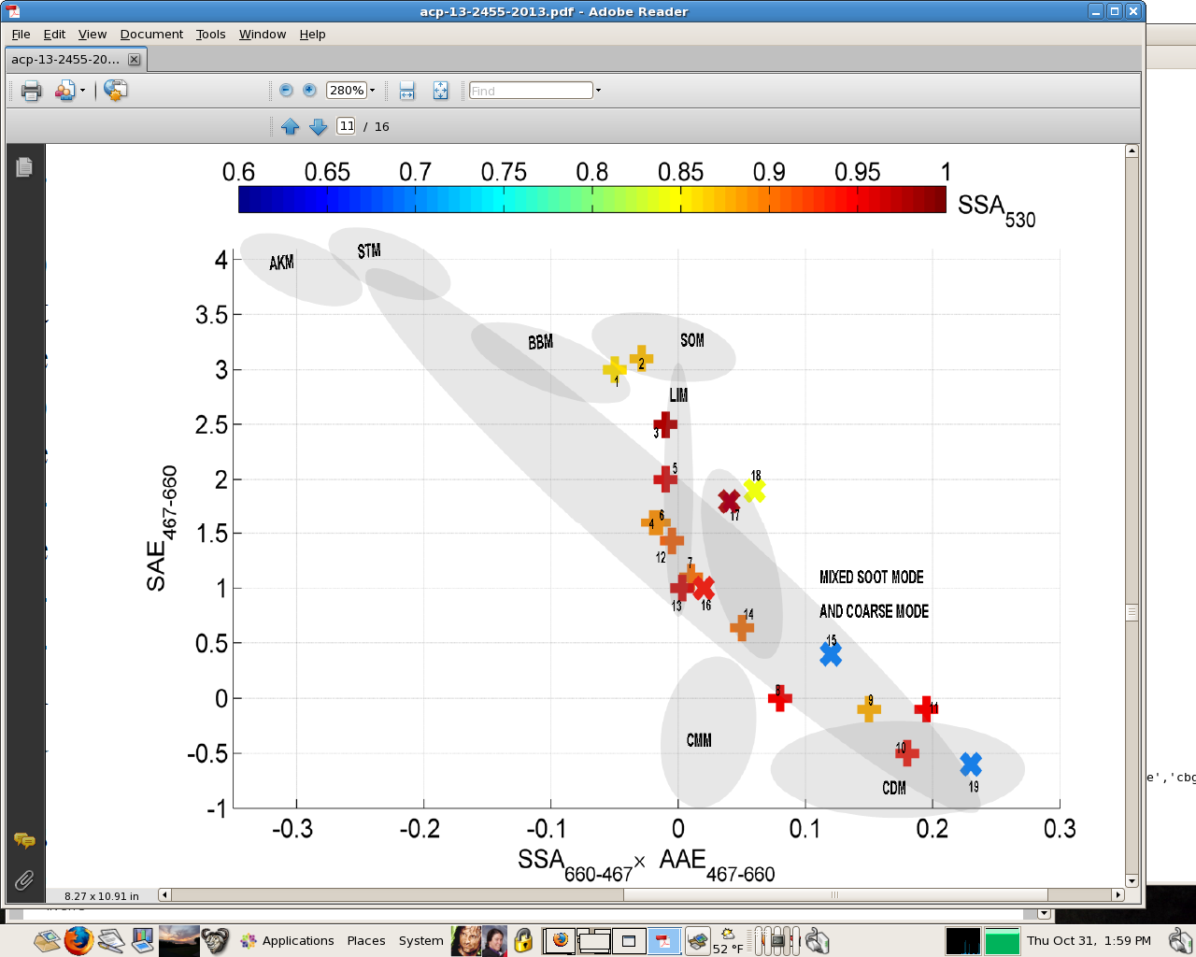
AMY data in relation to aerosol ‘type’ matrices
Plot from Costabile et al., 2013
Plot based on in-situ data using
same instruments as at AMY
Soot
Aitkin
Biomass
Small Organic
AMY in-situ median values represented by large dot ( ).
AMY AERONET median values represented by large dot ( ).
(2000-2007 data)
The tees and crosses represent other studies. The studies most similar to the AMY points were of mixed aerosol and urban/industrial pollution aerosol.
I
Large Inorganic
Extinction Angstrom
I
Large Organic
a
a
Mixed:
soot+coarse
Coarse Marine
Coarse Dust
Δ(Single scattering albedo)*Absorption Angstrom

Slide 17
AMY data – Systematic Variability
Approach used by Delene and Ogren, 2002; Andrews et al., 2011
THD – clean marine
AMY– polluted marine
GSN – polluted marine
ARN – polluted marine
WLG – high altitude+dust
LLN – high altitude+BB
APP – rural continental
KPS – rural continental
Scattering Angstrom
Smaller particles
Clean marine and dust environments are different from other sites and from each other
Natural Grouping
→continental (no dust)
Natural Grouping
→polluted marine

Slide 18
AMY data – Systematic Variability
Approach used by Delene and Ogren, 2002; Andrews et al., 2011
More absorption
More absorption
Smaller particles
Absorption Angstrom
Composition change
Scattering Angstrom
THD – clean marine
AMY– polluted marine
GSN – polluted marine
ARN – polluted marine
WLG – high altitude+dust
LLN – high altitude+BB
APP – rural continental
KPS – rural continental
Marine sites and Dust site:
Less absorption → bigger particles
Dust site clearly different than other sites, but all sites see changing composition

Slide 19
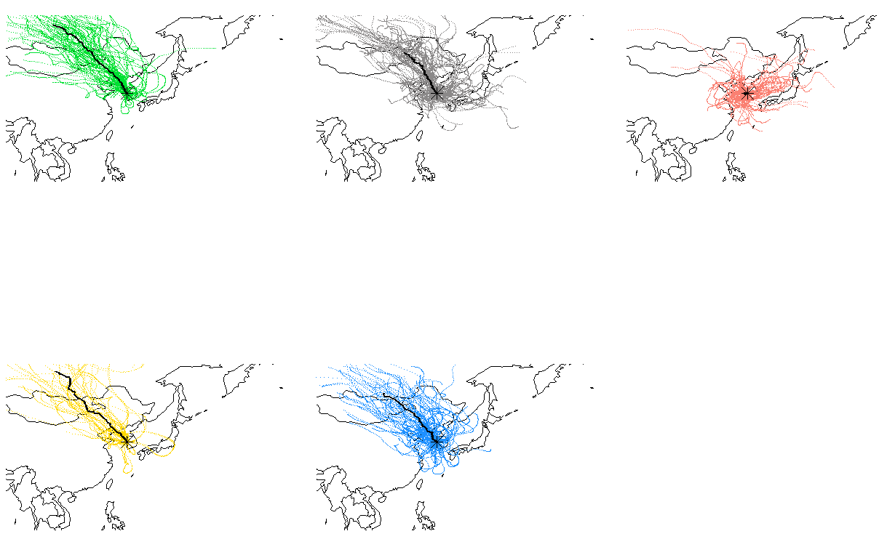
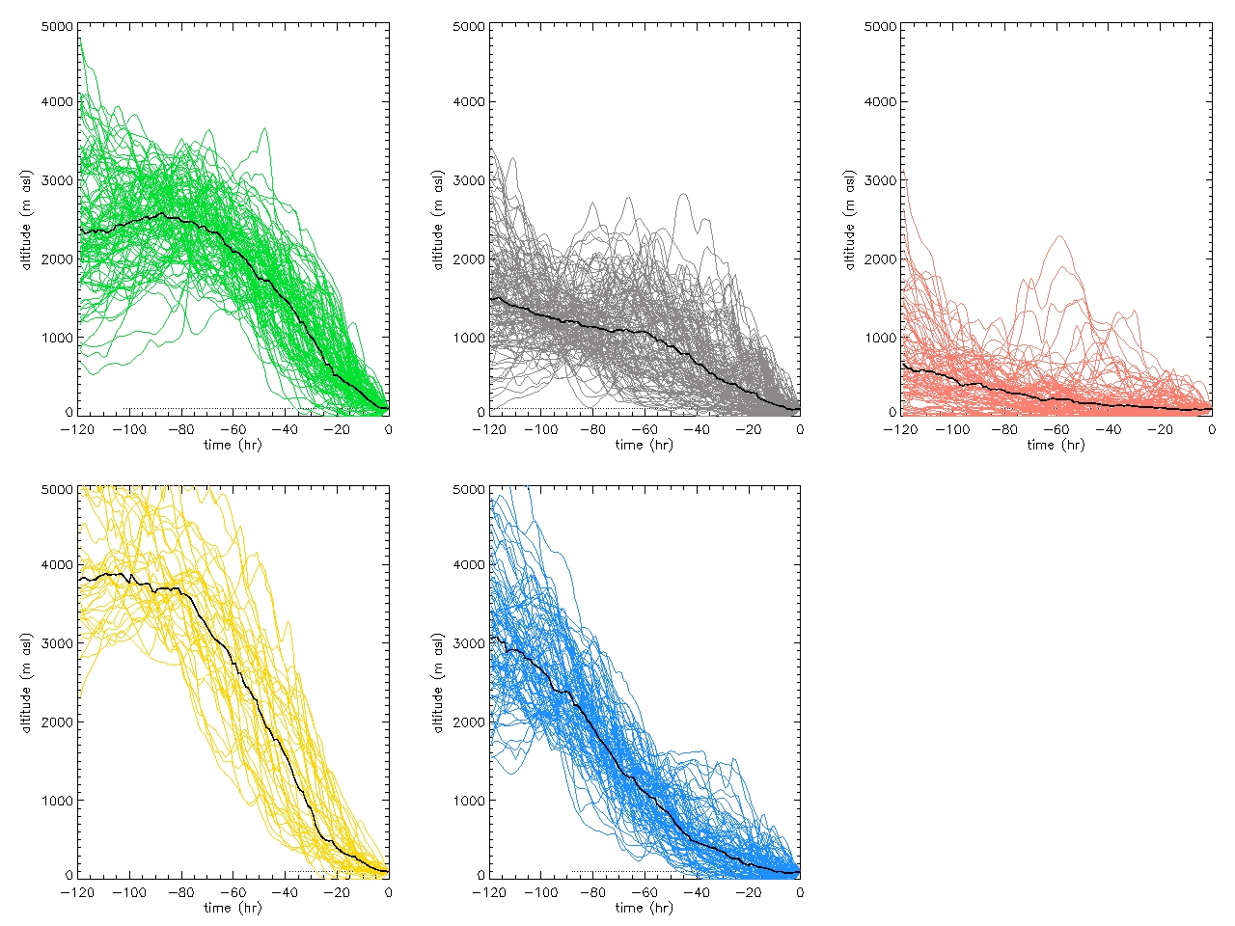
Trajectory Clustering
5-day back trajectories files at 0, 12 UTC were generated by Dr. Sangsam Lee of KMA.
Clustering of trajectories:
Clusters based on latitude, longitude and altitude vectors of individual trajectories
k-means clustering (as implemented in IDL graphical programming language)
Minimizes variability within cluster, maximizes variability among clusters
Example output:
Latitude/Longitude mapping
Altitude time series
Black line is cluster median.

Slide 20
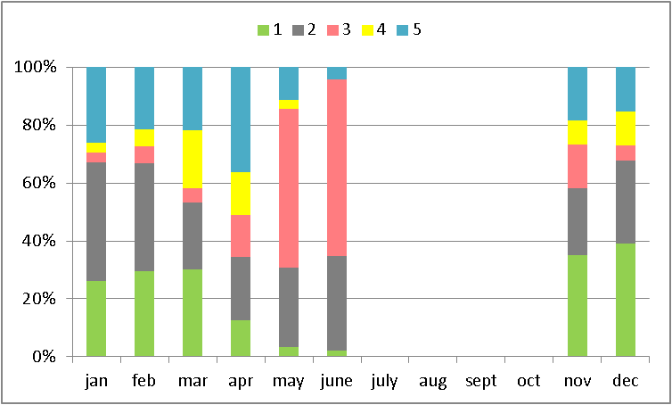
Trajectory Clustering - Annual
103
133
90
39
89
Pink (low altitude) most common in warm season.
Green&Blue most common in cold season
Gray occurs throughout year
Note:
‘annual’ covers Nov 2011-June 2012

Slide 21
How do these trajectories compare?
Previous air mass analysis (Turnbull et al., 2011) for the Taean peninsula suggests:
Ann Win Sum
RPCN 60% 80% 40%
RPCS 5% 10%
LK 30% 40%
OBG 5% 10%
→northern China (RPCN) is primary air mass source to Taean peninsula except in summer.
(Local)
(OceanBackground)
This is consistent with the Nov-June trajectory clustering results presented in this talk.

Slide 22
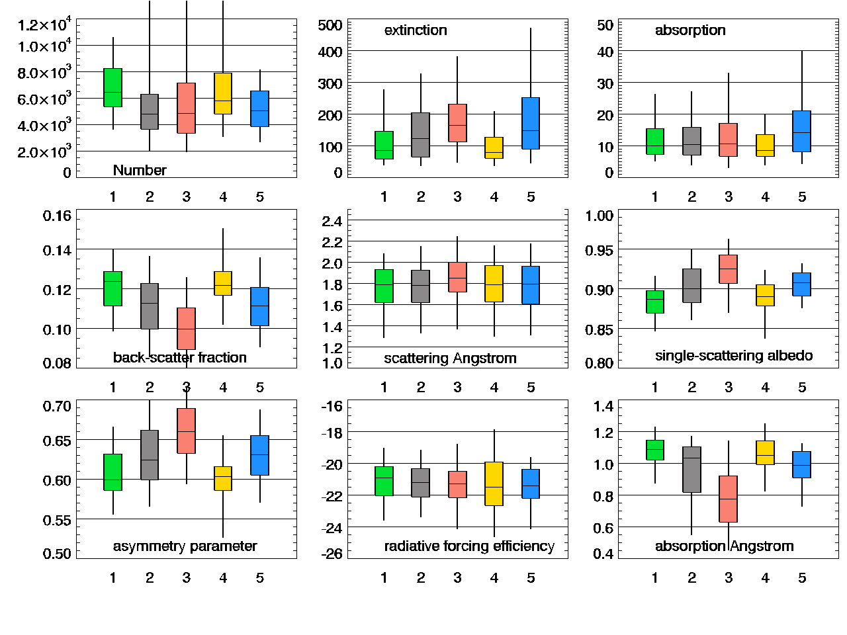
Trajectory Clustering - Annual
None of these clusters have the typical characteristics of dust:
→low scattering Angstrom < 1.5
→high absorption Angstrom > 1.5
In between
(blue, gray)
→similar and properties between high and low trajectories
Most time under 1000 m
(pink)
→high extinction
→high single scattering albedo
→low absorption Angstrom exponent
Most time above 2000 m
(green, yellow)
→high number, low extinction
→low single scattering albedo
→high absorption Angstrom exponent

Slide 23
Conclusions
Temporal aerosol property patterns
Aerosol property diurnal cycles are not particularly strong.
There is a weekend effect in some aerosol properties measured at AMY.
There are strong seasonal cycles in some aerosol properties suggesting the influence of different sources and/or processing.
Systematic aerosol property patterns
Comparison of AMY aerosol data to aerosol property matrices suggest the AMY air masses are dominated by urban/industrial pollution.
AMY has similar systematic variability as other polluted marine sites (ARN, GSN)
Spatial aerosol property patterns
Trajectory clustering shows:
→winter air masses are primarily transported from NW (China, Mongolia, Russia)
→warm season air masses are closer to surface and more often local
→low altitude trajectories tend to have higher loading and whiter particles (possibly due to thick coatings on particles)
→high altitude trajectories are cleaner, and darker (lots of EC+some organics?)
→no obvious dust cluster in this analysis

Slide 24
Future work
Near future:
→revisit trajectory analysis with fuller data set
→statistics – are the clusters properties really different?
→Conference presentation? International Aerosol Conference (Busan, 2014)
→Paper?
Far future:
→long term trends (need ~10 years of data to do good trend analysis)

Slide 25
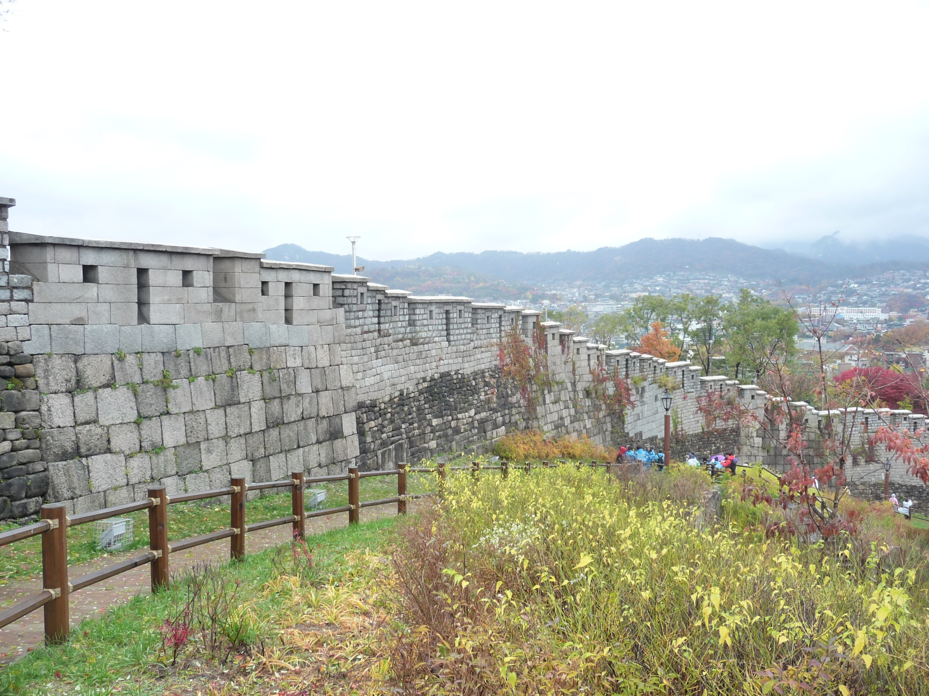
Thank you!
Any Questions?

Slide 26
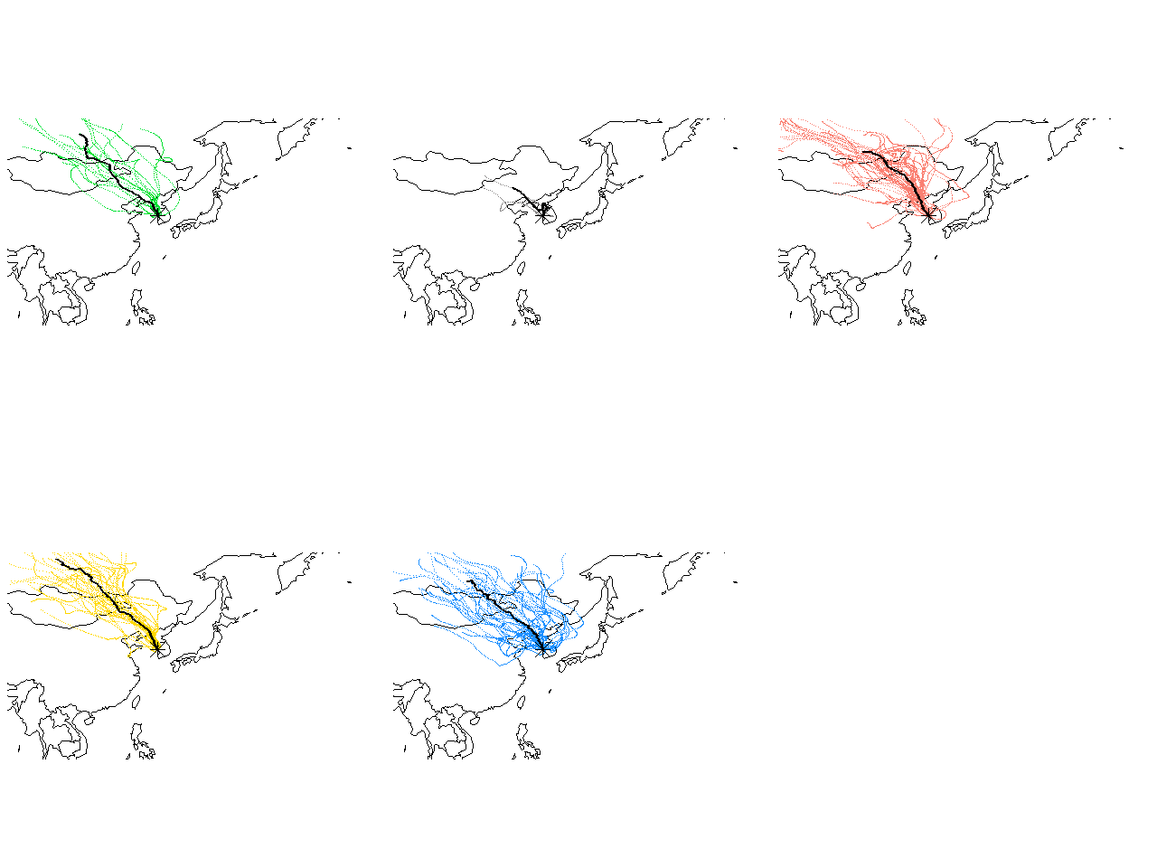
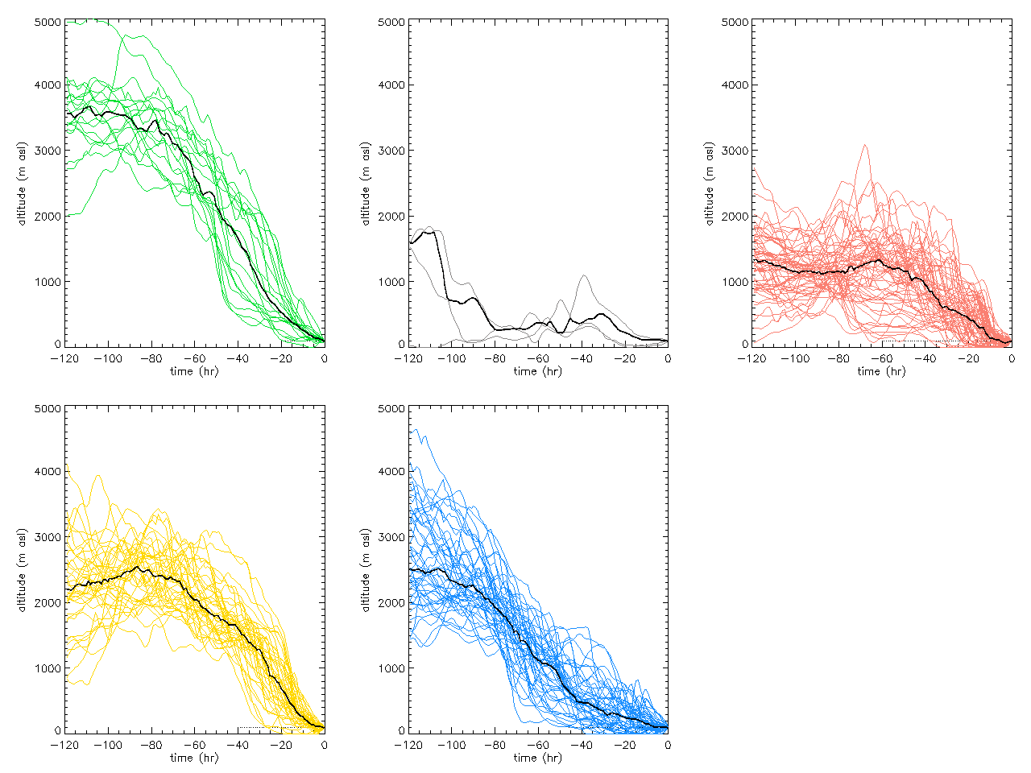
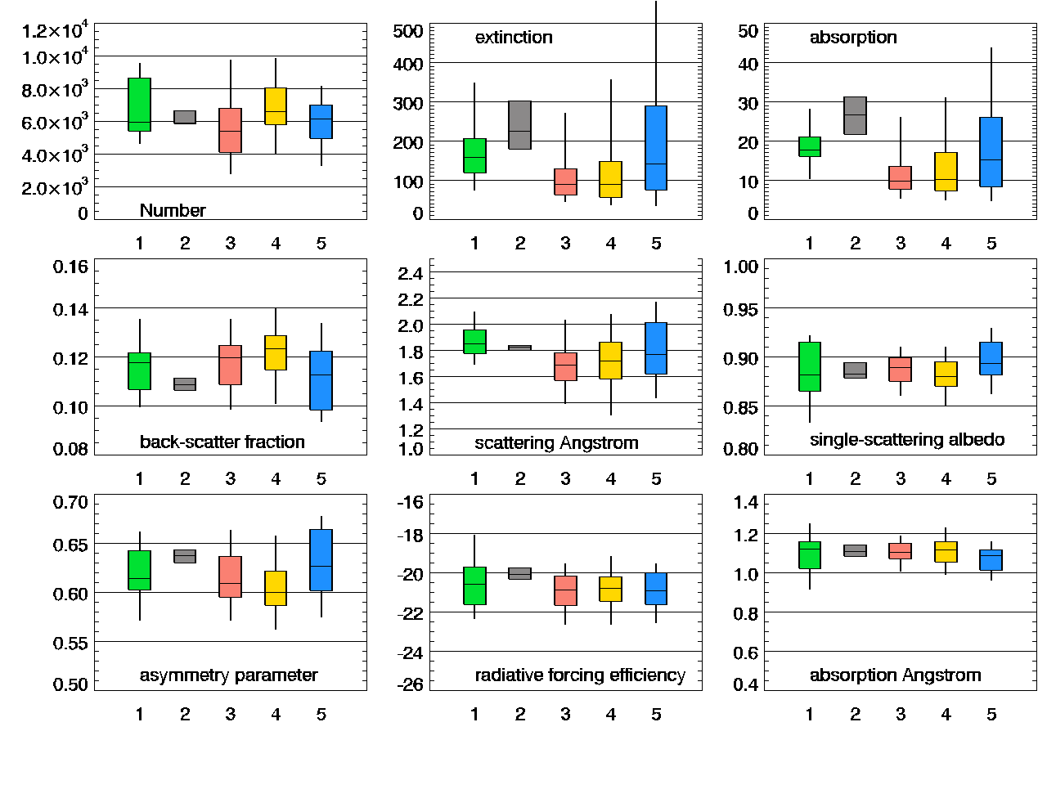
Winter

Slide 27
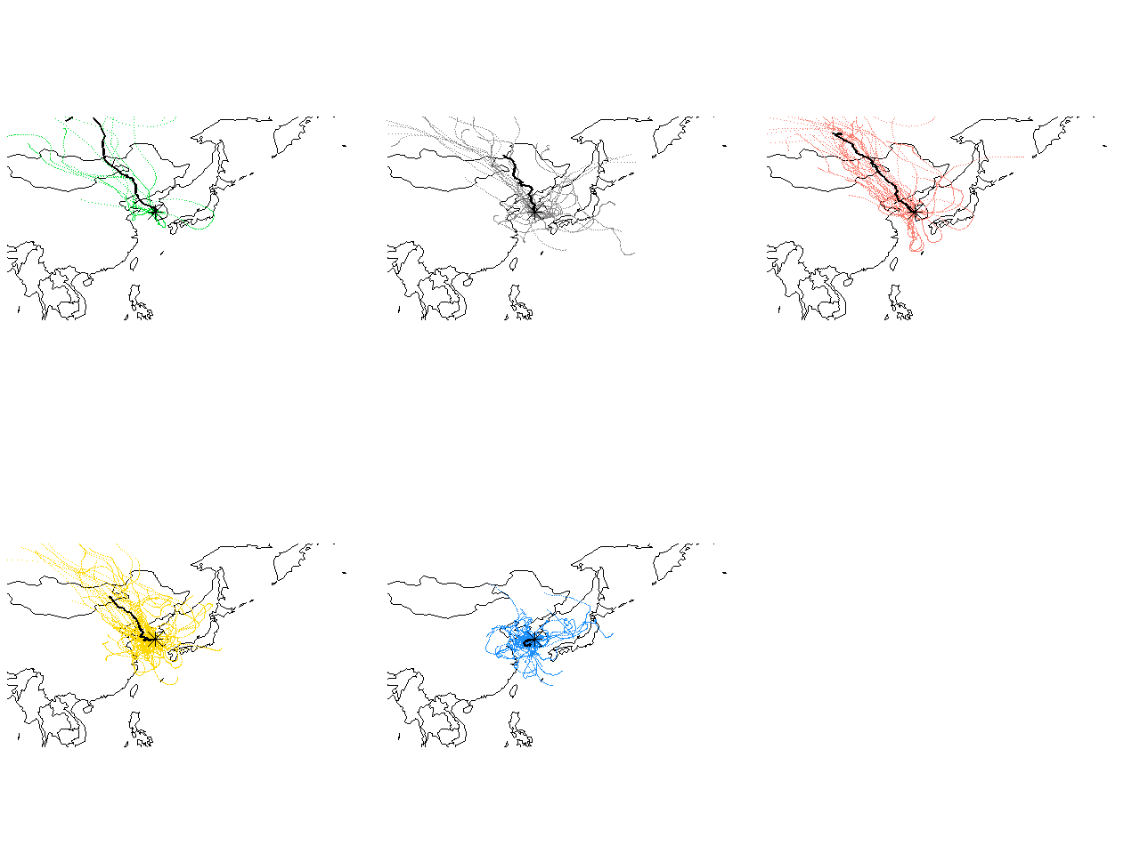
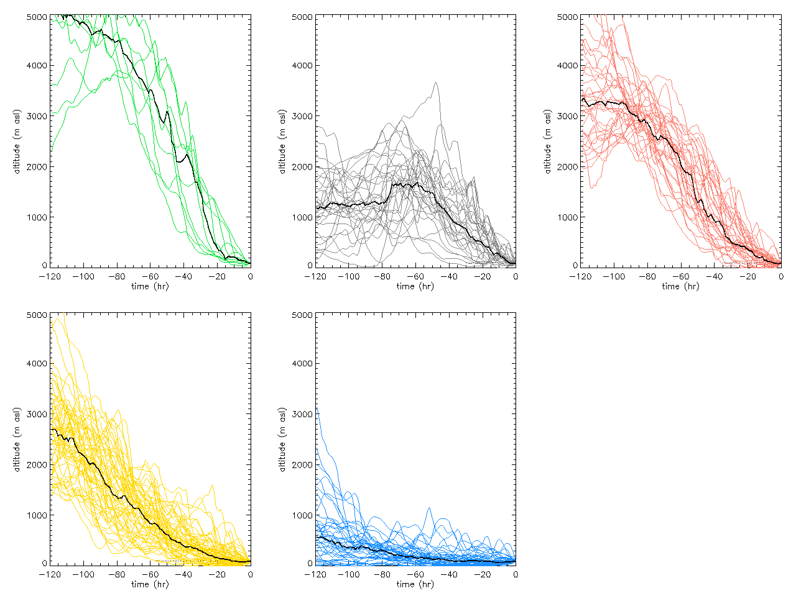
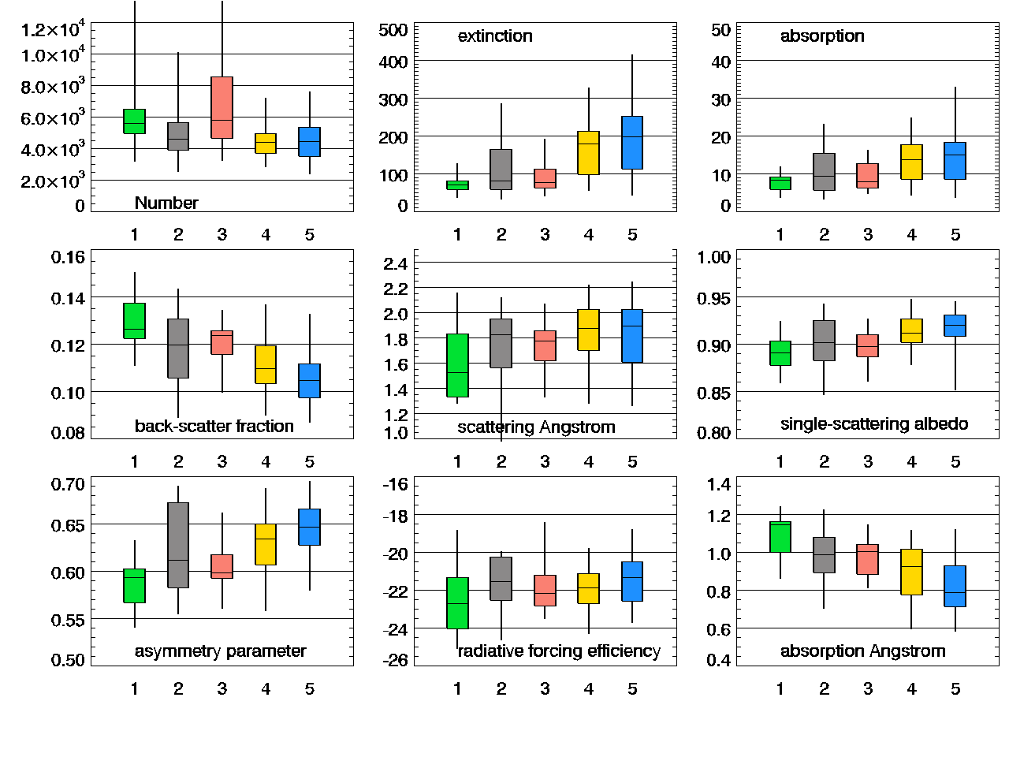
spring

Slide 28
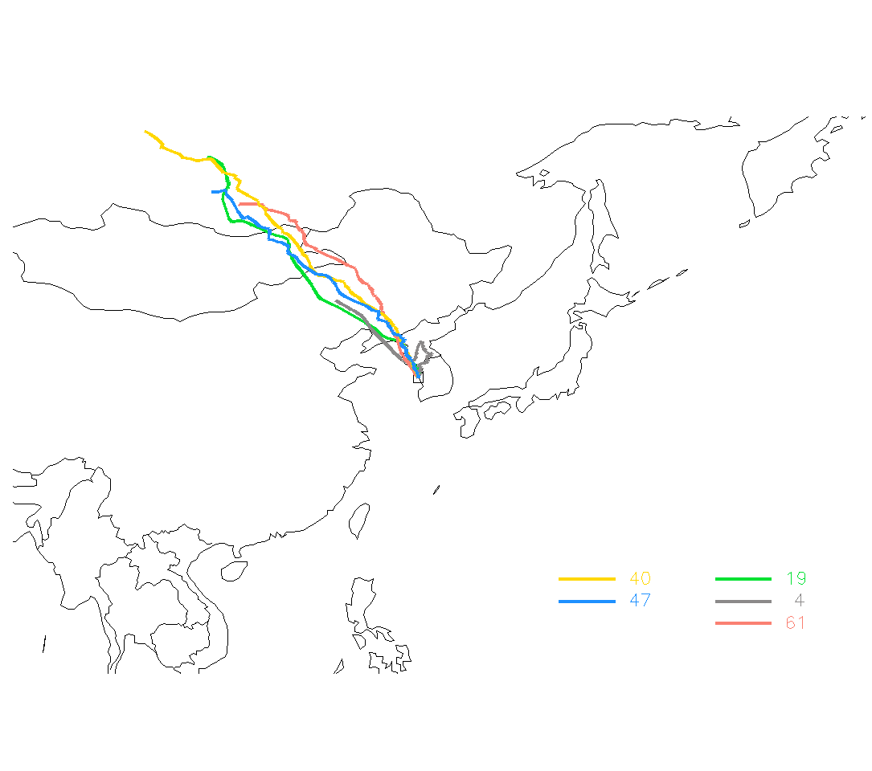
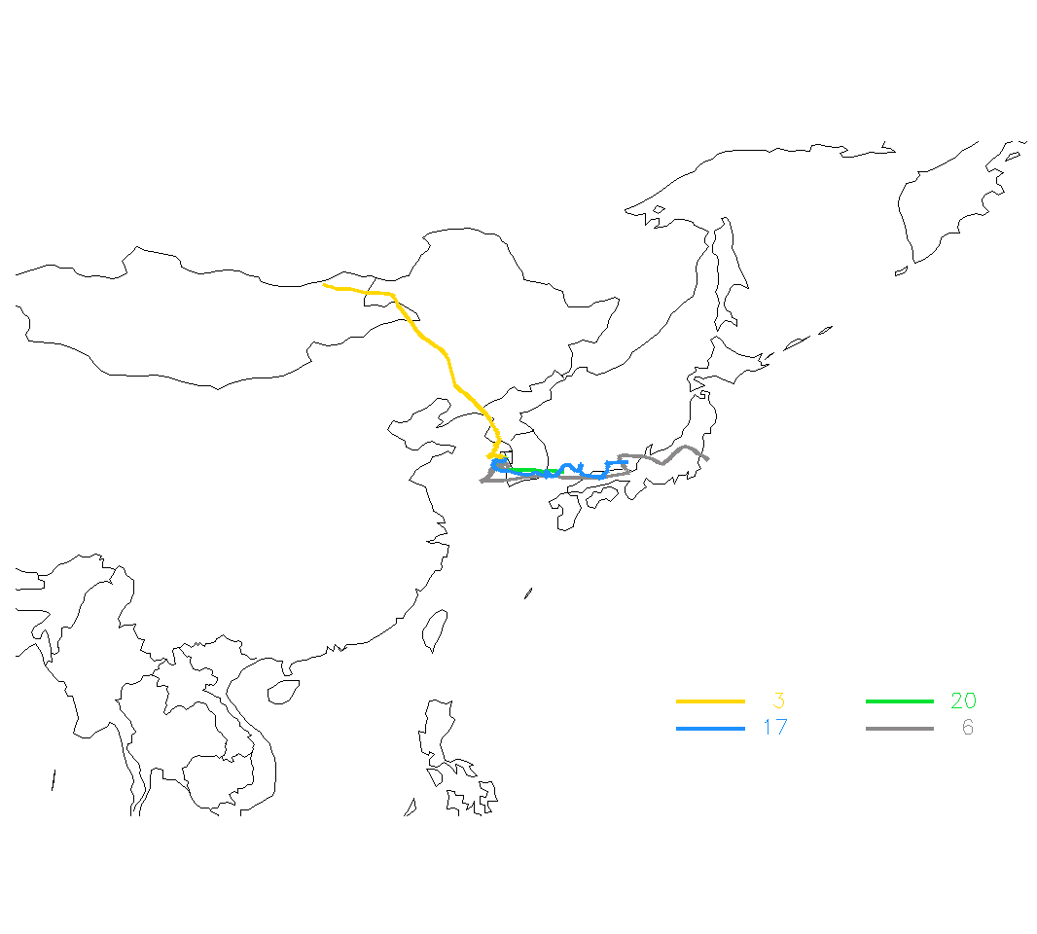
Clustered trajectories for Winter and Summer
(see difference between seasons, but waiting for more summer trajectory files!)
Winter (Dec 2011-Feb 2012
Summer ← these trajectories are only for June 2012

Slide 29
Any relationship between seasonality of aerosol properties and carbon cycle gases?
Difficult to assess because of gaps in data and protocols for gas sampling.

