Slide 1
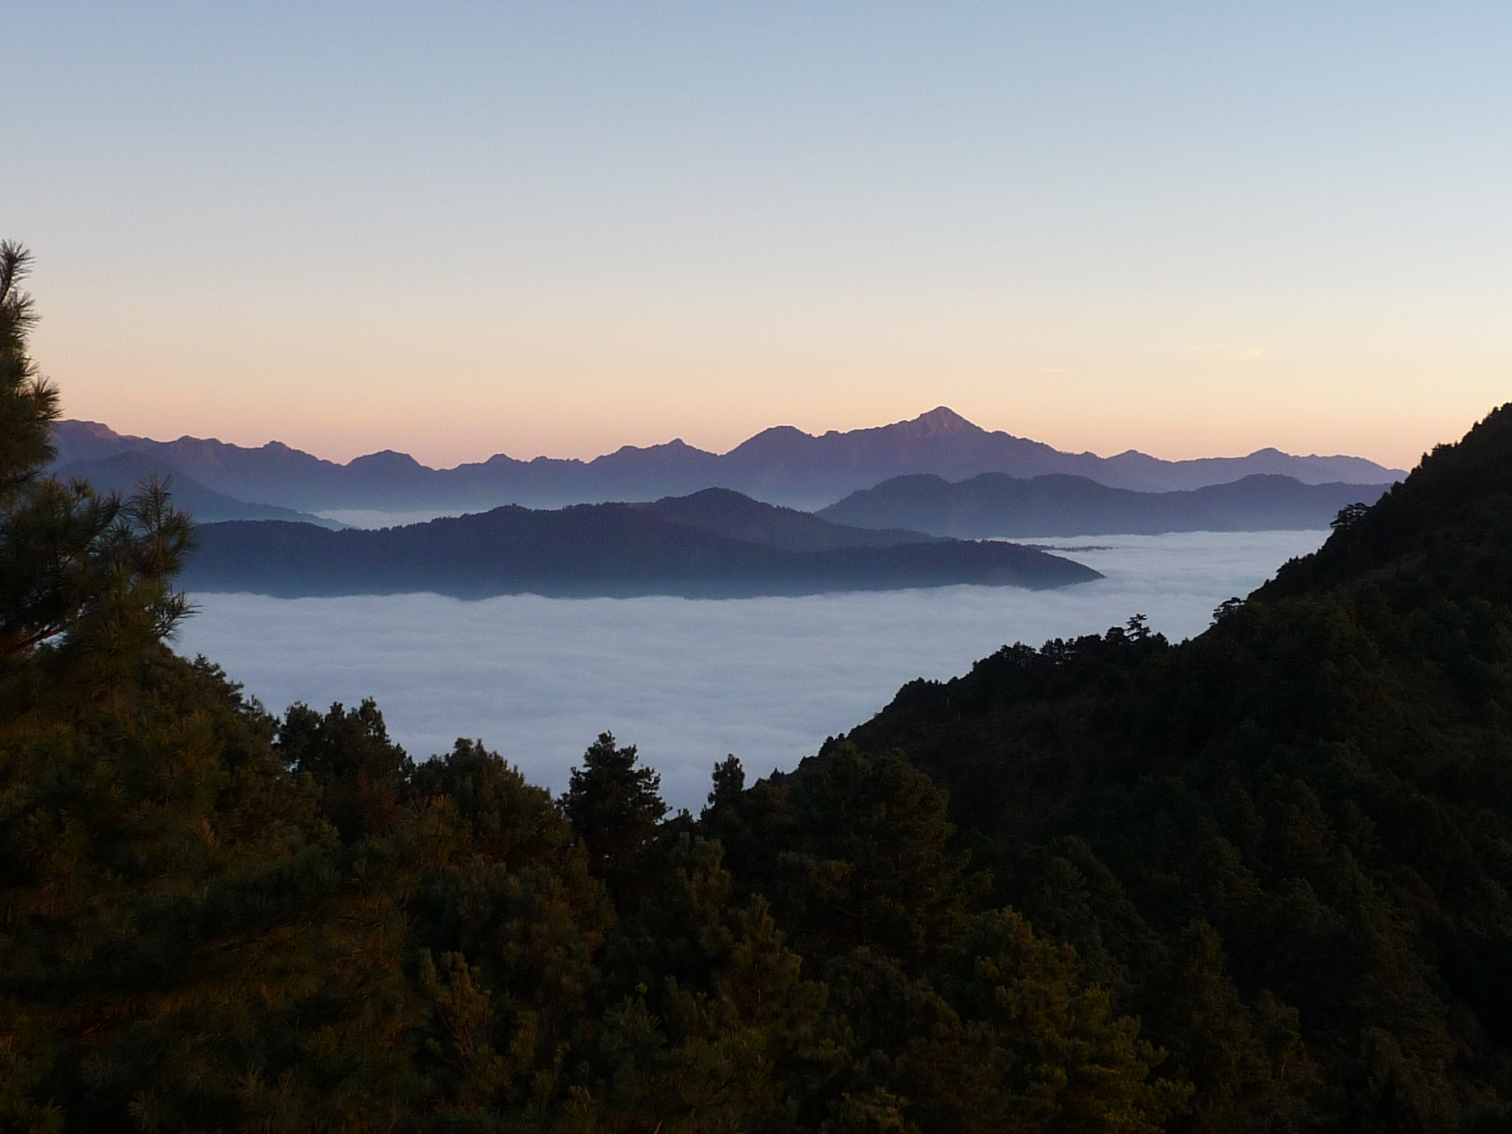
Temporal variability of aerosol properties at mountain sites – a lag-autocorrelation analysis
Andrews, E.^{1,2}, Ogren, J.A.¹, Bonasoni, P.³, Marinoni, A.³, Cuevas, E.⁴, Rodríguez, S.⁴, Sun, J.Y.⁵, Baltensperger, U.⁶, Bukowieki, N.⁶, Weingartner, E.⁷, Collaud Coen, M.⁸, Sharma, S.⁹, Macdonald, A.M.⁹, Leaitch, W.R.⁹, Lin,N.-H.¹⁰, Laj, P.¹¹, Sellegri, K.¹², Arsov, T.¹³, Kalapov, I.¹³, Hallar, G.¹⁴, Ries, L.¹⁵, Jefferson, A.^{1,2}, Sheridan, P.J.¹, Bergin, M.¹⁶, Strellis, B.¹⁶, L. Valle¹⁷, G. Torres¹⁷, Andrade, M. ¹⁸, Velarde, F.¹⁸, Moreno, I.¹⁸ , Wiedensohler, A.¹⁹, Krejci, R.²⁰
¹NOAA/ESRL, Boulder, USA; ²CIRES, University of Colorado, Boulder, USA; ³ISAC-CNR, Institute of Atmospheric Sciences and Climate, Bologna Italy; ⁴Izaña Atmospheric Research Centre, AEMET, Santa Cruz de Tenerife, Canary Islands, Spain; ⁵Key Laboratory for Atmospheric Chemistry, Centre for Atmosphere Watch and Services, Chinese Academy of Meteorological Sciences, Beijing, China; ⁶Paul Scherrer Institute, Laboratory of Atmospheric Chemistry, Villigen PSI, Switzerland; ⁷Institute of Aerosol and Sensor Technology, University of Applied Sciences, Windisch, Switzerland; ⁸Federal Office of Meteorology and Climatology, MeteoSwiss, Payerne, Switzerland; ⁹Environment Canada, Toronto, Canada; ¹⁰Department of Atmospheric Sciences, National Central University, Chung-Li, Taiwan; ¹¹UJF-Grenoble 1 / CNRS, Grenoble, France; ¹²U. Blaise Pascal/CNRS/OPGC, Clermont-Ferrand, France; ¹³Institute for Nuclear Research and Nuclear Energy, Sofia, Bulgaria; ¹⁴Desert Research Institute, Reno, USA; ¹⁵Federal Environment Agency, Langen, Germany; ¹⁶School of Civil and Environmental Engineering, Georgia Institute of Technology, Atlanta, USA; ¹⁷Dirección Meteorológica de Chile, Santiago, Chile; ¹⁸Laboratory for Atmospheric Physics, Universidad Mayor de San Andres, La Paz, Bolivia; ¹⁹Leibniz Institute for Tropospheric Research, Leipzig, Germany; ²⁰Department of Applied Environmental Science (ITM), Atmospheric Science Unit, Stockholm University, Stockholm, Sweden

Slide 2
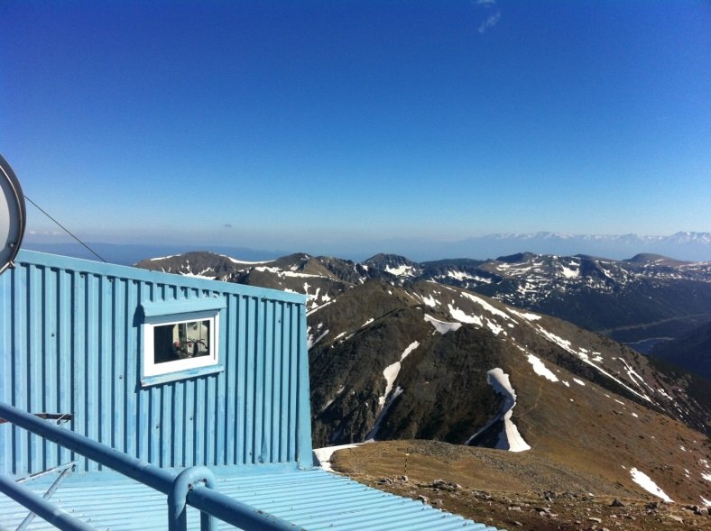
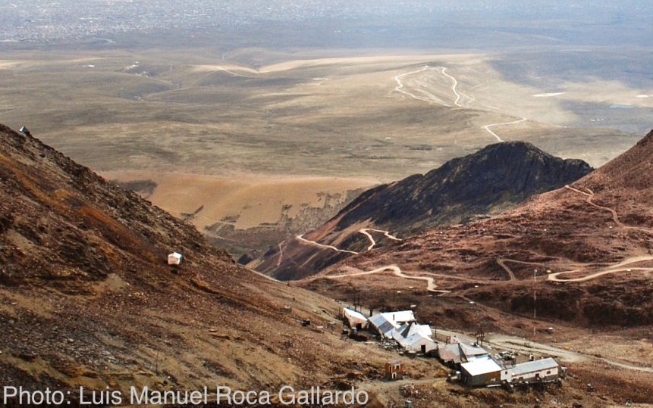
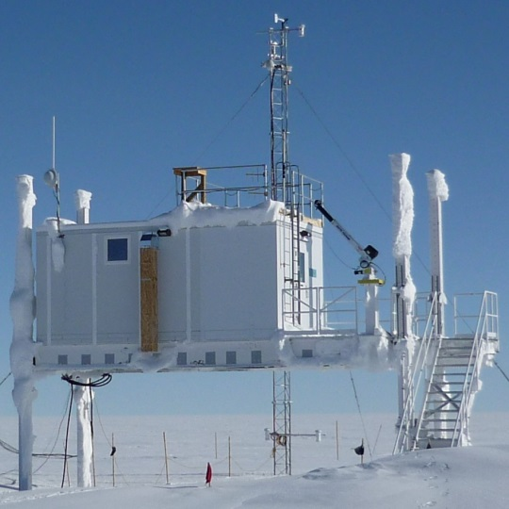
Motivation
Mountains are an interface between the atmospheric boundary layer and free troposphere.
Complex terrain →difficult to parameterize aerosol and atmosphere properties.
Lag-autocorrelation analysis can tell us about the time scales of mountain aerosols.
Notes:
Time scales = cycles and persistence

Slide 3
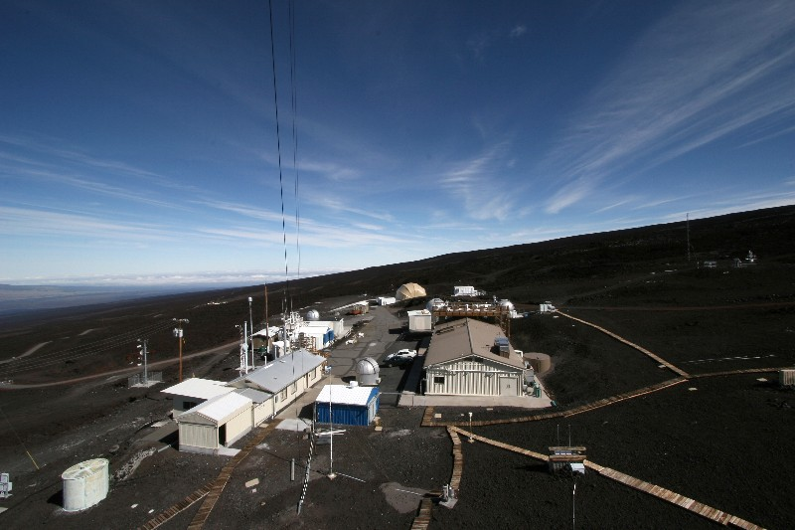
Scientific questions
What are the temporal variation scales of in-situ high elevation aerosol properties?
What can autocorrelation analysis tell us about aerosol sources and/or atmospheric processes at high altitude sites?
Does the aerosol persistence observed at mountain sites differ from that observed at other (low elevation) site types (e.g., coastal, continental, polar)?

Slide 4
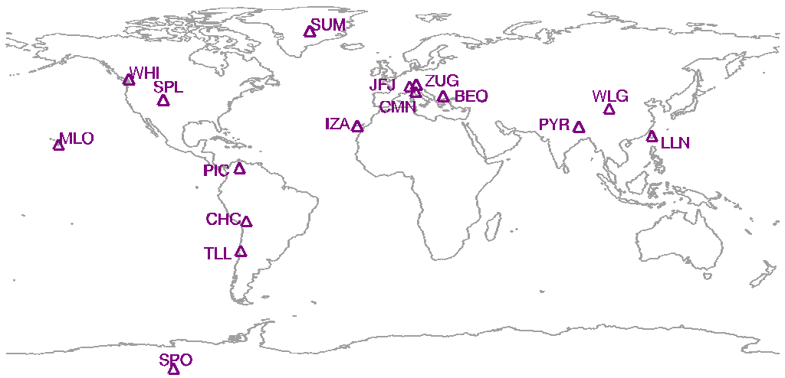
Location of Mountain Sites
MLO – Mauna Loa, USA (3.4 km)
SPO – South Pole, Antarctica (2.8)
WHI – Whistler, Canada (2.2 km)
SPL – Storm Peak, USA (3.2 km)
PIC – Pico Espeje, Venezuela (4.7 km)
CHC – Chacaltaya, Bolivia (5.3 km)
TLL – El Tololo, Chile (2.2 km)
SUM – Summit, Denmark (3.2 km)
IZA – Izana, Spain (2.4 km)
JFJ – Jungfraujoch, Switzerland (3.6 km)
CMN – Monte Cimone, Italy (2.2 km)
ZUG – Zugspitz, Germany (3.0 km)
BEO – Beo Moussala, Bulgaria (2.4 km)
PYR – Pyramid, Nepal (5.1 km)
WLG – Mt Waliguan, China (3.8 km)
LLN – Mt Lulin, Taiwan (2.9 km)
Sites have CN, scattering and/or absorption data.

Slide 5
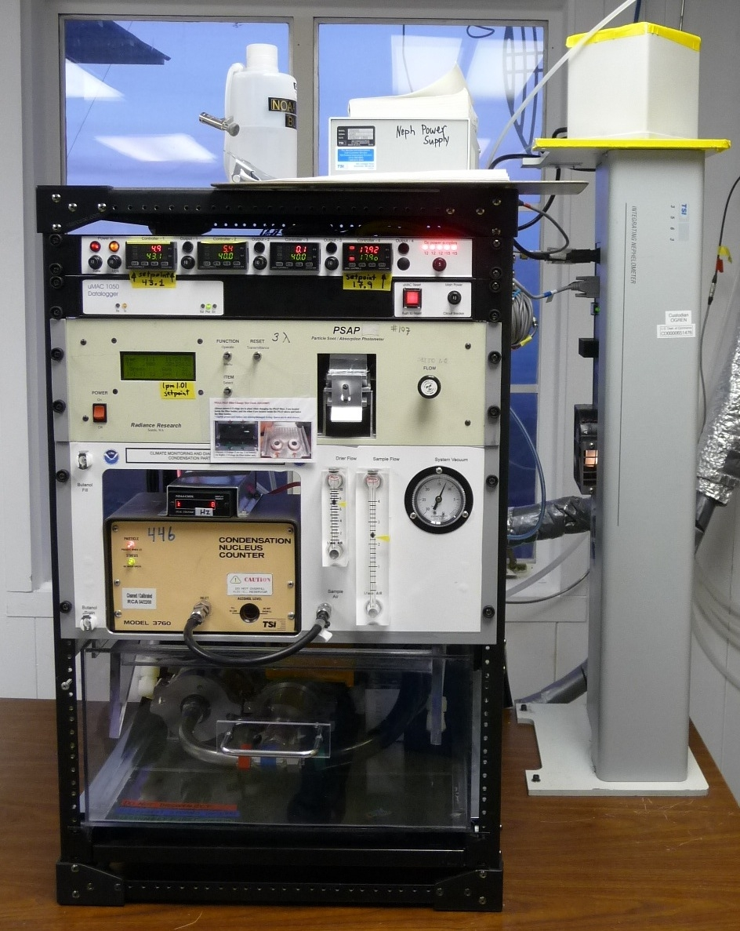
Measurements and Data
Aerosol light scattering,
3λ nephelometer (TSI or Ecotech)
total and hemispheric backscattering
Aerosol light absorption
Multiple instruments (MAAP, PSAP, CLAP, aethalometer)
Single and multi-wavelength
BC →absorption using 7.5 m²/g
Particle number concentration
Multiple instruments
Different lower size cuts
Data Processing
Hourly averaged, edited and corrected
Absorption and scattering adjusted to and presented at STP and 550 nm (where possible)
MLO aerosol rack
(Bond et al., 2005)
Notes:
Using all data, not just ‘FT’ data.

Slide 6
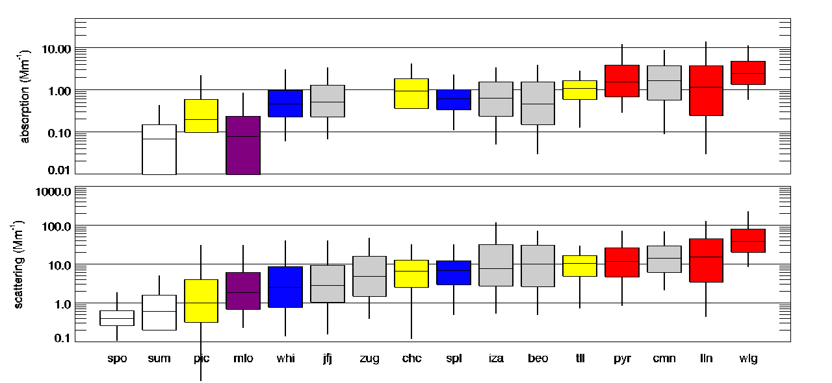
Scattering/absorption/CN statistics comparison
Polar
S. America
Pacific
N. America
Europe
Asia
new WHI data??
New pyr CN data?
Notes:
Made using ~/conf*/mtn*/data/plot_compare_sites_steamboat

Slide 7
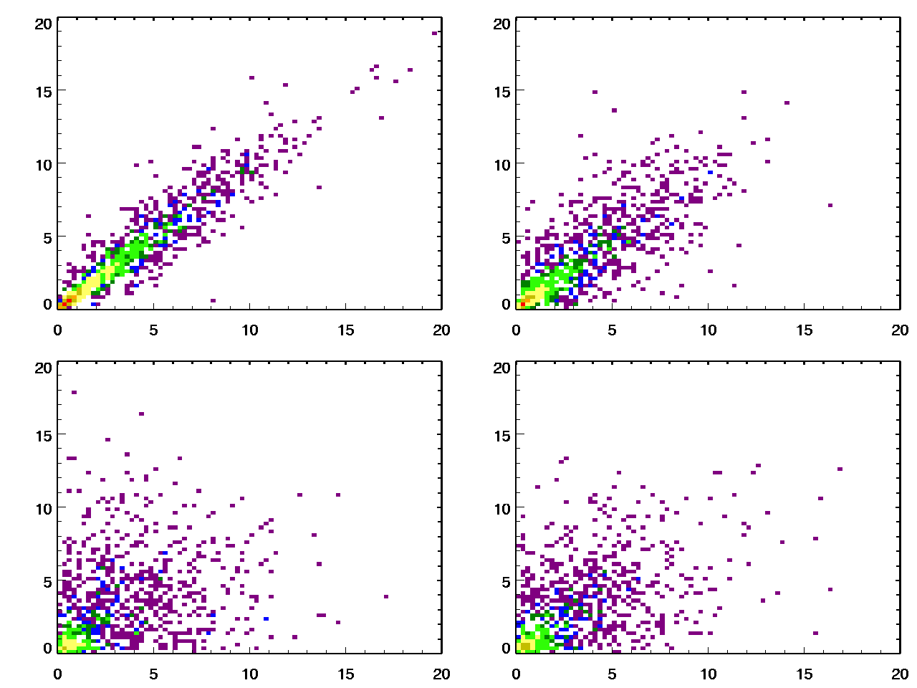
Aerosol Persistence
How well does a measurement at time ‘t’ represent a measurement at time t+Δt?
Δt=1 hour, r=0.96
Δt=3 hours, r=0.86
Scattering at t=t₀+Δt
Δt=12 hours, r=0.68
Δt=24 hours, r=0.57
Scattering at t=t₀
Colors represent density of points
IZA scattering
Notes:
This matters because often scientists try to match up measurements at time X with other measurements or models slightly shifted in time.

Slide 8
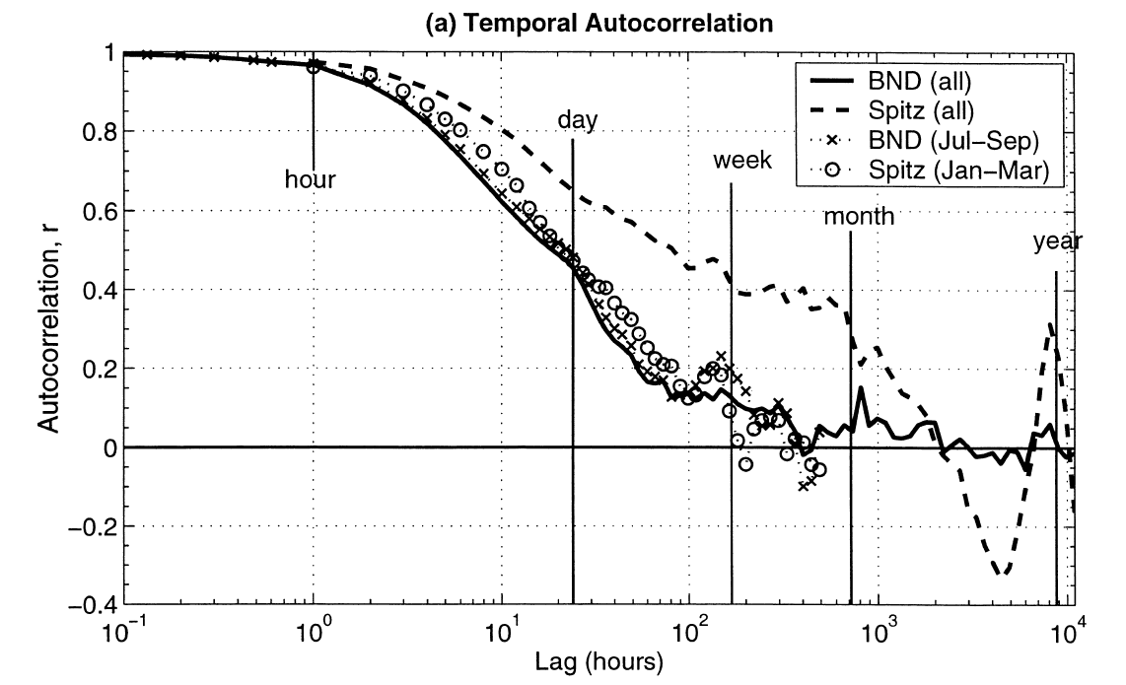
Autocorrelation Analysis
Lag autocorrelation relationships for aerosol light scattering at Bondville, IL (rural continental site) and Spitzbergen (Arctic site)
(Anderson et al., 2003)
Lag is the time between measurements being compared (Δt).
‘r’ is the lag autocorrelation statistic.
Autocorrelation analysis can be used to identify aerosol persistence.
Notes:
Low altitude sites.
Are there similarities at mountain sites despite 3 order of magnitude difference in loading?

Slide 9
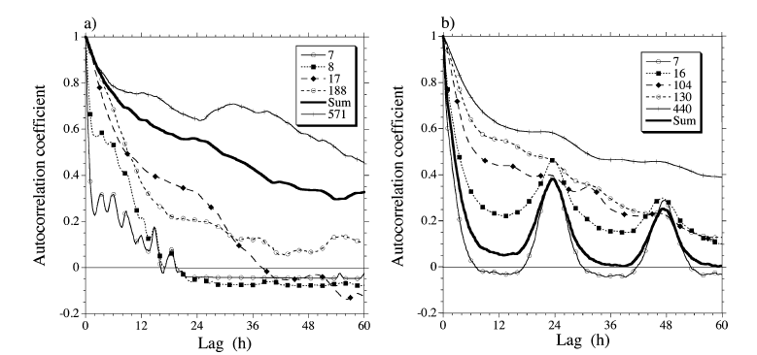
Autocorrelation Analysis
Lag autocorrelation relationships for aerosol number concentration at Cape Grim (clean marine site) and Melpitz (polluted continental site)
Clean Marine
Polluted continental
(Heintzenberg et al, 2004)
Autocorrelation can be strong function of site characteristics.
Autocorrelation may provide information about atmospheric processes.
Peaks at 24 and 48 h indicate diurnal variations.
Notes:
At polluted continental site the oscillations are driven by NPF (other?)

Slide 10
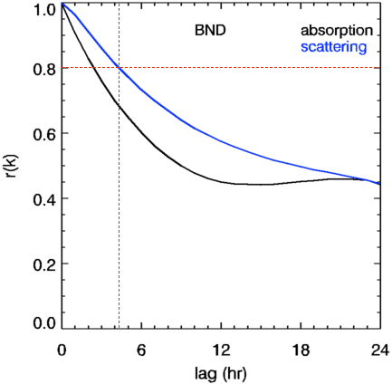
Applications of lag autocorrelation analysis
→coordinate measurement strategies (e.g., during a campaign)
→constrain comparisons by identification of expected ‘best case’ agreement between different data sources
→determine whether data from different measurement platforms and models are internally consistent such that satellites/models can be used to fill the spatial gaps in in-situ measurements.
Lag
12 h
3 h
1 h
Notes:
Additional benefit – can lead to more rigorous data QC – for example, found some issues with MLO data editing during upslope flow.

Slide 11
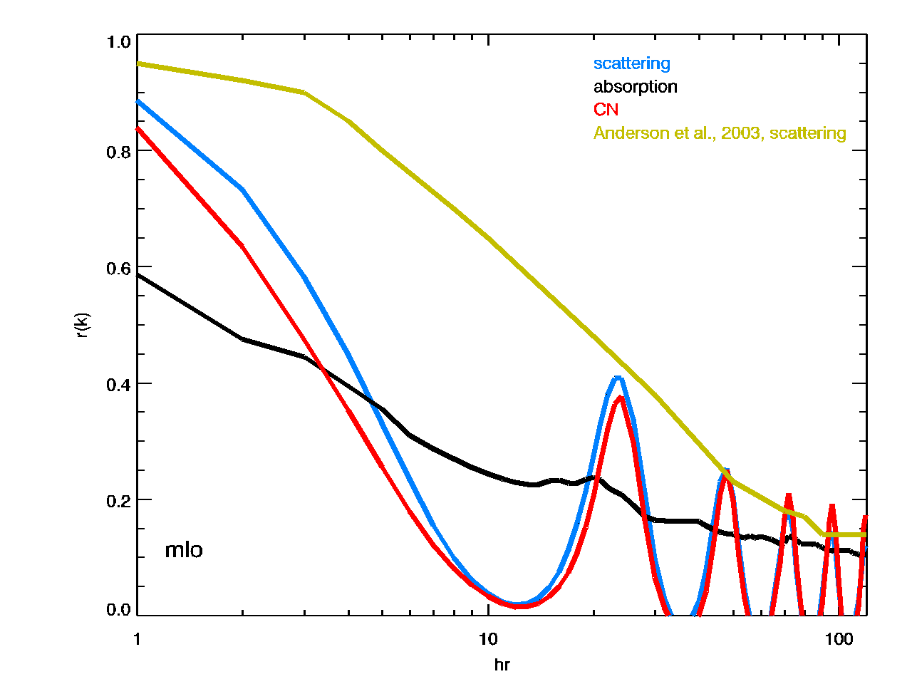
What do we see at these 16 mountain sites?
Scattering
Absorption
CN
Autocorrelation for light scattering at Bondville (Anderson et al., 2003)
mlo

Slide 12
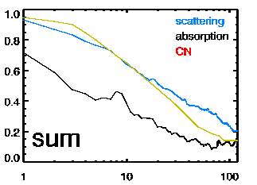
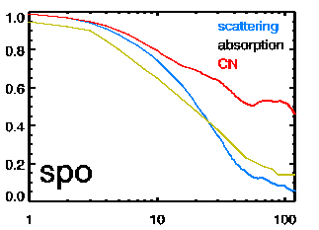
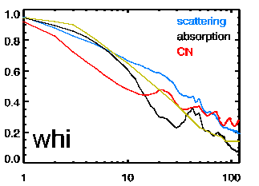
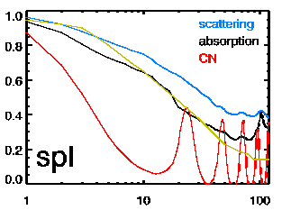
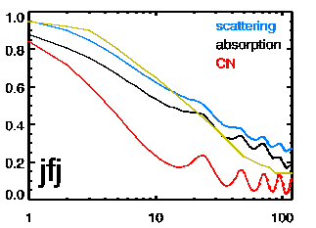
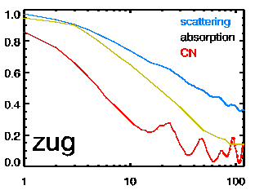
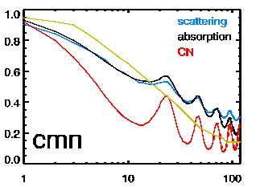
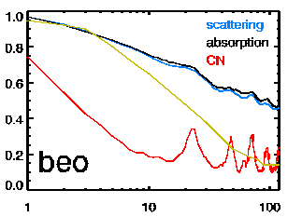
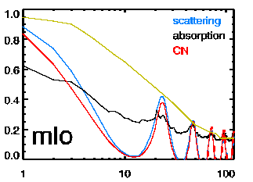
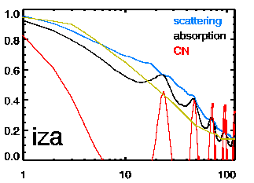
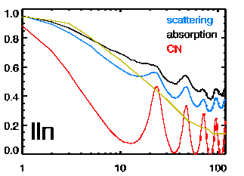
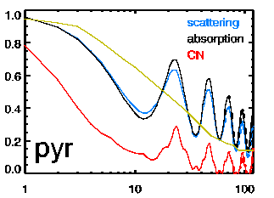
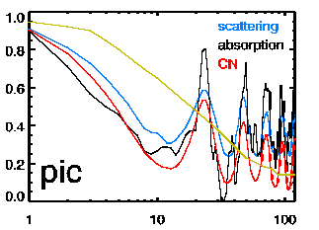
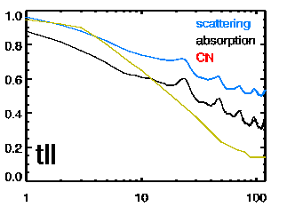
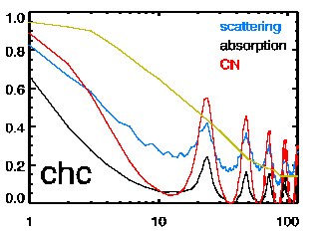
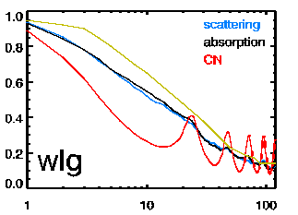
Lag Autocorrelation of mountain sites – Short term
N.america
Lag Coefficient ‘r(time)’
Lag time (hr)
Notes:
Properties behave differently:
Most sites show CN oscillations→NPF?
Oscillations in scattering and/or absorption largest at MLO, LLN, PYR
→upslope
Yellow line based on mid-continental low elevation US surface site (from Anderson et al., 2003)

Slide 13
Similarities among mountain sites
Increasing persistence
Number
Absorption
Scattering
Decreasing persistence
Notes:
Note that colors are different for different plots/stations
Absorption tends to have lower persistence values (measurement noise?)
Persistance tends to decrease with altitude – higher altitude=more variable
Persistance tends to increase with latitude – higher latitude=less variable
Most persistent: beo, spl, zug
Least persistent: mlo, iza, pyr, cmn, pic, chc

Slide 14
Summary of short term lag results
All mountain sites experience diurnal oscillations in CN, except SPO
Strength of diurnal CN cycle varies at each site and for each parameter
→atmospheric processing (NPF)
→transport (upslope/downslope)
Lowest persistence (<0.75 at 1h lag) observed for absorption
→sum, mlo, chc
Persistence tends to decrease with elevation and increase with latitude
Anderson 2003 autocorrelation curve is good surrogate for some sites and some parameters
Future work
Seasonality of the lag autocorrelation – cold weather months when the site is more likely to be isolated in the free troposphere may look different than all year, while diurnal cycles may be enhanced in the summer.
Notes:
Persistence not related to longitude (that I can see, see spreadsheet in conferences/mtn*/abstracts/*xls

Slide 15
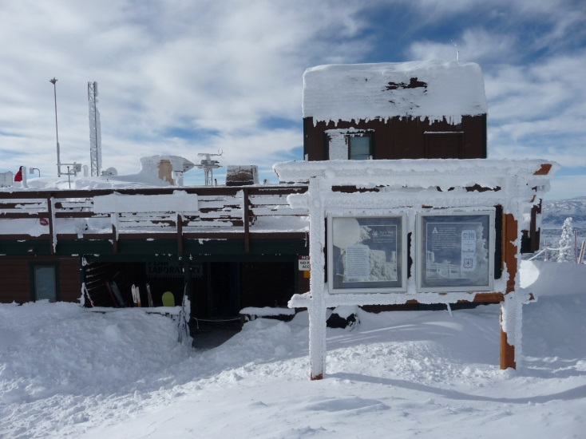
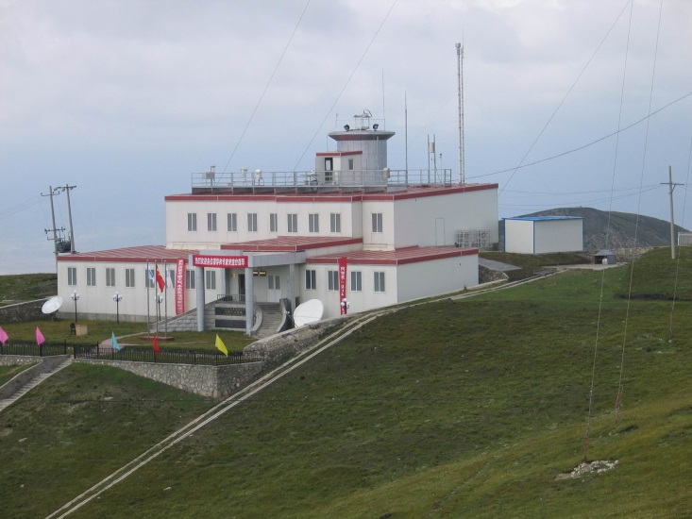
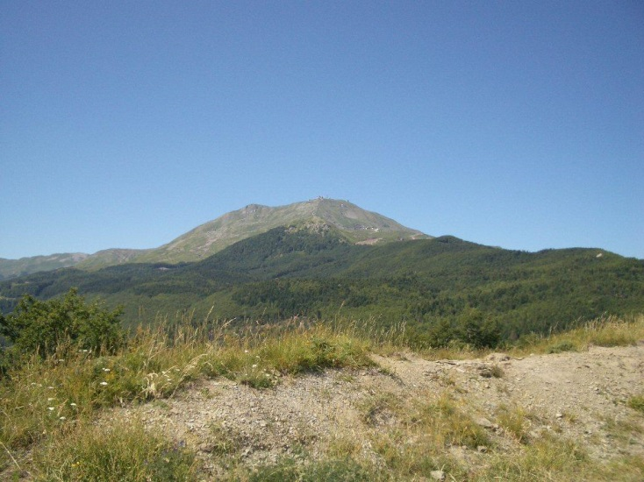
Sources/processes
Lag-autocorrelation analysis can help identify whether aerosol properties co-vary.
Co-variance could indicate similarities in:
→source and/or transport
→atmospheric processes
Conversely, lack of co-variance suggests differences in sources/transport or atmospheric processing

Slide 16
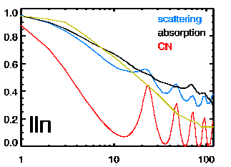
Some Examples
Similar cycles in all 3 properties
Different cycles for CN and scattering/absorption
absorption is different… scattering is different…
Notes:
Note: strength of CN diurnal cycle may be influenced by CN instrument lower cutoff size

Slide 17
Comparison with other site types
BRW
EGB
ALT
THD
WSA
BND
SGP
Low elevation<315 m asl
Continental: BND, EGB, SGP
Coastal: THD, WSA
Polar: ALT, BRW
Are there characteristics of mountain sites that allow us to distinguish them from other site types?
Notes:
SGP is “highest” low elevation site at 315 m asl

Slide 18
CN – Compare with other site types
Polar
Continental
Coastal
Mountain CN are most similar to continental CN in terms of temporal variance
Mountain sites can see both more and less CN persistence than other site types

Slide 19
Absorption – Compare with other site types
Polar
Continental
Coastal
Variability of mountain site absorption may be similar to that at other site types
Only mountain sites see strong diurnal variation in absorption

Slide 20
Scattering – Compare with other site types
Polar
Continental
Coastal
Variability of mountain site scattering may be similar to that at other site types
Only mountain sites see strong diurnal variation in scattering
Notes:
Surprising (to me) not to see on-shore off-shore signal at coastal sites

Slide 21
Summary of site type comparison
There is a range in the lag-autocorrelation for other site types as well as mountain sites.
Primary difference: mountain sites are more likely to see stronger diurnal oscillations in all parameters (CN, absorption, scattering).
→this is likely upslope/downslope flow driven.
However, there is no obviously distinct characteristic of mountain sites.
Future work
Compare with other non-mountain sites (e.g., NOAA federated network sites)

Slide 22
Conclusions/implications/future work
Mountain top measurements have widely varying time scales
Aerosol parameters may have different time scales at the same site
Mountain sites tend to have stronger diurnal patterns than other site types
→Critical how FT air is filtered from BL and orographically lifted BL air
→Care must be taken when comparing data sets on different time scales
Future work
Size distributions can help identify processes vs transport (e.g., Wehner et al and Heintzenberg et al)
How do other aerosol parameters (albedo, angstrom exponent, etc.) look?
Seasonality of persistance
Paper using NOAA network sites is in the works (suite of mountain, coastal, polar, continental sites)

Slide 23
Extra slides…

Slide 24
Instruments used for autocorrelation analysis
SITE | Number | Absorb. | Scatter
BEO | DMPS | CLAP | TSI
CHC | SMPS | MAAP | Ecotech
CMN | 3772 | MAAP | Ecotech
IZA | 3025 | MAAP | TSI
JFJ | 3010 | Aeth | TSI
LLN | 3010 | PSAP | TSI
MLO | 3760 | PSAP | TSI
PIC | 3010 | PSAP | DMPS
PYR | SMPS | MAAP | TSI
SPL | 3010 | PSAP | TSI
SPO | 3760 | - | TSI
SUM | - | PSAP | TSI
TLL | - | Aeth | Ecotech
WHI | 3022 | PSAP | TSI
WLG | 3010 | PSAP | TSI
ZUG | 3772 | - | TSI

Slide 25
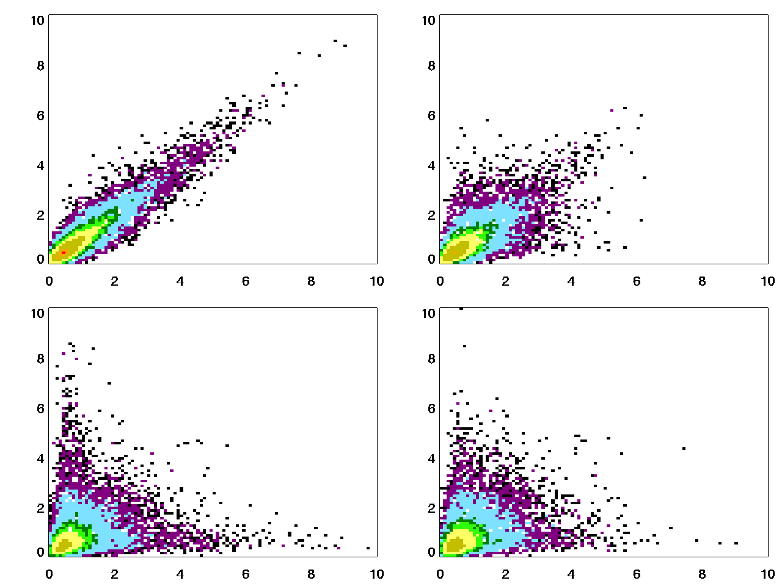
Lag=1 h, r=0.89
Lag=3 h, r=0.58
Lag=12 h, r=0.02
Lag=24 h, r=0.41
MLO scattering

Slide 26
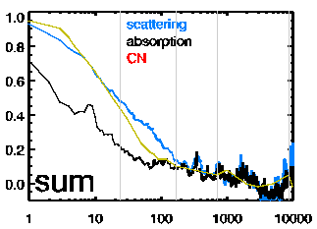
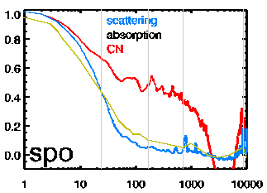
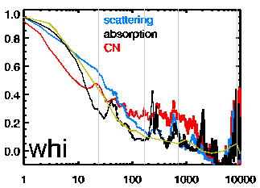
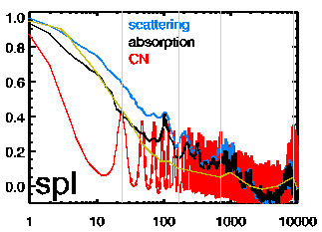
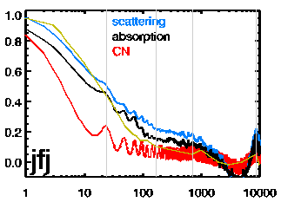
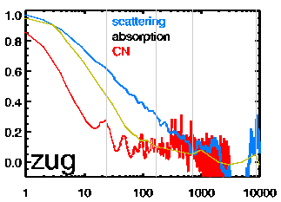
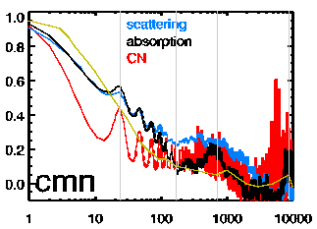
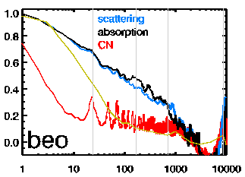
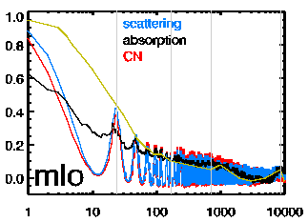
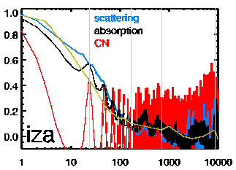
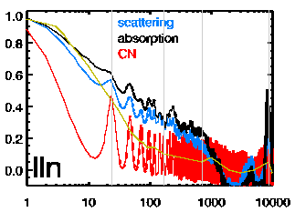
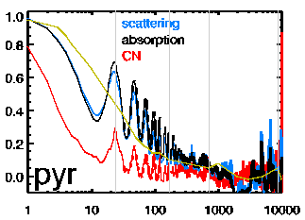
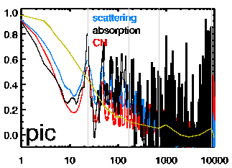
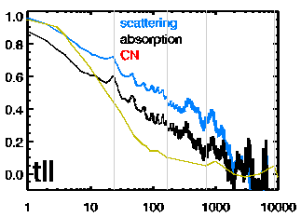
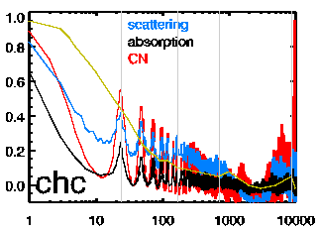
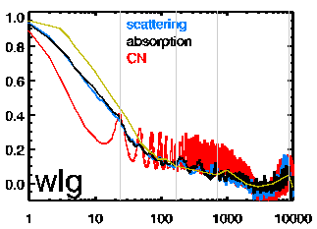
Lag Autocorrelation of mountain sites – Long term
Lag Coefficient ‘r(time)’
Lag time (hr)
Notes:
Gray lines indicate: 1day, 1week, 1month, 1year (year hard to see – on edge, h=8784)

Slide 27
Seasonality of CN Persistence
Summer
(JJA)
Winter
(DJF)
Summer diurnal oscillations in CN tend to have larger magnitude
Notes:
Outhern hemisphere sites use northern hemisphere definitions of summer and winter.

Slide 28
Seasonality of Absorption Persistence
Summer
(JJA)
Winter
(DJF)
Summer absorption is often more persistent than in winter; diurnal cycle = f(season)

Slide 29
Seasonality of Scattering Persistence
Summer
(JJA)
Winter
(DJF)
Summer scattering is often more persistent than in winter; diurnal cycle = f(season)

Slide 30
schnee
ZUG
JFJ
CMN
BEO
Topo map from wikipedia

