Slide 1
Assessing Potential Bias in Preliminary Estimates of Global GHG Trends
Ed Dlugokencky, Kirk Thoning, and Molly Crotwell
NOAA ESRL Global Monitoring Division
Acknowledgement: Ken Masarie & Pieter Tans

Slide 2
NOAA Trends Products:
In situ MLO CO₂ trends (daily & monthly updates)
In situ global CO₂ trends (daily updates)
Deseasonalized average of 4 NOAA observatories (BRW, MLO, SMO, and SPO)
Global CO₂ and CH₄ trends (monthly updates)
Based on cooperative global air sampling network
~35,000 hits per month

Slide 3
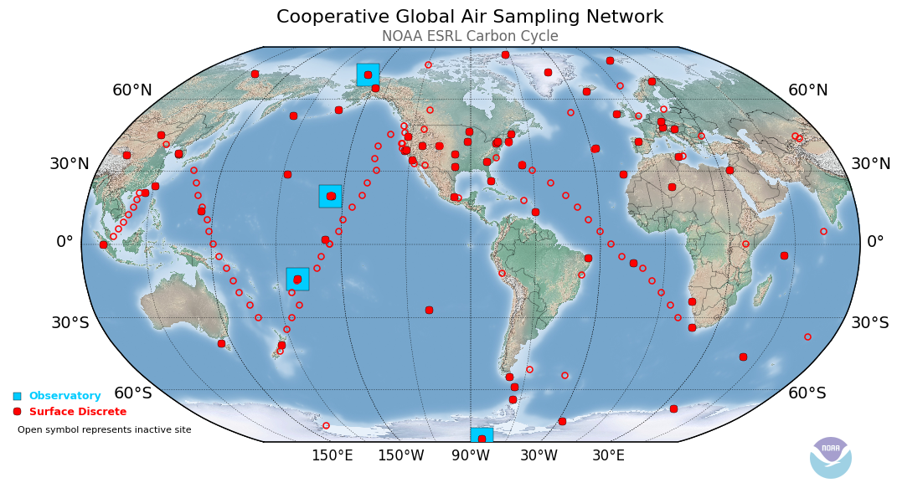

Slide 4
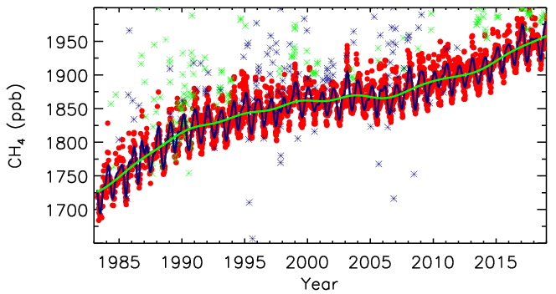
5th of month → “web runs”
Use subset of weekly BG sites
Smooth each record in time
Synchronized values from curve
Notes:
Something about curve fits and running mean as approximation.

Slide 5
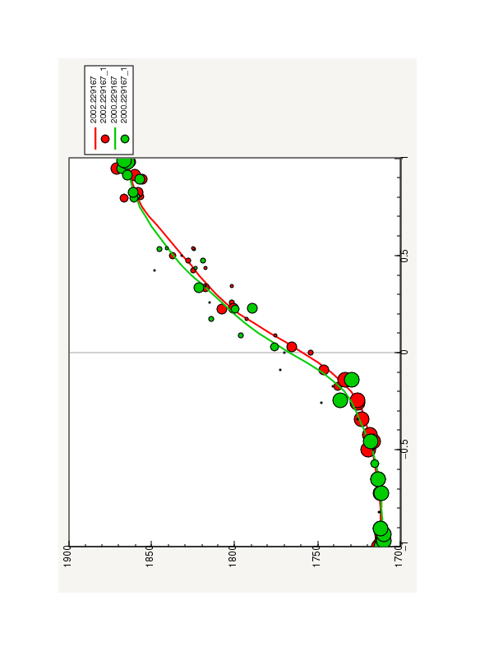
Fit curves as function of sine(latitude) at each t-step
CH₄ (ppb)
S
Sine (lat)
N

Slide 6
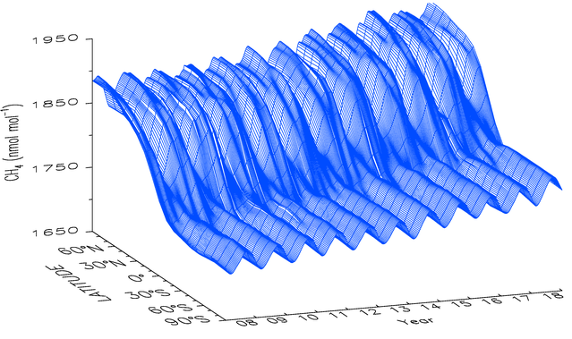
Matrix of values → zonal and global means
48 time steps yr⁻¹
Lag between sampling and measurement
End effects
Notes:
Basis for trends web pages

Slide 7
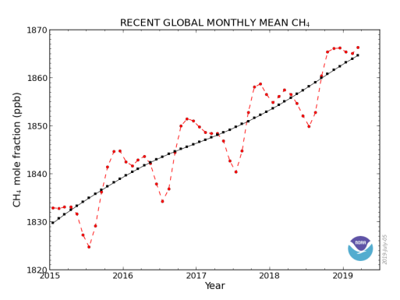
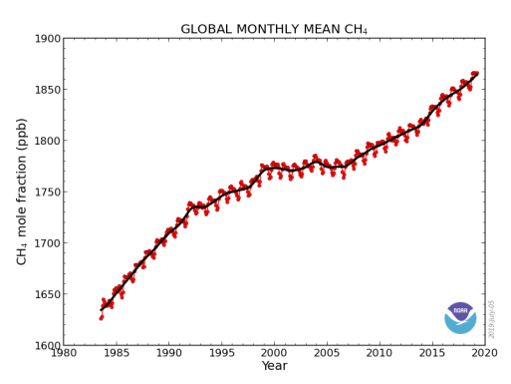
“Global Trends” https://www.esrl.noaa.gov/gmd/ccgg/trends/global.html
Monthly updates of:
Annual means
Monthly means
Annual increase
Uncertainties estimated annually using nonparametric methods
For CO₂ and CH₄ (soon: N₂O and SF₆)
Notes:
Updates done on 5th of each month.

Slide 8
What Issues Are We Addressing and Why?
Web runs: 1990 - 2017
Compare initial estimates with “finalized” ones
Are initial estimates biased?
Network “lag” effects: delay between sampling and analysis
Curve fitting end effects: lack of constraint at time of web run
If biased, how do we minimize the bias?
Avoid claims of exaggerating changes

Slide 9
Annual Means: CO₂
?
u = ±0.1 ppm
1990-2017
?
Initial estimates of annual means: relatively small bias that converges quickly; insensitive to method.
Notes:
In January of each year, we calculate an annual mean for the previous year, and we want to track how it changes with each subsequent monthly update relative to a final, stable value. We do that by comparing it with the annual increase for the same year at the end of the experiment. Here, that difference is plotted for each color-coded year from 1990 to 2017. As it turns out, the initial estimate isn’t biased by too much, roughly ±0.1 ppm. Average behavior is shown in the RH plot, in this case the mean Abs val of differences and SD for all years. Again, biases are small and converge quickly, except the abrupt changes in cyan and green. Look more closely at these.

Slide 10
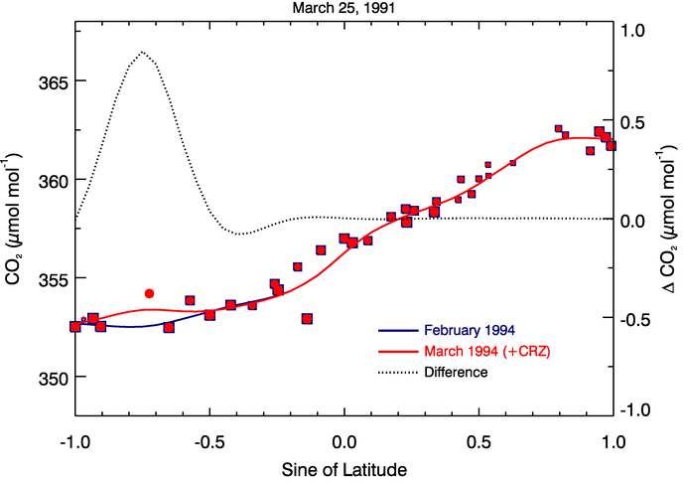
2013 - POC
1991 - CRZ added

Slide 11
Monthly Means: CH₄
u = ±1.2 ppb

Slide 12
Monthly Means: CO₂
u = ±0.1 ppm

Slide 13
Annual Increase: CO₂
u = ±0.07 ppm yr⁻¹
1990-2017
Initial estimates of annual increase can have relatively large bias; add caveat to web page.
Notes:
LH plot: Annual increases, color-coded by year, calculated with PPT method for 1990-2016. Little difference between PPT and EXT, but PPT is what is used for trends web pages. RH plot: Average absolute values of differences as subsequent web runs refine the calculation of annual increase. Given annual increases of 1.6 to 3 ppm/yr over past 10 years, the magnitude of the initial bias is significant.

Slide 14
Annual Increase: CH₄
u ≈ ±0.6 ppb yr⁻¹
Initial estimates of annual increase can have significant bias, even with 4 month lag. Add caveat to page.
Notes:
Figures as for CO2: given that CH4 annual increase has been 4.6 to 12.7 during past 10 years, these initial biases are large.

Slide 15
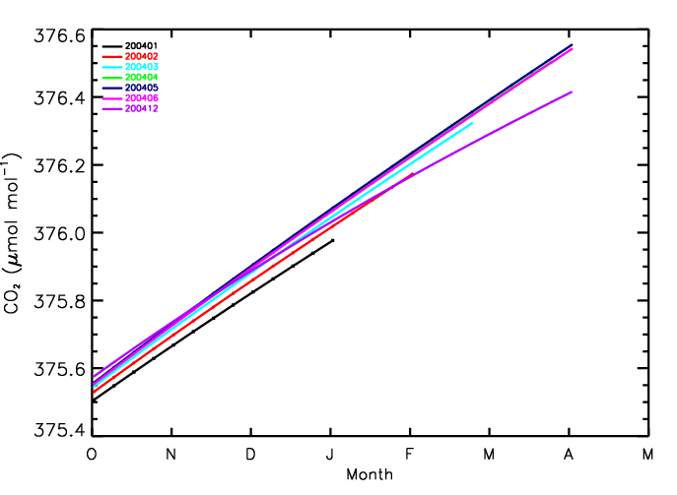
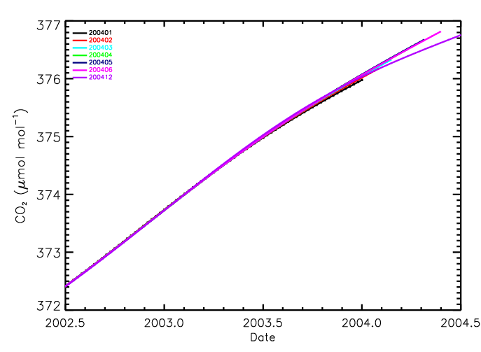
Curve Fit End Effects
Oct., 2003 - Apr., 2004
Network effects eliminated: Based on sample date.

Slide 16
Summary and Conclusions
Initial estimates are biased by more than uncertainty
Initial estimates poorly constrained by web run
Not improved by averaging method
Annual means:
Relatively small bias: most of year already constrained
Monthly means:
Large changes: smooth curve needs 6 weeks or more to be constrained
Delay release by 3 to 4 months
Annual increase:
Large changes: trend needs 6 mos. or more to be fully constrained
Delay release by 3 to 4 months
Add caveat to web page text

Slide 17
Extra Slides

Slide 18
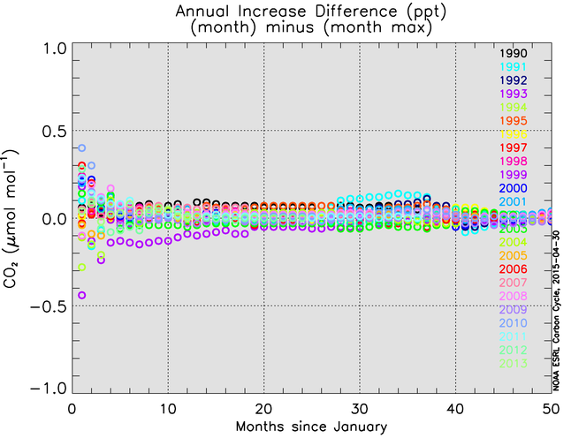
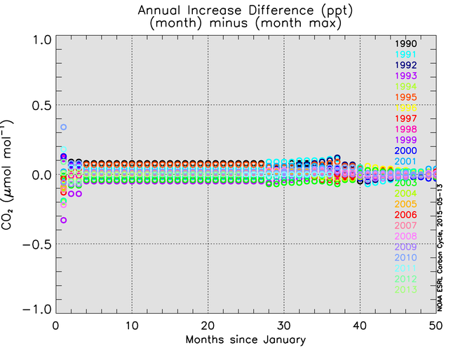
Network/Curve Fitting End Effects
With network effects
Without network effects
1990-2014
Notes:
LH plot: Mimics how web runs are done; with each month, temporal and spatial coverage are added. RH plot: With each month, only temporal coverage increases.

Slide 19
Extension Method (EXT)
Used for CH₄ trends website.
Starts with standard weekly global averages.
Calculates monthly means using only those values that fall within the month (Fig., red symbols).
De-seasonalized trend is similar to 12-month running mean (red trend line).
Moderates IAV in signals.
Annual increase calculated from de-seasonalized trend curve as:
Jan 1 (year+1) - Jan 1 (year).
This is the method used to smooth discreet air samples to calculate weekly zonal averages.
Alternate Method (PPT)
Used for CO₂ trends website.
Starts with weekly global averages.
Calculates monthly means using 5-value weighted average that overlaps with previous and following months (blue symbols).
Deseasonalized trend curve determined by subtracting 7 adjacent seasonal cycles centered on the month to be corrected (blue trend line). This result is less-smoothed than with EXT.
Larger IAV than EXT in the de-seasonalized trend.
Annual increase calculated from deseasonalized monthly means:
(Dec(yr)+Jan(yr+1))/2-(Dec(yr-1)+Jan(yr))/2

Slide 20
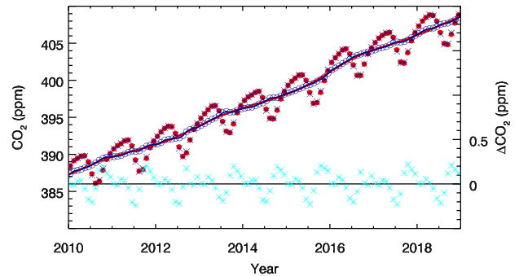
Processing Global Means: Smoothing (Monthly Mean)
Method: Alternative (PPT)
Method: Standard (EXT)
MM Difference: PPT - EXT
Method: Alternative (PPT)
Method: Standard (EXT)
Trend Difference: PPT - EXT
Notes:
As with any product that’s evolved with multiple people involved, multiple methods are used. We always start with the same zonal means I just described. For the alternative method, the 4 globally averaged values per month are weighted differently, more accurately reflecting a monthly mean. Here, monthly means are plotted, our historical method in red and the alternate method in blue; differences between MMs are in cyan. It varies by ±0.2 ppm through the year with clear seasonal differences.

Slide 21
Processing Global Means: Smoothing (Trend)
Method: Alternative (PPT)
Method: Standard (EXT)
Trend Difference: PPT - EXT
Notes:
The is also a difference in how the deseasonalized trend is calculated, too. The alternative method results in a trend that is less-smoothed than the standard method. This will impact the annual increase, making it more variable.

Slide 22
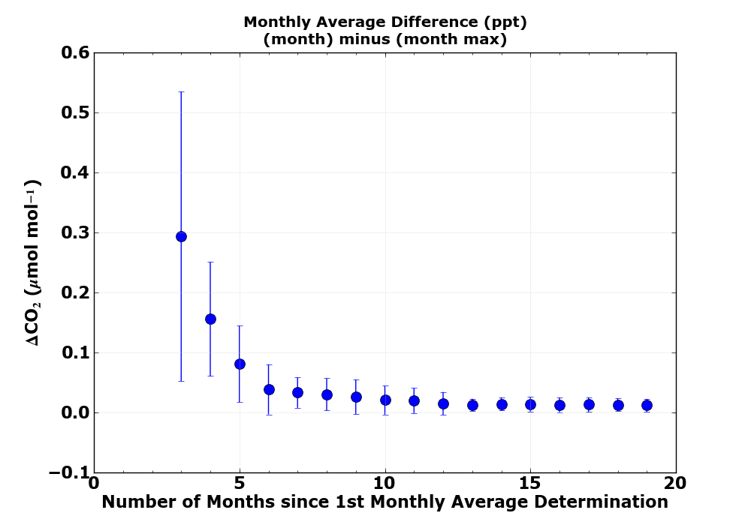
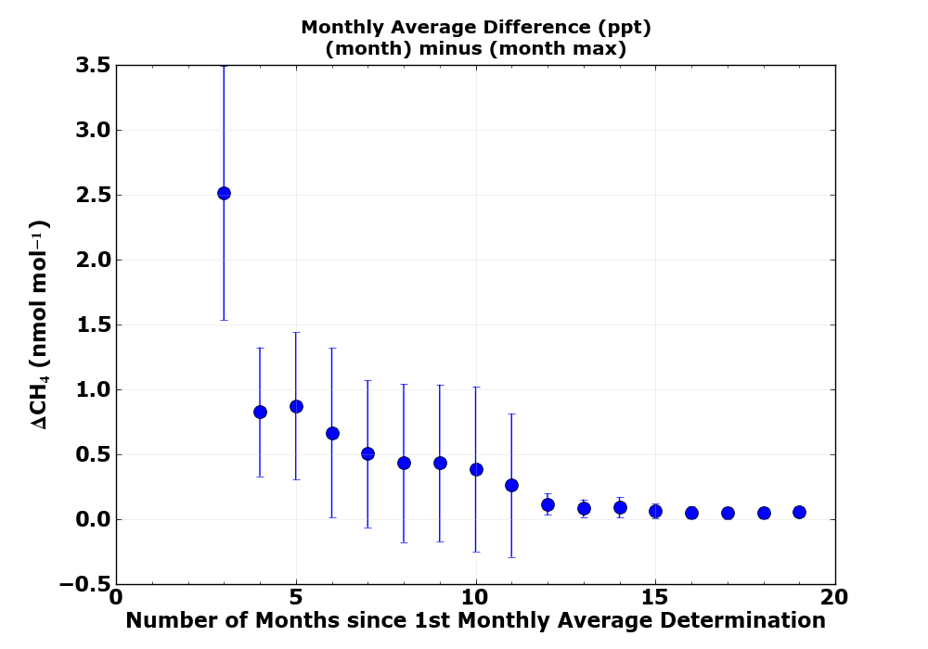
Monthly Means: Average over months
2009
2010
u = ±0.1 ppm
u = ±1.2 ppb
To limit bias, delay release of means by 3 (CO₂) or 4 (CH₄) months

Slide 23
Annual Means: CH₄
u = ±0.7 ppb
1990-2017
Initial estimates of annual means: relatively small bias that converges quickly; insensitive to method.

Slide 24
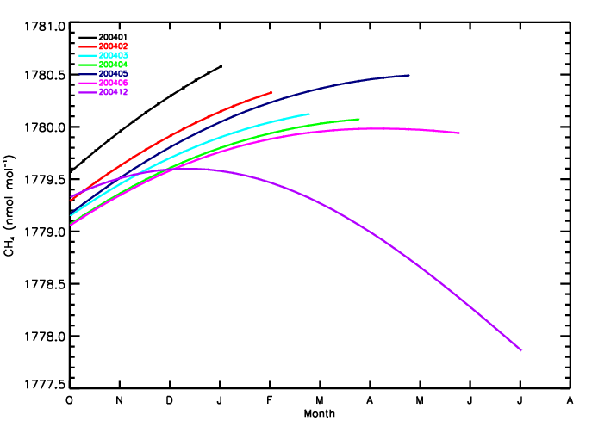

Slide 25
Monthly Means: Average over months
u = ±0.1 ppm
u = ±1.2 ppb
To limit bias, delay release of means by 3 or 4 months

Slide 26
Monthly Means: W/ and W/O ABS
Taking ABS: Difference always positive and smaller SD

Slide 27
Annual Increase: N₂O
u ≈ ±0.13 ppb yr⁻¹

Slide 28
Annual Means: N₂O

Slide 29
Annual Increase: SF₆
u ≈ ±0.01 ppt yr⁻¹

Slide 30
Annual Means: SF₆

Slide 31
5th of month → “web runs”
Use subset of weekly BG sites
Smooth each record in time
Fit curves as function of latitude
Matrix of values → zonal and global means
48 time steps yr⁻¹
Lag between sampling and measurement
End effects
Notes:
Basis for trends web pages

