Slide 1
Constraining Large-Scale GHG Budgets with Atmospheric Observations
Ed Dlugokencky
NOAA Earth System Research Laboratory
Global Monitoring Division

Slide 2
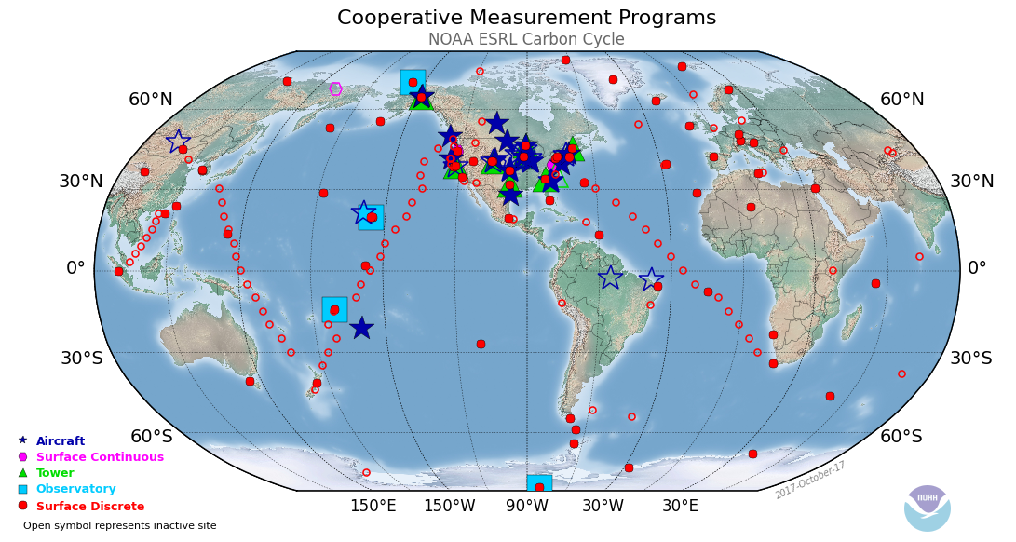
Cooperative Global Air Sampling Network - unique in its coverage
Weekly samples collected with portable sampler
Sites selected to sample well-mixed air
Data available: ftp://aftp.cmdl.noaa.gov/data/greenhouse_gases/
Notes:
Most sites in red are from our CGASN, the background component of our GGGRN. Scale of cooperative air sampling network, currently with 55 sampling sites, is unique in the world. Samples are collected weekly and returned to Bldr for measurements of a suite of LLGHGs and other tracers at NOAA and at CU. NACP focus and observatories also shown.

Slide 3
Scientific Motivation
Determine budgets and how they change with time
Quantify emissions and sinks of LLGHGs (and ODSs) at global to large regional spatial scales
Determine impacts of climate change on LLGHG budgets
Long-term continuity and consistency of observations are important
Approach
Accurately, precisely measure spatial and temporal distributions of LLGHGs and related tracers
Meaningful temporal and spatial gradients
Ensure long-term consistency with QA scheme
Foundations developed by Dave Keeling in 1950s
Notes:
Science-driven program. Since its beginning in the late-1960s, science objectives have evolved from a program that monitors trends in anthropogenic climate forcing to its current state to quantify GHG emissions and sinks at large spatial scales and how they change with time. We are also very interested in attributing observed changes to the impacts of climate change on GHG budgets, where appropriate. This requires long-term, internally-consistent observations. High quality measurements of LLGHGs and related species covering as much of the BG atmosphere as possible and for as long as possible. Measurement methods have evolved to keep up with technology and science goals, but fundamental QA/QC approach, much of it developed by Dave Keeling in the late-1950s, remains in place.

Slide 4
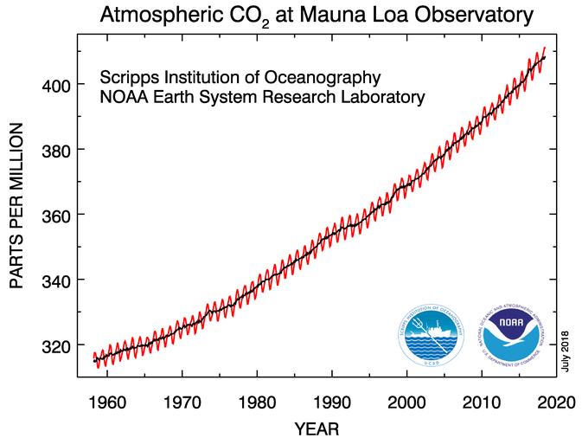
Updated monthly:
www.esrl.noaa.gov/gmd/ccgg/trends/
CO₂ (ppm)
Notes:
Measurements of CO2 were begun by Dave Keeling of SIO at MLO in 1958; NOAA measurements began in 1974. We currently update monthly mean CO2 MLO once per month. To keep up with increasing scientific demands of measurements, NOAA began expanding observations from a flask-air sampling network and currently sample at 55 sites. Why so many?

Slide 5
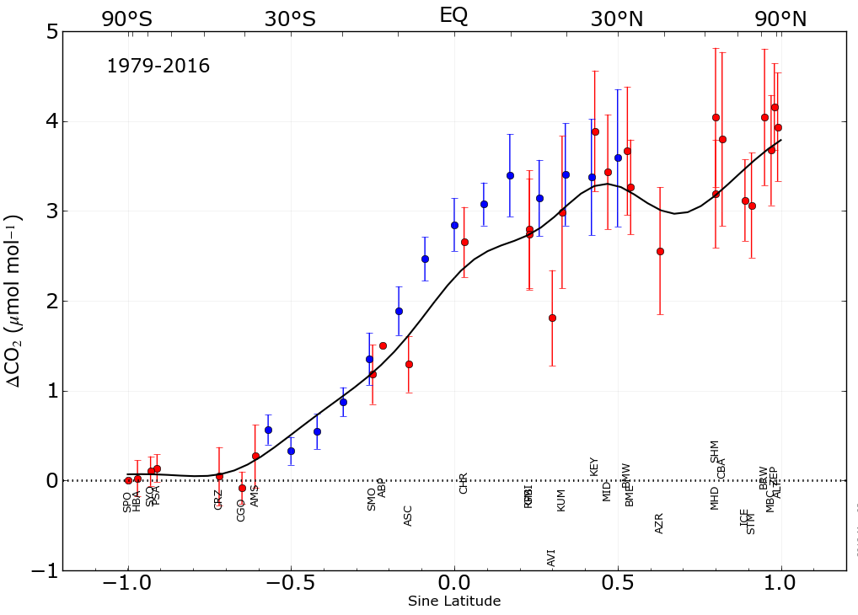
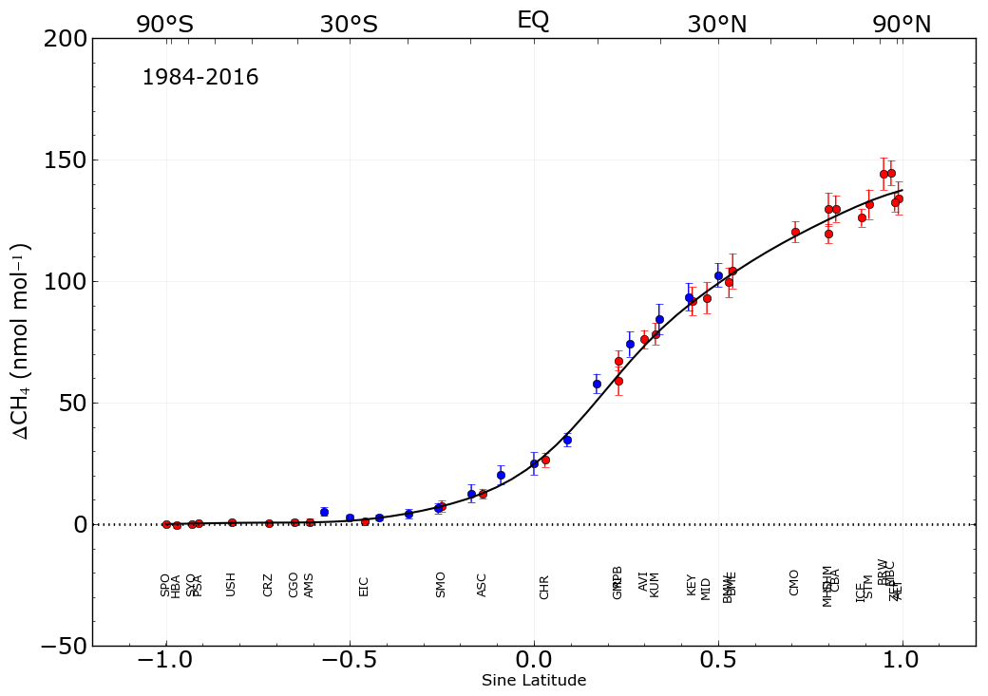
Latitude gradient constrains budgets of emissions and sinks:
Tans et al., 1990: NH terrestrial carbon sink
Fung et al., 1991: Less HNH, greater tropical CH₄ emissions
Notes:
Over the past few decades, the spatial coverage in the observations has been used for significant improvement to understanding the distribution of emissions and sinks. Here are N/S gradients relative to SPO for CO2 and CH4. Scientific conclusions start with confidence in the measurements. In Tans et al., the observed N/S gradient indicated a significant sink for CO2 in the terrestrial biosphere of the NH. This study had a huge impact of GHG monitoring globally resulting in the NA carbon program and greatly expanded monitoring in Europe, too. For CH4, Fung et al. showed that estimates of CH4 from high NH WLs were too large and resulted in a shift to tropical WLs. Similarly, Hirsch et al. (not shown) used measurements of N2O to redistribute emissions of N2O from high SH to low NH.

Slide 6
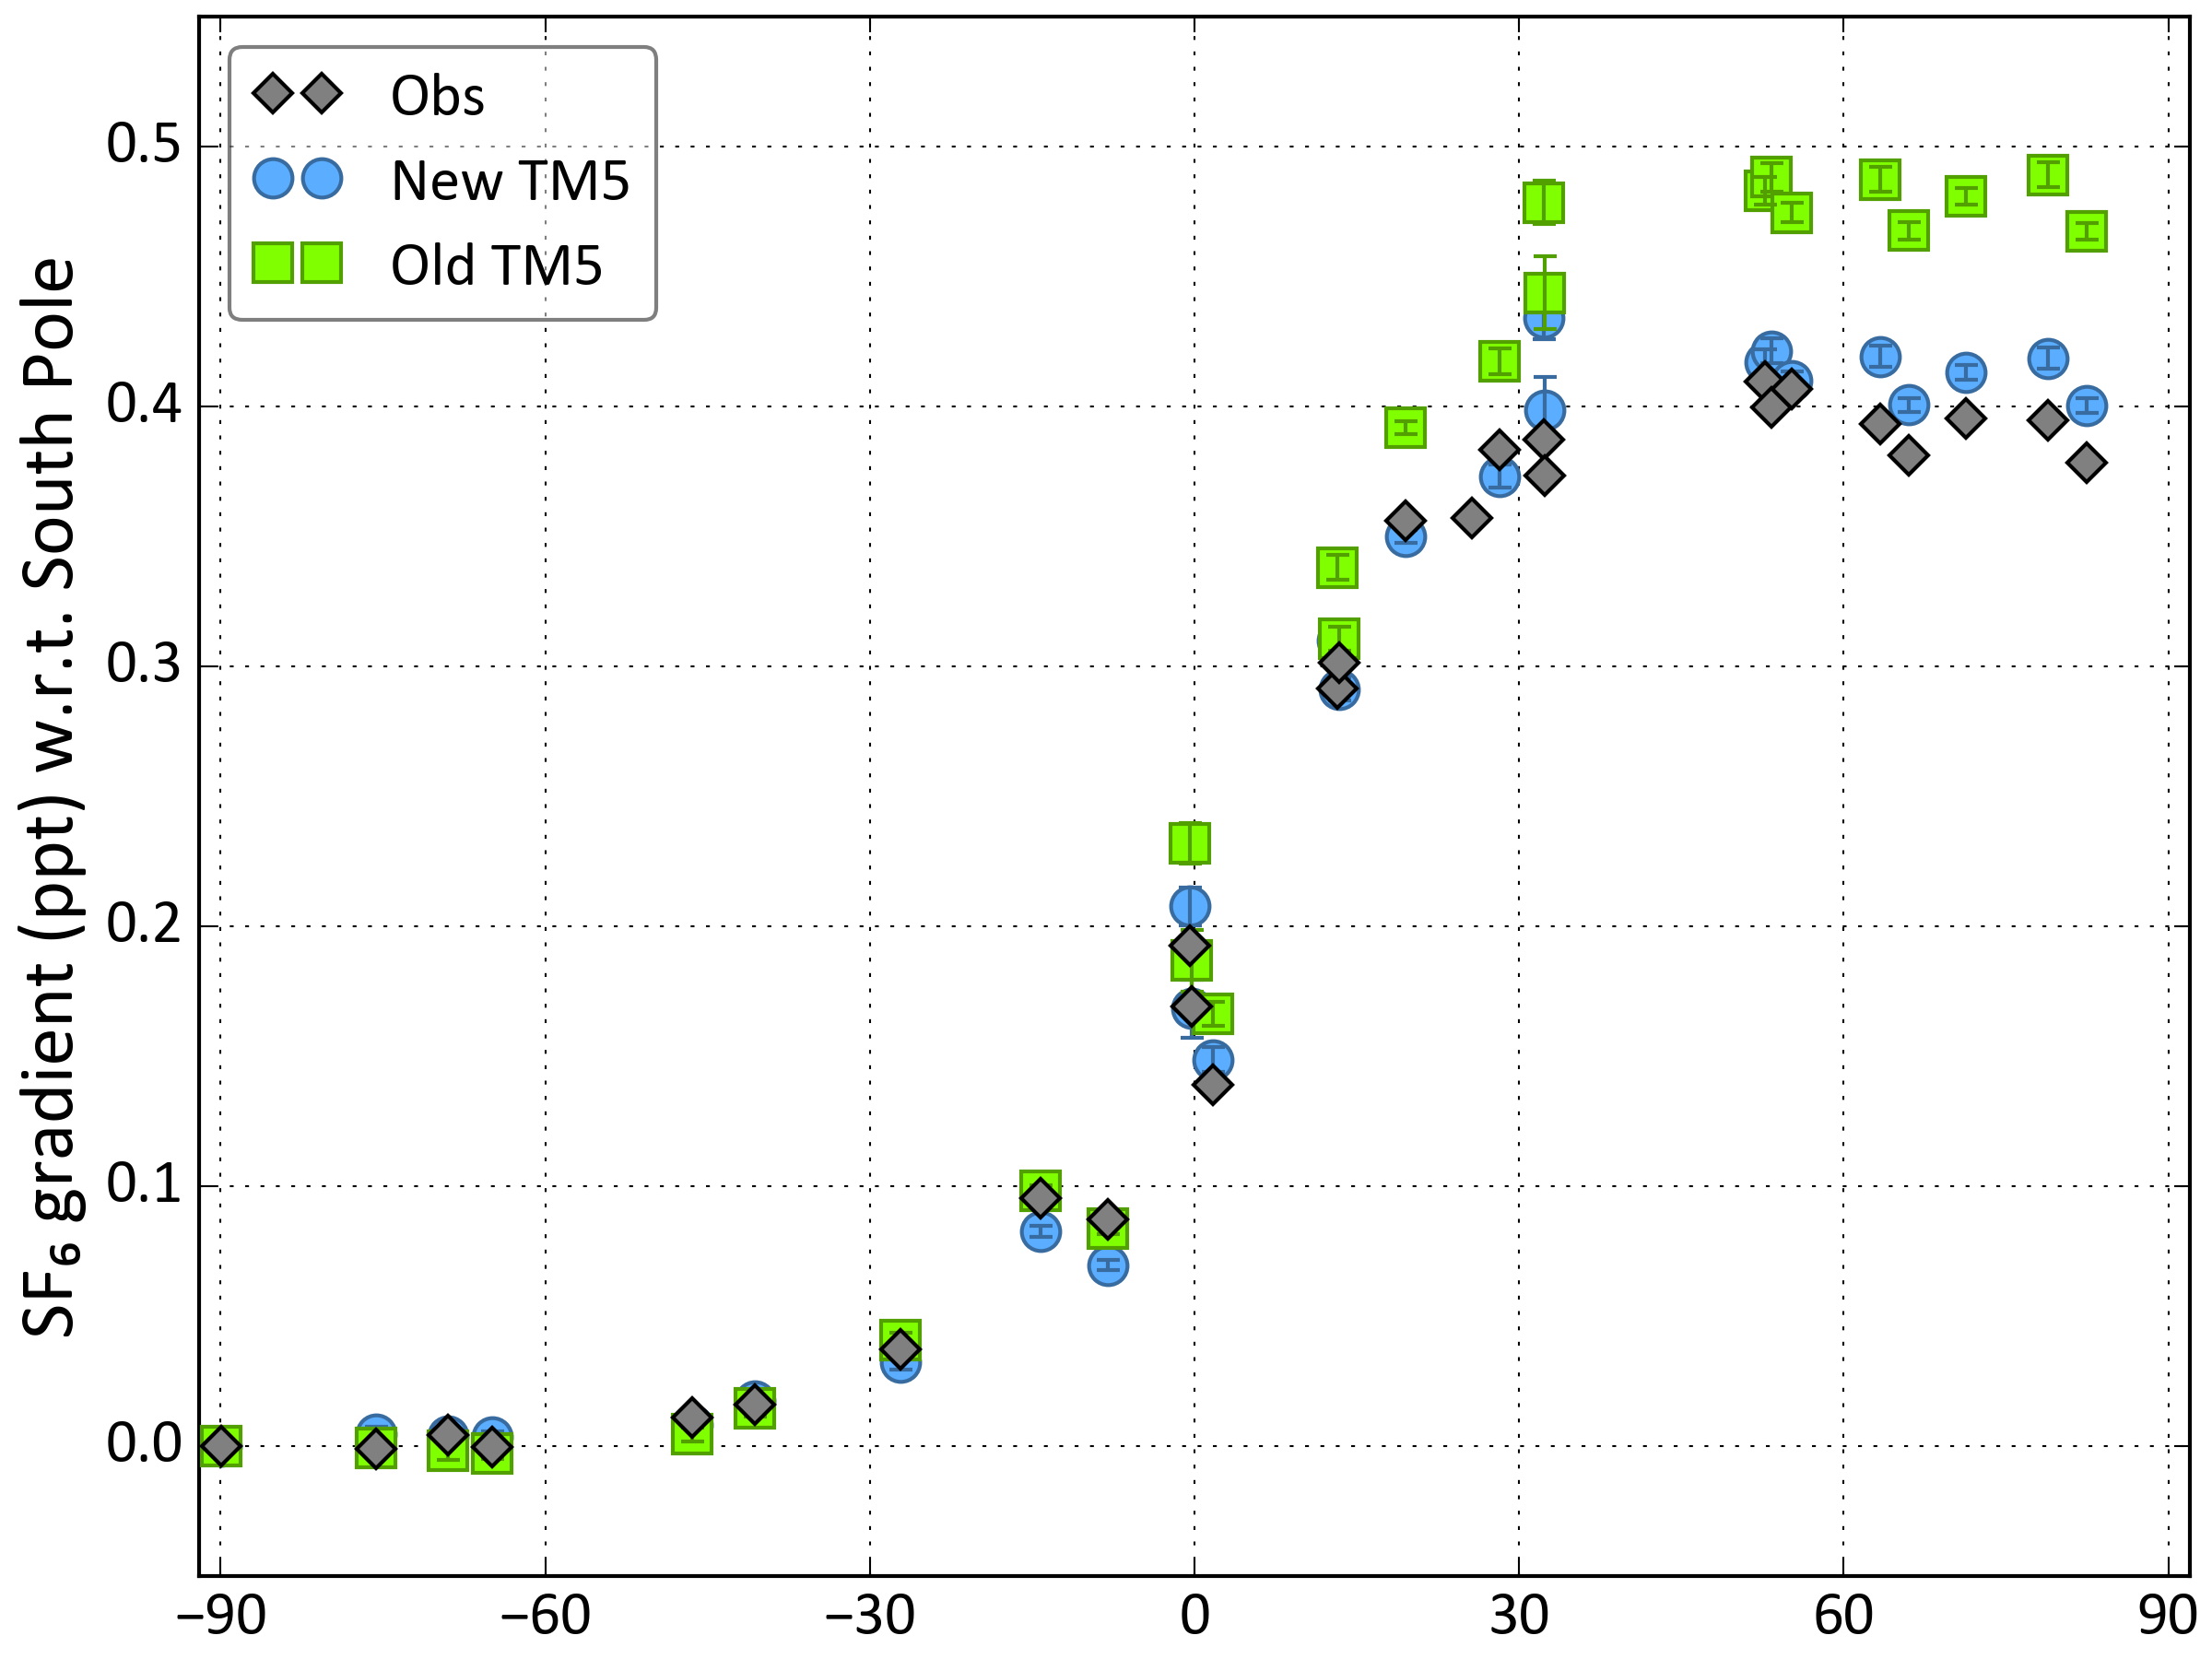
SF₆: Test Model Transport
Peters et al., JGR, 2004; Basu et al., ACP, 2016.
Notes:
In cases where emissions magnitude and distribution are reasonably well know, e.g., for SF6, can use the observations to test transport, as done by Transcom. Peters et al., 2004 showed transport in TM5 flawed. In early version of TM5, transport to the free troposphere was not vigorous enough, resulting in over estimate of latitude gradient. For CH4 and N2O, this resulted in under-estimate of emissions at mid-northern latitudes.

Slide 7
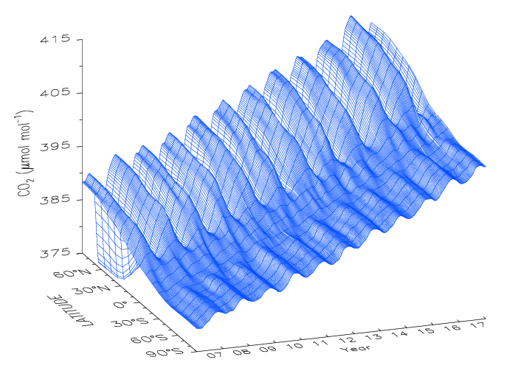
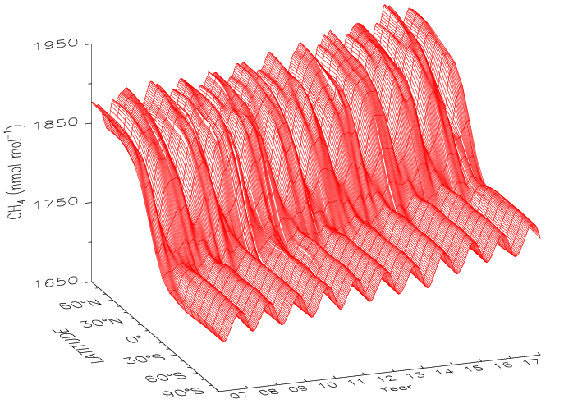
Calculation of global and zonal surface means:
NOAA global trends web pages (Organizations, e.g., 2º Institute)
Assessments (e.g., IPCC)
AGGI (Radiative forcing)
Peer-reviewed global GHG budget analyses with mass-balance
Notes:
Another advantage of the coverage in our cooperative sampling network is our ability to reasonably estimate surface zonal and global averages. To do that, we smooth the data in time, then in latitude and create a matrix of GHG values as plotted here for CO2 and CH4. Here we see CO2 and CH4 plotted as fn of latitude and time from 2007 to 2017. There is a lot of information about CO2 and CH4 cycling in these plots that I will skip over, but we can use this matrix to approximate global and other zonal averages of GHGs, then use them to study the large scale budget.

Slide 8
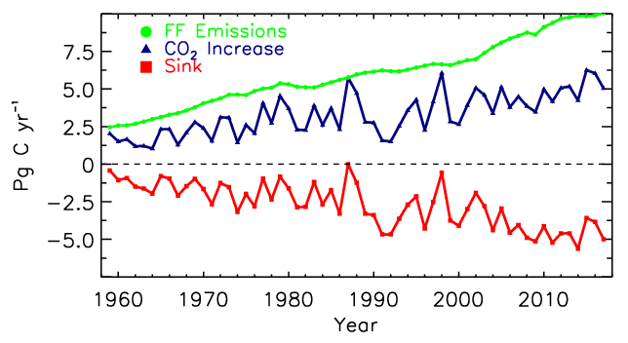
~45% of FF
Based on update of Ballantyne et al., Nature, 2012.
Notes:
By using the matrix of values shown in the previous slide, can calculate zonal averages. In this case annual increases in globally averaged surface CO2 from SIO and NOAA in blue are combined with CO2 emissions (green) and the observed sink (difference between emissions and atmosphere, red) are used to show that ~45% of FF emissions to the atmosphere end up in ocean and terrestrial biosphere. This is the type of fundamental constraint on GHG budgets that can be obtained from the observations.

Slide 9
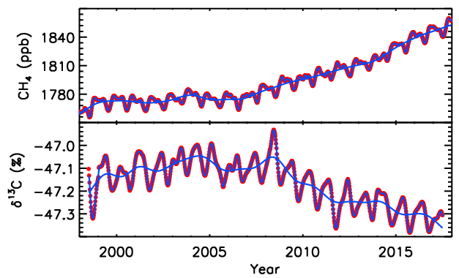
Globally averaged CH₄ and δ¹³C(CH₄)
Sylvia Michel, INSTAAR
Scenario most consistent with observations: Increased emissions from microbial sources, especially in the tropics.

Slide 10
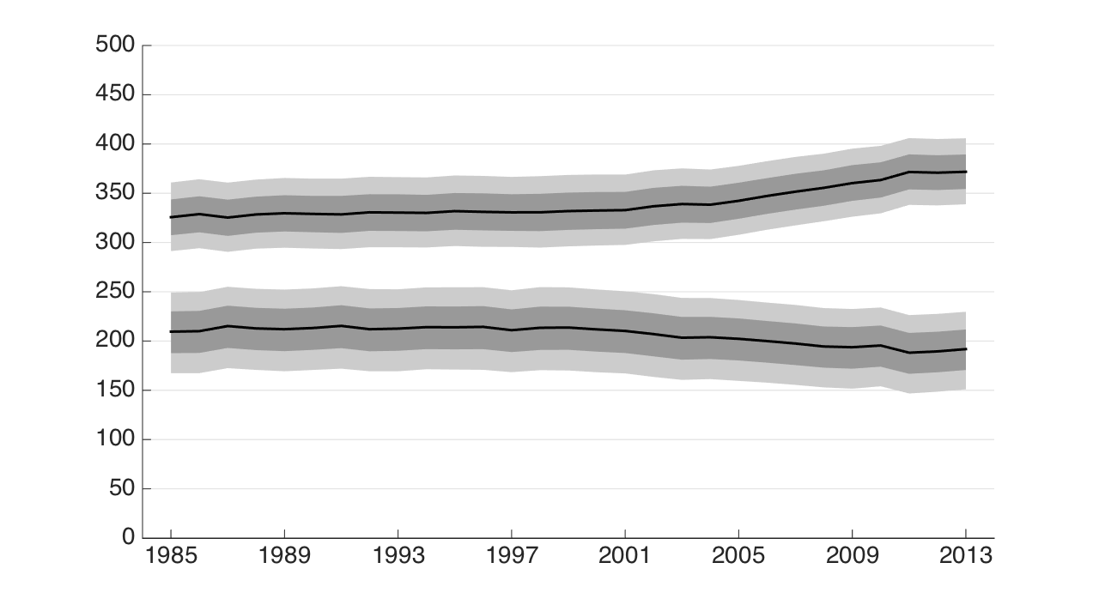
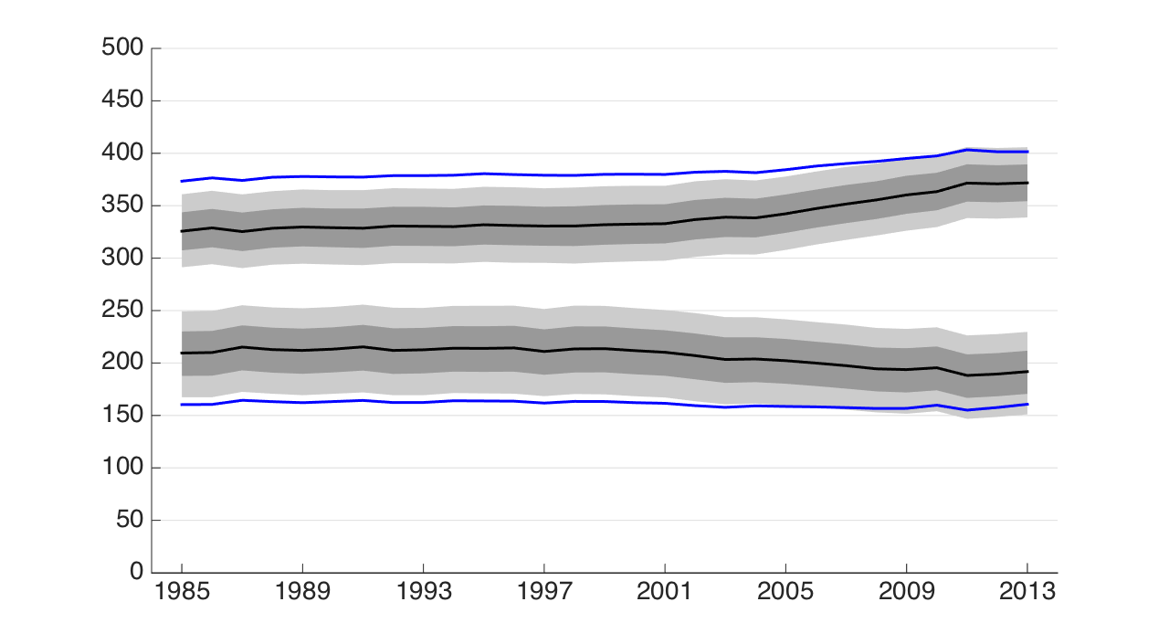
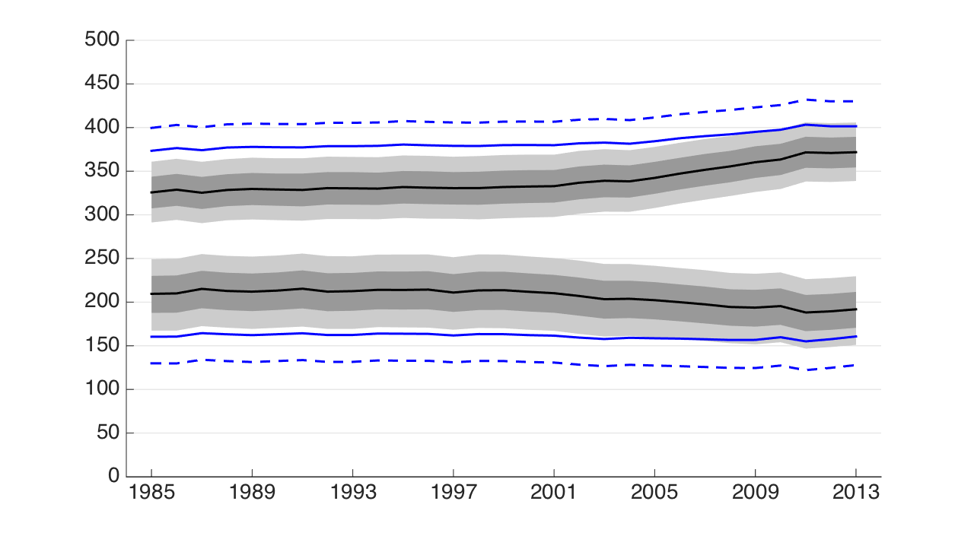
Fossil CH₄ emissions not increasing
(Schwietzke et al., Nature, 538, 88-91, 2016)
Microbial sources (wetlands, ruminants, rice, landfills/waste, termites)
Global CH₄ emissions (Tg/yr)
Fossil (Gas/Oil/Coal) + Geologic
Mean values using “traditional” δ¹³C_{FF}
Mean values using “traditional” δ¹³C_{FF}, δ¹³C_{Mic}, and δ¹³C_{BB}
Year
Notes:
Based on review of >10k measurements of source composition, isotopic source signatures for CH4 were re-evaluated. Based on these, two important conclusions: 1. CH4 emissions from FF sources are not increasing. 2. The fraction of CH4 emissions from FF sources is significantly greater than previously believed.

Slide 11
Trends in deseasonalized CH₄(Courtesy of Xin Lan)
2006-2015
North
central
Great Lakes region
West coast
Mountain
South central
Northeast coast
Southeast coast
Trends in vertical difference for deseasonalized CH₄
North
central
2006-2015
West coast
Mountain
Great Lakes region
Northeast coast
Southeast coast
South central
ΔCH₄ trend (%/yr)
Courtesy of Xin Lan

Slide 12
Hu et al.
Consensus on average NA C uptake: -0.70 (-1.24 to -0.34) PgC yr⁻¹ (2007 – 2015)
N.A. carbon uptake increases during El Niño, opposite to global picture

Slide 13
Summary
GAW network continually evolving to meet scientific needs
Great scientific benefit at relatively small cost
Fundamental constraints on GHG budgets, but….
Need to ensure internally-consistent, calibrated observations of known quality over long time scales
Detailed GAW QA/QC system
Most effective if all GAW labs share data
Temporal resolution should be sufficient for science needs

Slide 14
NOAA Analytical Capabilities
(Flask-air samples)
Gas Uncertainty (68% c.i.) Technique
CO₂ 0.08 μmol mol⁻¹ NDIR → CRDS
CH₄ 0.9 nmol mol⁻¹ GC/FID → CRDS
CO 1.7 nmol mol⁻¹ VUV-RF → TILDAS
H₂ *0.5 nmol mol⁻¹ GC/PD-HeID
N₂O 0.26 nmol mol⁻¹ GC/ECD → TILDAS
SF₆ 0.04 pmol mol⁻¹ GC/ECD
δ¹³CO₂ *0.01‰ DI-IRMS
δ¹³CH₄ *0.04‰ GC/CF-IRMS
C₂-C₇ NMHC †<15% GC/FID
*Repeatability; †Median pair difference
Notes:
All discrete air samples from GGGRN analyzed on this system, including samples from the NA aircraft and tall tower projects. For projects that use PFP/PCPs, ~50 species are measured on another GC/MS system
Tunable Infrared Laser Differential Absorption Spectroscopy (TILDAS)

Slide 15
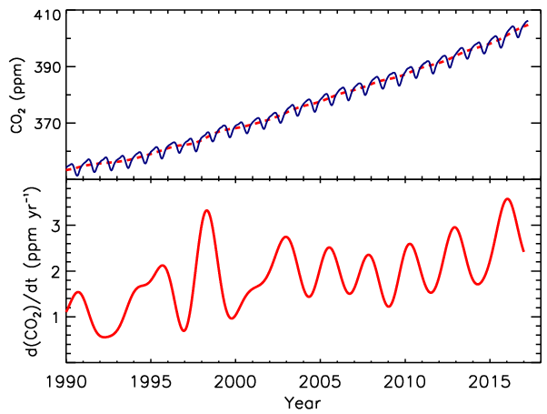
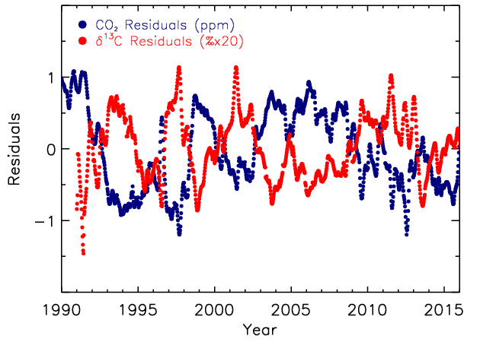
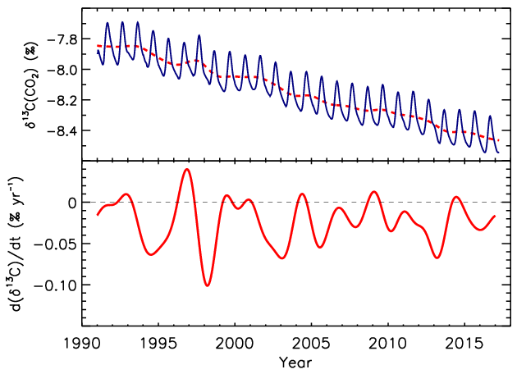
δ¹³C as process indicator:
-Differentiate ocean/terrestrial biosphere fluxes
-Biosphere: ~0.045‰ ppm⁻¹
-Ocean: ~0.005‰ ppm⁻¹
CO₂
δ¹³C scaled to match CO₂ residuals:
δ¹³C
Notes:
Measurements of δ13CO2 can distinguish between ocean and biospheric sources of CO2.
Δδ13CO2 = (400 ppm x (-8.4‰) + 1 ppm (-25‰))/401 ppm –8.4 = 0.042‰/ppm.

Slide 16
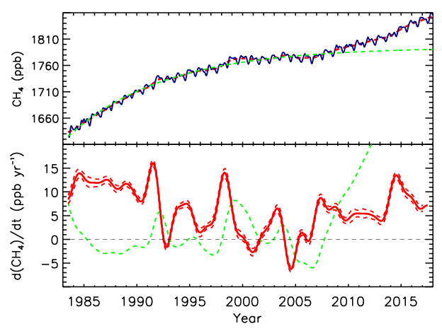

Slide 17
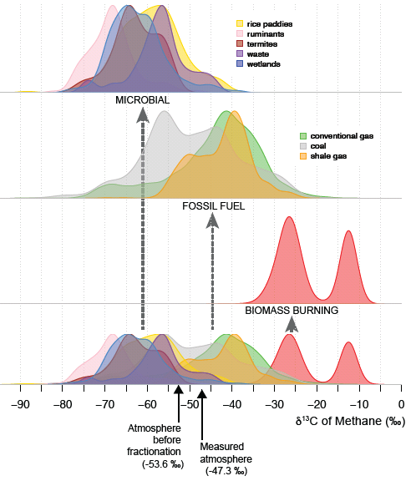
Improving δ¹³C(CH₄) source signatures:
Sherwood et al., ESSD Discuss., doi: 10.5194/essd-2017-20, in review, 2017.

Slide 18
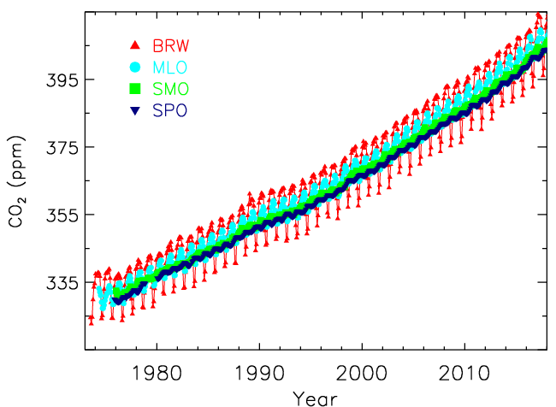

Slide 19
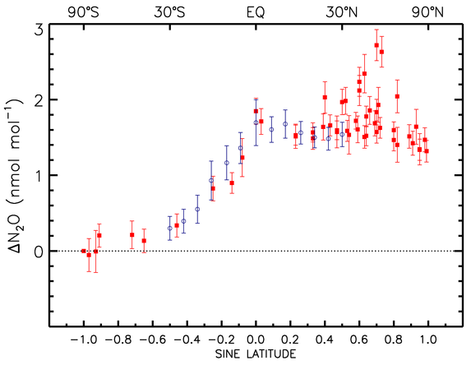
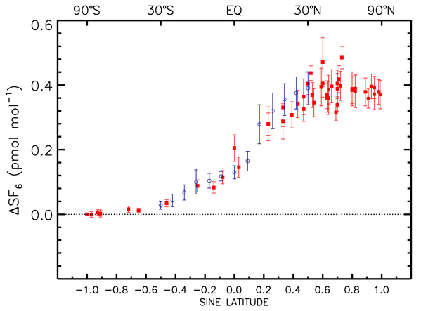
Hirsch et al., GBC, 2006: Redistributed emissions, doubling those from N tropics
Use SF₆ to:
-show emissions reported to UNFCCC are too small
-test transport in ATM

Slide 20
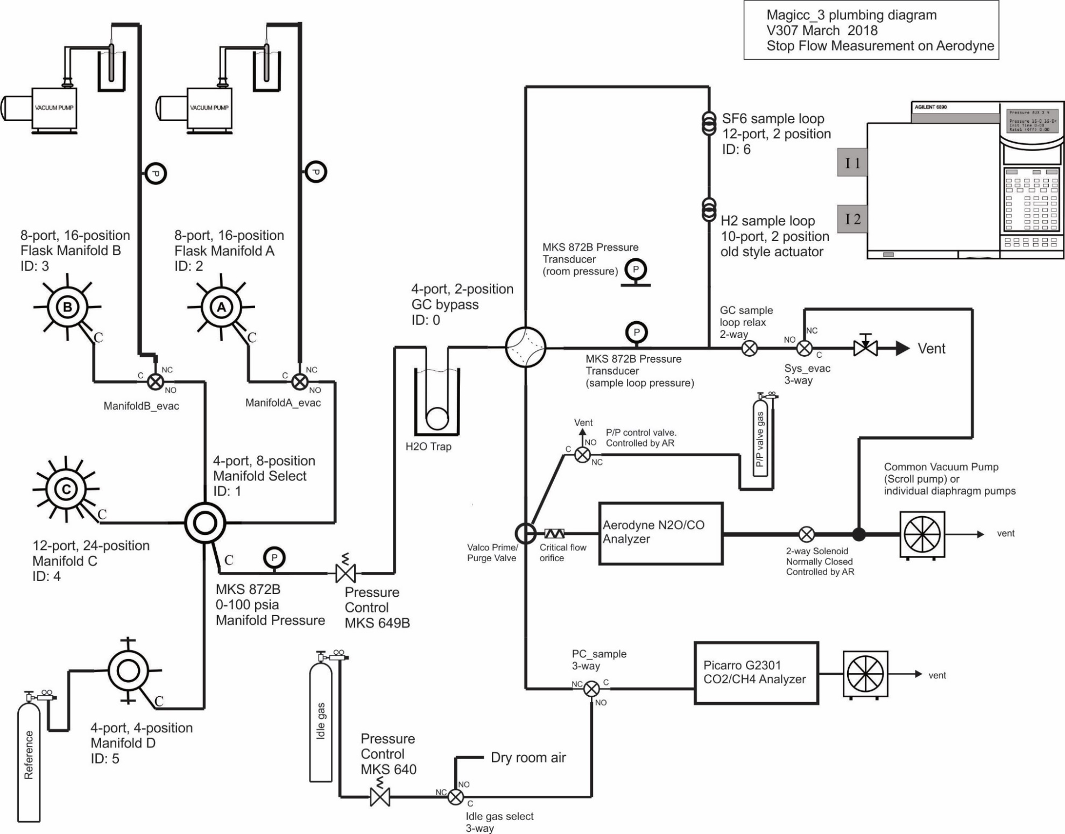
Analysis Upgrade:
Same time/sample
Less Sample Used
Improved Precision
Standard Cal Scheme
Improved User Interface
Increased Efficiency
Notes:
It is shown schematically here. The important points are that with the new system, measurement quality will improve and efficiency will be increased.

Slide 21
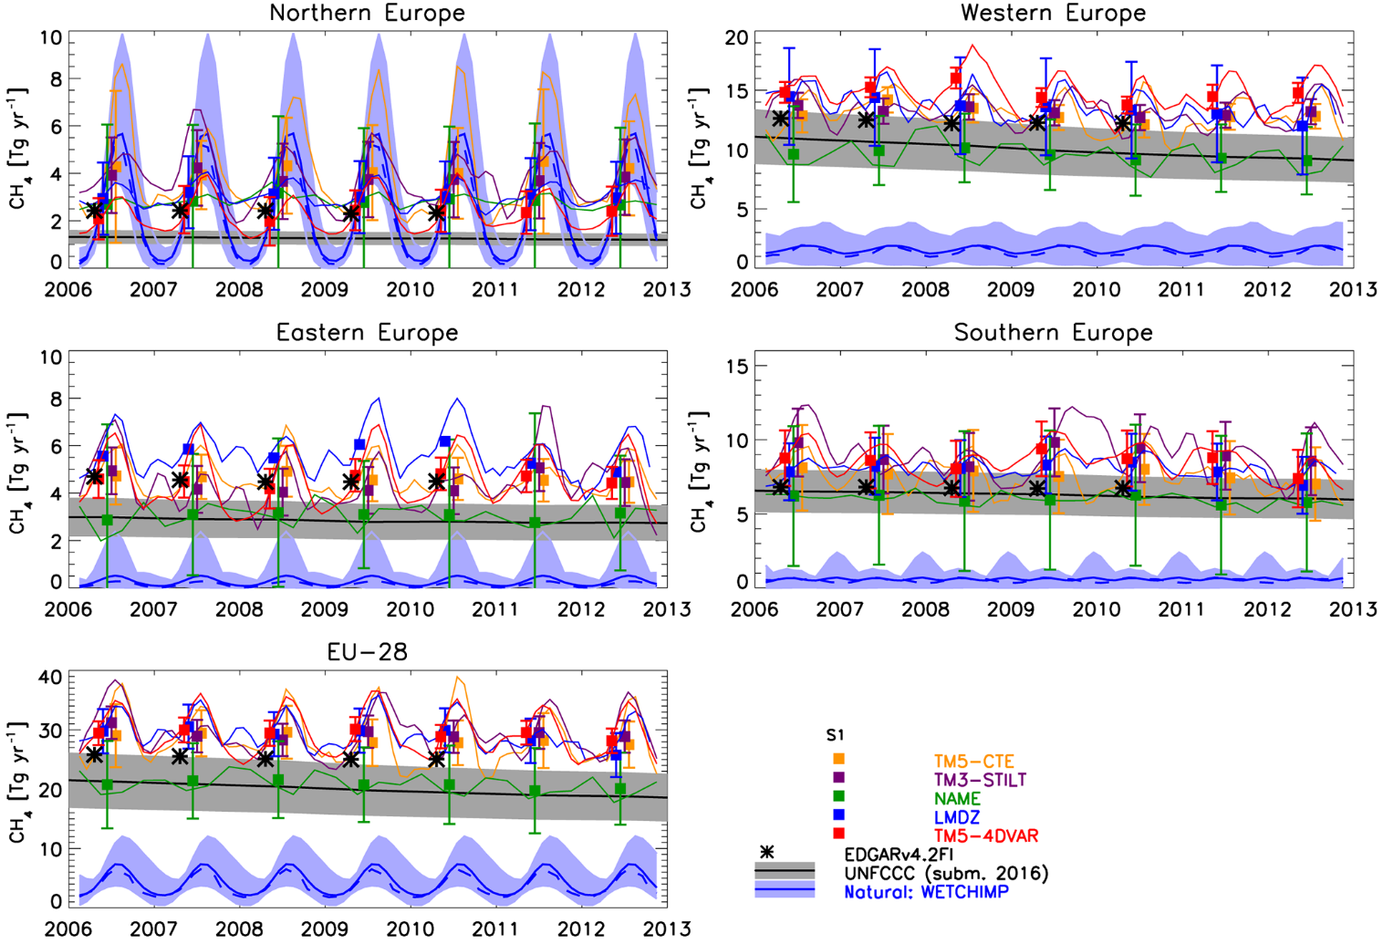
Use of observations in atm inversion products to study global budgets:
CT (CO₂ and CH₄)
CAMS (CO₂, CH₄, and N₂O)
GCP (CO₂ and CH₄)
Research studies
Also used in regional-scale studies:
Bergamaschi et al., 2018

Slide 22
Remote Sensing
Never calibrated, only evaluated
e.g., with vertical profiles; Aircore
Sensor degradation over time
Potential biases (e.g., land vs ocean)
“Short” deployment for satellites
Retrieve total column; strongest signals at surface
Different retrieval versions give very different results
e.g., in CO₂ inversions

Slide 23
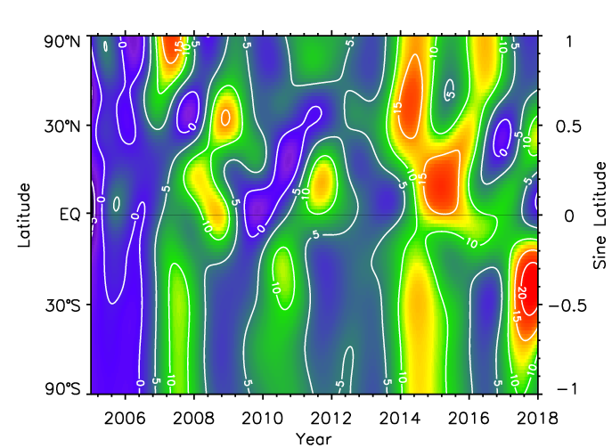
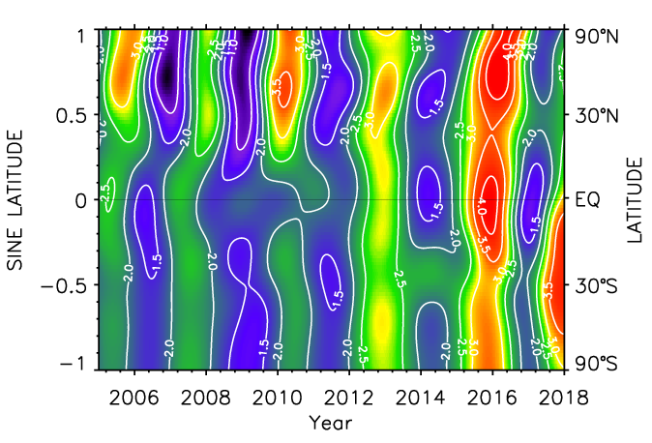
CH₄
CO₂

Slide 24
Calibration: Calibration links the measured response of an analyzer, under controlled conditions, to known values of measurement standards (with known uncertainties). That response is used to assign values and uncertainties to other samples. Standards must be linked to fundamental SI units in a single, unbroken, hierarchical chain of traceability.

Slide 25
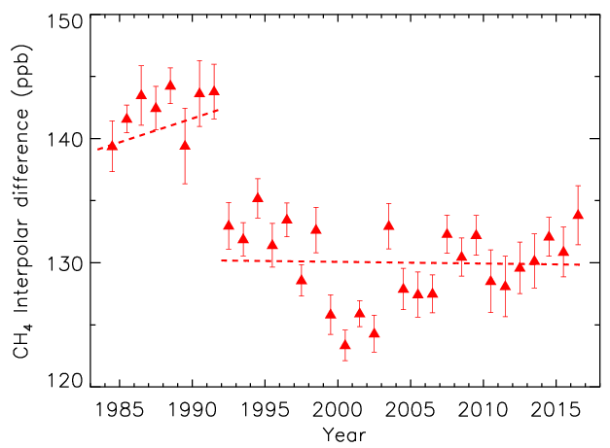
Indicator of changing Arctic CH₄ emissions
Updated from: Dlugokencky et al., Geophys. Res. Lett., 30 (19), 1992, doi:10.1029/2003GL018126, 2003.

Slide 26
