Slide 1
What have we learned from three decades of high-quality atmospheric CH₄ measurements?
Ed Dlugokencky
NOAA Earth System Research Laboratory
Global Monitoring Division
Boulder, Colorado USA
ed.dlugokencky@noaa.gov

Slide 2
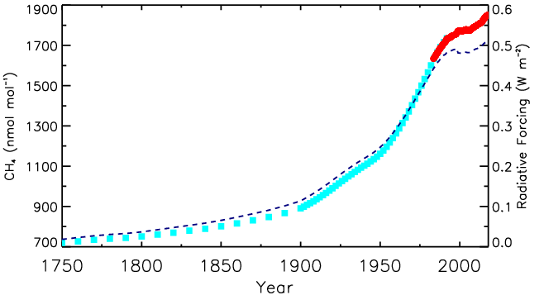
Globally Averaged CH₄
NOAA Global Averages
IPCC RF
Ice core + firn air

Slide 3
Outline
CH₄ Budget
Data
  Sampling and measurements
  Quality control
Long-term trends
Anomalies in CH₄ growth rate (IAV)
  Eruption of Mt. Pinatubo
  Economic collapse of former Soviet Union
Recent changes in atmospheric CH₄

Slide 4
CH₄ Budget: 2000s
(Tg CH₄ yr⁻¹) | Top-down | Bottom-up
Natural | 218 | 347
Wetlands | 175 | 217
Other | 43 | 130
Anthropogenic | 335 | 331
Agriculture + Waste | 209 | 200
Biomass Burning | 30 | 35
Fossil Fuels | 96 | 96
Total Emissions | 553 | 678
Sinks | 550 | 632
Imbalance | 3 | 46
GCP-CH₄: Kirschke et al., Nature Geoscience, 2013, DOI: 10.1038/NGEO1955.
http://www.globalcarbonproject.org/methanebudget
Notes:
Historically, have a problem with BU vs TD budget. BU not consistent with PI budget; suggests XCH4 much greater (1130 ppb) if lifetime about same as today, or lifetime on order 5.7 yr (to match obs from ice core), which seems unreasonably small. Difficult to say with certainty.

Slide 5
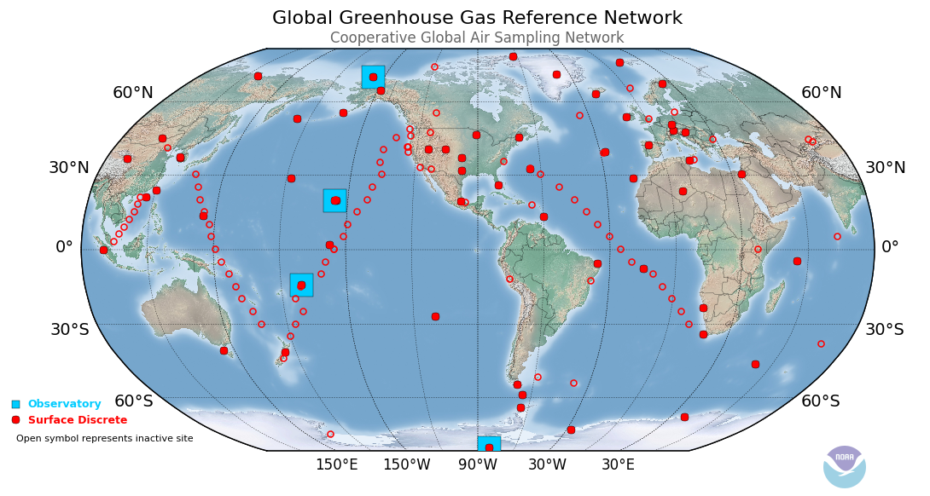
GMD Cooperative Global Air Sampling Network
*Weekly samples *Portable sampler *Analyzed by GC/FID
*www.esrl.noaa.gov/gmd/ccgg/iadv/

Slide 6
Ensuring Quality of Data
Quality Assurance
  SI-traceable standards (WMO scale) and bracketing reference
  Daily test flasks and monthly surveillance cylinders
  Testing portable air samplers and flasks
Quality Control
  Inspection of “data” for sampling and analysis problems
  Comparison with continuous observations at observatories
  Comparisons with other GAW laboratories
Selection for background
  Based on other species and expert intuition

Slide 7
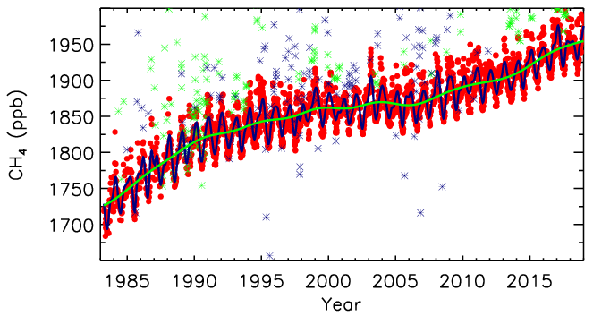
Barrow, AK: www.esrl.noaa.gov/gmd/ccgg/iadv/

Slide 8
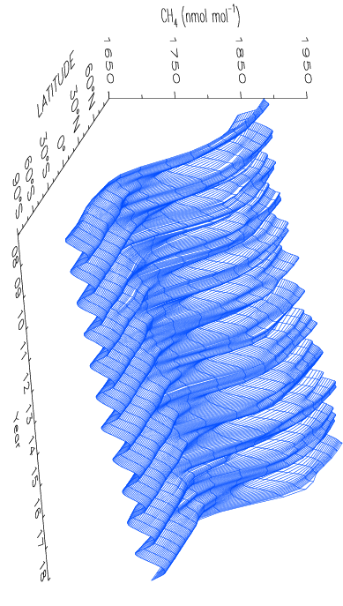

Slide 9
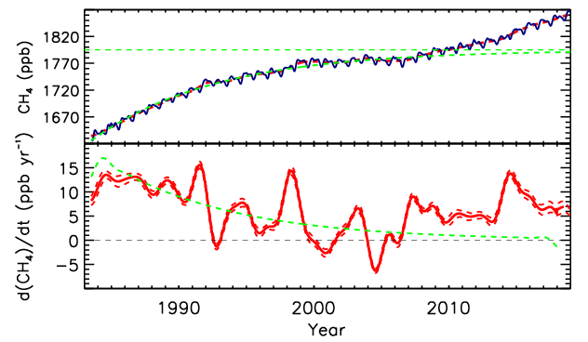
Lifetime ≈ 9.2 yr
[CH₄](t) = [CH₄]_{ss}-([CH₄]_{ss}-[CH₄]₀)e^{-t/τ}

Slide 10
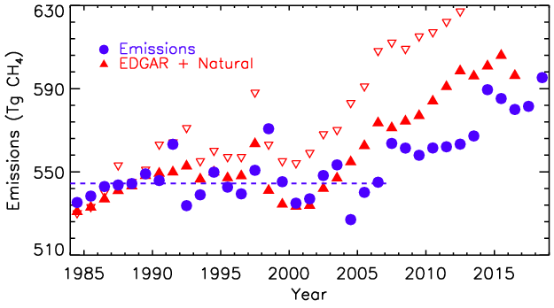
“Emissions” = d[CH₄]/dt + [CH₄]/τ
Trend = 0.0 ± 0.6 Tg CH₄ yr⁻¹ (95% c.l.)
Notes:
EDGAR 4.3.2 – open triangles are v4.2. Average 1984-2006=544.33 Tg CH4/yr; 2007-2013=562.44 Tg CH4/yr; 2014-2018=586.30 Tg CH4/yr.

Slide 11
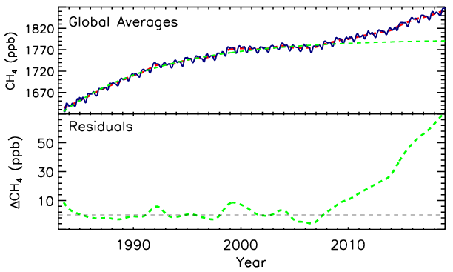
[CH₄](t) = [CH₄]_{ss}-([CH₄]_{ss}-[CH₄]₀)e^{-t/τ}
Fit 1984-2006: τ = 9.2 yr
(Trend - SS)
Abrupt shift in CH₄ budget
Pinatubo
BB + WLs

Slide 12
Summary of long-term picture
Global CH₄ burden and emissions/sink imbalance (annual increase) well-determined
Total global CH₄ emissions well-constrained
  Largest uncertainty is in lifetime (~±10%)
Assume no trend in τ: CH₄ → SS from 1983-2006
  No trend in total global emissions
  Emissions from individual sources changing
CH₄ global budget changed in 2007
Notes:
Summary of global long-term CH4 observations

Slide 13
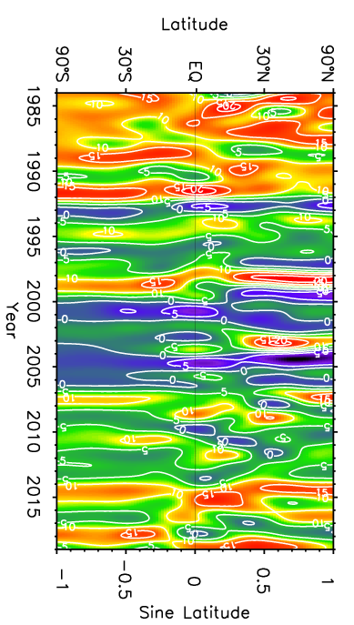
Growth rate (ppb yr⁻¹)

Slide 14
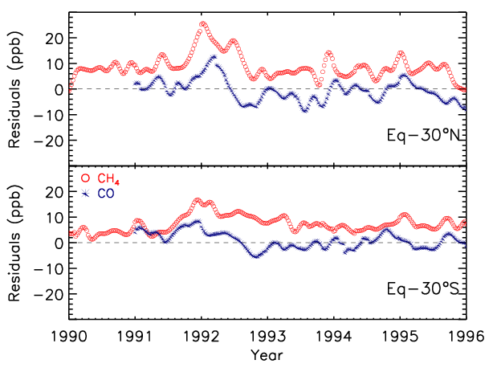

Slide 15
Chemistry
(Largest term in CH₄ budget)
OH + CH₄ → CH₃ + H₂O
O₃ + hν (330 ≥ λ ≥ 290 nm) → O(¹D) + O₂(¹Δ)
O(¹D) + H₂O → 2 OH
Rate of formation O(¹D) = j [O₃]
j = ∫F(λ) σ(λ) φ(λ) dλ

Slide 16
1991: Pinatubo and the CH₄ Lifetime
Eruption: 15 June 1991
~18 MT SO₂ oxidized to SO₄⁻²
3 to 5 km³ ash
Affects [OH] by affecting photochemistry:
Direct absorption of UV by SO₂
Scattering of UV by ash and aerosols
Dlugokencky, et al., 1996, GRL., 23(20), 2761–2764, doi:10.1029/96GL02638.

Slide 17
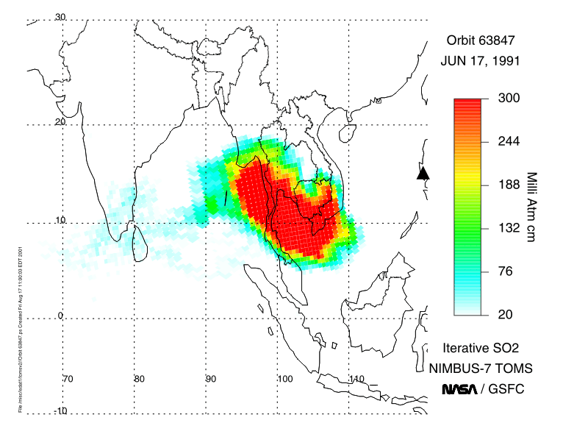
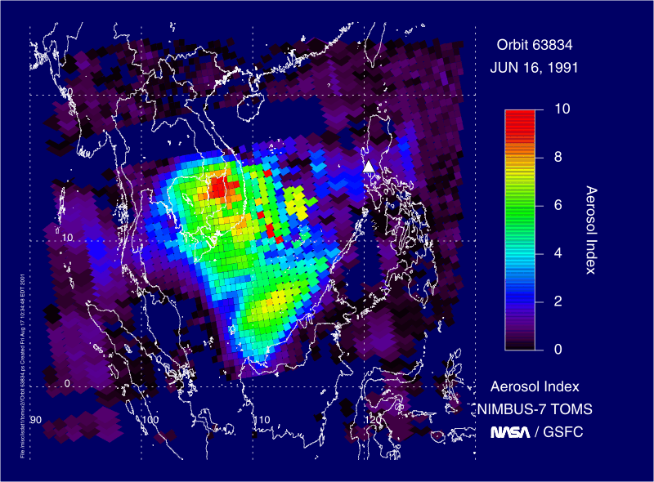
1 matm-cm = 1 DU
= 2.69x10¹⁶ SO₂ cm⁻²
AI < 0.1 means clear sky;
AI > 4 obscures mid-day sun

Slide 18
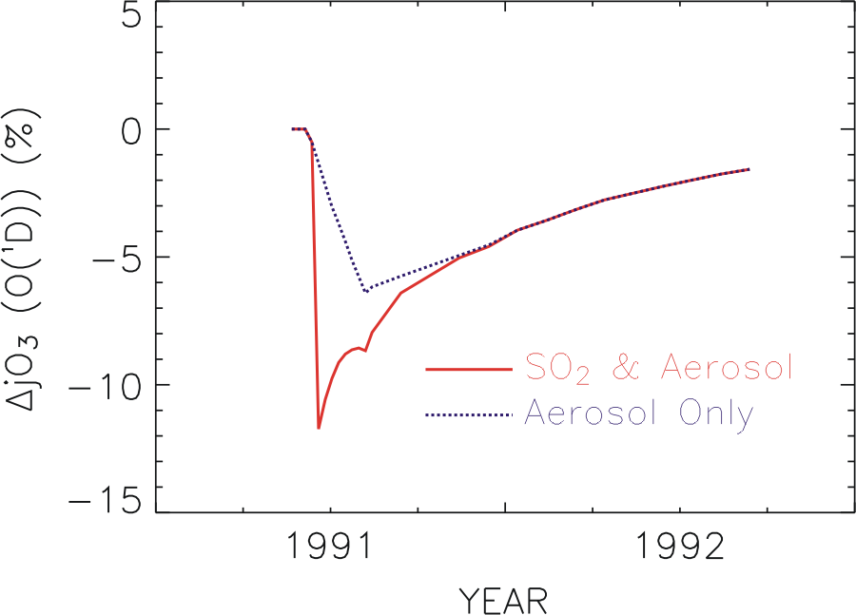
O₃ + hν (330 ≥ λ ≥ 290 nm) → O(¹D) + O₂
O(¹D) + H₂O → 2 OH
Rate of formation O(¹D) = j [O₃]
Dlugokencky et al., GRL, 1996
Notes:
Only 1 impact of many; exclude subsequent dec in strat O3, which made CH4’s lifetime smaller, impact of T-sensitive processes (WL emissions, T-dependence of rate coefficient and trop water, which affects OH primary production). Also somewhat coincident with economic collapse of fSU.…
Other changes would have had impacts too: Decreases in stratospheric O₃ from heterogeneous chemistry involving the aerosols would have cancelled some of the decrease by direct absorption alone. Cooling after the eruption, about 0.6°C, would have affected the rate coefficient for OH + CH₄ (~2%/degree) as would changes in H₂O as water responded following the Clausius Clapyron equation (~7%/degree) affect primary OH production. Cooling would have also affected emissions from WLs, which are sensitive to T.

Slide 19
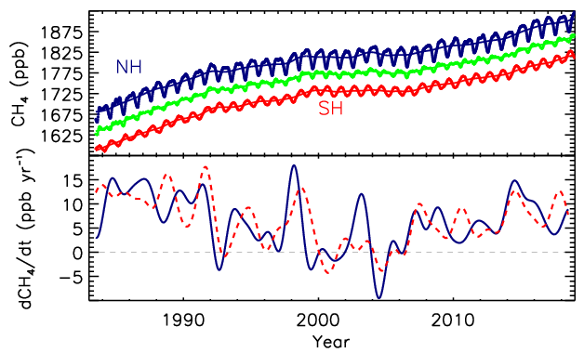

Slide 20
Growth rate (ppb yr⁻¹)

Slide 21
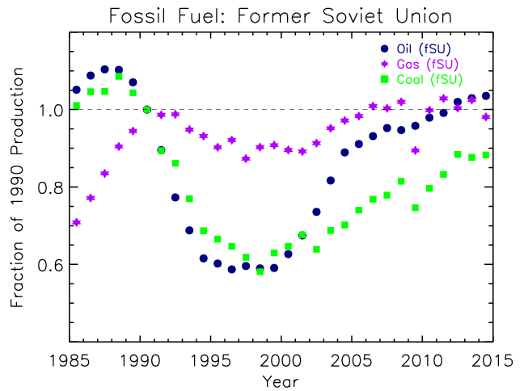
Source: BP Statistical Review of World Energy, June 2015

Slide 22
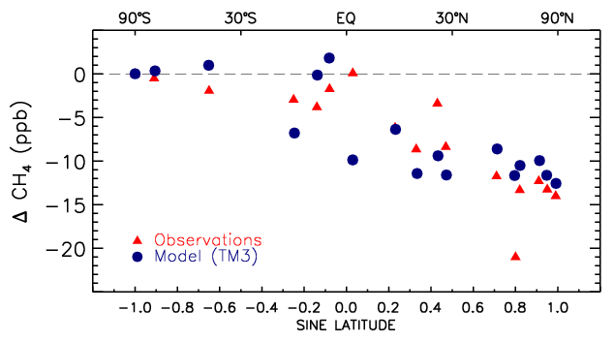
Late-1990s - mid-1980s
Dlugokencky et al., GRL, 2003.

Slide 23
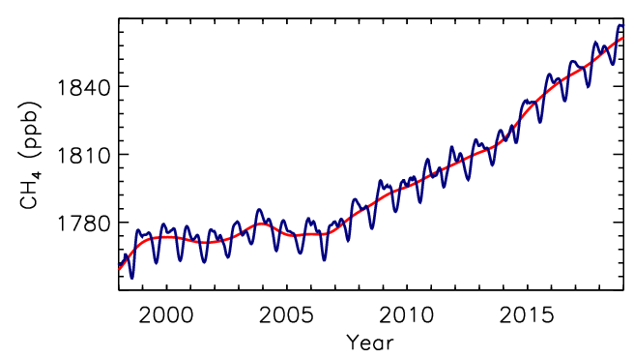

Slide 24
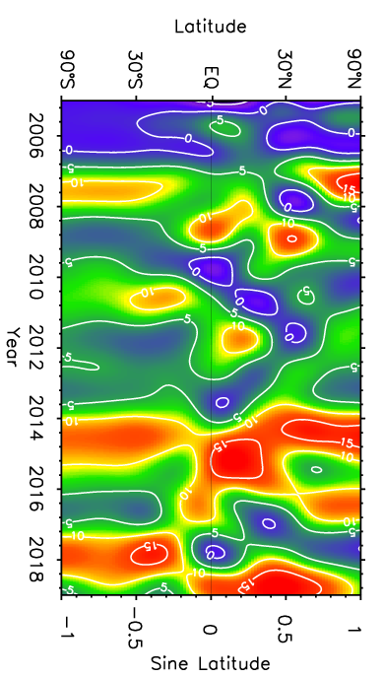
Growth rate (ppb yr⁻¹)

Slide 25
[CH₄](t) = [CH₄]_{ss}-([CH₄]_{ss}-[CH₄]₀)e^{-t/τ}
Fit 1984-2006: τ = 9.2 yr
(Trend - SS)
Abrupt shift in CH₄ budget
Pinatubo
BB + WLs

Slide 26
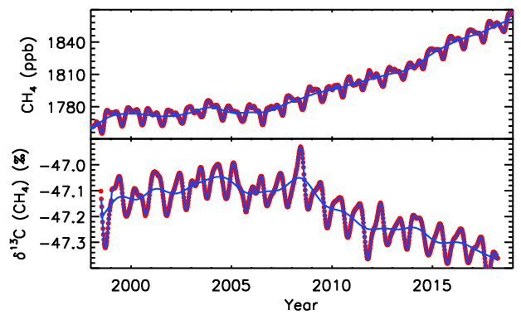
Globally averaged CH₄ and δ¹³C(CH₄)
Sylvia Michel, INSTAAR

Slide 27
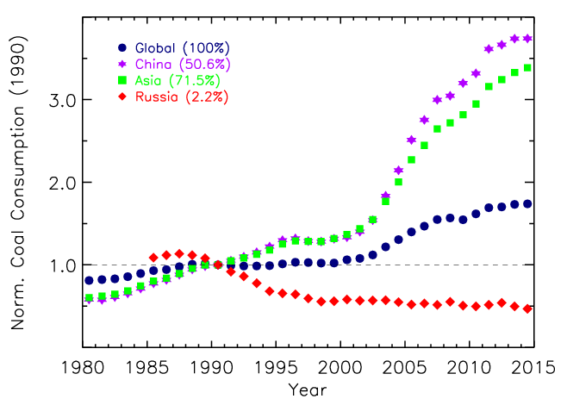
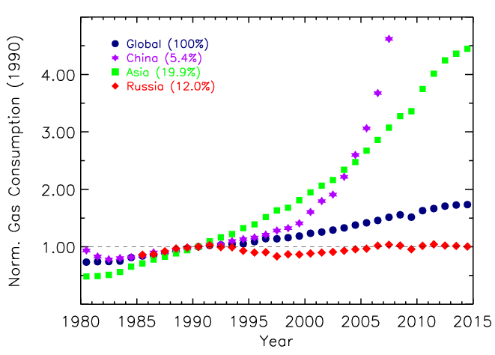
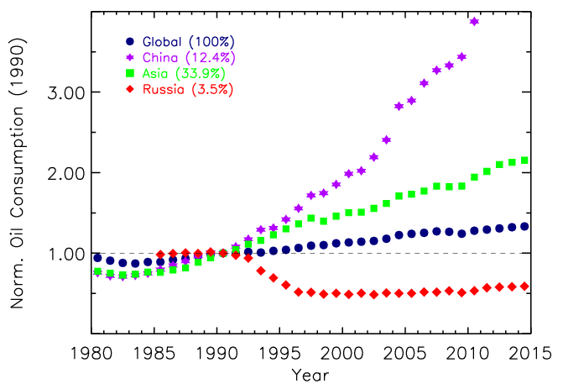
Potential causes: Δ Fossil fuel emissions?
From BP Statistical Review of World Energy, 2015
*Increased FF emissions alone not supported by isotope constraint

Slide 28
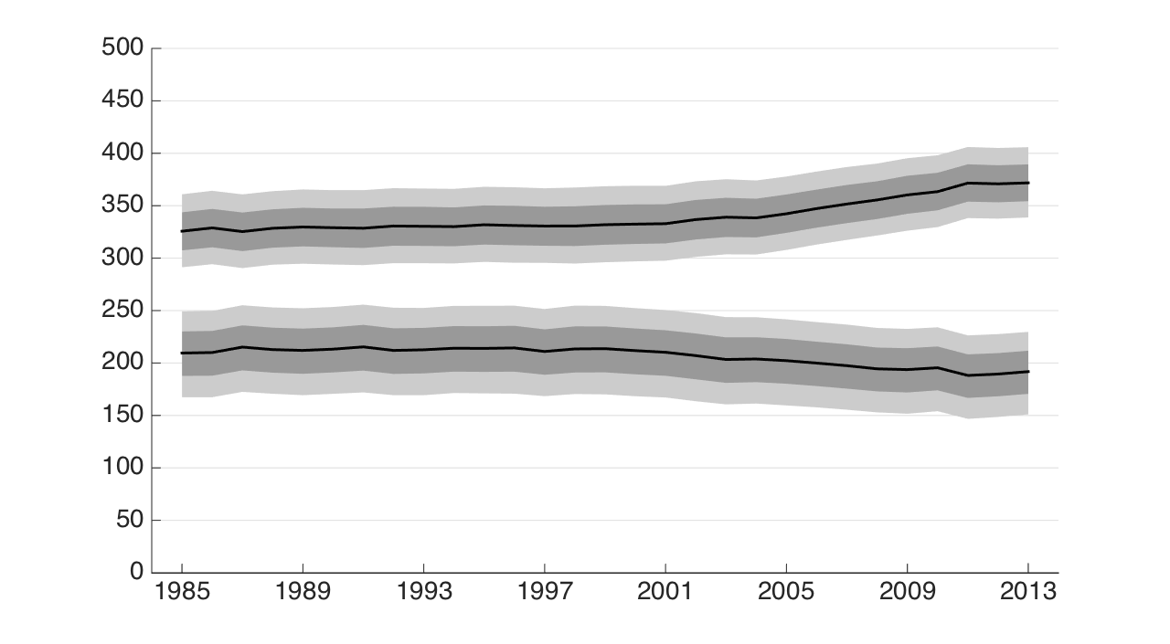
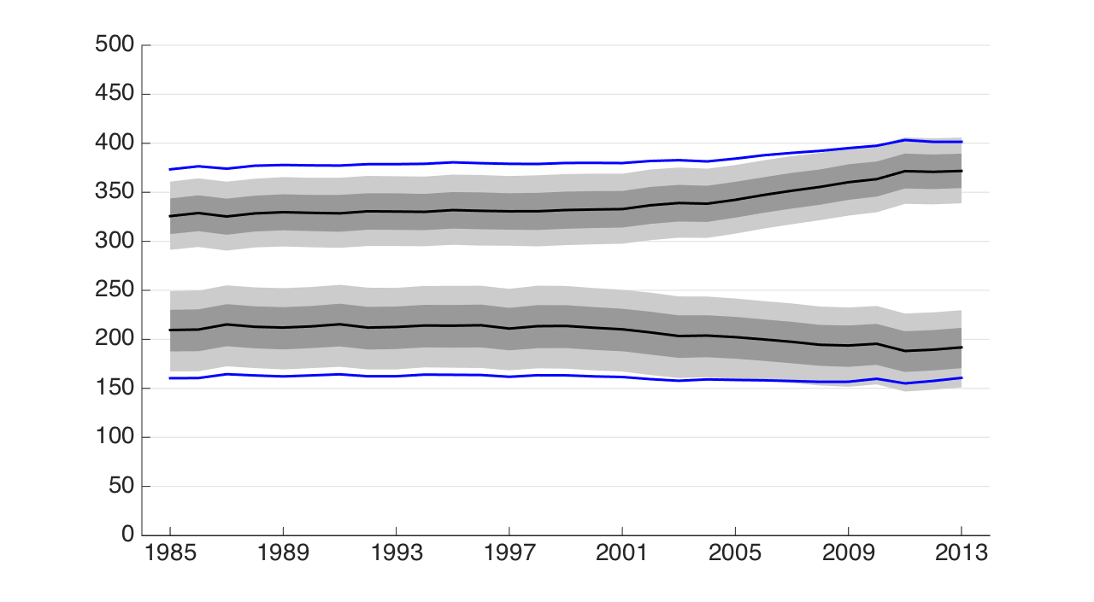
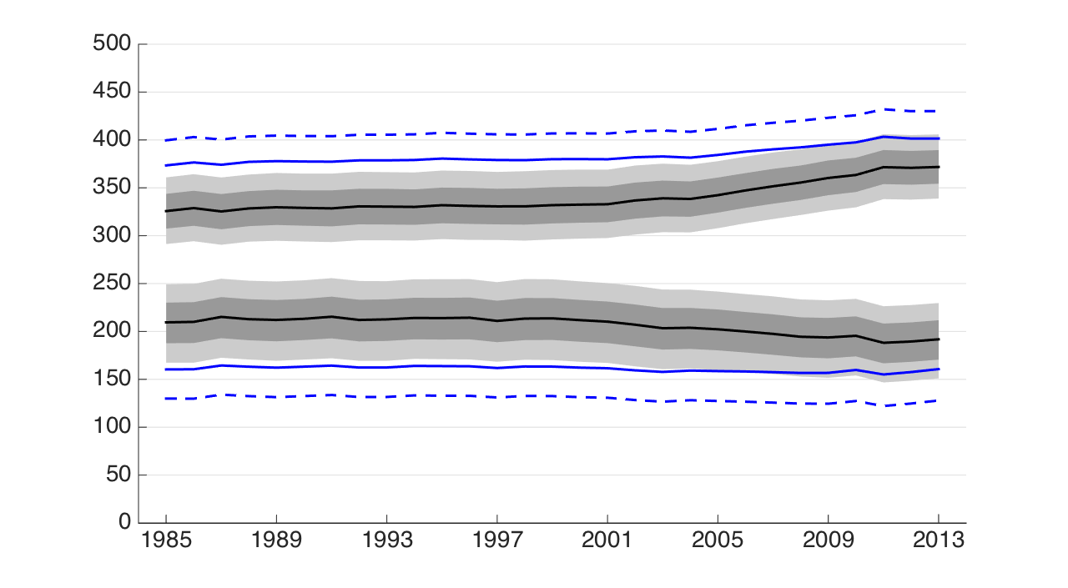
Fossil CH₄ emissions not increasing
(Schwietzke et al., Nature, 538, 88-91, 2016)
Microbial sources (wetlands, ruminants, rice, landfills/waste, termites)
Global CH₄ emissions (Tg CH₄/yr)
Fossil fuels (Gas/Oil/Coal) + Geologic
Mean values using “traditional” δ¹³C_{FF}
Mean values using “traditional” δ¹³C_{FF}, δ¹³C_{Mic}, and δ¹³C_{BB}
Year

Slide 29
Potential Causes of Increased CH₄: Changes in [OH]?
Two 2-box-model studies:
  Rigby et al. 2017; Turner et al., 2017
Both suggest decreasing trend in [OH]
Both agree data can be fit with no trend in [OH]
Neither suggest mechanism for Δ[OH]
Detailed spatial and temporal information not used
Not consistent with 3D CTM calculations of [OH] nor ¹⁴CO constraint (for SH extra-tropics)
Δ[OH] can not explain δ¹³C(CH₄)
Both suggest δ¹³CH₄ provides only a weak constraint

Slide 30
Potential Causes of Increased CH₄: Changes in OH?
Nicely et al., JGR, 2018
Δ[OH] = -0.08±0.19%/decade (1985-2015)
  Decreased [OH] from increased [CH₄] compensated by:
  Changes in ↑H₂O, ↑[NO_{x}], ↓column O₃, tropical expansion, ↑T
Naus et al., ACPD, 2019
Investigated systematic biases in transport and OH distribution in box models using 3D model:
  Accounting for biases reverses trend in [OH], making it positive:
    Interhemispheric exchange rate
    N/S asymmetry in [OH] (and species-dependent globally-averaged OH)
    Stratospheric loss
    Network bias in IHD (as in Pandey et al., 2019)

Slide 31
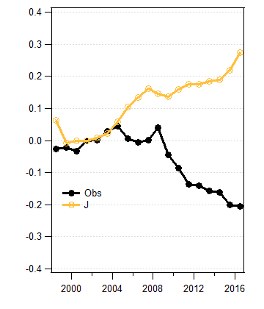
δ¹³CH₄ normalized to 2002:
*3-D CTM with [OH] reduced 8% and constant CH₄ emissions
*The influence of sink fractionation on atmospheric δ¹³CH₄ is determined not only by [OH], but the weighted averages of OH, Cl, O(¹D), and soil sinks.
δ¹³C H₄(normalized to 2002)
Model

Slide 32
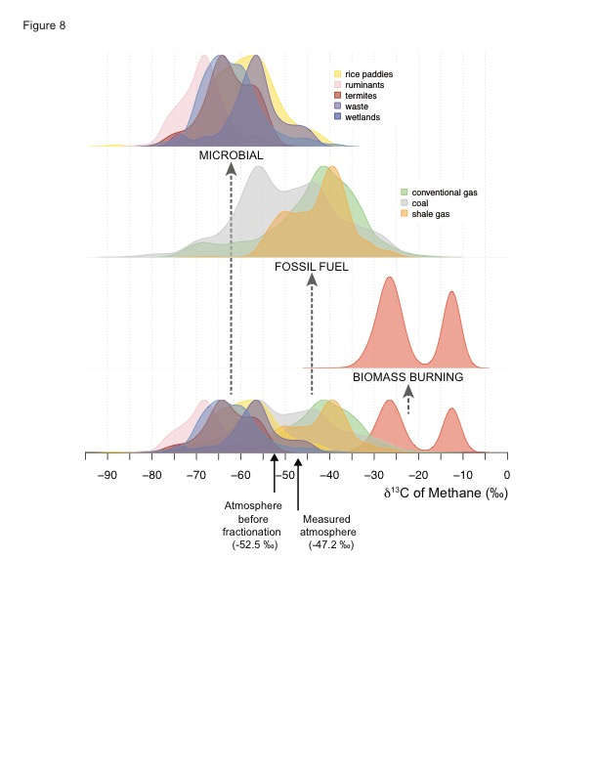
Is δ¹³CH₄ a weak constraint?
*Although wide range of values observed, emission-weighted mean well-defined.
*Larger uncertainty is with Cl:
Cl + CH₄: Small contribution to total sink despite larger k than for OH
  Large influence on δ¹³C(CH₄) (k(¹²C/¹³C)≈1.06)
Cl magnitude and distribution not well constrained
Sherwood et al., 2017
Sherwood
et al. 2017

Slide 33
Sources of tropospheric Cl:
Oxidation of natural and anthropogenic halocarbons (CH₃Cl, CHCl₃….)
Heterogeneous reactions involving sea salt
Annual mean column-integrated loss for CH₄ oxidation by OH and Cl:
Cl + CH₄: 12-13 Tg CH₄ yr⁻¹ (2.5%)
Contribution of Cl loss greatest at northern mid-latitudes
Allan et al. (2007): 13-37 Tg CH₄ yr⁻¹
Platt et al. (2004): up to 19 Tg CH₄ yr⁻¹
Hossaini et al., 2016

Slide 34
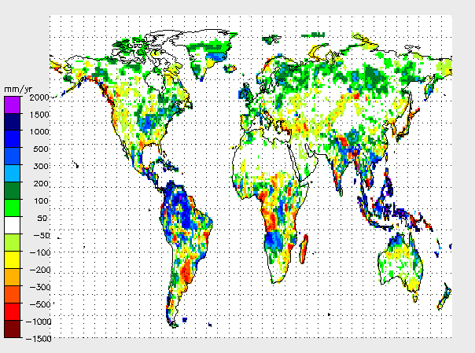
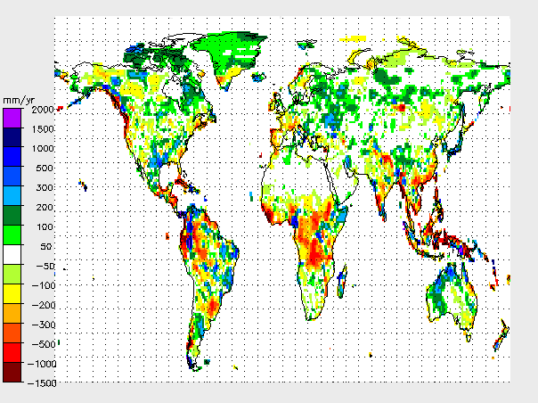
˜
ENSO and tropical precipitation anomalies
La Niña
~
El Niño
Source: GPCP

Slide 35
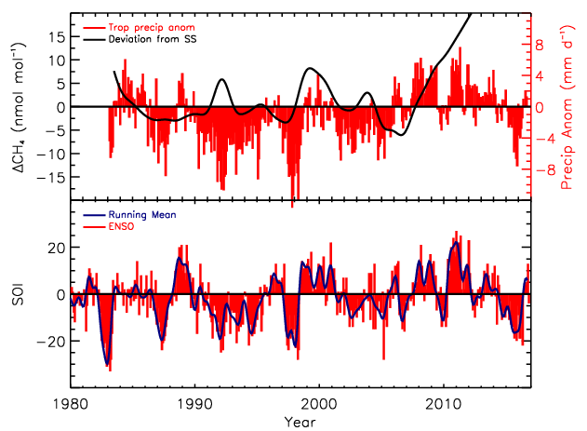
ENSO Phase: Tropical Precipitation
Base: 1961-1990
Source: GPCC
La Niña
El Niño
Australian BoM

Slide 36
Potential causes: Arctic sources
Rate of T increase is 2X global average
  Wetland emissions sensitive to soil T
  E_{T} = E_{T0}Q₁₀^{(T-T0/10)} where Q₁₀ = E_{T+10}/E_{T}
~1000 Pg C in top 3 m permafrost soils
  Melting PF expands wetland area and releases carbon
30 to 170 Pg CH₄ in Arctic Ocean hydrates

Slide 37
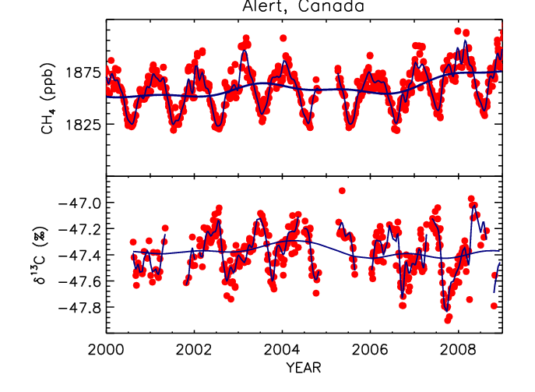
GISS: 2007 T anomalies
2007 also very wet
ΔCH₄ and Δδ¹³C suggest source with δ¹³C = -66‰

Slide 38
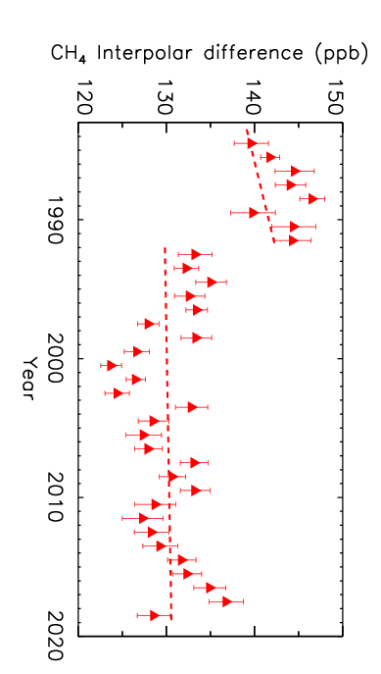
Difference between northern and southern polar annual means
Economic collapse in fSU

Slide 39
Can we Explain the Observations?: Going Forward
Understanding small changes to global budget is challenging
  CH₄ budget is complex: many sources and sinks
  Problem poorly constrained by observations
  Increase over past decade likely caused by combination of multiple processes
Trends and IAV in [OH] remain difficult to quantify
Wetlands are important and suspect process models are not realistic
  Fail to account properly for IAV in WL area and “memory effects”
Should not ignore temporal and spatial information
δ¹³C(CH₄) observations are useful
  Need better understanding of big levers: Cl and biomass burning
  δD(CH₄) currently too few to be useful
Sharp global increase in CH₄ (↓ δ¹³C) during recent strong El Niño
  Somewhat baffling, although positive precipitation anomalies in some regions (e.g., Paraná basin) and Ts were high

Slide 40
Extra Slides

Slide 41
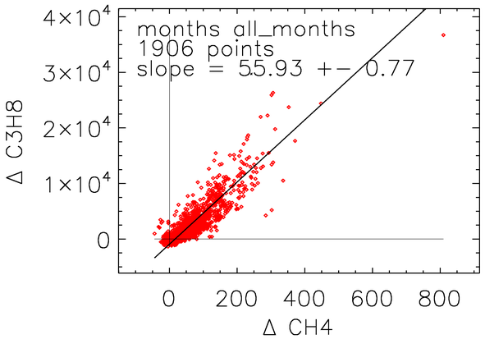
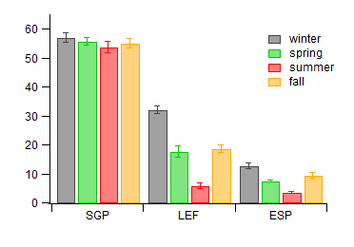
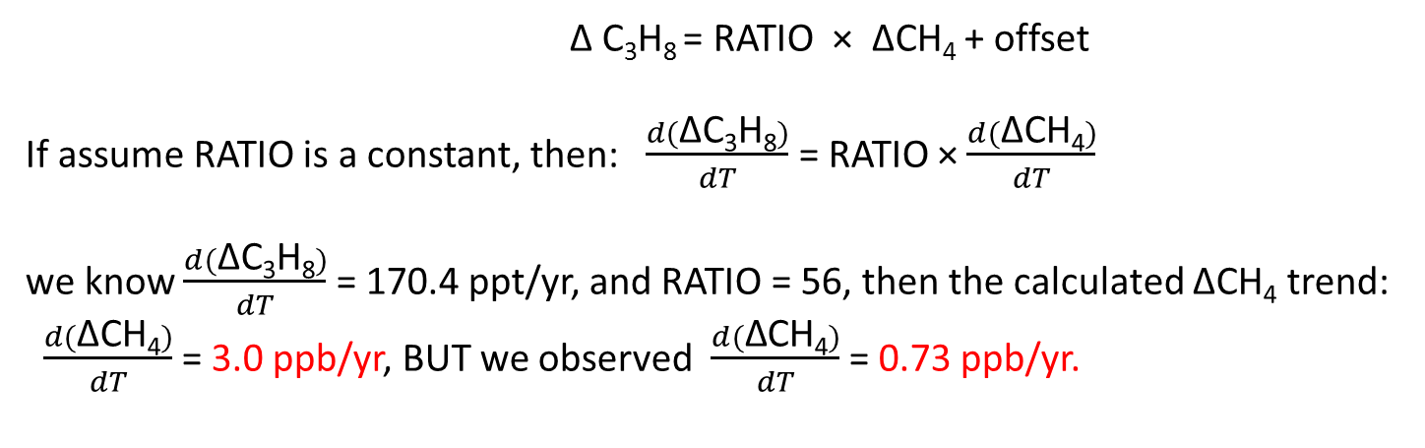
NMHC/CH₄ ratios overestimate methane trend
SGP is heavily influenced by ONG operations.
Δ : PBL – mid troposphere
Δ C₃H₈ / ΔCH₄
SGP: 2009-2015
R² =0.77

Slide 42
Allan at al., 2007:
Distributed over oceans in MBL.

Slide 43
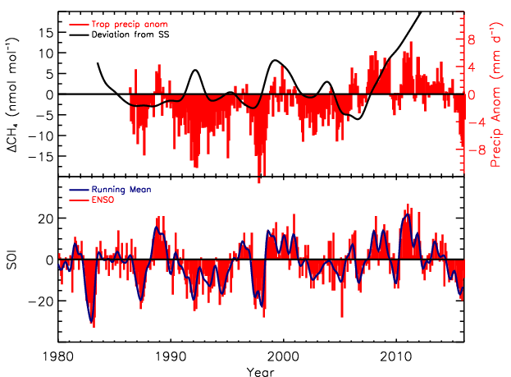
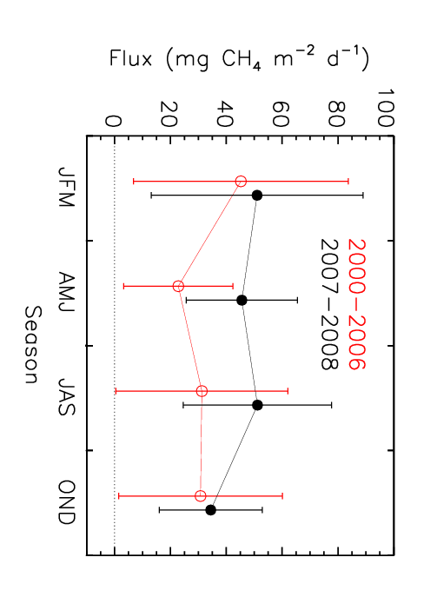
Potential causes: Tropical wetlands
Precipitation anomalies in tropics. (Source: GPCP)
Increased Amazon CH₄ fluxes in wet years.
Increased tropical emissions consistent with 0.2‰ decrease in δ¹³C since 2007

Slide 44
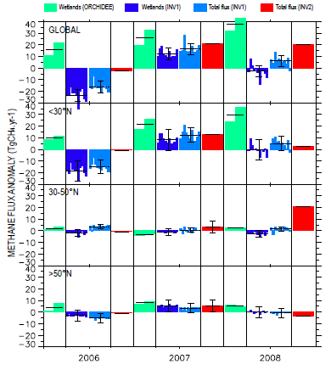
2007:
Tropical WL – NOAA VPs
Arctic WLs - δ¹³CH₄ at ALT
2008:
Inversions are inconsistent.
Data suggest anomalous emissions in tropics and mid-latitudes.
High N latitudes recovered.
*NOAA CT-CH₄ 2007 is consistent.
Bousquet et al., ACP, 2010.
Dlugokencky et al., GRL, 2009.

Slide 45
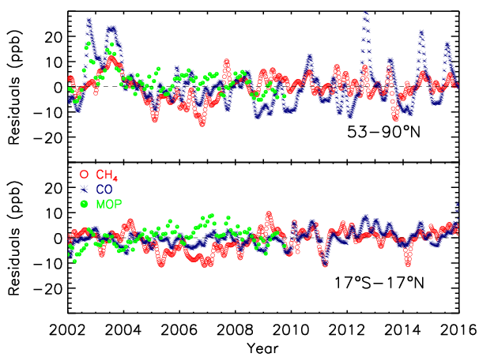
Potential causes: Biomass burning
Louisa Emmons NCAR

Slide 46
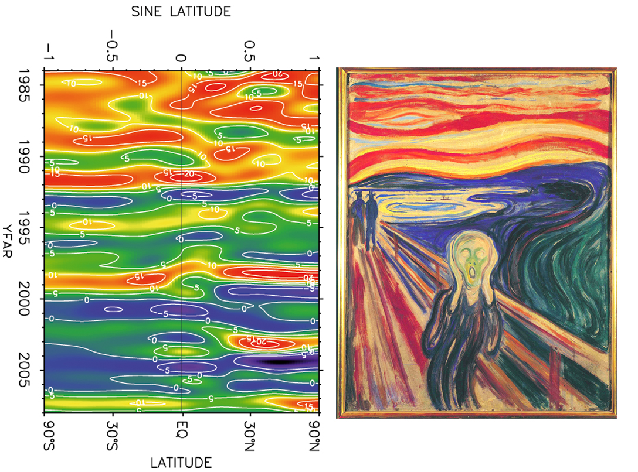
Source: Carl Brenninkmeijer

Slide 47
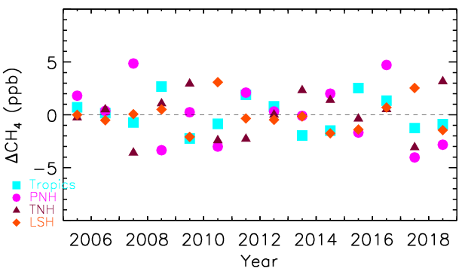

Slide 48
High Latitude (60-90°N) Emissions (2000-2008)
Calculated from 9 CTMs
Source | Tg CH₄ yr⁻¹
Wetlands | 12.9 ± 1.1 (27.4)
Biomass Burning | 0.5 ± 0.1
Agriculture + Waste | 1.1 ± 0.4
Fossil Fuel | 6.5 ± 3.0
Other | 1.9 ± 2.3
Total | 23.1 ± 2.0 (37.0)
Source: Kirschke et al., Nature Geoscience, 2013, DOI: 10.1038/NGEO1955.

Slide 49
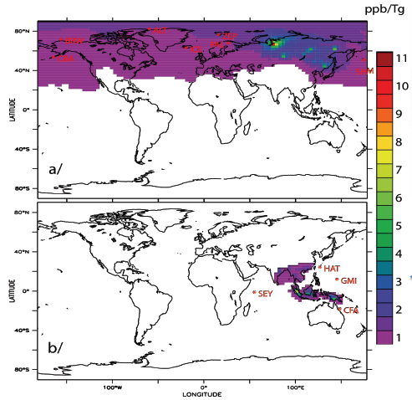
1 Tg pulse over 1 month
Boreal Asia
Tropical Asia
Transported for 11 months
No sink
Bousquet et al., 2011, ACP.

Slide 50
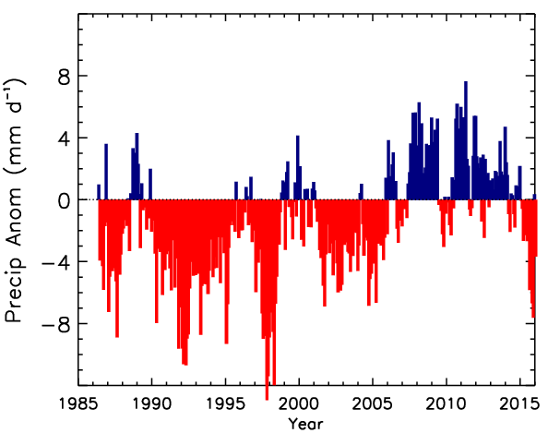
Base: 1961-1990

Slide 52
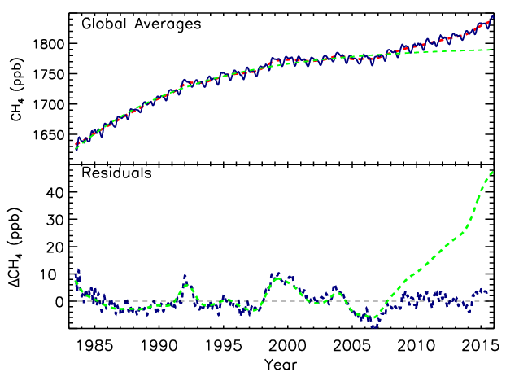
Trend - SS

Slide 53
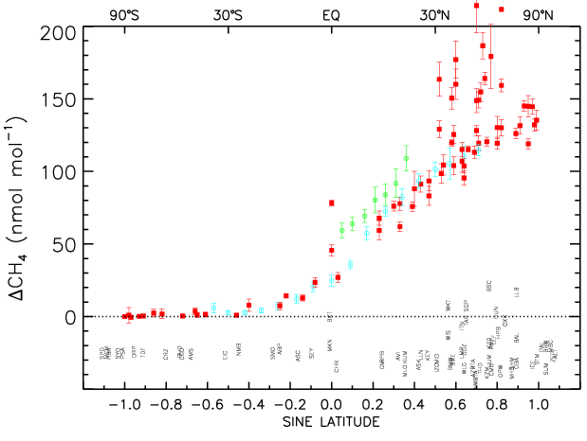

Slide 54
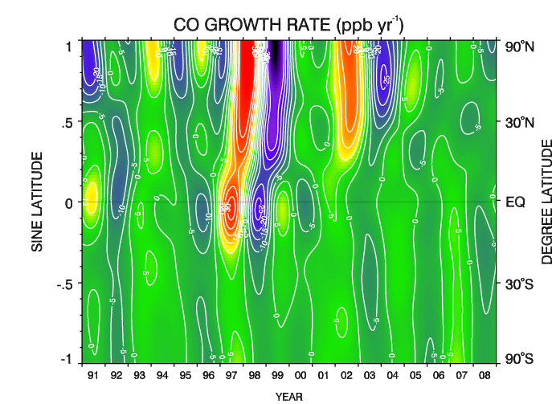
Compliments of Paul Novelli, NOAA ESRL

Slide 55
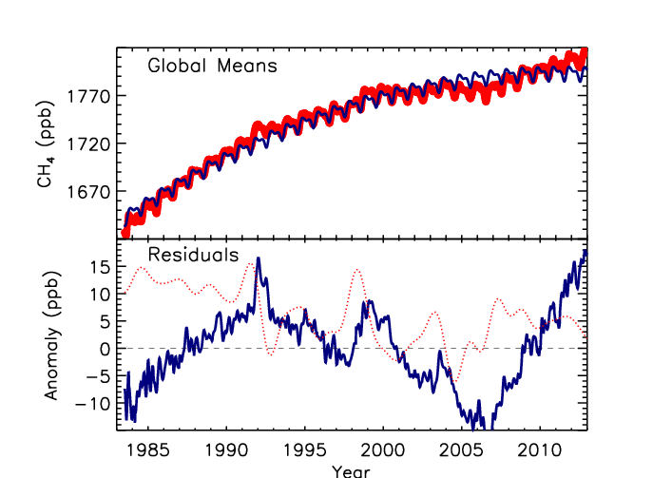

Slide 56
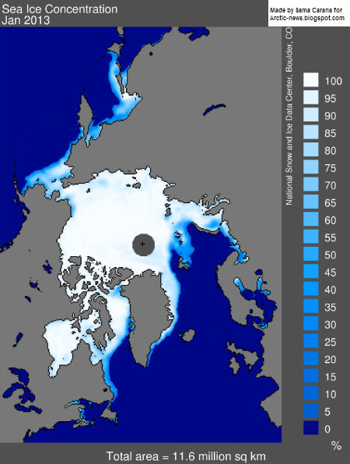
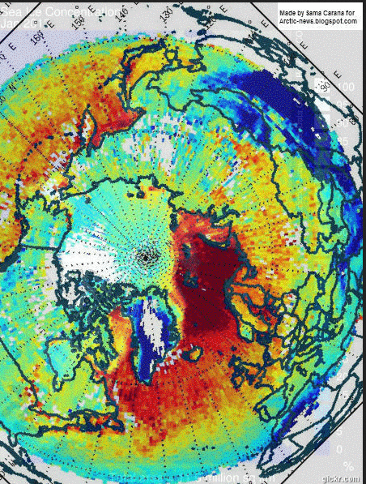
NSIDC: Sea Ice Loss (%)
1780
1920
AIRS CH₄: ppb

Slide 57
Remote Sensing
Never calibrated, only evaluated
  Vertical profiles; Aircore (TCCON insufficient)
Sensor degradation over time
Potential biases (e.g., land - ocean)
“Short” deployment for satellites
Retrieve total column; strongest signals at surface
Different retrieval versions give very different results (e.g., in inversions)

Slide 59
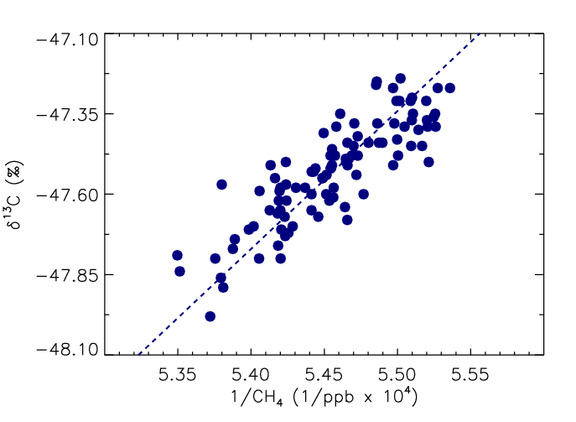
Data from Fisher (RHUL) Westbrook et al., GRL, 2009
Intercept ~ -65‰
Consistent with wetland source
(Hydrates = -53‰)

Slide 60
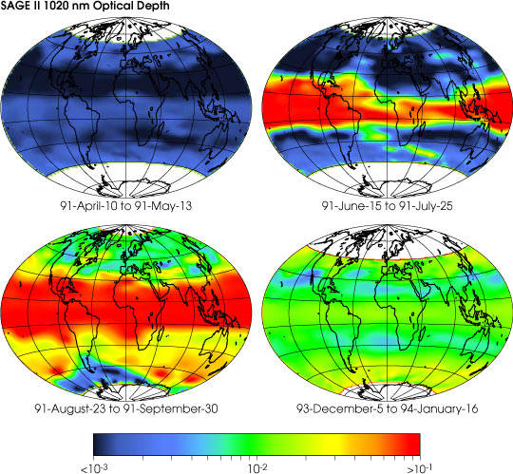

Slide 61





Slide 62

Residuals for 30°N to 90°N

Slide 63

Residuals for 17.5°N to 17.5°S

Slide 64

www.esrl.noaa.gov/gmd/ccgg/iadv/

Slide 65


Quality Control

