Slide 1
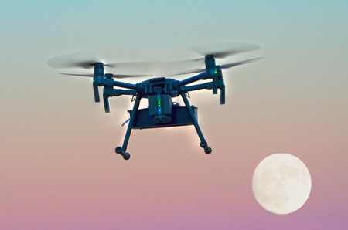
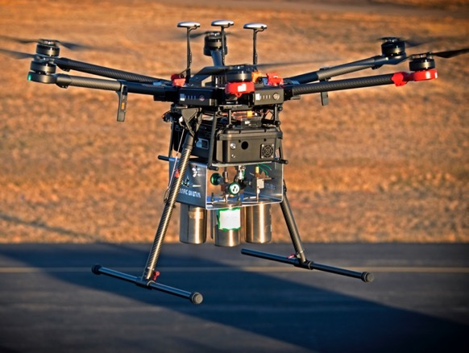
Unmanned Drones
All of our drones are equipped with winds, temperature, relative humidity, pressure, and methane
Best for near-field quantification, and surface to 400 ft agl flight altitudes
Real-time data display and upload, including images and video
DJI Matrice 210
DJI Matrice 600 Pro
13 minute flight time with 5 lb payload
Easy-to-handle wheeled case
Quick setup/tear down
30 minute flight time with 5 lb payload
Up to 13-pound payload
Enough payload to collect whole air samples for offline VOC analysis

Slide 2
Measuring the Wind
Initial Objective - Measure the wind without the addition of ANY hardware
Scientific Principle
Compare the drone’s actual acceleration with what we predict using the balance of forces
Using the drag force law, calculate the “missing” force and convert that to a wind direction and speed.
Comparison of winds simultaneously measured by drone and 2-D sonic anemometer

Slide 3
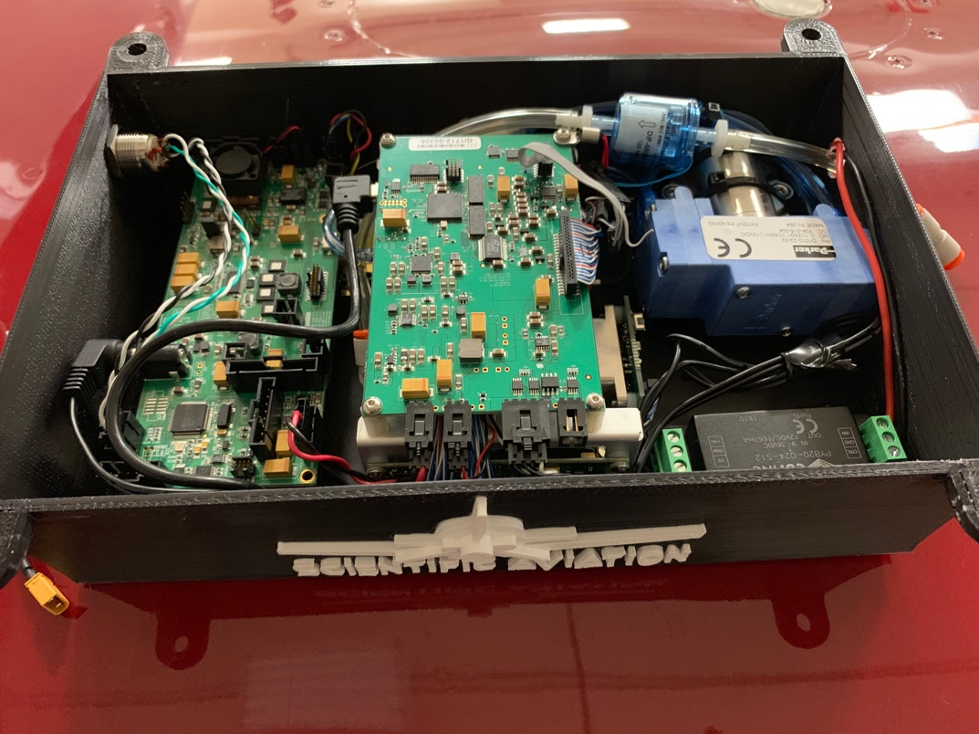
Measuring Methane Aboard the M210
Sensor Requirements
Low Power (~ 15 watts)
Maximum weight 4 pounds
Aeris Pico Specifications
1 ppb CH₄ precision
Low power (15 W)
Weight 6 pounds
With custom lightweight case and removal of batteries, we were able to get the Aeris under 4 pounds.

Slide 4
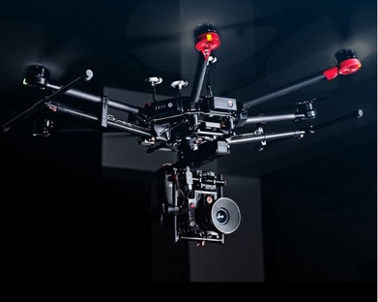
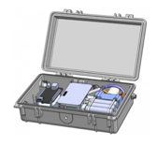
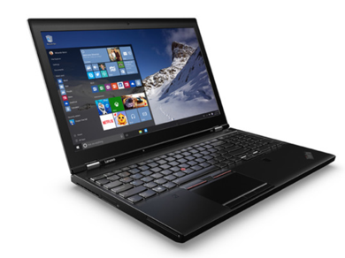
High-Level System Architecture
iPad app receives raw data from onboard computer and video feed. Data are stored in files and sent to computer (Swift)
Onboard computer collects methane and UAV telemetry and transmits through remote to iPad (C++)
Onboard methane sensor continuously collects and reports methane mixing ratio
Python app on computer calculates emission rates and generates shape files (Python)

Slide 5
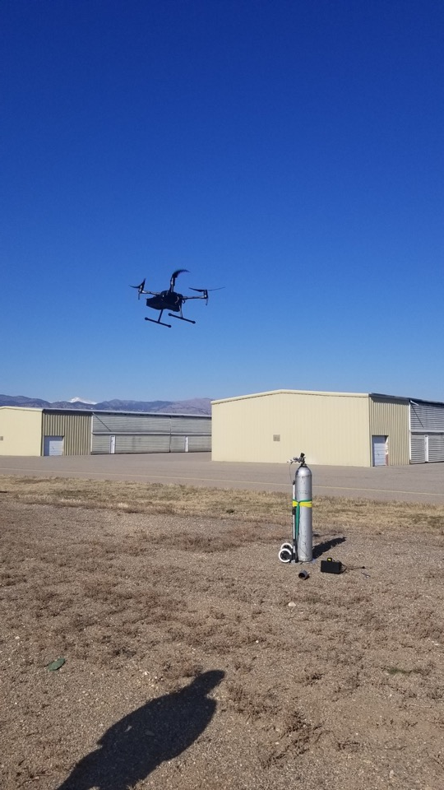
Test #1: Controlled Release November 5, 2018, Boulder Municipal Airport
Question: Can we see a small leak from a safe distance?
Test Setup:
Obtained air tank with 5% methane (below LEL)
Used flow meter to maintain constant flow rate ~20 liters per minute.
Release rate = 2 scf/hour

Slide 6
First Test – Operator View
November 5, 2018. We released 20 liters/per minute of 5% methane mixture. That equates to 42 grams/hour or 2 scf/hour.

Slide 7
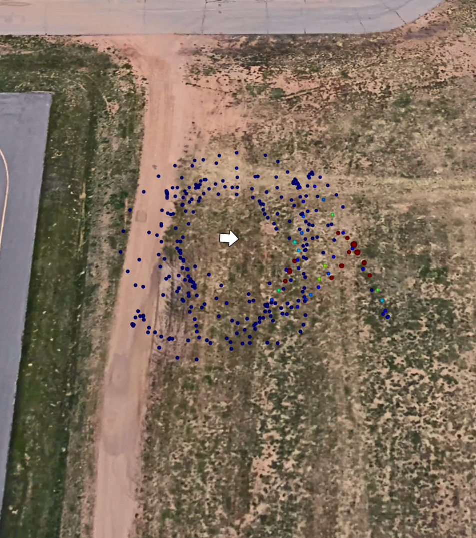
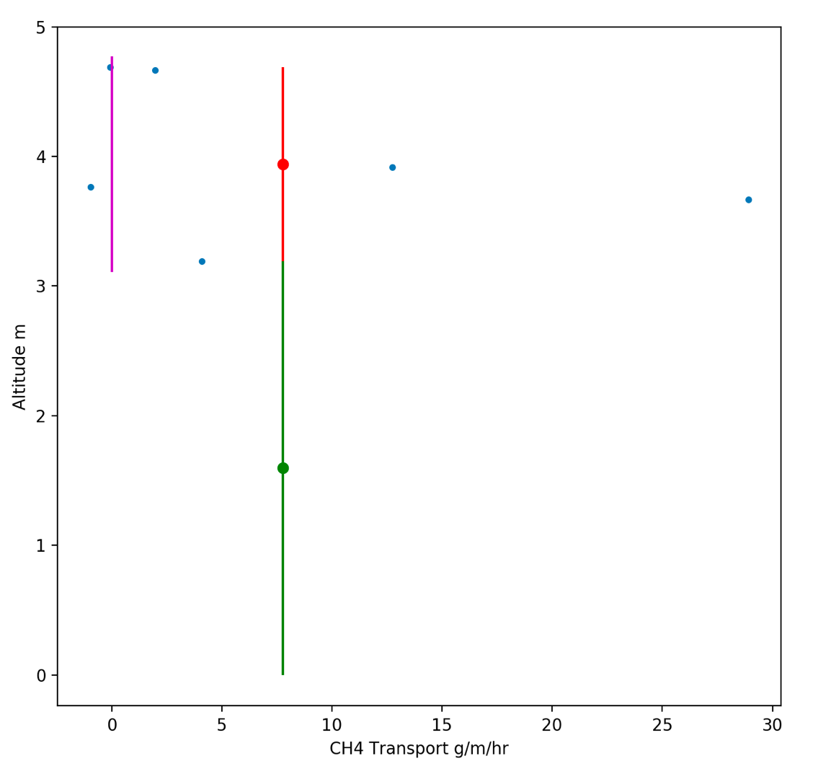
First Test – Emissions Analysis
Average flux from 6 laps = 7.8 g/m/hr. Maximum Height = 4.7 m.
Emission = 7.8 g/m/hr * 4.7 m = 37 grams / hour = 1.8 scf/hr

