Slide 1

Touring NOAA’s Global Monitoring Division
1
NOAA’s David Skaggs Research Center
Boulder, CO
NEXT

Slide 2
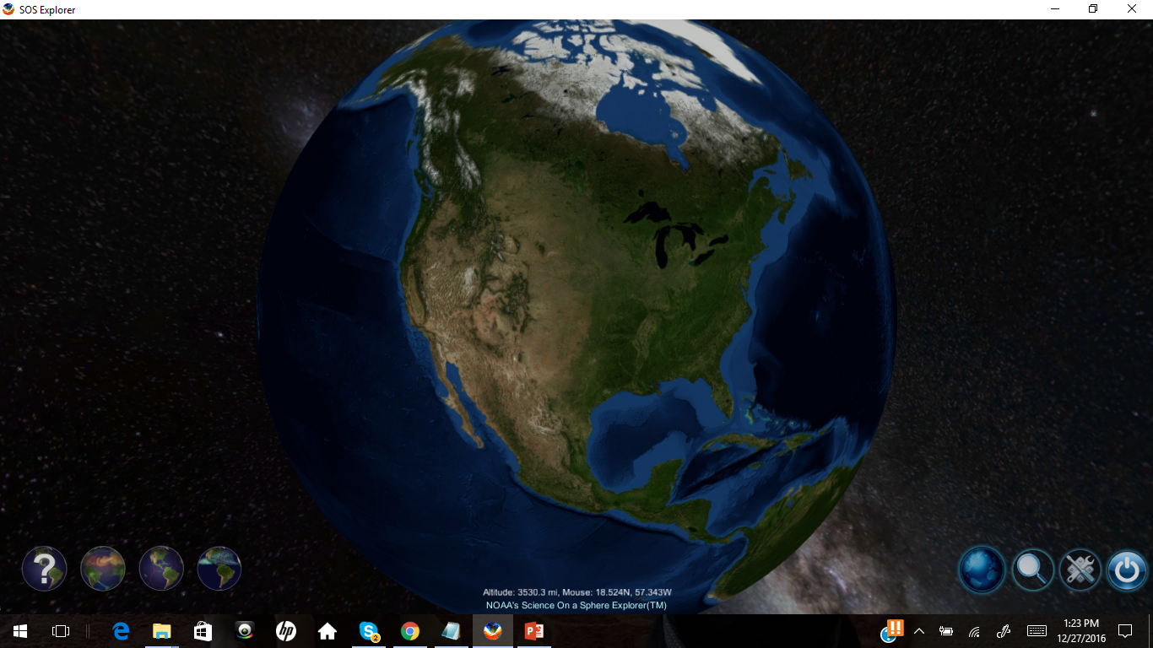
2
Instructions
Before continuing on with the PowerPoint follow the instructions below.
Your teacher will show you how to open up Science on a Sphere Explorer Lite on this computer or another laptop.
Once you have opened it your screen should look like this.
Click the question mark button in the bottom left-hand corner. This gives you a brief overview of how to find data sets and use the tools they provide.
*Be sure to ask your teacher any questions you
have about the program before moving on.
Once you complete the steps above, select next to
continue onto the presentation.
BACK
NEXT

Slide 3

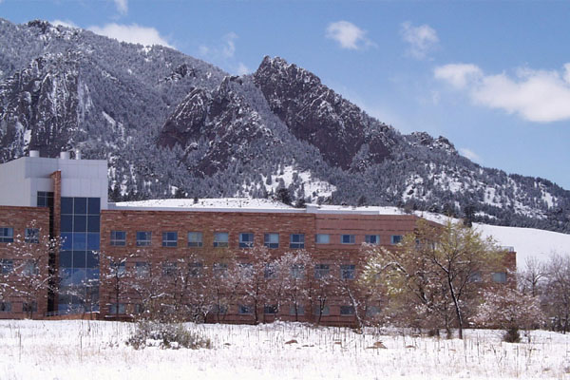
The Global Monitoring Division’s
Overall Mission
3
To acquire, evaluate and make available accurate, long-term records of atmospheric gases, aerosol particles, and solar radiation in a manner that allows the causes of the change to be understood.
What does that mean?
This means that NOAA’s goal is to collect publicly-available, long-term, accurate measurements of the atmosphere so we can understand how the atmosphere changes over time.
BACK
NEXT

Slide 4
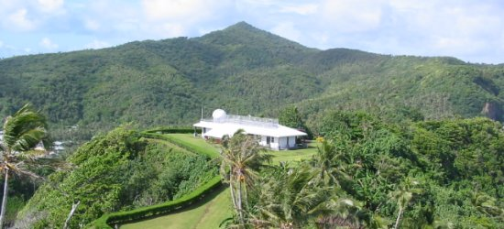
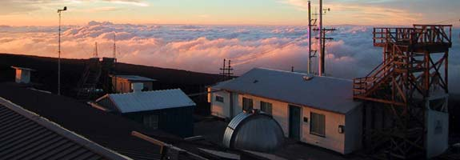
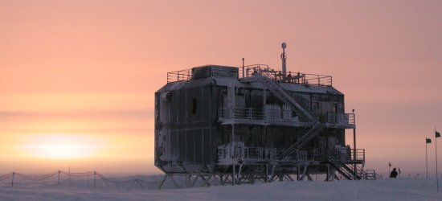
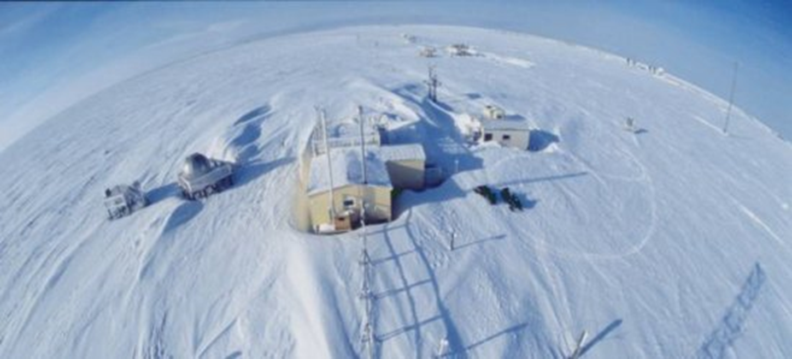
NOAA’s Atmospheric Baseline Observatories
4
BACK
NEXT

Slide 5
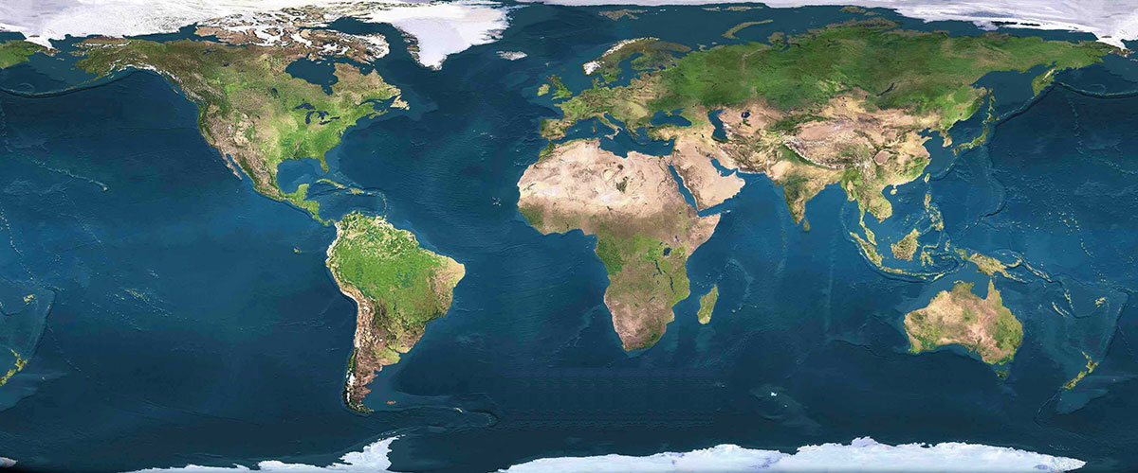
Sites
5
GMD collects data from sites all over the world, however there are 4 especially important research sites called the Atmospheric Baseline Observatories…
These sites were chosen due to their location: they are located far from civilization, meaning cleaner air
A cleaner air sample better represents the atmosphere as a whole
Click on each star to learn more about the Baseline Observatories.
BACK
NEXT

Slide 6
Ozone in the Atmosphere
6
BACK
NEXT

Slide 7
Ozone
7
Greenhouse gas that helps trap heat in our atmosphere
Protects us from harmful rays from the sun called Ultraviolet rays (UV)
UV rays are the reason why we get a sunburn and damage our skin from long sun exposure
Ozone is also known as O3, because it is made of three oxygen atoms
O
Got it!
O
O
BACK

Slide 8
Good VS Bad Ozone
8
Depending on the location of the ozone, it has the potential to harm us or protect us. Click on the link below to discover ozone's role in different layers of the atmosphere.
Learn more about Ozone in the Atmosphere Here
BACK

Slide 9
9
Layers of the Atmosphere
MESOSPHERE
Click on the layers to learn more about the ozone in them!
STRATOSPHERE
TROPOSPHERE
Click here when done!
EARTH
GO BACK

Slide 10
Tropospheric Ozone “Bad Ozone”
Found in areas ranging from ground level to lower atmosphere
Harmful to health if humans face great exposure
Can make it more difficult for people with asthma to breathe
Can cause cell damage to plants and animals
BACK

Slide 11
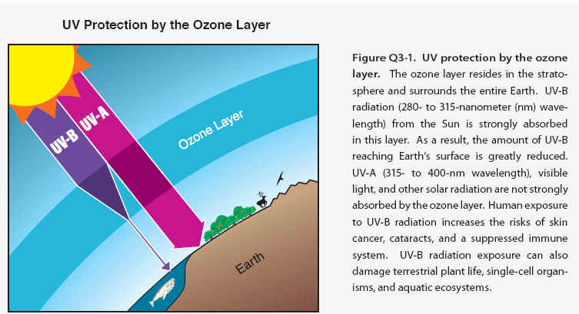
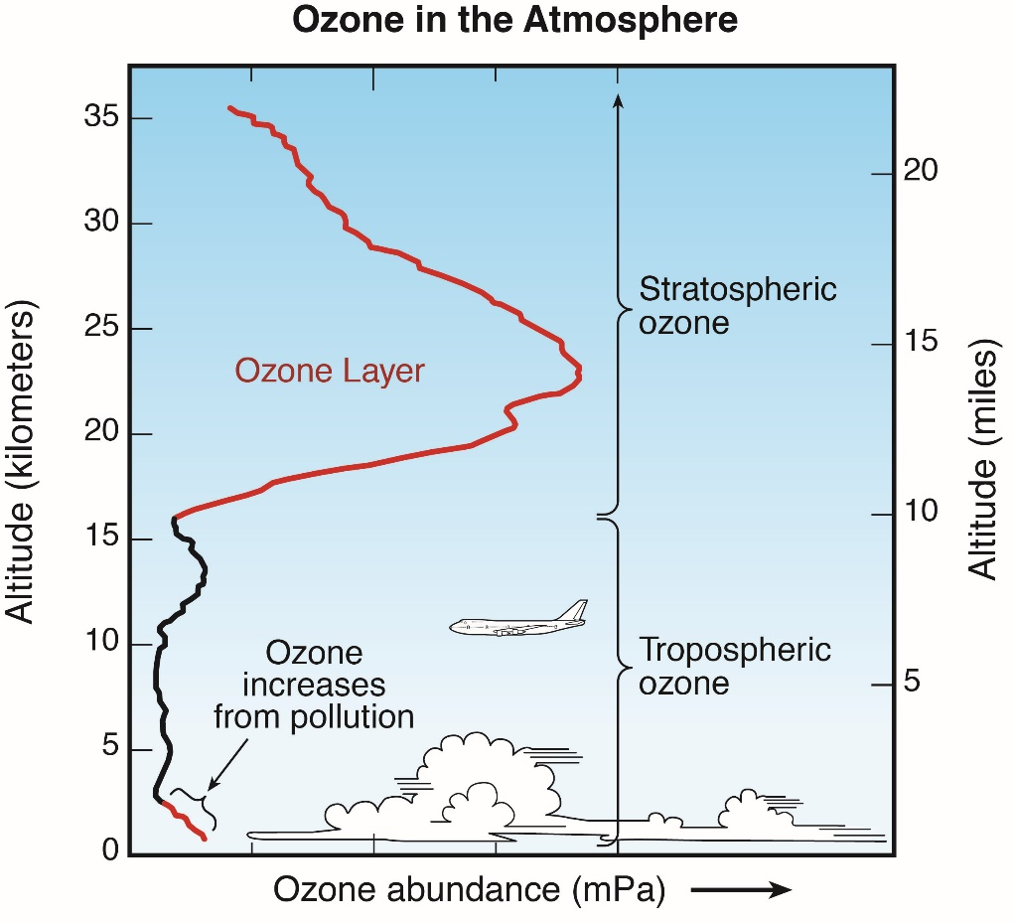
Stratospheric Ozone “Good Ozone”
Acts as a “shield” protecting Earth
Notice in the graph (below) that the ozone layer prevents much of the UV-B (Ultraviolet rays) from entering Earth’s lower atmosphere
The stratosphere contains more ozone than the troposphere and that is why you see a bulge in the graph below
Ozone in the upper atmosphere captures more heat than the surrounding area. The measurable change in temperature helps define this layer of the atmosphere
(the stratosphere)
BACK

Slide 12

Barrow, Alaska
Barrow Live Feed Camera:
https://www.esrl.noaa.gov/gmd/obop/brw/livecamera.html
Because Barrow is located North of the Arctic Circle, and the consistent winds coming off the Beaufort Sea this site is best identified as having an Arctic maritime climate.
There are engineers and scientists at this location year round to maintain instruments and collect atmospheric data.
To find out more, explore: http://www.esrl.noaa.gov/gmd/obop/brw/
Back

Slide 13
South Pole
Click this link to see the live web cam feed from the South Pole! Also right below the video is the daily temperature so you can see just how cold it really is there!
https://www.usap.gov/videoclipsandmaps/spWebCam.cfm
This site is located on the Antarctic plateau at an elevation of 2837 m (9308 ft) above sea level, at the Geographic South Pole.
The South Pole Observatory was established in 1957.
To find out more, explore: http://www.esrl.noaa.gov/gmd/obop/spo/
Back

Slide 14
American Samoa
Two observatory technicians operate this facility on a small island in the middle of the South Pacific Ocean.
30% of its daytime power comes from solar panels.
To find out more, explore: http://www.esrl.noaa.gov/gmd/obop/smo/
Back

Slide 15
Mauna Loa, Hawaii
This tropical site has been collecting atmospheric data since the 1950s and is located on the Mauna Loa Volcano cone.
The building sits 3,397 meters above sea level (11,145 feet)!
Carbon Dioxide measurements started at this observatory. There is a rich scientific history here, this is where the Keeling curve originated!
To find out more, explore: http://www.esrl.noaa.gov/gmd/obop/mlo/
Back

Slide 16
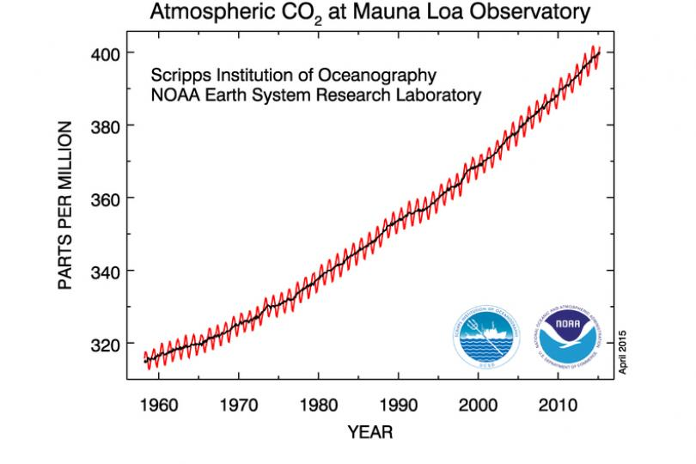
Back

Slide 17
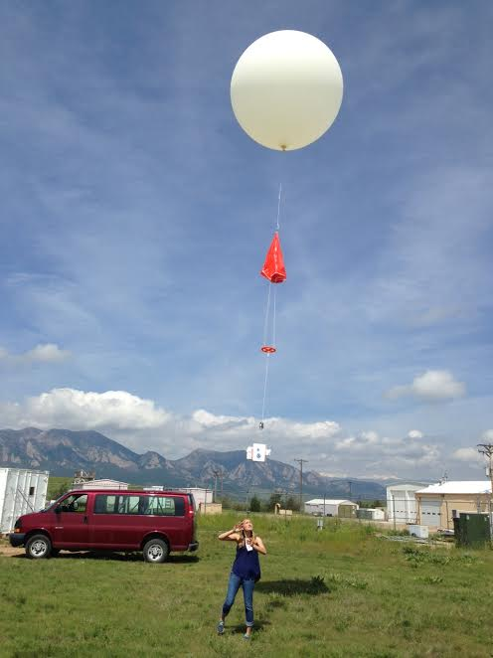
Ozone and Water Vapor Group
10
Balloon: The balloon expands as it rises and has the ability to carry the instruments up to 100,000 feet.
Instrument packages which measure ozone levels, called ozonesondes, collect data as the balloons rise in the atmosphere. These data are used to analyze variations in ozone from the surface of the planet up to 100,000 feet in the atmosphere.
Parachute: The parachute slows down the instrument’s fall speed after the balloon bursts, so the instruments do not get destroyed from a rough landing.
Instrument Package: The instruments are in a Styrofoam box to protect them throughout the launch and landing. The packaging also provides insulation so the instrument does not get too cold or hot during the flight.
BACK
NEXT

Slide 18
11
Aerosol Group
BACK
NEXT

Slide 19
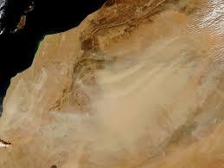
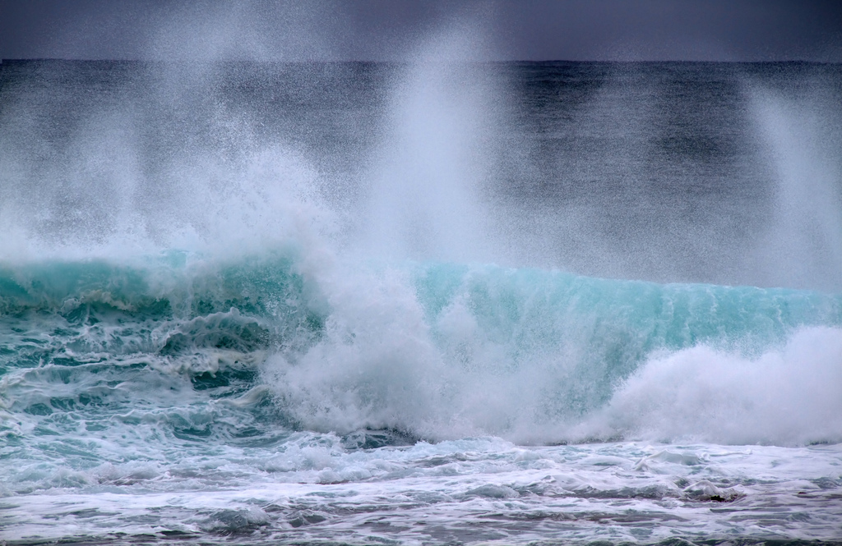
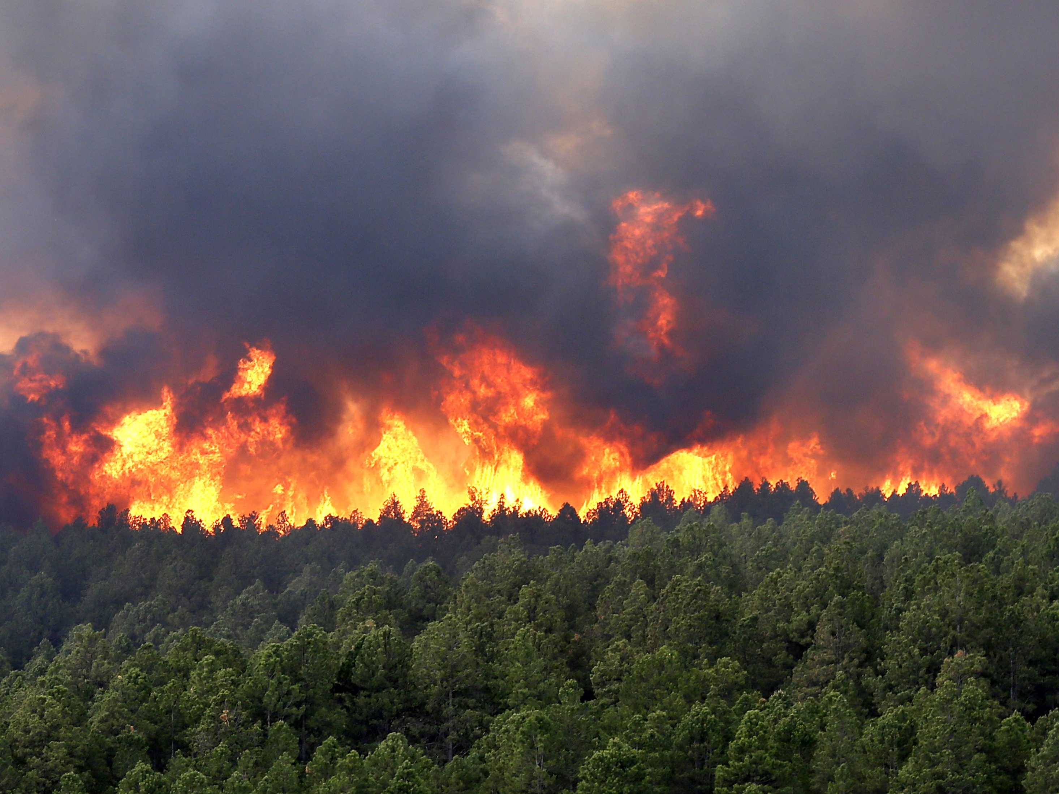
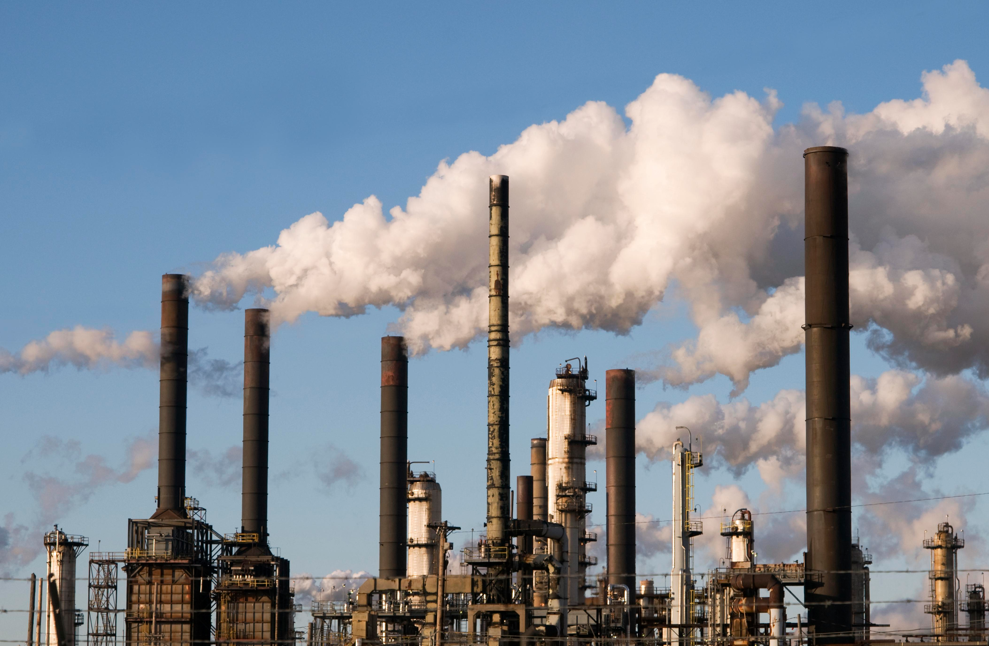
Aerosols
12
What are aerosols?
Aerosols are particles or droplets suspended in the atmosphere
There are natural and human-made sources of atmospheric aerosols
Aerosol particles are highly variable and different regions will have different amounts and types of atmospheric aerosol. GMD’s aerosol group uses instruments located around the globe to continuously monitor aerosol light scattering and absorption.
Examples:
-desert dust
- sea spray
- combustion (e.g., wildfires and cars)
-industrial emissions from factories and power plants
BACK
NEXT

Slide 20
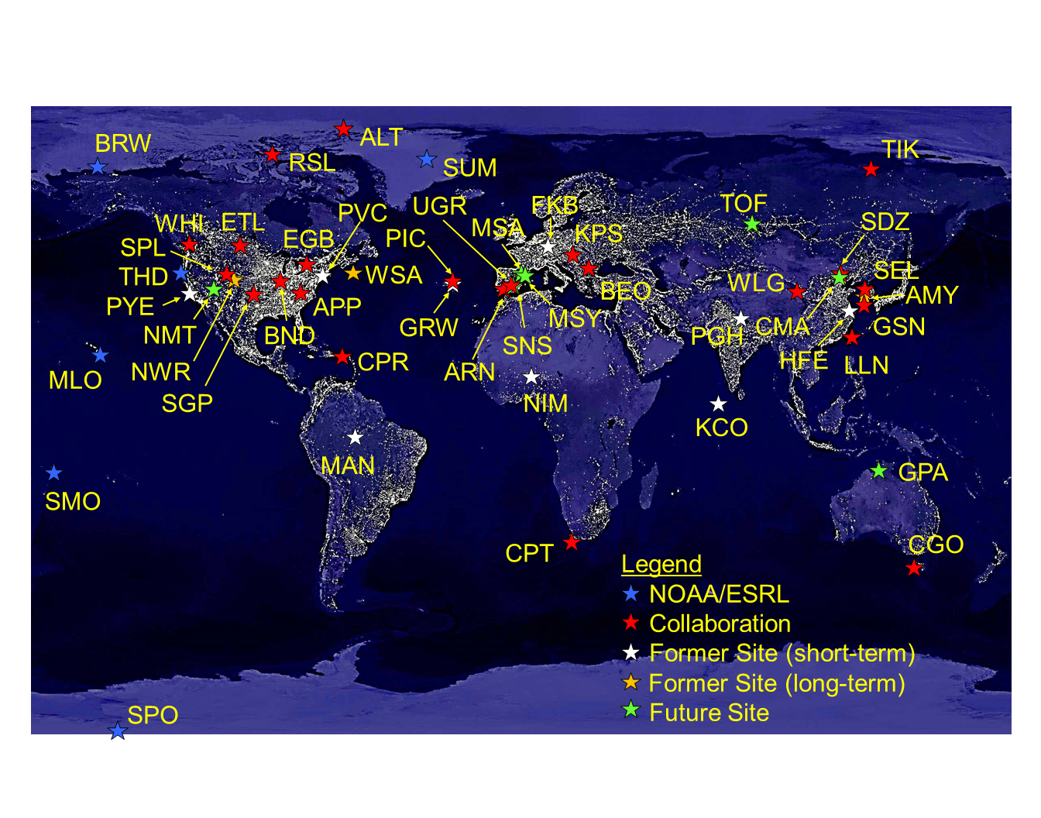
13
AEROSOLS
The GMD Aerosols group measures the optical properties (light scattering and absorption) of atmospheric particles.
The optical properties indicate how atmospheric particles interact with sunlight. This is important for understanding their role in the Earth’s energy budget.
Aerosols group - monitoring sites
BACK
NEXT

Slide 21
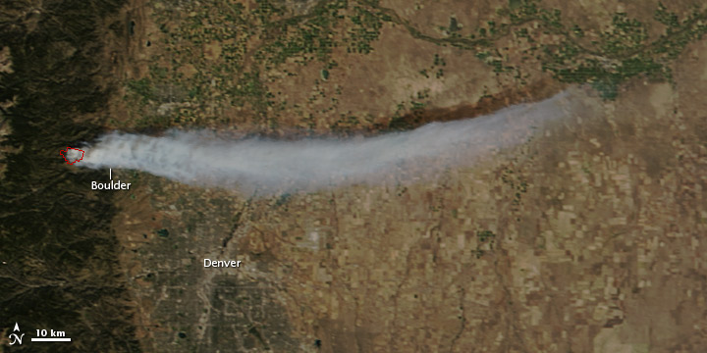
Aerosols Example
14
Smoke from wildfires contains large amounts of particles and gases which can affect climate, air quality and health.
As the world gets warmer and drier the amount and impact of wildfires may increase.
NASA satellite image of Fourmile Canyon fire, September 6, 2010
Wildfires are just source of aerosols. Volcanic Eruptions also contribute greatly to atmospheric aerosols. Continue onto the next page to see an example of volcanic eruptions.
BACK
NEXT

Slide 22
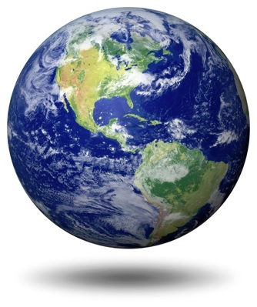
Volcano Eruption Data Set
Instructions
15
Go to the data sets (magnified glass icon on bottom right corner of your screen)
Find/load Atmospheric Chemistry: GOES-5 Model.
This data set shows the sources of particulates (aerosols like dust) in the air and how they move around the atmosphere.
Find the volcanic eruption off the lower, Eastern coast of Africa. Note how the particles from the eruption can impact large areas around the volcano.
BACK
NEXT

Slide 23
16
Carbon Cycle and Greenhouse Gases Group
BACK
NEXT

Slide 24
The Basics
17
Carbon Dioxide Molecule
Carbon
Oxygen
Oxygen
What is carbon dioxide?
Phase: gas
Carbon dioxide = CO2
most important long-lived greenhouse gas
most abundant form of atmospheric carbon
BACK
NEXT

Slide 25
Why do we care about carbon dioxide?
18
Due mostly to fossil fuel combustion (product of cars and factories), its concentration is increasing by about 2ppm (parts per million) per year.
Monitoring atmospheric carbon dioxide concentration is crucial to GMD and to the climate science community because it prevents heat from escaping to space (so our planet can stay warm) and is the single largest cause of global warming.
Carbon dioxide is a gas that dissolves easily in water: when it dissolves in water it turns into an acid (carbonic acid).
  This means that because the amount of carbon dioxide is increasing, the amount of acid in the ocean is increasing.
  A higher acidity in the oceans harms coral reefs and ultimately changes the ocean food chain.
  Changing the ocean food chain has the potential to harm many species.
Once carbon dioxide is put into the atmosphere/oceans, it does not simply disappear by natural processes; it remains in the atmosphere-ocean system for thousands of years.
Because carbon dioxide is a greenhouse gas it absorbs heat radiation released from the Earth that would otherwise leave our atmosphere and go into space.
  So, more carbon dioxide means more heat is getting “trapped” in Earth’s atmosphere and heating the climate system.
  The effects of this will likely last for many future generations.
BACK
NEXT

Slide 26
19
Something important to take away from this…
Carbon dioxide is the largest contributor to climate change.
Climate change has many negative effects on our environment.
People play a large role in contributing CO2 to the atmosphere and we need to take action in order to reduce emissions.
BACK
NEXT

Slide 27
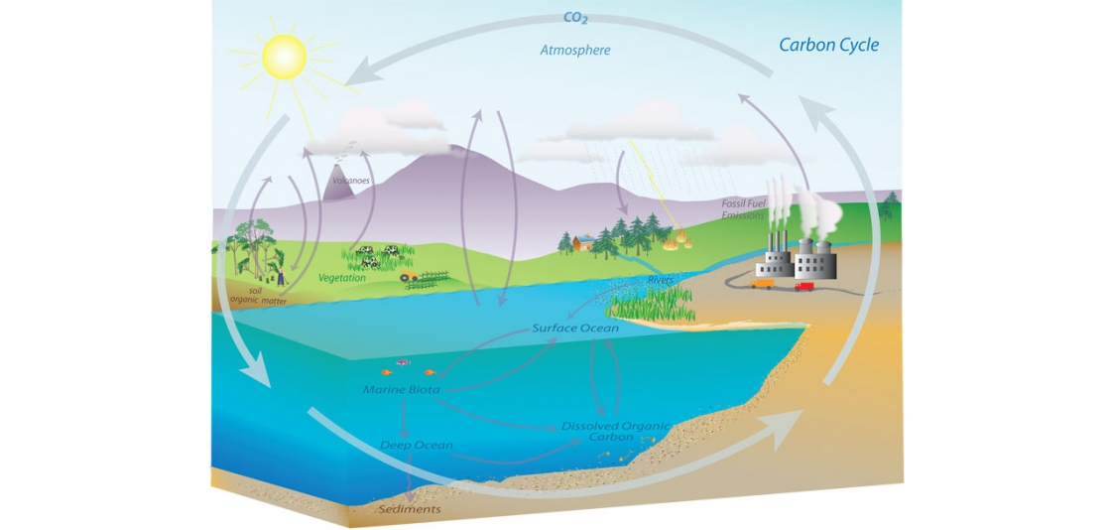
How does carbon move around our atmosphere and ecosystems?
20
BACK
NEXT

Slide 28
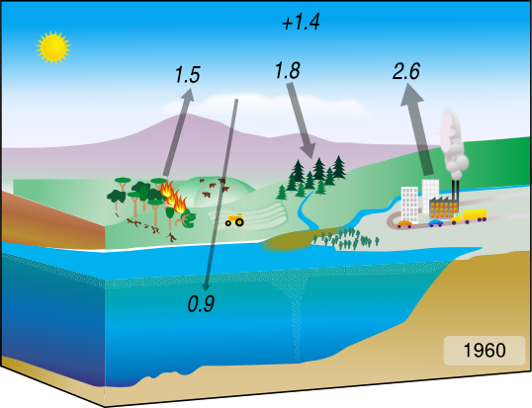
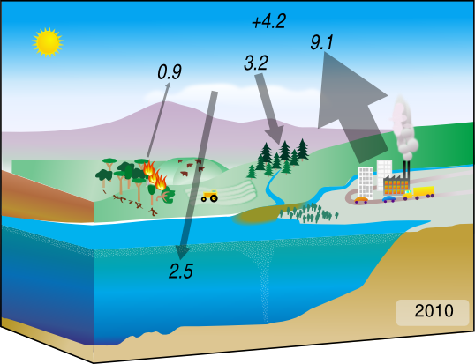
Keeping in mind the Carbon Cycle image from the previous slide, take a look at the two images below from 1960 and 2010. What differences do you notice?
21
BACK
Once you observe some differences move on to the next slide!
NEXT

Slide 29
If you paid close attention to the numbers you should have noticed that in 2010 the contributions from humans/factories have greatly increased since 1960 while carbon dioxide contributions from deforestation have actually decreased.
22
Because more carbon dioxide is being placed into the atmosphere more is being returned to our land and oceans.
BACK
NEXT

Slide 30
CO2 Cycles
23
Atmospheric CO2 concentrations have a large annual cycle (see the cycle here)
In the Northern hemisphere, the highest concentration of CO2 in the cycle is in April, just before growing season begins.
Photosynthesis by trees and other plants removes CO2 from the atmosphere, which is why the concentration of CO2 begins to fall after the growing season starts. There are more plants conducting photosynthesis which extracts CO2 from the air.
Because of that same idea, the CO2 minimum in the Northern hemisphere cycle is in September just after the peak growth of plants.
The cycle is almost balanced.
Growing season
(spring and summer)
More plants
Less carbon dioxide in the atmosphere
Fall/winter
(after end of growing season)
Less plants
More carbon dioxide in the atmosphere
BACK
NEXT

Slide 31
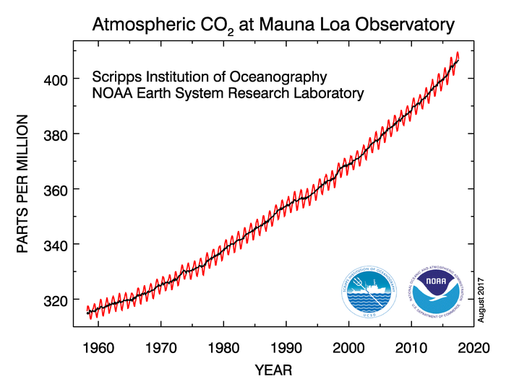
24
Remember: Mauna Loa is GMD’s Baseline Observatory in Hawaii.
You can see the cycle generally follows the seasons, as discussed on the previous slide. However, there is another very important trend that this graph exhibits. Do you know what it is?
Overall, the graph shows an increasing trend in atmospheric carbon dioxide concentration.
BACK
NEXT

Slide 32
CO2 Data Set
Instructions
25
Go to the data sets (magnified glass icon on bottom right corner of your screen)
Find/load Carbon Tracker: 2005-2010.
This data set shows how the amount of carbon (shown in parts per million) has changed across the globe over the years.
Do you notice any trends?
BACK
NEXT

Slide 33
26
Halocarbons & Other Trace
Species Group (HATS)
BACK
NEXT

Slide 34
HATS
27
Ozone-depleting gases are gases that destroy “good” ozone in the stratosphere.
This group monitors how the global atmosphere is changing in response to international agreements regarding ozone-depleting gases.
Because of the effort of countries across the world, many of the ozone-depleting gas levels have gone down. This is great for the environment and the stratospheric ozone layer!
However, we need to pay attention to the gases in the atmosphere that replaced the ozone-depleters, and are actually increasing.
BACK
NEXT

Slide 35
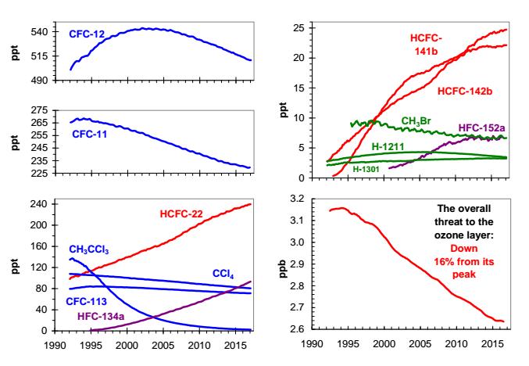
Halocarbons and Trace Gases Group
28
Can you identify what gases are increasing and what gases are decreasing in the atmosphere?
BACK
NEXT

Slide 36
29
This is the overall trend in ozone-depleting gases in the atmosphere. What is the trend and why do you think it is that way?
BACK
NEXT

Slide 37
30
Global Radiation Group
BACK
NEXT

Slide 38
Global Radiation
31
The Global Radiation Group, or G-RAD, observes long term variations in incoming and outgoing radiation from the sun. The data they collect is used to improve satellite observations and climate model predictions.
Uneven distribution of energy reaching Earth’s surface from the sun is the driver for weather and climate patterns that people experience on daily to decadal time scales.
Factors that affect the uneven distribution of this energy include Earth-Sun geometry, surface cover type (land vs ocean; forest vs farmland), cloud occurrence and properties, gases and aerosols. Press the ‘next’ button when you are ready to move on.
BACK
NEXT

Slide 39
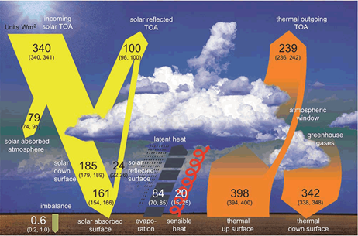
Global Radiation
32
What absorbs more solar radiation, the atmosphere or surface?
BACK
NEXT

Slide 40
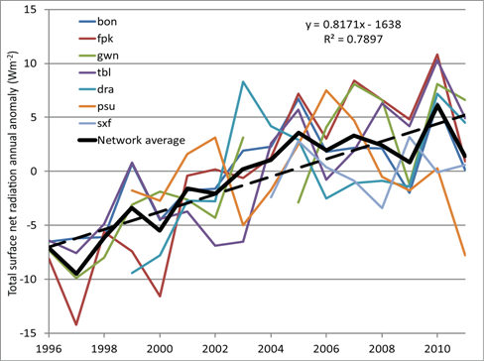
Radiation Trends
33
There are seven surface radiation sites across the United States that, over the last 16 years, have shown a large increase in net surface radiation. This increase is primarily due to a decrease in cloudiness.
BACK
NEXT

Slide 41
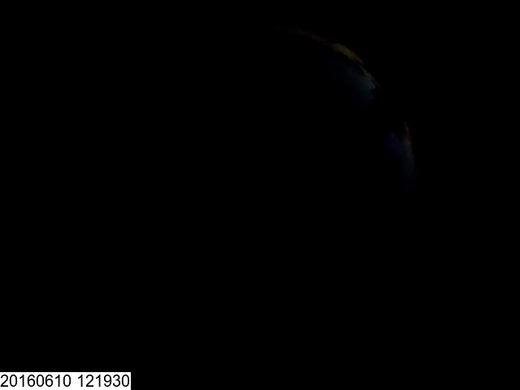
Global Radiation
34
Clouds respond to changing temperatures in the atmosphere.
In addition to retrieving cloud properties from surface radiation measurements, this group takes frequent ‘total sky’ images, an approximately 160 degree field-of-view continuously at global radiation monitoring sites. This provides a true view of the sky conditions at any time.
STOP
End of Presentation
BACK

